Slide 1
Simulation Status and Tasks
Zhiwen Zhao
Seamus Riordan

Slide 2
Simulation Software
use JLAB_VERSION=1.3 with Geant4.10.01.p03 and GEMC 2.3 for PreCDR update
skip JLAB_VERSION=2.0 with Geant4.10.02.p02 and GEMC 2.5
Test GEMC 2.6
CAD import
Fast MC mode
GEMC 3.0 is under work
multithreading at event level
Hit process as plugin
How current simulation will work with art? (Zhiwen, Ole)
https://gemc.jlab.org/gemc/html/documentation/releases/roadmap.html

Slide 3
General
Move software from svn to github (Zhiwen,Ole)
Move setup to new magnet and new location (Zhiwen)

Slide 4
Event generator
Internal and external radiative effects (???)
Check “solid_bggen” (based on hallD code) rate from He3 cell glass window (???)
check and compare Yuxiang's inclusive ele generator and “eicrate” (Seamus)

Slide 5
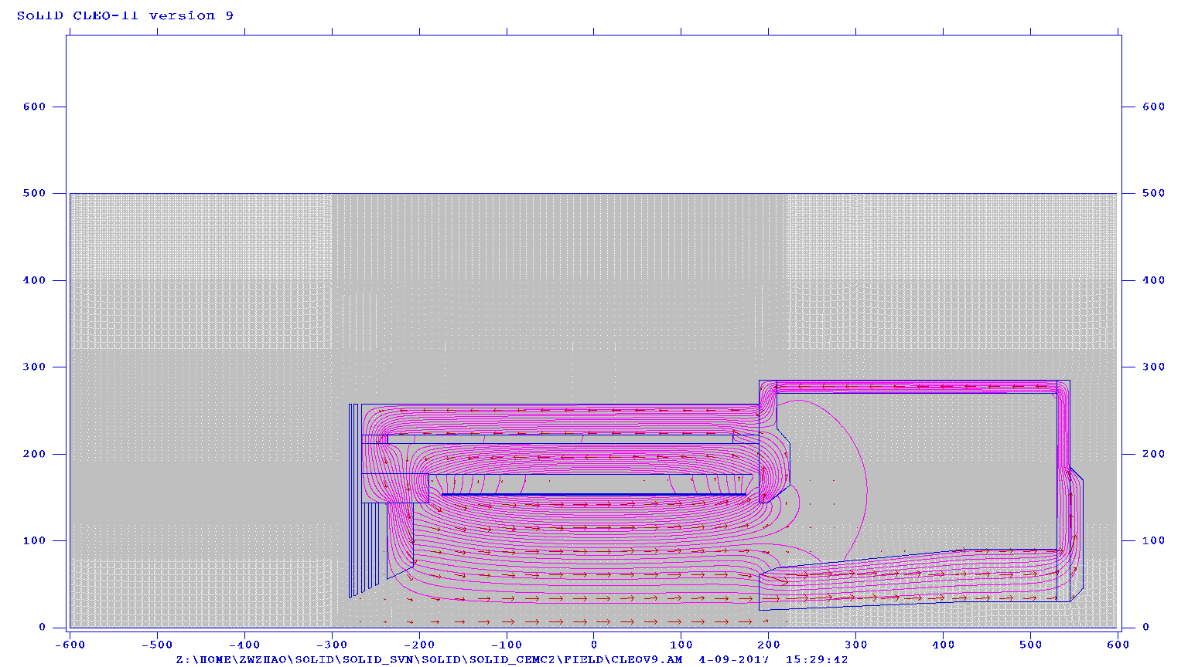
Magnet
A 2D map is made as a start
make a 3D map from Jay’s new Opera model (Zhiwen, Jay)
Format checked
Need to make the map when modeling done

Slide 6
EC
Has ANL layout and energy deposition in modules
add Birk effect in scintillator, add photon statistics (Ye Tian, Zhiwen)
Study EC trigger for SIDIS and Jpsi (Ye Tian)
Simulation for beam test (Ye Tian)

Slide 7
GEM
Optimize for PVDIS (???)
Optimize for SIDIS and Jpis setup (???)
Add layout and dead area (???)
Optimize digitization code (???)
Resolution with background for PVDIS,SIDIS H3, Jpsi (Weizhi)
Simple document with howto (Weizhi)
SIDIS NH3 tracking (???)

Slide 8
LHC and HGC
Tuning for new location
Add more details
(Zhiwen and Michael)

Slide 9
MRPC
Has energy deposition in layers, has initial digitization
Finish digitization verification with data (Sanghwa)
Iterate to improve simulation if needed (Sanghwa and Zhiwen)
Finish occupancy study (Sanghwa)
Study trigger condition and trigger response (Sanghwa)

Slide 10
SPD
add Birk effect in scintilator, add photon statistics (Sanghwa, Zhiwen)
Finish occupancy study (Sanghwa)

Slide 11
Other studies
Trigger study
Jpsi 3e in more details (Zhiwen)
NH3 (???)
DAQ (need a detailed plan)
Deadtime (???)
occupancy
Cerenkov readout
MRPC readout
PVDIS acceptance optimization with new magnet (Rich,Zhiwen)

Slide 12
After new magnet
more documentation with code checked in for any major physics result, so that it can be repeated after new magnet
All studies need to redo or recheck, major ones below
Acceptance (Zhiwen,Rich)
Efficiency (Zhiwen,Rich)
Baffle (Rich)
Radiation (Lorenzo)
Trigger (???)

Slide 13
Digitization and reconstruction
Digitization (keep it independent of simulation)
MRPC and GEM digitization are most advanced, they are after simulation. For other detectors, we could do the same
In simulation, Cerenkov record photons, SPD and EC record energy deposition, then in digitization, convert Cerenkov,SPD,EC to number of p.e., unless it can’t be separated
This would save a lot of simulation time
Reconstruction
We have simple code to produce some plots and numbers
Need to look into how to do it with art
Both
Keep code modular for different detector, algorithm and file format

Slide 14
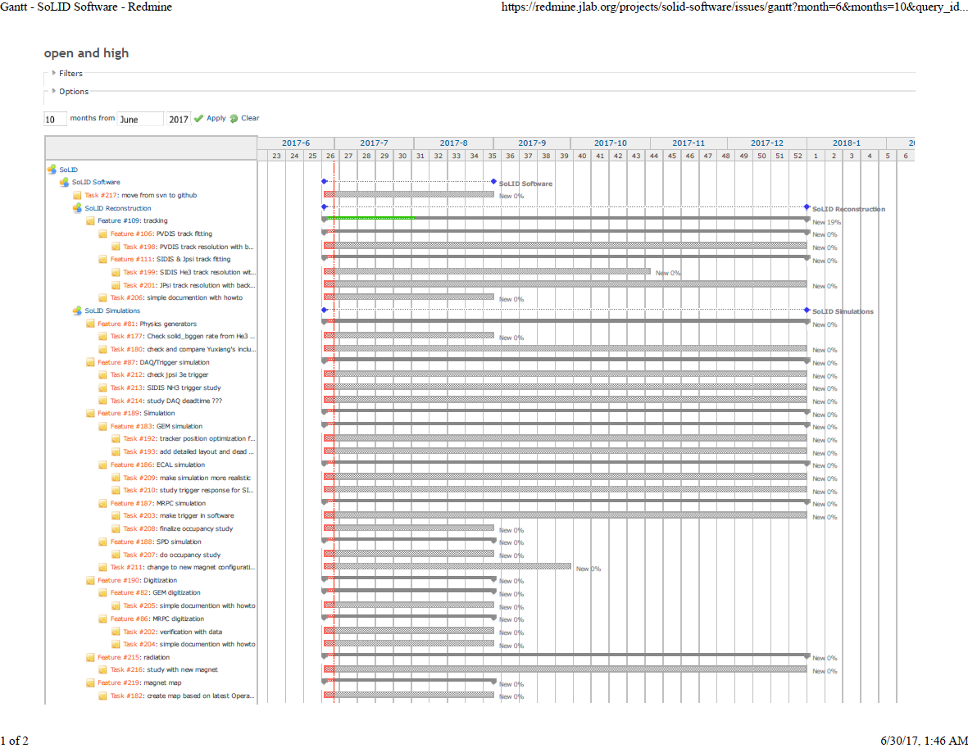
Manage tasks on redmine.jlab.org
Link to git once coversion done
Moving all or part of wiki also?

Slide 15
Priority
Urgent
PVDIS acceptance optimization with new magnet (Rich,Zhiwen)
High
LGC and HGC tuning for new location (Zhiwen,Michael)
New field map (Jay,Zhiwen)
Medium
How current simulation will work with art? (Zhiwen,Seamus,Ole)

Slide 16
if only 1FTE can be requested (need discussion)
0.25 simulation of Jpsi (trigger and physics)
0.25 simulation of SIDIS He3 and NH3 (trigger and physics)
0.25 tracking
0.25 detector definition service and reconstruction in art

