Slide 1
SoLID DAQ update SoLID collaboration meeting
Alexandre Camsonne
June 7th 2018

Slide 2
Outline
Outstanding issues
PVDIS / SIDIS data rates
DAQ preR&D and R&D request
FADC dead time simulation
MRPC
SAMPA test stand

Slide 3
Outstanding issues
PVDIS
trigger rate ok
GEM ok ( 3 samples readout do we need more ? )
calorimeter resolution and pion rejection ( pile-up, 3 samples readout sufficient )
finalize Cerenkov readout
data reduction ( improve trigger with Cerenkov pixel readout )
data transfer
SIDIS
demonstrate 100 KHz rate capability with 1 sample
finalize Cerenkov readout
can we take all singles : 200 KHz several samples
SPD background ( pile up and photon rejection )
MRPC timing resolution with background
J/Psi
ok in triple coincidences
trigger rates with 3 samples in double coincidence
reconstruction efficiency tracking

Slide 4
PVDIS electron trigger
Coincidence ECAL and Gas Cerenkov
 | Old | Hall D
Singles ECAL | 290 KHz | 230 KHz
Singles rates Cerenkov | 1.9 MHz | 803 KHz
Accidental 30 ns | 16.5 KHz | 4.1 KHz
DIS electron | 10 KHz max | 7.7 KHz
Total rate | 27 KHz | 12.1 KHz

Slide 5
Event size data rates PVDIS
 |  |  |  | Event size |  | Data rate MBs | After noise cut | strips firing | event size bytes |  | MB/s
1 | 1156 | 21.17 | 244.73 | 3038.03 | 3038.03 | 60.76 | 9.97 | 115.25 | 1430.76 | 1430.76 | 28.62
2 | 1374 | 10.35 | 142.21 | 1765.39 | 1765.39 | 35.31 | 5.11 | 70.21 | 871.61 | 871.61 | 17.43
3 | 1374 | 8.81 | 121.05 | 1502.71 | 1502.71 | 30.05 | 4.42 | 60.73 | 753.92 | 753.92 | 15.08
4 | 2287 | 3.07 | 70.21 | 871.60 | 871.60 | 17.43 | 1.64 | 37.51 | 465.61 | 465.61 | 9.31
5 | 2350 | 2.79 | 65.57 | 813.93 | 813.93 | 16.28 | 1.50 | 35.25 | 437.60 | 437.60 | 8.75
 |  |  |  |  | Total | 159.83 |  |  |  | Total | 79.19
FADC
 | 20000 |  |  |  |  |  | 10
 | Event size FADC | Nb channel | Header |  |  | Trailer | Sample
 | Calorimeter | 14 | 4 |  |  | 4 | 12 | 280
 | Preshower | 9 | 4 |  |  | 4 | 12 | 180 | 400
 | Cerenkov | 9 | 4 |  |  | 4 | 12 | 180
 |  |  |  |  |  |  |  |  | 11600000
 |  |  |  |  |  |  |  | 740 | 11600000 | 11.6
 |  |  |  |  |  |  |  |  | Total rate | 94 | MB/s
About 2.9 GB/s for PVDIS at 20 KHz

Slide 6
SIDIS event size
Occupancies with one sample readout by Weizhi , rates for 100 KHz
GEM | Occupancy | Number of strips | XY strips | Strips per chambers | MB/s
1 | 2.21 | 453 | 906 | 27180 | 245
2 | 8.78 | 510 | 1020 | 30600 | 1184
3 | 3.63 | 583 | 1166 | 34980 | 559.5
4 | 2.31 | 702 | 1404 | 42120 | 428.7
5 | 1.78 | 520 | 1040 | 31200 | 244.71
6 | 1.3 | 640 | 1280 | 38400 | 220
Total | 20.01 | 3408 | 6816 | 204480 | 2901
GEM dominating ( 35 bigger than initial proposal ) 2.9 GB/s same requirement as PVDIS

Slide 7
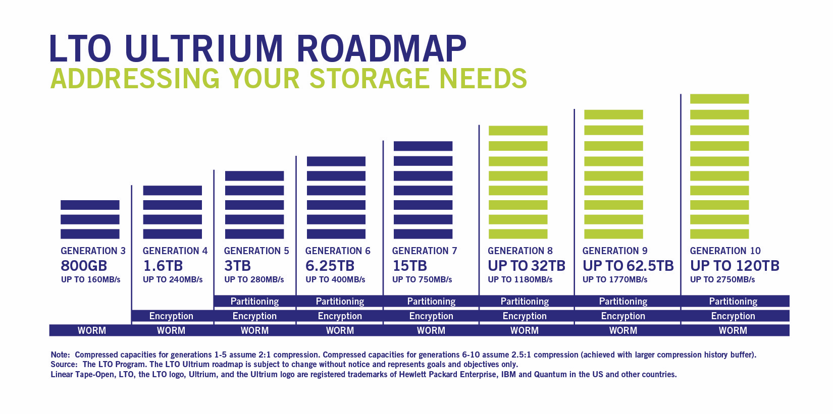
LTO timeline
Currently : 14 drives give 2.24 GB/s ( LTO4 to LTO6) up to 16 drives for now. With LTO8 could be up to 0.36 GB/s per drive max 5.78 GB/s for 16 arms
Bottom-line : 3 GB/s is reasonable by 2020

Slide 8
Silo current status
12,500 slots in 11 frames, with 16 frame maximum
24 tape drives
8 LTO-5 drives, 140 MB/s 1.5 TB raw per LTO-5 cartridge, reads and writes LTO-4
8 LTO-6 drives, 160 MB/s 2.5 TB raw per LTO-6 cartridge, reads and writes LTO-5, reads LTO-4
4 LTO-7 drives, 300 MB/s 6 TB raw per LTO-7 cartridge; reads and writes LTO-6, reads LTO-5
4 LTO-8 drives, 360 MB/s 12 TB raw per LTO-8 cartridge; reads and writes LTO-7 (coming online Spring 2018)
potentially :
8.64 GB/s with all 24 to LTO8
11.52 GB/s with 32 LTO8

Slide 9
Time of flight MRPC
Simulation
TDC vs sampling
Hardware
need new chip to handle rate DRS5 or AARDVARC or other
Beam test : ensure time resolution reachable in realistic condition

Slide 10
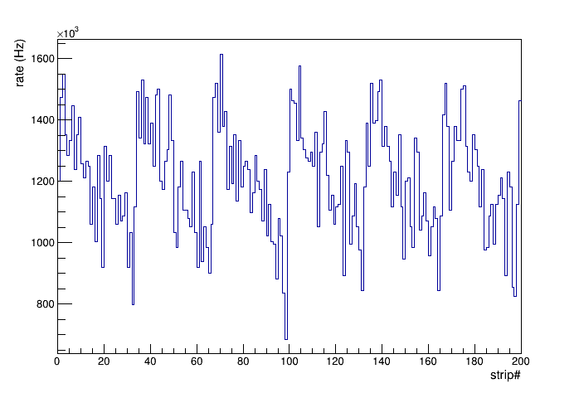
Time of flight MRPC Single rate
Beam on target
Average rate/channel:
total induced charge > 0.0 pC: 1.2 MHz
total induced charge > 0.5 pC: 893.2 kHz
total induced charge cut (pC) | Average rate / channel (MHz)
0.0 | 1.20
0.1 | 1.11
0.2 | 1.06
0.3 | 1.00
0.5 | 0.95
0.6 | 0.84
0.7 | 0.80
0.8 | 0.76
0.9 | 0.72
1.0 | 0.69
1.1 | 0.65
total induced charge > 0 pC

Slide 11
Time of flight MRPC Rate (kHz)/cm²
Charge > cut | Rate (kHz)/cm²
 | R = 96 cm | R = 105 cm
No cut | 656 | 539
Charge > 0.00 | 38.7 | 36.3
Charge > 0.10 | 37.1 | 34.8
Charge > 0.20 | 35.6 | 33.0
Charge > 0.30 | 33.8 | 31.5
Charge > 0.40 | 32.3 | 30.1
Charge > 0.50 | 31.0 | 28.4
Charge > 0.60 | 29.6 | 27.5
Charge > 0.70 | 28.1 | 26.4
Charge > 0.80 | 27.0 | 25.6
Charge > 0.90 | 26.1 | 24.7
Charge > 1.00 | 25.2 | 23.6

Slide 12
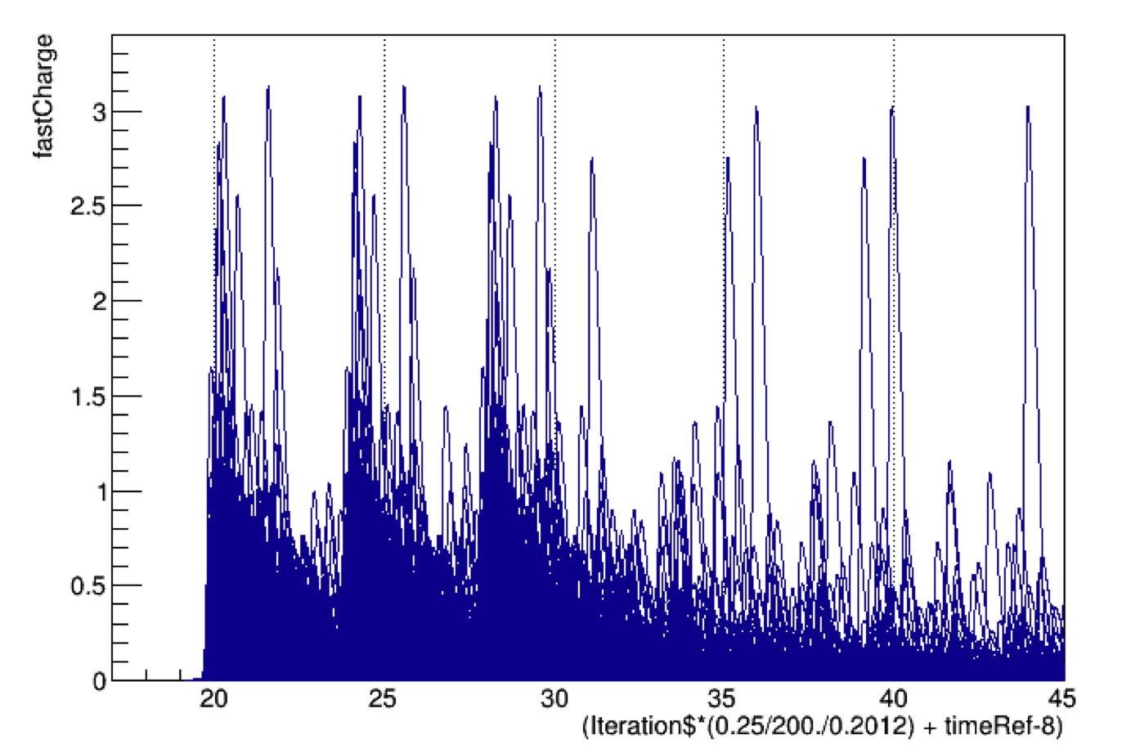
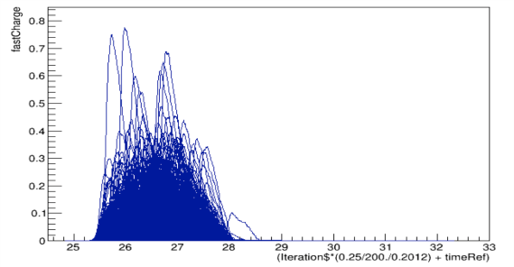
Pulse background beam on target shifted -4ns -8ns
Time of flight MRPC

Slide 13
Cerenkov PMT readout
MAROC3 close to what we need
64 channels
Variable gain
Discriminated fast logic signal
Missing : analog sum of 8, need sum of 64
8 sum of 8 available just need to sum them, will check with INFN for modified RICH board, requested 10 K$ preRD money
Radiation hardness is pretty good, need to be tested, possibility of new version to handle Single Event Upset
MAROC default option
MAROC test board available
Will check design with electronics group for FADC analog output
Possible readout schemes
FADC only ( default )
FADC + VETROC
VETROC only : needs to be evaluated
Preferred : Add TDC readout for each Cerenkov channel 232 VETROC additional 700 K$, could improve Cerenkov trigger
Need simulation to evaluate options
Need to follow with electronics group to start testing ( anyone from Cerenkov group interested ? )

Slide 14
TOF options
Expected timing resolution 80 to 50 ps
Default readout
NINO + TDC : 20 ps timing resolution
R&D MRPC : 20 ps
Sampling TDC ASICs : PSEC4/5, SAMPIC, DRS4 give 5 to 1 ps resolution
Need new chip DRS5 or PSEC5 (AARDVARC NALU) to handle SoLID trigger rate ( analog pipeline ) first prototypes for 2018
Depends on final detector choice
sPhenix solution: DRS4 system , existing chip but not optimal
Need to determine effect of photon background, might need sampling to deal with pile up

Slide 15
GEM readout
SRS deployed in Hall B Prad
MPD implemented in CODA
BLT testing few KHz
Optical fiber readout to be implemented for high rate test ( 100 MB/s to 1.6 GB/s )
Preliminary results from Weizhi : one sample no deconvolution not sufficient, new occupancy number
Data reduction on SSP for SBS
On chip deconvolution ( implemented in MPD ) still an option if needed
preRD to get VMM3 chip
SAMPA chip from ALICE

Slide 16
preRD request
GEM SAMPA test stand
Calorimeter trigger and readout
Coincidence trigger Cerenkov SPD MRPC
Dead time measurements
Cerenkov MAROC readout
MRPC readout and test

Slide 17
preRD request
FADC 250 | 4500 | 4 | 18000 | Cerenkov | 4 | 18000
VETROC | 4500 | 2 | 9000
TD | 3000 | 1 | 3000
VTP | 7000 | 1 | 7000
SSP | 5000 | 1 | 5000 |  | 1 | 5000
TID | 3000 | 1 | 3000 |  | 1 | 3000
SD | 2500 | 1 | 2500 |  | 1 | 2500
FADC trigger Dist | 4000 | 1 | 4000 |  | 1 | 4000
VXS crate | 15000 | 1 | 15000 |  | 1 | 15000
VME CPU | 4500 | 1 | 4500 |  | 1 | 4500
Optical fiber | 100 | 20 | 2000
Computer | 3000 | 1 | 3000
APV readout | 4500 | 1 | 4500
Network router | 10000 | 1 | 10000
Total |  |  | 72500
GEM VMM3 eval | 10000 | 1 | 10000
MAROC eval | 10000 | 1 | 10000
 |  | Total | 92500 |  | Total | 52000

Slide 18
preRD and RD request
Tasks | R&D | preR&D
Ecal trigger | 3 | 3
GEM performance | 3 | 3
PVDIS trigger prototype | 3 | 3
SIDIS trigger prototype | 3 | 3
FADC performance | 3
Data transfer test to SILO | 1 | 1
Dead time for PVDIS | 3
Data reduction | 6
L3 farm need evaluation | 3
Cerenkov readout | 3 | 3
Test stand - beam test | 6
Total months | 37 | 16

Slide 19
FADC Trigger Dead Time
(Ed Jasztrembski)
RAM
External trigger
VME
Processing trigger
ADC Processing FPGA
Control FPGA
ADC Data
FIFO

Slide 20
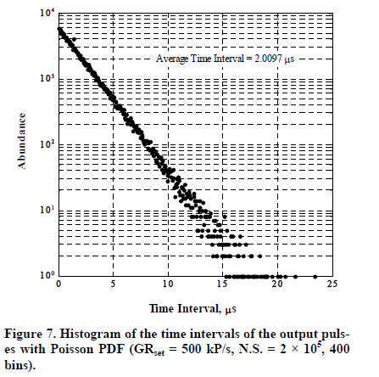
FADC Trigger Dead Time
(Ed Jasztrembski)

Slide 21
FADC Trigger Dead Time
(Ed Jasztrembski)
Test of Simulation Code
100K triggers, Processing time per trigger = 6 us, Maximum stored triggers = 4
Trigger rate (KHz) | Trigger dead time (%)
50 | 0.2
75 | 0.6
100 | 2.0
125 | 4.6
150 | 9.2

Slide 22
SAMPA

Slide 23
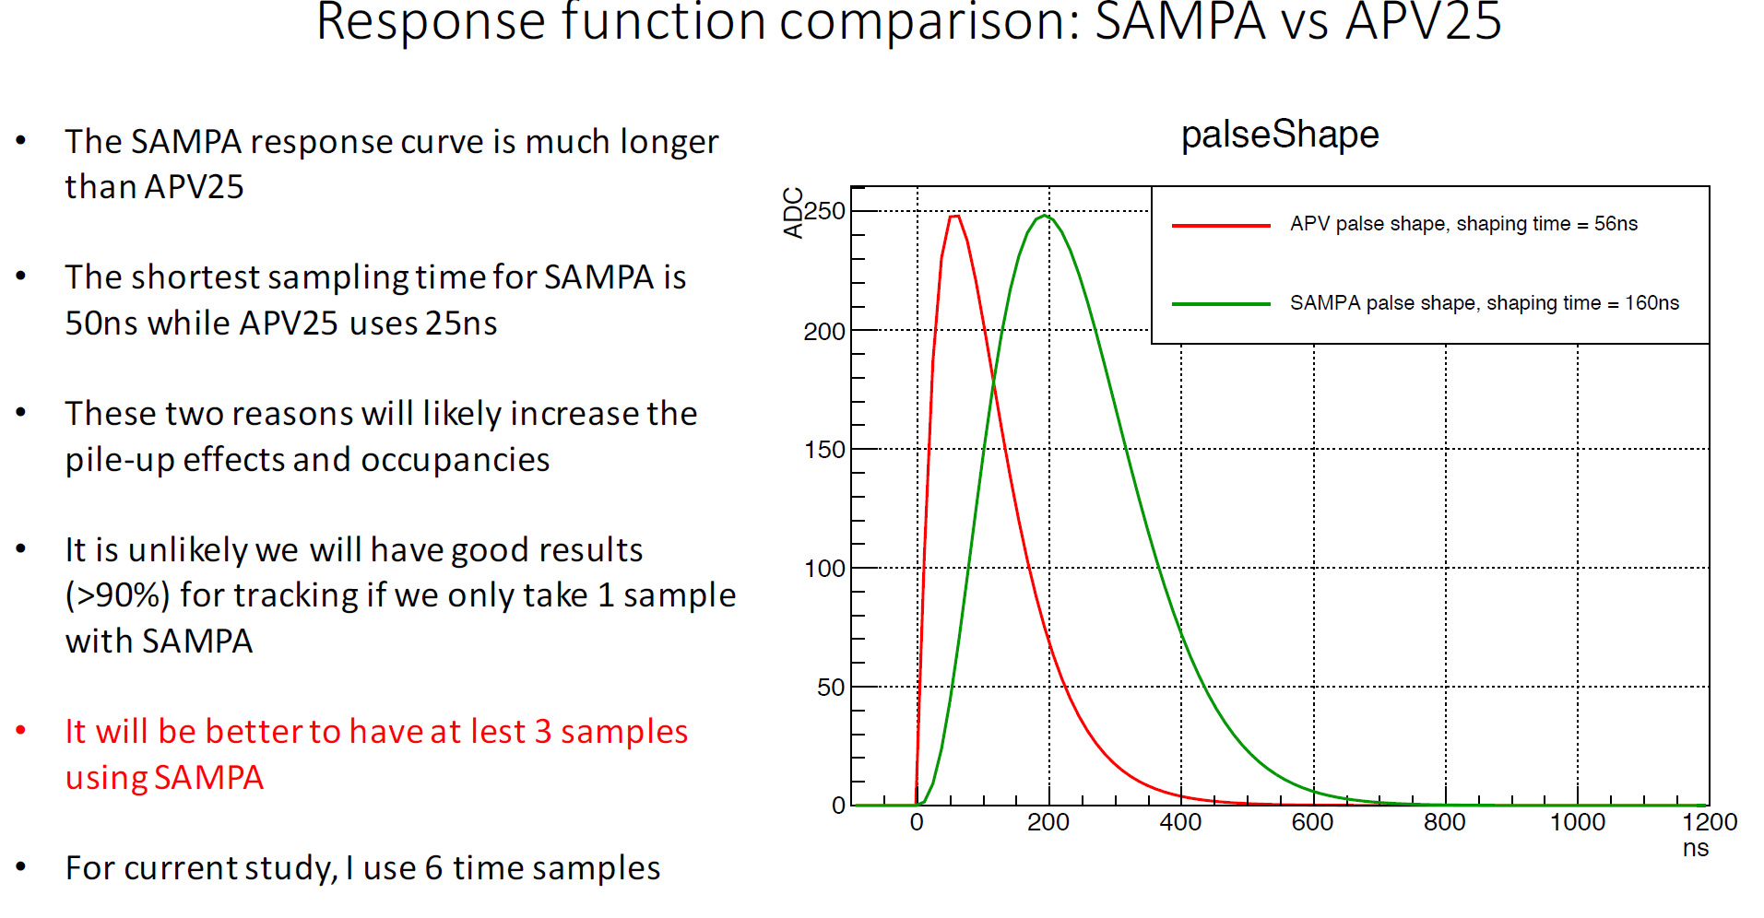
SAMPA study by Weizhi

Slide 24
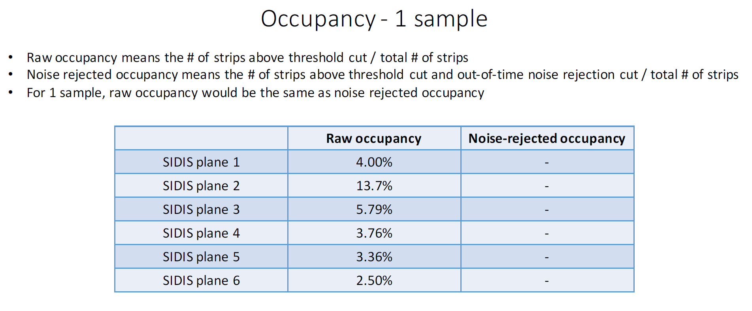

Slide 25
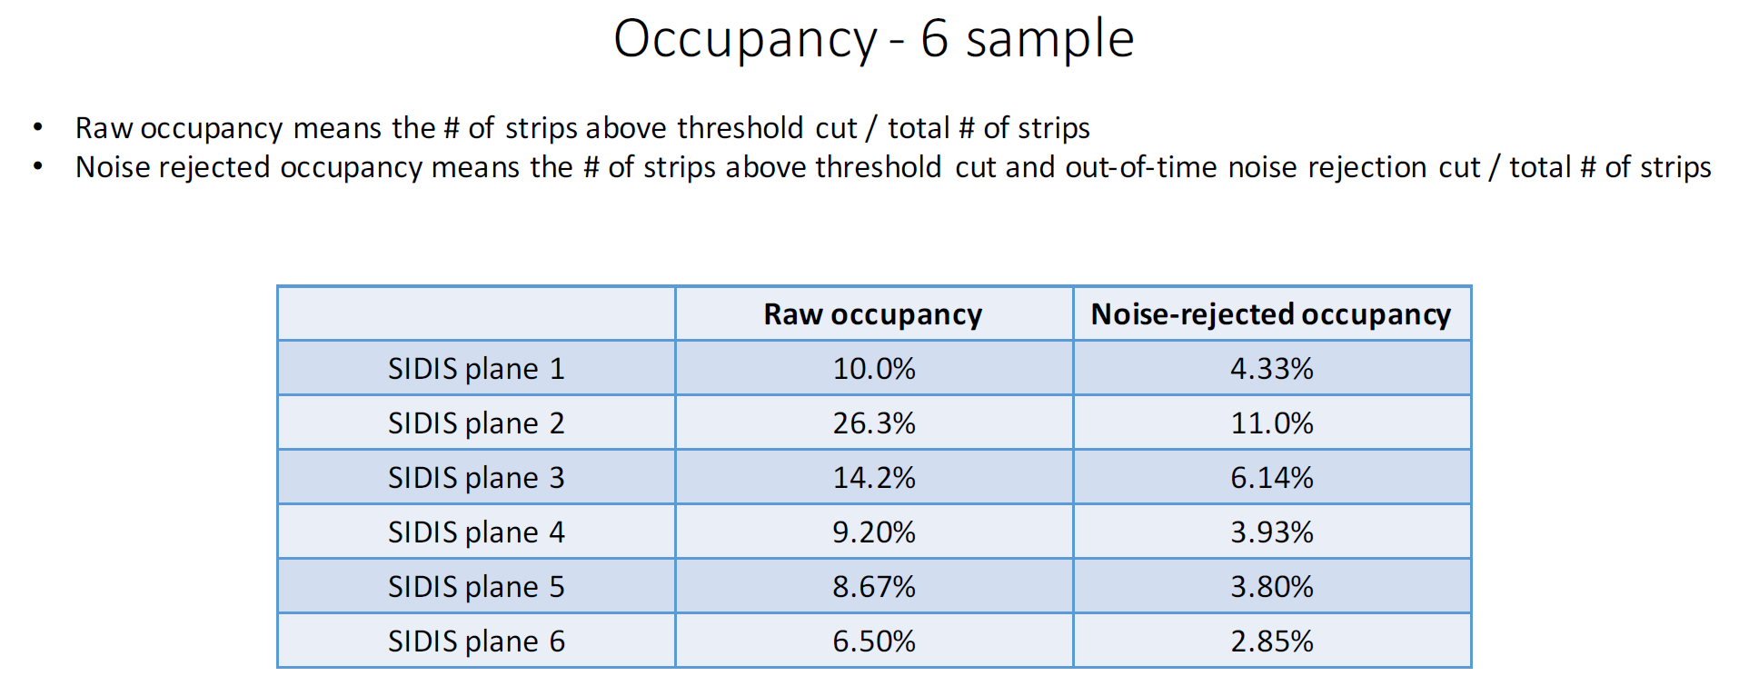

Slide 26
SAMPA readout (Ed Jasztrembski)

Slide 27
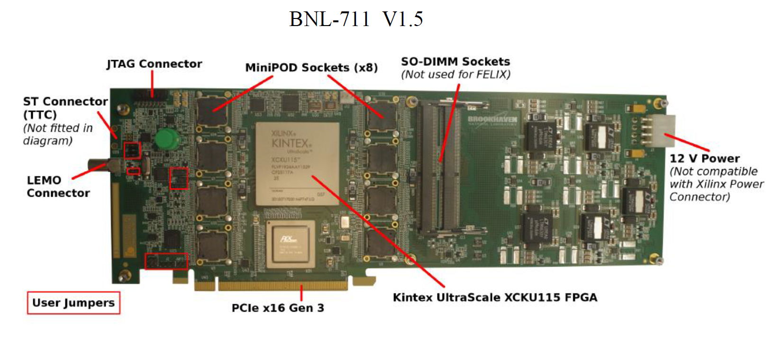
Readout board

Slide 28
SAMPA test stand
Status as of 6/4/18: (1) SAMPA chips - Acquiring tested chips has been difficult since ALICE is in the process of instrumenting a complete sector of their TPC. Marco Bregant (SAMPA designer) has just obtained 50 chips from the Lund test facility; he is shipping these to us. (2) CERN custom ICs (GBTx, GBT-SCA, VTTx, VTRx) - ordered; should arrive within the next week. (3) Front-End Cards (FEC) - We delayed construction until components (1) and (2) were available. Requisition will be placed in the next week. 4 week fabrication/assembly time has these ready by mid July. (4) Common Readout Unit (CRU) - ATLAS BNL-711 PCIe card delayed until mid July. (5) FEC power supplies - in place (6) High performance PC - in place

Slide 29
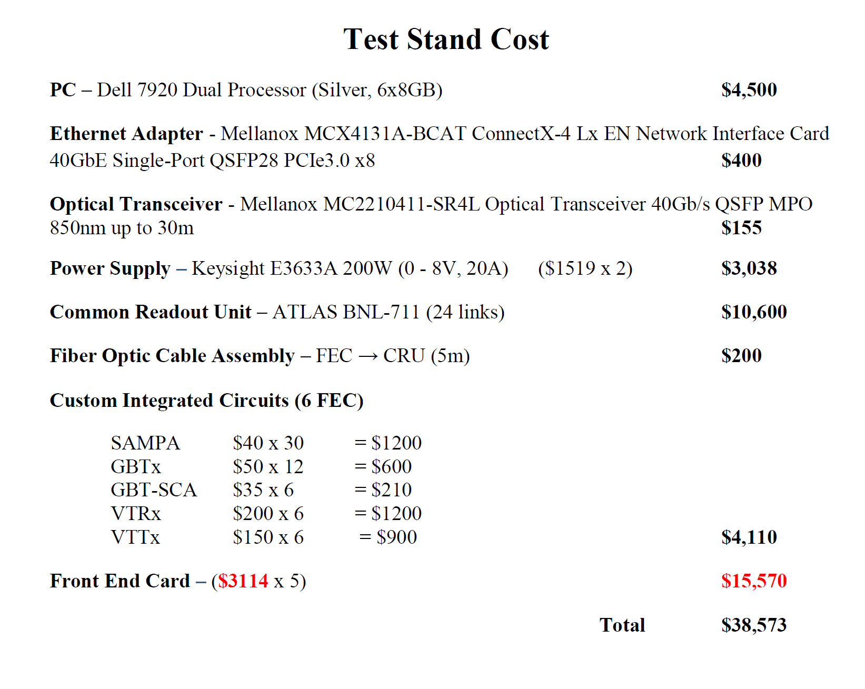
SAMPA budget

Slide 30
JLab contribution to SoLID
Ed Jasztrembski : dedicated for Hall A
FADC dead time
SAMPA test stand
William Gu
VETROC for MRPC readout
Ben Raydo
FADC VXS readout
Calorimeter Cluster trigger
FPGA trigger in VTP for PVDIS and SIDIS trigger
MAROC readout

Slide 31
Conclusion
preRD hardware and manpower request
PVDIS mostly ok : dead time / data rates
SIDIS : GEM rate capability, TOF
Finalize Cerenkov readout
preR&D and R&D allows to book time with JLAB DAQ and electronics group
SAMPA study by Weizhi
SAMPA test stand ready by mid July

