Slide 1
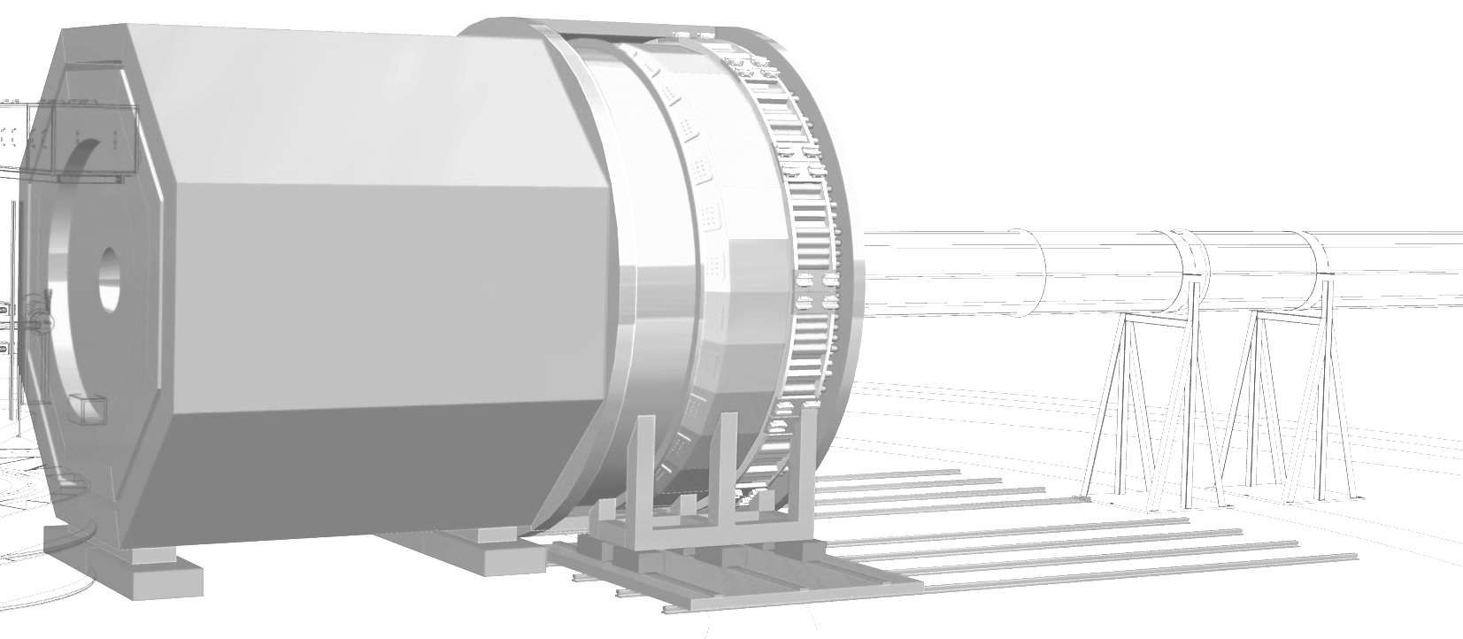

Status and Overview of SoLID
SoLID Collaboration Meeting
October 8-9, 2020
Jian-ping Chen
Jefferson Lab

Slide 2
Outline
1. Update Since June 2020 Collaboration Meeting
Overview of SoLID, Timeline, Collaboration and
Technical Requirements
Pre-Conceptual Design
Subsystems, Simulated Performance,
Risk Assessments and Pre-R&D Plan
5. Summary

Slide 3
Progress Since June 2020 Collaboration Meeting
Main Progress:
Pre-R&D: excellent progress for 2nd quarters and moving into 3rd quarter
Cherenkov beam tests data taking completed
DAQ tests progressing well
Most milestones met
2nd quarter progress report submitted
Successful Mid-term Review of Pre-R&D
Other subsystems:
Magnet tests on-going
Simulations, ECal, GEM, MRPC, Software
3. Science Review dates are set to be March 8-10, 2021. Preparation underway.

Slide 4
SoLID Physics Overview

Slide 5
Timeline
- Since 2010: Five SoLID experiments approved by PAC with high rating
3 SIDIS with polarized ³He/p target, 1 PVDIS, 1 threshold J/ψ
Six run-group experiments approved
collaboration, with Jlab support, has been continuously working on
pre-conceptual design and pre-R&D
2013: CLEO-II magnet requested, agreed, arrived at JLab 2016,
steel arrived August 2019.
2014: pCDR submitted to JLab with cost estimation and proposed schedule
2015: 1st Director’s Review: positive with many recommendations
2015: LRP strong endorsement of SoLID science cases
- 2017: Updated pCDR submitted to JLab with responses to the recommendations
- 7/2018: DOE NP visit and discussion: → update cost estimation
- 1/2019: Updated pCDR (new cost estimation) submitted to JLab
- 8/2019: Update cost estimation with WBS structure and proposed schedule
9/2019: 2nd Director’s Review: successful with only few recommendations
11/2019 Pre-R&D plan approved, funding started 2/2020
2/2020: SoLID MIE (with updated pCDR) Submission to DOE
3/2021: SoLID DOE Science (Scheduled)

Slide 6
Strong Collaboration
- 270+ collaborators, 70+ institutions from 13 countries
Large international participations and anticipate significant contributions
Strong theory support
A global map with flags indicating the collaborating groups (to be added)

Slide 7
Technical Requirements
High luminosity (10³⁷ for SIDIS and J/ψ, 10³⁹ for PVDIS with baffle)
Large acceptance: 2π in φ angle, θ angle: 8-24 degrees for SIDIS, J/ψ
22-35 degrees for PVDIS
Momentum range: 1 - 7 GeV/c
High rates (100 KHz trigger rate for SIDIS, 600KHz/30 for PVDIS)
High background (~ GHz, dominated by low energy photons/electrons)
High radiation environment
Moderate resolutions (1-2% in momentum, 1-3 mr in θ, 6 mr in φ)
Good electron PID
Moderate pion PID (SIDIS)
Demanding Kaon PID (SIDIS-Kaon, enhanced configuration)
High precision with low systematics
* Targets (cryogenic LH2/LD2, T/L polarized 3He, T polarized NH3)
* Beam polarimetry (demanding for PVDIS, 0.4%)
* dependencies, see talk by Thia Keppel

Slide 8
SoLID in Hall A
Plan for installing SoLID in Hall A with other equipment moved out of the way.

Slide 9
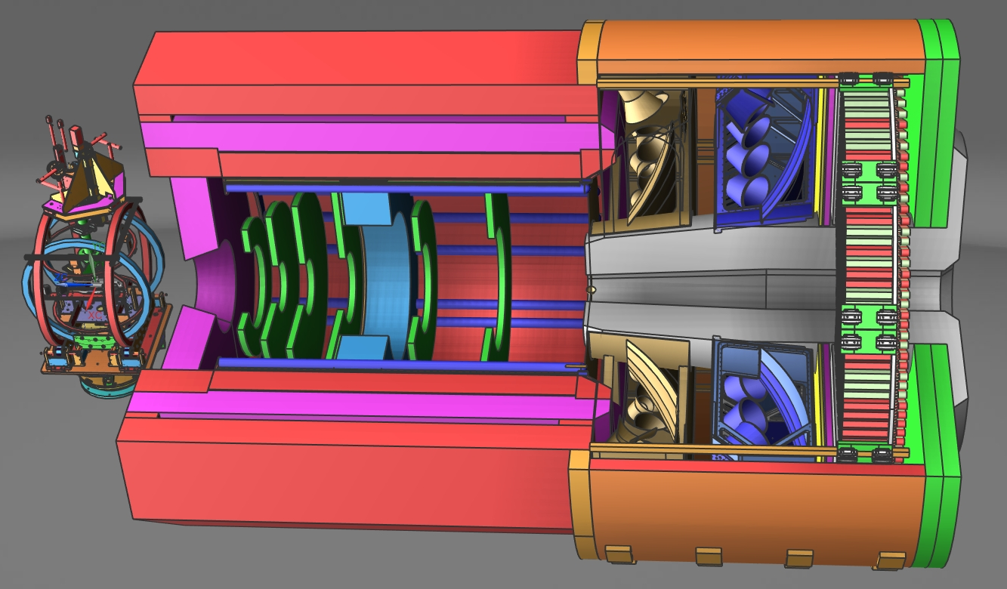
SoLID Apparatus
Polarized ³He (``neutron”) @ SoLID
Requirements are Challenging
High Luminosity (10³⁷-10³⁹)
High data rate
High background
Low systematics
High Radiation
Large scale
New Technologies
  GEM’s
  Shashlyk Ecal
  Pipeline DAQ

Slide 10

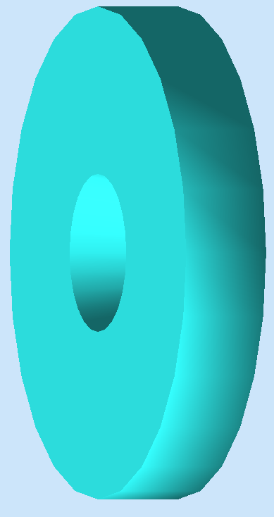
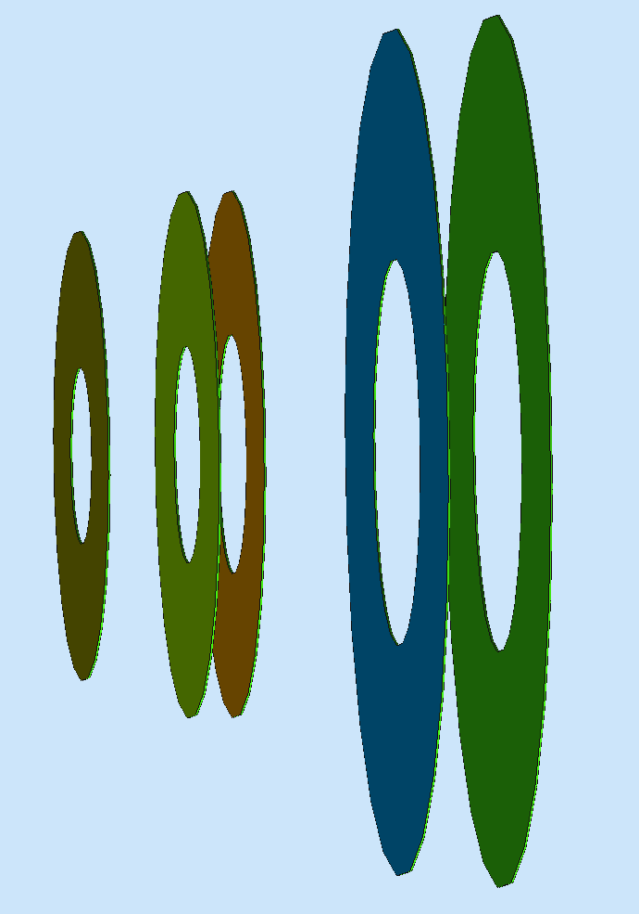
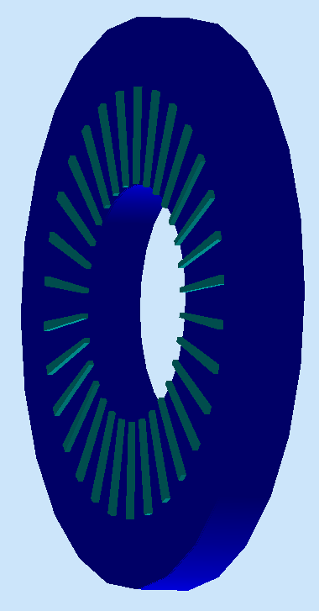
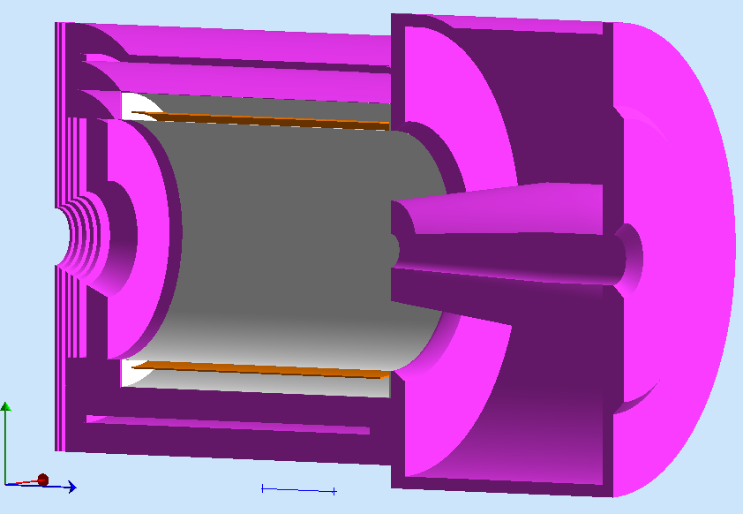
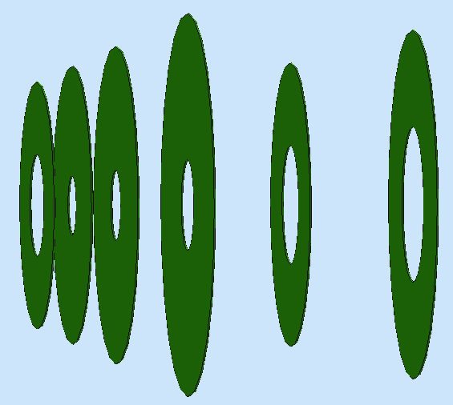
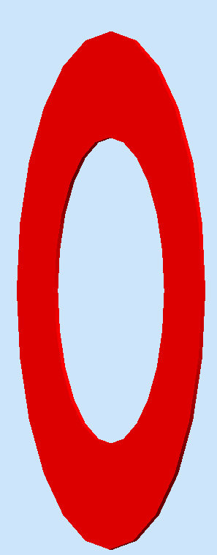
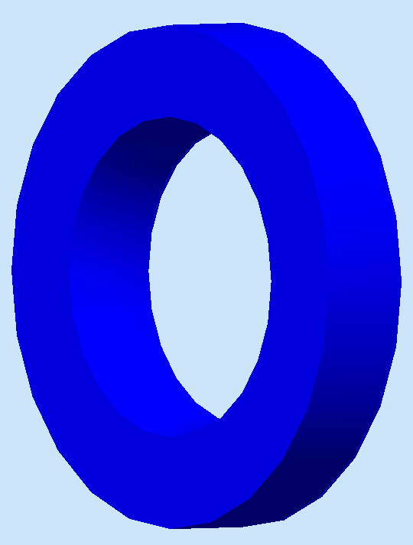
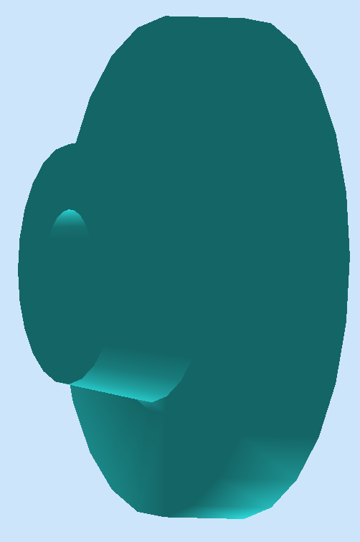
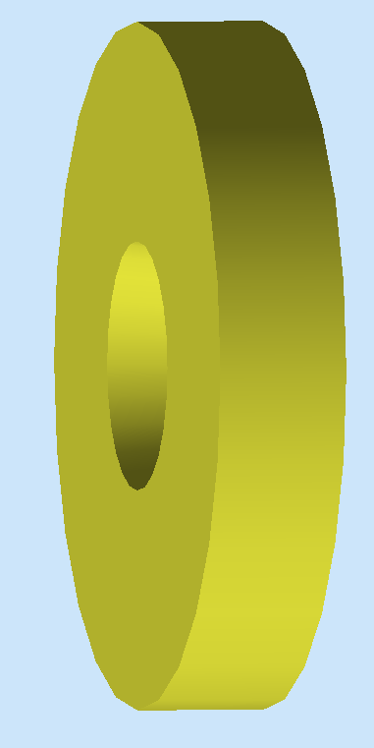


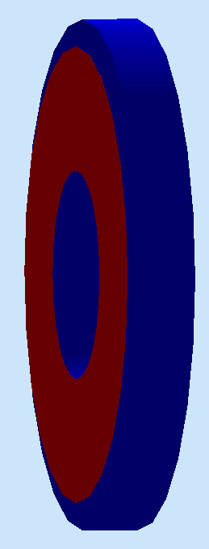
SoLID Detector Subsystems
Uses full capability of Jlab electronics
PVDIS: Baffle LGC 5xGEMs EC
SIDIS&J/Psi:
6xGEMs LASPD LAEC LGC HGC FASPD MRPC FAEC
Pre-R&D items: LGC, HGC, GEM’s, Electronics

Slide 11
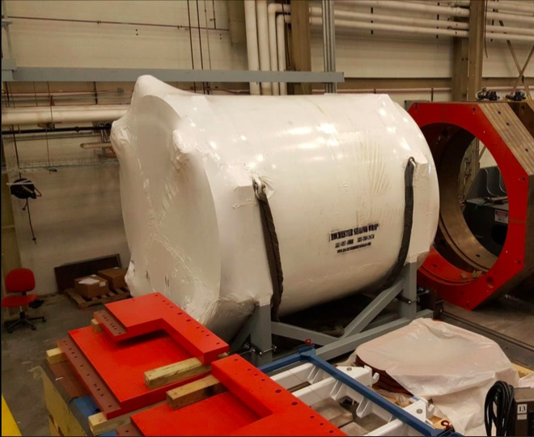
Magnet: Requirement and Design
Requirements:
→Acceptance: Φ: 2π, θ: 8º-24º (SIDIS), 22º-35º (PVDIS), P: 1.0 – 7.0 GeV/c,
→ Resolution: δP/P ~ 2% (requires 0.1 mm tracking resolution)
→ Fringe field at the 3He target < ~5 Gauss
CLEO II coil at JLab
Use CLEO II magnet with the following modifications
  Two of three layers of return yoke
  needed
  Add thickness to front endcap
  Add extended endcap
Yoke for SoLID

Slide 12
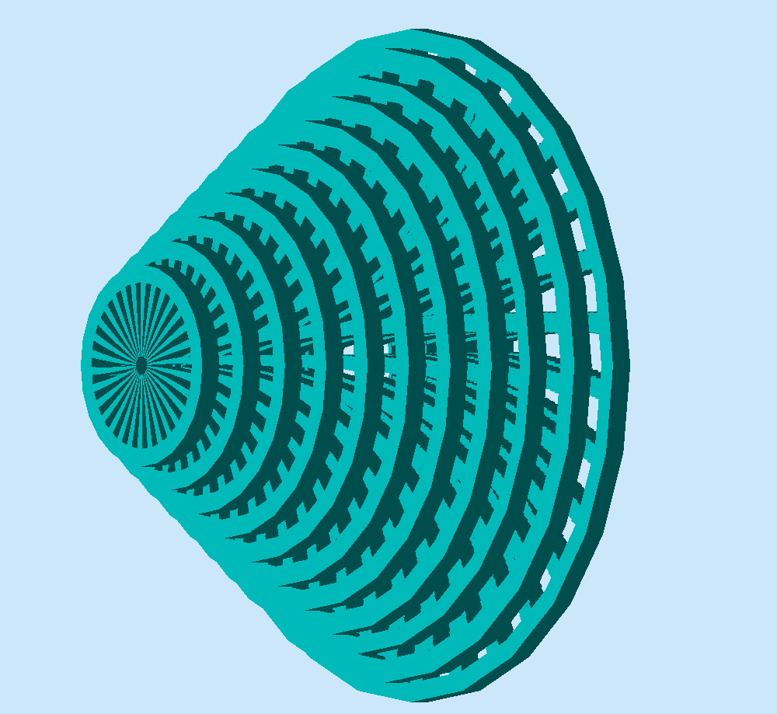
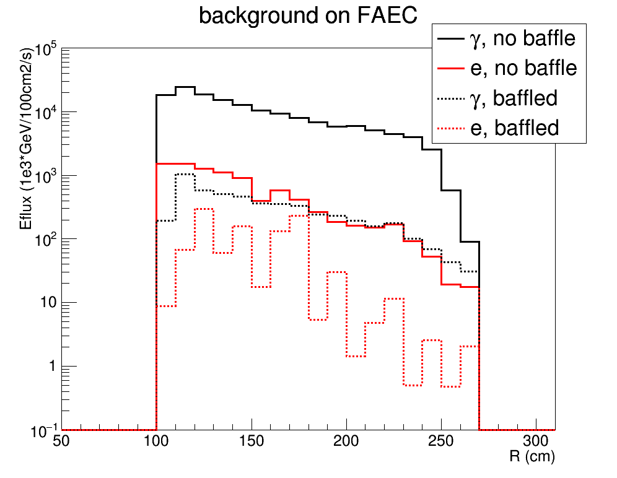
PVDIS Baffle Design
SoLID PVDIS needs to run 1x10³⁹/cm²/s luminosity
Baffle is made of 12 planes of 9cm thick lead with slits following electron bending in SoLID field
It blocks neutral and positive tracks from target, and thus reduces background and trigger rate
Acceptance ~30% for DIS electrons is maintained at P>3GeV and x>0.4 region

Slide 13
GEM tracking
Rate capabilities > many MHz/cm
High position resolution
Cover large areas at reasonable cost
Low thickness (~0.5 radiation length)
Used in many experiments (COMPASS, STAR, ALICE…)and planned for many future experiments CMS upgrade, EIC…)
Gem configuration
GEM Technology
EIC Prototype: similar to SoLID design

Slide 14
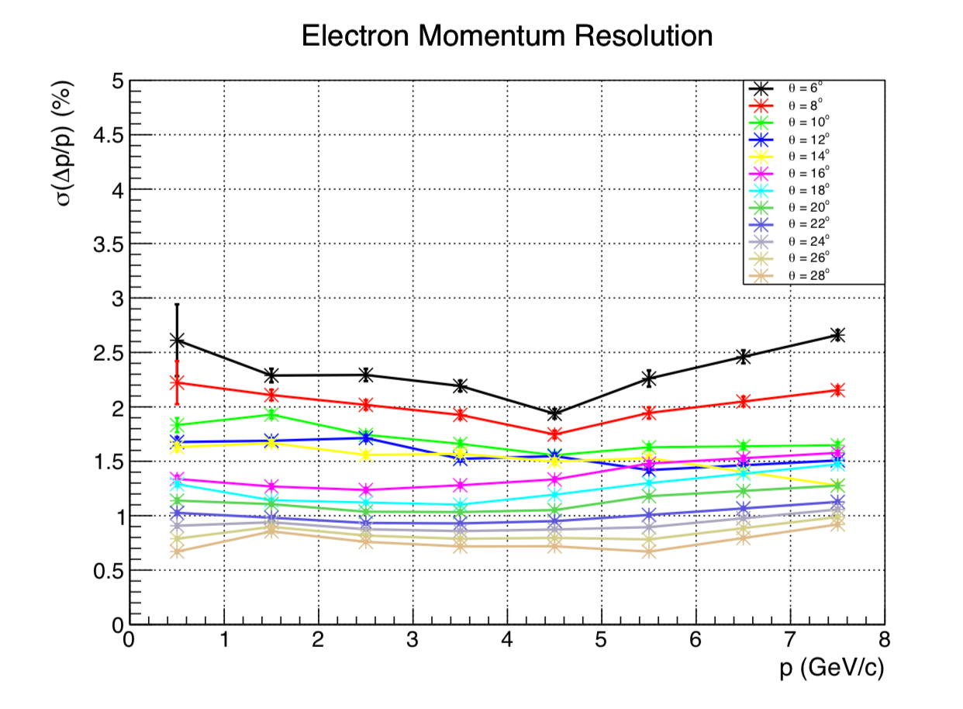
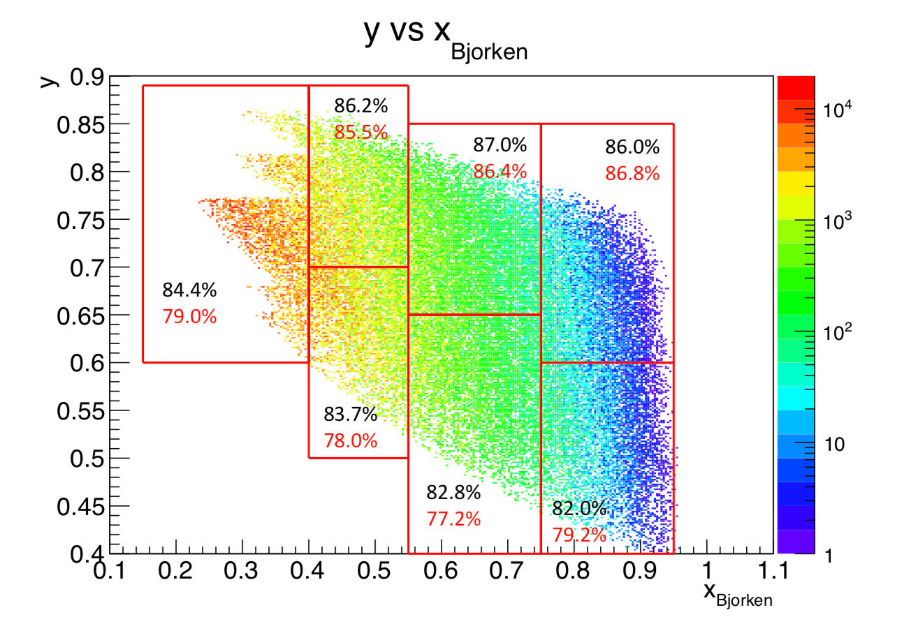

Simulated GEM Performance
<2% for $θ$ > 10º
Electron Momentum Resolution versus angle
Efficiency and accuracy for
PVDIS versus kinematics
Risk:
VMM chips need testing: addressed in Pre R&D plan
APV versus VMM

Slide 15
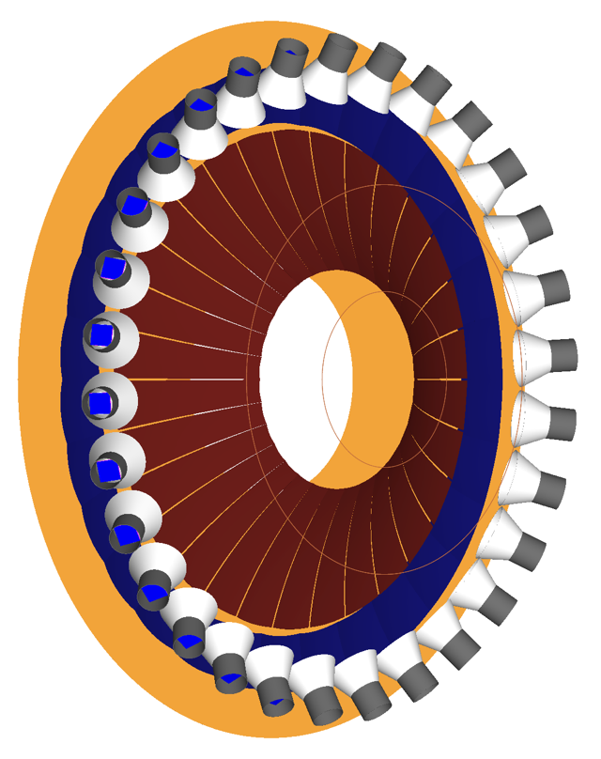
Light Gas Cerenkov: Requirements
General Requirement A: Provide 500:1 electron / pion separation for the major SoLID programs: PVDIS, J/Psi, and SIDIS.
General Requirement B: Provide trigger level input while maximizing efficiency and minimizing cost.

Slide 16
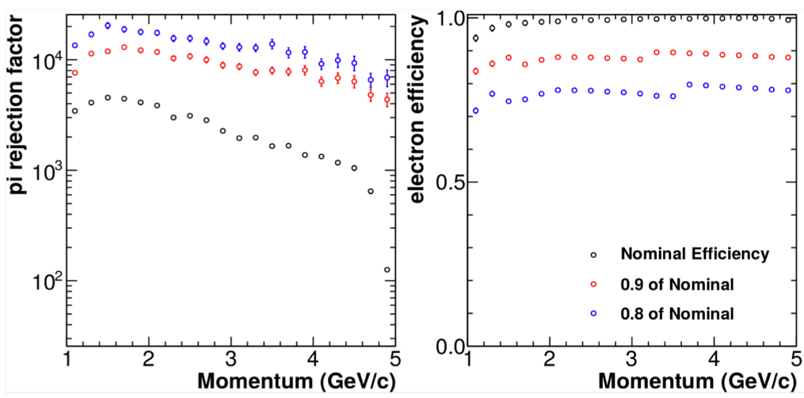
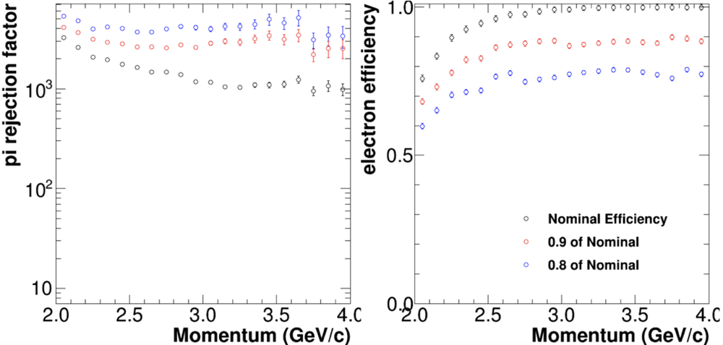
LGC Performance and Risk
With the proposed LGC design, pion rejection factors stay above 500:1 for all cuts for both configurations.
Pion threshold at 293 K and 1 atm:
  N₂: 5.73 GeV/c
  CO₂: 4.67 GeV/c
J/Psi SIDIS
PVDIS
Technical risk: optimizing performance at high rates, to be addressed in Pre R&D plan.

Slide 17
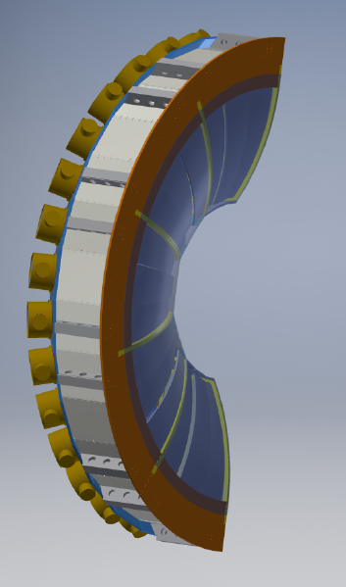
Heavy Gas Cerenkov (HGC)
HGC is used to identify charged pions and reject charged kaons.
It is only used for SIDIS polarized He₃ and SIDIS polarized proton (NH₃) experiments.
Kinematic coverage: 2.5GeV< P <7.5GeV, 8º < θ < 15º, full azimuthal angle
π⁺/π⁻ detection: efficiency >90%, Np.e. > 10
K⁺/K⁻ rejection: factor >10
Space limit along beam direction: ~1m
Field at photonsensor location: ~100G
Radiator: ~1m long gas C₄F₈ at 1.7atm at 20ºC
Otherwise similar to the LGC

Slide 18
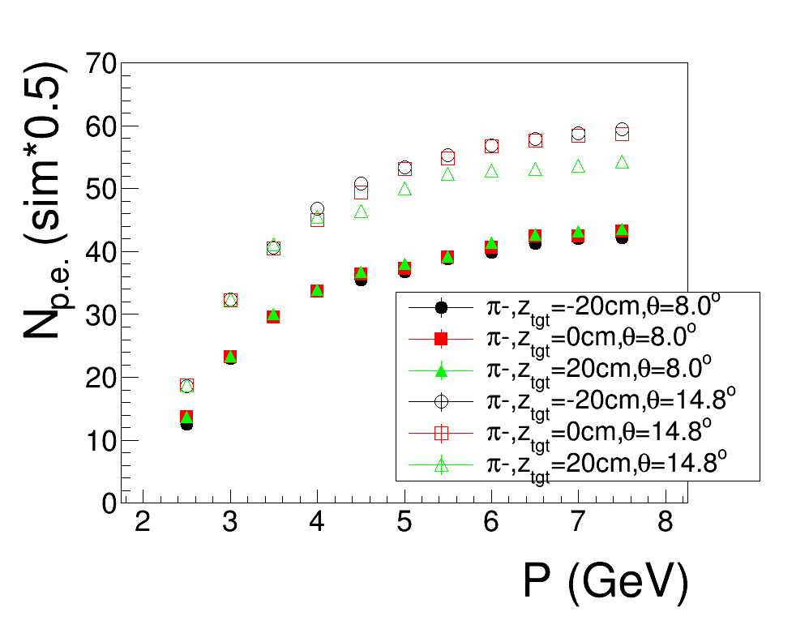
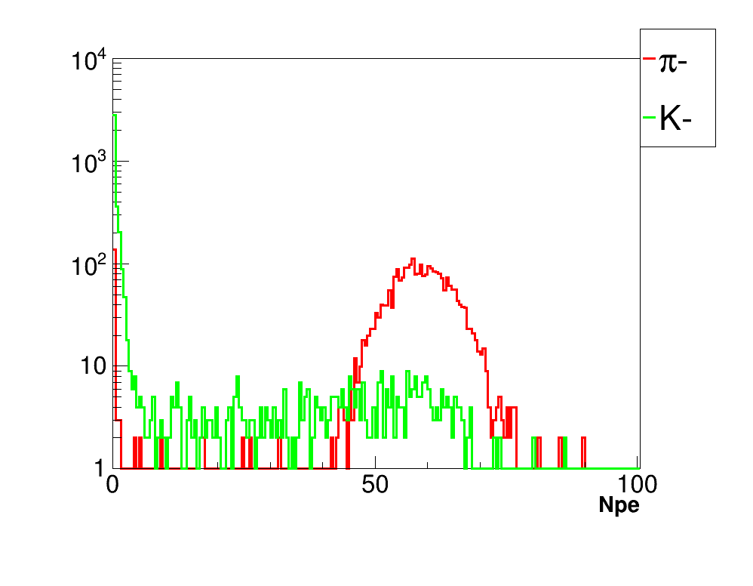
Heavy Gas Cerenkov: Simulated Performance
7.0-7.5GeV, 14-15deg
Simulated PE Yield versus momentum
Simulated Response to pions and kaons

Slide 19
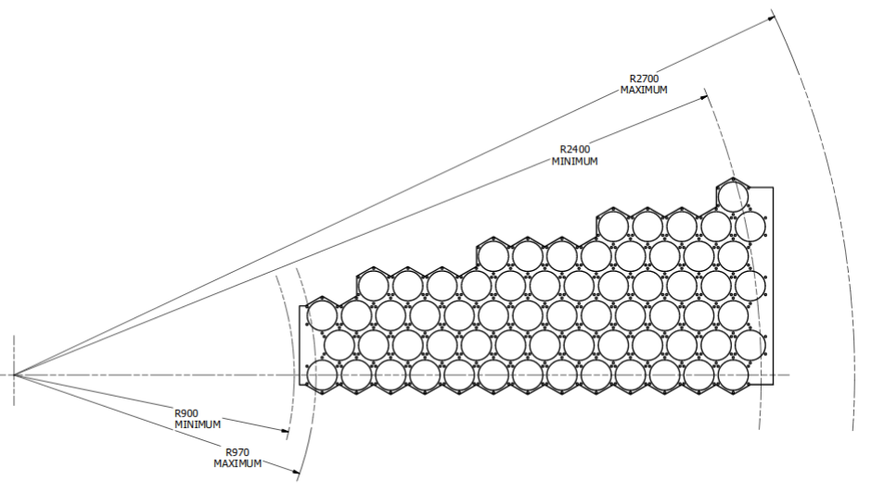
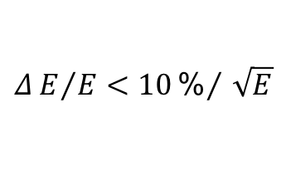
ECal Requirement and Design
– Combined with LGC to provide triggering;
– 50:1 pion rejection with 90% electron efficiency;
– provide ~1cm shower position for background suppression;
– radiation hard: >500 krad, high neutron background;
– inside 1.5 T field
– modules swappable between PVDIS and SIDIS
$$ΔE/E<10{\text{\%}}/{\sqrt{E}}$$

Slide 20
ECAL Performance and Risk
Realistic simulation with background and supporting material
FAEC electron
Resolution: for all angles, reached p0~(5-6)% and p2~(5-6)%
FAEC pion

Slide 21
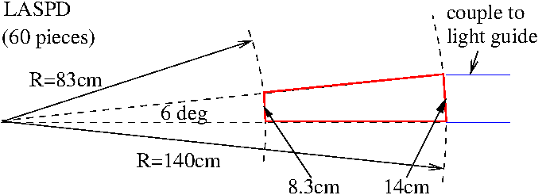
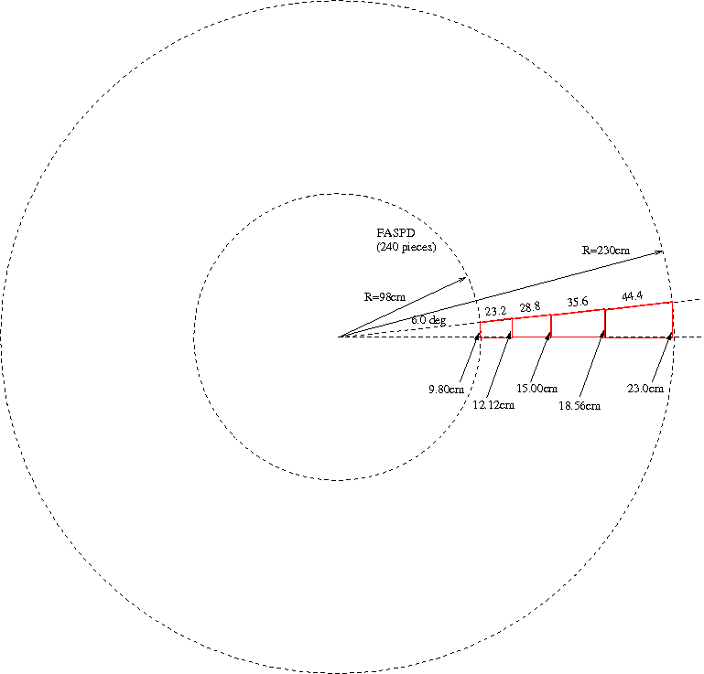
SoLID Scintillator Pad Detector (SPD): Requirement and Design
LASPD: photon rejection 5:1; coincidence TOF
(150ps preferred)
→ design: 20mm-thick,
60 azimuthal segments,
direct coupling to fine-mesh PMT
FASPD: photon rejection 5:1
→ design: 5-10mm-thick
240 segments (60 X 4)
WLS fiber embedding,
MAPMT (outside magnet)

Slide 22
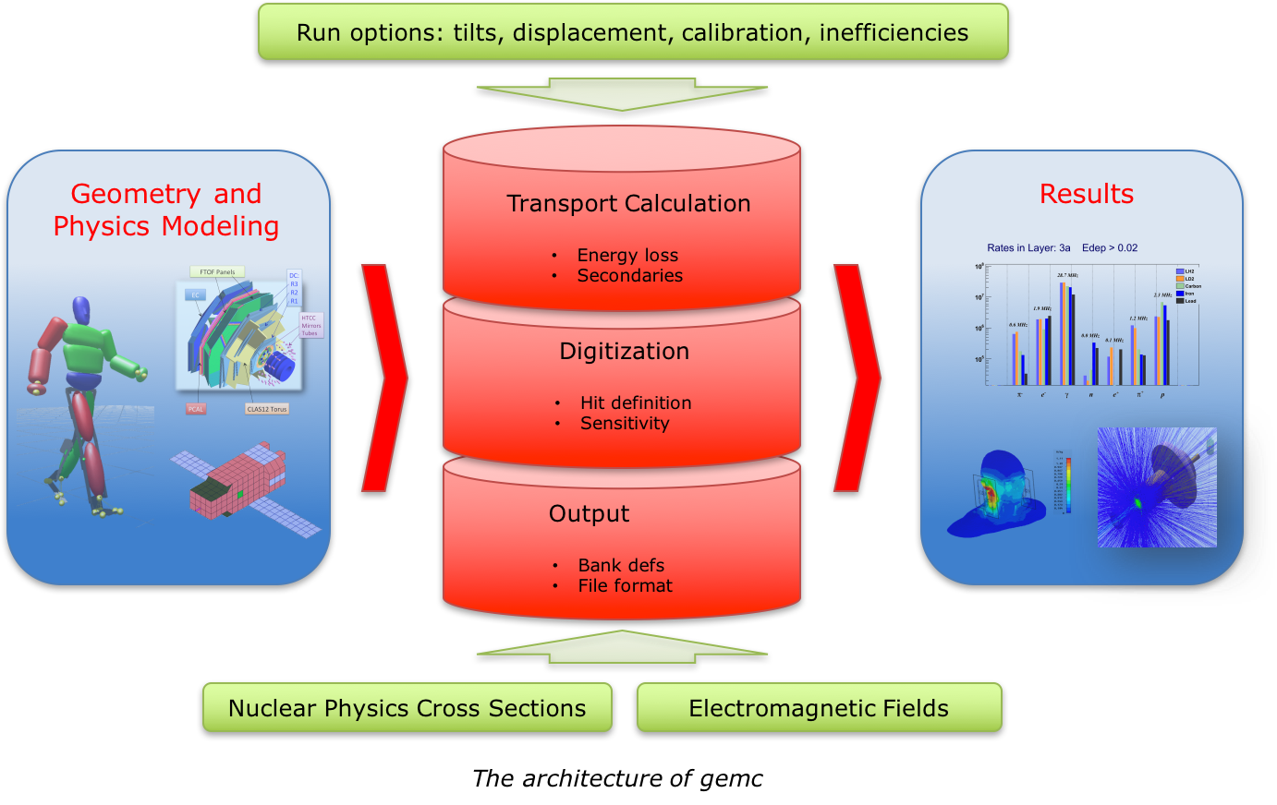
Software and Simulations Project Goals
Put in place an end-to-end simulation and reconstruction chain
  Integrated software environment for (almost) all parts of data processing
  Addresses recommendations from prior Director’s Review
Carry out simulations to
  Optimize detector designs
  Optimize figures-of-merit of experiments
  Quantify and understand experimental backgrounds
Provide online analysis software and tools to facilitate experiment commissioning and data quality assessment
Existing simulations: SoLID_GEMC
GEMC is Geant4-based simulation package, used by CLAS12 and JLEIC
Implemented SoLID detector description and signal processing. Set of physics generators available.
Used extensively for SoLID preCDR. Also is being used in pre-R&D studies.

Slide 23
Data Acquisition Requirement and Design
Pipelined DAQ
Digital triggering scheme
  ( coincidence calorimeter and Cerenkov )
Calorimeter clustering
Design goal:
60 KHz/sector for PVDIS (expect 30kHz)
100 kHz total for SIDIS (expect 100 kHz)
DAQ based on 12 GeV FADC base pipelined electronics designed for 200 KHz trigger rates currently used in Hall B and D ( can meet PVDIS deadtime requirement of 0.1% deadtime)
Added GEM readout similar to SBS but with trigger rates up to 100 KHz
  APV25 based readout 100 K channels : 3.6 us readout time per sample
    Set limit to 200 KHz in one sample mode and 60 KHz with 3 samples
    ( note that HPS currently running at 50 KHz with 6 samples )
  VMM chip for remaining channels

Slide 24
DAQ Risk Assessment and pre-R&D
Technical risk low : existing with current technologies available ( deadtime less pipeline electronics, network, data bandwidth ) for example data rates much smaller than CERN LHC
Making sure all requirements are met within cost
  Simulation with full background
    Trigger rates
    Data reduction algorithms
    Occupancies
    Systematic errors
    Evaluation of amount of data to be recorded
  Small scale prototyping and beam tests to validate simulation and modeling of the DAQ
Addressed in the Pre-R&D plan

Slide 25
Summary
SoLID: A large acceptance device which can handle very high luminosity to allow full exploitation of JLab12 potential
→ pushing the limit of the luminosity frontier
After a decade of hard work, we have a mature pre-conceptual design with expected performance to meet the challenging requirements for the three major science programs
Technical risks are assessed and addressed in the pre-R&D plan (Michael Paolone’s talk)
Magnet testing, Hall A infrastructure and detector integration will be discussed by Whit Seay
Cost and schedule has been evaluated multiple times (Steve Wood’s talk)
Dependencies will be discussed by Thia Keppel
SoLID benefited greatly from the previous Director’s Reviews (See Xiaochao Zheng’s talk)

