Slide 1

EC and SPD Updates
The SoLID EC Working Group
SoLID Collaboration Meeting
Jan. 7-8, 2021

Slide 2
Outline
Overview of Ecal shashly prototypes
Prototype construction status
Fiber and light connection status
Current status of light yield and contribution to energy resoltuion
FTBF test status

Slide 3
Shashlyk prototype and light yield overview
Proto-type | scintillator | lead | reflective layer | WLS fiber | WLS fiber end | module side | cosmic vertical test Npe | cosmic horizontal test Npe | PMT gain method
SDU1 | Kedi original | US | printer paper | BCF91A (SC) | none | Tyvek→ TiO₂ | 254 | 48 | SPE/SDU
SDU2 | Kedi new | Chn | printer paper | BCF91A (SC) | Chn silver-plating | Tyvek→ TiO₂ | 383 | 83 | SPE/SDU
SDU3 | Kedi new | US | printer paper | Y11(200) (MC) | Chn silver-plating | TiO₂+glue (1/1) | 450 | 108 | SPE/SDU
SDU4 | Kedi new | Chn | Powder paint | BCF91A (SC) | ESR | TiO₂+glue+water | 562 |  | SPE/SDU
SDU5 | Kedi new | US | Tyvek (0.145mm) | BCF91A (SC) | ESR | BCF91A (SC) | 398 |  | SPE/SDU
SDU6 | Kedi new | Chn | ESR | Y11(200)MC | ESR (individual) | TiO₂+glue | 813 |  | SPE/SDU
THU1 | Kedi original | Chn | mirror mylar (reflective) | Y11(200)MC | Italian silver shine | TiO2 (Kedi) | 430-470 | 96 | not measured
THU2 | Kedi new | Chn | powder paint (diffusive) | BCF91A-SC | Italian silver shine | Tyvek wrapping | 748 → 570* | 90-103 | SPE/IHEP
THU3 | Kedi new | Chn | Powder paint | BCF91A-MC
*re-tested at SDU with better-understood PMT gain

Slide 4
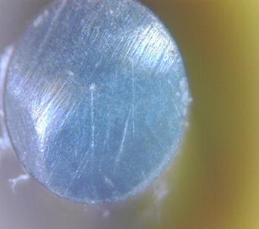
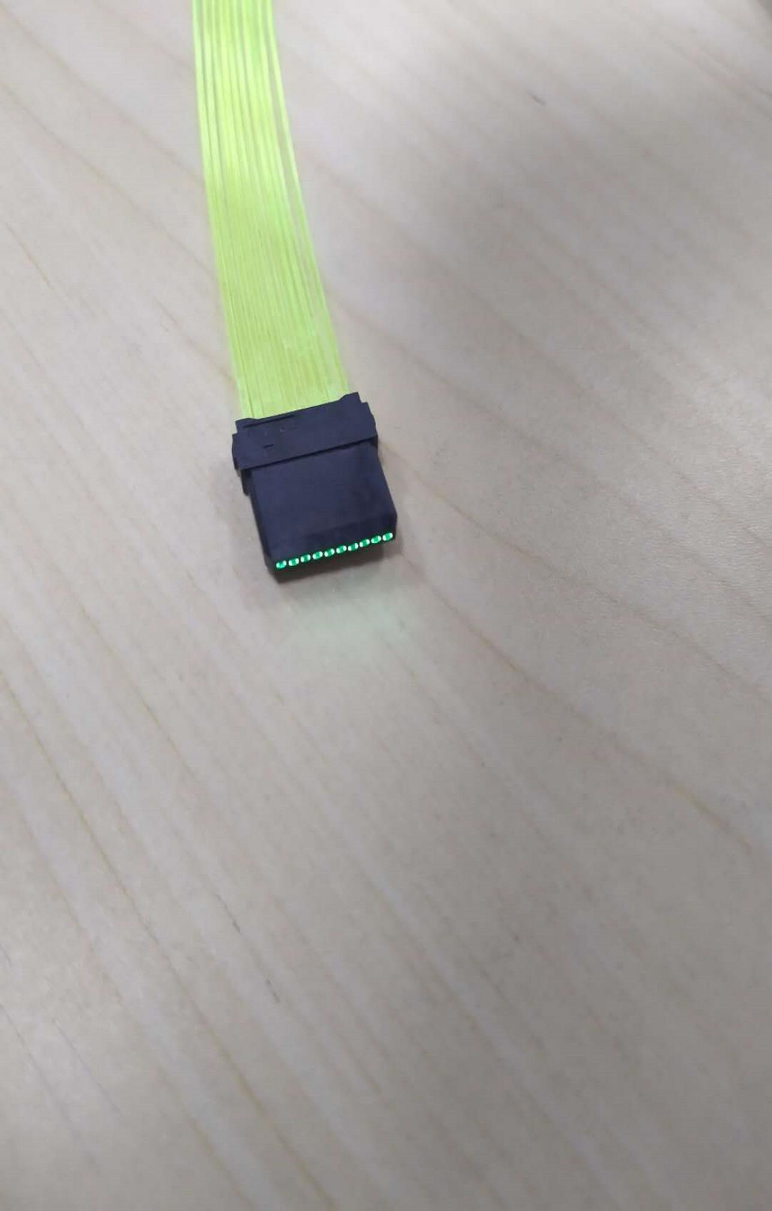
Fiber Status
In August, met with Saint-Gobain to discuss WLS and clear fiber issues.
“faulty” BCF91A-MC fiber has been replaced and tested by SDU, now showing 25% higher light yield than BCF91A-SC as expected (note: Y11-MC is 46% higher). Fiber diameter is 1.06mm (vs. 1.00m of SC fibers), but should not be a problem for assembling.
Fiber type | ADC channel
BCF91A-SC | 2588
BCF91A-MC faulty | 2577
BCF91A-MC new | 3219
Chunhui PMMA fiber tested by SDU with attenuation length ~20m, but radiation hardness is questionable.
DDK fibre connectors tested by SDU repeatedly, ~22% light loss, small variation depending on polishing quality.
Chunhui PMMA fiber

Slide 5
Shashlyk Prototype Modules – Light yield analysis and plan
Best light yield is SDU6, 800 p.e. with Y11(200)MC; scale to 680 p.e. for BCF91A-MC (so far SoLID cost estimate is using BCF91A-MC);
With 800 p.e. for cosmic (~60MeV), scaling up to 1 GeV electron with 20% sampling ratio gives 2666 p.e./GeV electron. Compare to LHCb 2.6-3.5 p.e./MeV, 4-4.4p.e./MeV;
Using BCF91A-MC we expect 2265 p.e./GeV.
Adding factor of 2-3 for light loss to PMT (fiber connector 25% and 1.5m=71%*0.75=0.53, 2.5m=57% *0.75=0.43, 3.5m=46% *0.75=0.35 clear fiber of type BCF98, with attenuation length 4.5m), we get 1/sqrt(1333)=2.7% or 1/sqrt(888)=3.4% contribution to energy resolution due to photon statistics. This is pushing the margin considering the intrinsic resolution is (5-6)%. Ideally the effect of photoelectron statistics should be negligible. – simulation needed to study impact on PID/triggering
LHC collaboration contacted me for our method of light readout under high radiation...
Ultimately depends on the current energy resolution of the modules → see FTBF test
?? Would like to order 8 IHEP prototypes to (1) measure their light yield; (2) study their material and structure; but need funding ($70-80k).

Slide 6
Some discussions with Raytum Photonics
Suggested using liquid light guide. Large ones (11mm in dia) is not commercially available but some companies may be interested in developing it → Chunhui/SDU, see next slide
Raytum will get some DDK connector samples and study the polishing technique. However, polishing for SoLID is technically tedious and we do not know how much they will charge us.

Slide 7
Some discussions with Chunhui (through SDU)
Confirmed they also have two types of clear fibers:
  PS-core: loss 25%/m, radiation hardness is “good”;
  PMMA-core: ligh loss 5%/m, radiation hardness is “normal”;
  Both types are single-cladding from Chunhui
Willing to develop two methods. The light loss for both plans are expected to be worse than our current DDK connector method (but may reduce manpower cost of polishing 97 fibers)
  All 97 WLS fibers from a module to a lens then → 2-3mm diameter fiber;
  All 97 WLS fibers from a module to a liquid light guide.

Slide 8
Some other remaining issues
Connector of fiber → PMTs
MAPMT use for Preshower and FASPDs (purchased two MAPMT assemblies from Hamamatsu)
Support structure design

Slide 9
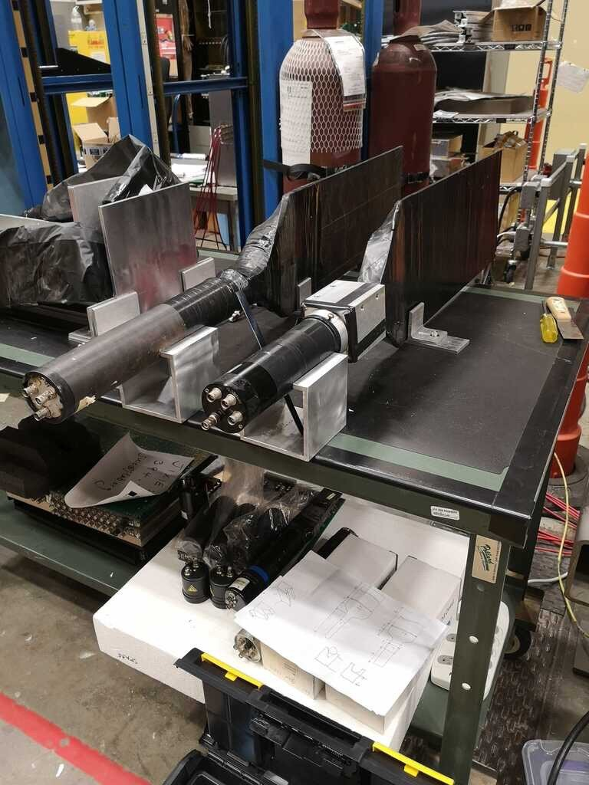
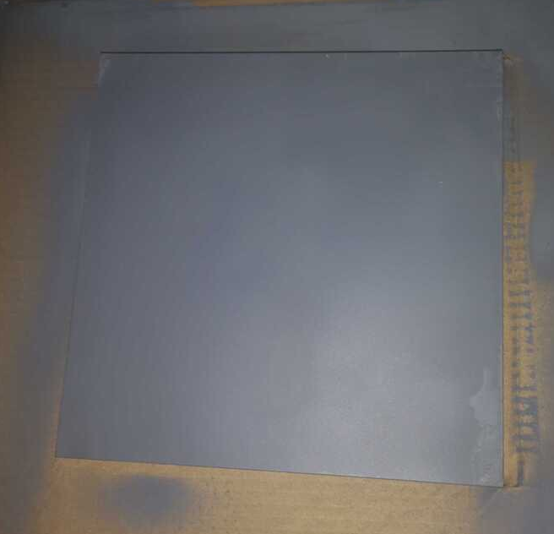
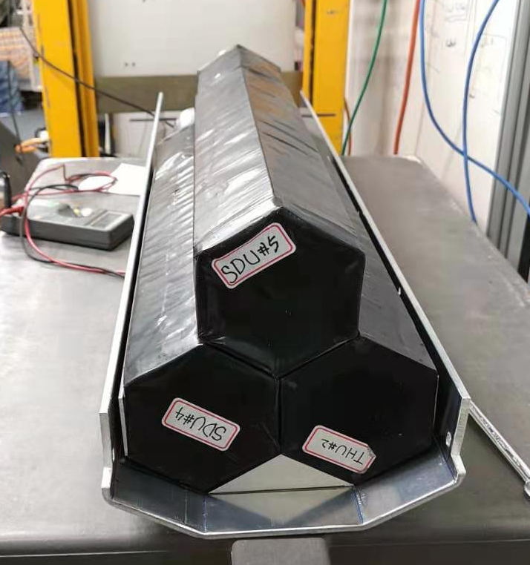
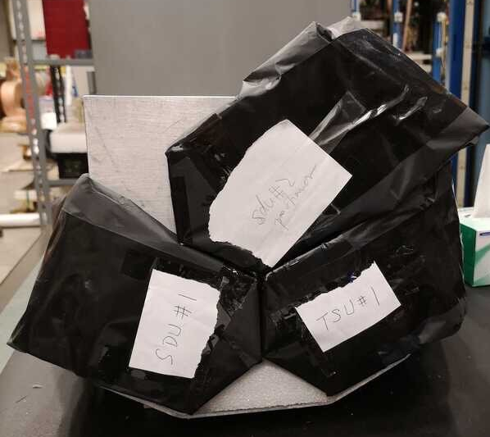
Testing at Fermilab Test Beam Facility
Beam scheduled for Jan. 13-27 (daytime during 1st week, night time 2nd week);
Lead by Jixie Zhang, Xinzhan Bai (UVA)/ Alexandre Camsonne, David Flay (JLab)/ with local help from Paul Reimer, Manoj Jadhav, Junqi Xie (ANL)
Using 3 shashlyks (SDU4,SDU5,THU2), 3 preshowers, and 2 scintillators for triggering. 2X0 prelead and a 1(2?)cm Al plate are also in place. Main goal is to characterize energy resolution for GeV-level electrons.
Test lab pictures

Slide 10
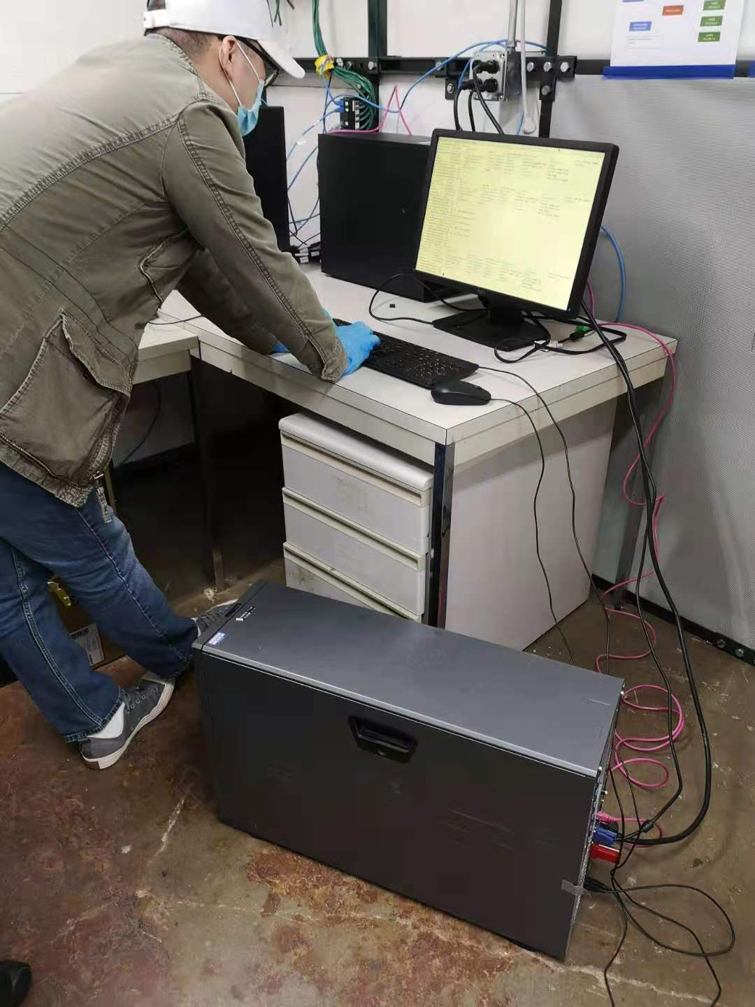
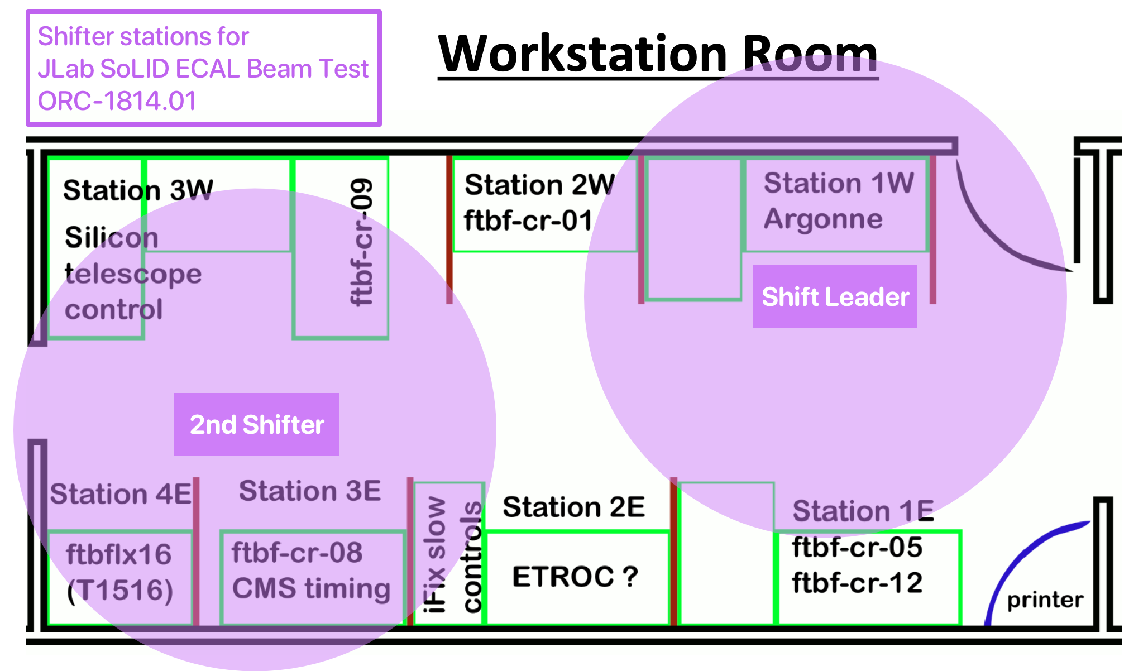
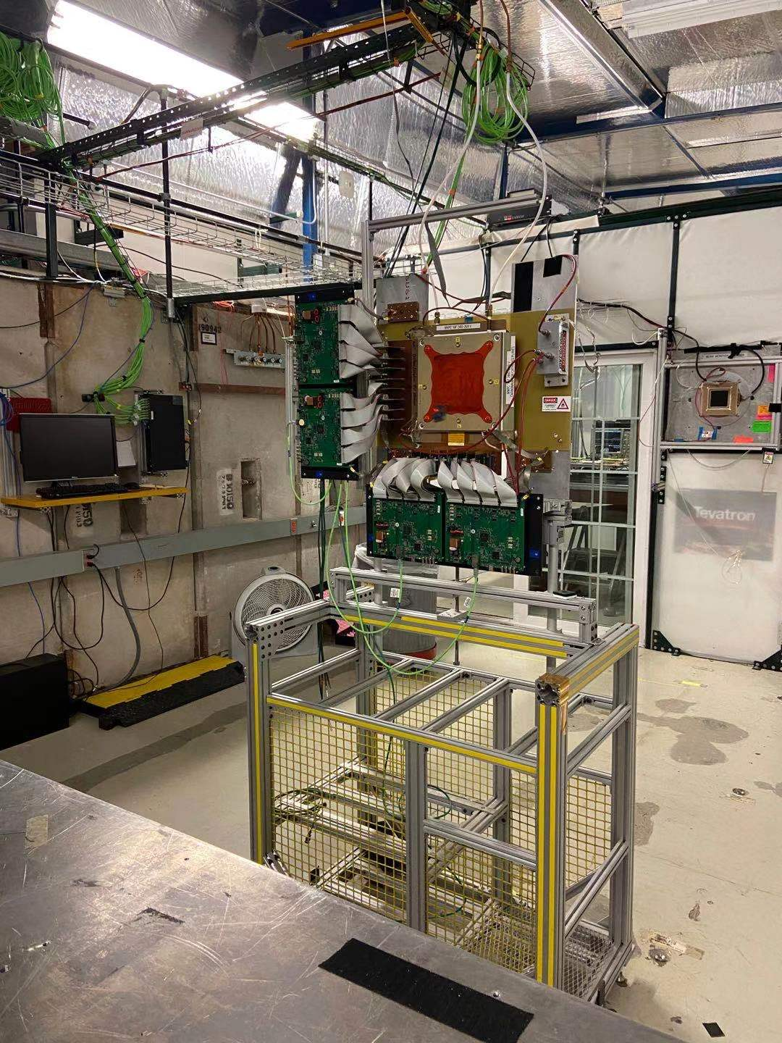
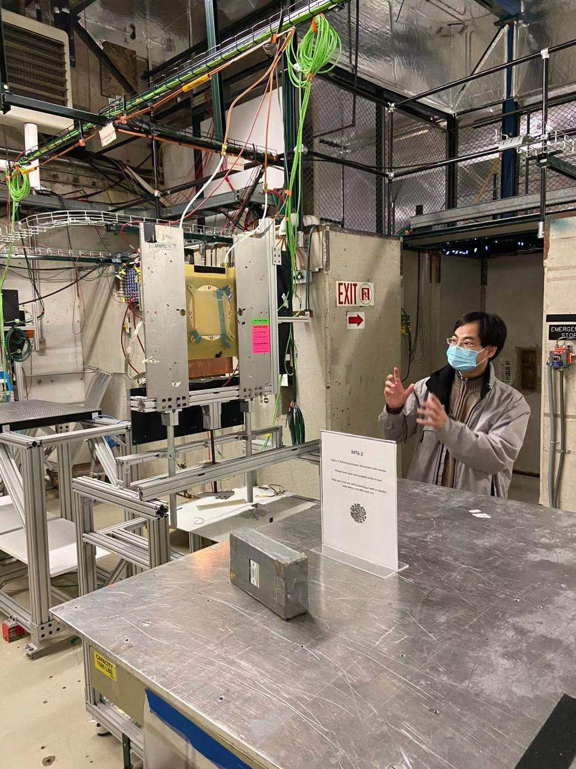
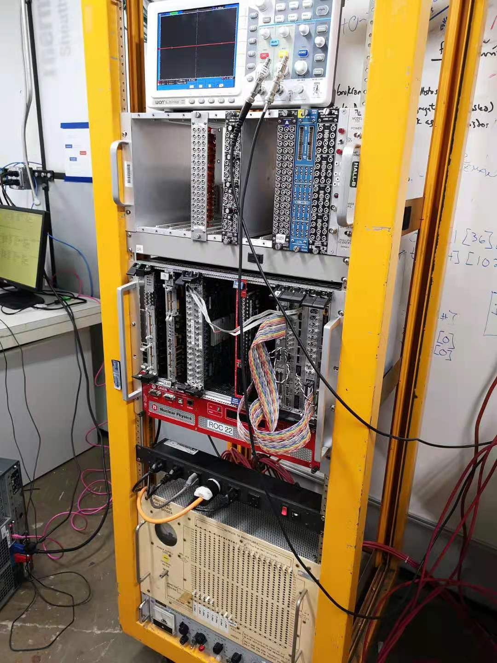
Testing at Fermilab Test Beam Facility
UVA team arrived at FTBF on Wed. Jan.6th
getting badge, training, hazard analysis, shift prep (2 in-person, 1 remote, 6-hr rotation), installation underway.
FTBF pictures

Slide 11
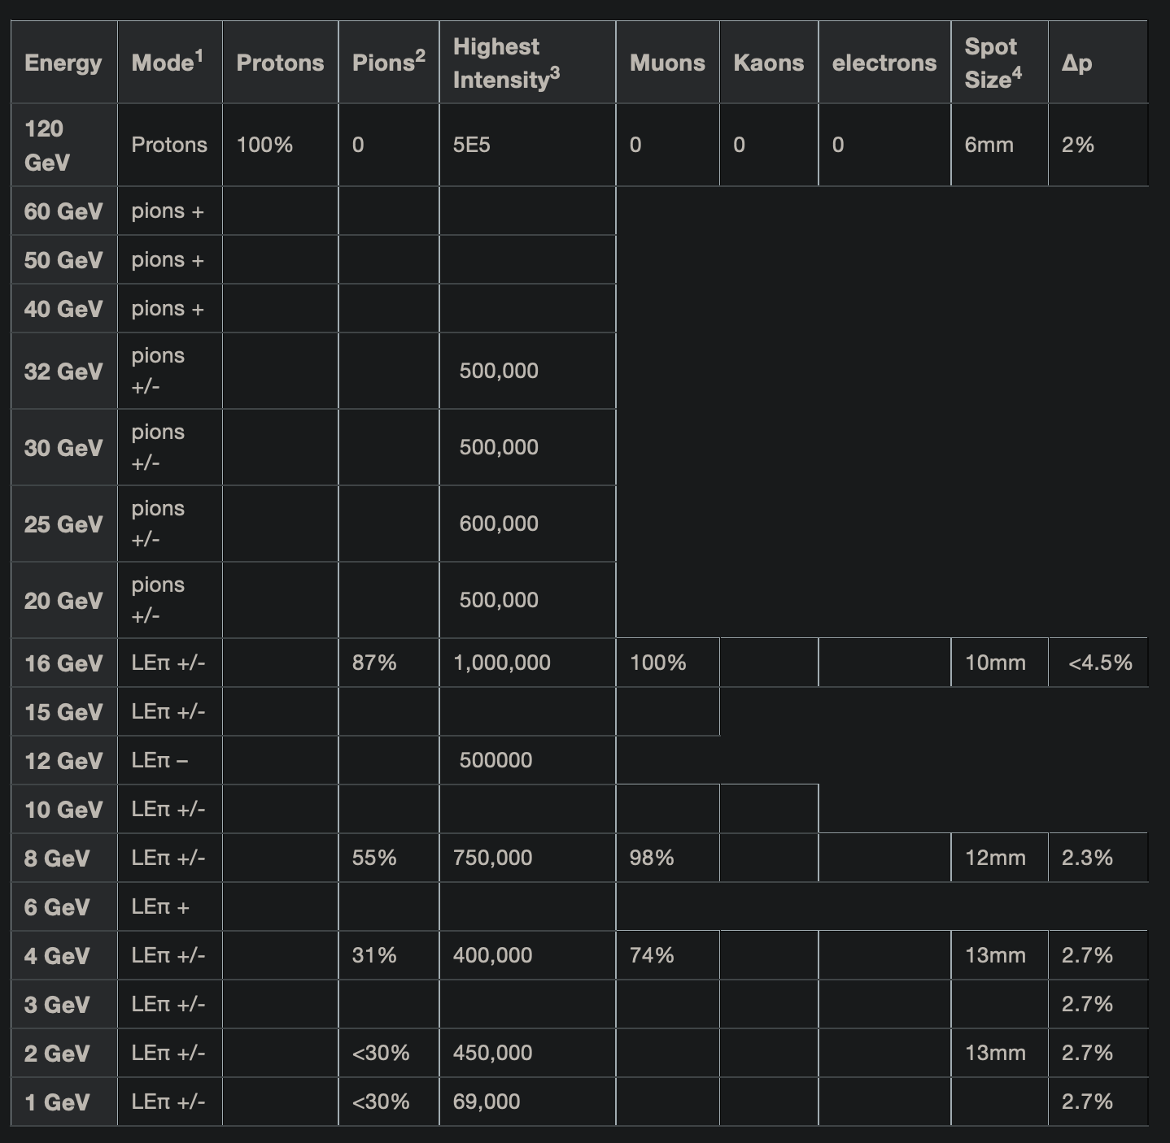
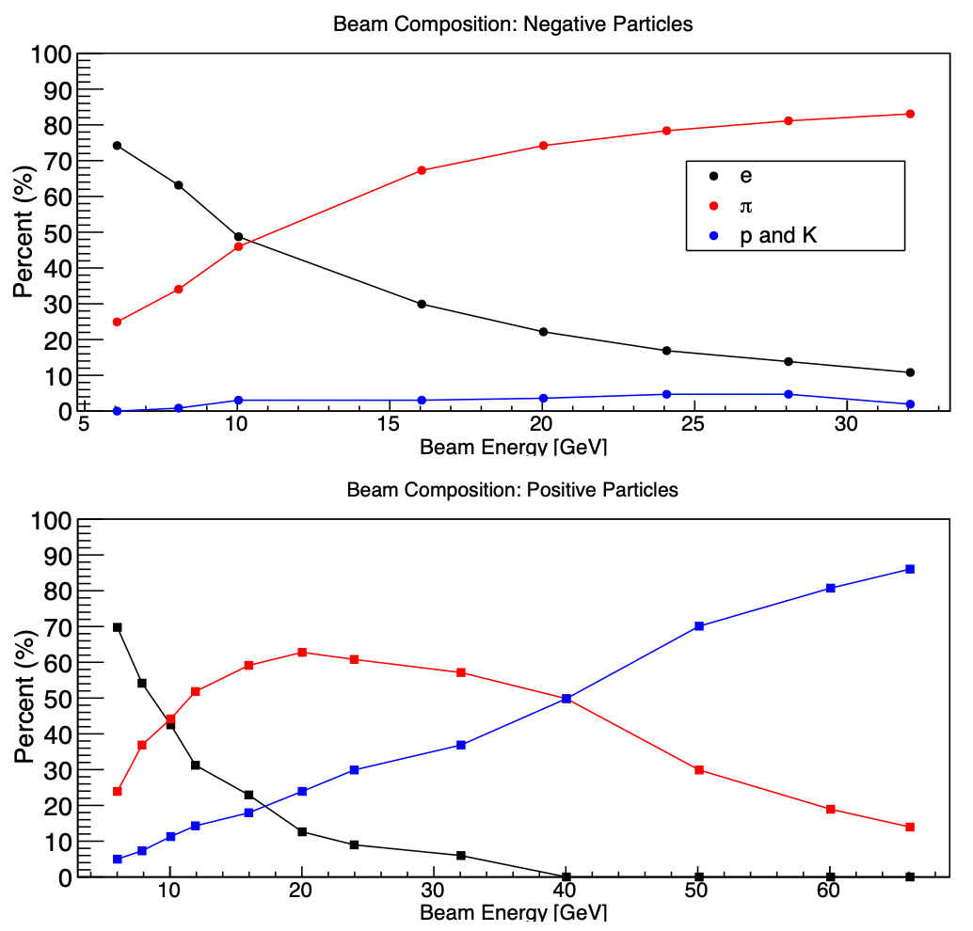
FTBF Beam Intensity and Composition
From FTBF
Will use FTBF Cherenkov for PID, and MWPC for positioning info.
Note: Beam intensity = particles/spill
Length of spill = 4.2 sec

Slide 12
Revised Run Plan for 12 Shifts — Electrons Only
Rates now account for duty factor f = (spill = 4.2 sec)/(rep time = 60 sec) = 0.07
NOTE: This is for e⁻ only!
NOTE: Still need to account for DAQ dead time
E (GeV) | Particle Rate (kHz) | Weight (~ 1/rate) | Time (hrs) | Number of Shifts (1 shift = 12 hrs) | Number of Particles
1.0 | 12.7 | 0.08 | 11.5 | 1.0 | 5.3E+08
2.0 | 12.1 | 0.08 | 12.2 | 1.0 | 5.3E+08
4.0 | 10.7 | 0.10 | 13.7 | 1.1 | 5.3E+08
6.0 | 9.3 | 0.11 | 15.8 | 1.3 | 5.3E+08
8.0 | 7.9 | 0.13 | 18.5 | 1.5 | 5.3E+08
10.0 | 7.2 | 0.14 | 20.4 | 1.7 | 5.3E+08
12.0 | 6.5 | 0.16 | 22.7 | 1.9 | 5.3E+08
16.0 | 5.0 | 0.20 | 29.3 | 2.4 | 5.3E+08
TOTAL | — | 1.00 | 144.0 | 12.0 | 4.2E+09

Slide 13
Revised Run Plan for 12 Shifts — All Particles
Rates now account for duty factor f = (spill = 4.2 sec)/(rep time = 60 sec) = 0.07
NOTE: This includes e⁻, π⁻, p⁻ and K⁻
NOTE: Still need to account for DAQ dead time
E (GeV) | Particle Rate (kHz) | Weight (~ 1/rate) | Time (hrs) | Number of Shifts (1 shift = 12 hrs) | Number of Particles
1.0 | 12.9 | 0.13 | 18.6 | 1.5 | 8.6E+08
2.0 | 12.8 | 0.13 | 18.7 | 1.6 | 8.6E+08
4.0 | 12.6 | 0.13 | 19.0 | 1.6 | 8.6E+08
6.0 | 12.4 | 0.13 | 19.3 | 1.6 | 8.6E+08
8.0 | 12.3 | 0.14 | 19.6 | 1.6 | 8.6E+08
10.0 | 13.4 | 0.12 | 17.9 | 1.5 | 8.6E+08
12.0 | 14.5 | 0.12 | 16.6 | 1.4 | 8.6E+08
16.0 | 16.7 | 0.10 | 14.4 | 1.2 | 8.6E+08
TOTAL | — | 1.00 | 144.0 | 12.0 | 6.9E+09

Slide 14
Backup Slides

Slide 15
ECal + SPD cost overview
Item |  | Note on duration, uncertainties, risks
Shashlyk | SDU: 2,953k | – Minimum 90 weeks construction, Shower scintillators can be delivered ~13 months; IHEP possible
Preshower | SDU; 395k | – IHEP, Eljen both possible + US $40k lead (material only, estimate)
SPD (Eljen) | FA: $62.1k (4.5mm grooves) LA: $39.7k | can deliver within 3 months. Can start deliver in batches in month 2.
HV/CAEN | see DAQ
PMT/Hamamatsu | $714.7k (Hamamatsu + JLab in-house design bases) | shipping rate can be 1/12 of full quantity per month
Fiber (Saint Gobain) | 192km BCF91A-MC at $1.8/m; 520km BCF98-SC at 1.25/m; total $995.6k (March 2017) | 2019 update to $1.91/m and $1.33/m → $1,056k, may need BCF98-MC → $1,235k delivery will be 12-18 months
Fiber (Kuraray) | 6800m Y11(200)MC at $4.67/m, total $31.8k | subject to currency exchange rate, awaiting for delivery schedule
Fiber connectors | WLS ↔ clear using Fujikura ($220k), Fiber ↔ PMT est $200k | need Fiber ↔ PMT design
Supporting frame | $884.5k | very preliminary design for Shower, scaled by area; no design for SPD and Preshower
Total | $6.5M | + 220k (~3.4%)

Slide 16
Anything I may be forgetting?
– IHEP shashlyk prototyping (~$65-70k estimate in 2014);
– Lead sheet for Preshower (50k$? I can estimate this using Kolga quote for the lead sheet with holes, scale by mass);
– need confirm PMT base cost + contingency code;
– better estimate for fiber ↔ PMT connector? (got drawing from Hall B PCAL);
– MAPMT shielding?
– PMT frame?
– SDU construction manager?? (GlueX BCAL had one)
– misc: light-tight wrapping???

Slide 17
Irradiated Preshower Results
Students: Margaret Doyle, Sam Blum
Optical grease is from 2014, expired. We tested the preshower “as is”, after replacing grease, and after replacing the fiber. All NPE lower than before radiation but could be partly due to mechanical (not radiational) damage to fiber
Tile # | location in Hall A | Before Radiation | Radiation Dose (krad) | With Old Grease “as is” | After replacing grease | After replacing fiber
Kedi 1 | Beam Right lumis | 87.1 | 161-164 | 56.6 | 74.4 | 73.3
Kedi 2 | Upstream of scattering chamber | 85.4 | 185-189 | 57.6 (fiber had a kink) | 67.3 | 68.0
Kedi 3 | Beamline grider | 87 | 31-38 | 66 | 69.7 | 77.3
Kedi 4 | Compton chicane | 91 | 9-17 | 55(?)*-74 (fiber broken) | 86.5
CNCS 1 | beam left lumis | 83.4 | 156-172 | 56.2 | 49.7 | 70.0
CNCS 2 | Beam Right scattering chamber | 84.7 | 43-53 | 61.6 | 71.0 | 74.5
CNCS 3 | Beam Left scattering chamber | 81.8 | 20-24 | 62.5 | 69.3
CNCS 4 | Hall A dump | 83.4 | 230-286 | 41.2 | 47.2 | 54.0
Green numbers are updated results after replacing a loose-wire PMT
Red numbers were performed with a PMT that behaved inconsistently.
http://hallaweb.jlab.org/experiment/PVDIS/SoLID/EC/meetings/2014-test/2016-test/Documents/PSH_rad_tests_02Jan2017.pdf

Slide 18
More background information
LHCb tracker upgrade (scifi tracker) reported irradiation test of fibers and 4 models to extend to higher doses. Light loss starts to be visible at 0.5kGy or 50krad, and drops by factor two at roughly 2-3kGy or 200-300krad. These are plastic fibers where radiation damage affects mostly the clarity (attentuation length) and the scintillating efficiency and the two are similar. Thus damage is expected to be more visible for longer fibers. For WLS fibers, there can be additional damage to the WLS dye/fluor that is not applicable to the LHCb scifi tracker.
Radiation dose expected for SoLID (see ECal meeting minutes from 3/26/14, maybe outdated), and the run duration corresponding to 200krad dose: SPD 2krad/month (100 months); Preshower 10krad/month (PVDIS?, 20months); Shashlyk 2krad/month (PVDIS?, 100 months).

Slide 19
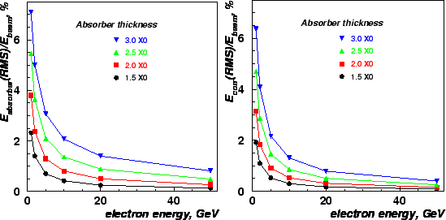
Ecal Simulation (Ye Tian/Syracuse)
Then try to separate the effect of incident angle (PVDIS), the 2cm Al support between the preshower and the shower, and the 2Xo of pre-lead before the preshower
In fact this is consistent with LHCb’s study:
Ecal configuration | 1 GeV e- dE/E
1748 modules, 25 deg, 2cm Al, no pre-lead | 4.03 ± 0.03
1748 modules, 25 deg, 2cm Al, 2Xo pre-lead | 6.20 ± 0.05
1748 modules, 25 deg, no Al, 2Xo pre-lead | 5.84 ± 0.05
Figure 3.3 from LHCb Cal TDR: Simulation of the energy lost in lead by electrons. On the left plot the relative error on the energy measurement is shown. This should be compared with the design ECAL module resolution of 10%/sqrt(E) plus 1% constant. On the right shown is with correction of the prelead Edep using preshower signal.

