Slide 1
PVDIS baffle
Zhiwen Zhao
2013/10/15

Slide 2
Intro
Previously, I couldn’t obtain an ideal baffle with the code (makebaf5.C)
For the writeup, we used “BaBar more1 block” which is based on Eugene’s BaBar baffle with 5 additional plates and 1 more degree in phi and photon blocks before EC
Now I take a look at baffle design again and try to develop a method

Slide 3
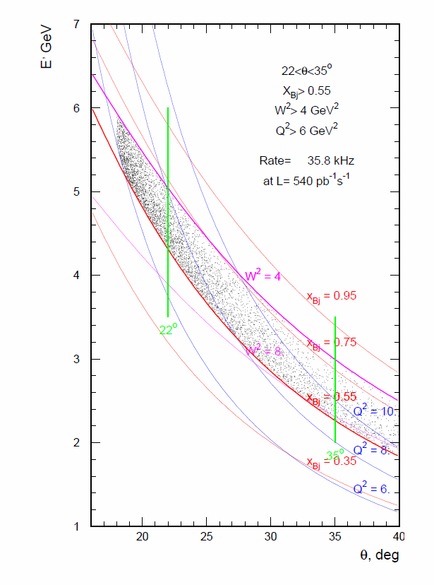
How it’s done, Step 1
Use CLEO v8 field map
eDIS (W>2) of 40cm long LD2 target, from code eicRate
11 baffle plates from Z=40cm – 180cm, 30 slits in 1 plate, 20 blocks in 1 slit
1st baffle min radius at 5cm (>5.2º, to avoid Moller e⁻)
Study phi change from these eDIS events at every baffle plate front face. Allow 96%(from 2% to 98% of phi change) of rate weighted events with 0.35<x<0.8 and p>1.5GeV to pass through. This define the opening for a very narrow phi slice of eDIS events from the target
Enlarge this opening by 3.5º where positive leaks start to appear, expect 30%=3.5/12 acceptance for eDIS events with 0.35<x<0.8 and p>1.5GeV. I name this “baffle 0.35x3.5deg”

Slide 4
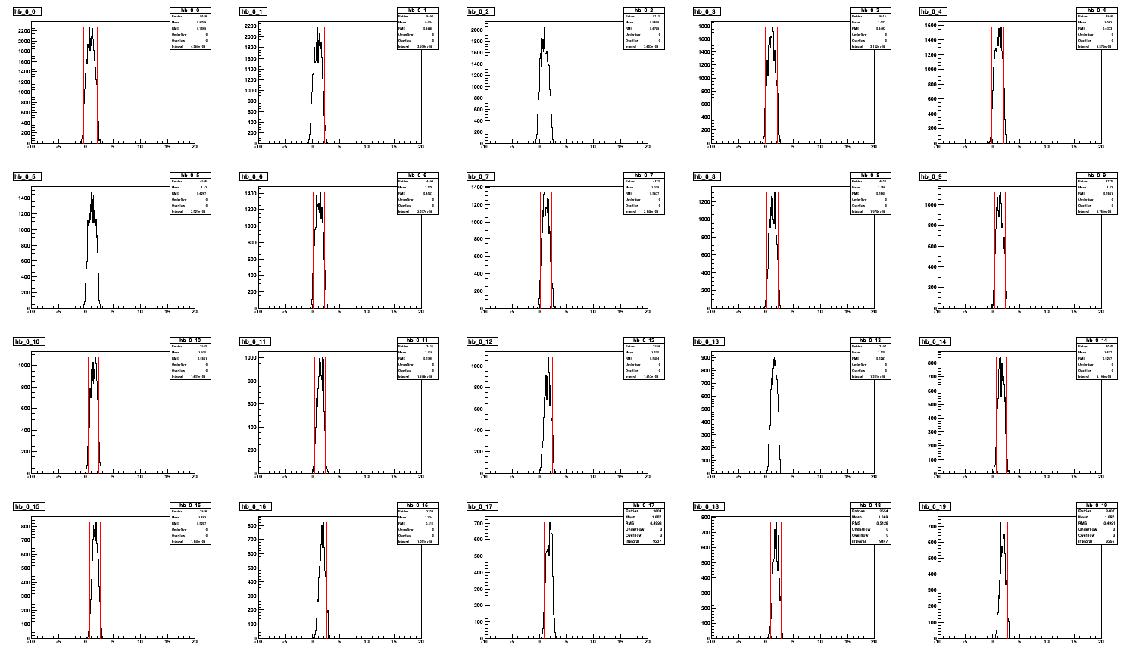
Rate VS Phi turning
20 blocks at 1st baffle

Slide 5
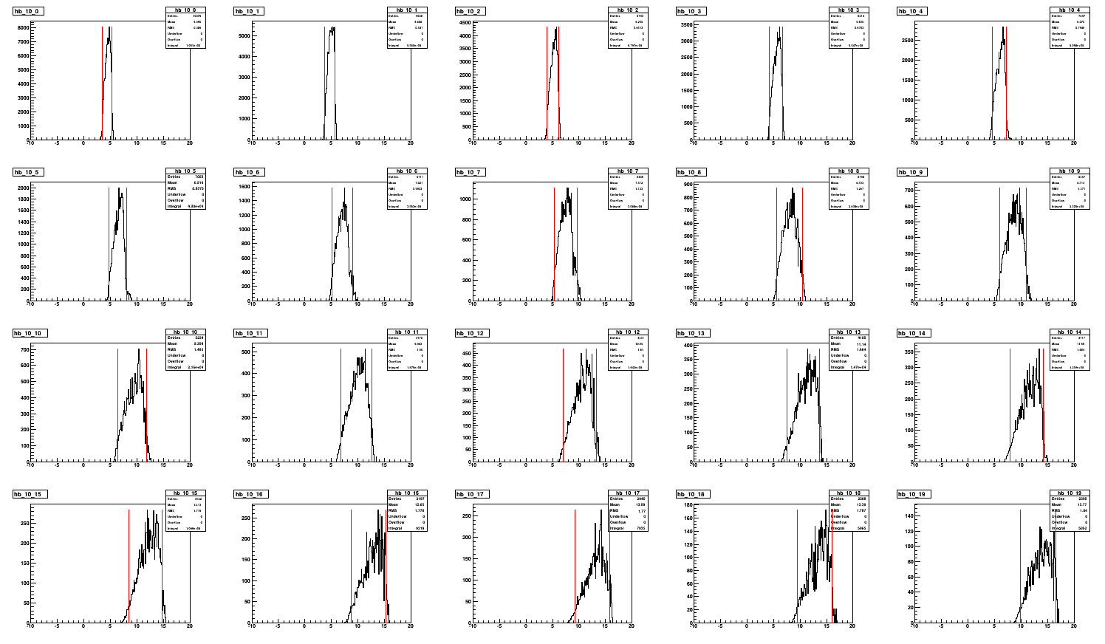
Rate VS Phi turning
20 blocks at 11th baffle

Slide 6
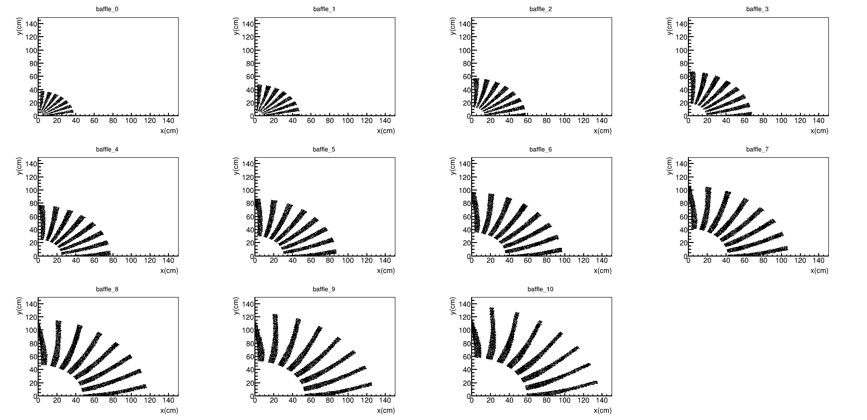
“Baffle 0.35x3.5deg”
It looks similar to “BaBar more1”

Slide 7
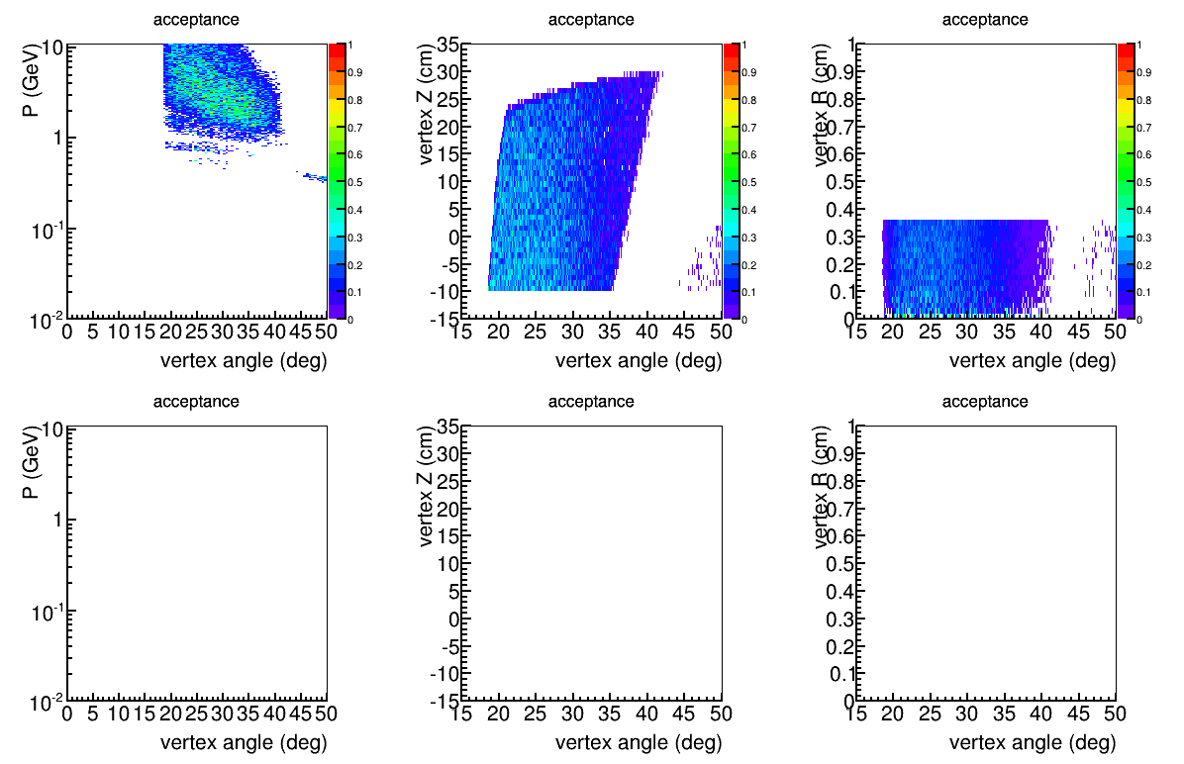
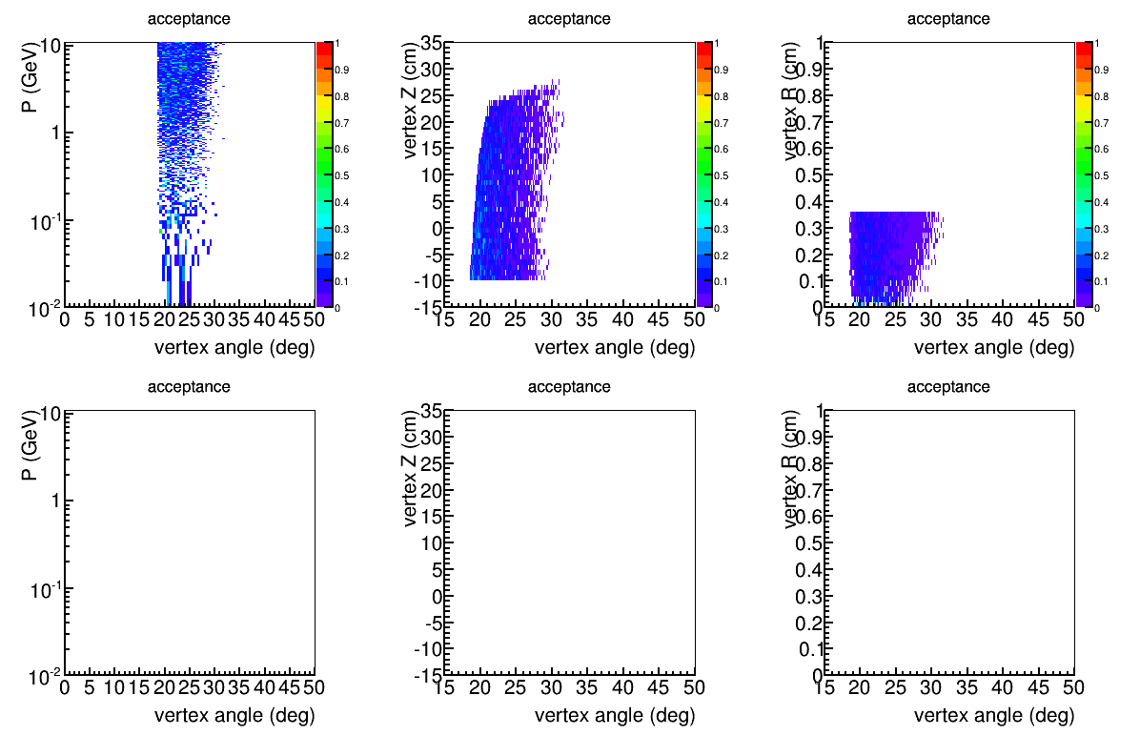
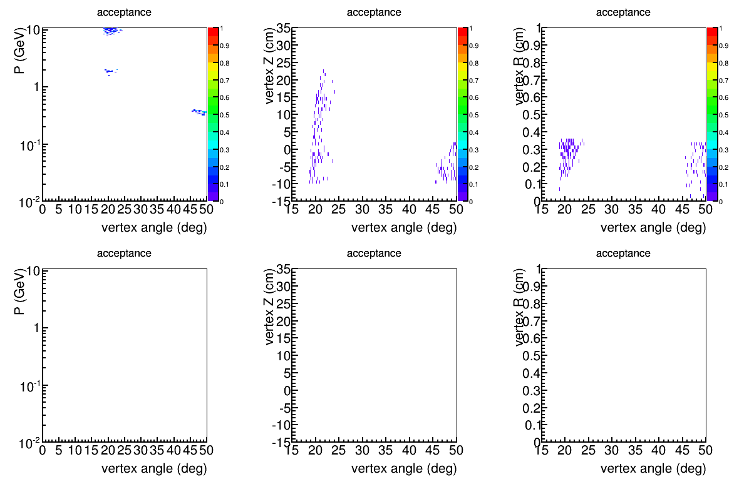
Acceptance,
Baffle 0.35x3.5deg
negative
source
Z(-10,30)cm
R(0,3.536)mm
for 5x5mm raster
neutral
positive

Slide 8
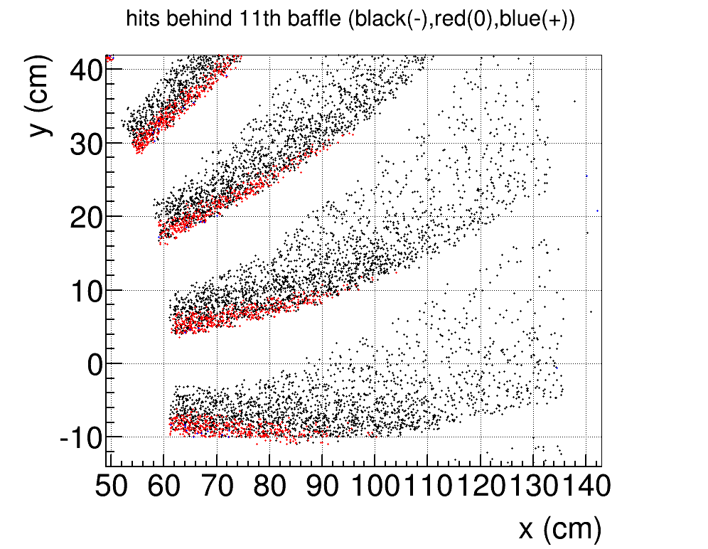
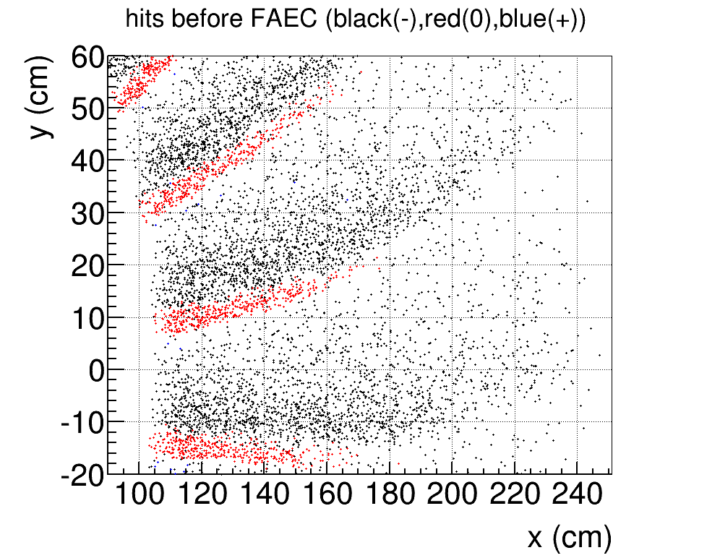
How it’s done, Step 2
Further block photons by adding more material
At the last (11th) baffle, negative and neutral mixes with each other at low phi where high x and high P events are. Block photon here will harm eDIS acceptance at high x. I name this “baffle 0.35x3.5deglast”
At EC, negative and neutral split well from each other due to the additional flight path. Photon block at EC works better. I name this “baffle 0.35x3.5degblock”

Slide 9
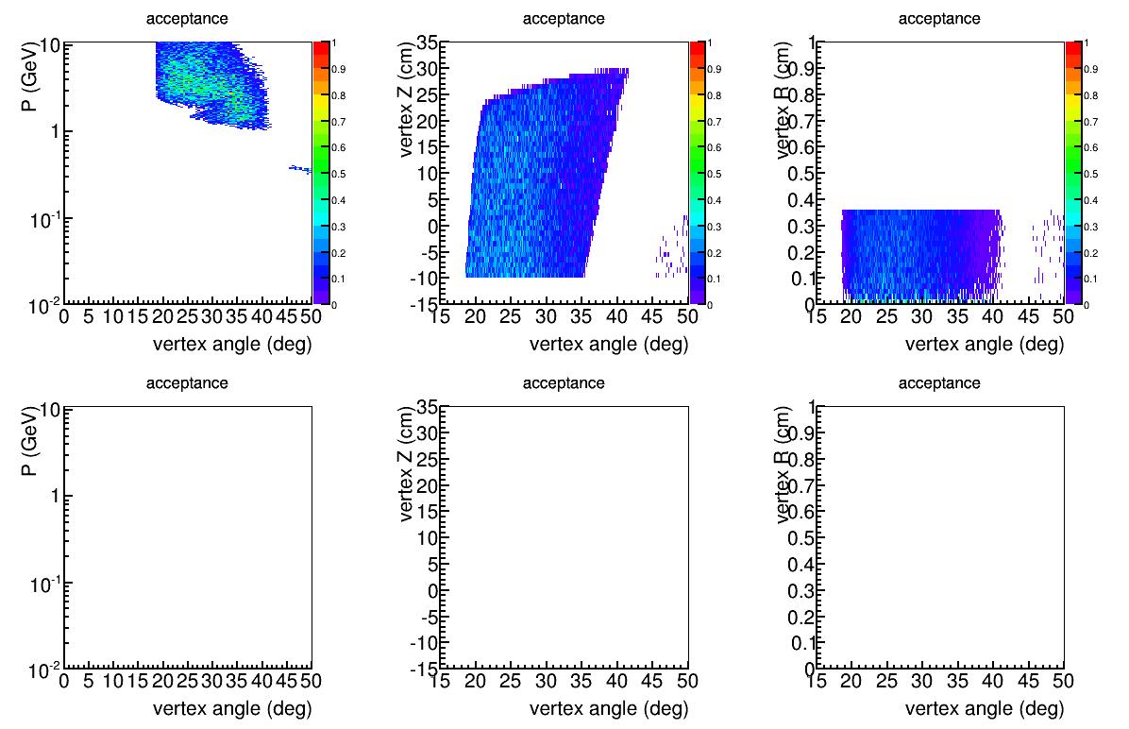
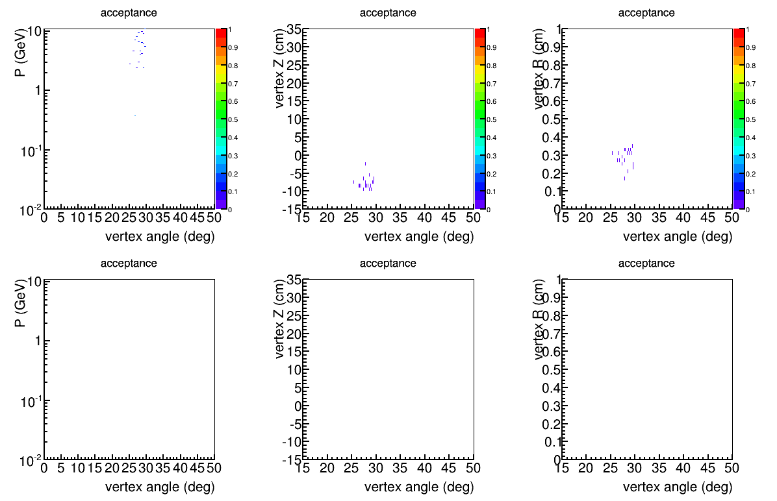
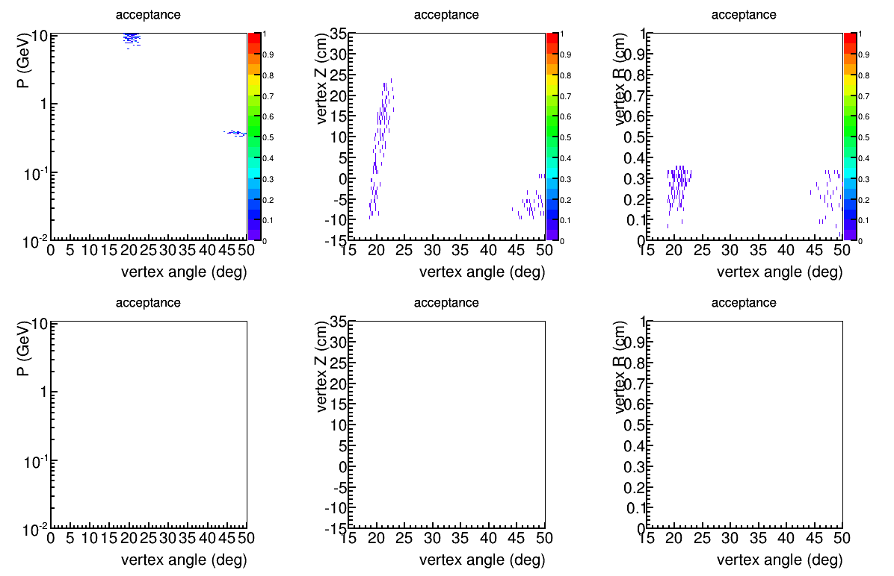
Acceptance,
Baffle 0.35x3.5degblock
negative
source
Z(-10,30)cm
R(0,3.536)mm
for 5x5mm raster
neutral
EC module R(110,265)cm
EC photon block (“baffle 3.5degblock”)
30 of them
R(105-200)cm
Start from 3 degree and width 4 degree. (They can be further optimized)
5cm(8*X₀) thick lead, hope to reduce photon energy by 1 order
positive

Slide 10
Another adjustment
Optimize for eDIS 0.55<x<0.8 (instead of 0.35<x<0.8)
Enlarge the opening by 5º (instead of 3.5º) where positive leaks start to appear, expect 40%=5/12 (instead of 30%)
Keep all other conditions same

Slide 11
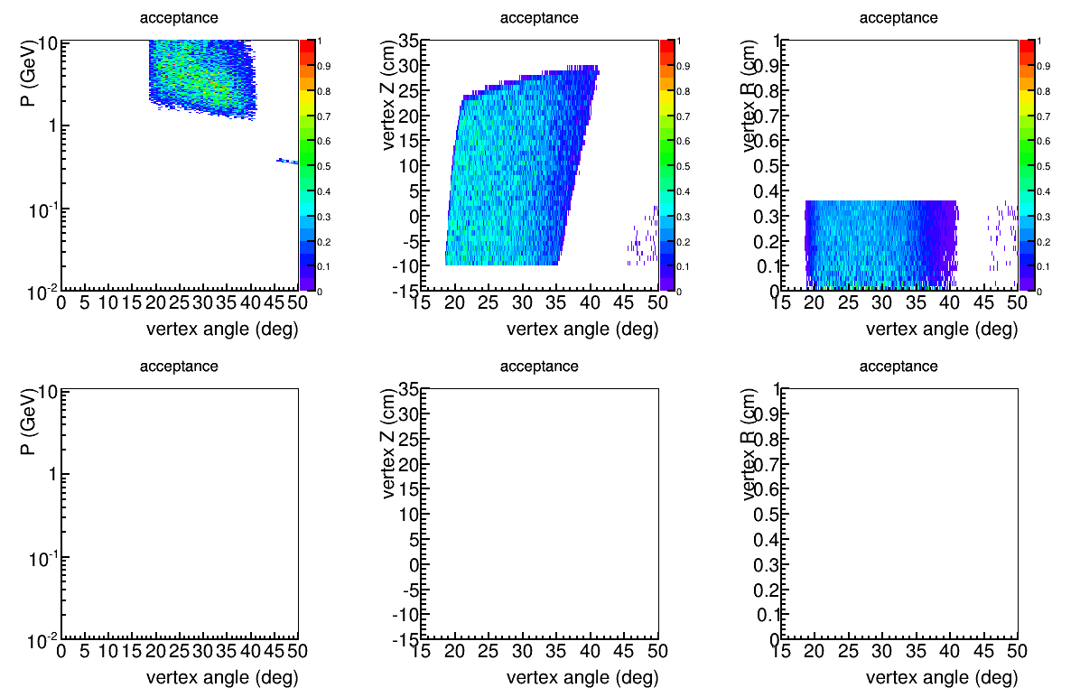
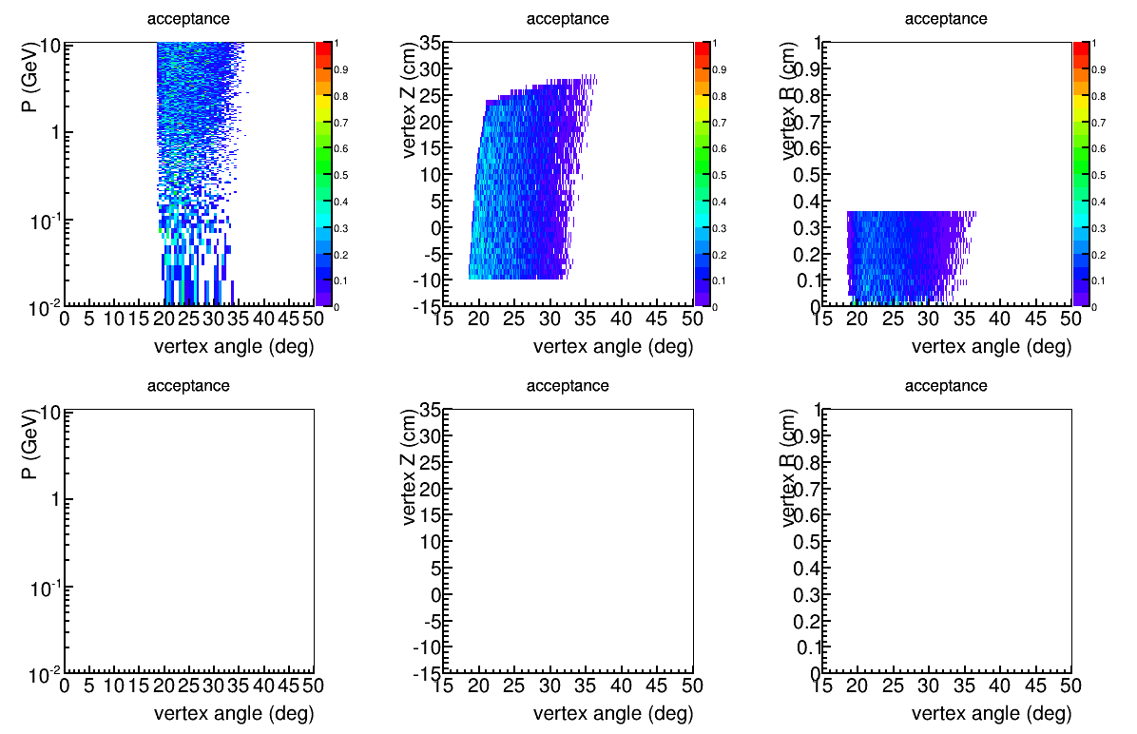
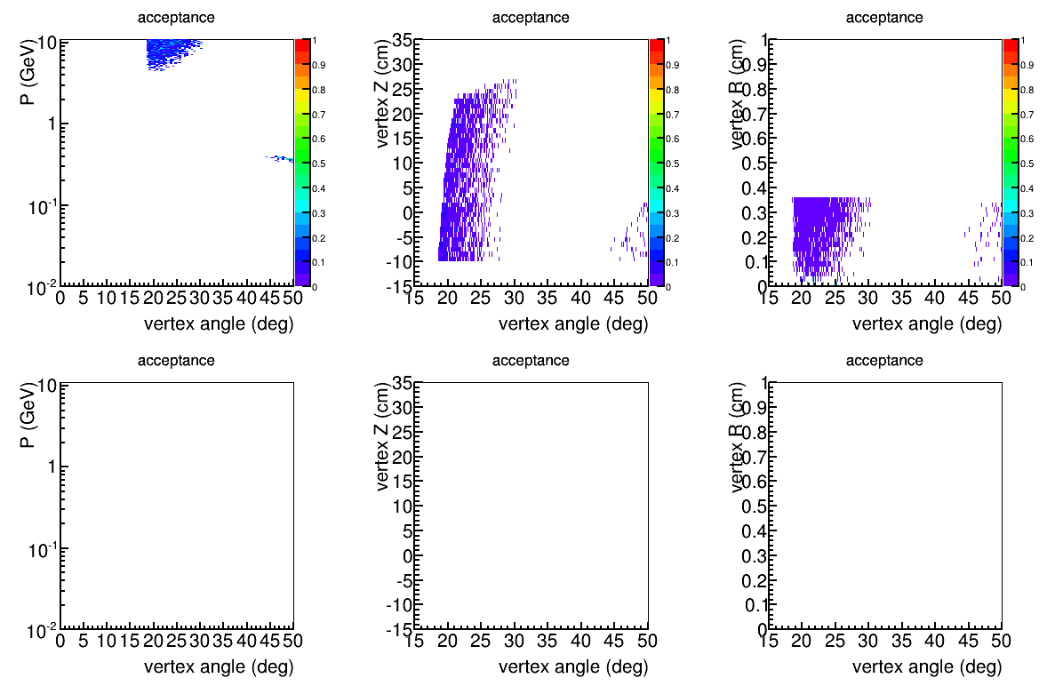
Acceptance,
Baffle 0.55x5deg
negative
source
Z(-10,30)cm
R(0,3.536)mm
for 5x5mm raster
neutral
positive

Slide 12
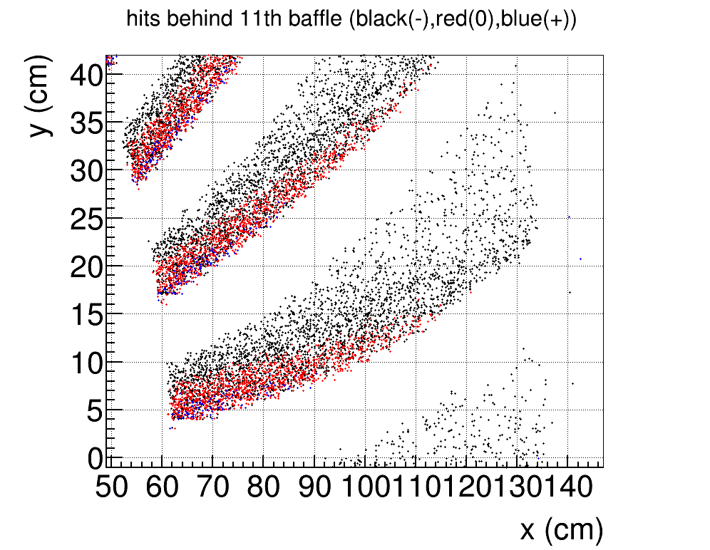
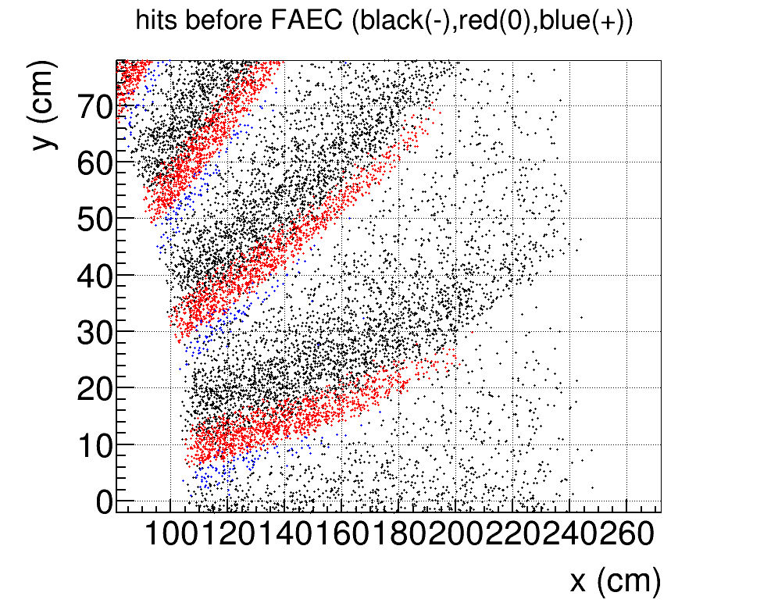
Further block photons by adding more material
At the last (11th) baffle, negative and neutral mixes with each other at low phi where high x and high P events are. Block photon here will harm eDIS acceptance at high x
At EC, negative and neutral split well from each other due to the additional flight path. Photon block at EC works better. I name this “baffle 0.55x5degblock”

Slide 13
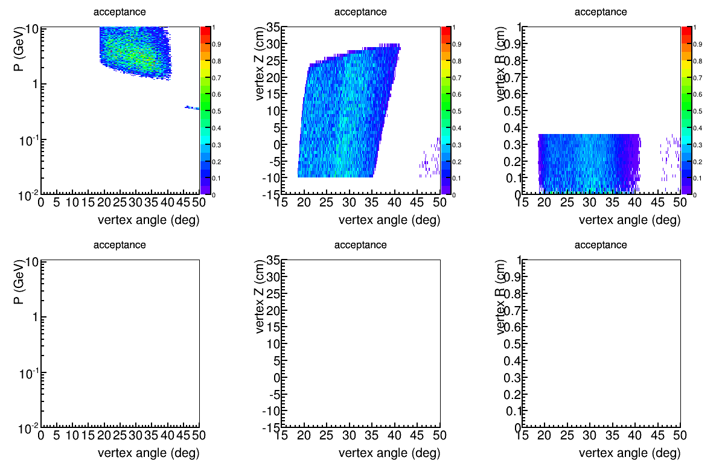
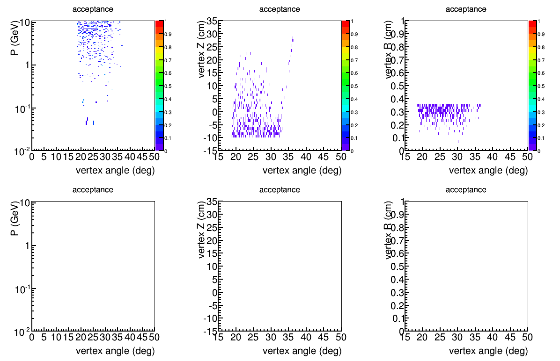
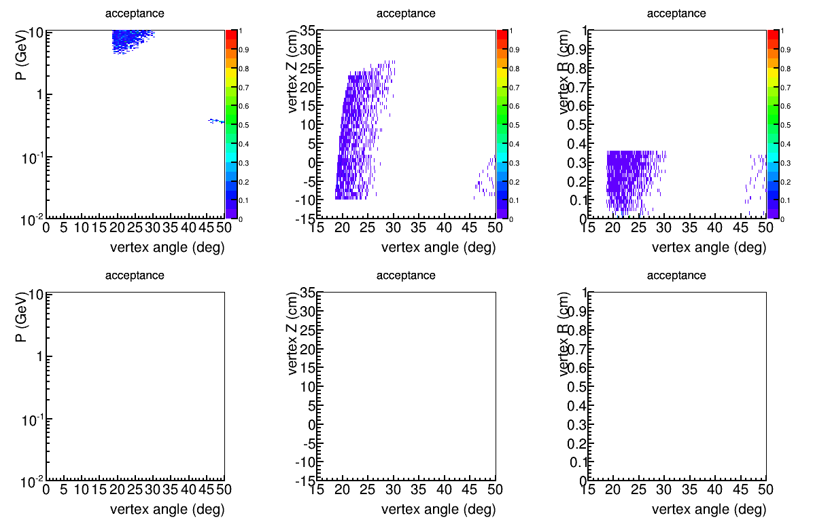
Acceptance,
Baffle 0.55x5degblock
negative
source
Z(-10,30)cm
R(0,3.536)mm
for 5x5mm raster
neutral
EC module R(110,265)cm
EC photon block (“baffle 3.5degblock”)
30 of them
R(105-205)cm
Start from 2.8 degree and width 4 degree.
5cm(8*X₀) thick lead, hope to reduce photon energy by 1 order
positive

Slide 14
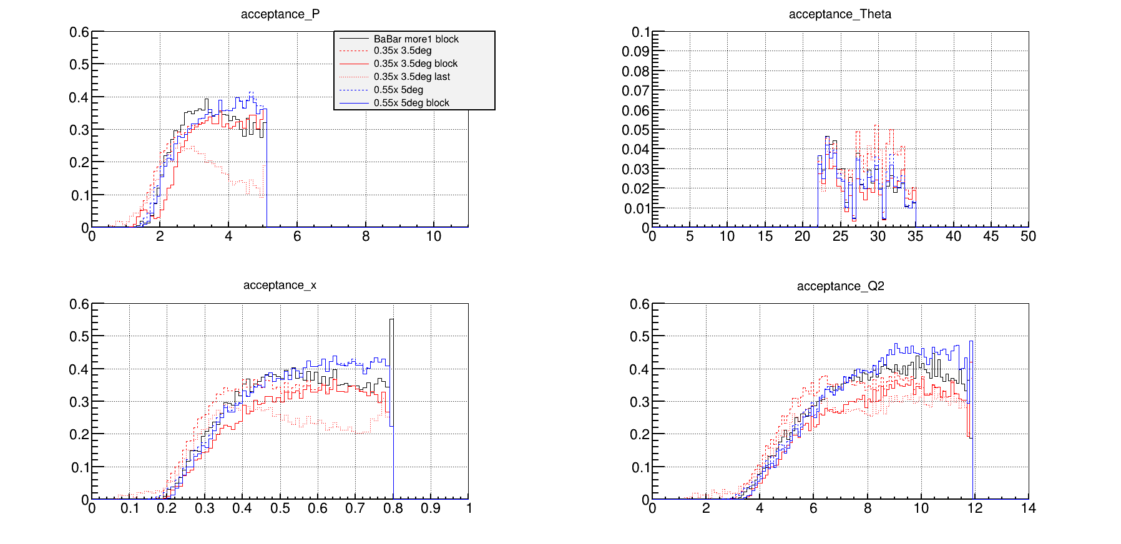
eDIS acceptance comparison at EC
“0.55x 5deg” and “0.55x 5deg block” has best acceptance at high x

Slide 15
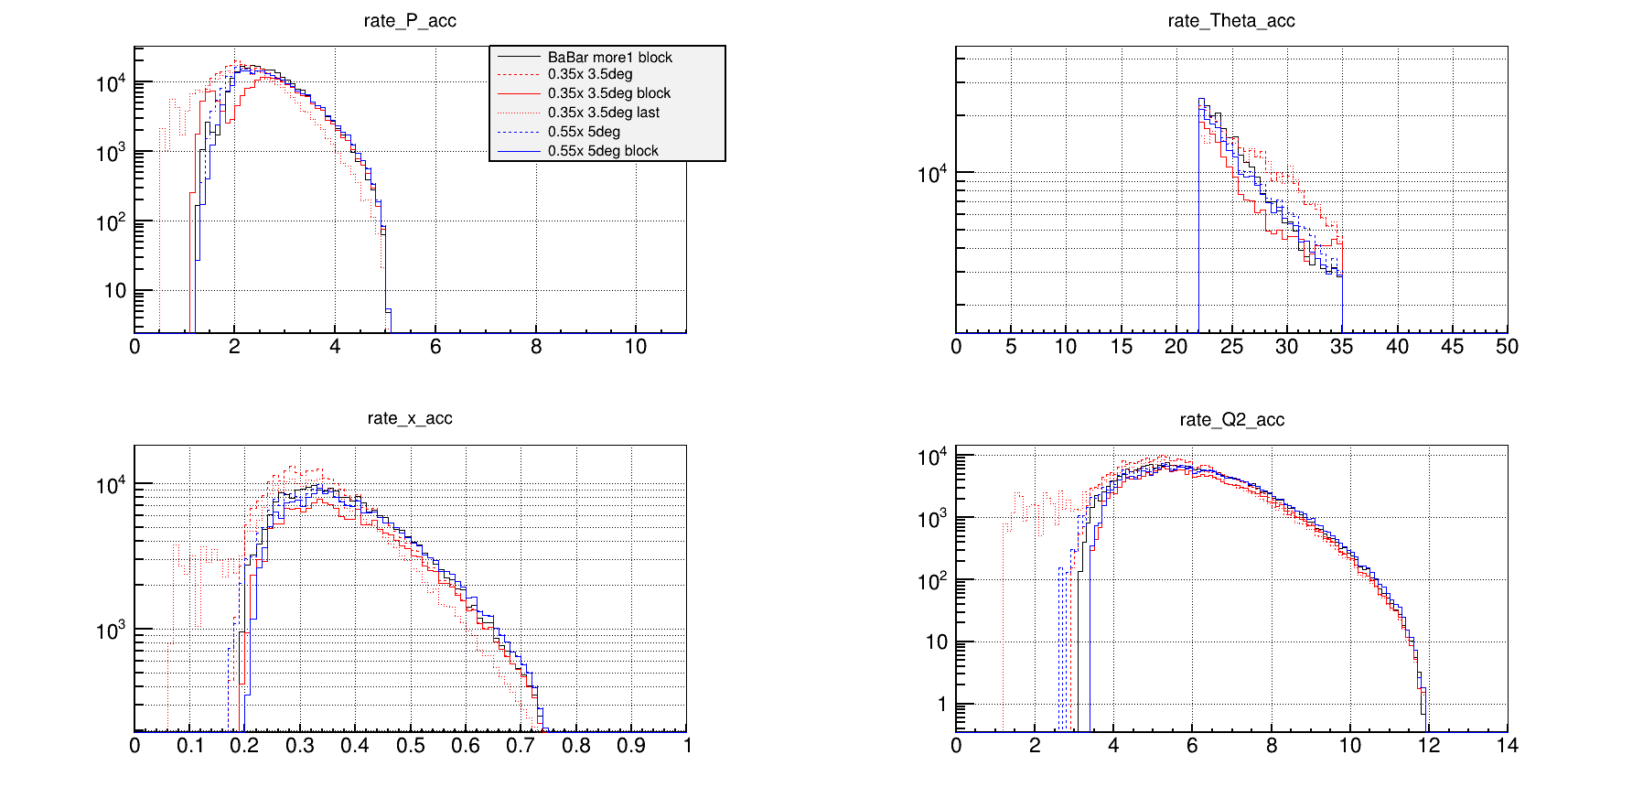
eDIS rate comparison at EC
“0.55x 5deg” and “0.55x 5deg block” has no low mom leak which could leads to high trig rate

Slide 16
Err_Apv(%)
Assume 50uA, 40cm LD2
Pol_beam 85%, 120 days
EC R(110,250)cm nominal acceptance
No trig cut
x | 0.20-0.30 | 0.30-0.35 | 0.35-0.40 | 0.40-0.45 | 0.45-0.50 | 0.50-0.55 | 0.55-0.60 | 0.60-0.67 | 0.67-0.80
BaBar more1 block | 0.290 | 0.304 | 0.287 | 0.294 | 0.319 | 0.356 | 0.427 | 0.468 | 0.641
0.35x 3.5deg | 0.246 | 0.266 | 0.267 | 0.283 | 0.318 | 0.367 | 0.434 | 0.470 | 0.645
0.35x 3.5deg Block | 0.315 | 0.316 | 0.307 | 0.309 | 0.335 | 0.378 | 0.440 | 0.473 | 0.646
3.5deg Last | 0.281 | 0.302 | 0.303 | 0.328 | 0.373 | 0.447 | 0.530 | 0.585 | 0.789
0.55x 5deg | 0.283 | 0.303 | 0.289 | 0.289 | 0.309 | 0.343 | 0.397 | 0.424 | 0.573
0.55x 5deg Block | 0.311 | 0.310 | 0.291 | 0.289 | 0.309 | 0.344 | 0.398 | 0.426 | 0.578

Slide 17
For eDIS x>0.8
For eDIS with cut W>2GeV, events with x>0.8 only happen for large angle
The acceptance shown has cut 22<theta<35deg
There are some acceptance for 35<theta<40deg from the downstream part of the target, but its x only extends to 0.81 (see next slide)
The largest x output by the generator with cut W>2GeV is at 0.84 (see slide after next)

Slide 18
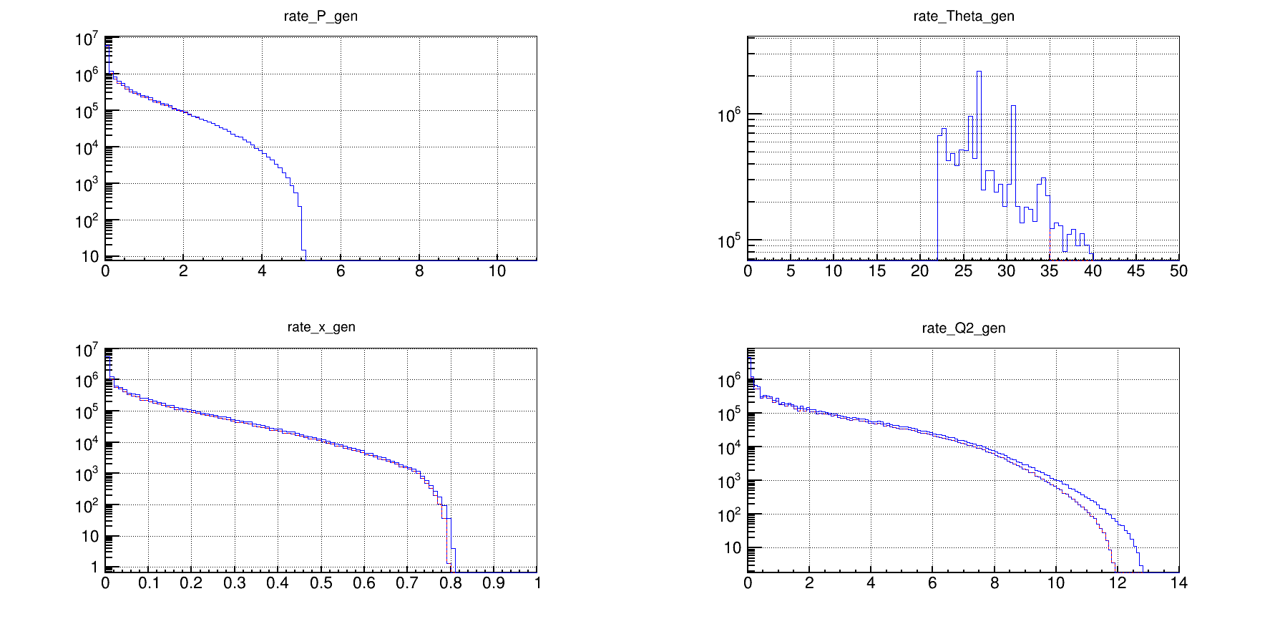
eDIS rate comparison from generator
Red with theta 22-35 deg, blue with theta 22-40 deg

Slide 19
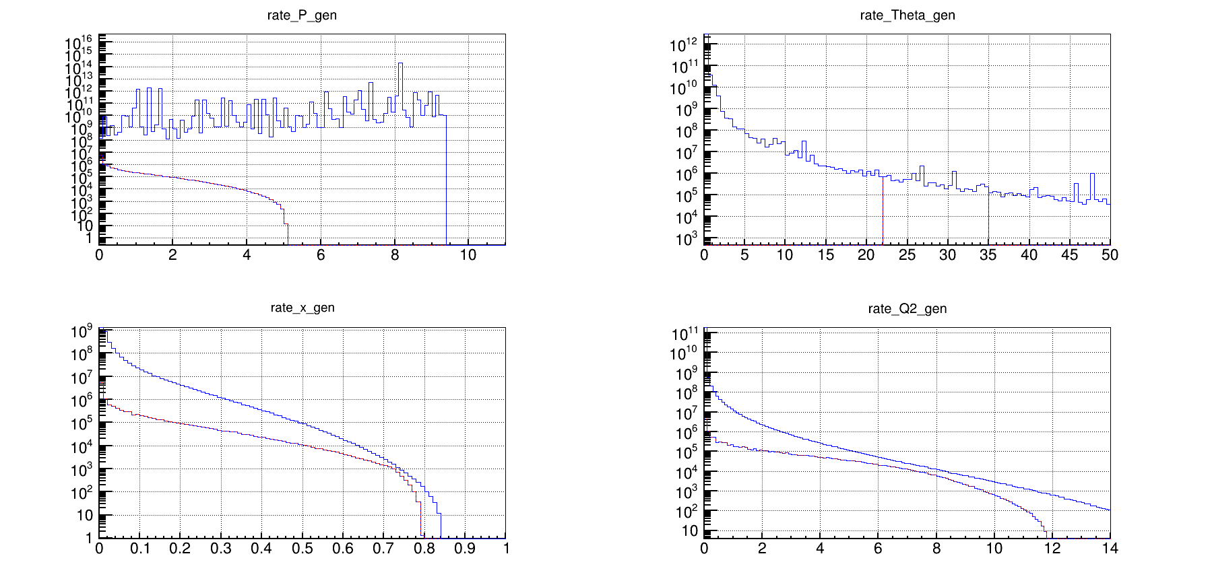
eDIS rate comparison from generator
Red with theta 22-35 deg, blue with theta 0-180 deg

