Slide 1
Test MAPMT at Carl’s test stand
Zhiwen Zhao, Bo Yu
Carl Zorn, Jack McKisson
08/2023

Slide 2
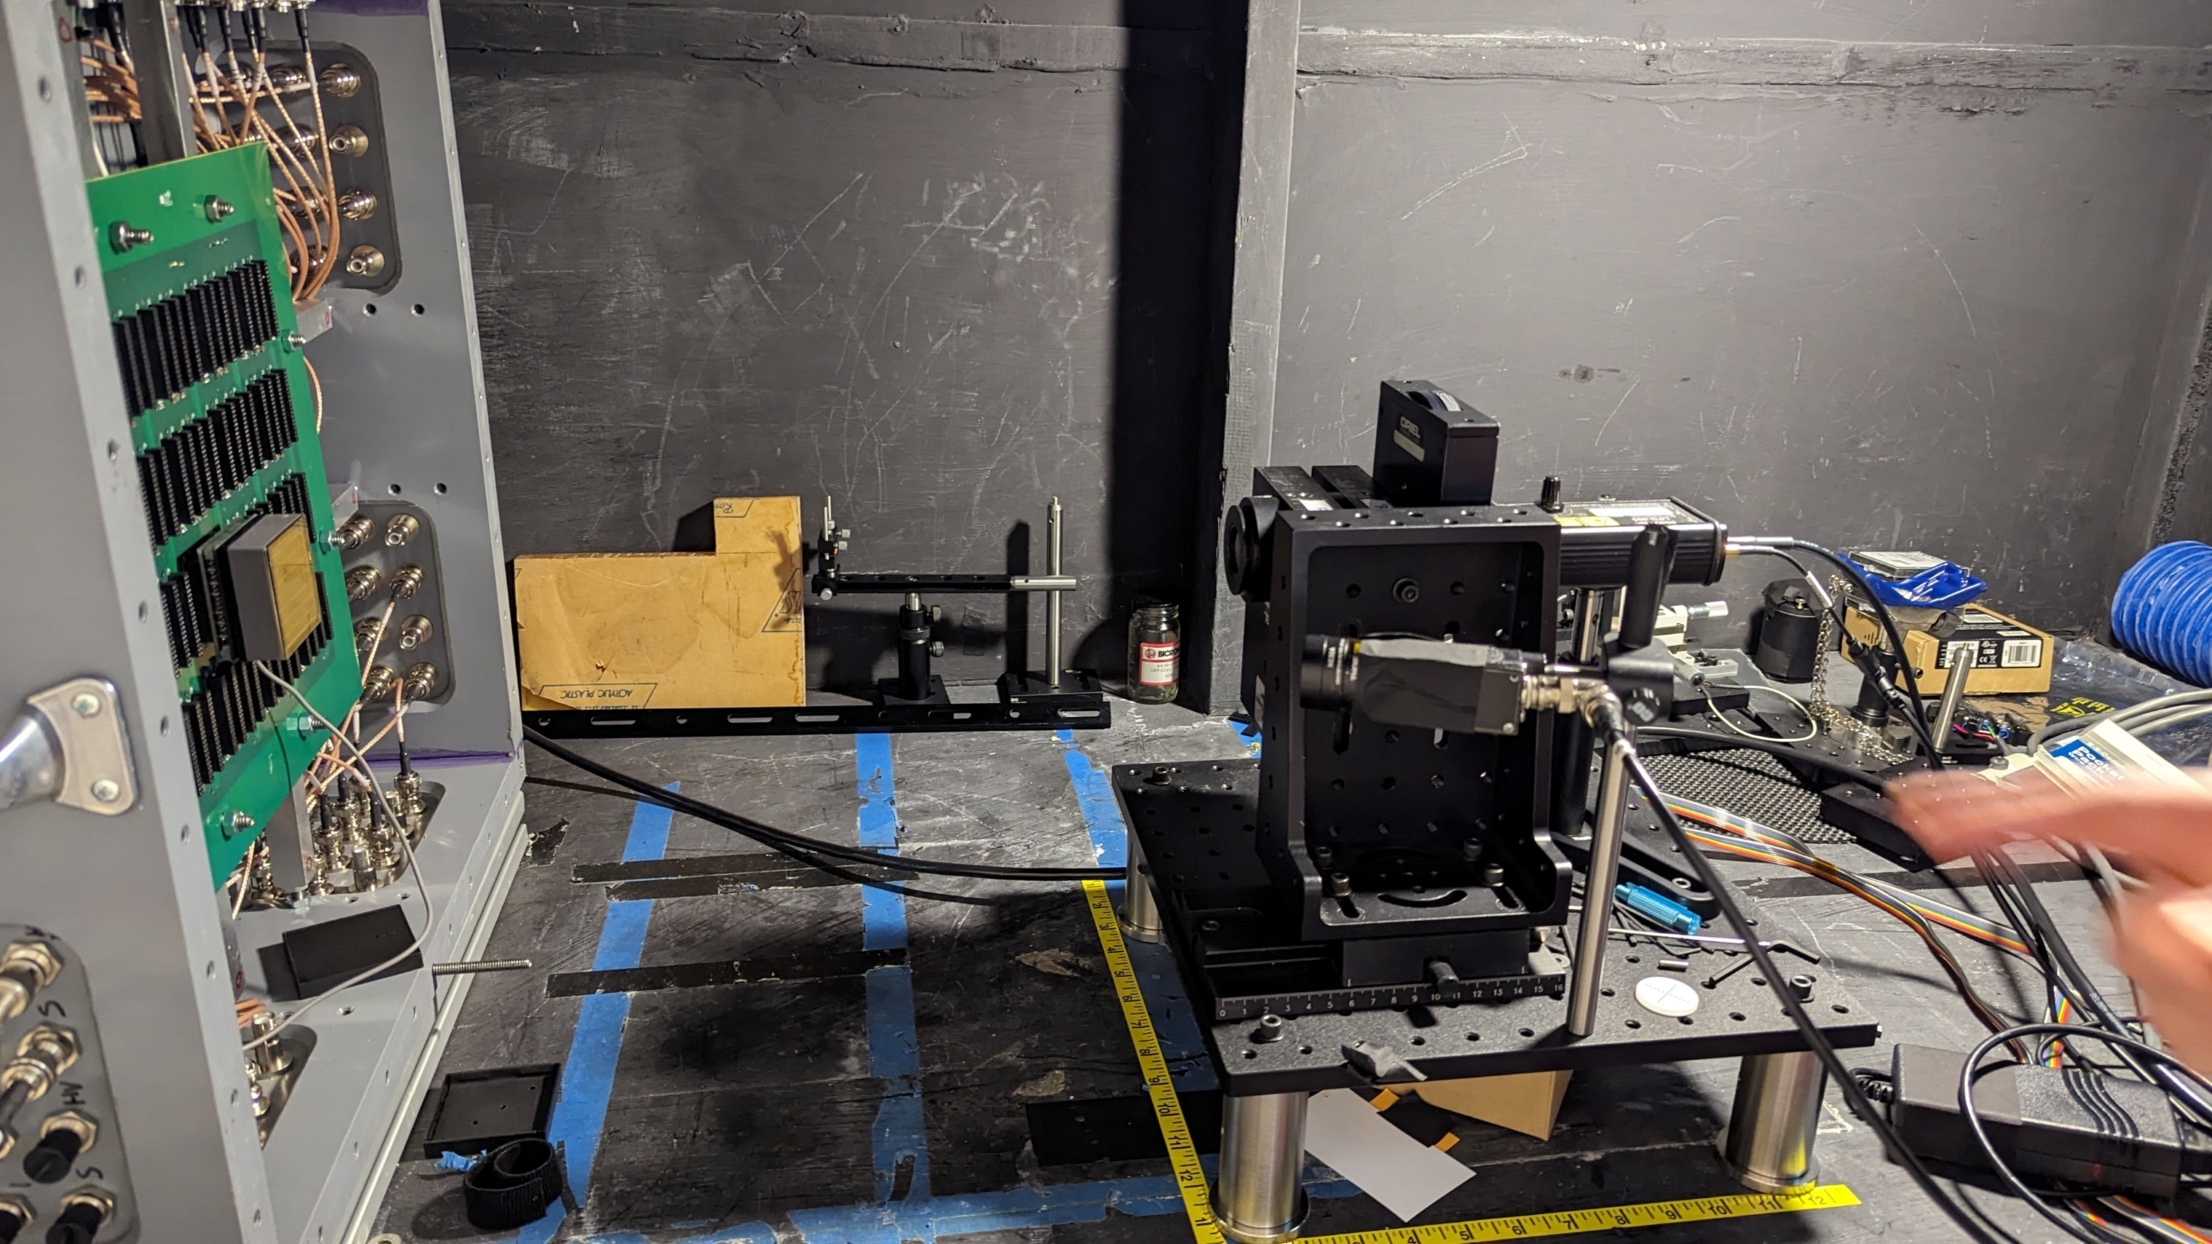
Carl’s test stand
https://solid.jlab.org/wiki/index.php/Cherenkov_readout#Carl_test
In a large black box at ARC L215
Laser with adjustable filters as signal with small number of photons
LED as background with single photon at high rate
Both have light diffused
Laser 405nm with filters
MAPMT with simple sum
blue LED

Slide 3
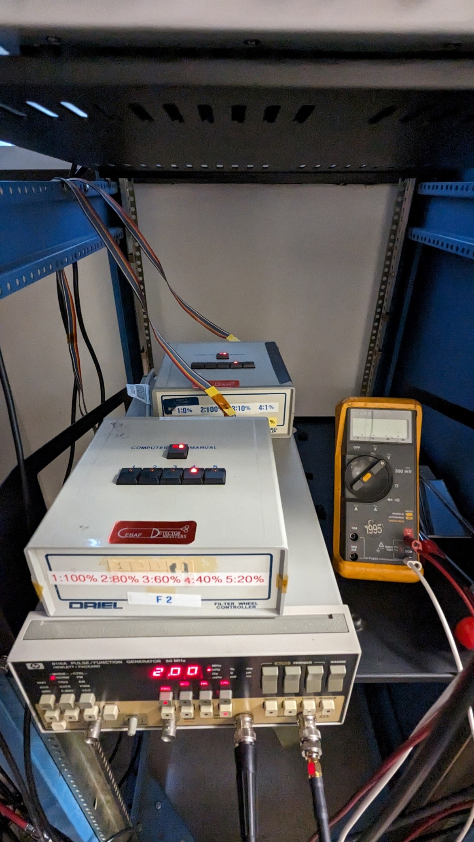
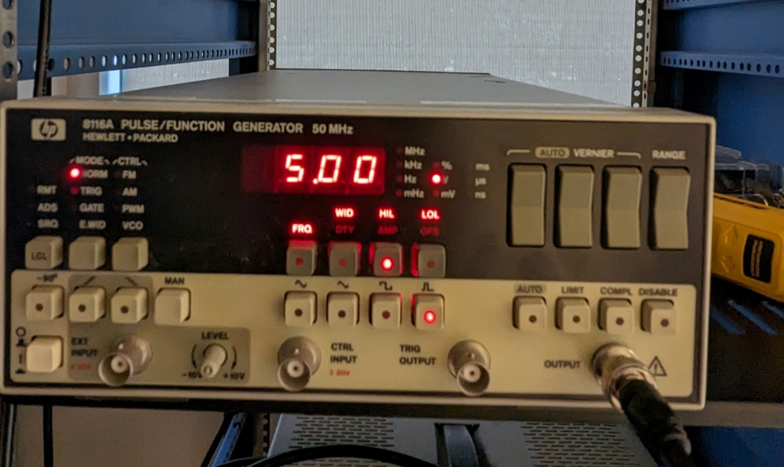
Carl’s test stand
Laser control fixed (FRQ 10khz, WID 100ns,HIL 5V, LOL 0V)
Two laser filters in series to adjust light by order of 5000 (0.02%-100%)
LED control adjust FRQ and HIL (WID 8ns,LOL 0V)
Laser filter1 (0.1% - 100%)
Laser filter2 (20% - 100%)
LED control
Laser control

Slide 4
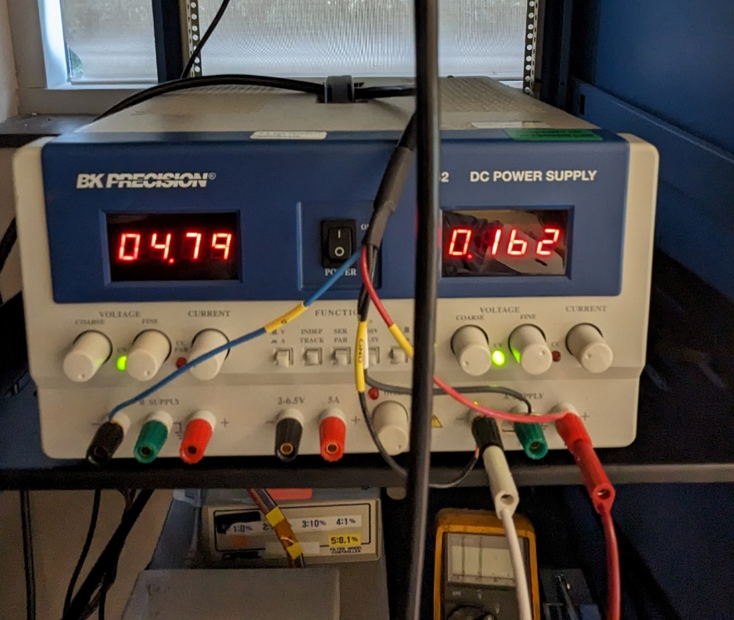

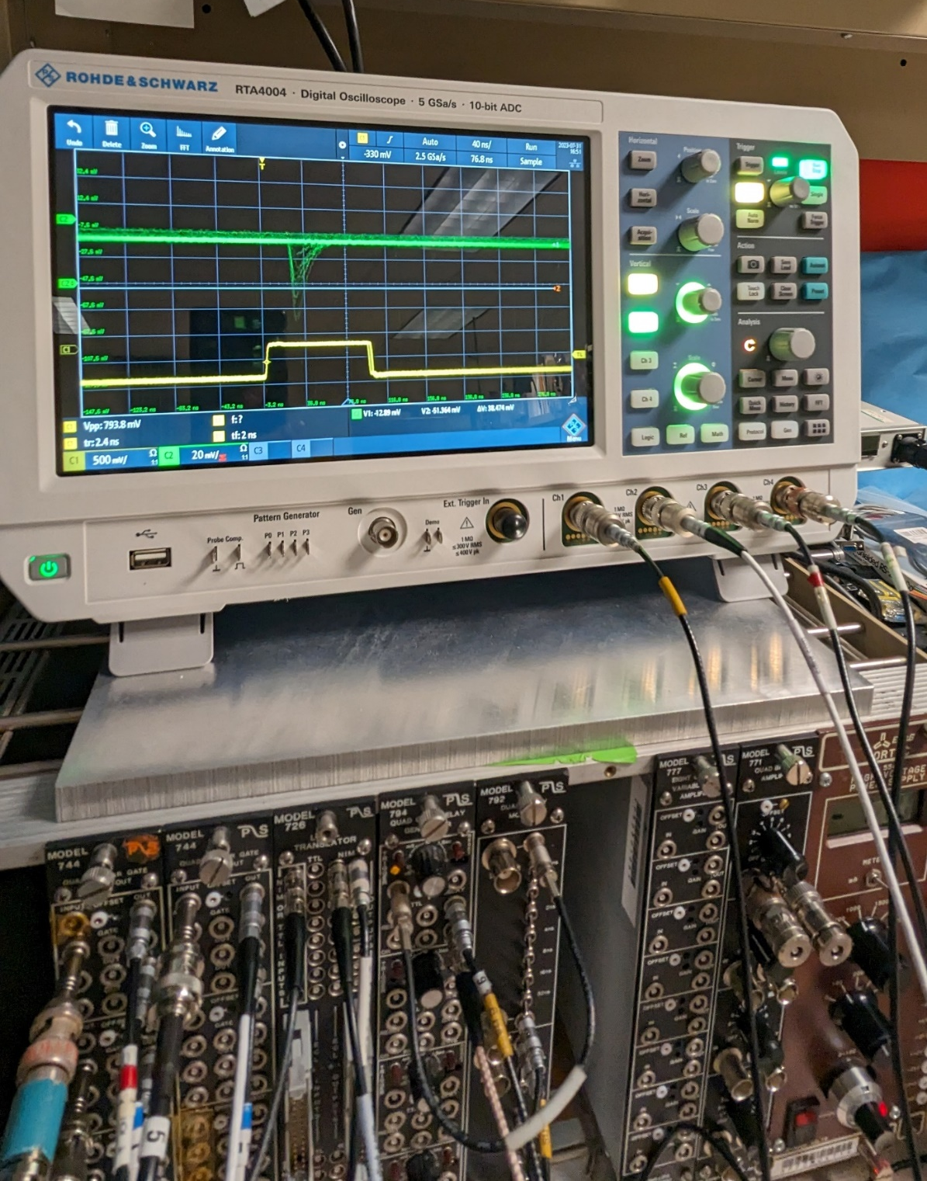
Carl’s test stand
Readout LV control
Readout LV control, DC power supply display not very accurate, using meter to read +5/0/-5 for simple sum readout only
PMT HV control
Laser control or LED control provide trigger with 100ns gate
Scope to check gate and readout
PMT HV control

Slide 5
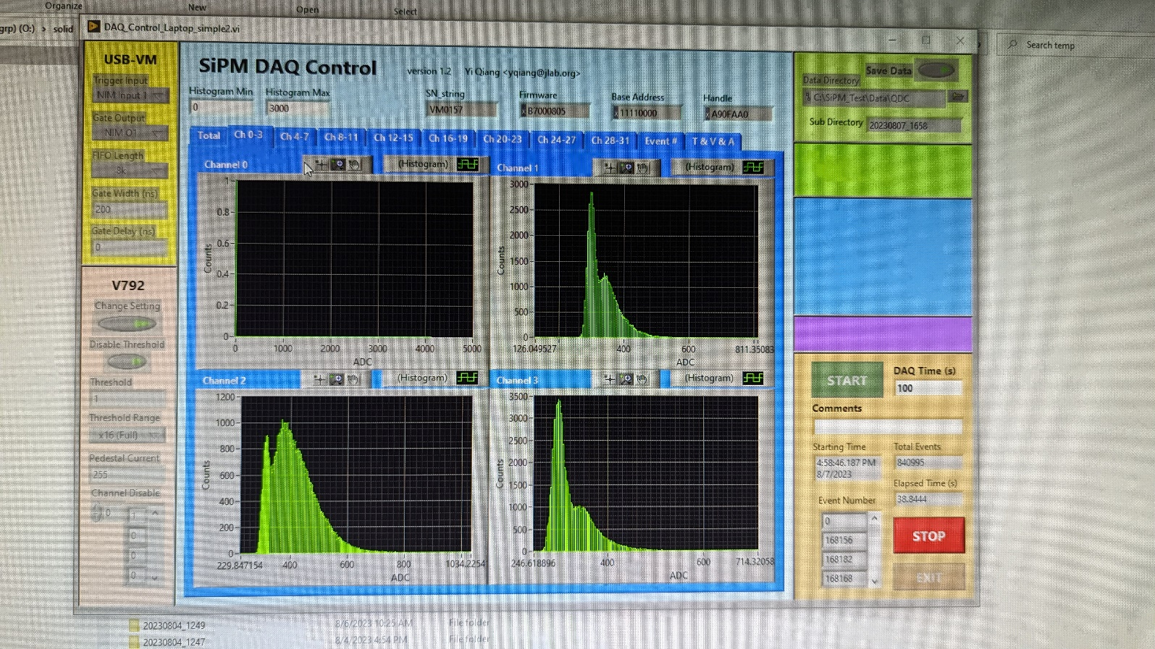
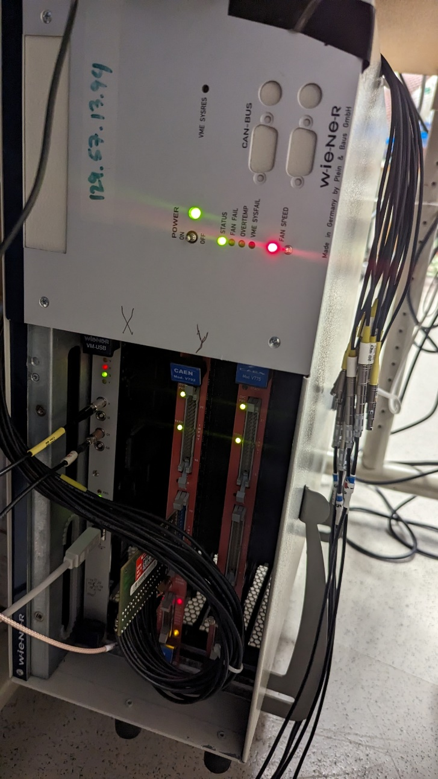
Carl’s test stand
DAQ by CAEN QDC v792 (12 bits) and labview program to collect data for all channels
  ch1-4 for quad 1-4, ch5 to sum for simple sum
DAQ starts to have deadtime when trigger rate is above 500hz with 5 channels of data taking. This doesn’t affect data taken at higher freq
When use laser and laser+LED, we take data at 10khz using laser as trigger. When use LED only, we take data using LED as trigger

Slide 6
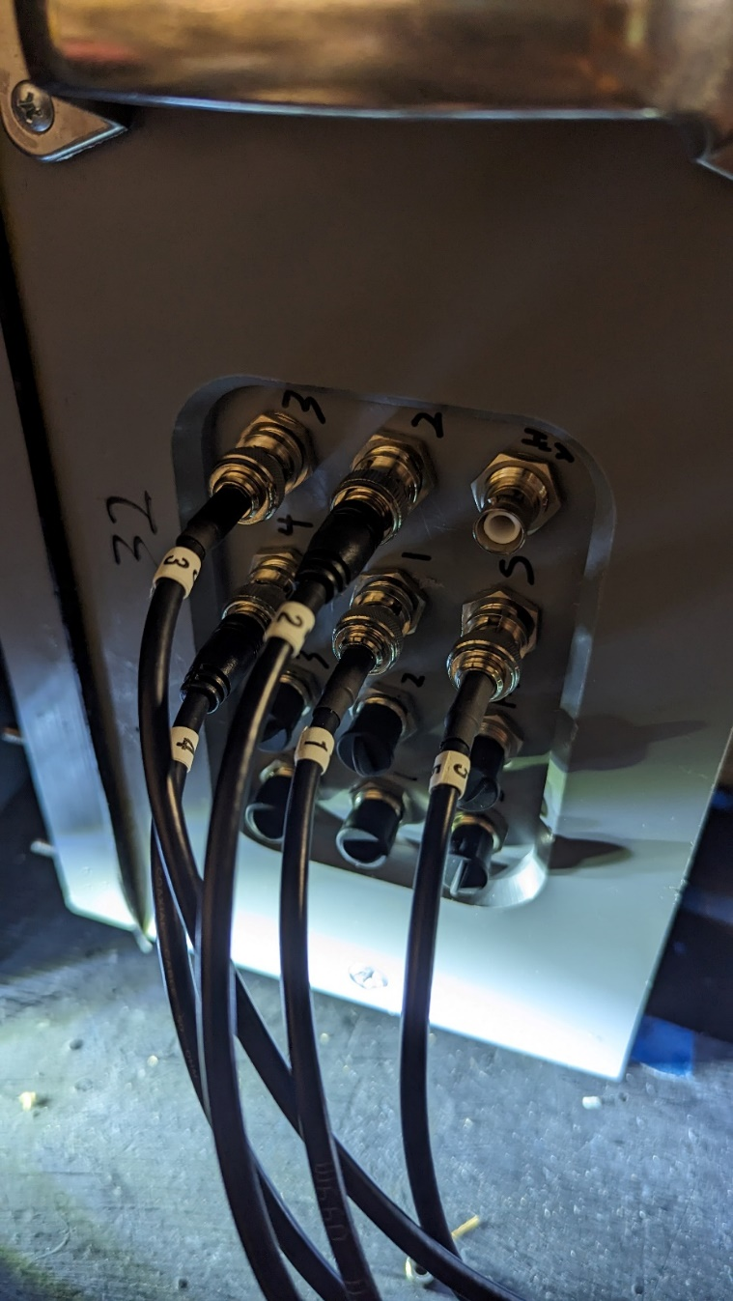
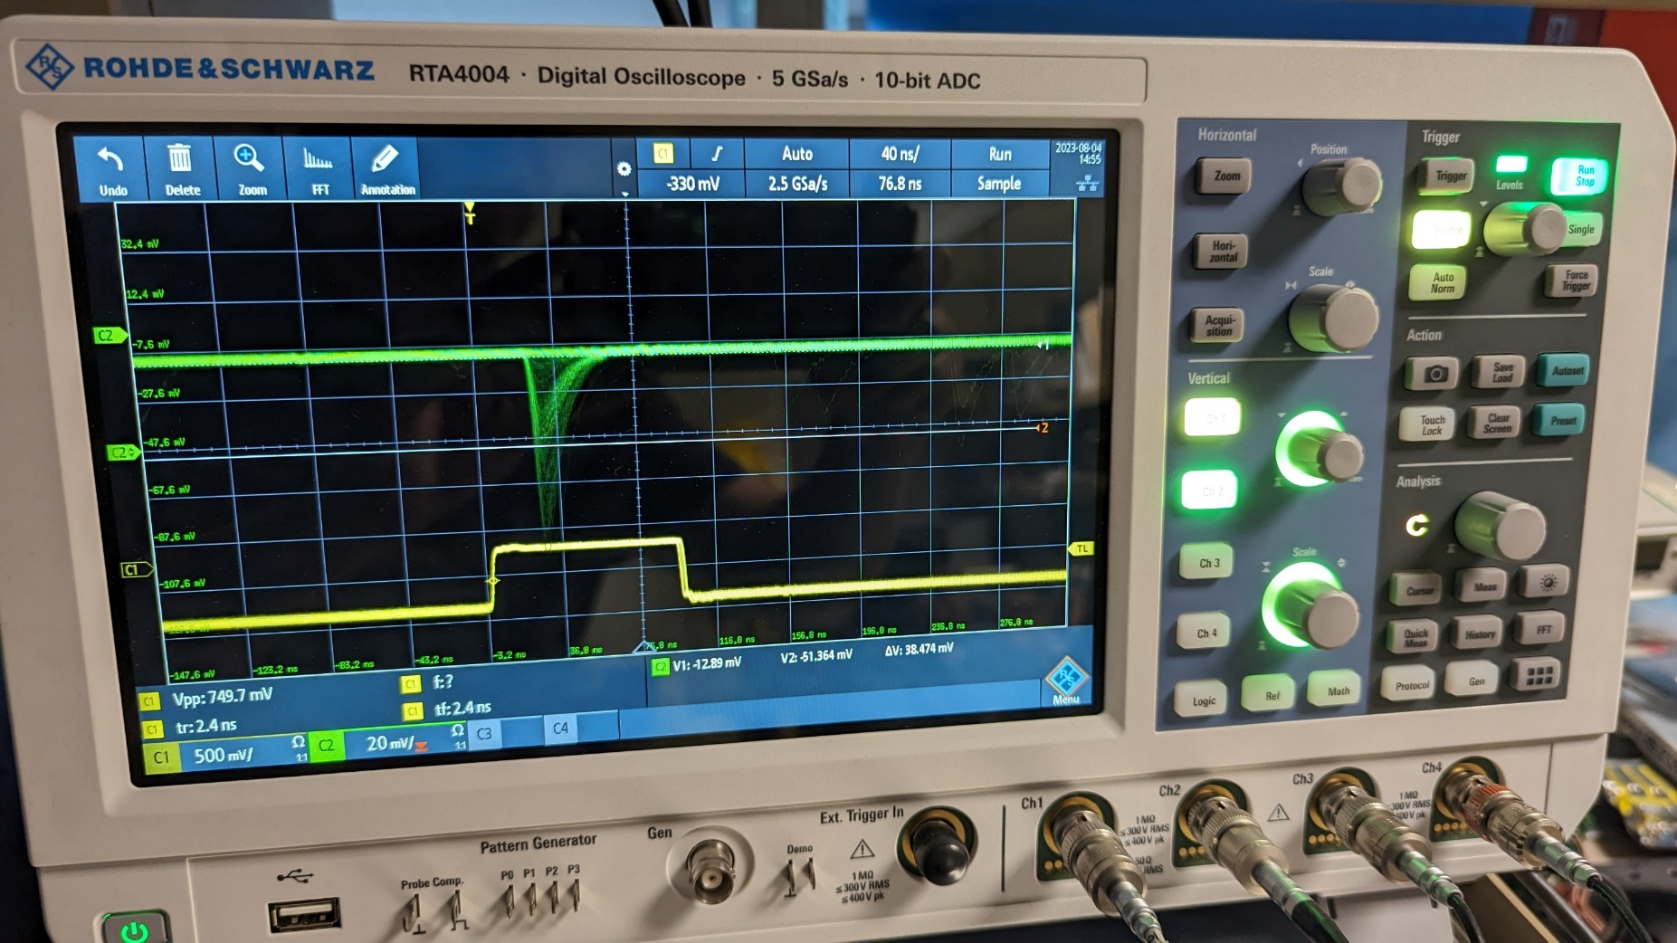
Test object 1
MAPMT with 16-pmt simple sum readout board (2020 beamtest)
  H12700-03 (SN HA0011) at position 32 (not the original PMT at this position)
    HA0011 got WLS coating removed by accident before this test
  4 quad simple sum signal are positive and 1 sum signal is negative
    signal wide ~50ns without oscillating tails
    Simple sum board has ~10x amplifier, so no NIM amplifier used at this test

Slide 7
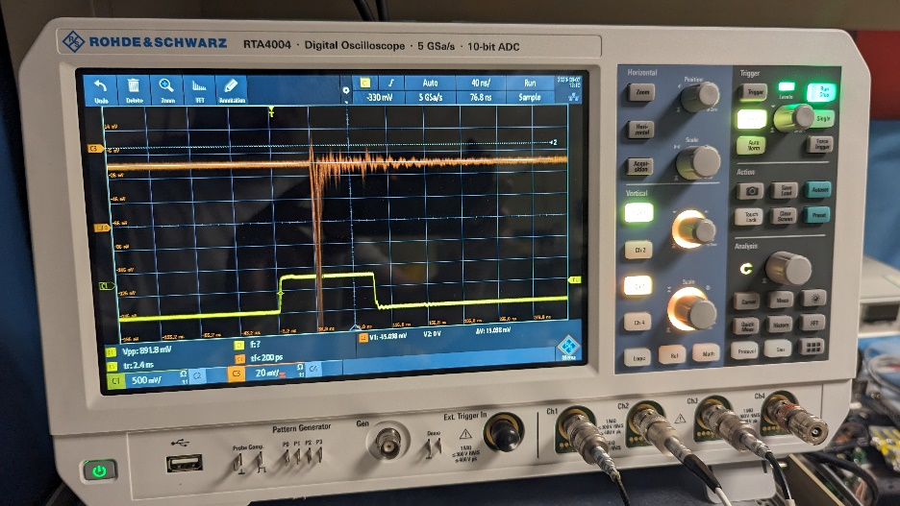
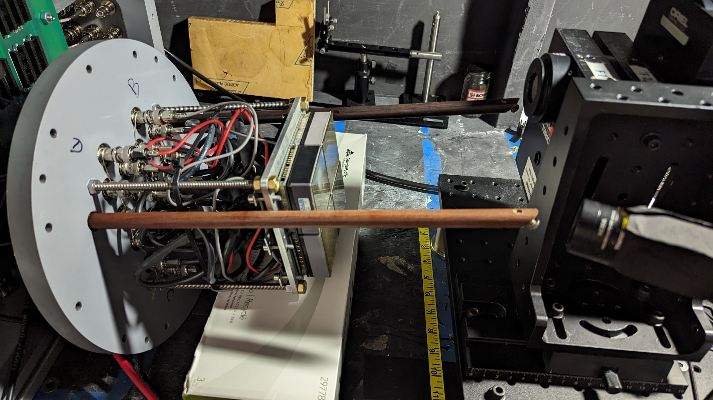
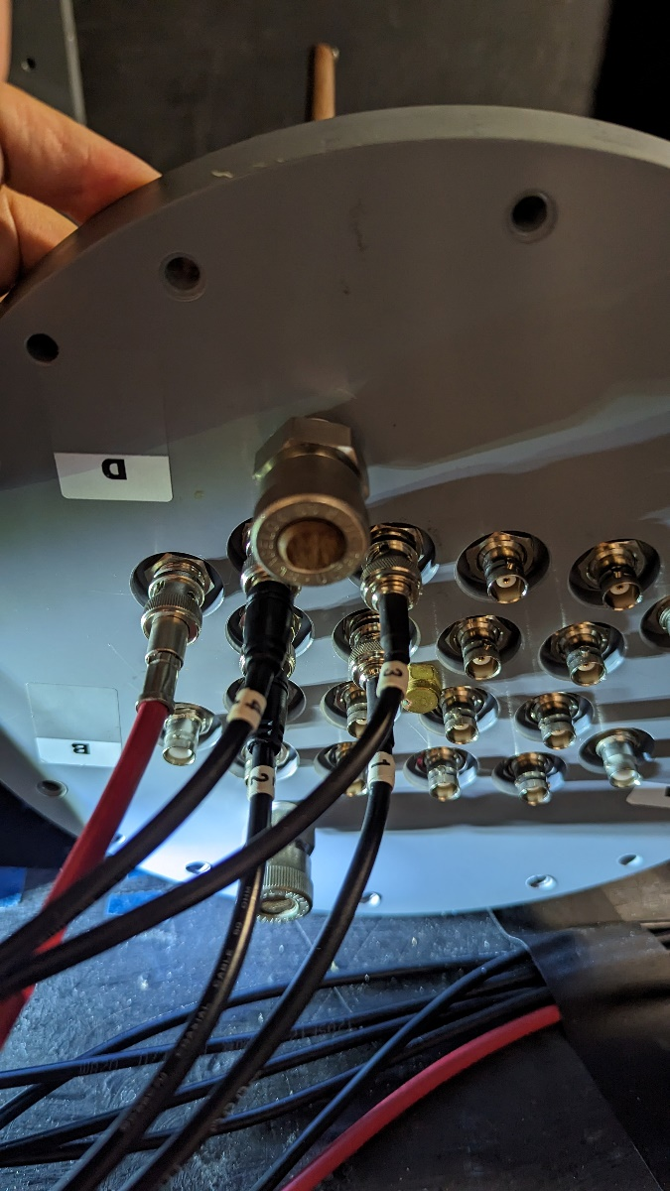
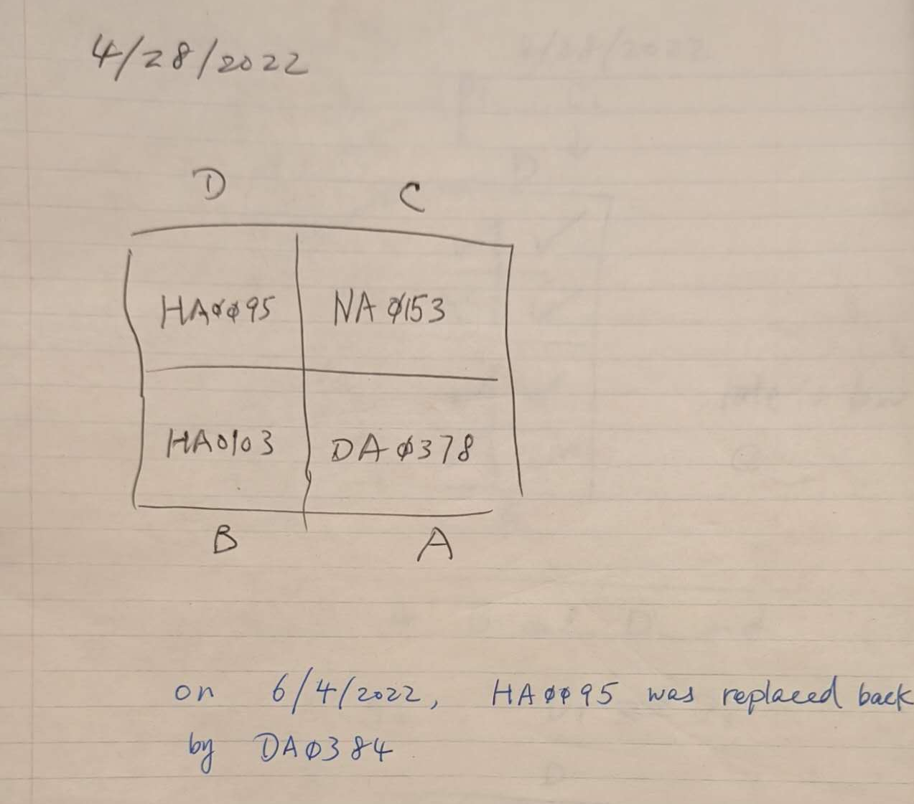
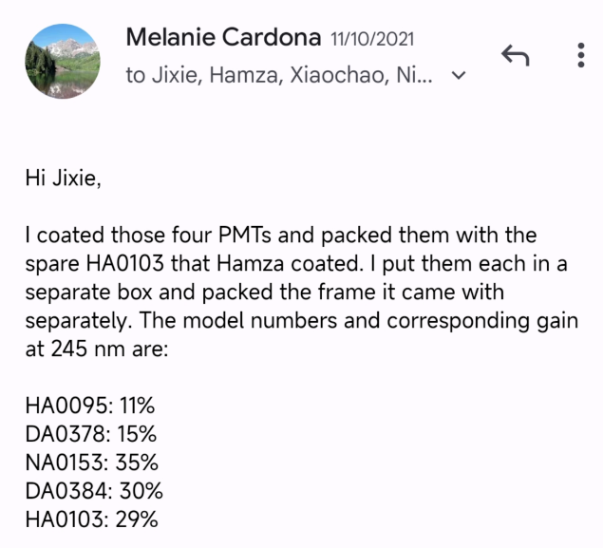
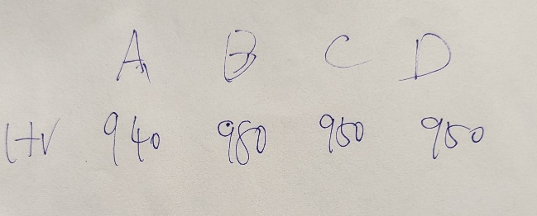
Test object 2
MAPMT with raw sum
MAPMT with raw sum readout (2022 beamtest)
  PMT-D, H8500-03 with SN DA0384
  PMT-B, H12700-03(?) with SN HA0103
  PMT-A, H8500-03 with SN DA0378
  PMT-C, H12700-03(?) with SN NA0153
  (D and A can see labels, but B and C labels are hidden when installed. 2020 test paper mentioned 2 H8500-03 and 2 H12700-03 were used)
  4 quads of raw sum signals are negative
    signal wide ~20ns with oscillating tails
    10x NIM amplifier used for this test
  During beamtest, the readout is on the right side of tank looking from front. pmt B and D with two poles holding mirror are at front. pmt A and C are at back
  Quad1,2,3,4 are shown on the photo, following PMT A,B,C,D order
  During beamtest, 10x NIM amplifier used for 18deg, but no amplification for 82deg or 7deg
Looking from back of PMTs as during beamtest
Quad 1,2,3,4 follow same order
Particle
direction

Slide 8
Result Summary
Simple sum
  Signal shape good with its built-in ~10x amplifier
  pedestal shift to higher adc with light
  Pedestal shift to lower adc and widen with high rate background
  No obvious linearity problem at high rate background
  No problem for gain and HV relation
Raw sum
  Signal shape has tails and some weird shape and it needs external amplifier
  pedestal shift to higher adc with light slightly also
  Pedestal not affected much by high rate background
  No obvious linearity problem at high rate background
  No problem for gain and HV relation

Slide 9
MAPMT signal fitting and single PE adc position determination
Follow papers on MAPMT pixel adc fitting (arxiv:1608.07525 and arxiv: 2202.07776), and apply the fit to quad and total sum
The fitting is a NPE poisson convoluted with a SPE function. The SPE function is not a simple gaussian but PMT type related and for MAPMT it can have two peaks
“mu” is average NPE
“scale” is SPE adc value, which can be near the dip of the 1st SPE function and lower than the 1st bump
  General way to get Npe for each event is to find SPE adc value by eye or fitting and divide adc of each value by it
  For beamtest data, if using 1st bump as SPE adc value instead of “scale”, we can overestimate SPE adc value and thus underestimate NPE for each event, when using adc divide SPE value.
  Could this be the reason our 2020 and 2022 beamtest data Npe is underestimated comparing to sim by 40-50%?

Slide 10
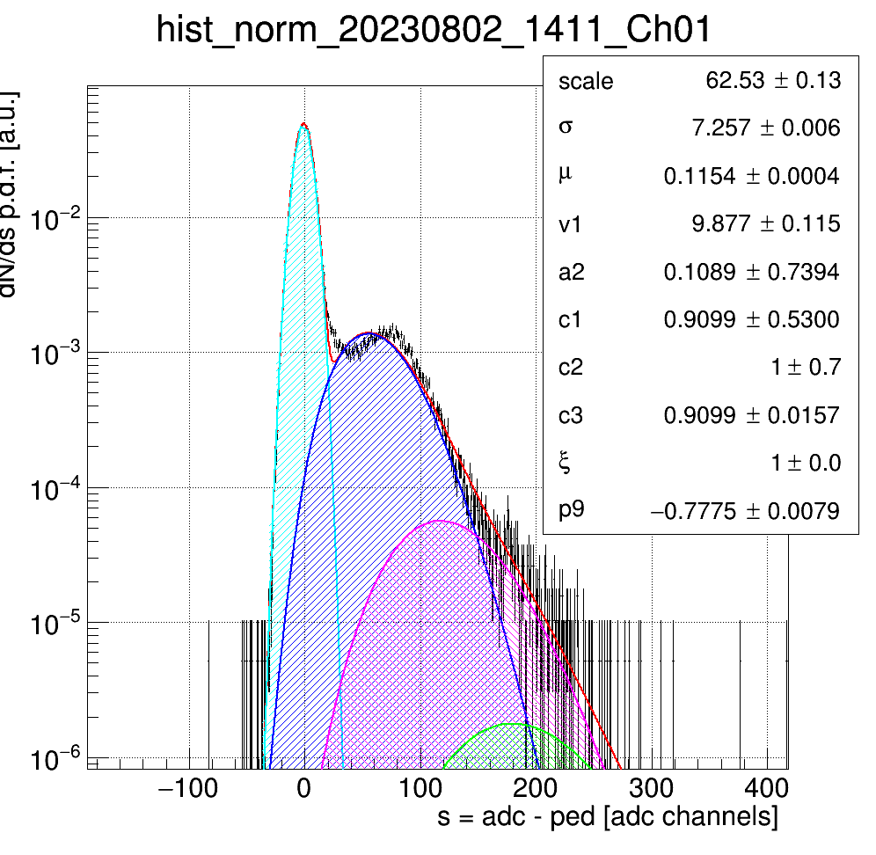
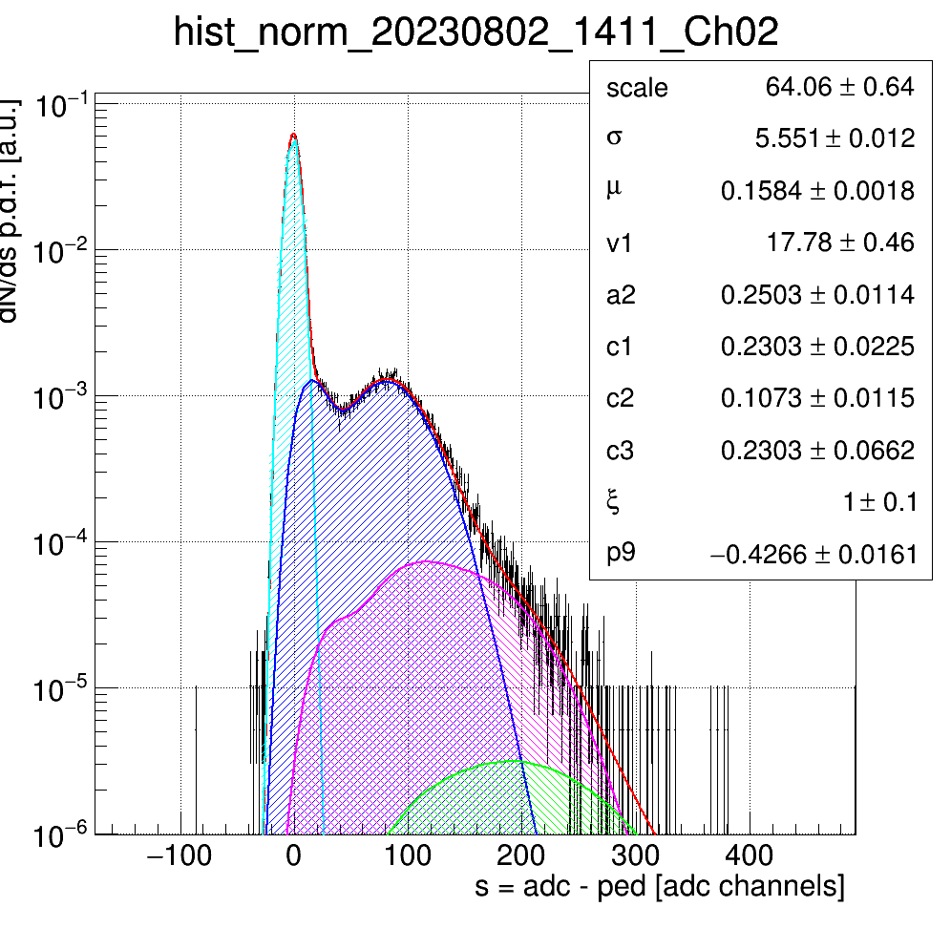
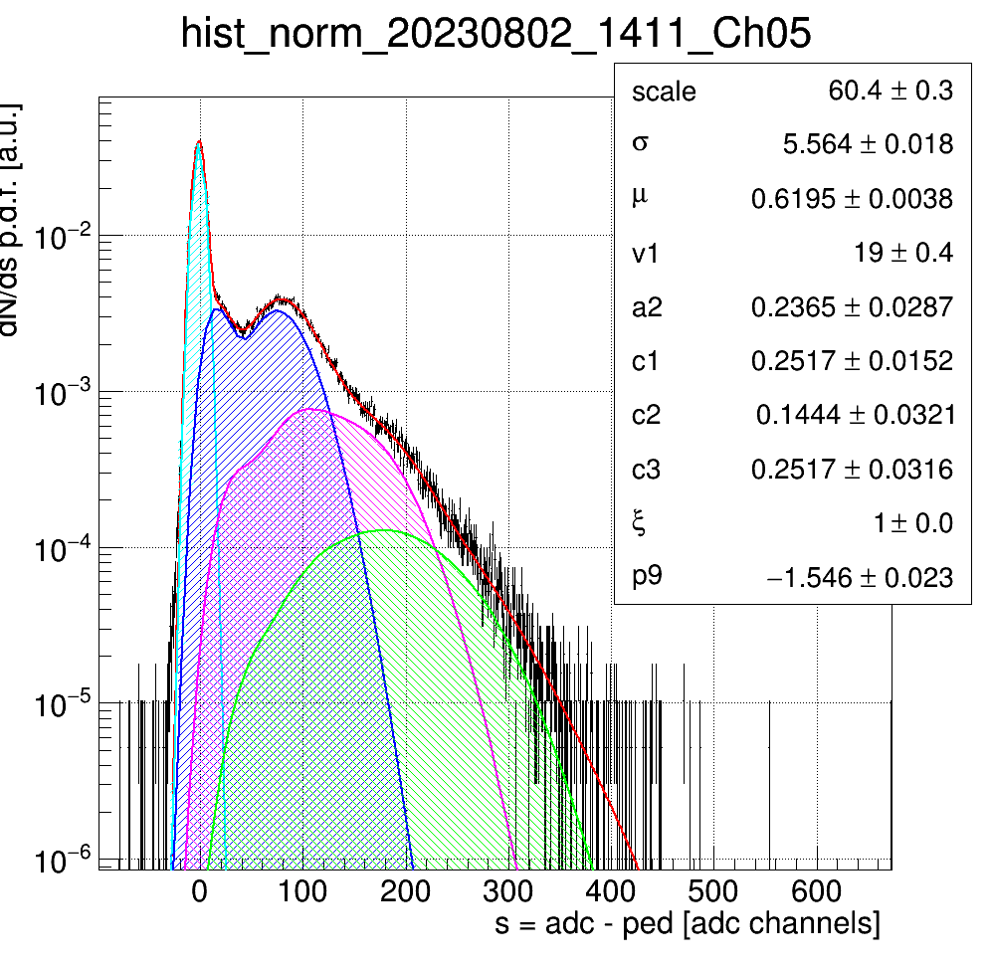
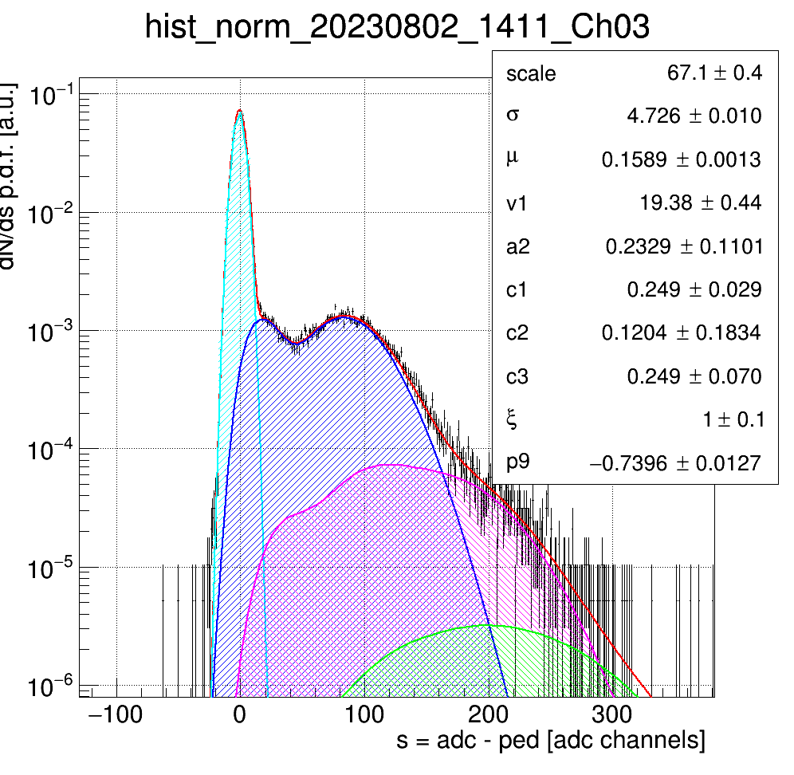
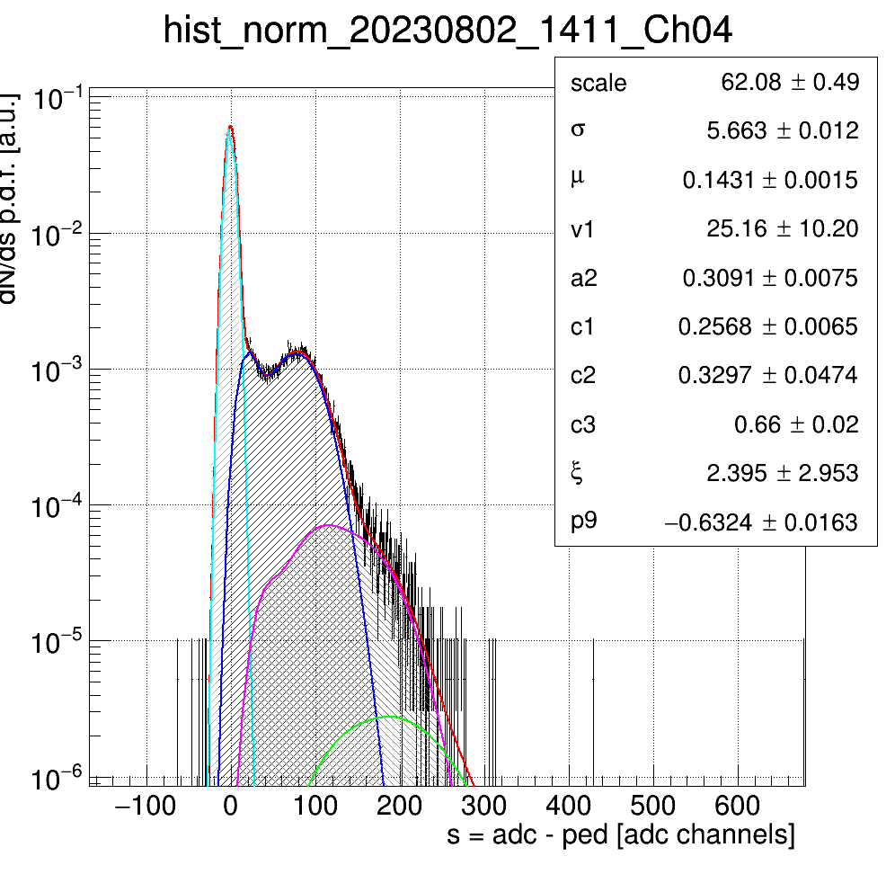
MAPMT simple sum: LED only (LED trigger)
At 2.5V, average PE (mu) is 0.6 at PMT sum, which means 55% no PE, 33% 1 PE, 10% 2 PE according to poisson distribution. Each quad has about ¼ of lights

Slide 11
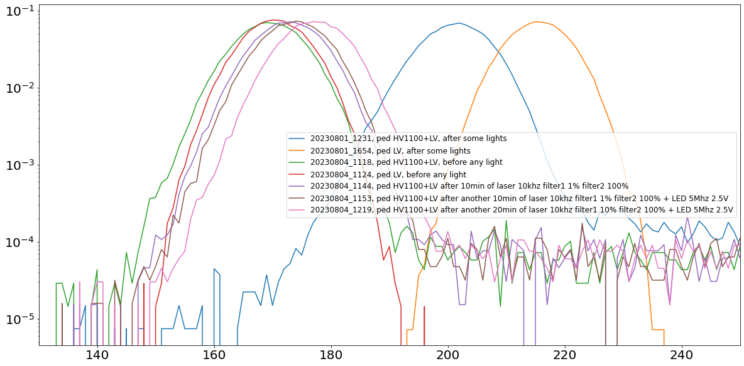
MAPMT simple sum: ped
Pedestal is mainly from simple sum board, not pmt.
It will increase when expose to lights

Slide 12
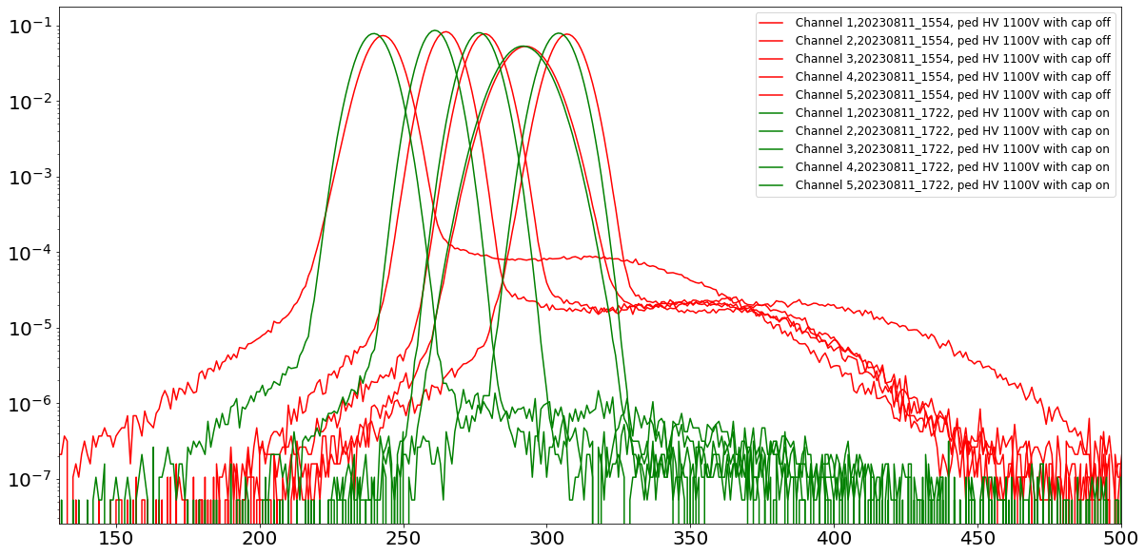
MAPMT simple sum: ped
Table or plot with scale needed
There are small light leaks at a couple Hz level

Slide 13
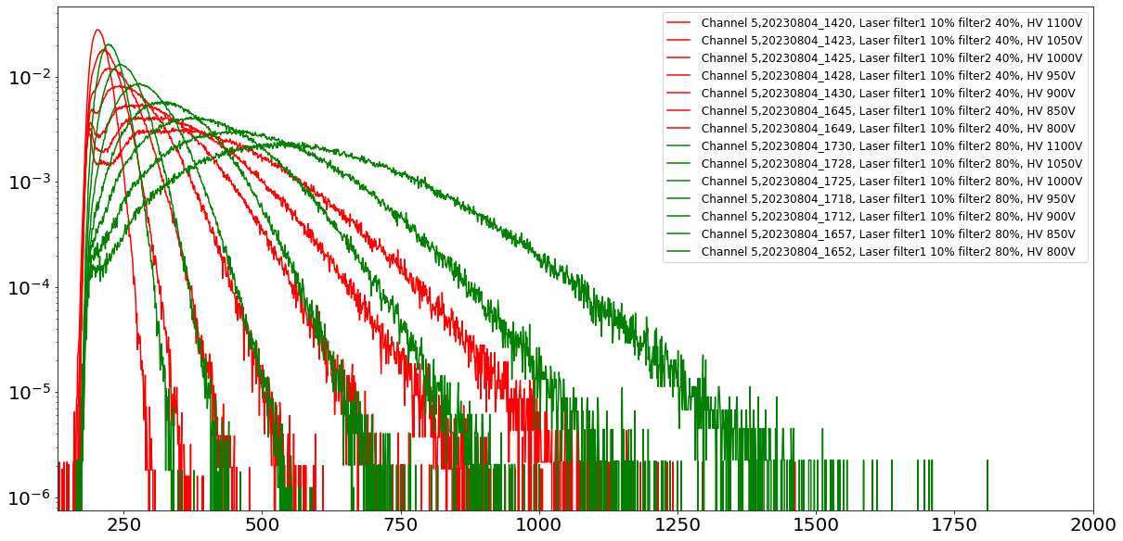
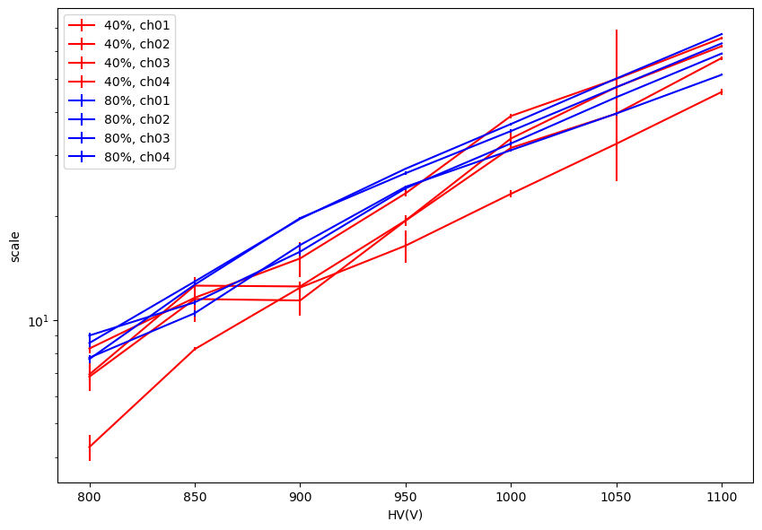
MAPMT simple sum: laser only, HV change
SPE (scale from fitting)
Gain increase with HV in log

Slide 14
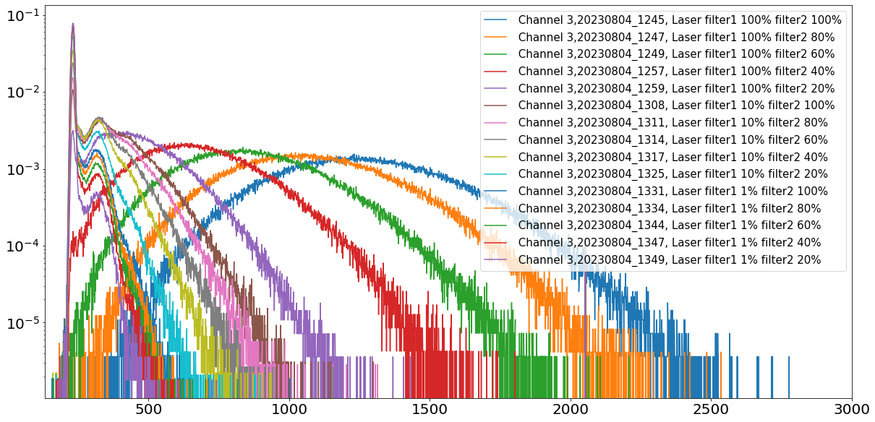
MAPMT simple sum: laser only, light change
output increase with light input to high Npe

Slide 15
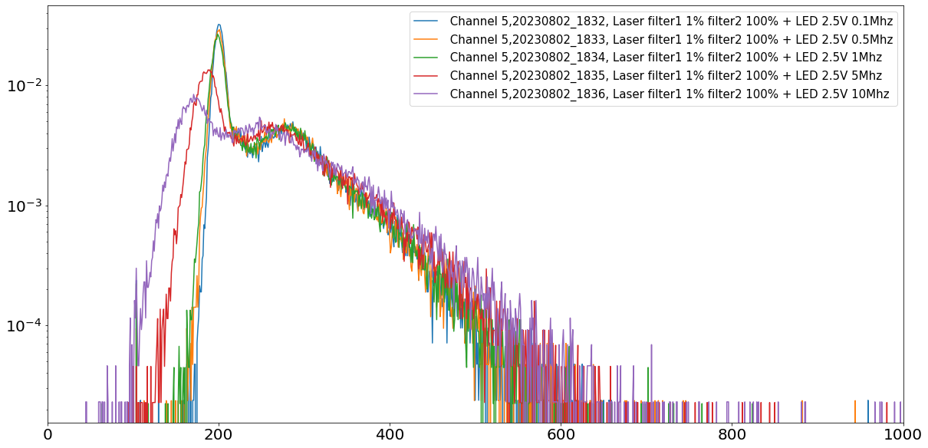
MAPMT simple sum: laser+LED, different LED light rate
At 0.1,0.5,1MHz, pedestal doesn’t change much, at 5 and 10MHz, pedestal is moved to lower values by LED
Possible reason is due to a lot of LED lights depleting photocathode, need more time to study and there is no easy fix

Slide 16
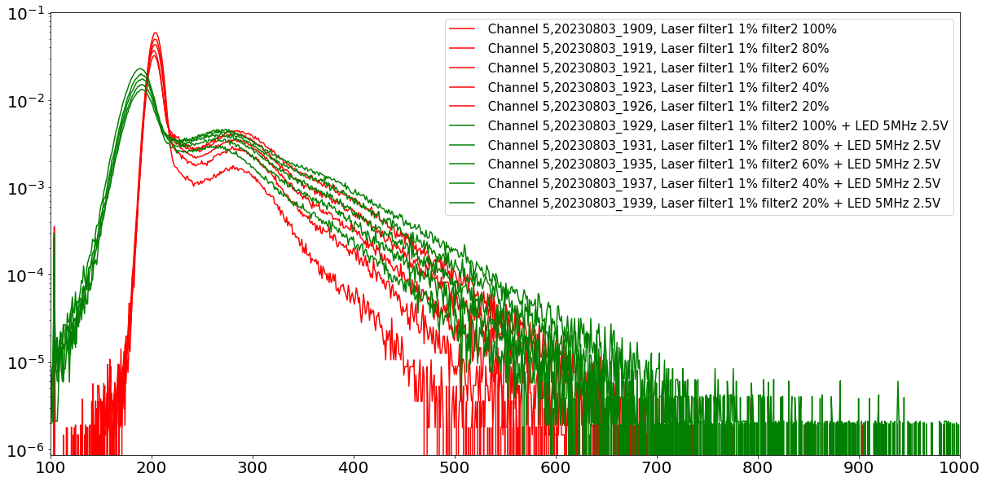
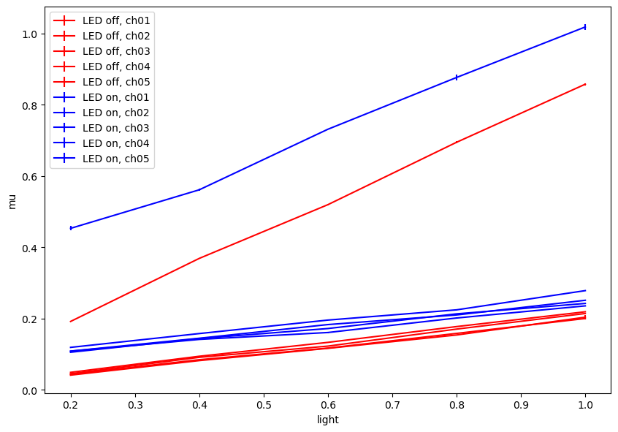
MAPMT simple sum: laser+LED, less laser light
Average Npe (mu from fitting)
With LED 5MHz 2.5V, when laser and LED have comparable amounts of lights, adc are pushed to higher values by LED besides pedestal

Slide 17
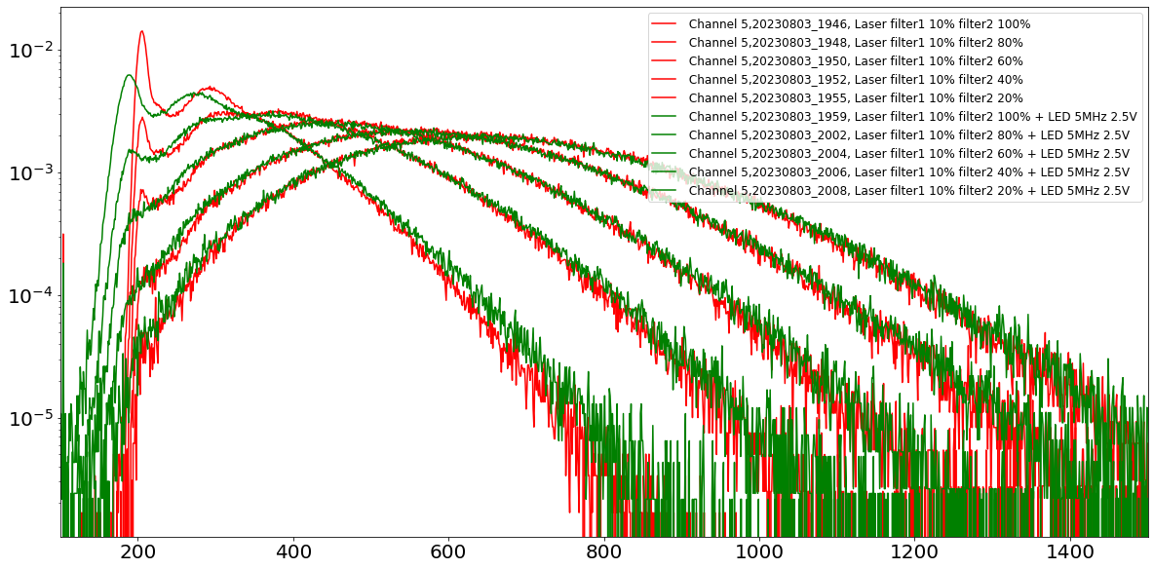
MAPMT simple sum: laser+LED, more laser light
With LED 5MHz 2.5V, when laser lights are much stronger than LED lights, adc values are not affected much except pedestal

Slide 18
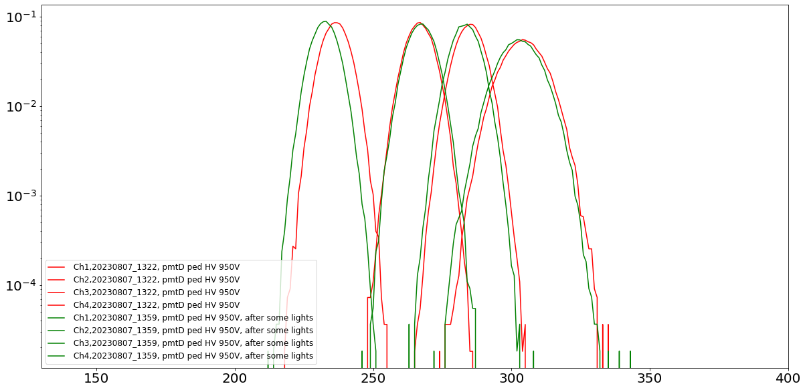
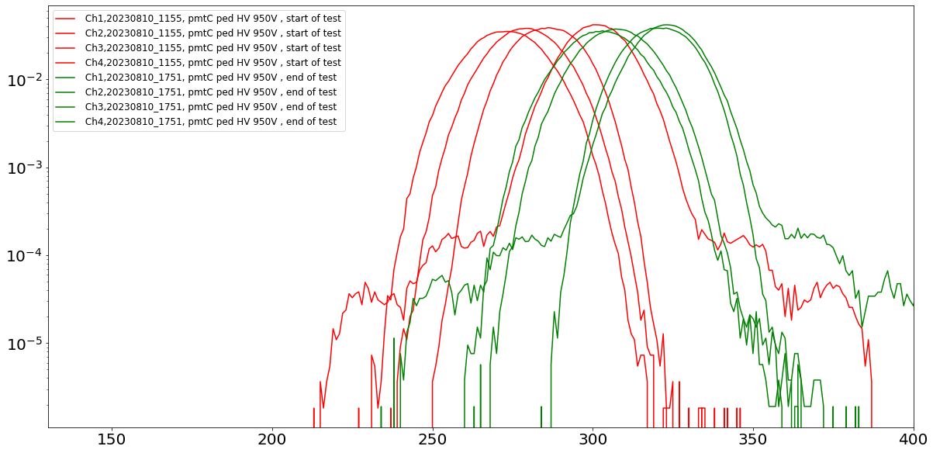
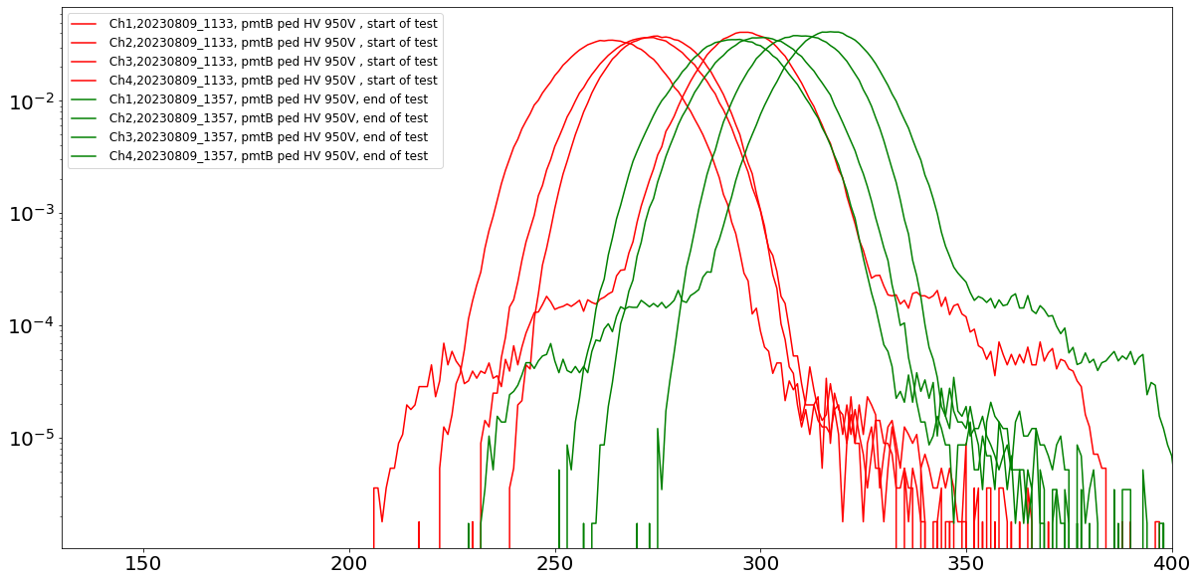
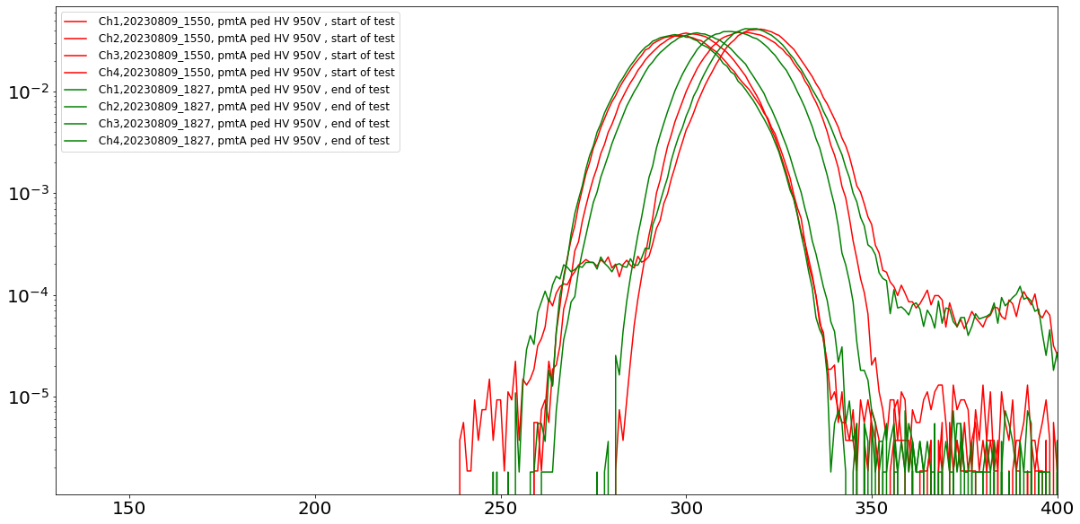
MAPMT raw sum: ped
ped affected by light also and it’s pmt dependent
ped widen slightly with NIM 10x amplification (pmtB,A,C) comparing to without (pmtD)

Slide 19
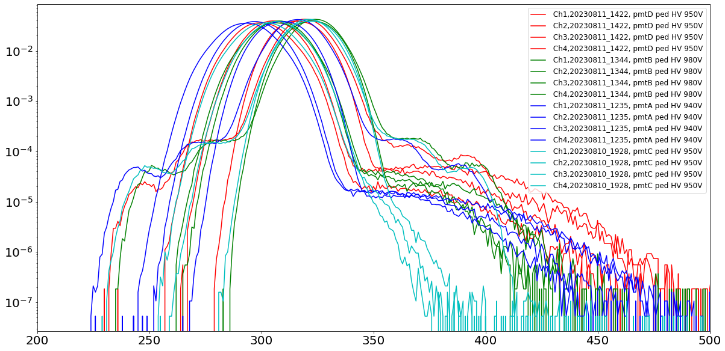
MAPMT raw sum: ped
Ch4 for all 4 pmts has some weird shape
Similar light leak
Table or plot with scale needed

Slide 20
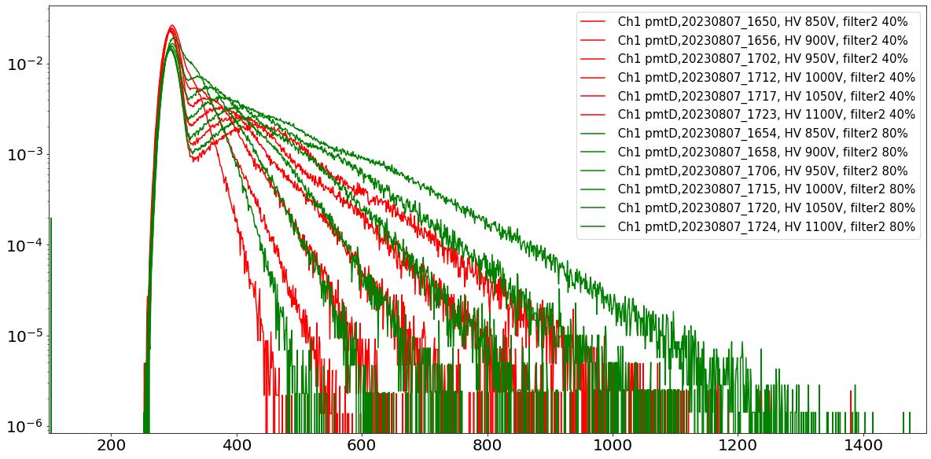
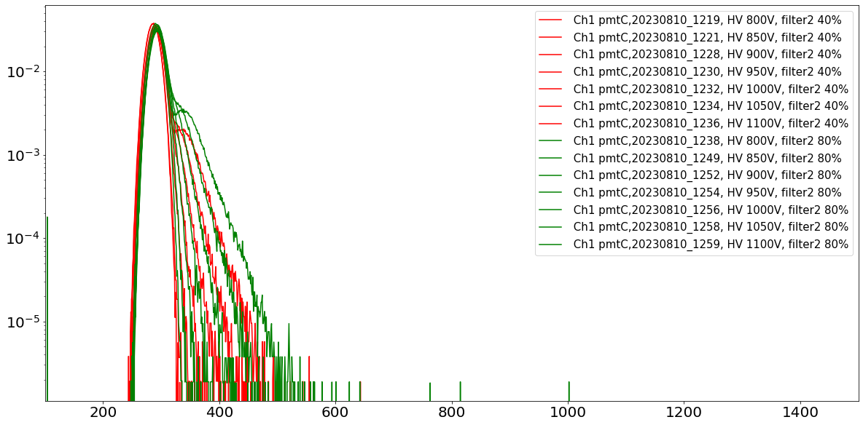
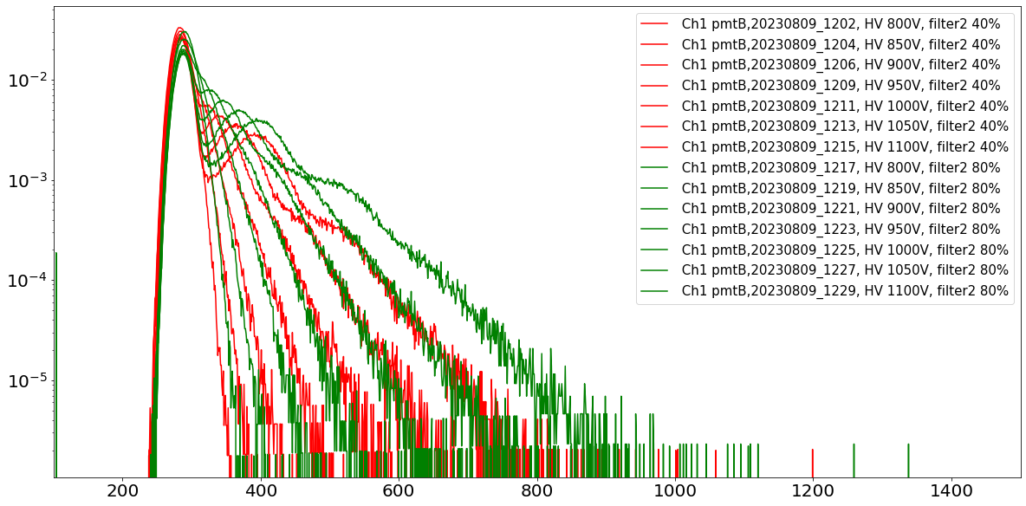
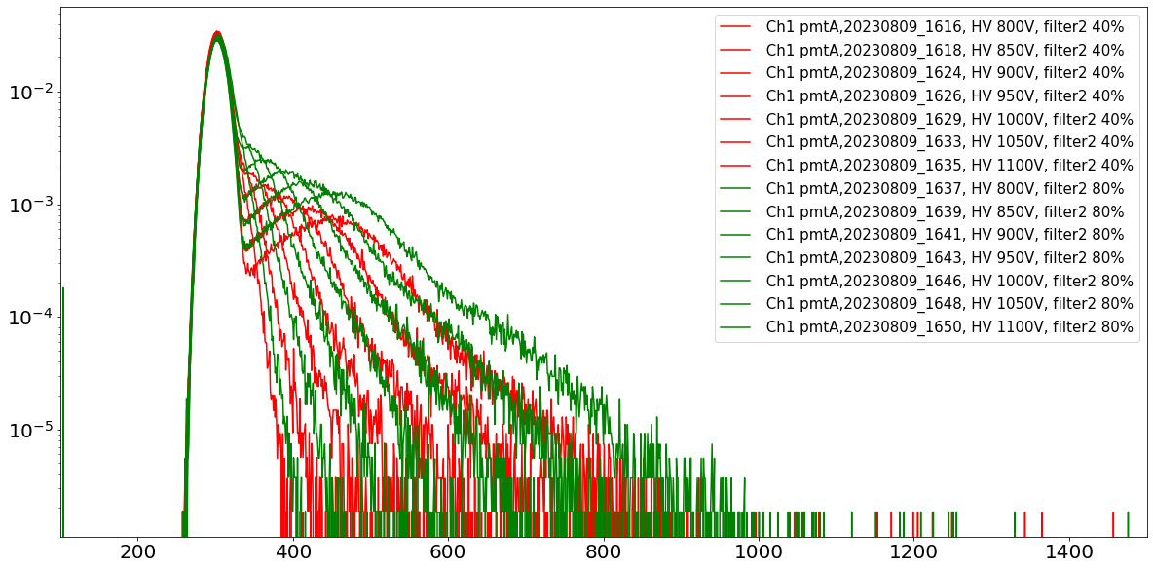
MAPMT raw sum: laser only, HV change
Table or plot with scale needed

Slide 21
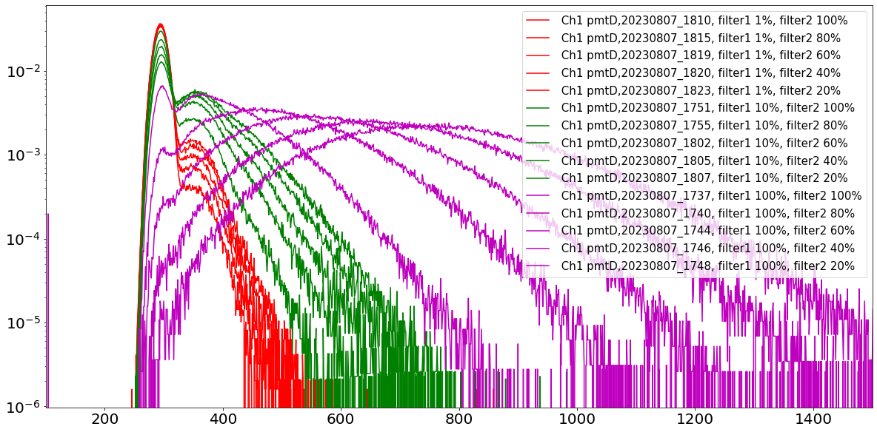
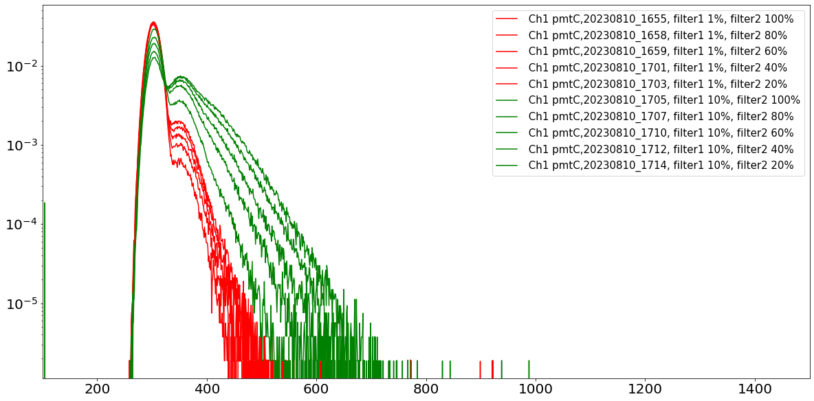
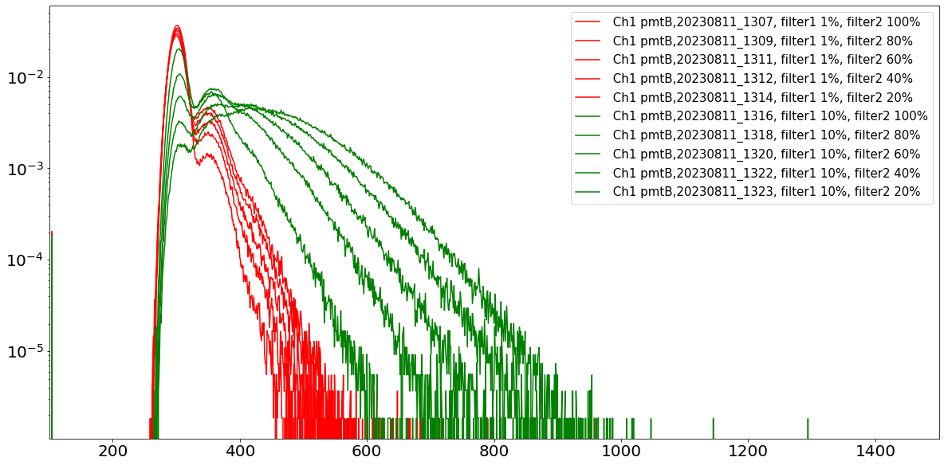
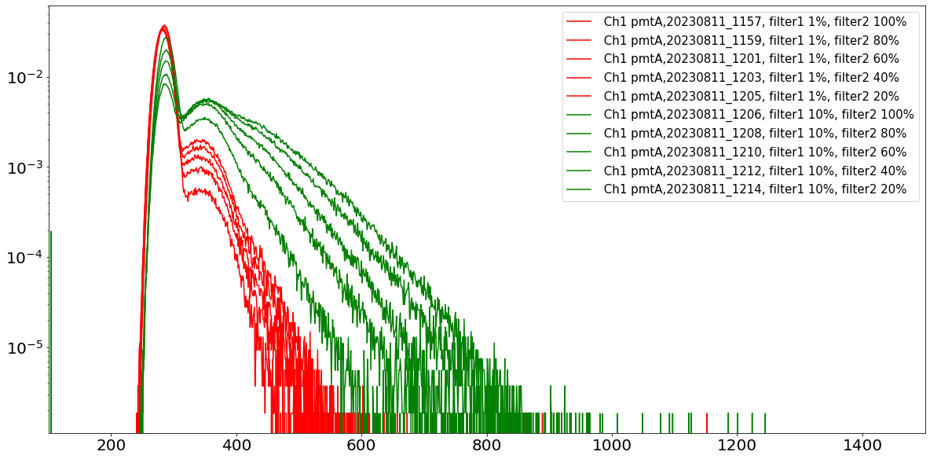
MAPMT raw sum: laser only, light change

Slide 22
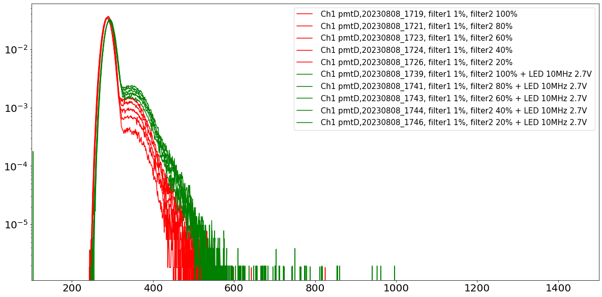
MAPMT raw sum: laser+LED, less laser light

Slide 23
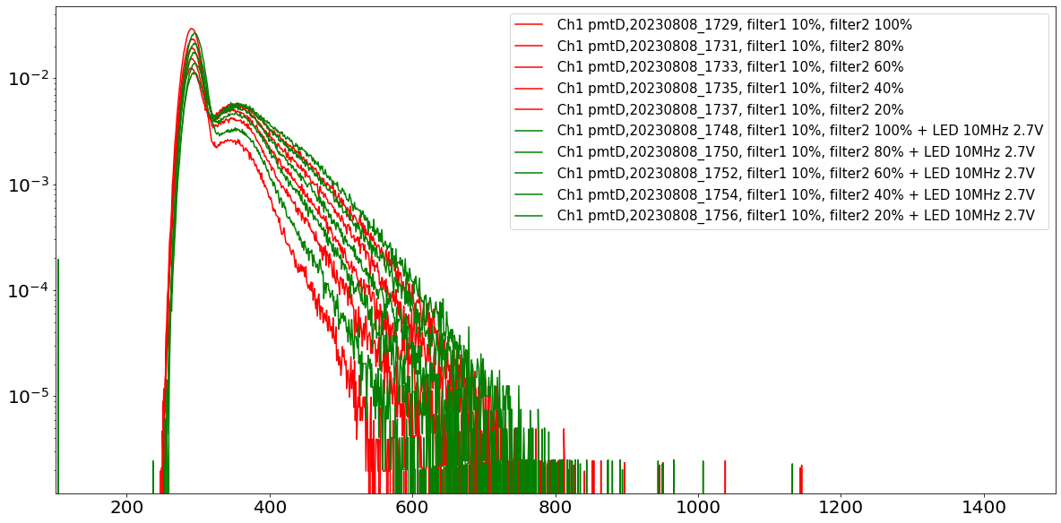
MAPMT raw sum: laser+LED, more laser light

