Slide 1
Testing New Ideas for Calorimeters
Jin Huang
Los Alamos National Lab
for the calorimeter working group

Slide 2
Idea 1: HERMES – LHC-b type of preshower

Slide 3
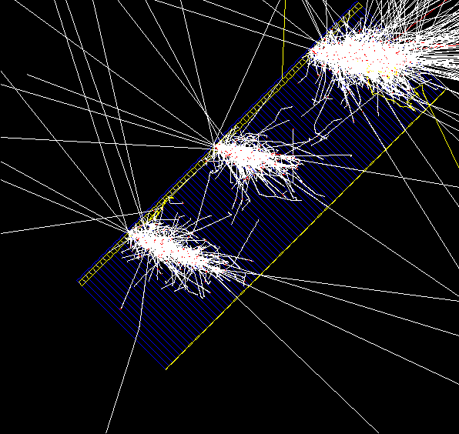
Setup – PVDIS configuration simulated
A 2-radiation length thick Pb plate and 2 cm thick scintillator plate was added to the default Shashlik calorimeter (1.5 mm scint + 0.5 mm Pb per layer)
Shashlik calorimeter have a single readout, serve as shower detector
Shower length = 18 X0 with 1.5mm Scint – 0.5mm Pb sandwiches 1/Sqrt(E) energy resolution : ΔE/E ~5%/√ (E) compared with pure shashlik conf. with 4%/√ (E)
Electron Events Shown
2 X0 Lead
2 cm scintillator

Slide 4
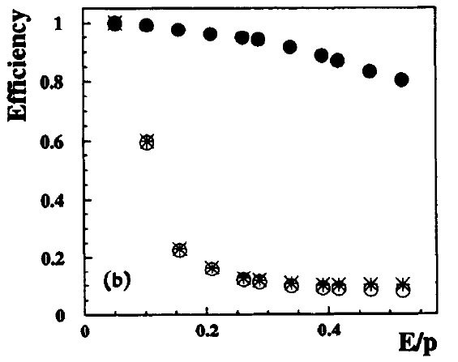
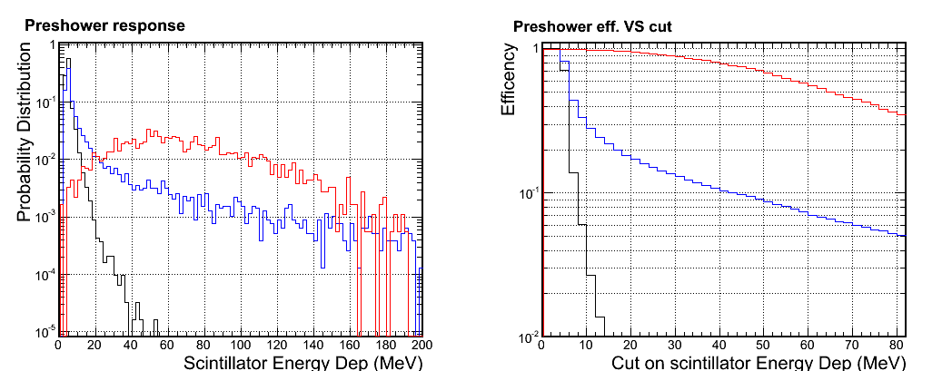
Preshower response
HERMES NIM 1996
●Electron
○Pion
*Pion/Electron
Preshower alone, cut eff. ~15% (pion) VS ~95% (electron)
Similar performance for Shashlik preshower
Legend : Electron; Pion; Muon
E/p cut

Slide 5
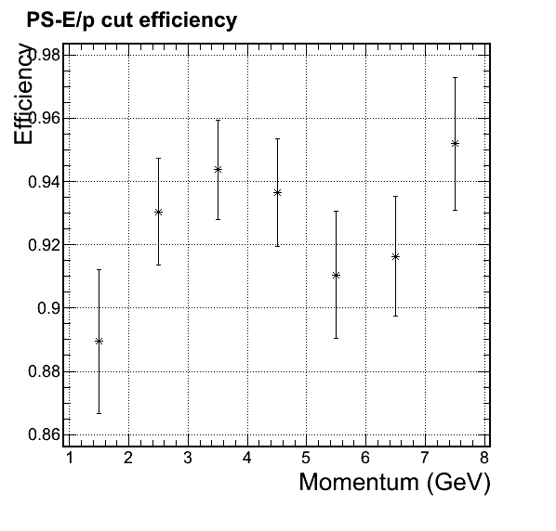
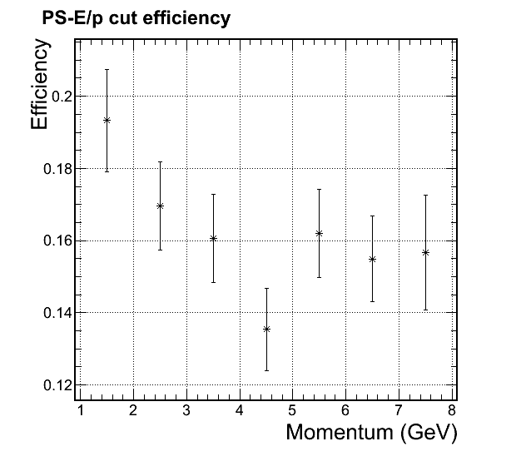
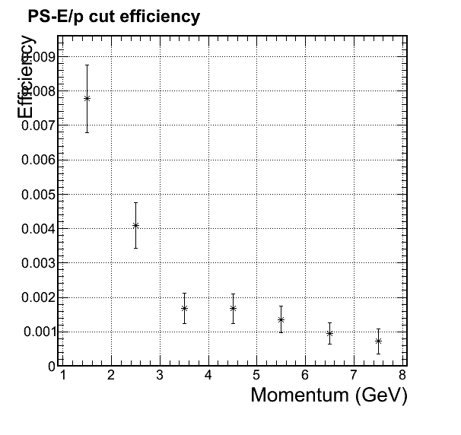
Momentum dependent cuts and eff. Preshower cut only
Shown in last meeting, which is consistent level compared with Shashlyk preshower
Electron
Pion
Muon

Slide 6
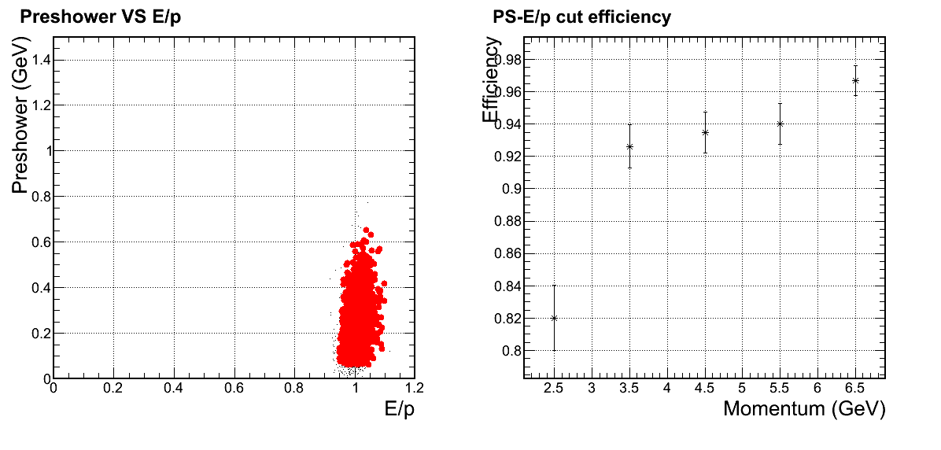
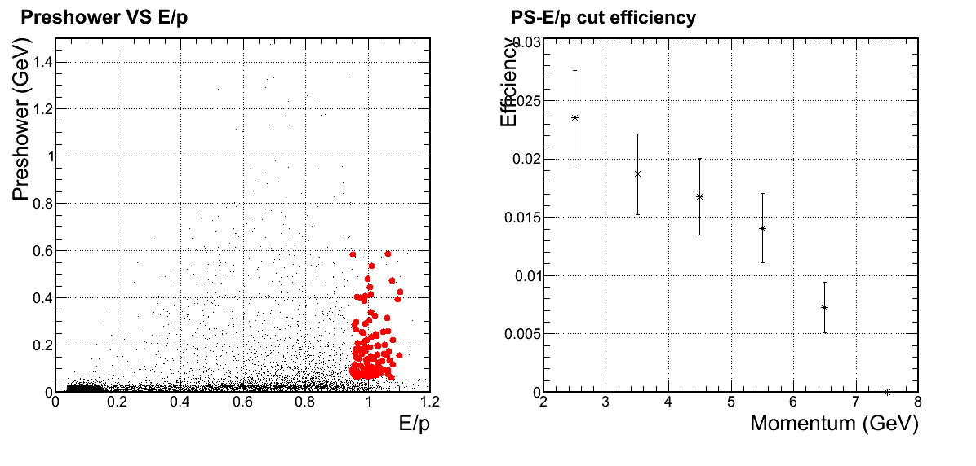
Preshower + shower rejection - not better than full Shashlik design
Electron
Pion

Slide 7
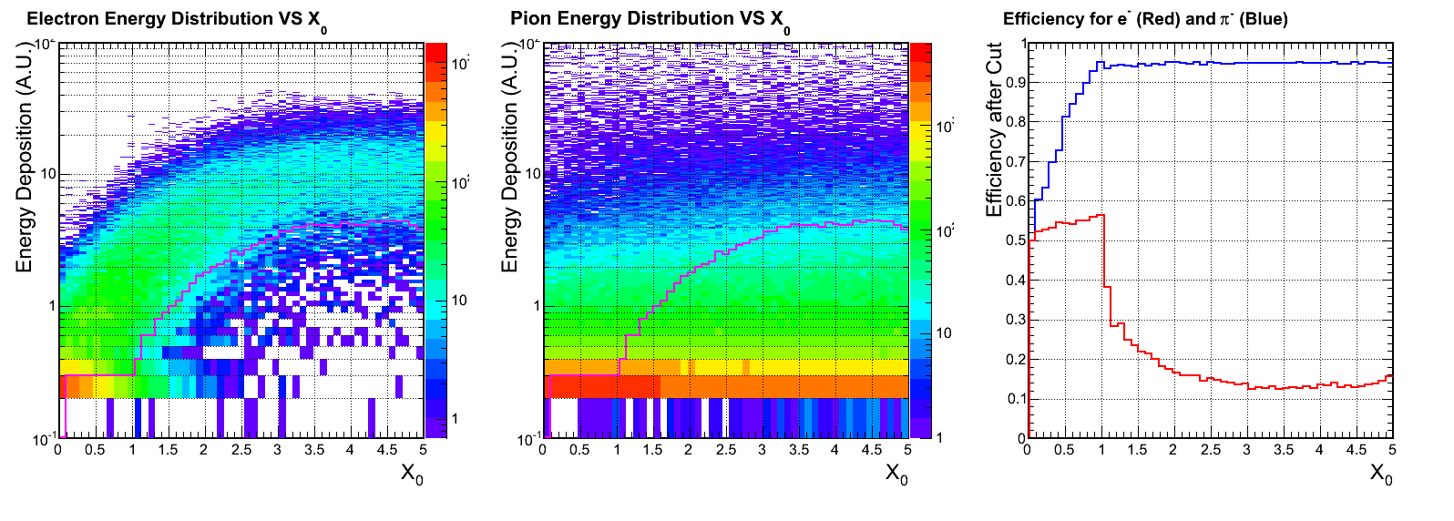
Other choice? Radiator thickness scan
Energy deposition in scintillator pad
No diff.
Give Another Try
Thickness of passive radiator
HERMES

Slide 8
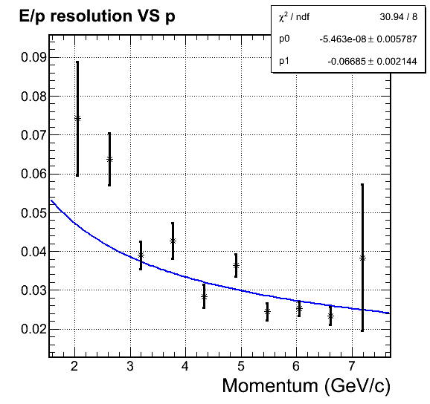
Give another try: radiator = 3 X₀ Lead
Resolution is significantly degraded with 3X₀ passive radiator
Significant contribution of 1/E term (~10%/E)

Slide 9
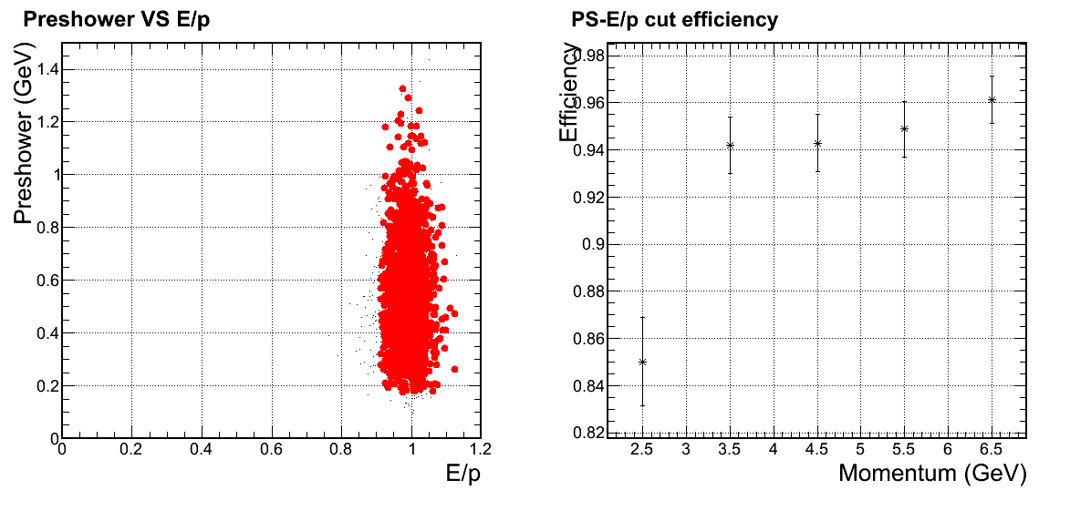
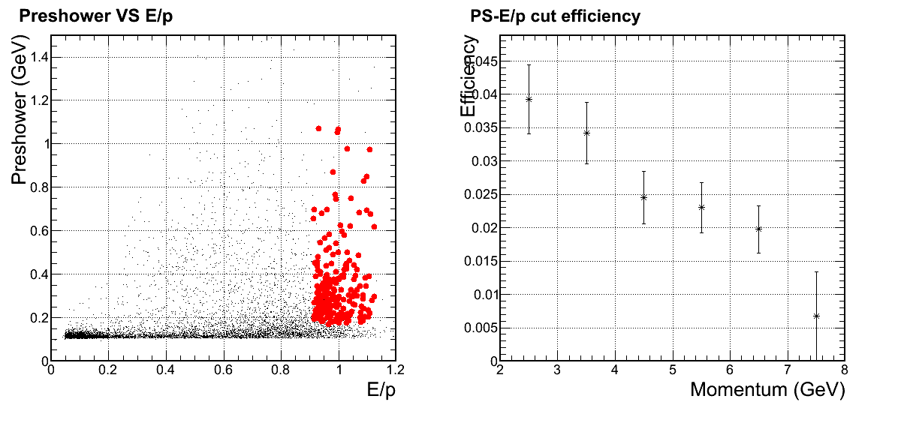
Preshower + shower rejection - worse than the HERMES design
Electron
Worse than before
Pion

Slide 10
Idea 2: Hadron detector at end of calorimeter

Slide 11
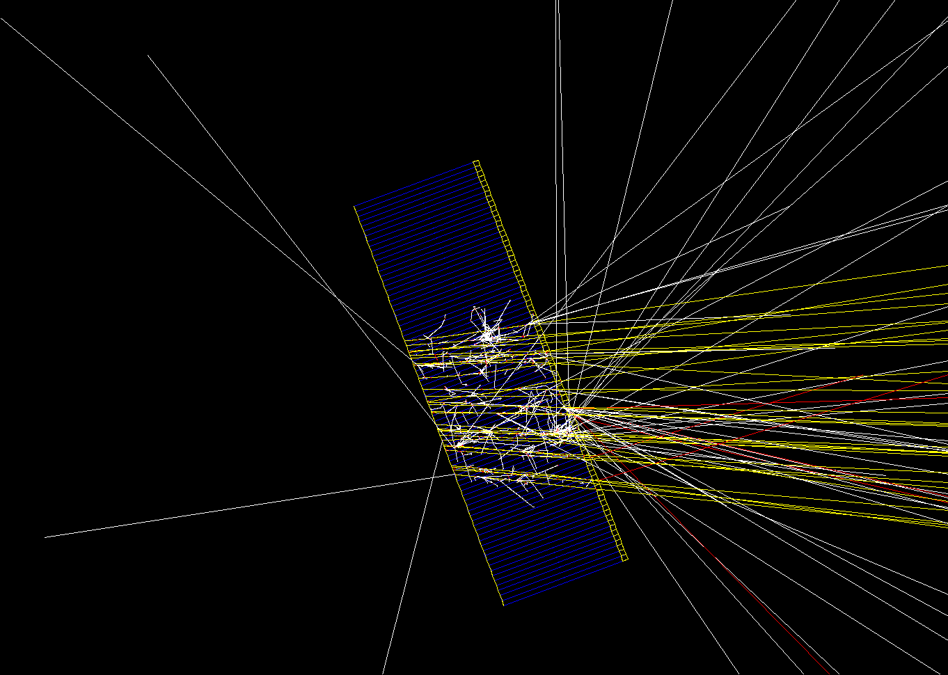
Setup indenting angle of 22º-27º simulated
2 cm of scintillator at the end of 20 X0 Shashlyk detector
Expect hadronic shower leak to this scintillator , while EM shower is fully absorbed
2 cm scintillator
100x Muon events shown

Slide 12
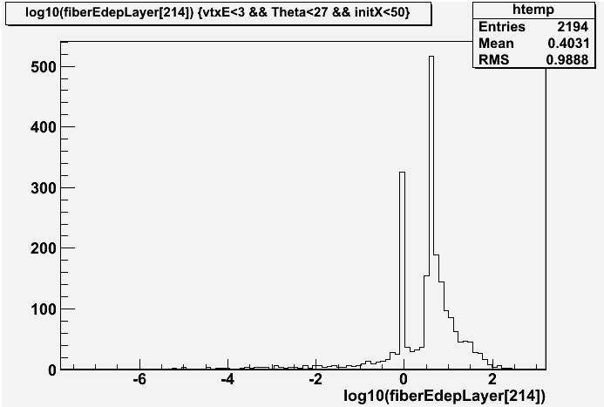
Turn out that low energy pion can not punch trough too …
1/3 lower energy pions do not reach this layer
Absorbed or track significantly deflected
<- MIP peak
No Deposition Energy ->
Log 10 of energy deposition

Slide 13
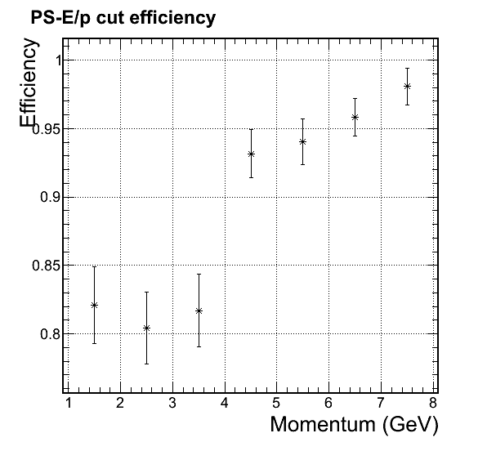
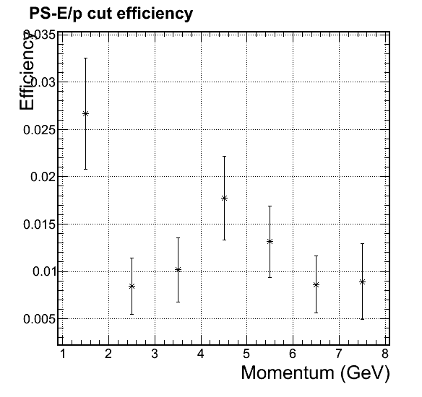
Conclusion
Can help reject some low energy hadron but left with ~80% electron efficiency
Electron
Pion
With cut
With cut

Slide 14
Idea 3: Lower efficiency to trade for rejection

Slide 15
The idea
Sacrifice efficiency to trade for pion rejection
The idea came from Ed
He concern that we quote too high efficiency which might degrade due to practical reasons (noise, background, …) and push us to the corner to archive high pion rejection too
He suggest that we lower efficiency to ~80%, which may be more realistic and make rejection easier
We probably want to do so for low-P region
Low-P region have larger cross section which can sacrifice some efficiency
Low-P region have larger pion/e ratio
Low-P region have smaller pion rejection

Slide 16
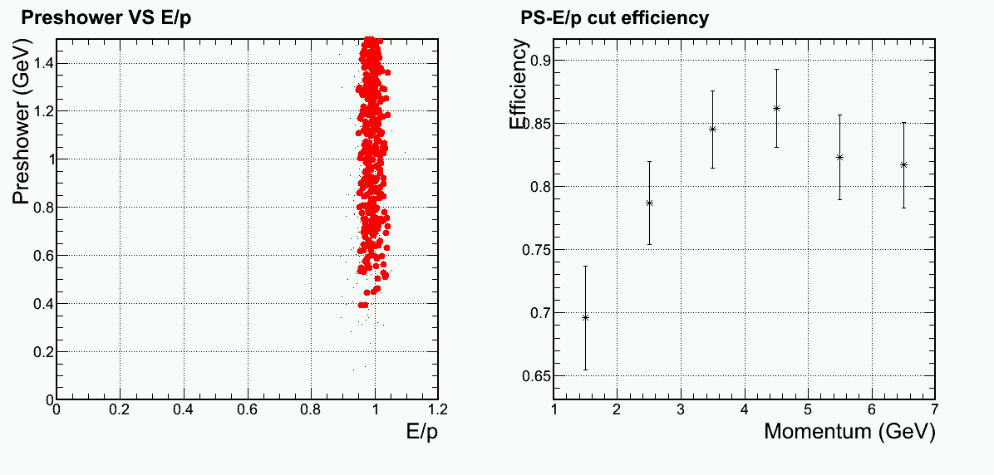
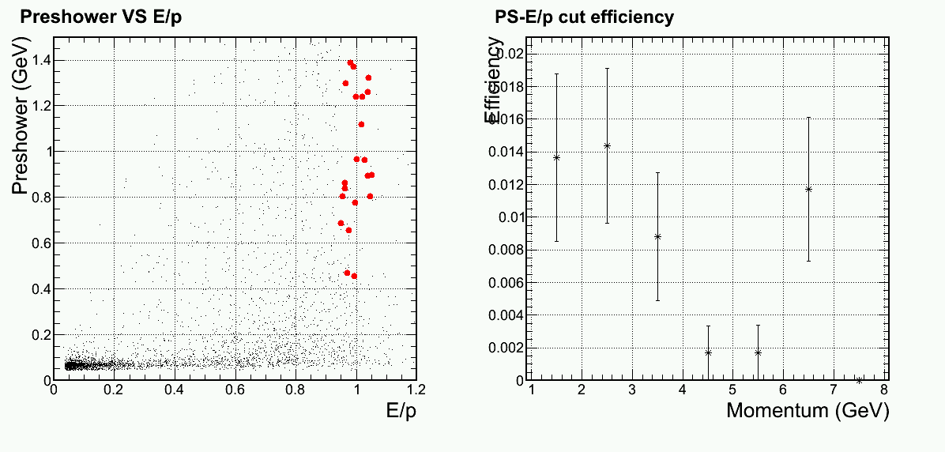
It is an effective way to enhance rejection
Electron
Pion

Slide 17
Idea 4: Try new Physics List

Slide 18
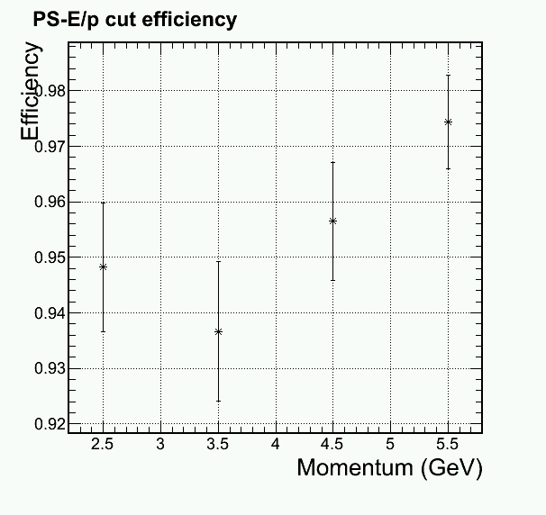
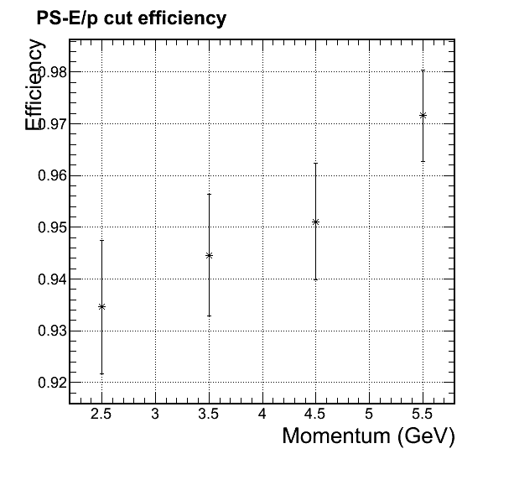
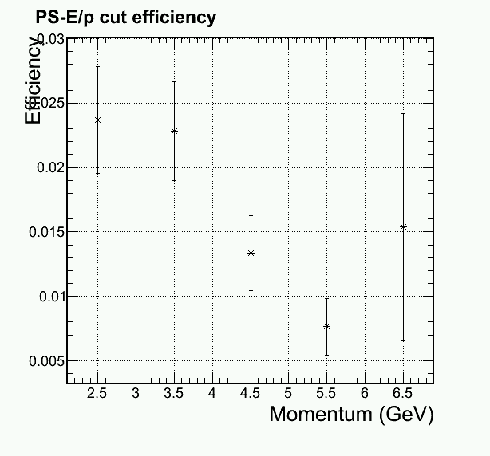
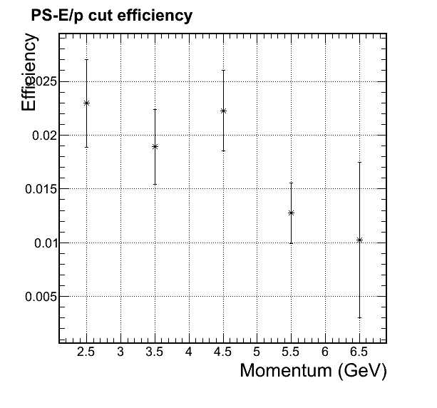
Physics List QGSP_BERT -> FTFP_BERT
QGSP_BERT
FTFP_BERT
Electron Eff
Electron Eff
1/Pion Rej.
1/Pion Rej.

