Slide 1
Update on Calorimeters
Jin Huang (LANL),
Mehdi Meziane (Duke), Paul Reimer (ANL),
Zhiwen Zhao (UVa), Xiaochao Zheng (UVa)
Nuclear Physics Group (William&Mary)

Slide 2
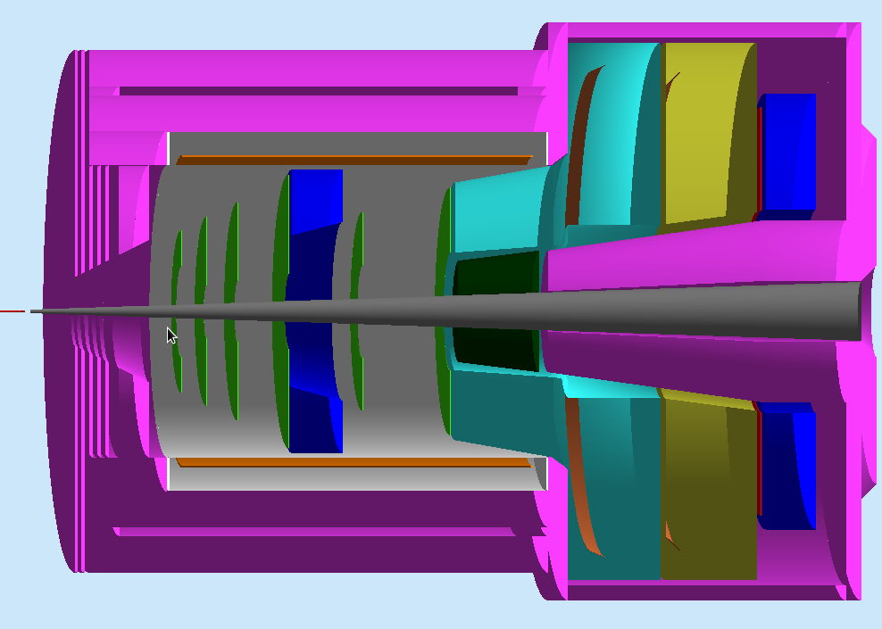
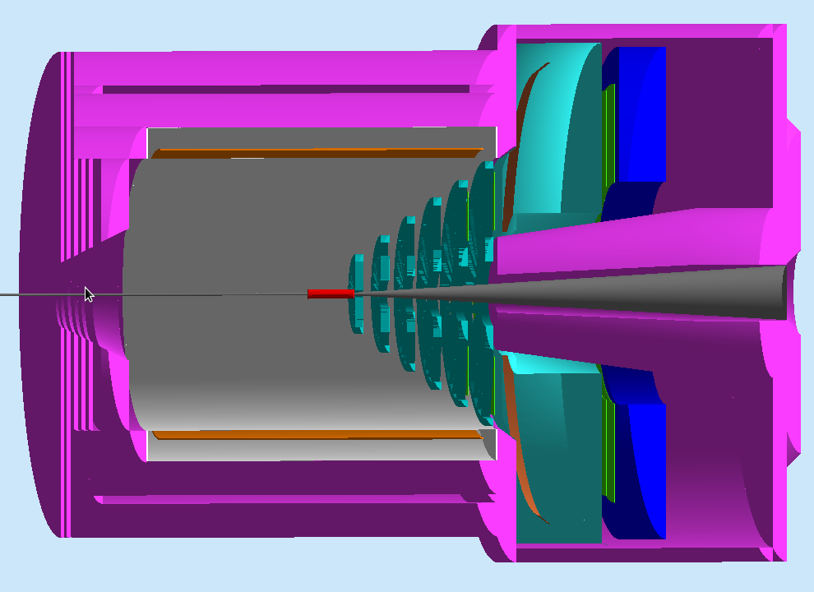
SoLID Calorimeter Overview
PVDIS forward angle
SIDIS forward angle
SIDIS large angle
SoLID EM Calorimeters | Polar Angle (degree) | P (GeV / c) | Max π / e | Cerenkov Coverage | Area (m²)
PVDIS Forward-Angle | 22 - 35 | 2.3 – 6 | ~ 200 | <3-4 GeV/c | ~17
SIDIS Forward-Angle | 8-15 | 1 -7 | ~ 200 | <4.7 GeV/c | ~11
SIDIS Large-Angle | 17-24 | 3 - 6 | ~20 | None | ~5

Slide 3
Summary of design
Based on COMPASS Shashlyk module design.
0.5 mm Pb/1.5 mm scintillator, 240 layers
48cm long (20 X0), 4X0 preshower, 16X0 shower.
  Balance between longitudinal size and pion rejection
  20:1 - 100:1 pion rejection with 95% electron efficiency (depending on momentum)
10x10 cm² square shape modules ← balance between cost and position resolution/background
100 WLS fibers per module (1 cm⁻²)
Total 1600(SIDIS) ~ 1700(PVDIS) modules
Fiber connection still being studied

Slide 4
Main comments received since last review
Design
  Ed: reduce the electron efficiency to improve hadron rejection
  Ed: explore scintillator pad at the end of calorimeter for hadron-rejection
  Paul S. & Zhiwen : passive-radiator preshower (HERMES-LHCb type)
Readout
  Ed: explore preshower readout options
    Wave length shifting pad readout
    Additional fiber group for readout
  Ed: evaluate the feasibility of using APD or other field insensitive photon-detector instead of fiber-connector option
Background –
comparing background simulation between GEANT4 & FLUKA
Budget - improved budget required

Slide 5
Design Updates
Ed: Reduce the electron efficiency to improve hadron rejection

Slide 6
The idea
Sacrifice efficiency to trade for pion rejection
  The idea came from Ed
  He concerns that we quote too high efficiency which might degrade due to practical reasons (noise, background, …) and push us to the corner to achieve high pion rejection too
  He suggests that we lower efficiency to ~80%, which may be more realistic and make rejection easier
We probably want to do so for low-P region
  Low-P region has larger cross section which can sacrifice some efficiency
  Low-P region has larger pion/e ratio
  Low-P region has smaller pion rejection

Slide 7
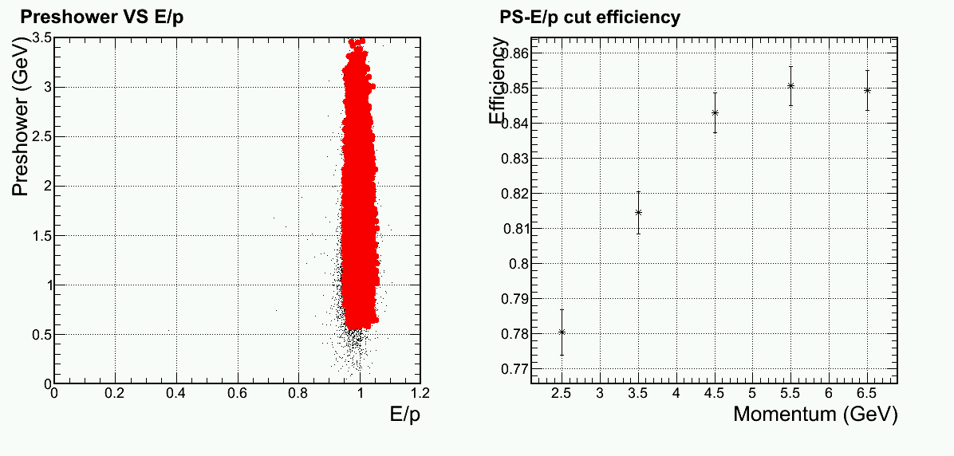
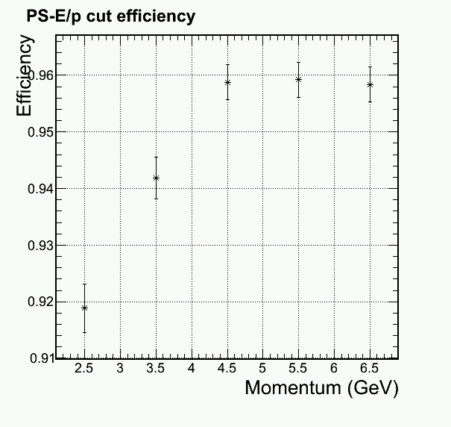
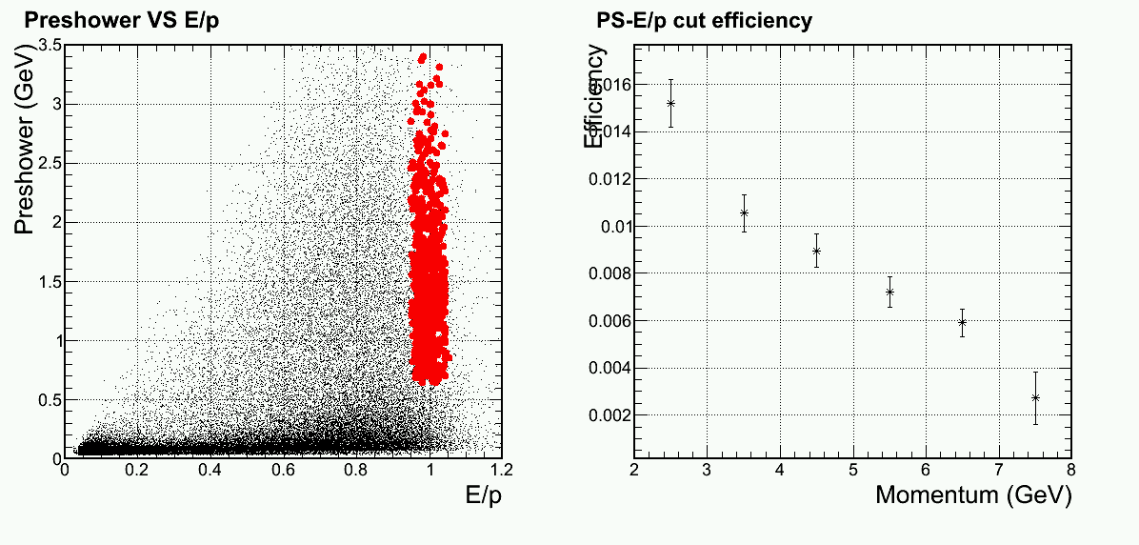
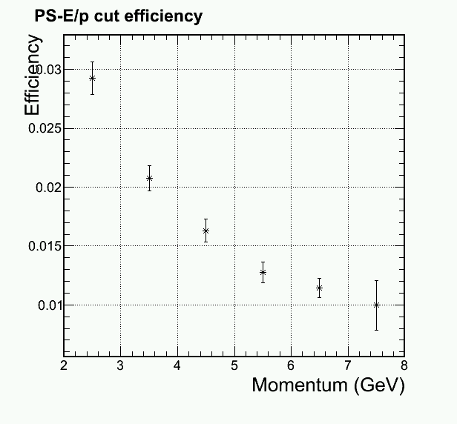
It is an effective way to enhance rejection
Electron
(Default)
Electron
95% cut
Electron
80% cut
(Default)
Pion
Pion
Pion
Notes:
Better slides on cuts

Slide 8
Design Updates
Ed: explore scintillator pad at the end of calorimeter for hadron-rejection

Slide 9
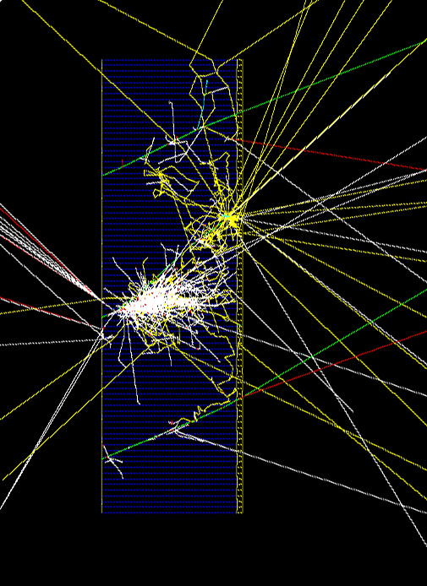
The idea
2 cm of scintillator at the end of 20 X0 Shashlyk detector
Expect hadronic shower to leak to this scintillator , while EM shower is fully absorbed
Indenting angle of 22º-27º simulated
2 cm scintillator
Three 3GeV pion track shown
Notes:
Pion in plot

Slide 10
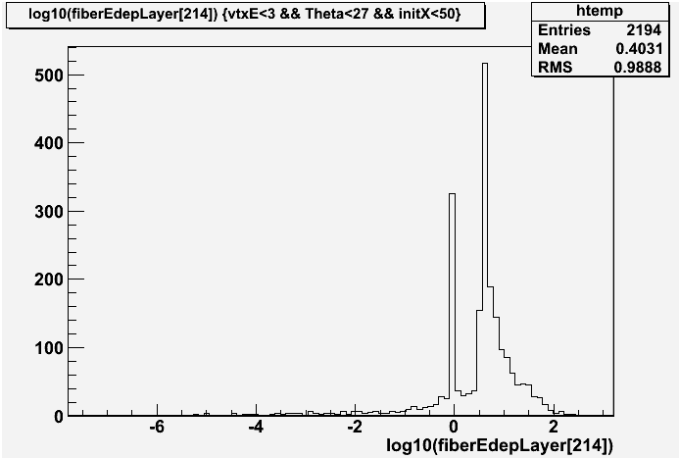
Turn out that low energy pion can not punch through too …
1/3 lower energy pions do not reach this layer
  Absorbed or track significantly deflected
<- MIP
peak
No Deposition Energy ->
Log 10 of energy deposition

Slide 11
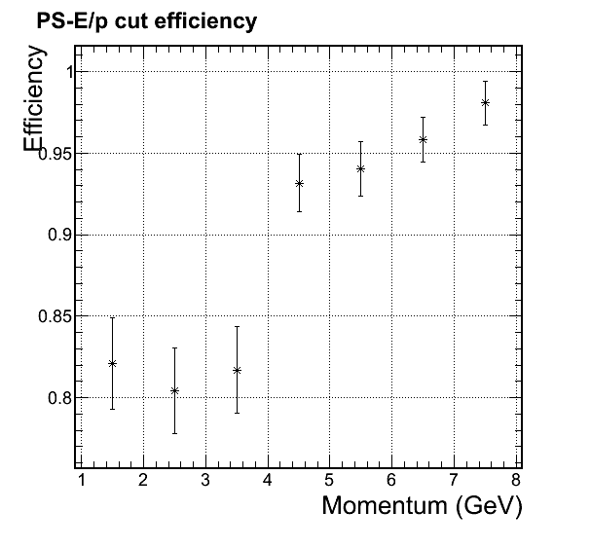
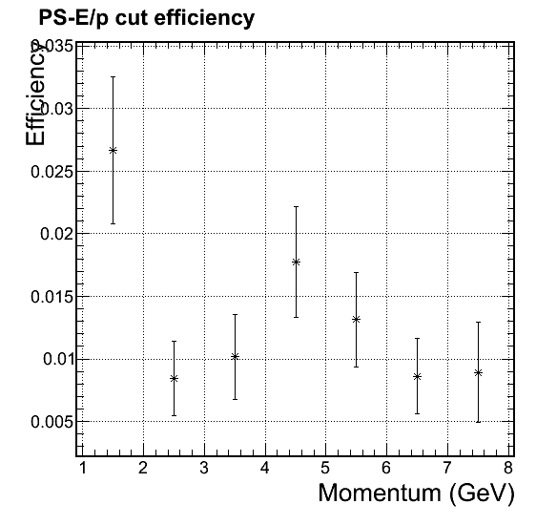
Try to use this pad to help pion rejection at lower energy (p < 4 GeV)
Can help reject some low energy hadron but left with ~80% electron efficiency
Similar improvement in pion rejection can be achived with lower the threshold, but this mothod go through trouble of hardware construction.
Not suitable for SoLID.
With cut
With cut
Pion
Electron

Slide 12
Design Updates
Paul S. & Zhiwen : passive radiator preshower (HERMES-LHCb type)

Slide 13
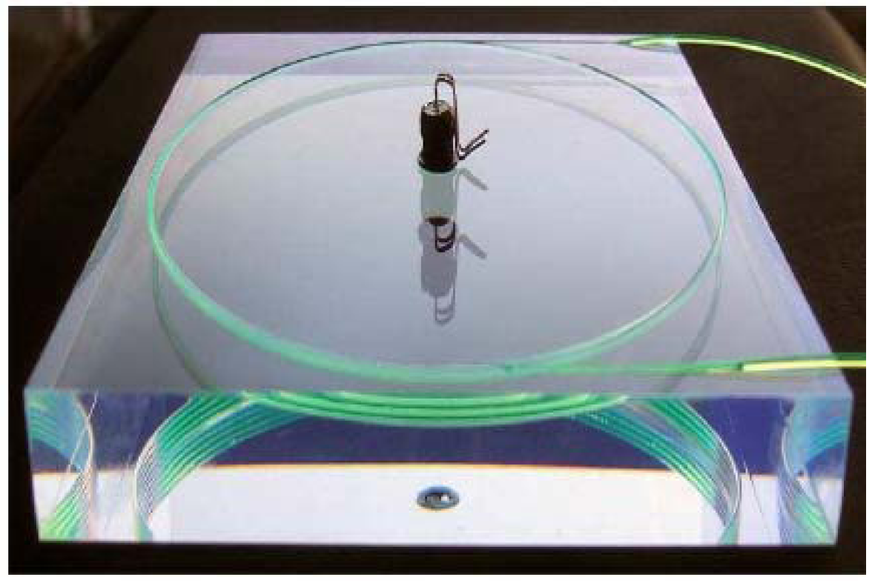
Testing a new preshower configuration
Passive-radiation and Scintillator-Pad
Preshower has 1 layer of 2X₀ lead as passive radiator and
1 layer of scintillator with embedded WLS fiber for readout
Preshower WLS fibers
Shower, 20-2 X_{0,} Shashlik
Shower WLS fibers
Preshower (2X₀ lead + scintillator)
Used by LHCb and Hermes
Good hadron rejection
Simple design with no change to Shashlyk module prodution
Preshower work as radiation shielding
Reduce number of fiber significantly for readout in preshower

Slide 14
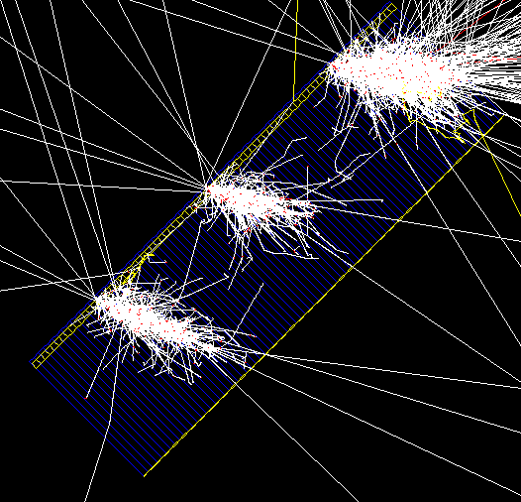
Simulation studies
A 2-radiation length thick Pb plate and 2 cm thick scintillator plate were added to the default Shashlik calorimeter (1.5 mm scint + 0.5 mm Pb per layer)
Shashlik calorimeters have a single readout, serve as shower detector
Shower length = (20 – 2) X0 with 1.5mm Scint – 0.5mm Pb sandwiches
1/Sqrt(E) energy resolution : ΔE/E ~5%/√ (E)
compared with pure shashlik conf. with 4%/√ (E)
Electron Events
on PVDIS EM Cal
2 X0 Lead
(HERMES - LHCb)
2 cm scintillator

Slide 15
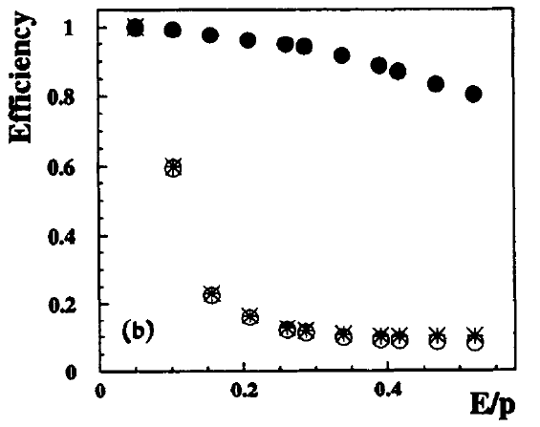
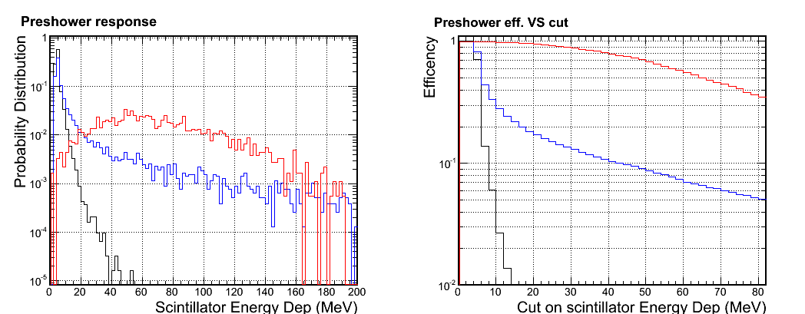
Preshower response
HERMES NIM 1996
●Electron
○Pion
*Pion/Electron
Preshower alone, cut eff.
~15% (pion) VS ~95% (electron)
Similar performance for Shashlik preshower
Legend : Electron; Pion; Muon
E/p cut
Also: momentum dependent cut shows slightly worse-performance than Shashlik preshower

Slide 16
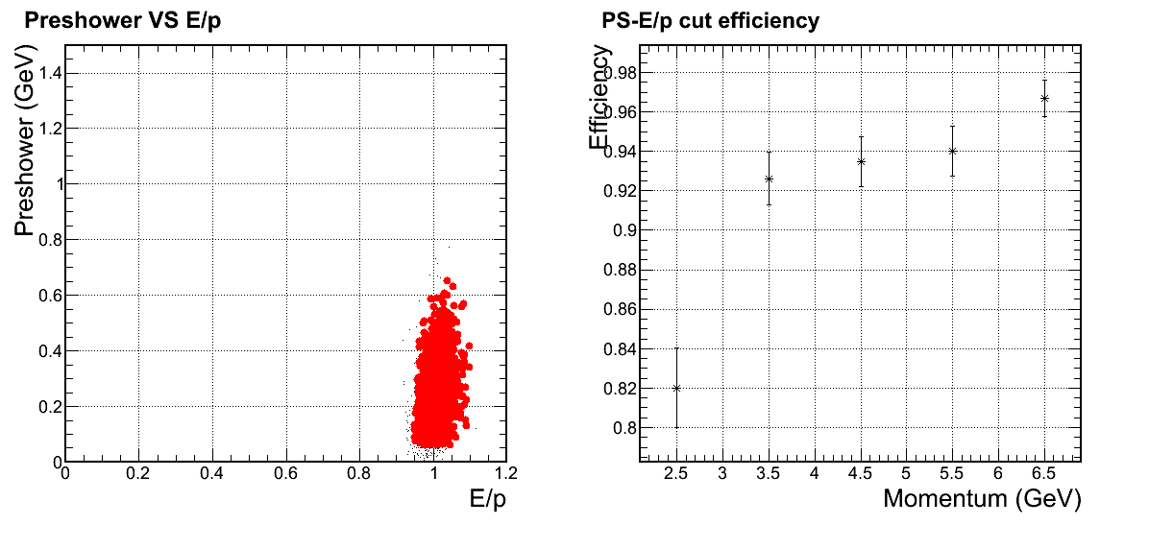
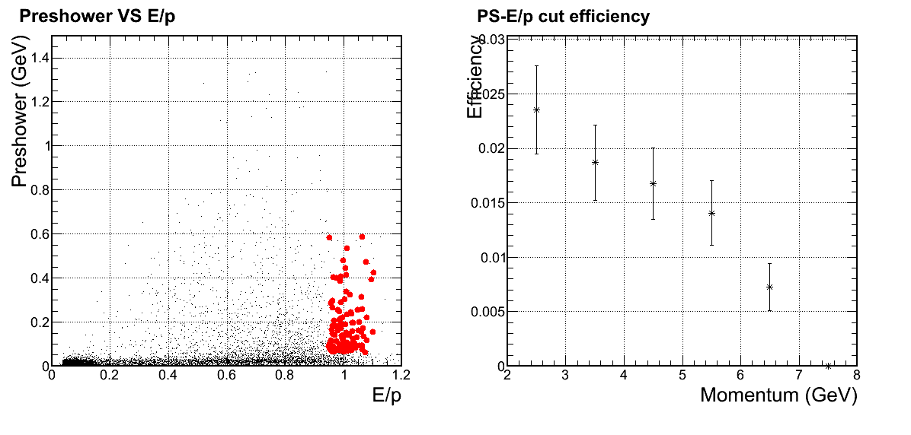
Preshower + shower rejection
- not better but close-to full Shashlik design
Electron
Pion

Slide 17
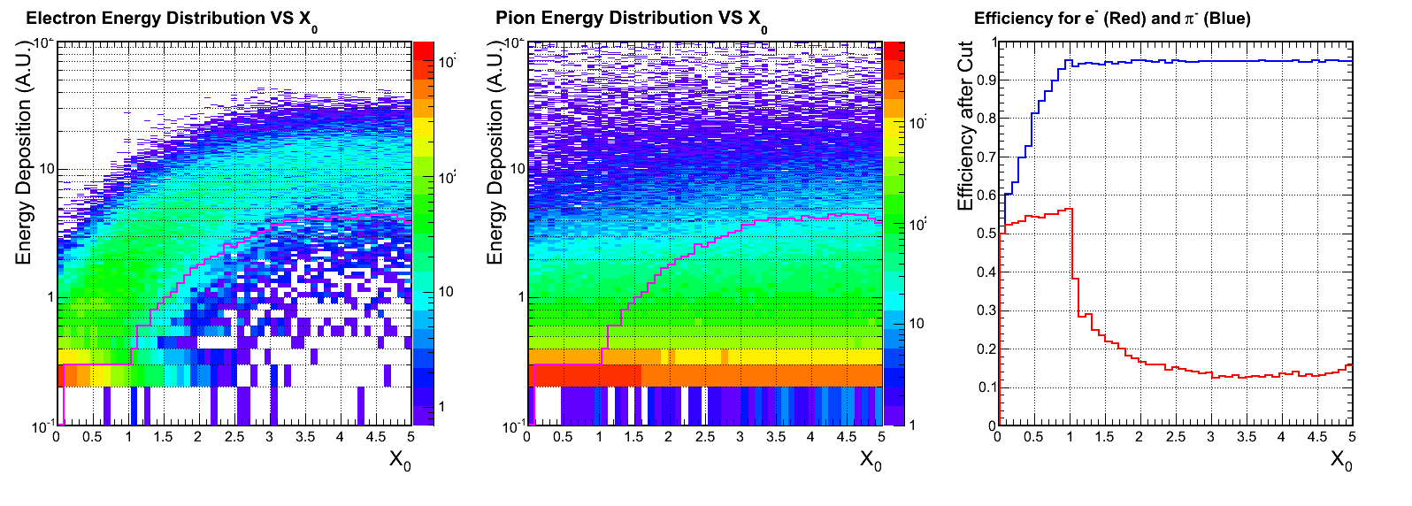
Other choice? Radiator thickness scan
Energy deposition in scintillator pad
Red : Pion Eff.
Blue: Electron Eff.
cut
cut
Cut on MIP Peak
95% e
Thickness of passive radiator
HERMES
Give Another Try

Slide 18
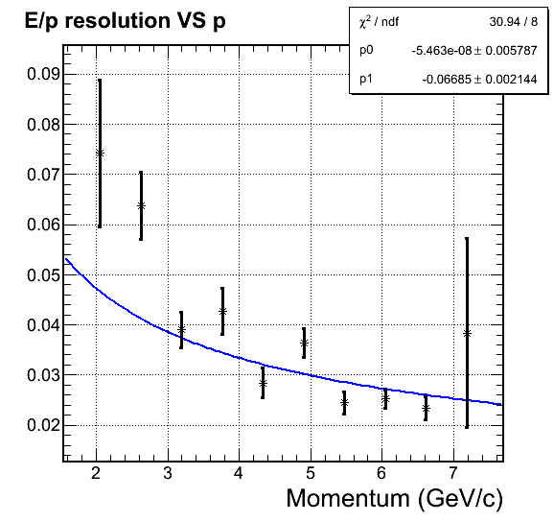
Give another try: radiator = 3 X₀ Lead
Resolution is significantly degraded with 3X₀ passive radiator
Significant contribution of 1/E term (~10%/E)

Slide 19
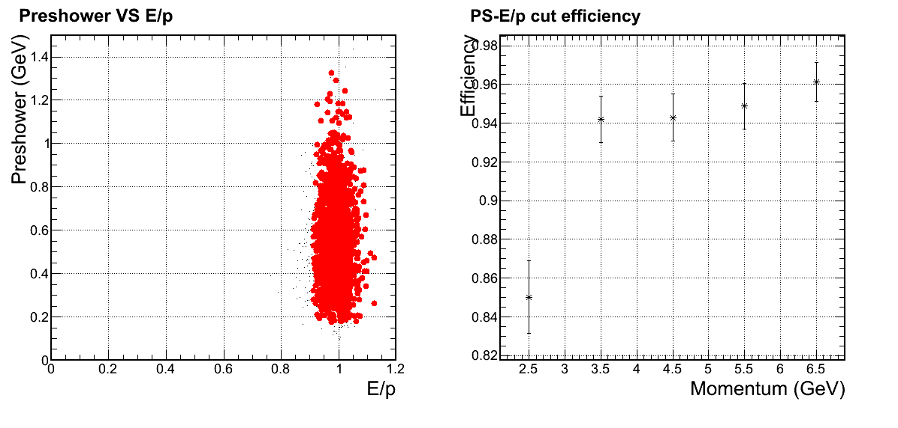
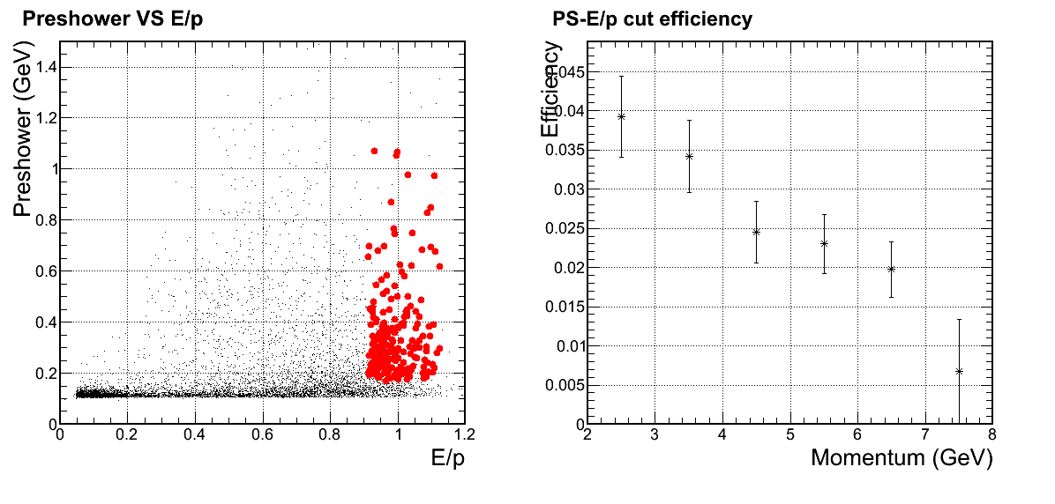
Preshower (3X₀) + shower rejection
- worse than the HERMES design
Electron
Worse than before
Pion

Slide 20
Conclusion - passive radiator preshower
Do not provide improved performance than our default design (Shashlik calorimeter)
However, considering its advantage in construction and readout, makes this option is attractive
2X₀ passive radiator as used in HERMES and LHCb is still suitable for SoLID

Slide 21
Readout Updates
Ed: explore preshower readout options
Wave length shifting pad readout
Additional fiber group for readout

Slide 22
Pad readout
Preshower has thin WLS plate for readout and use embedded clear fibers to send signal at back. Shower has WLS for readout.
Preshower Clear fibers
Preshower
Shower
Shower WLS fibers
WLS plate
WLS plates are available and have been used in other calorimeters.
Problem, the 1.5mm thickness of scintillation layers won’t allow enough lights to be collected by pad on the side.
--> Light cannot go beyond ~few cm

Slide 23
Readout Updates
Ed: evaluate the feasibility of using APD or other field insensitive photon-detector instead of fiber-connector option

Slide 24
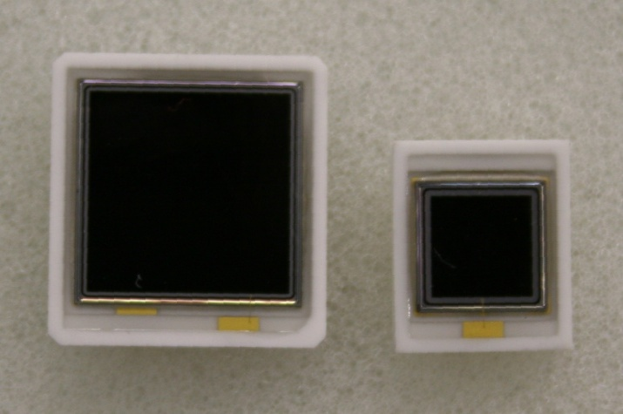
Field Insensitive photon-detector
APD
  Pro: not sensitive to field, large QE
  Con: radiation sensitive, low gain 50-1000, bias V sensitive, noise
SiPM
  Pro: not sensitive to field
  Con: radiation sensitive (much worse than APD), bias V sensitive, noise
VPT (Vacuum Phototriode)
  Pro: radiation hard, high rate capability, not very sensitive to field within certain angle
  Con: low gain 10-40
Finemesh PMT
  Pro: not very sensitive to field within certain angle
  Con: expensive ($1600?)
All are being investigated
APD
PANDA
CMS
10x10mm²
5x5mm²

Slide 25
Current progress
Study of field Insensitive photon-detector is still ongoing.
  In contact with Hamamatsu
Ongoing study of fiber and connectors
  Waiting for quotes from Moritex and Avantes for
  light concentrating lenses/ optical connectors
  Waiting for quotes from Leoni fibers for multi-furcated fibers option.
  Received quotes from Saint Gobain and Kuraray.
Evaluating other ideas from Ed on improving preshower readouts

Slide 26
Budget
Improved budget required

Slide 27
Cost estimate
- default Shashlyk design
Number of Module: 1700
Number of clear fibers per module: 10
Number of fiber connectors per module: 10
cost not included
  Supporting structure Robin included in magnet budget
  DAQ Alex included in DAQ budget
 | Per-module cost($) | Total cost($M)
Module material | 500 | 0.85
Module production | 1000 | 1.7
Clear fibers | 240 | 0.41
Fiber connector | 120 | 0.2
PMT | 600 x 2 | 2.0
Labor | 5 Tech year 5 Student year | 0.75
TOTAL |  | ~ 5.9
TOTAL + 30% contingency |  | ~ 7.7
Cost for R&D prototyping : $0.2M
Notes:
Repeat of Xiaochao’s slides
Backup slides for backup readout options
Cones only unknown

Slide 28
Conclusion
Design
  Ed: reduce the electron efficiency to improve hadron rejection
  Very effective to improve rejection
  Ed: explore scintillator pad at the end of calorimeter for hadron-rejection
  Pad’s information is correlated with shower, not much help
  Paul S. & Zhiwen : passive-radiator preshower (HERMES-LHCb type)
  Useful in simplifying the construction
Readout
  Ed: explore preshower readout options
    Wave length shifting pad readout - Do not work for scintillator
    Additional fiber group for readout - May work, under investigation
  Ed: evaluate the feasibility of using field insensitive photon-detector
  - under investigation
Background – Solved, see Lorenzo’s talk
Budget - Updated

Slide 29
Backup Slides

Slide 30
More details on cuts

Slide 31
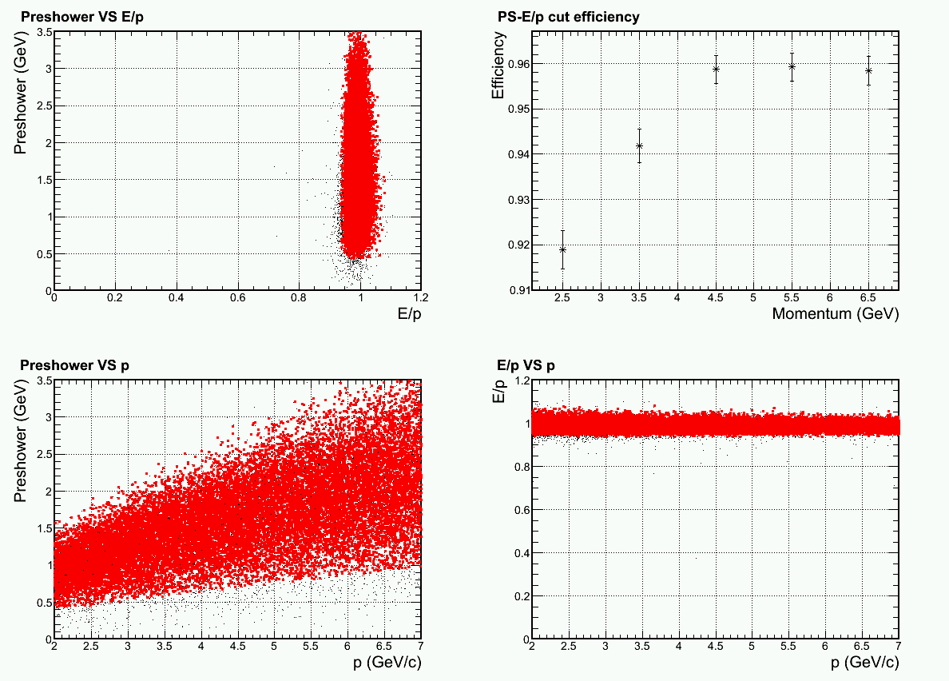
3-D cuts Electron (~95% eff. cut)

Slide 32
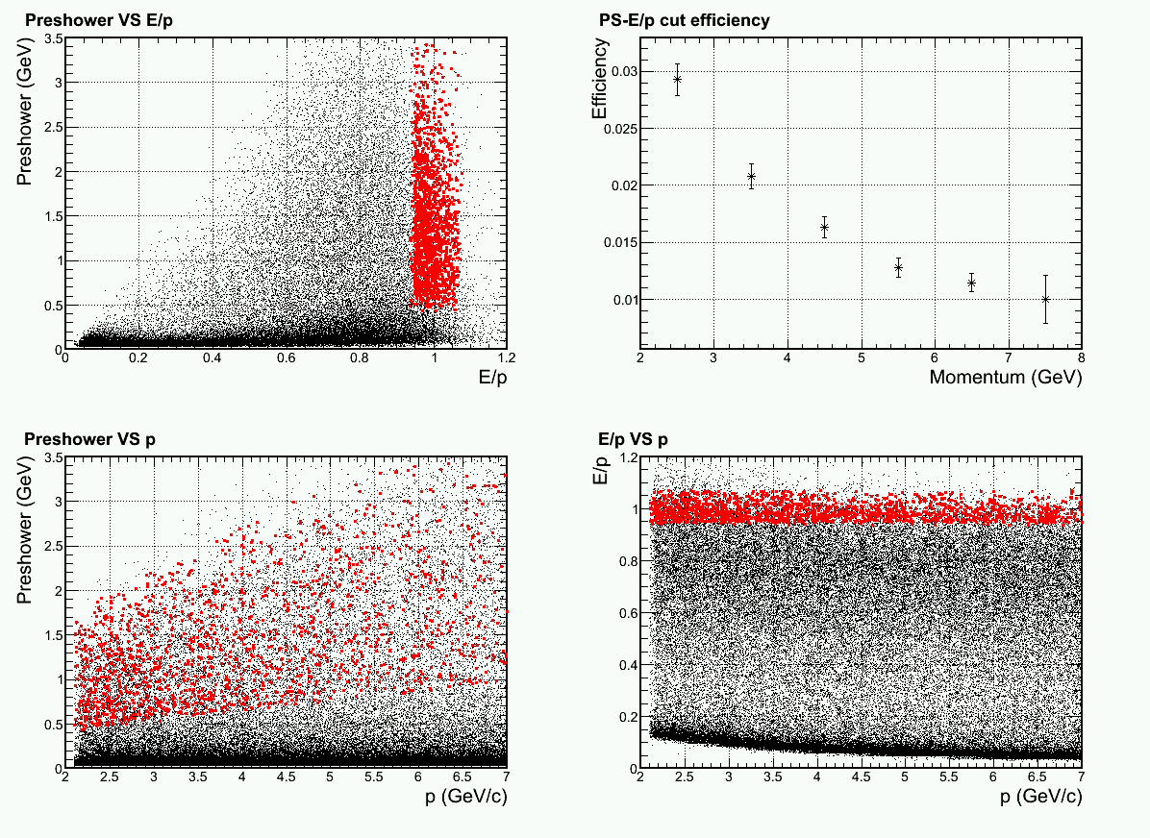
3-D cuts Pions (~95% electron eff. cut)

Slide 33
High statistics
Electron
Electron
Electron
80% cut
Pion
Pion
Pion
Notes:
Better slides on cuts

Slide 34
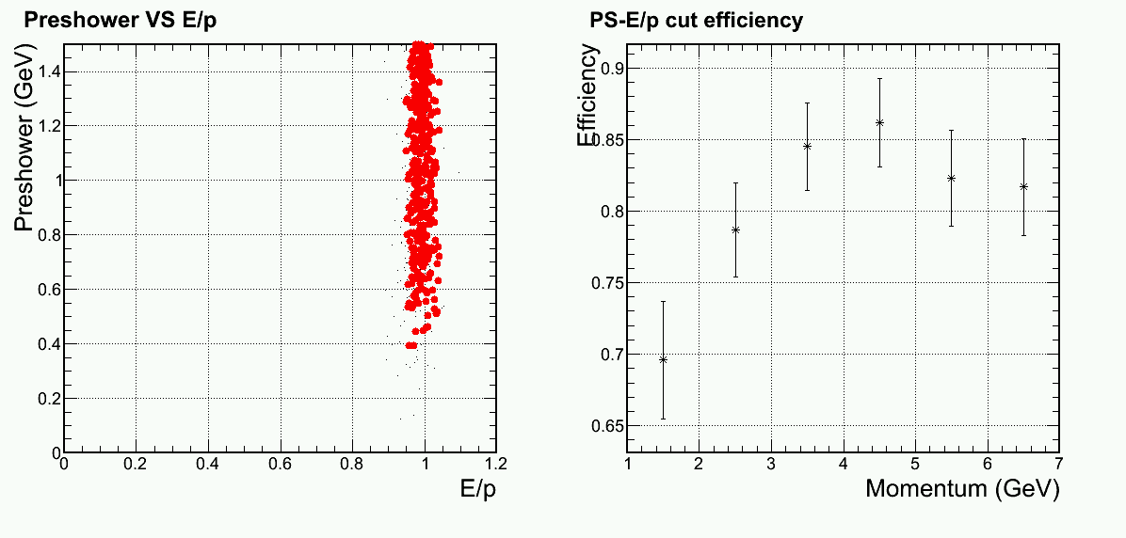
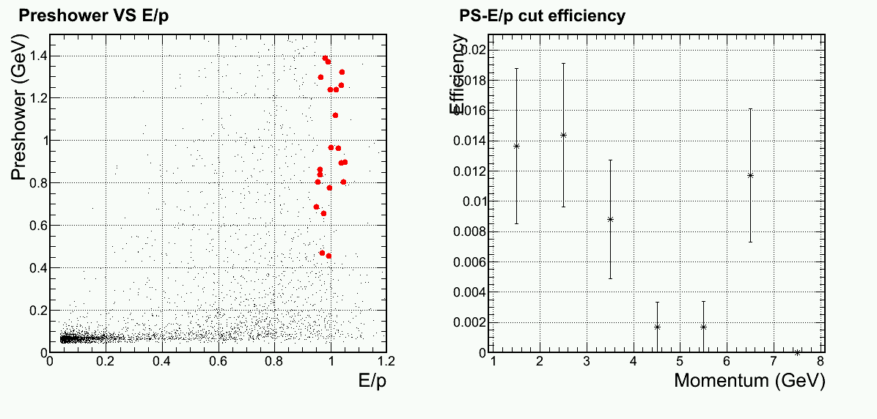
Same cut / What if lower statistics
Electron
Pion
Notes:
Better slides on cuts

Slide 35
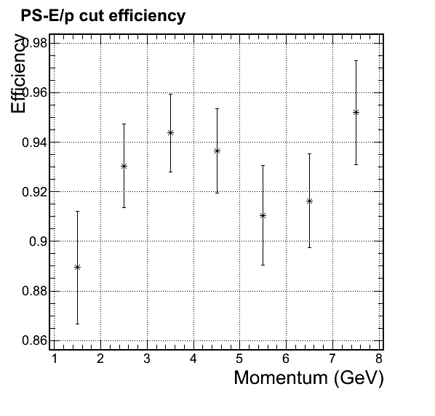
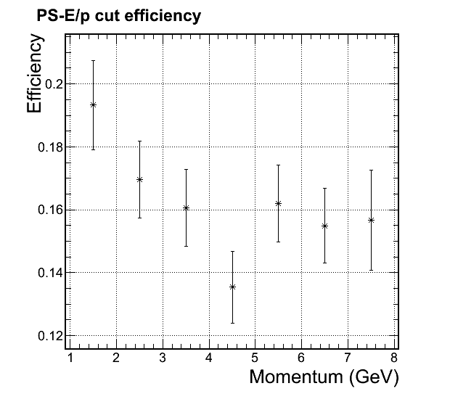
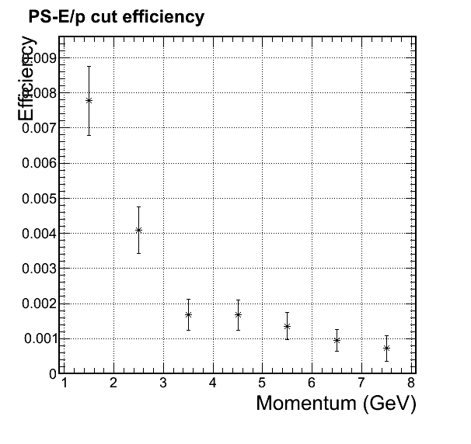
Momentum dependent cuts and eff.
Preshower cut only
Shown in last meeting, which is consistent level compared with Shashlyk preshower
Electron
Pion
Muon

Slide 36
SoLID EC cost estimate
Module total $2.55M
  Number of module 1700 (SIDIS large angle 450, SIDIS forward angle 1150, PVDIS forward angle 1700)
  Module cost $1500 (30% material, 70% production)
Readout option 1 (clear fiber and common PMT) total $2.31M ???
  Clear fiber total $0.41M, cone total $0.2M???
    Each module has 100 WLS fibers to 10 2mmD clear fibers with factor 2.5 reduction winston cone
    2mmD unit cost $4/m (saint-gobain), $10/m(Kuraray)
    average 3 meters on both preshower and shower
  PMT total $1.7M???
    Unit price 500
Readout option 2 (field insensitive photonsensor) total $5.5M???
  finemeshPMT unit cost $1600, total $5.5M ???
  Vacuum Phototriode (VPT) unit cost ???
  APD unit cost ???
Labor total $0.75M???
  5 technician years (100k/year) + 5 student years (50k/year)
Total cost with readout option 1: 5.6M , after 30% contingency $7.3M ???
Total cost with readout option 2: 8.8M , after 30% contingency $11.5M ???
Cost for R&D prototyping : $0.2M ???
cost not included
  Supporting structure Robin gives total 0.5M estimated for all detector support, included in magnet budget
  DAQ Alex included in DAQ budget

Slide 37
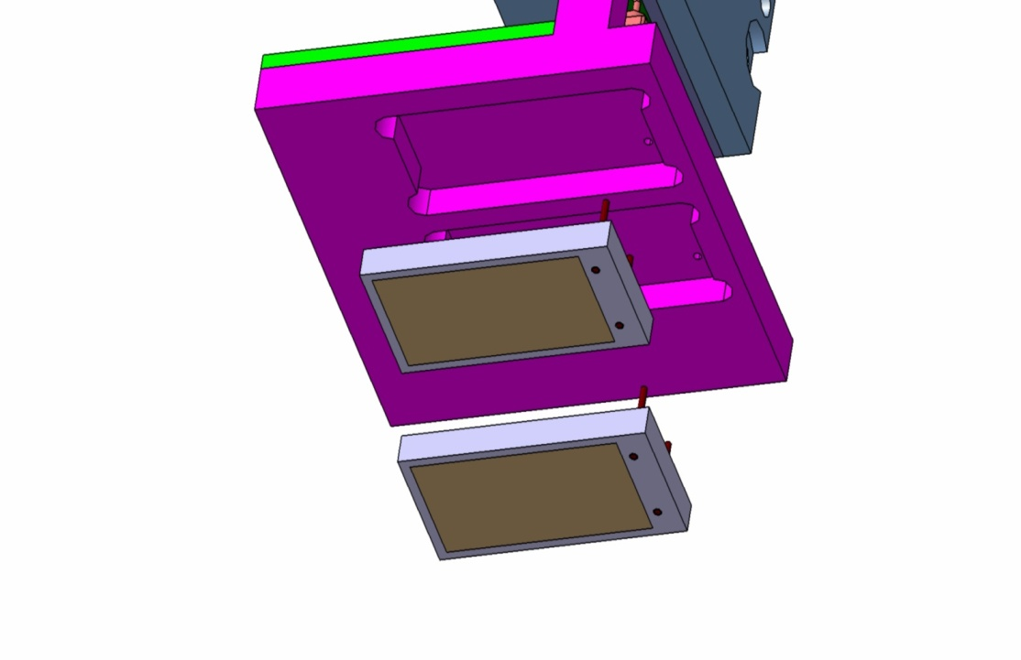
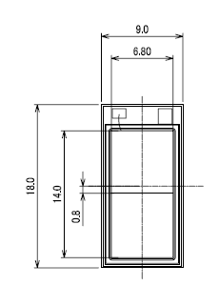
Panda APD
in collaboration with Hamamatsu Photonics
CMS
excellent performance
at RT and T = –25ºC
radiation resistent
up to 10¹³ protons
in particular at T = -25ºC
new
10x10mm²
5x5mm²
final concept: 2 LAAPDs/crystal,
separately readout
dimensions
7 x 14 mm²

Slide 38
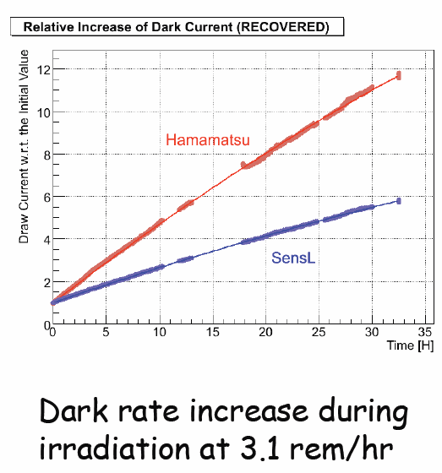
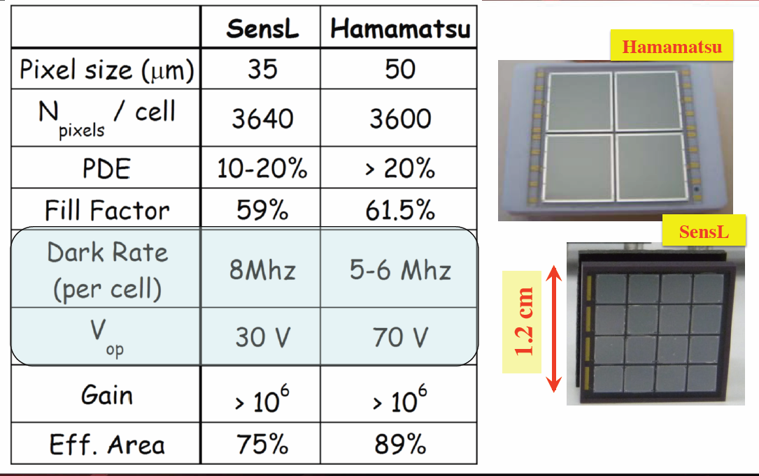
HallD BCAL SiPM
Dark rate increase by factor of 10
for 10e9 eq 1MeV neutron

Slide 39
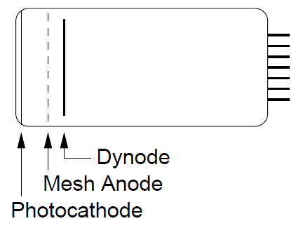
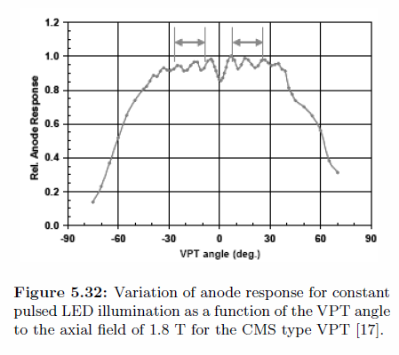
VPT
Field insensitive within 30 degree at 1.8T
Preamiplifier needs to be close to VPT
RIE St. Petersburg, Russia
  Tetrode (photo cathode, 2 dynodes, anode)
  G = 24 – 45
  QE = 14 – 20%

Slide 40
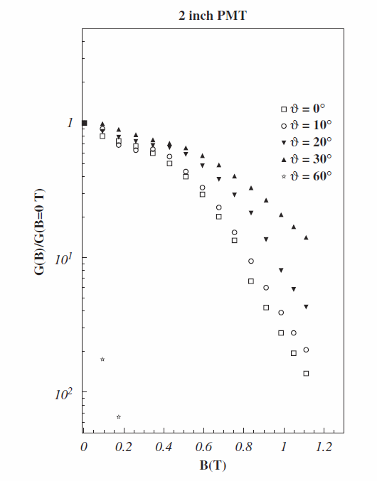
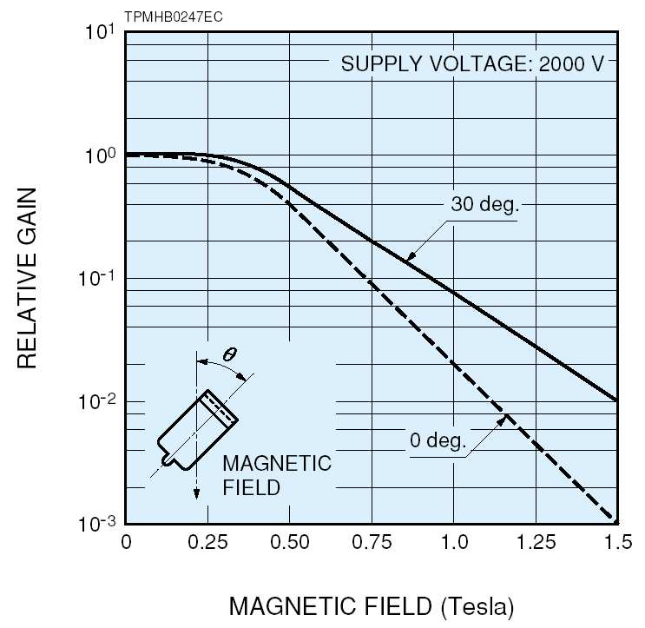
Finemesh PMT
Has closely spaced mesh dynodes
Need to be around 30 degree to work with 1.5T

Slide 41
Readout Updates
Generic updates

Slide 42
Generic Updates
Waiting for quotes from Moritex and Avantes for
light concentrating lenses/ optical connectors
Waiting for quotes from Leoni fibers for multi-furcated fibers option.
Received quotes from Saint Gobain and Kuraray.
Notes:
Add to budget slides

Slide 43
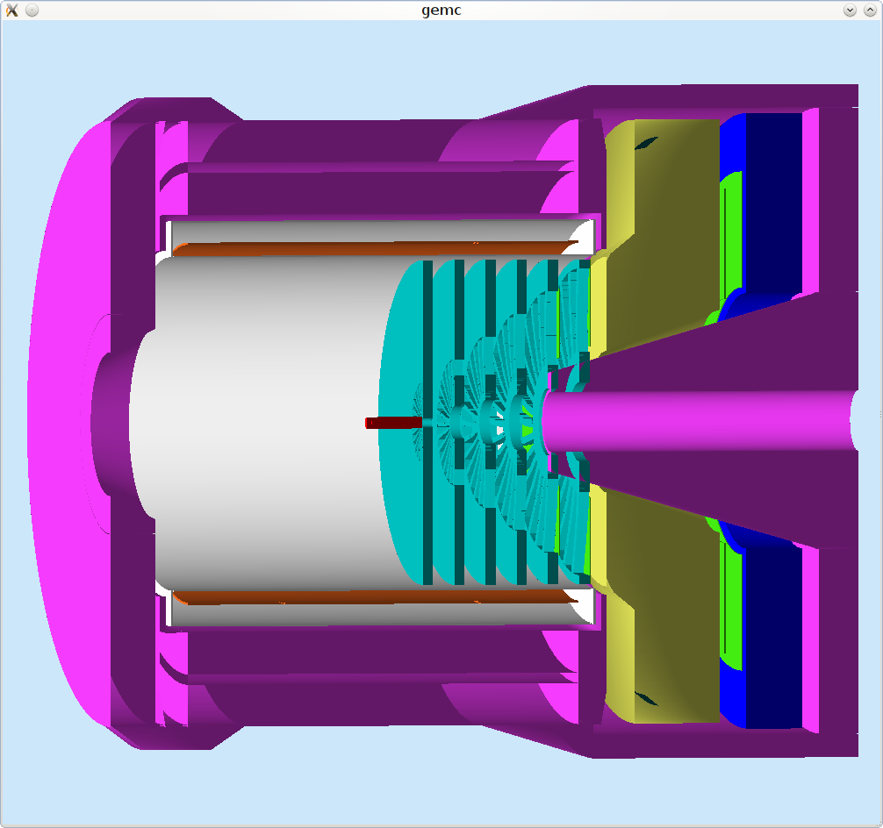
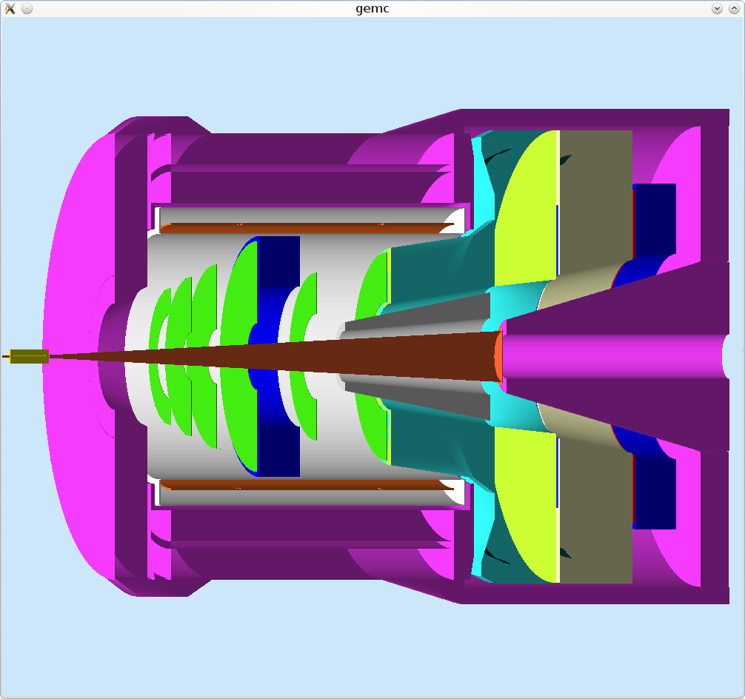
SoLID EC configuration
Provide key e/p separation, modules shared between PVDIS & SIDIS
PVDIS
SIDIS
Large angle
Calorimeter
Gas
Cherenkov
Heavy Gas
Cherenkov
Coil
Coil
Baffles
GEMs
Target
GEMs
Target
Light Gas
Cherenkov
GEMs
Yoke
Yoke
Forward
Calorimeter
Calorimeter

Slide 44
EC Design Requirements
Electron- hadron separation:
  20:1 - 100:1 pion rejection within p= 1 – 7GeV/c
  Energy resolution:
Time response: provide trigger, identify beam bunch for PID through coincidence TOF (SIDIS only);
  σ <~ a few hundreds ps (CEBAF beam bunch ~2ns)
Provide shower position to help tracking/suppress background
σ ~ 1 cm
Radiation resistance: 5x10⁵ rad for one PAC year
Magnetic field 1.5 T for SIDIS large angle EC: Silicon based photon-sensors (field-resistant) can’t survive high neutron environment and expensive; PMTs work but need to be away from high magnetic field.
Modules easily swapped and rearranged for PVDIS ↔ SIDIS
SIDIS needs 2-fold rotation (180º) symmetry

Slide 46
Choosing EC Type
PVDIS and SIDIS radiation level (~400 krad per year) is too high for leadglass and CSI-like crystals (typically 1krad).
Our ECs are large: Forward angle EC (10m²x0.4m depth), Large angle EC (5m²x0.4m), or PVDIS EC (20m²x0.4m) → Total 6-8m³
Crystals like PbWO₄ ($10/cc) and LSO ($40/cc) can stand 10⁶ rad, but too expensive: Total ~3m³→ $30M or $120M .
Both Shashlyk or SPACAL/SciFi (0.5-1Mrad) have enough radiation hardness and good energy, position and time resolution.
SciFi vs. Shashlyk:
SciFi needs about half volume being scintillation fibers to reach good energy resolution, 1mm-diameter fibers cost $1/m: Total 6m³ → $4M for fiber alone.
Compare to Shashlyk: total module cost from <$3M from IHEP.
Two orders of magnitude fibers than Shashlyk, hard to read out.
46

Slide 47
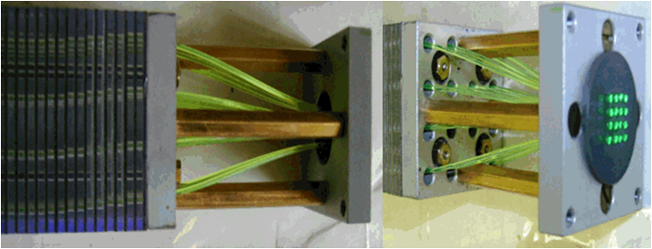
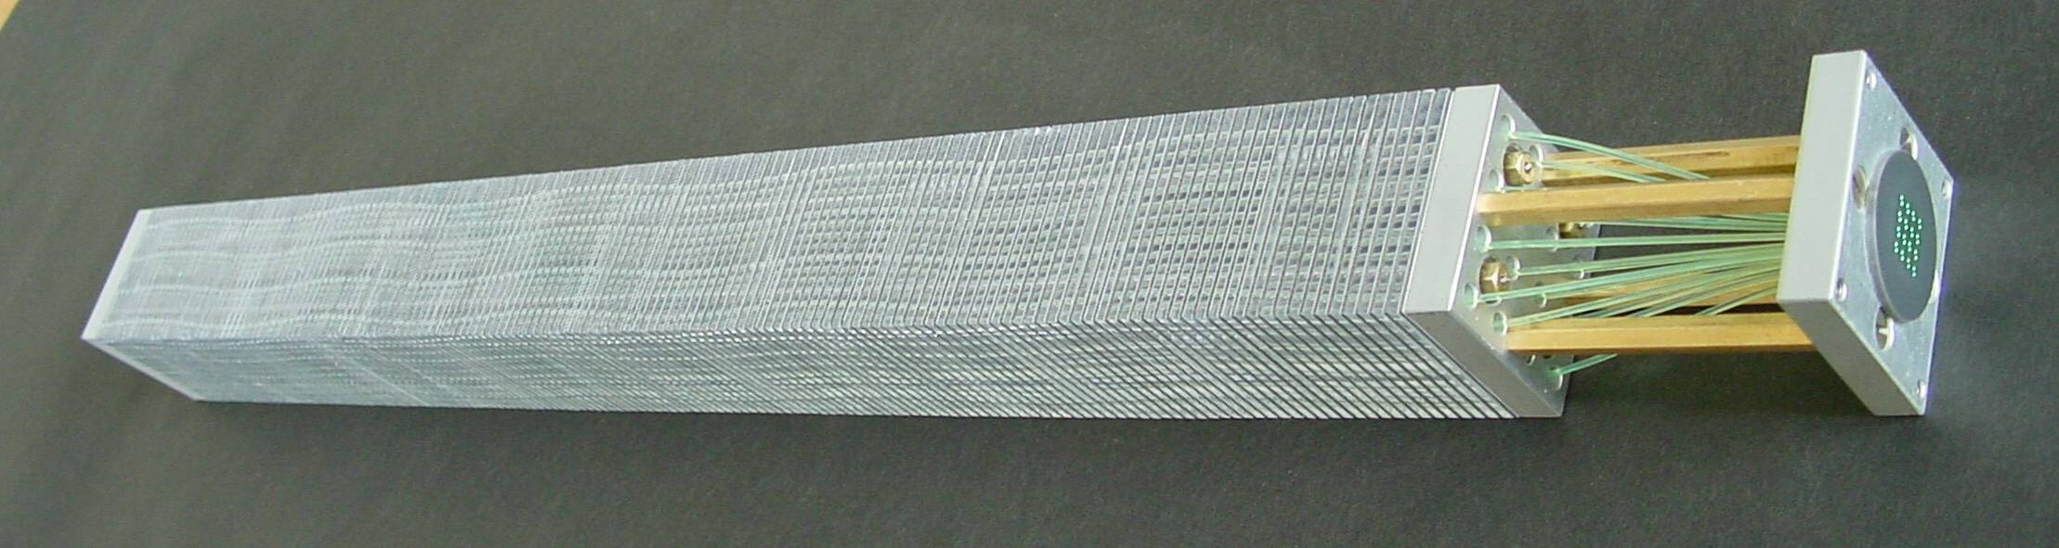
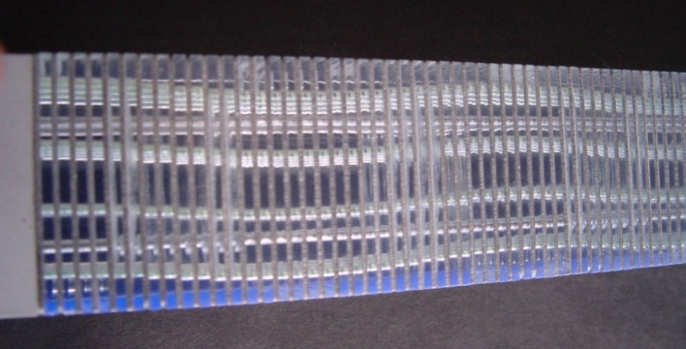
Shashlyk EC
IHEP, COMPASS Shashlik, 2010
Lead-scintillator sampling calorimeter
WLS fibers [1/(9.5mm)²] collect and guide out light → one PMT per module.
Good and tunable energy resolution
Radiation hardness: ~ 500 krad tested by IHEP
transverse size can be customized
Light collection and readout straightforward
Well developed technology, used by many experiments, IHEP production rate about 200/month

Slide 48
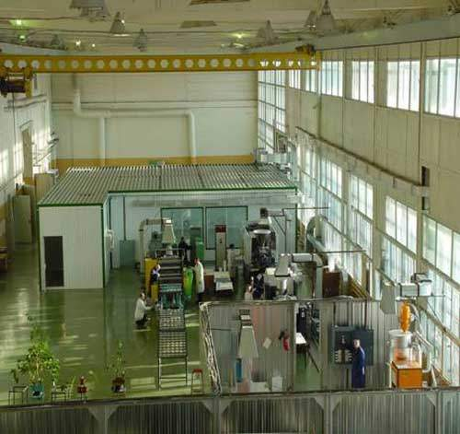
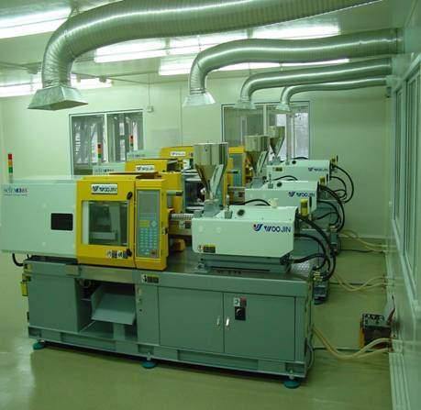
IHEP Scintillator Facilities
www.ihep.ru/scint/index-e.htm
48

Slide 49
Design Consideration 1: Pb/scintillator ratio
Thinner Pb layers give better energy resolution, but requires more layers → Balancing between energy resolution and module length

Slide 50
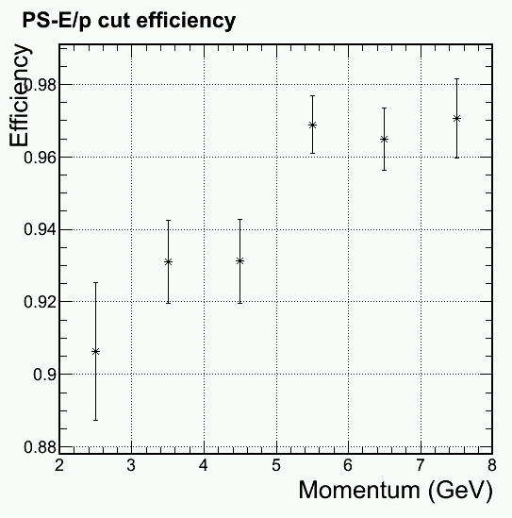
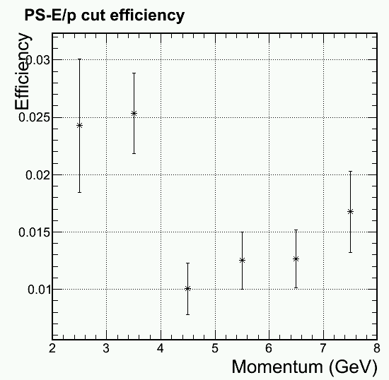
Design Consideration 1: Pb/scintillator ratio
  Minimize scintillator ratio while reaching 100:1 pion rejection → 0.5mm Pb/1.5 mm Scint. (BASF143E) per layer.
Electron Efficiency
1/(Pion rejection)
0.98
0.96
0.94
0.92
0.90
0.88
0.03
0.02
0.01
1/50 Rejection
95%
Preliminary Simulation with (4+16)X₀
2 3 4 5 6 7 8
2 3 4 5 6 7 8
p (GeV)
p (GeV)
SIDIS large angle: p=3~6 GeV

Slide 51
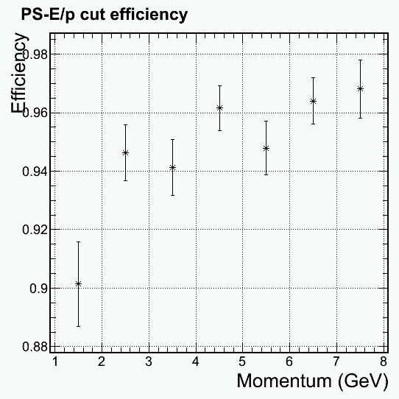
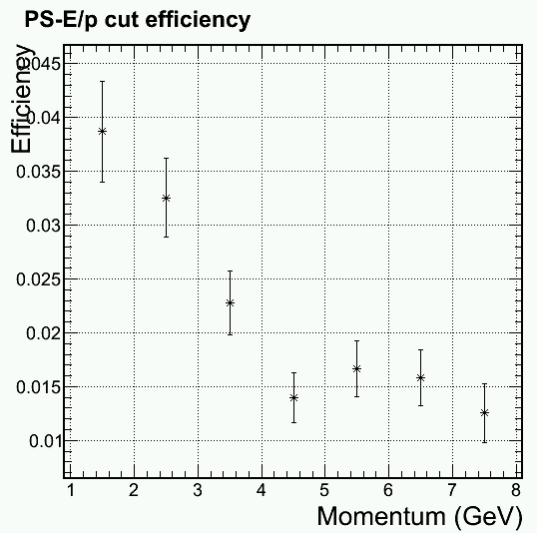
Design Consideration 1: Pb/scintillator ratio
  Minimize scintillator ratio while reaching 100:1 pion rejection → 0.5mm Pb/1.5 mm Scint. (BASF143E) per layer.
Electron Efficiency
1/(Pion rejection)
0.98
0.96
0.94
0.92
0.90
0.88
0.04
0.03
0.02
0.01
95%
Preliminary Simulation with (4+16)X₀
1/50 Rejection
1 2 3 4 5 6 7 8
1 2 3 4 5 6 7 8
p (GeV)
p (GeV)
SIDIS forward angle: p=1~7 GeV

Slide 52
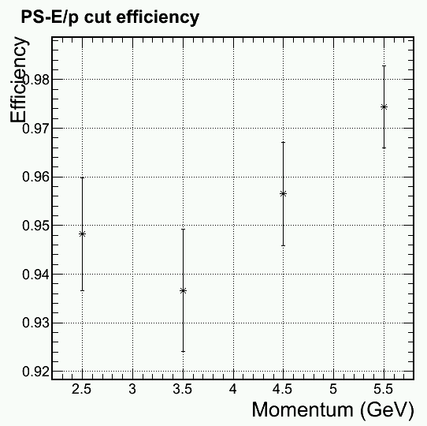
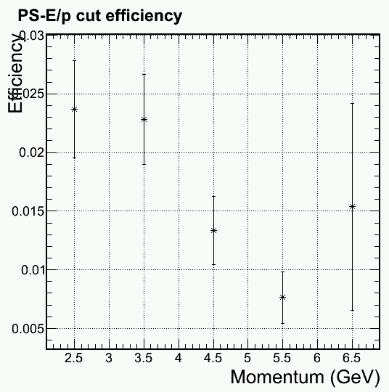
Design Consideration 1: Pb/scintillator ratio
  Minimize scintillator ratio while reaching 100:1 pion rejection → 0.5mm Pb/1.5 mm Scint. (BASF143E) per layer.
Electron Efficiency
1/(Pion rejection)
0.98
0.97
0.96
0.95
0.94
0.93
0.92
0.025
0.020
0.015
0.010
0.005
1/50 Rejection
95%
Preliminary Simulation with (4+16)X₀
2.5 3 3.5 4 4.5 5 5.5
3 4 5 6
p (GeV)
p (GeV)
PVDIS (forward angle): p=2.3~6 GeV

Slide 53
Design Consideration 2.0: Preshower/Shower
Preshower and shower have separate WLS readout in the current design:
Preshower
Shower
WLS

Slide 54
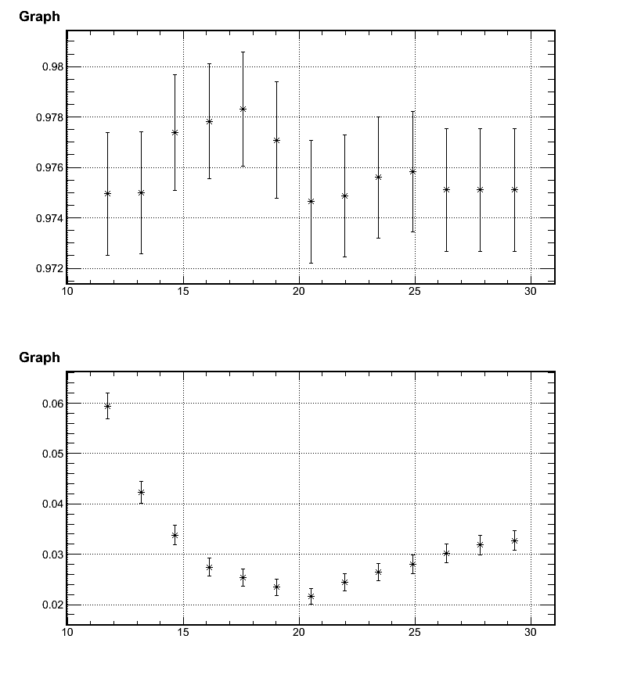
Design Consideration 2.1: Total Length
0.98
0.978
0.976
0.974
0.972
Electron Efficiency
Reach Best rejection at ~20X₀
10 15 20 25 30
0.06
0.05
0.04
0.03
0.02
Total Rad Length
1/(Pion rejection)
Can not contain EM shower
More hadron shower
10 15 20 25 30

Slide 55

Design Consideration 2.2: Preshower Length
0.98
0.96
0.94
0.92
0.90
Electron Efficiency
Reach Best rejection at ~4-6X₀
1 2 3 4 5 6 7 8
0.04
0.03
0.02
0.01
0.00
Preshower Rad Length
1/(Pion rejection)
P<4GeV
4GeV<P<8GeV
P>8GeV
1 2 3 4 5 6 7 8

Slide 56

Design Consideration 3: Lateral Size
4.0
3.5
3.0
2.5
2.0
1.5
1.0
0.5
0.0
w/ 50ns ADC gate
Background (%)
Good Balance
Resolution(cm)
Preliminary
module
+readout
cost ($M)
0 5 10 15 20 25
block size (cm)

Slide 57

Design Consideration 4: Edge Effect
PVDIS physics requires the largest incident angle (35º from target center, 37º from downstream target); Calorimeter covers up to ~40º.
1.0
0.8
0.6
0.4
0.2
0.0
P<4GeV
4GeV<P<8GeV
P>8GeV
Physics Need
EC coverage
30 32 34 36 38 40 42 44 46 48 50
electron incident angle (º)
95% contain at 37º
Fractional electron energy deposit

Slide 58

Design Consideration 5: Radiation Dose
Low E photon dominant
10⁴
10³
10²
Total
Electron
Photon
Pi+
Pi-
Preliminary
1 10 100
layer number
Can be shielded with 2mm Pb; Effect on energy resolution ~0.1%/sqrt(E) worse, no obvious effect on pion rejection (EM shower not yet developed in the first few layers)
Radiation dose (rad) per PAC month

Slide 59
Design Consideration 6: Fibers & Connectors
Fibers:
Wave Length Shifting fibers: KURARAY Y11
  Radiation hardness: 13% light loss at 0.1Mrad, 30% light loss at 0.7Mrad (manageable with scintillator BASF143E)
  Attenuation length ~3m, okay for PVDIS or SIDIS forward angle, but not for SIDIS large angle
  Difference between PVDIS and SIDIS large angle complicates re-arrangement.
  Clear Fibers (3-5m from SIDIS large angle to readouts): KURARAY, clear PS, Super Eska;

Slide 60


Design Consideration 6: Fibers & Connectors
Fiber connector options:
One to one WLS/clear fiber connector: used in previous experiments (LHCb, Minos,…), light loss studies and design well documented, but costly and must run 2x50000 fibers to readouts for SIDIS large angle alone;
128-fiber connector LHCb
Lucite rod would reduce the cost, but rigid and no information on light loss.
Winstone cone concentrator from Fermi Lab (~20 fibers to f3-mm, read out by 9 clear fibers): need 5000 cones + clear fibers (SIDIS large angle alone); larger clear fibers?
Searching for other fiber bundle to bundle connection.

Slide 61



Design Consideration 7: Shape & Layout
Prefer Square
easy assembly
mature production
easier rearrangement

Slide 62
Cost Estimation
Total ~ $5M
+ clear fiber
Based on module $1500EA, PMT~$500EA;
Table not including clear fibers and connectors, and DAQ.

Slide 63
Overview of Current Design
Based on COMPASS Shashlyk module design.
0.5mm Pb/1.5mm scintillator, 240 layers
48cm long (20 X₀), 4X₀ preshower, 16X₀ shower.
Balance between longitudinal size and pion rejection
20:1 - 100:1 pion rejection with 95% electron efficiency (depending on momentum)
10x10cm² square shape modules ← balance between cost and position resolution/background
100 WLS fibers per module (1/cm², KURARAY Y11)
Total 1500(SIDIS) ~ 2000(PVDIS) modules
Fiber connection still being studied

Slide 64
Summary
EC is the key detector for electron-hadron separation in SoLID.
The challenges:
  reach good pion rejection
  operate in high radiation environment
  and strong magnetic field.
Preliminary design is on-going.
We will collaborate with IHEP on prototyping and production.

Slide 65
Backup for beam test in Hall B

Slide 66




COMPASS modules used for TPE@CLAS
Jin Huang, Zhiwen Zhao
SoLID Collaboration Meeting
66

Slide 67


EC 4/2012 beam test: Modules and readout
Module is in TPE frame with original PMT removed. 30 of 3.8x3.8cm modules in 6x5 array.
Readout: 1.1"D Photonis
XP2972 PMTs, used in HallA
DVCS proton array.
SoLID Collaboration Meeting
67

Slide 68


Cosmic ray test (vertical setup) on 2nd floor counting house
Jin Huang, Zhiwen Zhao
SoLID Collaboration Meeting
68

Slide 69

Cosmic ray gain match after matching, most signals are within factor of 0.7-1.5
Jin Huang, Zhiwen Zhao
SoLID Collaboration Meeting
69

Slide 70


4/2012 Test under CLAS photon tagger
Electron with known energy and impact angle
Possibility to use Hall B DAQ resources
HallD FCAL
SoLID EC
HallD BCAL
Jin Huang, Zhiwen Zhao
SoLID Collaboration Meeting
70

Slide 71

In HallB, under Photon Tagger
electron
tagger
SoLID EC
worker
Tagger dump
Jin Huang, Zhiwen Zhao
SoLID Collaboration Meeting
71

Slide 73
Backup

Slide 74
Clear/Extension fiber cost
One-one connection:
  SIDIS forward WLS: 2x1000 modules x 100 fibers/module x 1m x $1.5/m = $800k
  SIDIS large angle clear: 2x 500 modules x 100 fibers/module x 4m x $2/m = $300k
  PVDIS: +1000 modules in forward → $800k+$800k (changing fibers) or $800k+$400k+$300k (keep clear fibers)
  Total: $1.6M + 200,000(?) connectors
Winstone cone:
  # fibers reduce by factor 2.2 (or more) → $0.73M (or less) +10,000 Winstone cones.

Slide 75


Design Consideration 1: Pb/scintillator ratio
  Minimize scintillator ratio while reaching 100:1 pion rejection → 0.6mm Pb/1.5 mm Scint. (BASF143E) per layer.
Electron Efficiency
1/(Pion rejection)
1
0.98
0.96
0.94
0.92
0.90
0.05
0.04
0.03
0.02
0.01
0
97%
Older Simulation
1/100 Rejection
1 2 3 4 5 6 7 8 9 10
1 2 3 4 5 6 7 8 9 10
p (GeV)
p (GeV)
p (GeV)
SIDIS large angle: 3~7 GeV

Slide 76




ECAL Shashlik
Dimensions 38.2x38.2 mm2
Radiation length 17.5mm
Moliere radius 36mm
Radiation thickness 22.5 X0
Scintillator thickness 1.5mm
Lead thickness 0.8mm
Radiation hardness 500 krad
Energy resolution 6.5%/√E 1%
76

Slide 77
Radiation on preshower
Reaching radiation limit (30% reduction in light output) for current approved experiments (about 300 PAC days)
A few possible solutions
Swapping modules between large R-inner R
  Radiation dose varies by factor of ~10
Keep searching for high radiation-resistant fiber/scintillator
Replacing the preshower part of calorimeter
Redesign preshower with PbWO4/LYSO crystal with wavelength shifting fiber read out
SoLID Collaboration Meeting
77

Slide 78


Simulate the radiation level
Overall dose close the calorimeter limit ->
inspect radiation inside calo.
The radiation dose for scintillators is 100krad~2Mrad (material dependent)
Use Geant3/Wiser tools to simulate radiation background
Use Geant4 simulate energy deposition in each layer for various background
Energy deposition for e-
Energy deposition for γ
Jin Huang <jinhuang@jlab.org>
SoLID Collaboration Meeting
78

Slide 79

Positioning calorimeter for PVDIS
PVDIS calorimeter have largest polar angle
22 – 35 degree
Not full azimuthal coverage, possible to rotate
Two main factor relates resolution with larger indenting angle
  Variation in shower position along track translates into transvesre position
  Spread charge into more module -> less discretization effect
Jin Huang, Zhiwen Zhao
SoLID Collaboration Meeting
79

Slide 80


Tested in specialized Geant4 simulation with SIMC inputs of realistic tracks
Default layout
Rotated to face central track
Track from target
Jin Huang, Zhiwen Zhao
SoLID Collaboration Meeting
80

Slide 81
Corrections
Shower location at predefined plane of nominal max shower =
Center of gravity
Average position with energy weighting
Energy/slope correction
Shifting of shower center with energy, fitted from simulation
Information available from calorimeter only
Discretization correction
Position readout discredited to center of each module
Can be corrected to some extent (see later slides)
Plane of nominal max shower
Jin Huang, Zhiwen Zhao
SoLID Collaboration Meeting
81

Slide 82


Effect 1: Probing shower longitudinal size effect w/ very fine segmentation
Nominal layout
Facing track
Residual for corrected shower position (mm)
Residual for corrected shower position (mm)
At nominal of 28 degree, variation of shower translate to 1 cm of uncertainty from the detector intrinsic best ~0.3 cm
Jin Huang, Zhiwen Zhao
SoLID Collaboration Meeting
82

Slide 83

Effect 2: Probing shower longitudinal size effect w/ very fine segmentation
Residual (mm) of center of of gravity
for 8x8 cm module = 12 mm
Reconstructed location
VS track projection
SoLID Collaboration Meeting
Corrected residual, improved by 2
Fit and correct discretization effect
(Based on calorimeter response only)

Slide 84


Position resolution VS lateral size
Blue: calorimeter modules along z axis
Red: calorimeter modules along central track
Electron
Hadron
Shifted pion ΔR
Jin Huang, Zhiwen Zhao
SoLID Collaboration Meeting
84

Slide 85
Comparison between two choise
No show stopper in either case
Nominal layout (along z)
Rotated to face track
Simple to support
Less discretization error
Better resolution after correction
Better pion reconstruction
Smaller size in R
Personal preferable
SoLID Collaboration Meeting
85
Jin Huang, Zhiwen Zhao

Slide 86

Simulate edge effect
Calorimeter module laid long z direction
Particle impacts to calorimeter with an angle to normal direction
Edge event can not be fully contained in calorimeter
How wide is this edge region?
Jin Huang <jinhuang@jlab.org>
SoLID Collaboration Meeting
86

Slide 87
Calorimeter Design: Connectors
Option 1:
One to one WLS/clear fiber connector,
used in previous experiments (LHCb, Minos)
128-fiber connector
LHCb
11

Slide 88

Calorimeter Design: Connectors
Option 2:
Thermal fusion: splice the WLS and clear fiber.
Giorgio Apollinari et al NIM in Phys. Research. A311 (1992) 5211-528
joint
Option 3:
Glue the WLS fibers to a lucite disk coupled to a lucite
Rod with optical grease or Si gel “cookie”.
Would reduce the cost significantly
Need more R&D to decide what is the best option.
12

