Slide 1
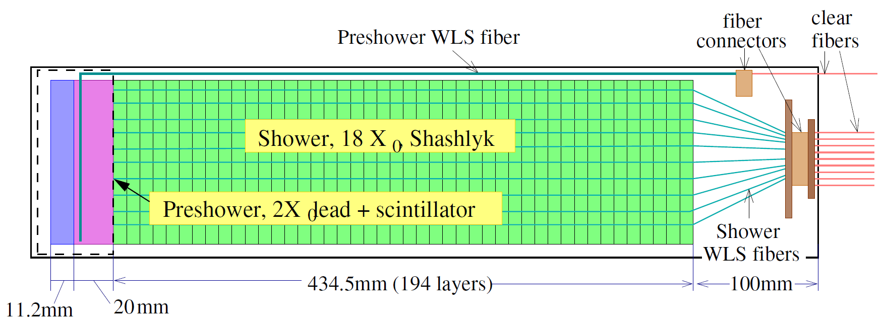
Update on Calorimeters Background
Calorimeter Group Internal Discussion

Slide 2
What’s new
LHCb/HERMES preshower, instead full Shashlyk preshower
As shown before, the preshower scintillator receive most of the radiation, due to the low energy backgrounds
This part radiation dose are now absorbed in 2X0 absorber, and we just see its EM tail now
New background distribution updated by Zhiwen
SIDIS:
With target collimator (suppress background by 4)
First large angle simulation
PVDIS: have option to remove direct photon sight (expected to be removed in the final baffle design)
Dominating background, photons 1-10 MeV
After preshower, which attenuate them a lot, they still penetrate ~10 layers in Shashlyk

Slide 3
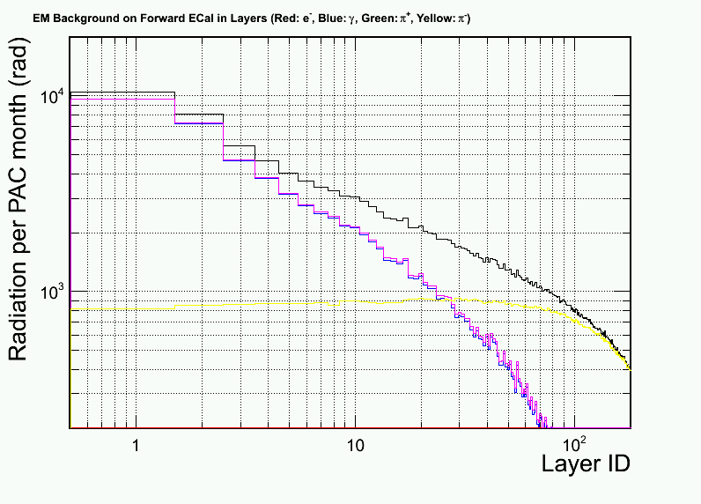
PVDIS – current baffle (with direct γ)
γ dominate
But attenuated quickly
Layer #1 is 2cm preshower scint.

Slide 4
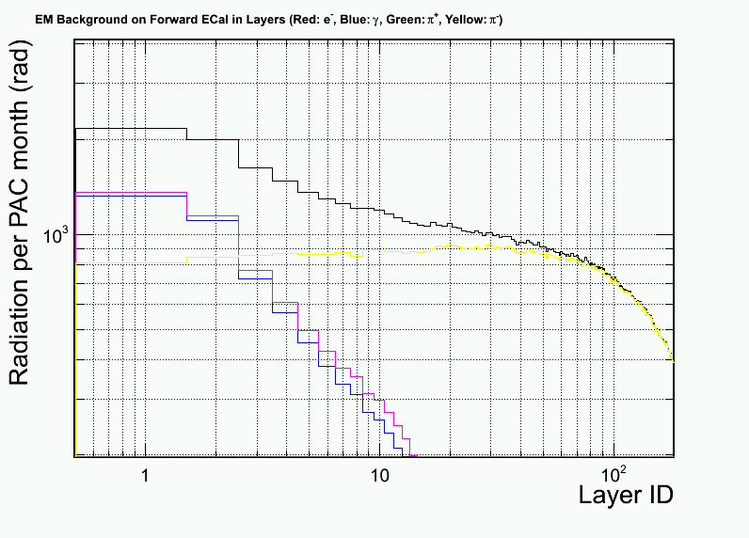
PVDIS – preview for a baffle w/o direct γ
γ get reduced by ~5
π⁻ become important here
Layer #1 is 2cm preshower scint.

Slide 5
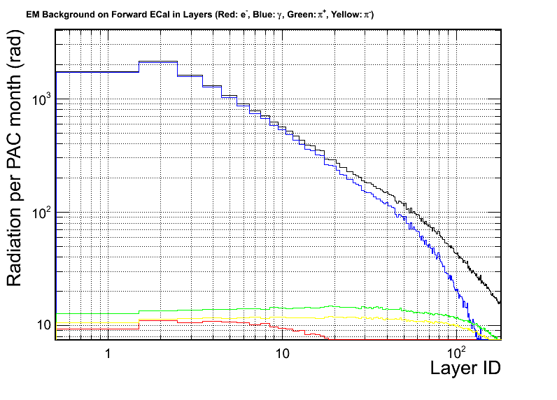
SIDIS – Forward
γ dominate
But attenuated quickly
Layer #1 is 2cm preshower scint.

Slide 6
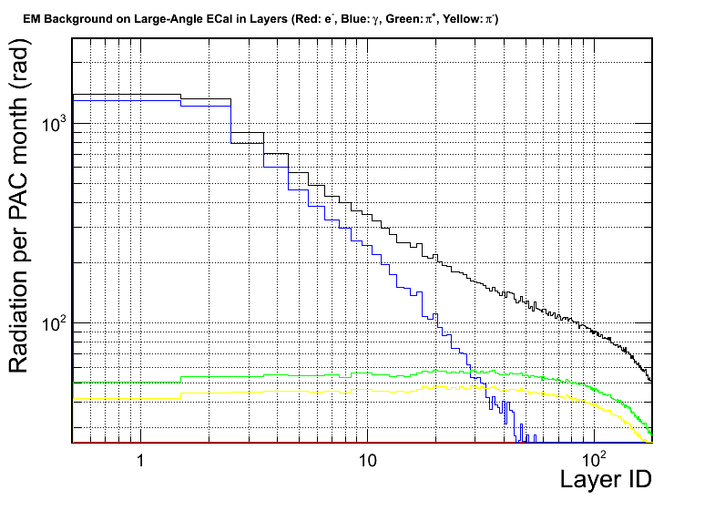
SIDIS – Large-Angle
γ dominate
But attenuated quickly
Layer #1 is 2cm preshower scint.

