Slide 1
Updates on Calorimeter Topics
Jin Huang
Los Alamos National Lab

Slide 2
Evaluation for HERAb calorimeter

Slide 3
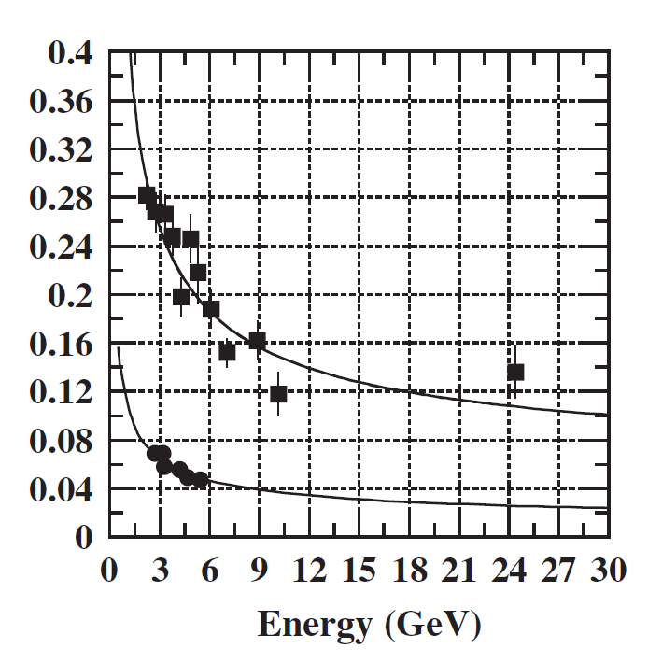
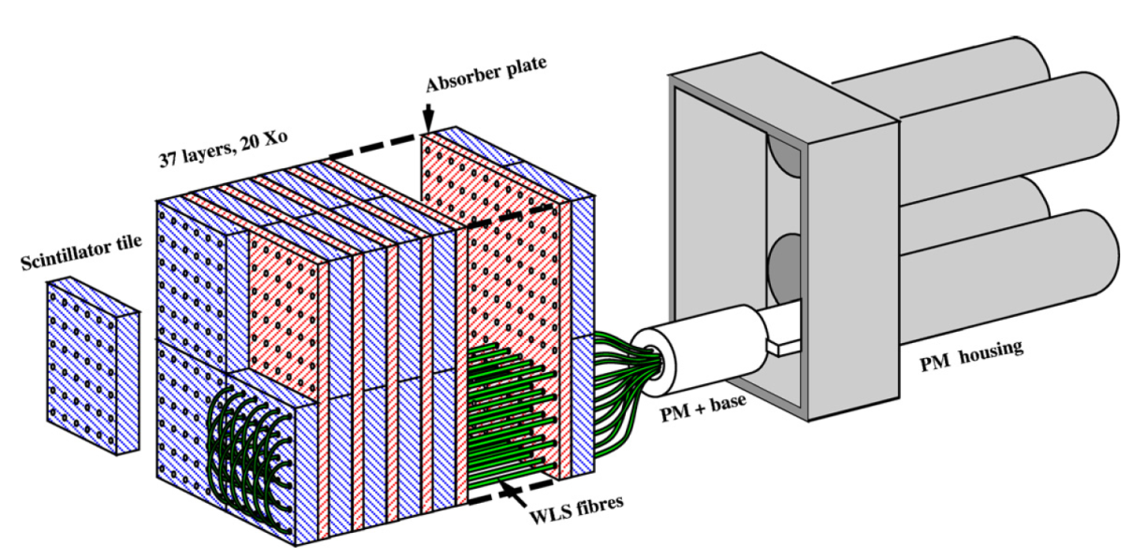
HERAb calorimeter (NIM A 580 (2007) 1209)
 | HERAb (Outer layer) | SoLID default
Absorber per layer | 3mm – Pb | 0.5mm Pb
Scintillator per layer | 6mm | 1.5mm
Total length | 20 X0 / 37 layer | 18 X0 / 194 layer + 2X0 PS
Energy resolution (1/√E) | 10.8% | 4-5%
σ_{xy} × 5
σ_{E} /E

Slide 4
Comment on finesse of sampling
Many experiment in our energy range use 1.5 mm Scintillator thickness (which defined absorber thickness in maintaining their ratio), which was adopted in SoLID default design.
The fineness of sampling is related to
Difference in response to MIP and EM shower
Rough sampling lead to less sampling for EM shower compared to MIP
Very important to pi/e separation purpose
Considered in original design and lead to the choice of thinnest scintillator
Expected reason: low-E photon in EM shower is more likely to convert in Pb and get fully absorbed. Therefore, number of charged particle is higher in Pb compared with Scint. However, for MIP, the ratio of charged particle is 1:1 in Pb : Scint
Energy resolution

Slide 5
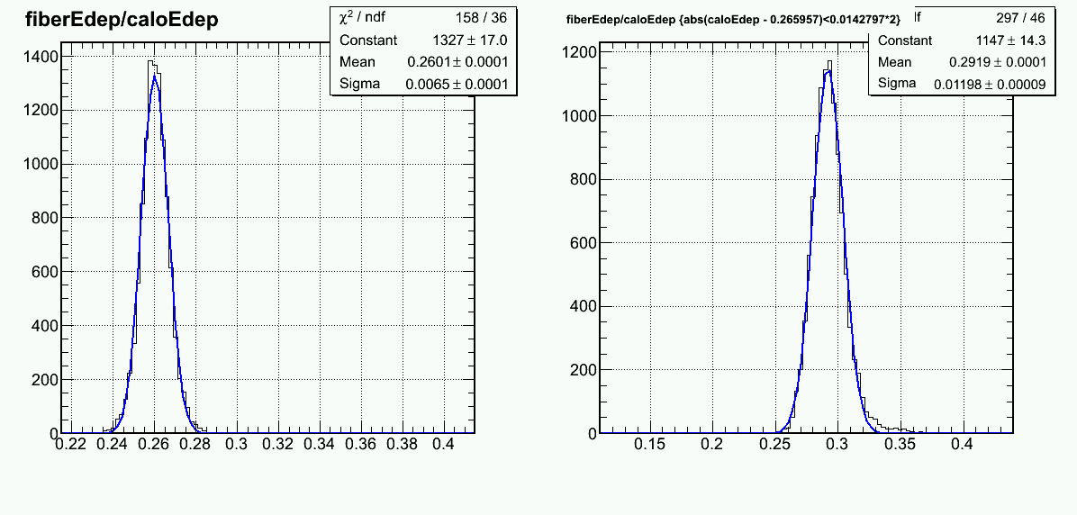
Sampling ratio in simulation
HERAb: 3mm Pb/6mm Scint
Sampling ratio for EM-Shower/MIP ~ 73:100
SoLID: 0.5mm Pb/1.5mm Scint
Sampling ratio for EM-Shower/MIP ~ 89:100
Making the Pb layer much thinner (<1/10) while maintainting Pb/Scint ratio:
EM shower retain same sampling ratio as MIP. But fail to output light through WLS

Slide 6
HERAb energy resolution
Simulation (w/pershower): σ_{E}/E~9.5%/√E (+) 3.7%/E
HERAb NIM (shower only): σ_{E}/E~10/√E (+) 1.4%

Slide 7
Pi/e separation – electron eff.
Same as SoLID

Slide 8
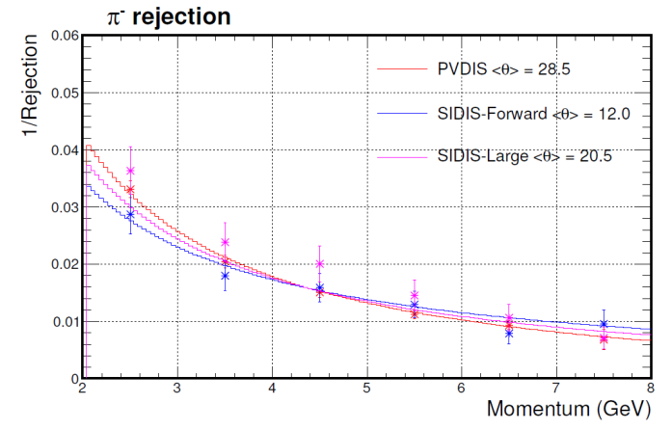
Pi/e separation – pion eff.
SoLID default design
~3 to 10 times worse than SoLID default design
No cluster size cut applied yet

Slide 9
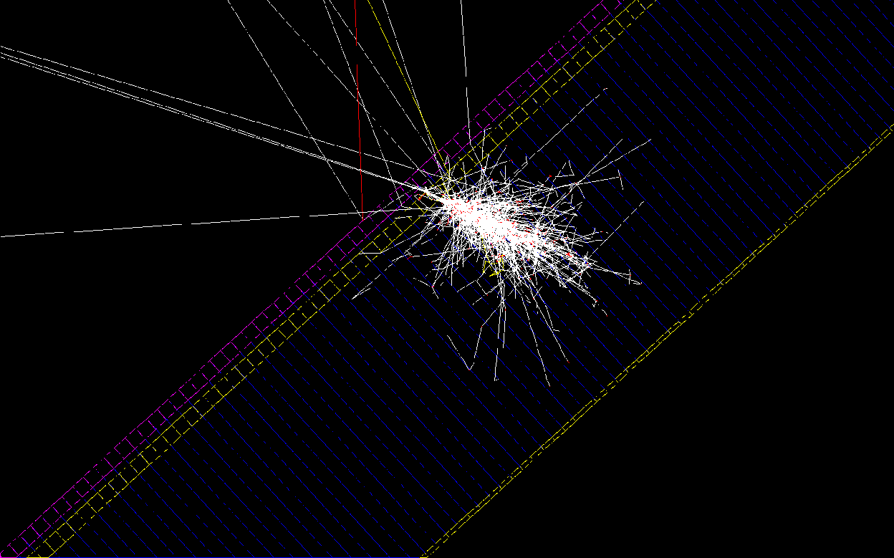
Scintillator before preshower as photon rejector
γ
Scintillator
Preshower Pb
Preshower Scint

Slide 10
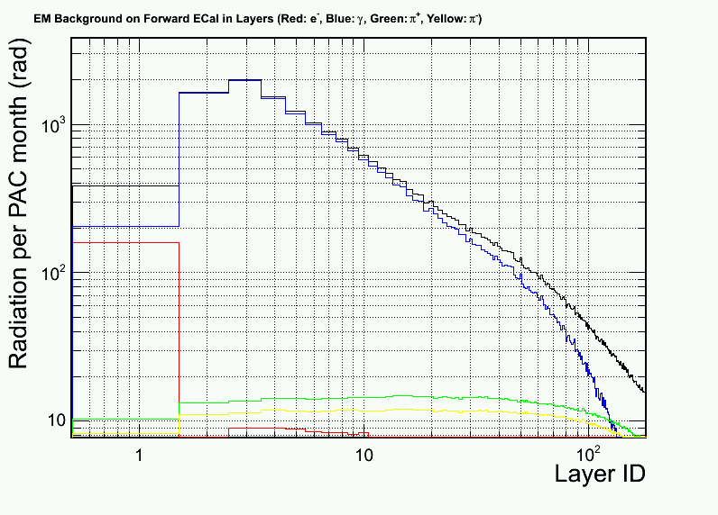
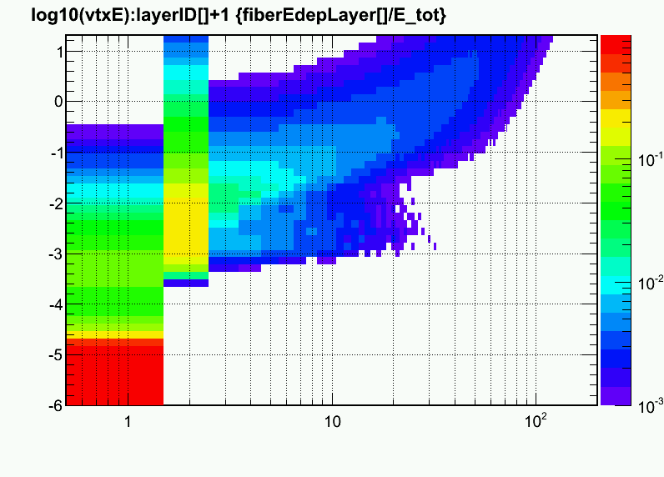
Major concern is radiation dose
Before the preshower Pb and without protection from lower energy EM background
Turn out to be not very bad since photon penetrate more depth
Ratio of energy deposition in active layers from a input photon
Log₁₀(E_{ϒ}/GeV)
Majority E
Dominated by low-E electron
Photon-rej Scintillator
Preshower
Photon-rej Scintillator
Preshower

Slide 11
Background rate estimation

Slide 12
Rate estimation
Preshower and scintillator are more vulnerable to background, since abundance in low-E bgd produce high rate of MIP like hit in them.
Calculate rate in preshower which produce a MIP or higher energy deposition
Presented in Hz per cm² and decomposed to source at the front surface of the system (scint + preshower + shower)
How much rate we can tolerate?
Assume 100ns signal length, and 10% change to see the background MIP → 1 MHz per area of readout
Area of readout
~ 100 cm² to match shower
~1000 cm² for fan shape

Slide 13
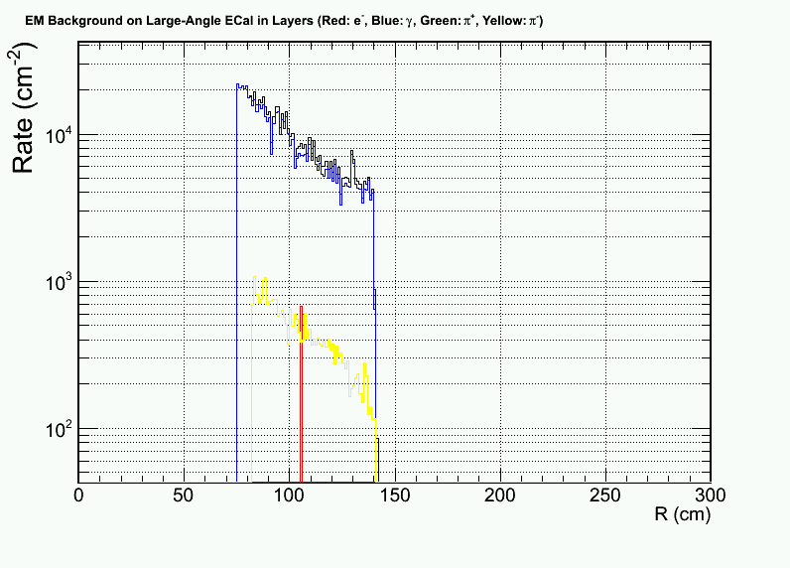
SIDIS large angle - preshower
Dominated by photons induced background rate

Slide 14
SIDIS forward angle
Preshower
(photon dominated)
Photon-rej scintillator
(Electron and photon dominated)

Slide 15
PVDIS - preshower

