Slide 1
Photon rejecting scintillator
Jin Huang
Los Alamos National Lab

Slide 2
Generic discussion
Add scintillator before preshower to reject photons VS electron
Interested energy range 1~few GeV (photon rate drop quickly)
Need to be simple & fast for trigger implementation
Generic rate for single photon on stand alone scintillator:
Prob. for photon energy dep = 1-exp(-L/L₀)
Where L₀ ~ 55 cm for scintillator
Simulated by Zhiwen:
Zhiwen’s simulation
10cm 22%
5cm 14%
2cm 5%
1cm 3.3%
0.5cm 2.3%
0.25cm 0.65%

Slide 3
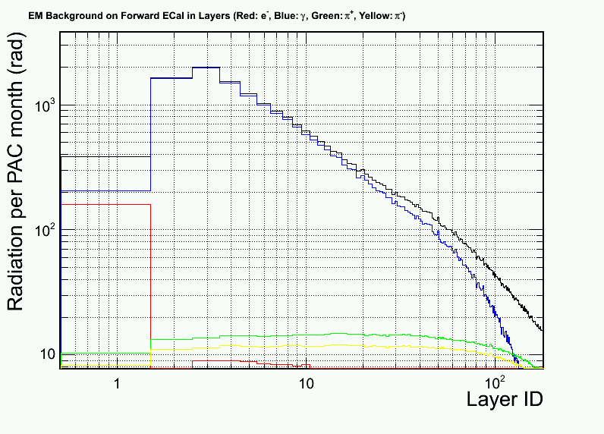
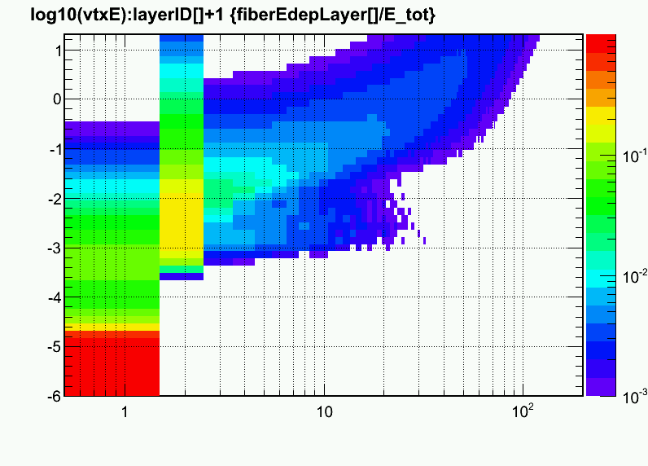
From last week - Radiation dose is OK
Before the preshower Pb and without protection from lower energy EM background
Turn out to be not very bad since photon penetrate more depth
Ratio of energy deposition in active layers from a input photon
Log₁₀(E_{ϒ}/GeV)
Majority E
Dominated by
low-E γ & electron
Photon-rej Scintillator
Preshower
Photon-rej Scintillator
Preshower

Slide 4
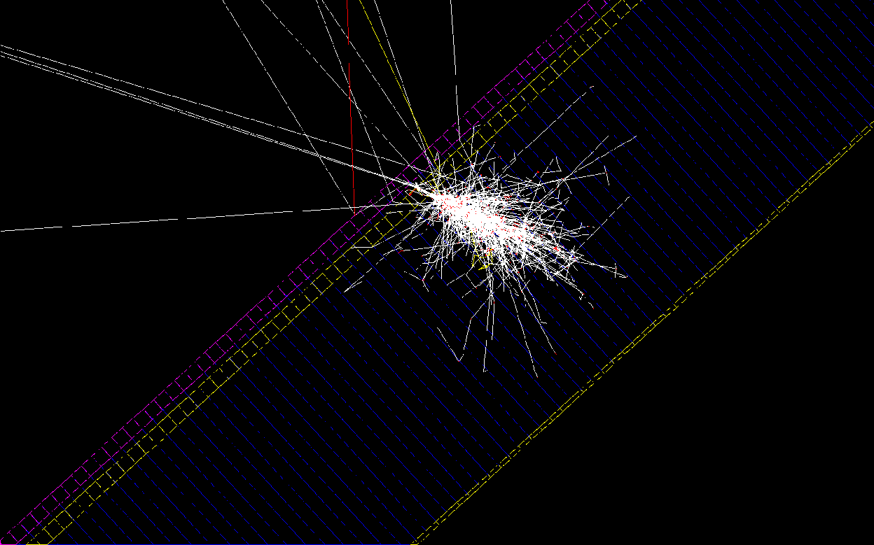
Geant4 Simulating scintillator before preshower
Lots of back scattering!
γ
Scintillator
Thickness = 5 mm
Preshower Pb
Preshower Scint

Slide 5
Simulated efficiency & rejection
Electron
Pion
Photon
Energy range: 1-7 GeV, flat phase space for SIDIS-forward
MIP peak
Efficiency
~1:7 γ-rej with cut below MIP peak
Cut on energy dep.

Slide 6
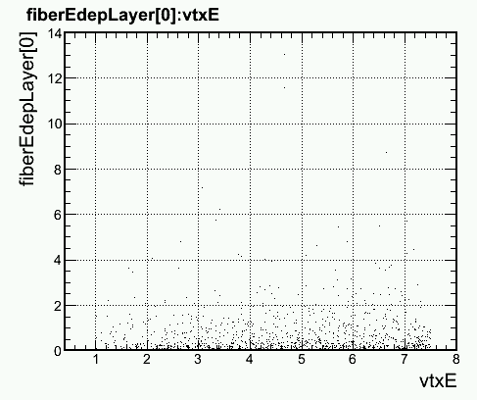
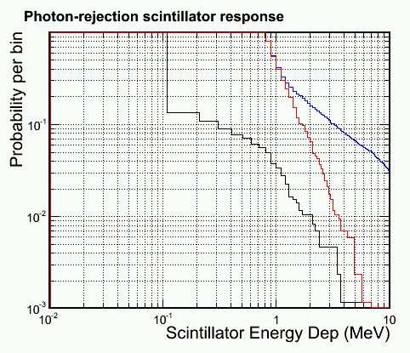
Simulated efficiency & rejection
Most photon focus on lower energy side (π₀ decay)
And lower energy photon produce less back scattering
Therefore, do the study again with 1<E_{γ}<2 GeV
Electron
Pion
Photon
1<E_{γ}<2 GeV
Efficiency
E dep for photons (MeV)
~1:20 γ-rej with cut below MIP peak
E_{γ} (GeV)
Cut on energy dep.

Slide 7
Discussion
Photon rejection:
1:20 (1-2 GeV)
1:7 (full E range)
Cut well below MIP peak
Back scattering from calorimeter is significant
We can try
Move scintillator away from preshower?
Ex. put it before the heavy gas cherenkov
Use two layer of scintillator to rej backscattering?
Probably not efficient
More to study
Background level – plan to use background imbedding
Correlated photon background from π⁰ delay
Energy deposition to trigger level smearing

