Slide 1
Simulation of the calorimeter support structure
Jin Huang
Los Alamos National Lab

Slide 2
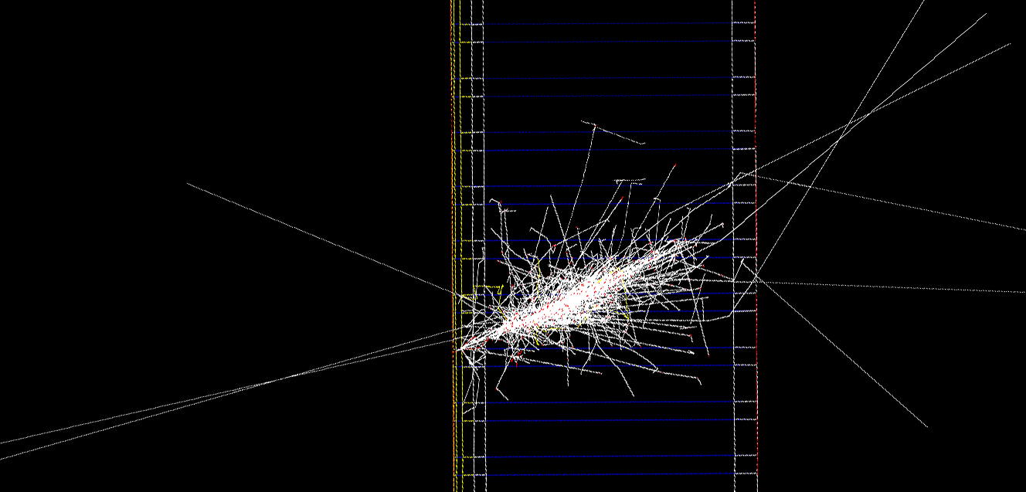
Adding support structure to simulation
Initial layers
0.5 cm scintillator (SPD)
2 X0 lead (absorber)
2 cm scintillator (preshower)
2 cm Al plate (mech. support)
4 cm Al plate
(mech. support)
3GeV electron
Simulation started before I leave China, finished in the weekend

Slide 3
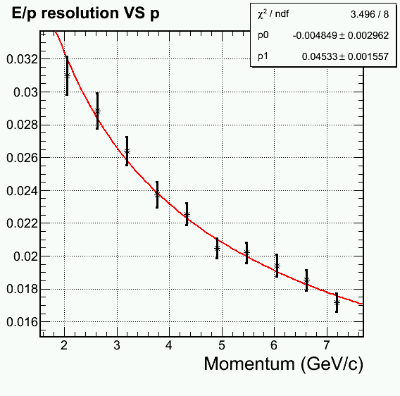
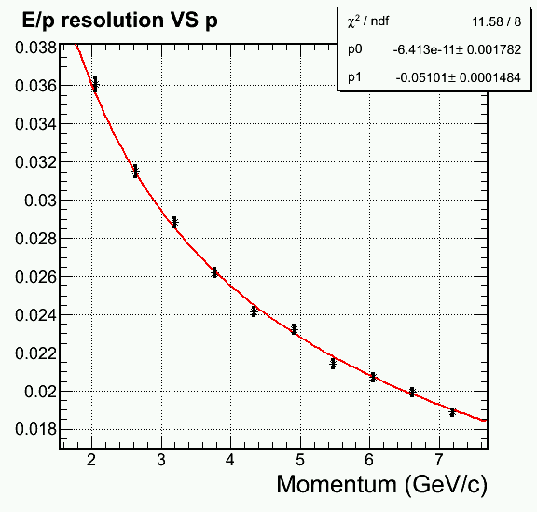
Change in energy resolution
Use preshower reading to recover missing energy in Al support structure
σ(E)/E ~ 4.5%/√E
σ(E)/E ~ 5.1%/√E
Without Al support plate
With Al support plate

Slide 4
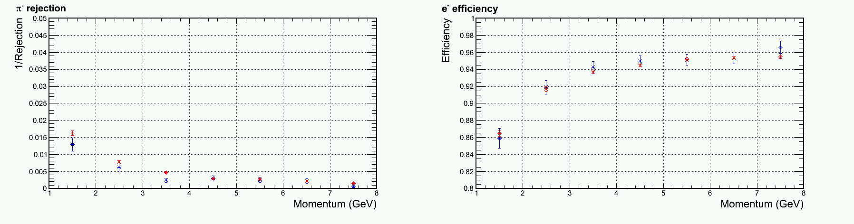
PID performance comparison
SIDIS forward configuration shown
No background embedding
Observed worse pion rejection at lower momentum bins
Intrinsic
With Al support structure

Slide 5
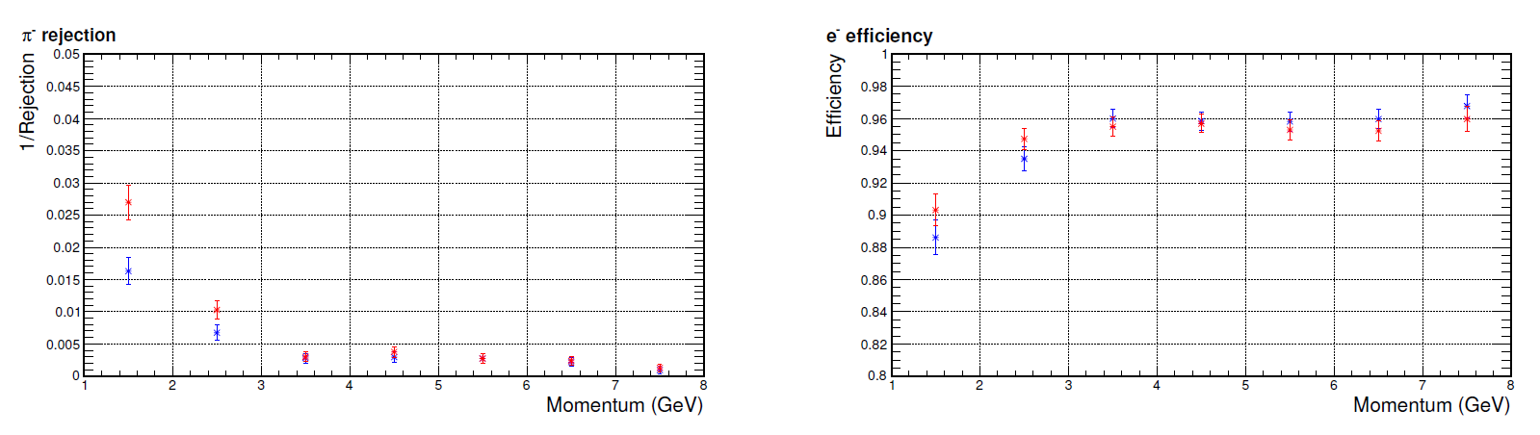
Comparing to effect of background
SIDIS forward configuration shown
Embedded with worse background region (inner-R)
Intrinsic
With bgd

Slide 6
Conclusion
Observed performance (minor) worsen
  Worse energy resolution and lower pion rejection
  Mainly at lower momentum bins, where higher fraction of energy deposited at the front side of calorimeter
Change in performance is minor comparing to the presence of background
I would support a design easier for support and readout

Slide 7
References to tech notes

Slide 8
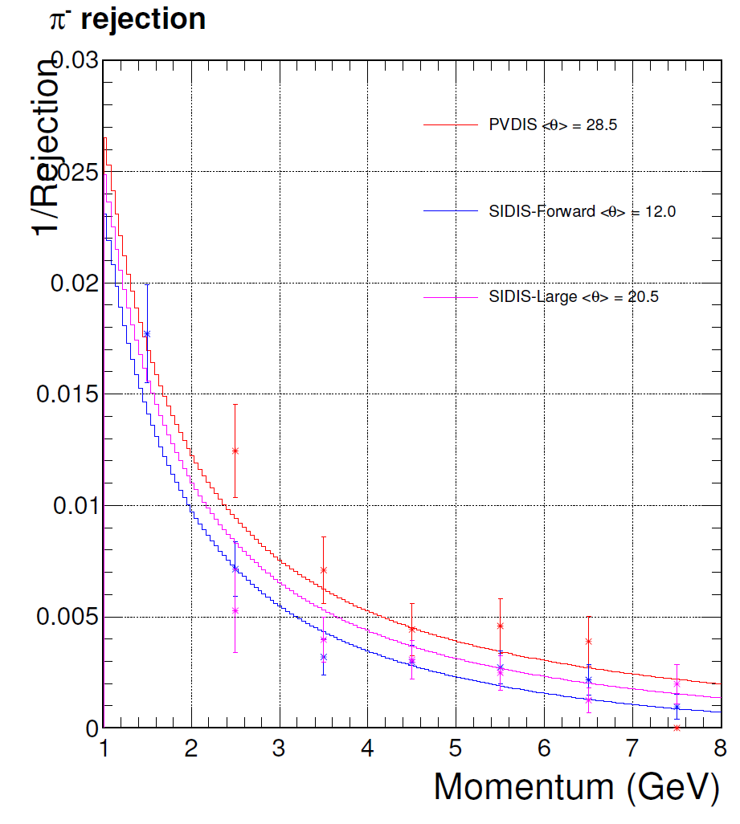
Pion rejection without bgd.
Electron = 95% for p>2GeV

Slide 9
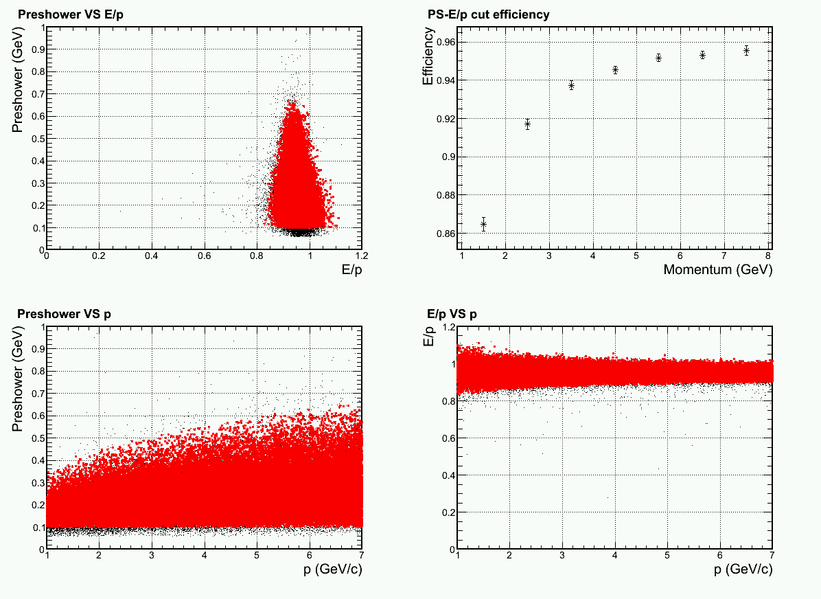
Electron cuts

Slide 10
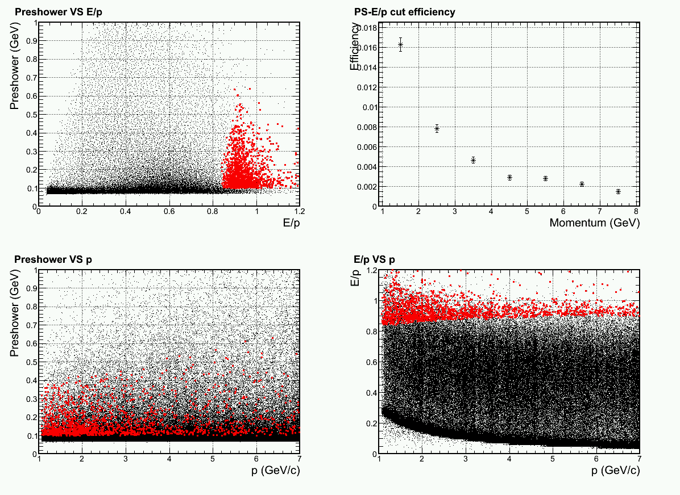
Pion cuts

