Slide 1
Simulation Updates
Jin Huang
Los Alamos National Lab

Slide 2
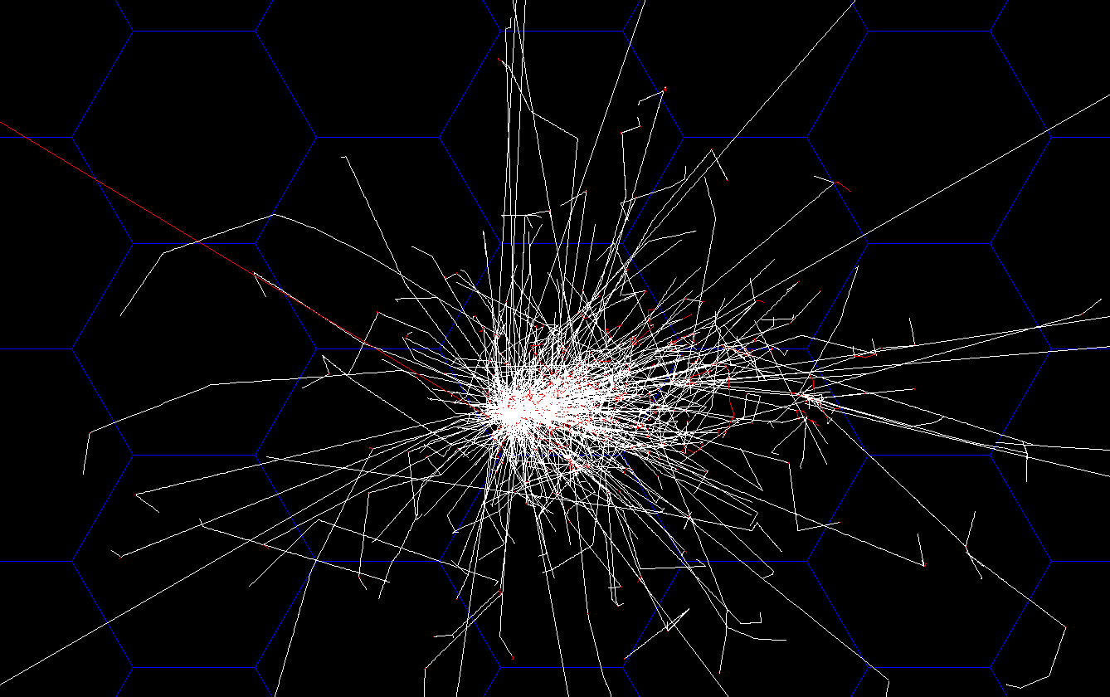
Hexagon Calorimeter Simulation
3GeV electron shower
On hexagon calorimeter grid
Orthographic projection along z axis
Side size = 6.25 cm, default layering
Provide nice shower area cuts – can be used in both
clustering – contains ~96% of shower energy
FPGA-based pattern trigger (HEX 1+6 trigger)

Slide 3
Pion rejection with HEX 1+6 clustering
PVDIS configuration, no background, >94% electron efficiency for all p-bins

Slide 4
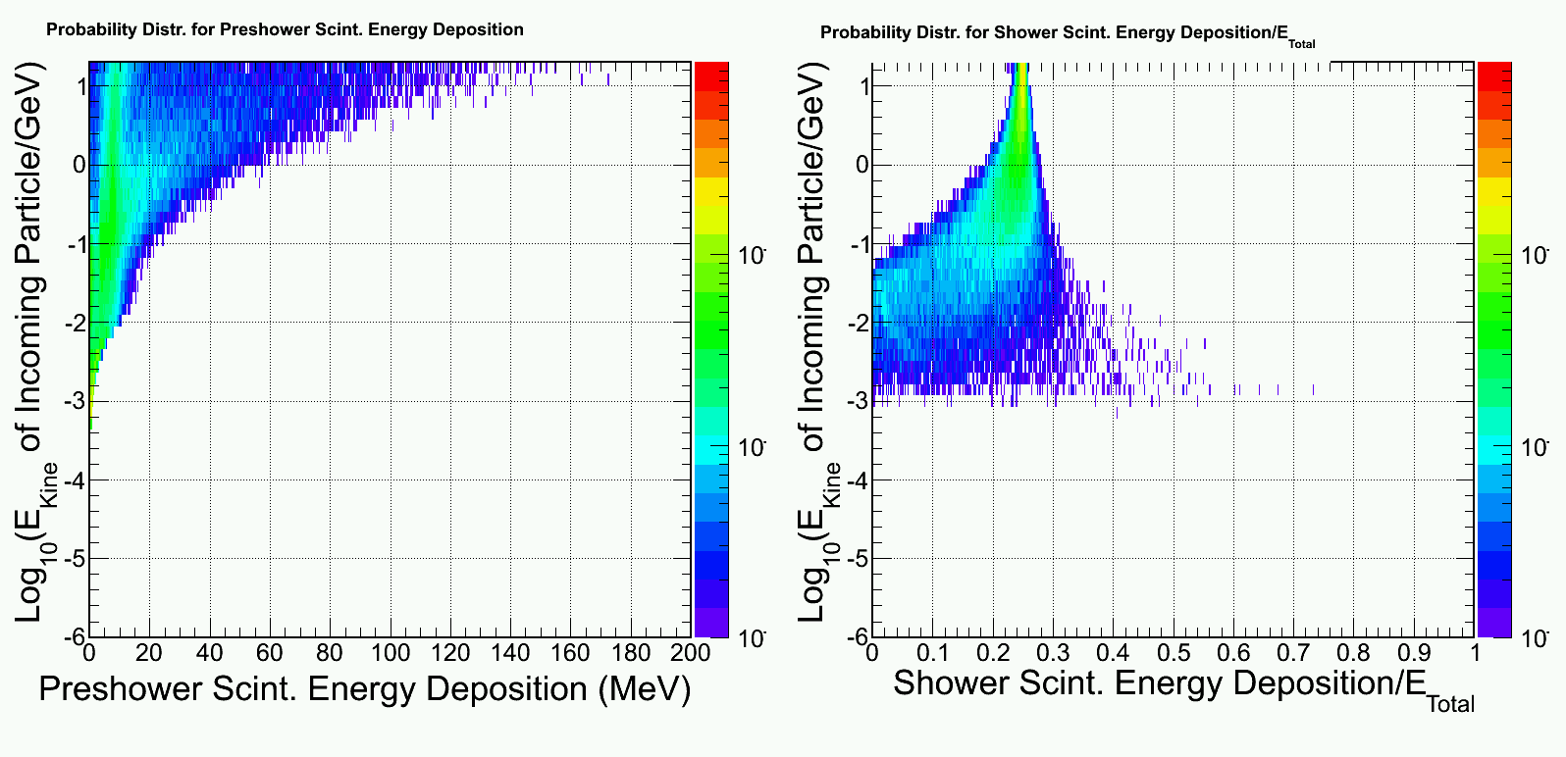
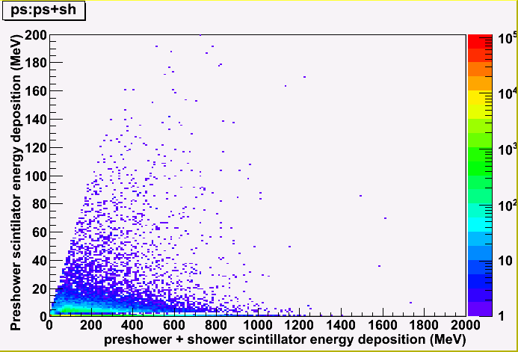
Background simulation
Example: photon response
Simulate background at front surface of calorimeter (Zhiwen)
Simulate calorimeter response to a wide range of background particle
Combine above two sum over all contributions (EM, DIS, pi0, pi+,pi-) -> background distribution
Imbed into the signal simulation (high energy e, pi), assuming a 50ns coincidental window
background for pi⁻ + e⁻

Slide 5
For PVDIS , MIP rate distribution Dominated by pion and electrons

Slide 6
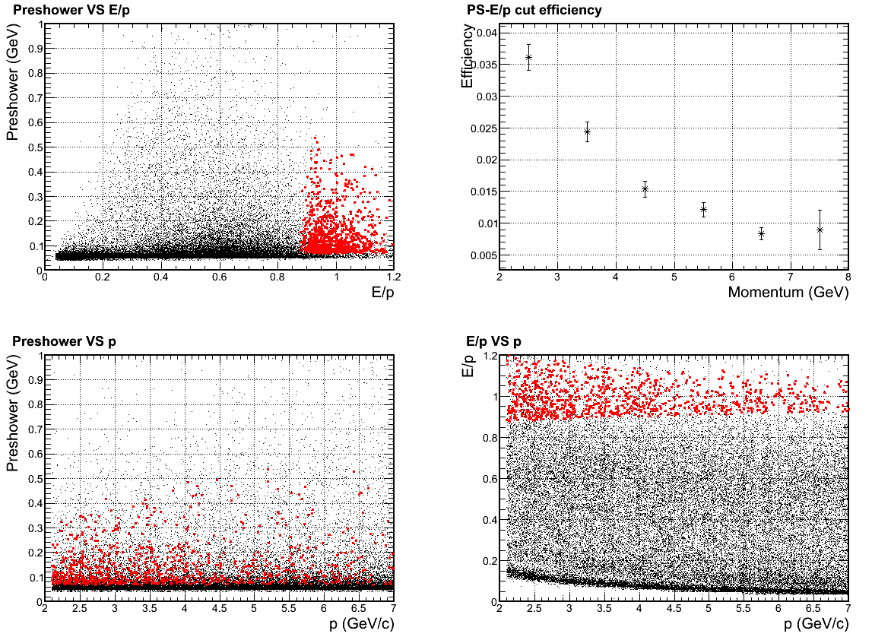
The result is still under check
Simulated 1+6 shower cluster + (10cm)² preshower for pion + electron bgd (do we still have direct photon sight on baffle?)
It did lead to significant change in pion rejection due to pile ups

Slide 7
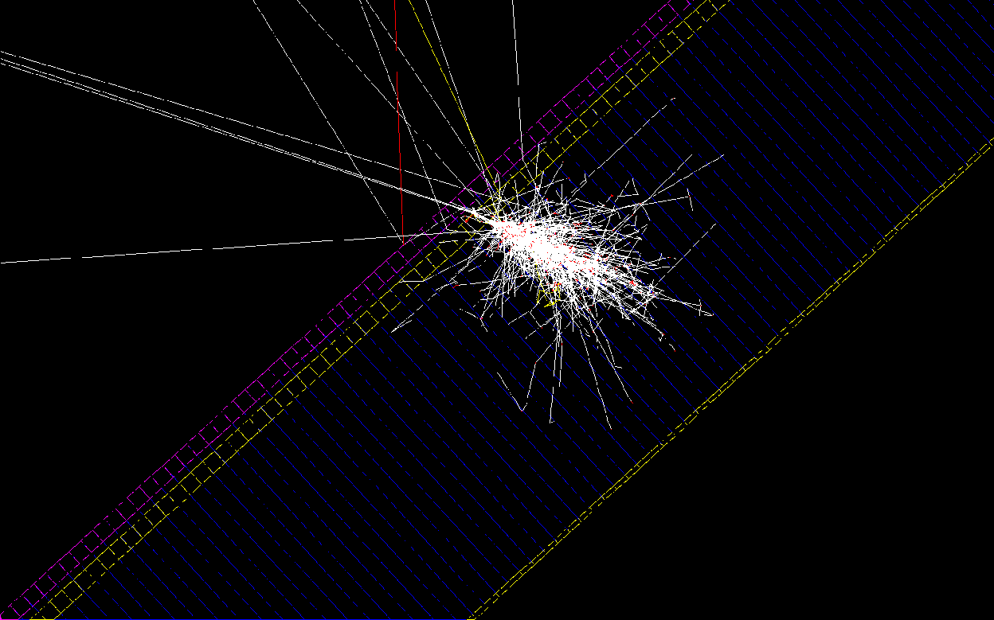
(From Jan) Geant4 Simulating scintillator before preshower
Lots of back scattering!
γ
Scintillator
Thickness = 5 mm
Preshower Pb
Preshower Scint

Slide 8
Simulated efficiency & rejection
Electron
Pion
Photon
Energy range: 1-7 GeV, flat phase space for SIDIS-forward
MIP peak
Efficiency
~1:7 γ-rej with cut below MIP peak
Cut on energy dep.

Slide 9
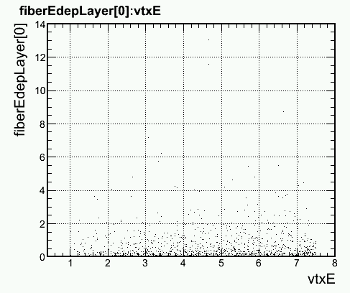
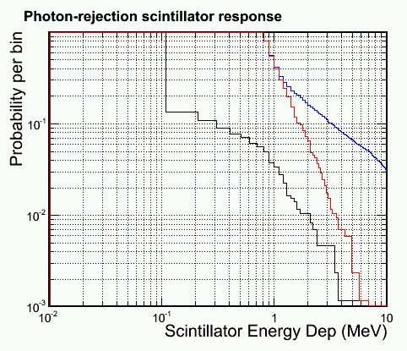
Simulated efficiency & rejection
Most photon focus on lower energy side (π₀ decay)
And lower energy photon produce less back scattering
Therefore, do the study again with 1<E_{γ}<2 GeV
Electron
Pion
Photon
1<E_{γ}<2 GeV
Efficiency
E dep for photons (MeV)
~1:20 γ-rej with cut below MIP peak
E_{γ} (GeV)
Cut on energy dep.

Slide 10
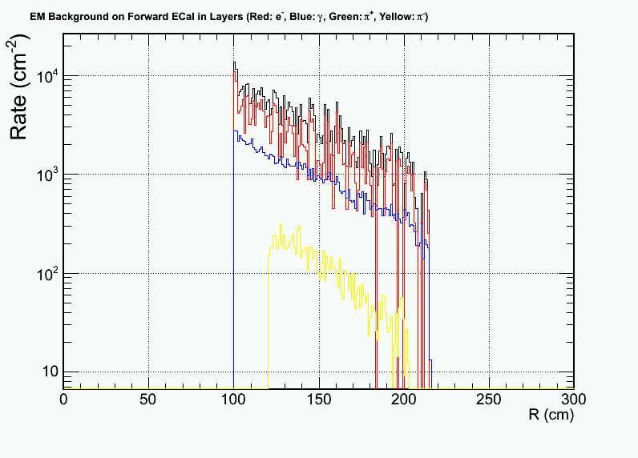
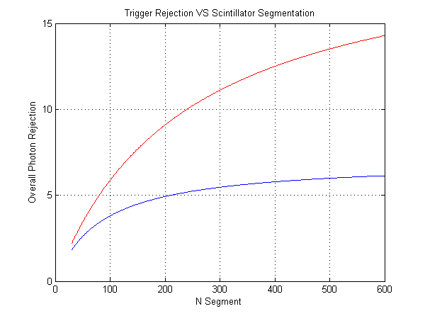
Pile up on background
Also from Jan: MIP rate on scintillator is 20% for 60 segments, which dominate the rejection
More fine segmentation pursued
Suggest sector shape, better match shower triggers
Low-E (1-2 GeV)
Full E range (1-7 GeV)

Slide 11
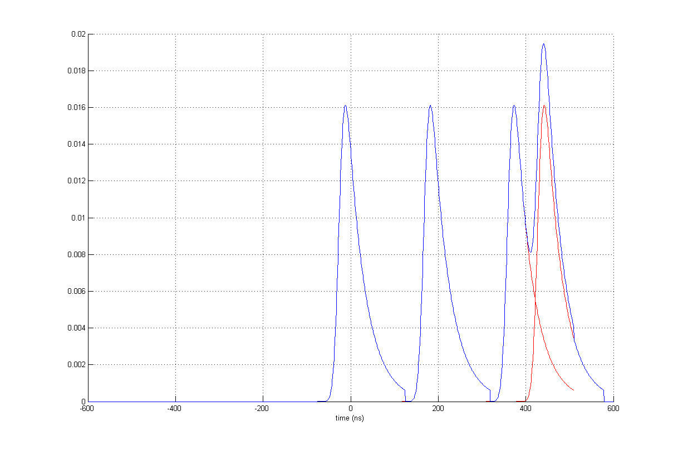
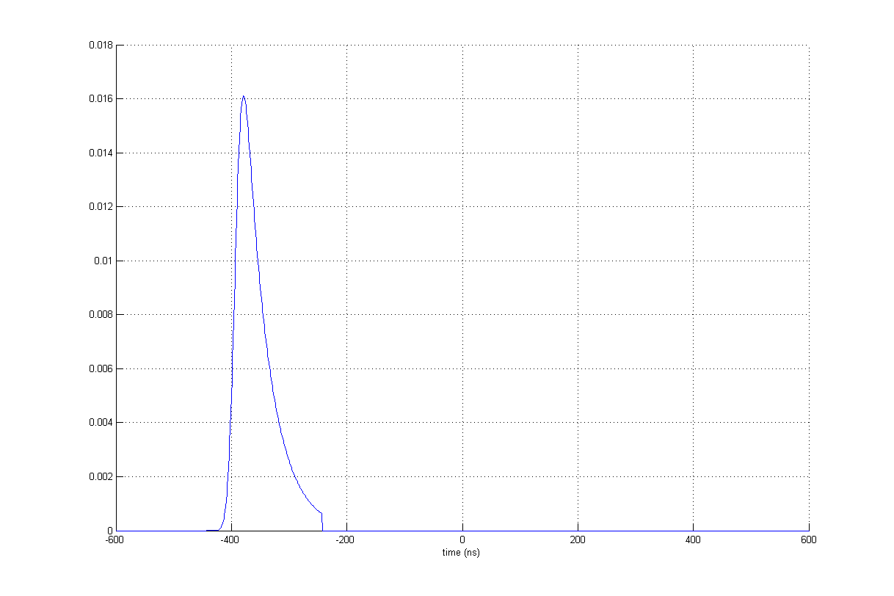
How signal looks like
30 sectors
8 MHz MIP
60 sectors
4 MHz MIP
240 sectors
1 MHz MIP

