Slide 1
Simulation Updates For May Collaboration Meeting
Jin Huang
Los Alamos National Lab

Slide 2
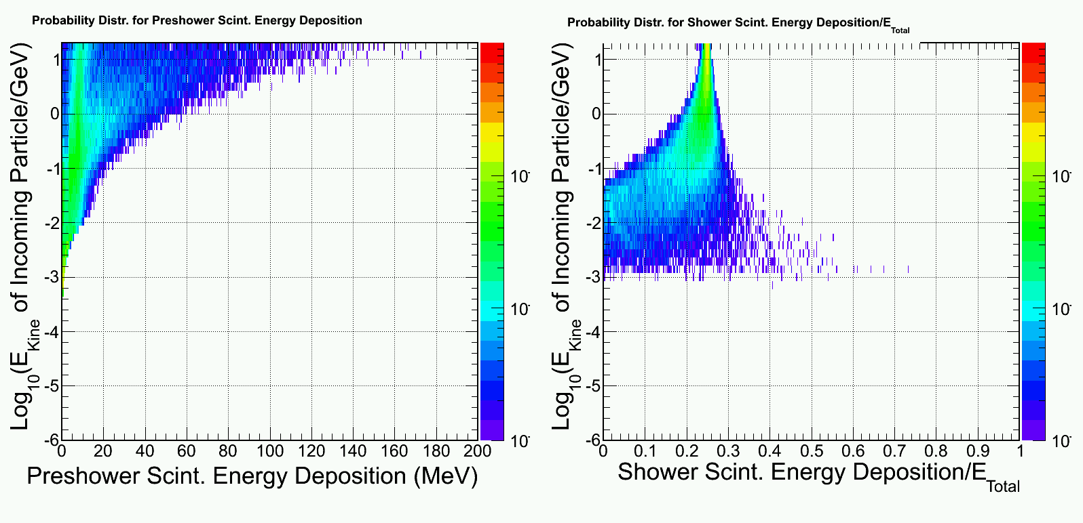
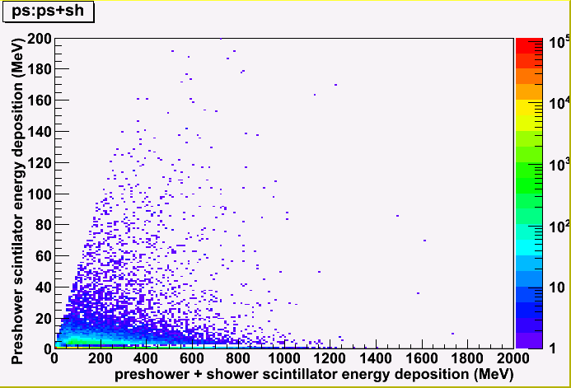
Background simulation
Example: photon response
Simulate background at front surface of calorimeter (Zhiwen)
Simulate calorimeter response to a wide range of background particle
Combine above two sum over all contributions (EM, DIS, pi0, pi+,pi-) -> background distribution
Imbed into the signal simulation (high energy e, pi), assuming a 50ns coincidental window
background for pi⁻ + e⁻

Slide 3
SIDIS – Large Angle

Slide 4
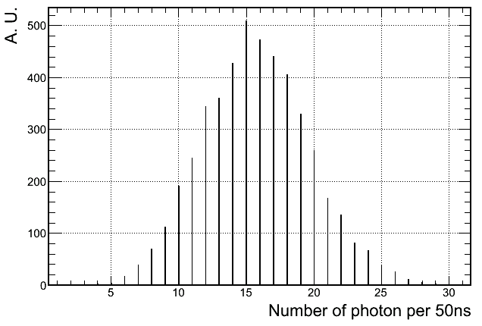
Dominant background
0.3 GHz low energy photon for inner-R 1+6 hexagon clusters
But well shielded by 2-X0 preshower absorber

Slide 5
Background distribution
Photon
Electron
Pion

Slide 6
Pion rejection w/o background @ 94% electron eff

Slide 7
w/ background (inner-R) Electron efficiency

Slide 8
w/ background (inner-R) Pion efficiency (1/rejecton)
Worse rejection
But not below the bar (1:100)

Slide 9
Trigger turn-on curve
Proposed trigger rate and rejection
Pion rejection needed ~ 20:1, but I think can be relaxed
Additional photon rejection help more
Single-Shower 1+6 cluster trigger tested
Full background spectrum considered
Cut on shower energy deposition > 2.6 GeV
Very high electron trigger efficiency

Slide 10
Pion turn-on curve Single-Shower trigger > 2.6 GeV
Rejection > 20:1 for lower energy pions

Slide 11
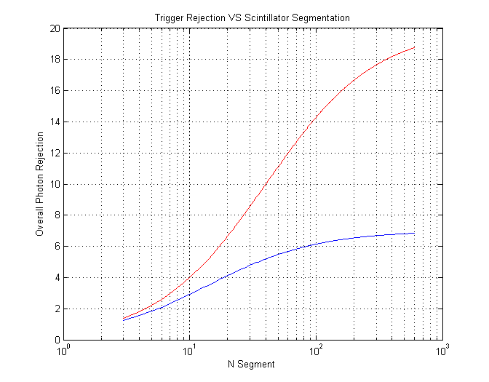
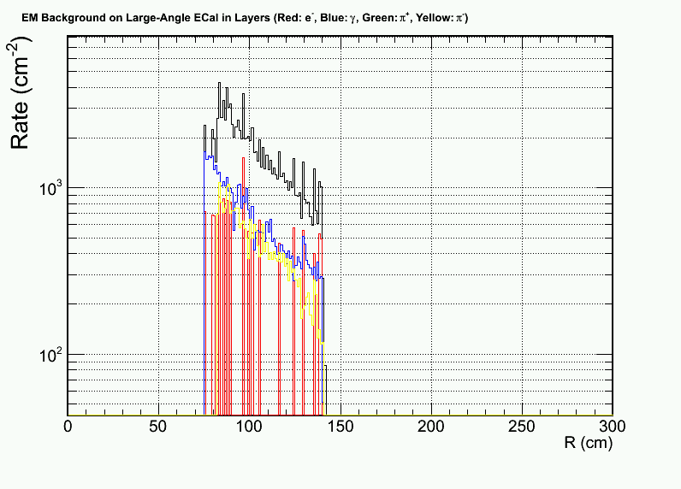
What if we also want to rejection photons? - Add a scintillator pad
Scintillator MIP rate
1GeV < Eγ< 7 GeV
1GeV < Eγ< 2 GeV
Photon originated
Electron
Pion
~10:1 rejection with 45 segments (matching size)

Slide 12
PVIDS Forward

Slide 13
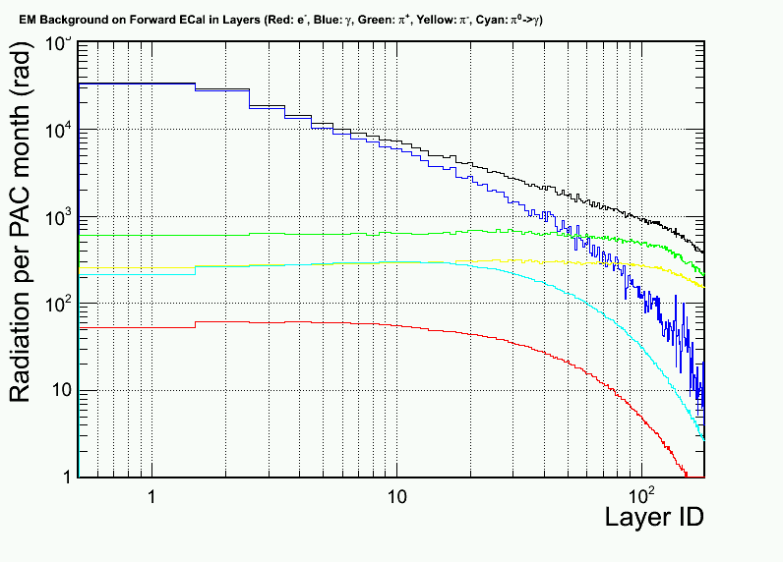
Updated radiation dose VS layers
Photon (EM) <- dominant!
Photon (Pi⁰)
Electron
Pion- Pion+ Proton
From 2nd Update
from 2nd update
Soft EM γ
Direct Pi⁰ γ
High radiation azimuthal region
Low radiation azimuthal region

Slide 14
Background imbedding and distribution Mid-R, High Radiation phi slice
Photon (6GHz/6+1 Hex cluster)
Electron
Pion- Pion+ Proton

Slide 15
Updated: Per-event pion rate for 1+6 hexagon cluster at Mid radius, high radiation slice
Electron (mostly absorbed in Pb)
Pion-
Pion+
+ 3 GHz photon not shown

Slide 16
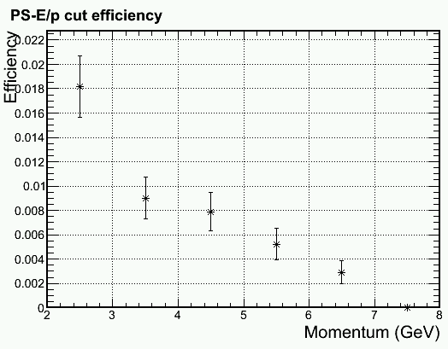
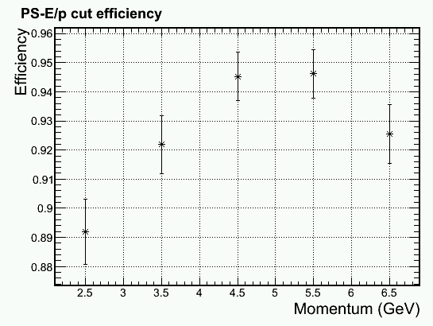
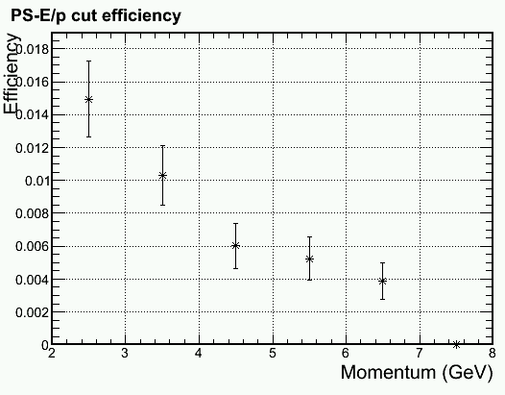
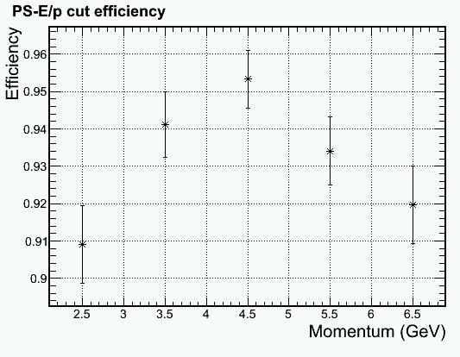
Update on PID with DC component removal (PS > MIP + Bgd + (2-3) σ)
Outer radius, higher γ φ-band
Due to Soft EM γ
Outer radius, lower γ φ-band
Pion Efficiency
Electron Efficiency

Slide 17
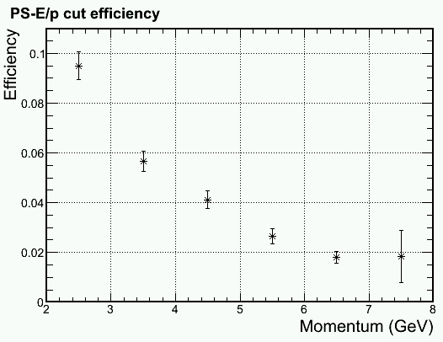
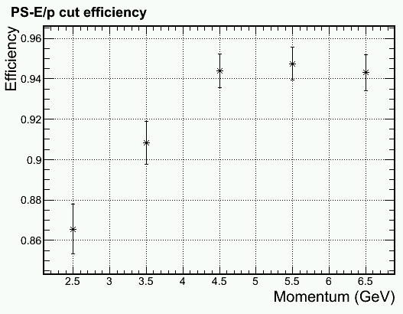
Update on PID with DC component removal (PS > MIP + Bgd + (2-3) σ)
Outer radius, higher γ φ-band
Mid radius, higher γ φ-band
Due to Hadron rate
Pion Efficiency
Electron Efficiency

Slide 18
More detail in PID cut Middle radius, lower γ φ-band, full bgd
Pion Efficiency
Electron Efficiency

Slide 19
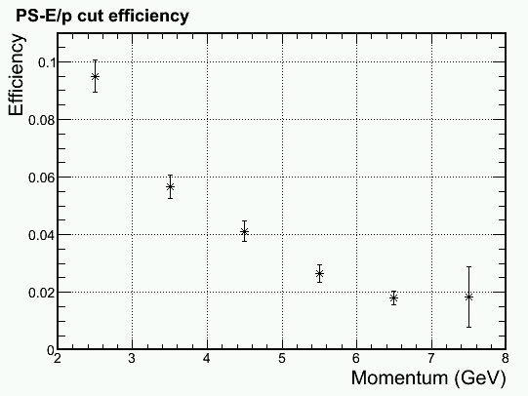
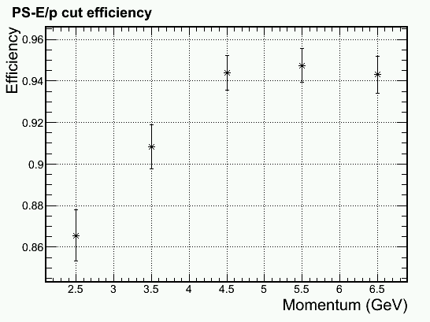
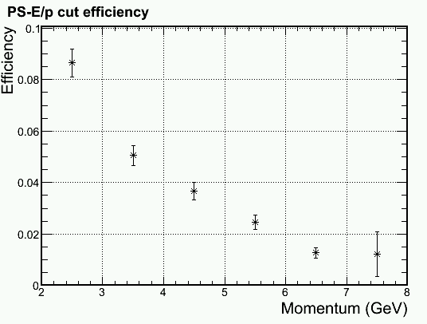
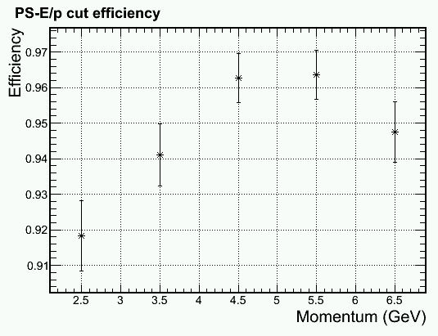
Update on PID with DC component removal (PS > MIP + Bgd + (2-3) σ)
Inner radius, higher γ φ-band
Inner radius, lower γ φ-band
Pion Efficiency
Electron Efficiency

Slide 20
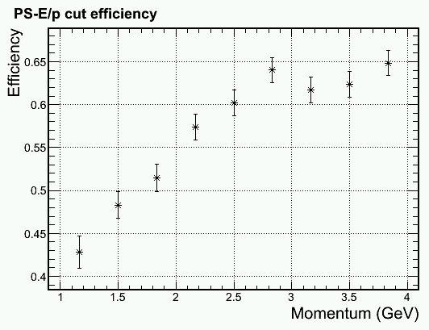
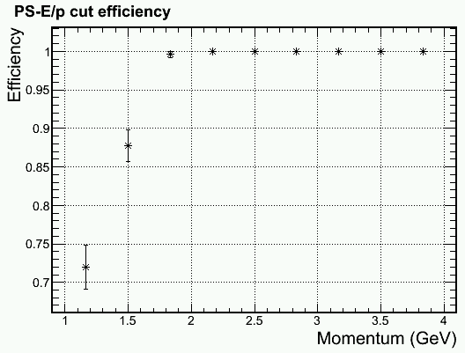
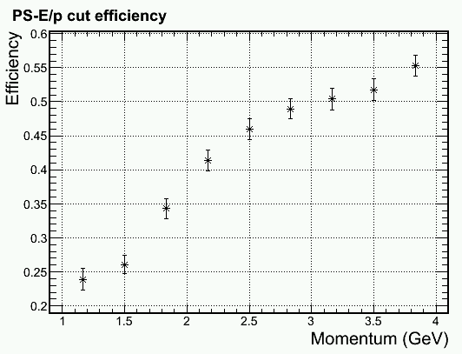
Trigger turn on curve for 2 GeV electron Shower Hex 1+6 trigger > 1.6 GeV
Inner radius, higher γ φ-band, full bgd
100% pass for ~250 events/bin
Physics
, full bgd
Middle radius, higer γ φ-band, full bgd
Physics
Pion Efficiency
Electron Efficiency

Slide 21
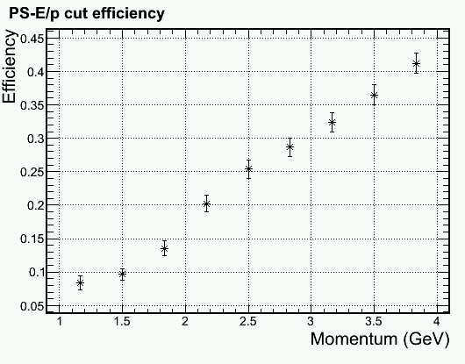
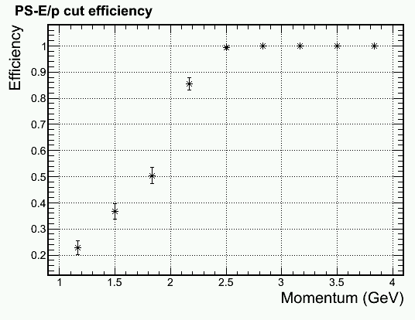
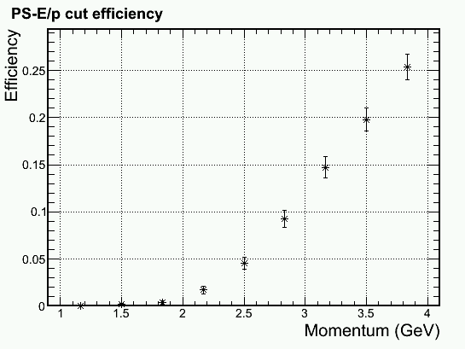
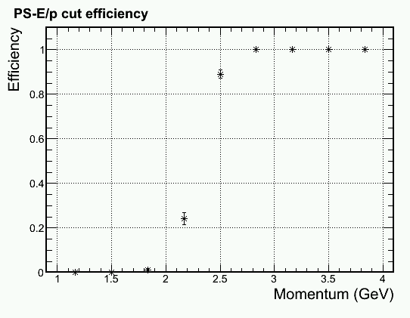
Trigger turn on curve for 2.5 GeV electron Shower Hex 1+6 trigger > 2.1 GeV
Middle radius, higher γ φ-band, full bgd
Physics
Outer radius, higer γ φ-band, full bgd
Physics
Pion Efficiency
Electron Efficiency

Slide 22
More detail in trigger cut Middle radius, higher γ φ-band, full bgd Shower Hex 1+6 trigger > 2.1 GeV
Pion Efficiency
Electron Efficiency

Slide 23
Readout occupancy per shower channel for ~75MeV zero suppression
High radiation phi slice
Low radiation phi slice

