Slide 1
Simulation Updates
Jin Huang
Los Alamos National Lab

Slide 2
Simulation setup with hexagon calorimeter modules

Slide 3
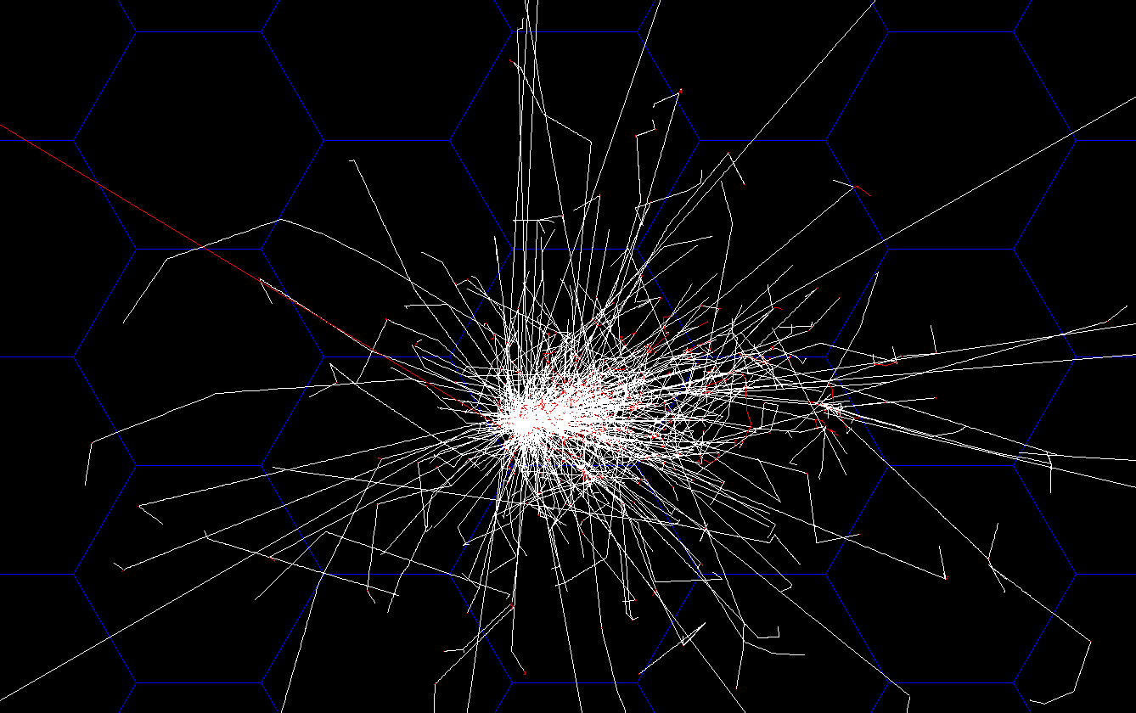
Hexagon Calorimeter Simulation
Side size = 6.25 cm, default layering
3GeV electron shower
On hexagon calorimeter grid
Orthographic projection along z axis

Slide 4
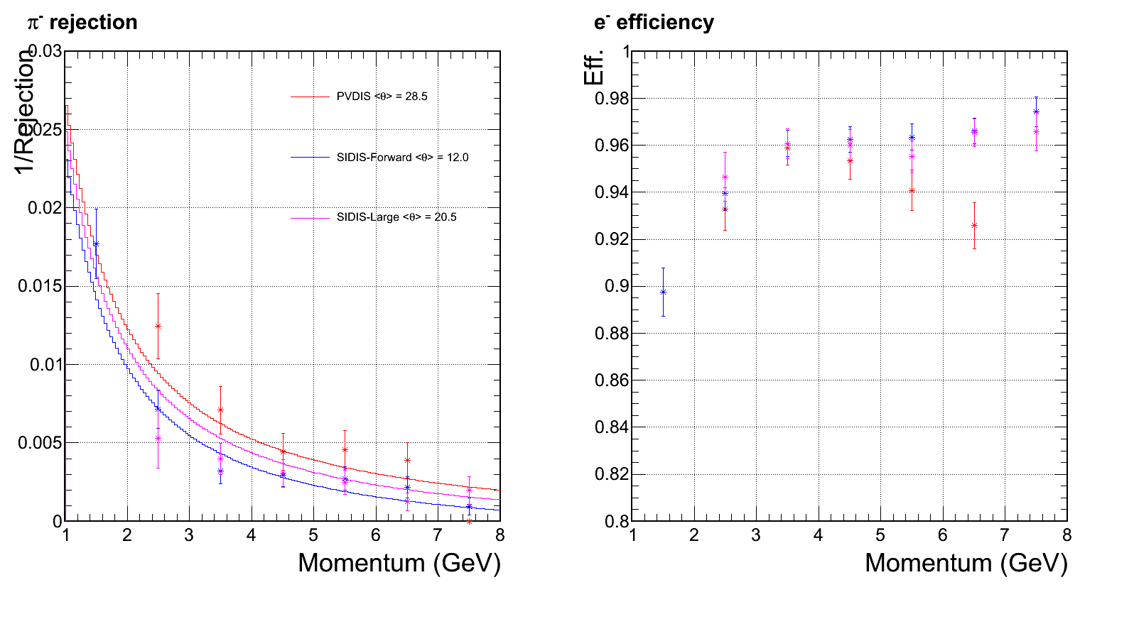
All rejection/efficiency reviewed with hexagon-shape calorimeter modules
From last meeting:
square module 3x3 clustering
94% efficiency
No background yet assumed at this step
Expect go high w/ higher stat.
Preshower ID power drop significantly at this bin

Slide 5
Back up 1/2 for previous slides
Electron eff. for SIDIS large angle calorimeter
All events
Accepted events w/ 3D cut

Slide 6
Back up 2/2 for previous slides
Pion eff. for SIDIS large angle calorimeter
All events
Accepted events w/ 3D cut

Slide 7
Review of Background Simulation

Slide 8
Calorimeter background simulation
Simulate background at front surface of calorimeter (Zhiwen)
Simulate calorimeter response to a wide range of background particle
Combine above two sum over all contributions (EM, DIS, pi0, pi+,pi-) -> background distribution
Imbed into the signal simulation (high energy e, pi), assuming a 50ns coincidental window

Slide 9
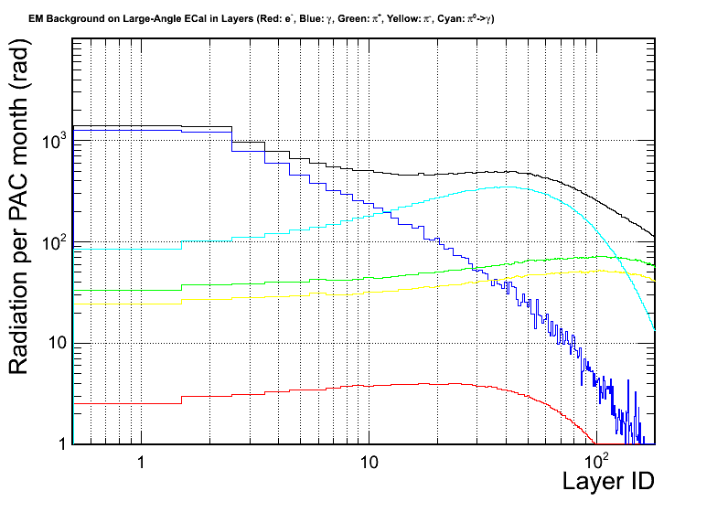
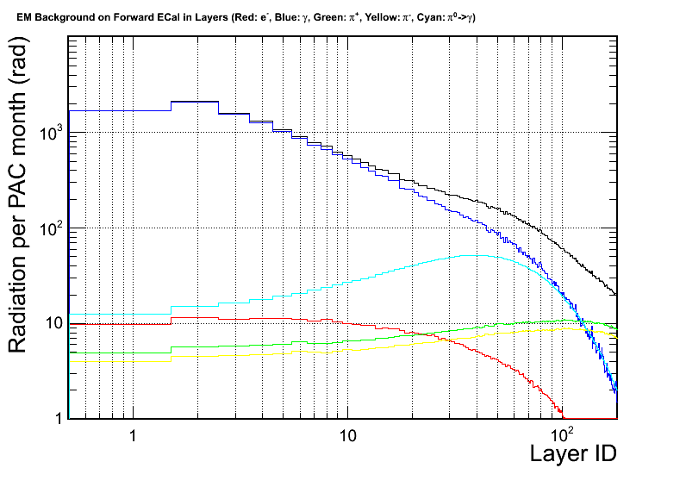
Radiation dose prediction remain stable
Dose is not a problem for SIDIS configuration
Still missing final PVDIS radiation dose, need final baffle w/o direct line of sight!
SIDIS – He3– Large Angle Calorimeter
SIDIS – He3– Forward Calorimeter

Slide 10
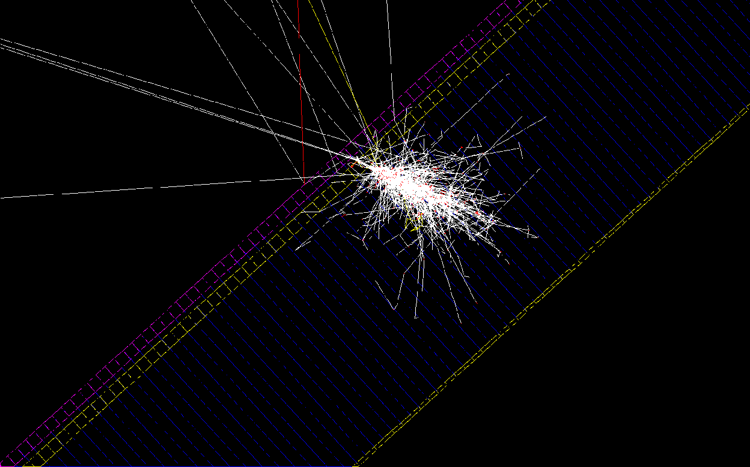
Geant4 Simulating scintillator before preshower
Lots of back scattering!
γ
Scintillator
Thickness = 5 mm
Preshower Pb
Preshower Scint

Slide 11
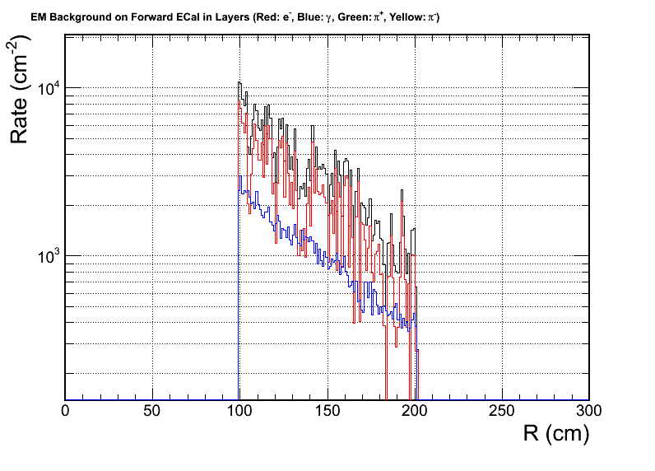
Main concern is back ground rate in open geometry
Dominated by low energy electrons
Source of low energy electrons
20% from end cap of heavy gas Cerenkov, other from more upstream
Have to be placed before MPRC, which have lots of material for conversion!
Rate: if 120 segment take 2MeV MIP per segment

Slide 12
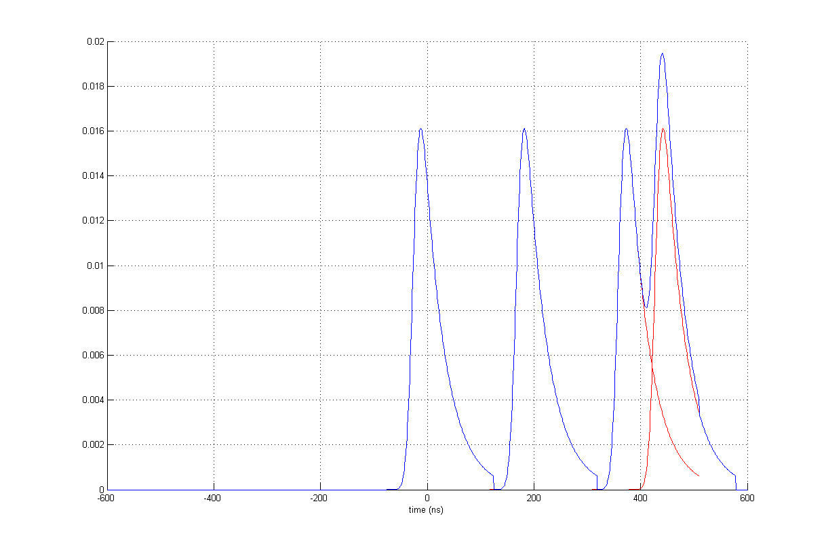
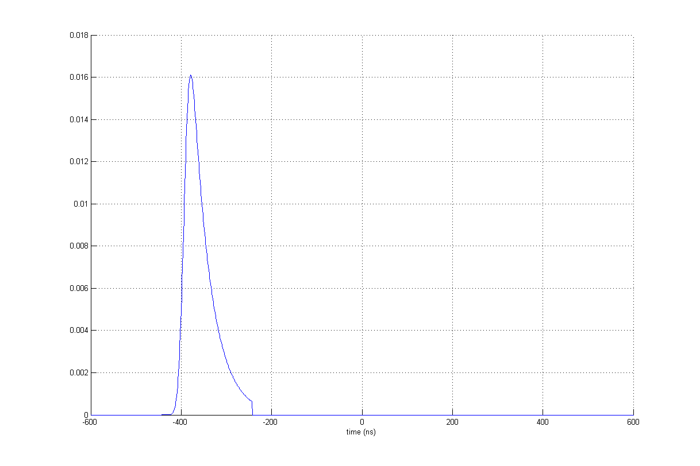
How signal looks like
30 sectors
8 MHz MIP
60 sectors
4 MHz MIP
240 sectors
1 MHz MIP

Slide 13
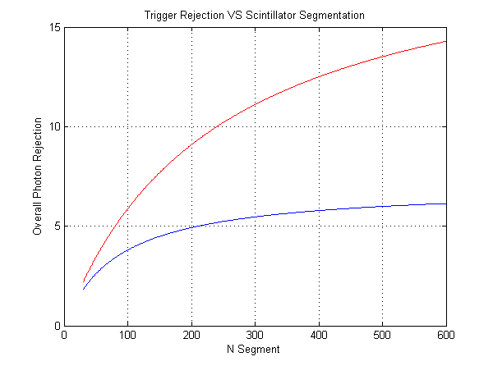
Optimizing the segment
Lower energy photon (1-2 GeV) are dominant, which we have higher rejection
Trigger require 5:1 rejection. Satisfied with margin at a 120 segments
A 50ns coincidental window with calorimeter assumed. Expect improvement in FPGA level
Low-E (1-2 GeV)
Full E range (1-7 GeV)

Slide 14
Backup - Simulated efficiency & rejection
Electron
Pion
Photon
Energy range: 1-7 GeV, flat phase space for SIDIS-forward
MIP peak
Efficiency
~1:7 γ-rej with cut below MIP peak
Cut on energy dep.

Slide 15
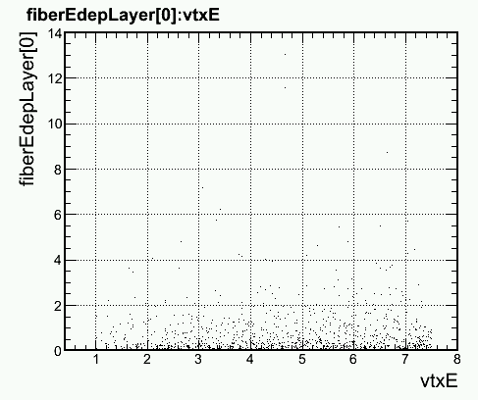
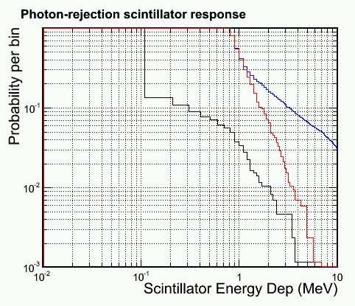
Backup - Simulated efficiency & rejection
Most photon focus on lower energy side (π₀ decay)
And lower energy photon produce less back scattering
Therefore, do the study again with 1<E_{γ}<2 GeV
Electron
Pion
Photon
1<E_{γ}<2 GeV
Efficiency
E dep for photons (MeV)
~1:20 γ-rej with cut below MIP peak
E_{γ} (GeV)
Cut on energy dep.

Slide 16
Full background simulation For SIDIS Forward Calorimeter

Slide 17
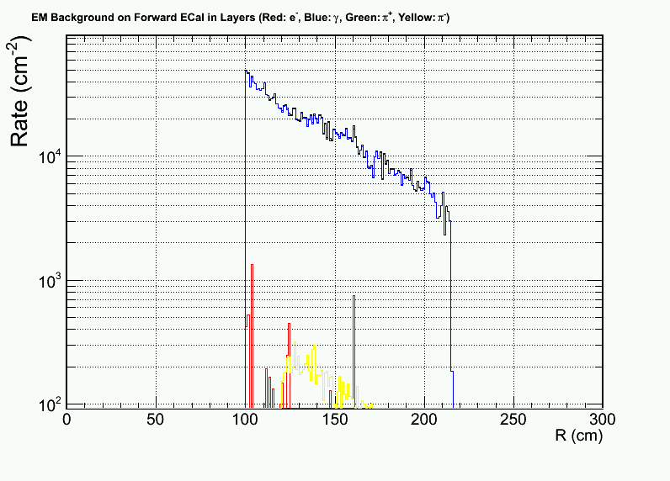
SIDIS forward background
We have good “shielding” with 2X0 preshower, save us from 1GHz/cm2 photon background
Dominated background: low energy photon 1-100 MeV, which lead to 10kHz/cm² MIP signal on preshower
The background on shower is small
Used in this study:
Most inner side (highest rate)
100 cm² segmented preshower
For outer radius, rate is 10x lower, cause segmentation can be used

Slide 18
Compare background to signal

Slide 19
Offline: No change in eff., reduce rejection at low-p end
Rejection reduced due to preshower pile up
w/o background
w/ realistic backgroun

Slide 20
Hexagon Calorimeter Trigger
3GeV electron shower
On hexagon calorimeter grid
Orthographic projection along z axis
Hexagon Provide nice shower area cuts – can be used in both online and 1st-order offline analysis
clustering – contains ~96% of shower energy
FPGA-based pattern trigger (HEX 1+6 trigger)

Slide 21
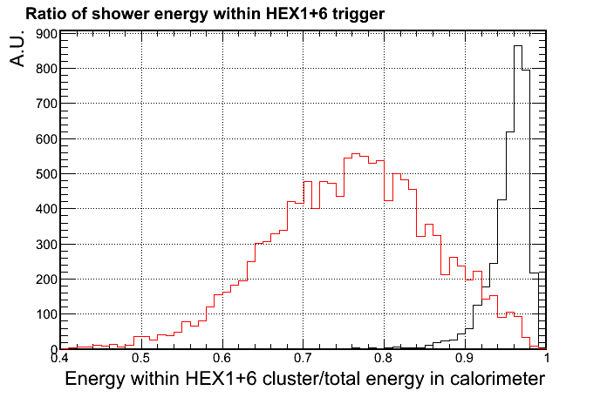
Online: Trigger with background
Hadronic shower which introduce a pion contamination, usually spread into larger area
A localized trigger, e.g. HEX1+6 trigger and significantly suppress the hadron response, while maintaining high eff. for electrons
Ratio of EM shower contained
Ratio of Pion shower contained

Slide 22
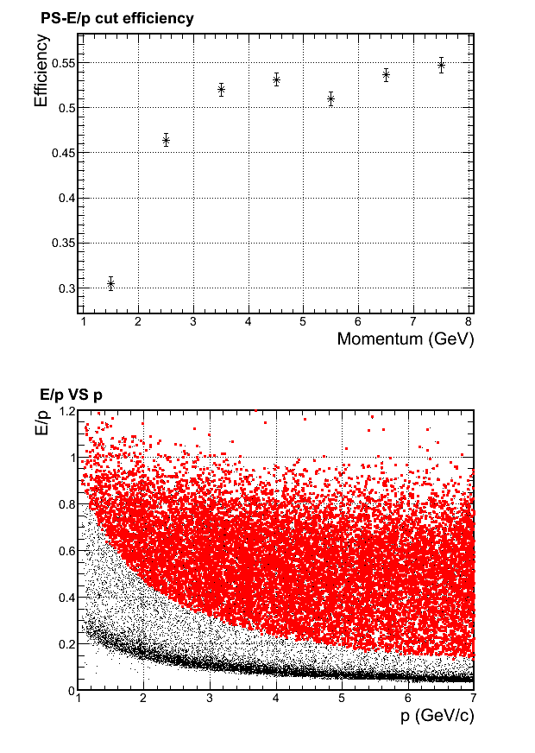
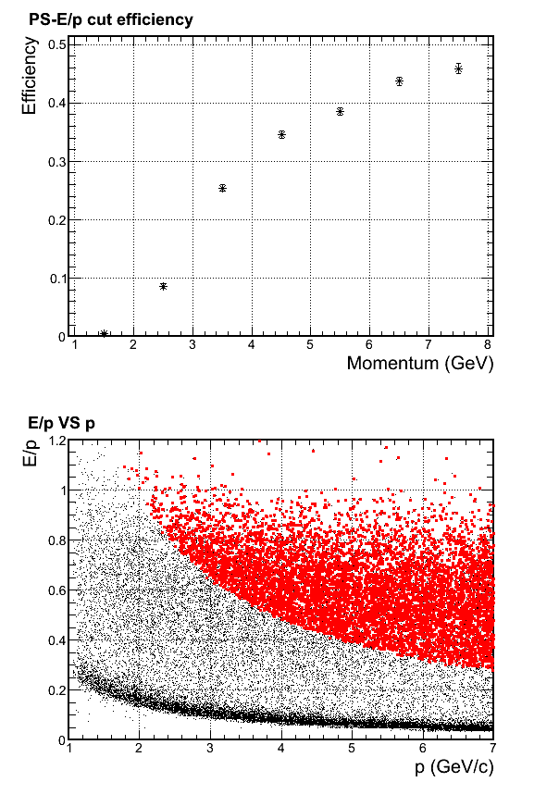
If only trigger on total EM energy
Do receive very high electron efficiency in simulation
However, for SoLID, wide momentum range is used.
Therefore to accept lowest momentum electrons, the shower cut have to be low.
the rejection for high momentum pion will be very limited
Simulated with full background . The pion response is shown below:
HEX1+6 Trigger
> 0.95GeV
HEX1+6 Trigger
> 1.95GeV
* Accepted
* All

Slide 23
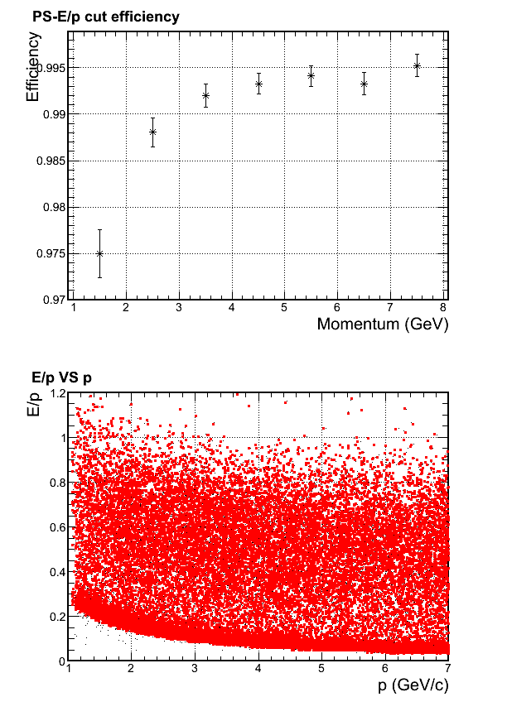
Charged Particle (Pion) trigger efficiency
Pion trigger response
* Accepted
* All
Full background simulation for pion efficiency shown on the right.
Trigger cut is HEX1+6 trigger raw signal is larger than 85% MIP (which is MIP – 2σ = 220MeV calibrated)
The background which pass this cut
rate ~20Mhz
is dominated by photon.
With an additional 1/5 suppression from scintillator, we get ~4MHz trigger rate, which fit in the DAQ limit (PR12-10-006)

Slide 24
Backup

Slide 25
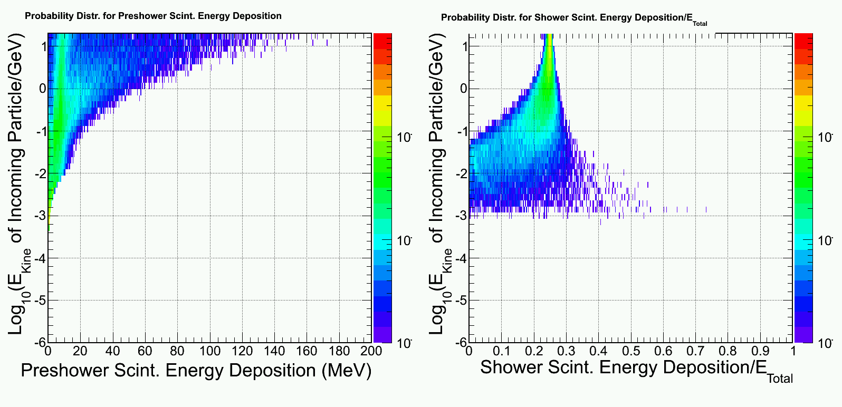
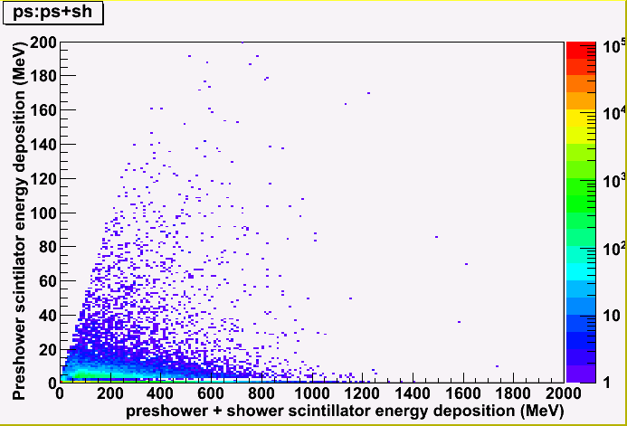
Background simulation
Example: photon response
Simulate background at front surface of calorimeter (Zhiwen)
Simulate calorimeter response to a wide range of background particle
Combine above two sum over all contributions (EM, DIS, pi0, pi+,pi-) -> background distribution
Imbed into the signal simulation (high energy e, pi), assuming a 50ns coincidental window
background for pi⁻ + e⁻

Slide 26
For PVDIS , MIP rate distribution Dominated by pion and electrons

Slide 27
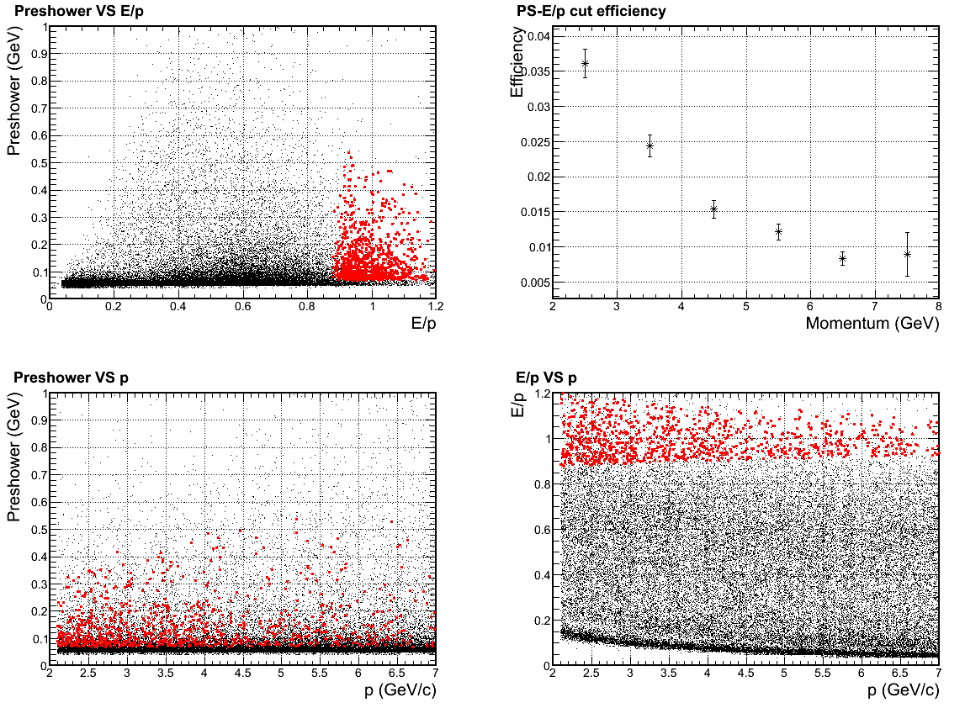
The result is still under check
Simulated 1+6 shower cluster + (10cm)² preshower for pion + electron bgd (do we still have direct photon sight on baffle?)
It did lead to significant change in pion rejection due to pile ups

