Slide 1
Simulation Updates
Jin Huang
Los Alamos National Lab

Slide 2
SIDIS Large Angle EC

Slide 3
Calorimeter background simulation
Simulate background at front surface of calorimeter (Zhiwen) and look at the most inner radius (highest background)
Simulate calorimeter response to a wide range of background particle
Combine above two sum over all contributions (EM, DIS, pi0, pi+,pi-) -> background distribution
Imbed into the signal simulation (high energy e, pi), assuming a 50ns coincidental window

Slide 4
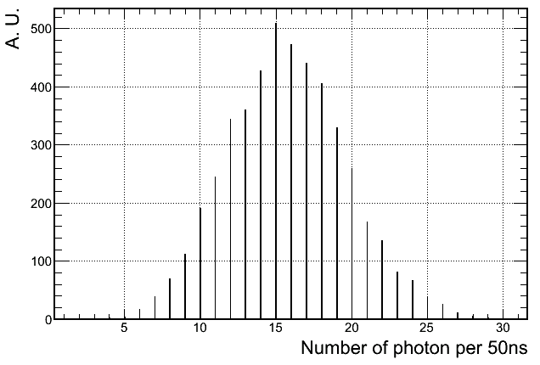
Dominant background
0.3 GHz low energy photon for inner-R 1+6 hexagon clusters
But well shielded by 2-X0 preshower absorber

Slide 5
Background distribution
Photon
Electron
Pion

Slide 6
Pion rejection w/o background @ 94% electron eff

Slide 7
w/ background (inner-R) Electron efficiency

Slide 8
w/ background (inner-R) Pion efficiency (1/rejecton)
Worse rejection
But not below the bar (1:100)

Slide 9
Trigger turn-on curve
Proposed trigger rate and rejection
Pion rejection needed ~ 20:1, but I think can be relaxed
Additional photon rejection help more
Single-Shower 1+6 cluster trigger tested
Full background spectrum considered
Cut on shower energy deposition > 2.6 GeV
Very high electron trigger efficiency

Slide 10
Pion turn-on curve Single-Shower trigger > 2.6 GeV
Rejection > 20:1 for lower energy pions

Slide 11
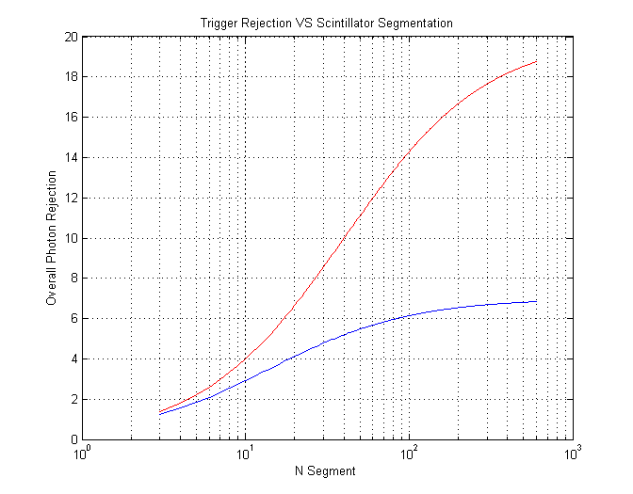
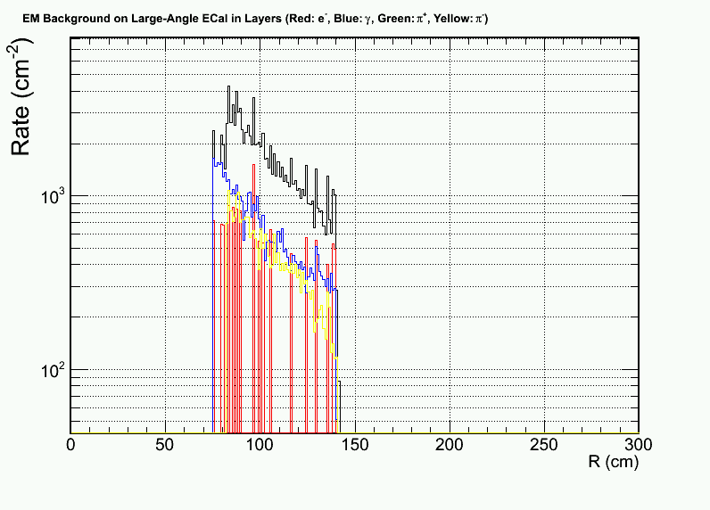
What if we also want to rejection photons? - Add a scintillator pad
Scintillator MIP rate
1GeV < Eγ< 7 GeV
1GeV < Eγ< 2 GeV
Photon originated
Electron
Pion
~10:1 rejection with 45 segments (matching size)

Slide 12
PVDIS Calorimeter
Simulated using Apr 2012 BaBar baffle
Still trying tricks to improve performance

Slide 13
Why it is hard – lots of deep pions
Photon
Electron
Pion- Pion+

Slide 14
Per-event pion rate for 1+6 hexagon cluster at inner radius
Electron
Pion-
Pion+
High pi+ rate??
Need to be checked

Slide 15
Electron efficiency w/ background at inner radius. Ignore gamma and pi+ bgd
Background pile ups

Slide 16
Pion efficiency w/ background at inner radius. Ignore gamma and pi+ bgd
Significant drop in rejection

Slide 17
What we can further try
Position or kinematic dependent trigger threshold and cut threshold
Use track multiplicity to assist calorimeter cuts

