Slide 1
Simulation Updates on PVDIS EC
Jin Huang
Los Alamos National Lab

Slide 2
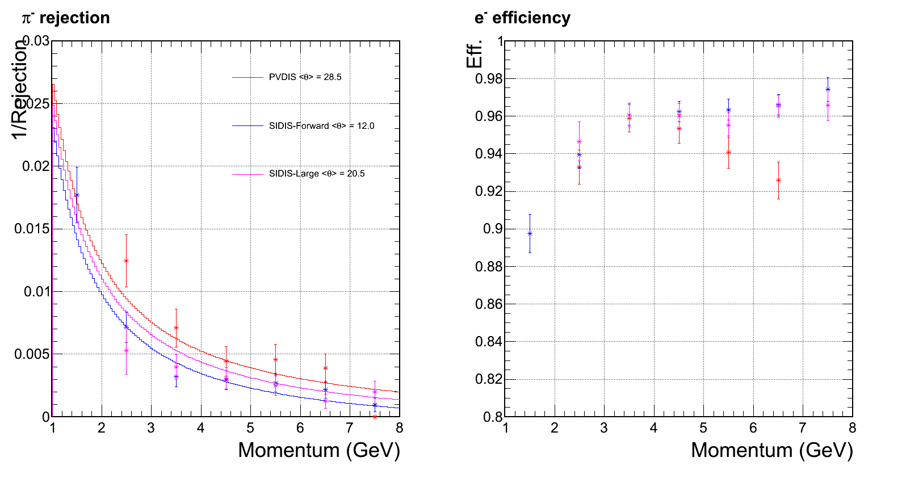
EC performance w/o background
Cited from March collaboration Meeting
Preshower ID power drop significantly at this bin

Slide 3
Sixth update of CLEO background
A.K.A. Babar More1 Block in Zhiwen’s notes
Significant improvement observed

Slide 4
Updated radiation dose VS layers
Lead baffle
~ 11 layers per radiation length
High radiation φ slice
Low radiation φ slice

Slide 5
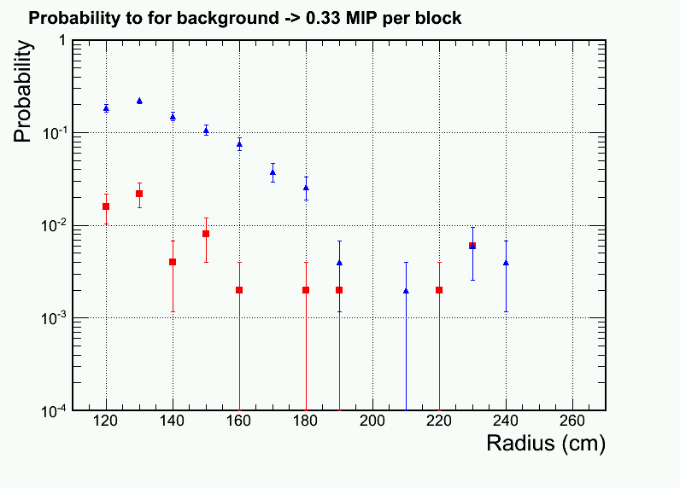
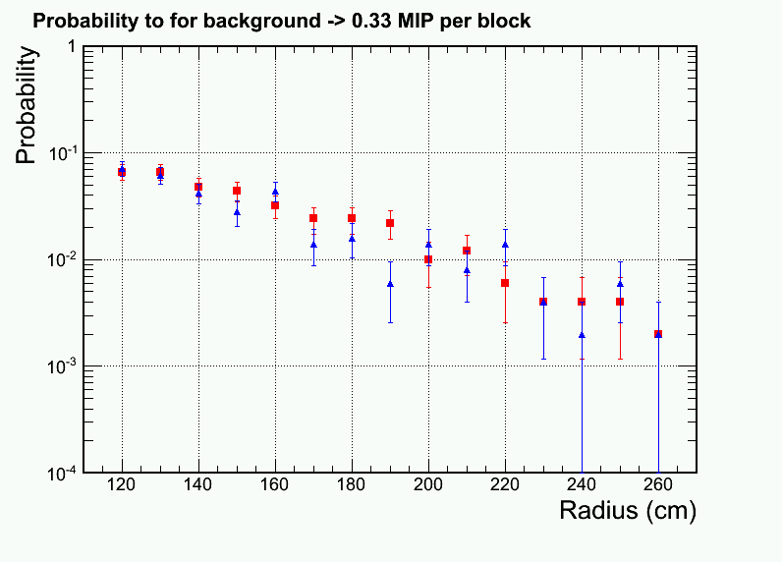
Readout occupancy per shower channel for ~75MeV zero suppression
Low Radius was high
Lead baffle, 6th bgd update
Zhiwen’s Babar More 1 Block baffle
Krypton baffle, 5th bgd update
Zhiwen’s Babar More 1 baffle
High radiation phi slice
Low radiation phi slice

Slide 6
Composition of background inner radius region within the high-radiation azimuthal sectors →Photon dominated
lead baffle
Photon (3.5GHz @ R=120 cm): EM and π⁰→γ origin
Electron
Pion- Pion+ Proton

Slide 7
PID performance – low radiation phi slice
Lead baffle

Slide 8
PID performance – high radiation phi slice
Lead baffle

Slide 9
Trigger curve – low radiation phi slice
Lead baffle

Slide 10
Trigger curve – high radiation phi slice
Lead baffle

Slide 11
New trigger strategy
Embedding bgd stochastically according to its 3D distribution
Look for percentage of 30ns trigger window that pass trigger threshold
Good for low energy background pile ups
Can not handle rare events due to stat. limit
Handle p<1GeV background particle trigger
Embedding bgd stochastically according to its 3D distribution
Produce trigger turn on curve for high energy particle
Good for rare events, e.g. DIS
Can not handle low energy particle dominated trigger, which is non-linear
Handle p>1GeV particle dominated trigger
From background embedding
From trigger turn on curve

Slide 12
Low energy (P<1GeV) particle trigger
Place a calorimeter 6+1 cluster at given reference radius location
Assume a 30ns trigger integration window, stochastically simulate which bgd particle would fly into calorimeter
including e/gamma/pi+/-/0/proton, 1keV – 1GeV
Particle with P>1GeV is ignored in this case, since their trigger rate should be counted in high energy trigger curve x rate study
Simulate scintillator energy deposition in the shower part for all these particle and sum to give a trigger signal
Repeat for 60k times, check the probability to produce a trigger. Trigger threshold set according to the radius
Multiply by number of trigger channels and get the total low energy trigger rate

Slide 13
Inspect on few triggered case
For low radiation slice at R=230 cm, trigger threshold is
scintillator energy > 283 MeV
targeted high trigger efficiency for electron with E>1.5 GeV
9 out of 60k simulations produced a trigger
n_* : number of that particle for 30ns window
sh_*: shower scintillator energy deposition for that particle species
************************************************************************************************************************************ * Row * n_elec * sh_elec * n_gamma * sh_gamma * n_gamma_p * sh_gamma_ * n_pip * sh_pip * n_pim * sh_pim * comment ************************************************************************************************************************************ * 5116 * 0 * 0 * 11 * 1.4133610 * 4 * 0.8096210 * 0 * 0 * 1 * 287.67065 <- Pi- dominated * 10508 * 0 * 0 * 13 * 0 * 10 * 17.858110 * 0 * 0 * 1 * 272.90136 * * 12082 * 0 * 0 * 13 * 1.1497589 * 5 * 3.1542911 * 1 * 328.03814 * 0 * 0 <- Pi+ dominated * 26961 * 0 * 0 * 15 * 0 * 9 * 13.370458 * 0 * 0 * 1 * 277.56695 * * 31170 * 0 * 0 * 18 * 3.771492 * 4 * 3.6389594 * 0 * 0 * 1 * 301.99948 * * 37962 * 0 * 0 * 12 * 0 * 2 * 0 * 0 * 0 * 2 * 315.43313 * * 40813 * 0 * 0 * 20 * 10.953822 * 6 * 12.016947 * 0 * 0 * 1 * 266.20440 * * 42284 * 1 * 0 * 13 * 1.1786102 * 5 * 1.1385887 * 1 * 82.557189 * 1 * 216.75323 <- two pion pile up * 42872 * 0 * 0 * 16 * 0.9754827 * 4 * 0 * 0 * 0 * 1 * 285.33731 * ************************************************************************************************************************************

Slide 14
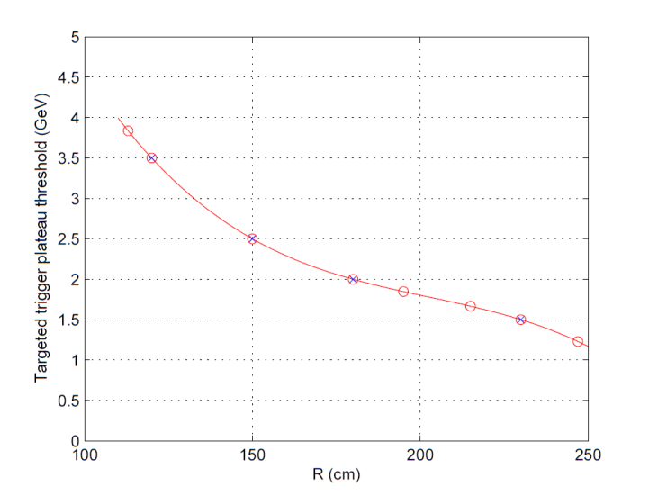
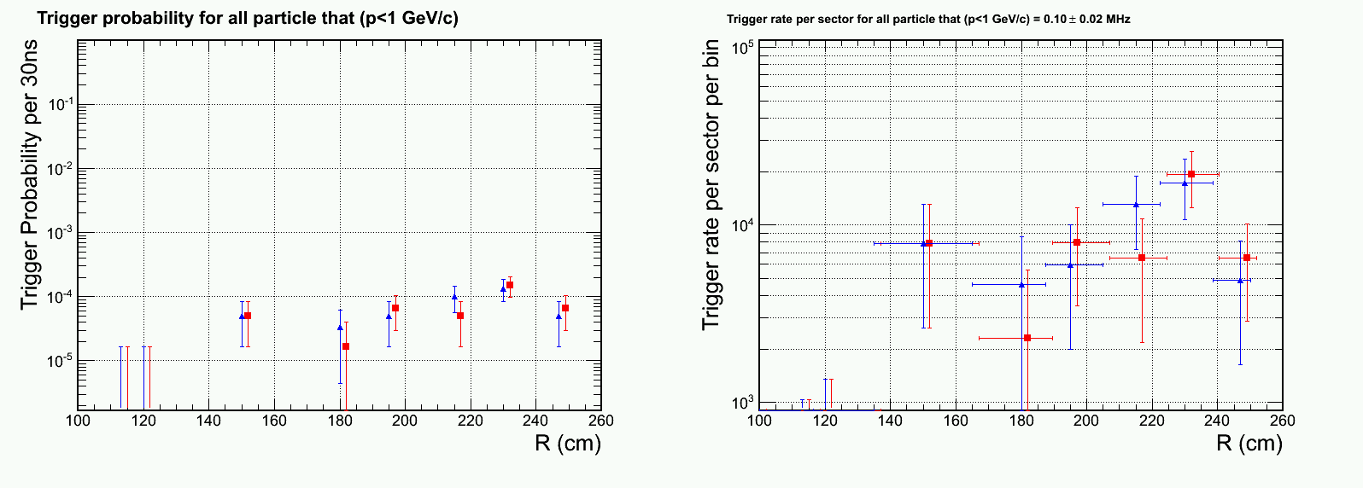
Total rate from P<1GeV particle
Sum = 0.10 ± 0.2 MHz per sector
Statistical precision can be improved with more simulation
Ignored correlation between neighboring trigger channels -> over estimate
Dominated by radius region R~230cm, where trigger threshold is low (E_{target}=1.5GeV)
High radiation phi slice
Low radiation phi slice

Slide 15
Fifth update of CLEO background
* A.K.A. Babar More1 in Zhiwen’s notes
* Inputs received on Friday Sept 6
Data points saved to ROOT format and uploaded to SVN:
https://solid.physics.umass.edu/svn/solid/solidtech/calorimeter/figs

Slide 16
Comments on this update
Use Babar More1 baffle in Zhiwen’s notes
Two version background are generated:
With krypton baffle for hadron background and that with lead baffle
Now only one region show significant radiation effect: inner radius in the higher-radiation phi slice
The updated dominate background is photons, which can be attenuated by x10 with 4 radiation length of absorbing material (~2cm lead)
Updated to use 30 ns-equivalent ADC integration window instead of 50 ns
Suggested in previous meetings
Confirmed again with Alex
Simulated assuming NO supporting structure between preshower and shower
Supporting structure could be before the Pb absorber or between Pb and the preshower scintillator
Updated plots and data points uploaded to SVN https://solid.physics.umass.edu/svn/solid/solidtech/calorimeter/figs

Slide 17
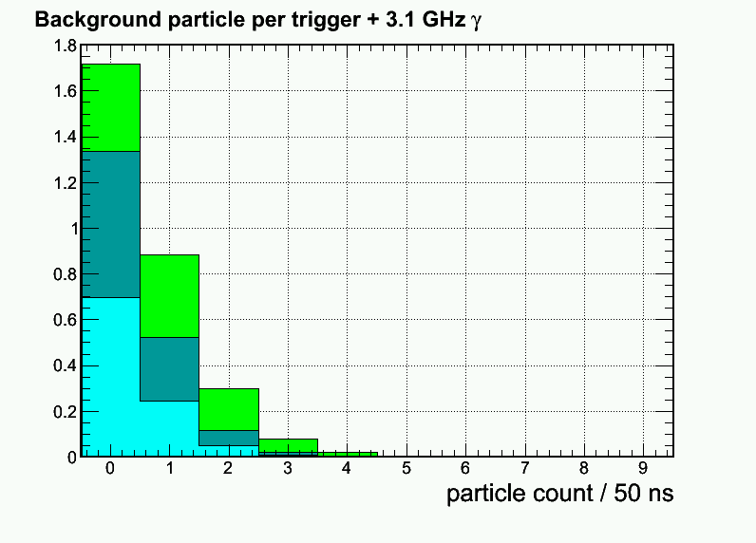
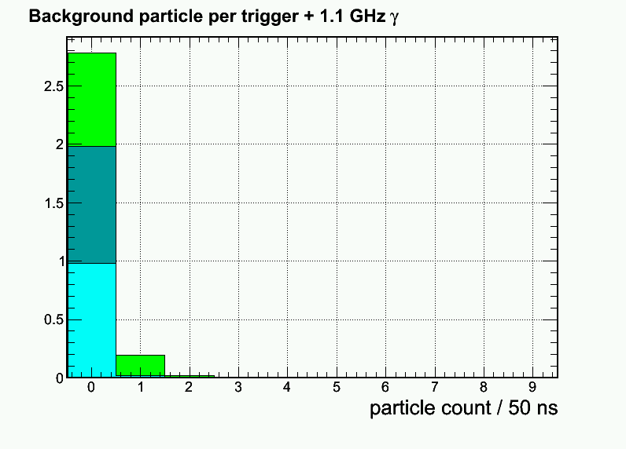
Updated: Per-event pion rate for 1+6 hexagon cluster at Mid radius, high radiation φ-slice
4th Update
Electron
Pion-
Pion+
Krypton baffle
New 5th Update
Significant improvement
in charged particle

Slide 18
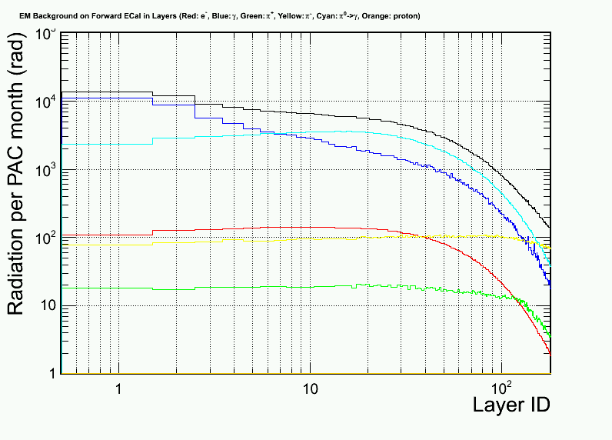
Updated radiation dose VS layers (High radiation φ slice)
Photon (EM) <- dominant!
Photon (Pi⁰)
Electron
Pion- Pion+ Proton
Krypton baffle
Improved
Soft EM γ
4th Update
New: 5th Update

Slide 19
Updated radiation dose VS layers
Krypton baffle
less than x2 smaller
~ 11 layers per radiation length
High radiation φ slice
Low radiation φ slice

Slide 20
Updated radiation dose VS layers
Lead baffle
less than x2 smaller
~ 11 layers per radiation length
High radiation φ slice
Low radiation φ slice

Slide 21
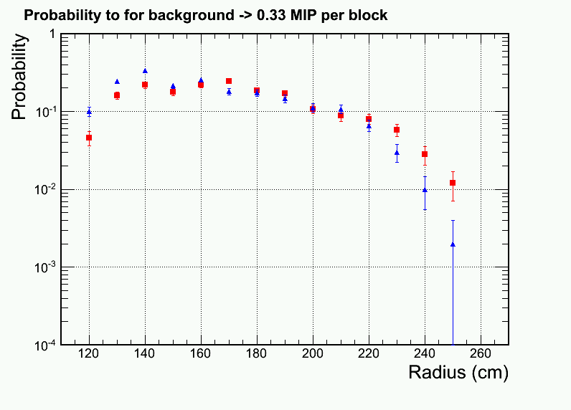
Readout occupancy per shower channel for ~75MeV zero suppression
Low Radius remains high
Krypton baffle
High radiation phi slice
Low radiation phi slice

Slide 22
Composition of background inner radius region within the high-radiation azimuthal sectors →Photon dominated
Krypton baffle
Photon (3.5GHz @ R=120 cm): EM and π⁰→γ origin
Electron
Pion- Pion+ Proton

Slide 23
PID performance – low radiation phi slice
Krypton baffle
Significantly improved

Slide 24
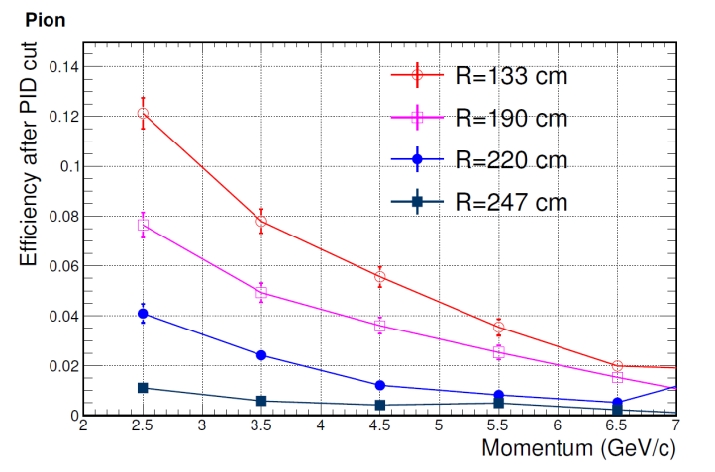
PID performance – high radiation phi slice
Lower radius remains high
Krypton baffle
4th update, last curve as reference
improved now

Slide 25
Trigger curve – low radiation phi slice
Krypton baffle

Slide 26
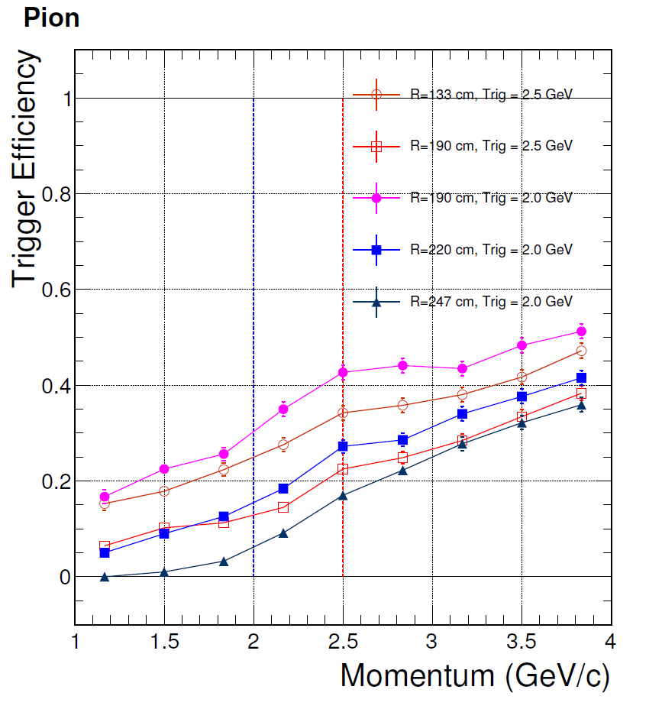
Trigger curve – high radiation phi slice
4th update
as reference
improved now
Krypton baffle

Slide 27
PID performance – low radiation phi slice
Lead baffle

Slide 28
PID performance – high radiation phi slice
Lead baffle

Slide 29
Trigger curve – low radiation phi slice
Lead baffle

Slide 30
Trigger curve – high radiation phi slice
4th update
as reference
Lead baffle

Slide 31
New trigger strategy
Embedding bgd stochastically according to its 3D distribution
Look for percentage of 30ns trigger window that pass trigger threshold
Good for low energy background pile ups
Can not handle rare events due to stat. limit
Handle p<1GeV background particle trigger
Embedding bgd stochastically according to its 3D distribution
Produce trigger turn on curve for high energy particle
Good for rare events, e.g. DIS
Can not handle low energy particle dominated trigger, which is non-linear
Handle p>1GeV particle dominated trigger
From background embedding
From trigger turn on curve

Slide 32
Forth update of CLEO background
Cutting 2cm away on 1st baffle inner radius
Received background simulation from Zhiwen on May 24

Slide 33
Updated: Per-event pion rate for 1+6 hexagon cluster at Mid radius, high radiation φ-slice
3rd Update
Electron (mostly absorbed in Pb)
Pion-
Pion+
New 4th Update

Slide 34
Updated radiation dose VS layers (High radiation φ slice)
Photon (EM) <- dominant!
Photon (Pi⁰)
Electron
Pion- Pion+ Proton
Improve by two-fold
Soft EM γ
Direct Pi⁰ γ
3rd Update
New: 4th Update

Slide 35
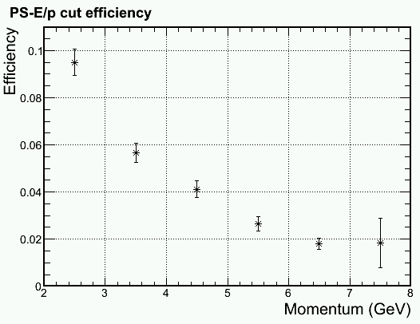
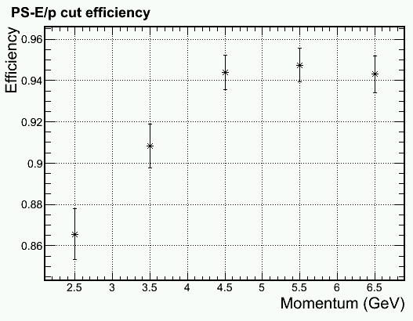
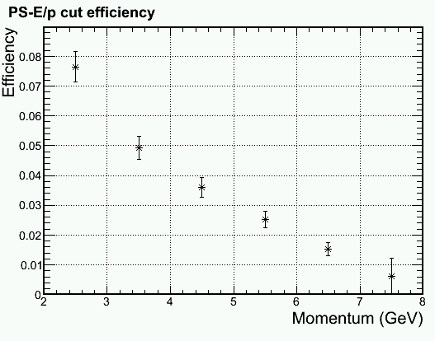
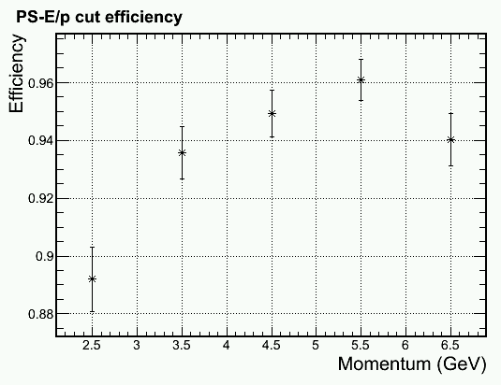
Update on PID Mid radius, higher γ φ-band shown Other configuration also simulated
Update
Improvement
Improvement
Pion Efficiency
Electron Efficiency

Slide 36
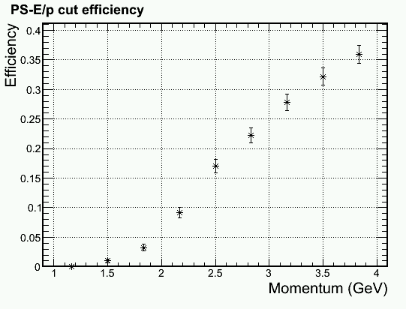
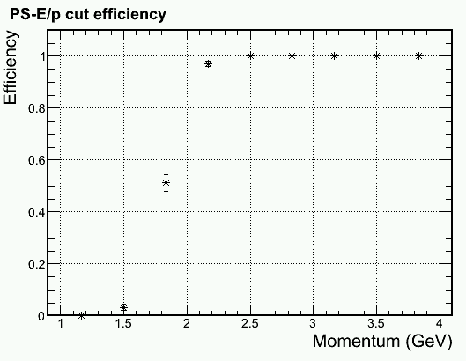
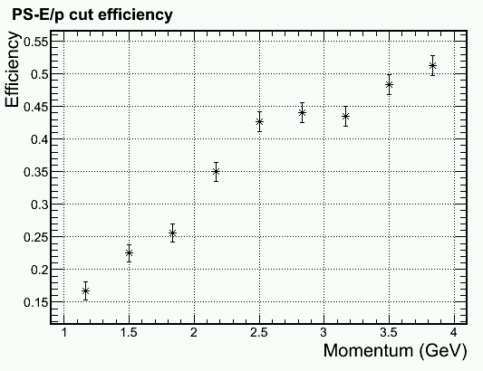
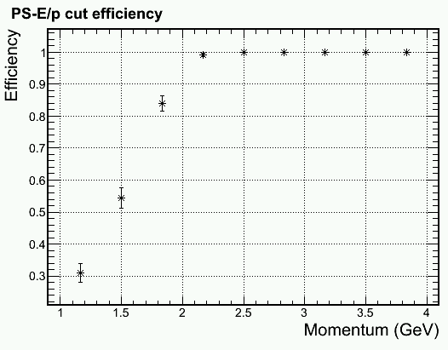
Trigger turn on curve for 2 GeV electron Shower Hex 1+6 trigger > 1.6 GeV
Outer radius, higher γ φ-band, full bgd
100% pass for ~250 events/bin
Physics
, full bgd
Middle radius, higer γ φ-band, full bgd
Physics
Pion Efficiency
Electron Efficiency

Slide 37
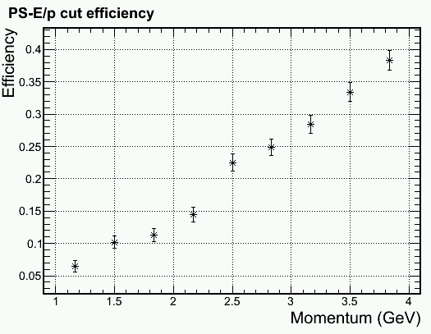
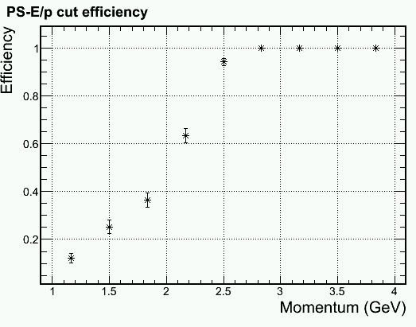
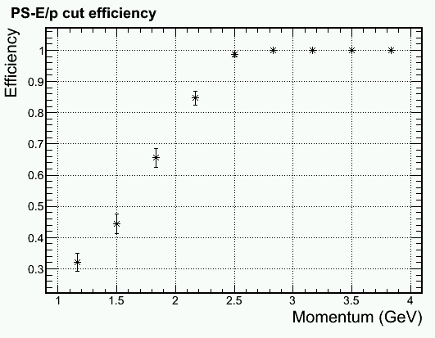
Trigger turn on curve for 2.5 GeV electron Shower Hex 1+6 trigger > 2.1 GeV
Middle radius, higher γ φ-band, full bgd
Physics
Inner radius, higer γ φ-band, full bgd
Physics
Pion Efficiency
Electron Efficiency

Slide 38
Readout occupancy per shower channel for ~75MeV zero suppression
Improvement
High radiation phi slice
Low radiation phi slice

Slide 39
Third update of CLEO background
Received background simulation from Zhiwen on May 19
Running background imbedding

Slide 40
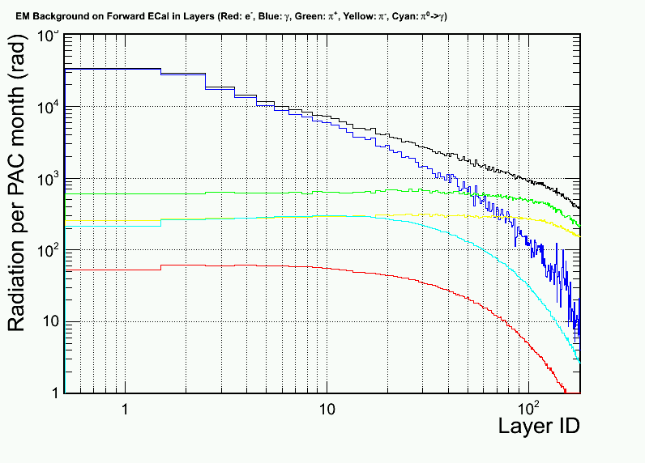
Updated radiation dose VS layers
Photon (EM) <- dominant!
Photon (Pi⁰)
Electron
Pion- Pion+ Proton
From 2nd Update
from 2nd update
Soft EM γ
Direct Pi⁰ γ
High radiation azimuthal region
Low radiation azimuthal region

Slide 41
Background imbedding and distribution Mid-R, High Radiation phi slice
Photon (6GHz/6+1 Hex cluster)
Electron
Pion- Pion+ Proton

Slide 42
Updated: Per-event pion rate for 1+6 hexagon cluster at Mid radius, high radiation φ-slice
Electron (mostly absorbed in Pb)
Pion-
Pion+
+ 6 GHz photon not shown (3GHz for lower φ-radiation )

Slide 43
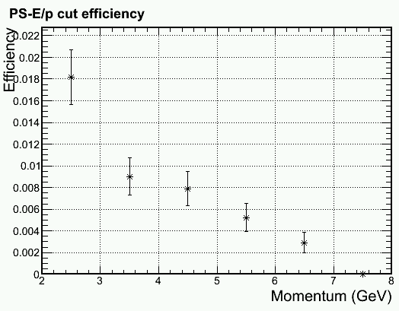
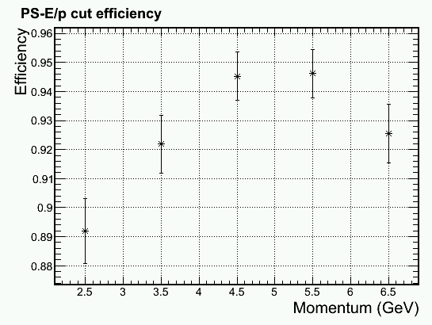
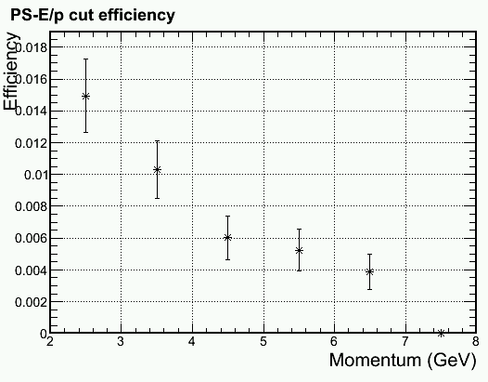
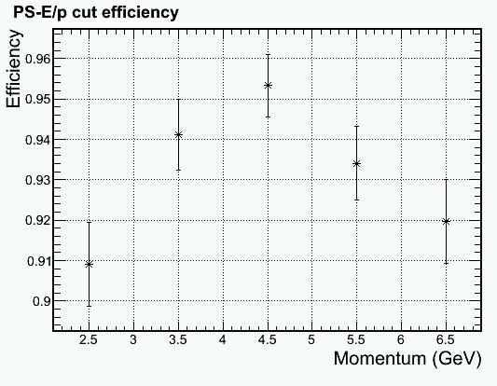
Update on PID with DC component removal (PS > MIP + Bgd + (2-3) σ)
Outer radius, higher γ φ-band
Due to Soft EM γ
Outer radius, lower γ φ-band
Pion Efficiency
Electron Efficiency

Slide 44
Update on PID with DC component removal (PS > MIP + Bgd + (2-3) σ)
Outer radius, higher γ φ-band
Mid radius, higher γ φ-band
Due to Hadron rate
Pion Efficiency
Electron Efficiency

Slide 45
More detail in PID cut Middle radius, lower γ φ-band, full bgd
Pion Efficiency
Electron Efficiency

Slide 46
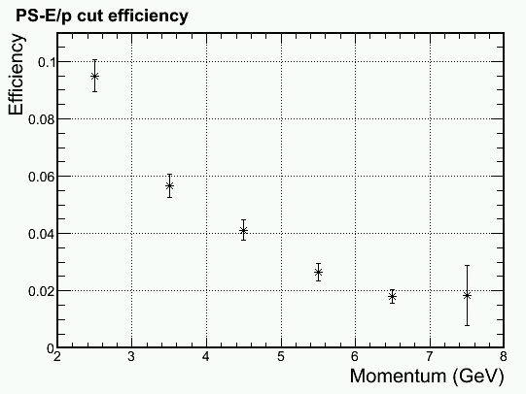
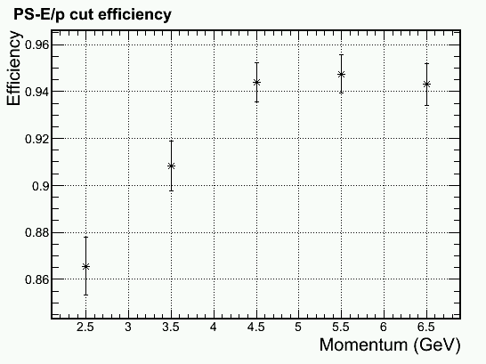
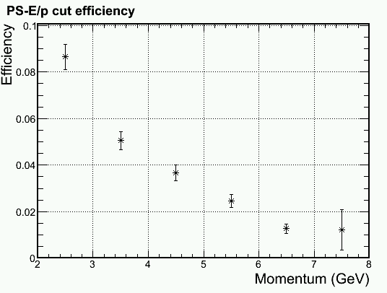
Update on PID with DC component removal (PS > MIP + Bgd + (2-3) σ)
Inner radius, higher γ φ-band
Inner radius, lower γ φ-band
Pion Efficiency
Electron Efficiency

Slide 47
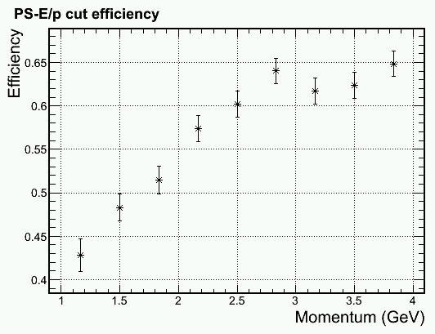
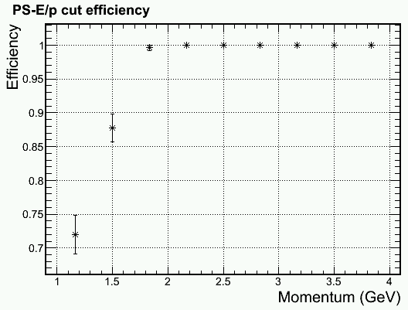
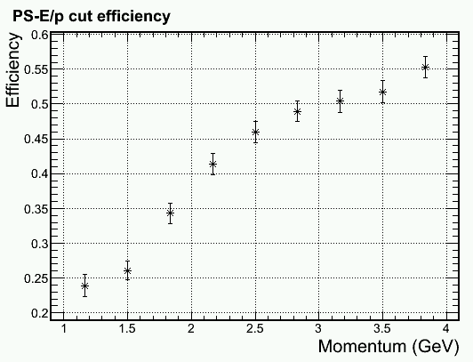
Trigger turn on curve for 2 GeV electron Shower Hex 1+6 trigger > 1.6 GeV
Inner radius, higher γ φ-band, full bgd
100% pass for ~250 events/bin
Physics
, full bgd
Middle radius, higer γ φ-band, full bgd
Physics
Pion Efficiency
Electron Efficiency

Slide 48
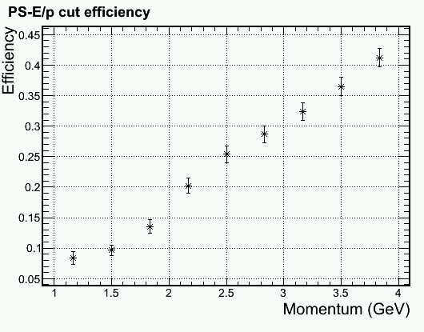
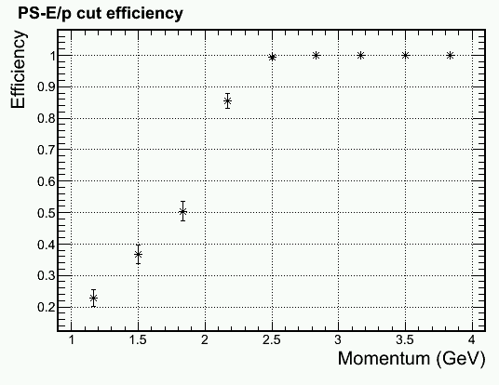
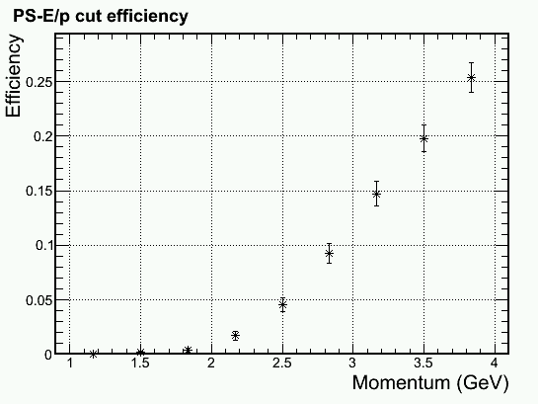
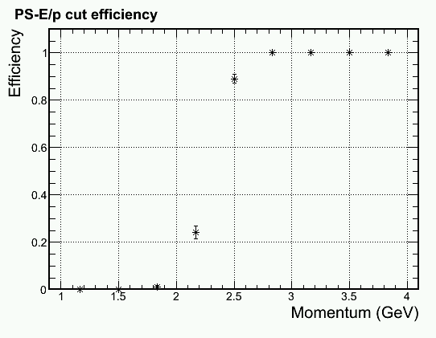
Trigger turn on curve for 2.5 GeV electron Shower Hex 1+6 trigger > 2.1 GeV
Middle radius, higher γ φ-band, full bgd
Physics
Outer radius, higer γ φ-band, full bgd
Physics
Pion Efficiency
Electron Efficiency

Slide 49
More detail in trigger cut Middle radius, higher γ φ-band, full bgd Shower Hex 1+6 trigger > 2.1 GeV
Pion Efficiency
Electron Efficiency

Slide 50
Readout occupancy per shower channel for ~75MeV zero suppression
High radiation phi slice
Low radiation phi slice

Slide 51
Trigger Study for Second update of CLEO background
Reported May 7 Calorimeter Meeting

Slide 52
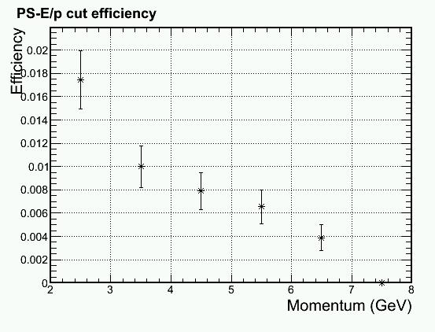
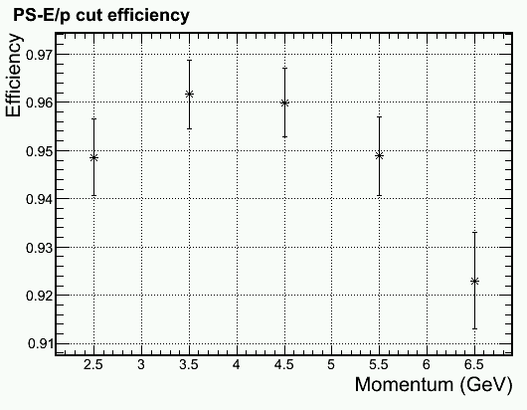
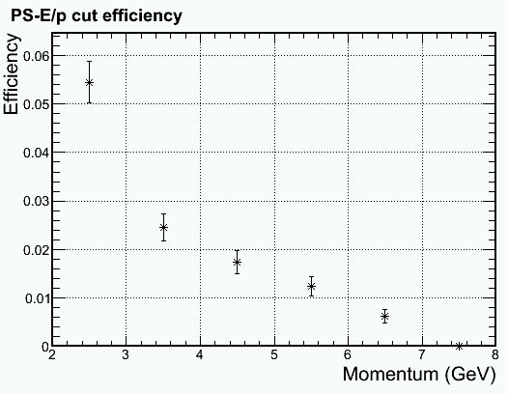
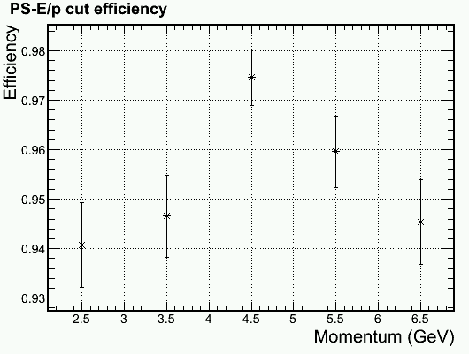
Update on PID with DC component removal (MIP + 2.5 σ)
Outer radius, higher γ φ-band
Mid radius, higher γ φ-band
Pion Efficiency
Electron Efficiency

Slide 53
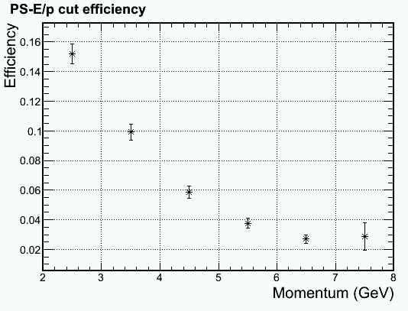
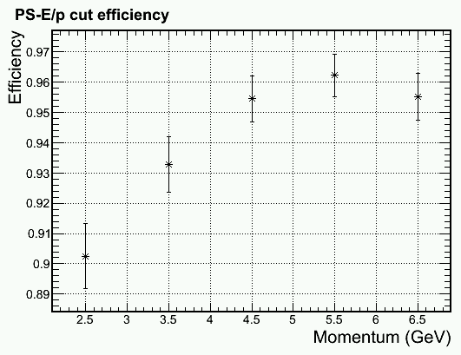
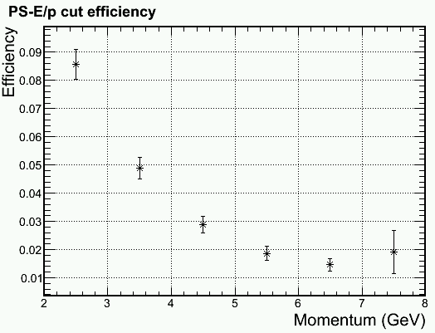
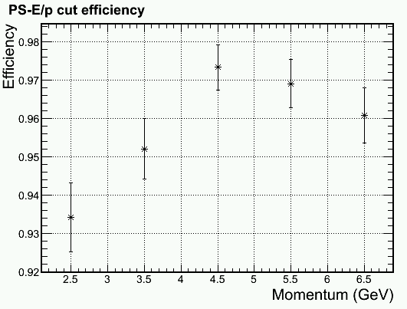
Update on PID with DC component removal (MIP + 2.5 σ)
Inner radius, higher γ φ-band
Inner radius, lower γ φ-band
Pion Efficiency
Electron Efficiency

Slide 54
Pion Trigger Turn-On Curve (No background), Electron Eff. > 97%
+ Preshower
-> x2 improve
Hex 1+6 Shower Trigger > 1.6GeV (for 2GeV electron)
+ Preshower Pad on top of central shower block > MIP + 1σ

Slide 55
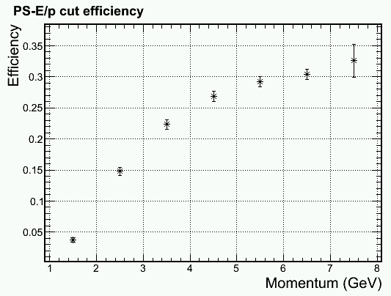
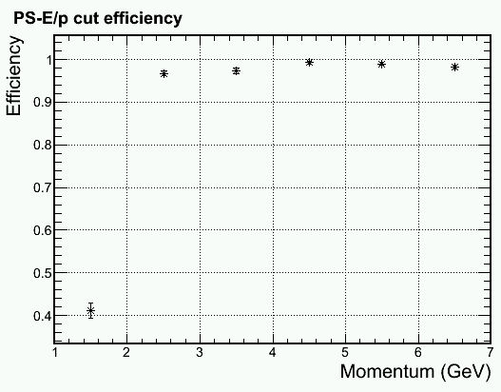
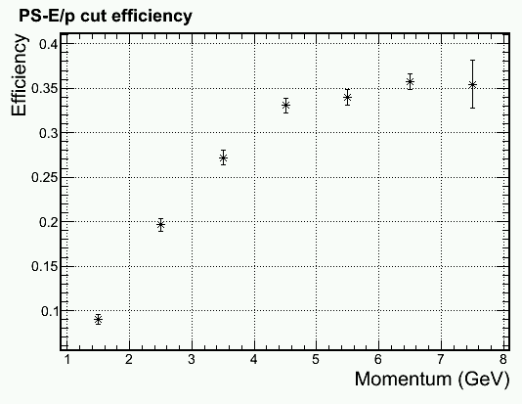
Trigger turn on curve with background
Middle radius, higher γ φ-band
Electron > 2GeV
Inner radius, higher γ φ-band
Electron > 2GeV
Pion Efficiency
Electron Efficiency

Slide 56
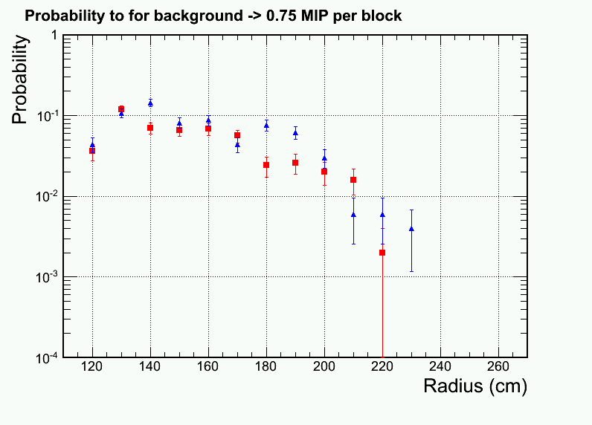
All background particle pile ups
Look at single Hexagon shower blocks which passed 0.75 MIP cut.
Full background spectrum used
ADC integration window = 50ns
~10% blocks will produce a 0.75MIP signal for clock trigger
Data readout is least 10% of modules
A shower MIP trigger is likely just trigger on lower energy particles
higher γ φ-band
lower γ φ-band

Slide 57
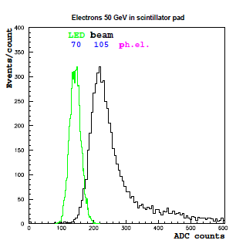
Quick estimation on impact of preshower radiation damage
Radiation on preshower is high for PVDIS
Last meeting we showed that preshower will show radiation damage in a few months run in PVDIS configuration (assuming no cure for photon bgd)
Estimated light loss is a fraction depending on the choice of scintillator and fibers
Our preshower was designed to produce high photon yield
Scint . thickness = 2cm with WLS imbedding
Expected photon / MIP = 140 e_{γ}
After 50% radiation damage (70 e_{γ}), MIP resolution from photon fluctuation = 12%
Intrinsic fluctuation on MIP sampling = 23%, PID cut on MIP + 2.5 σ
Therefore, effect on radiation damage to MIP resolution is expected to be minimal, as long as we calibrate the photon yield online
Beam test for LHCb pad (1.5cm thick)
From LHCb technical design report
1.5cm -> 105 e_{γ}

Slide 58
Second update of CLEO background
Reported Apr 30 Calorimeter Meeting

Slide 59
For each sector, background rate were calculated in high and low regions in phi
Babar baffle (for compare)
Photon (EM) <- dominant!
Photon (Pi⁰)
Electron
Pion- Pion+
Soft EM γ
Direct Pi⁰ γ
High radiation azimuthal region
Low radiation azimuthal region

Slide 60
Background distribution New: with photon and pi+, Mid R, High Rad phi slice
Photon (7 GHz/6+1 Hex cluster!)
Electron
Pion- Pion+

Slide 61
PID Performance (pion eff. w/ 94% elec. eff) w/o photon and pi+, Mid R, High Rad phi slice

Slide 62
PID Performance (pion eff. w/ 94% elec. eff) w/o photon, w/ pi+, Mid R, High Rad phi slice

Slide 63
PID Performance (pion eff. w/ 94% elec. eff) w/ photon, w/ pi+, Mid R, High Rad phi slice

Slide 64
Look elsewhere, Outer/Inner R PID Performance (pion eff. w/ 94% elec. eff)
w/ photon, w/ pi+, Outer R, High Rad phi slice
w/ photon, w/ pi+, Outer R, Low Rad phi slice
w/ o photon, w/ pi+, Inner R, High Rad phi slice
w/ o photon, w/ pi+, Inner R, Low Rad phi slice

Slide 65
First update of CLEO background
Reported Apr 23 Calorimeter Meeting

Slide 66
Zhiwen Updated background contribution for all configurations. PVDIS shown here:
Photon
Electron
Pion- Pion+

Slide 67
Updated: Per-event pion rate for 1+6 hexagon cluster at inner radius
Electron
Pion-
Pion+
Lower pi- rate in new simulation

Slide 68
Updated: electron efficiency Only electron and pi- background used
p>2GeV
Not much change in electron eff.

Slide 69
Updated: pion rejection Only electron and pi- background used
p>2GeV
x2 improved from last version

Slide 70
PVDIS trigger turn on curve 2GeV electron cut based on shower Hex1+6 cluster only

Slide 71
PVDIS – current baffle (with direct γ)
From Dec Collaboration Meeting
γ dominate
But attenuated quickly
Layer #1 is 2cm preshower scint.

Slide 72
PVDIS – preview for a baffle w/o direct γ
From Dec Collaboration Meeting
γ get reduced by ~5
π⁻ become important here
Layer #1 is 2cm preshower scint.

Slide 73
Last Version of Background Simulation (reported last week)

Slide 74
Why it is hard – lots of deep pions
Photon
Electron
Pion- Pion+

Slide 75
Per-event pion rate for 1+6 hexagon cluster at inner radius
Electron
Pion-
Pion+
High pi+ rate??
Need to be checked

Slide 76
Electron efficiency w/ background at inner radius. Ignore gamma and pi+ bgd
Background pile ups

Slide 77
Pion efficiency w/ background at inner radius. Ignore gamma and pi+ bgd
Significant drop in rejection

Slide 78
What we can further try
Position or kinematic dependent trigger threshold and cut threshold
Use track multiplicity to assist calorimeter cuts

