Slide 1
Update on EM Calorimeters
Calorimeter Group

Slide 2
Overview

Slide 3
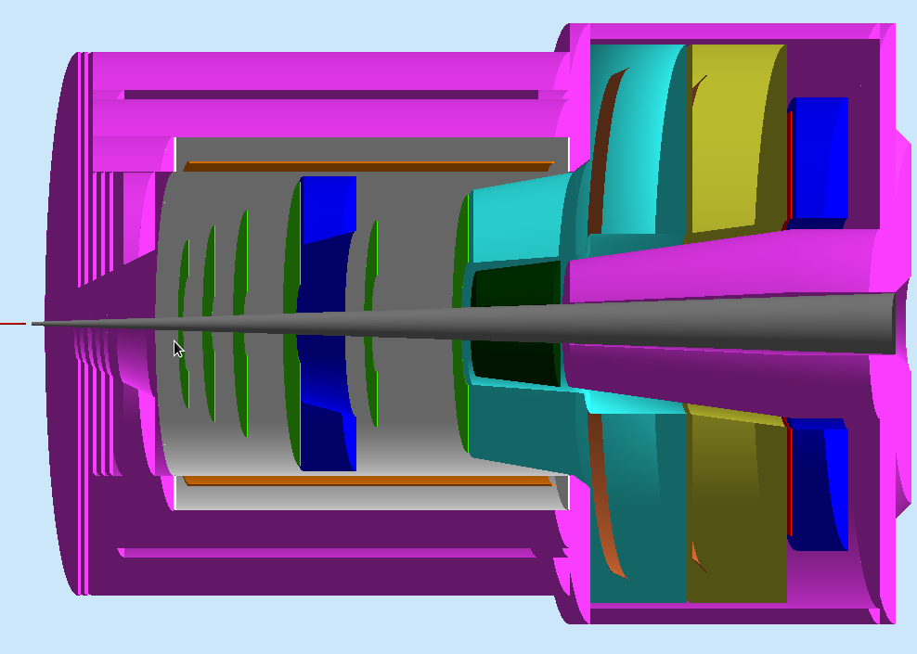
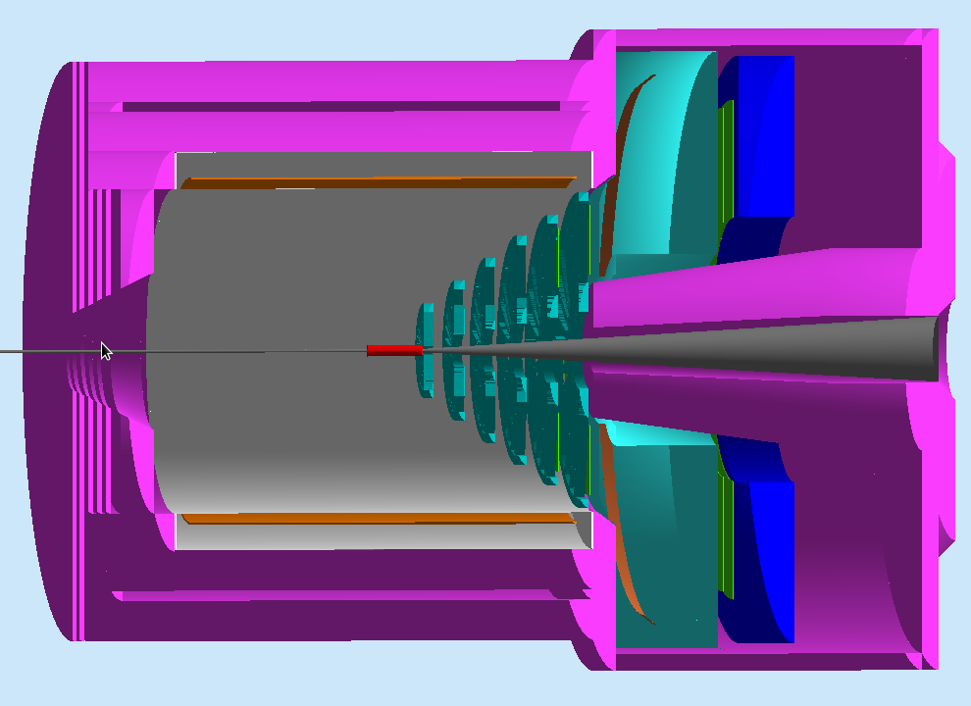
SoLID EM Calorimeter Overview
PVDIS forward angle
SIDIS forward angle
SIDIS large angle
SoLID EM Calorimeters | Polar Angle (degree) | P (GeV / c) | Max π / e | Cerenkov Coverage | Area (m²)
PVDIS Forward-Angle | 22 - 35 | 2.3 – 6 | ~ 200 | <3-4 GeV/c | ~17
SIDIS Forward-Angle | 8-15 | 1 -7 | ~ 200 | <4.7 GeV/c | ~11
SIDIS Large-Angle | 17-24 | 3 - 6 | ~20 | None | ~5

Slide 4
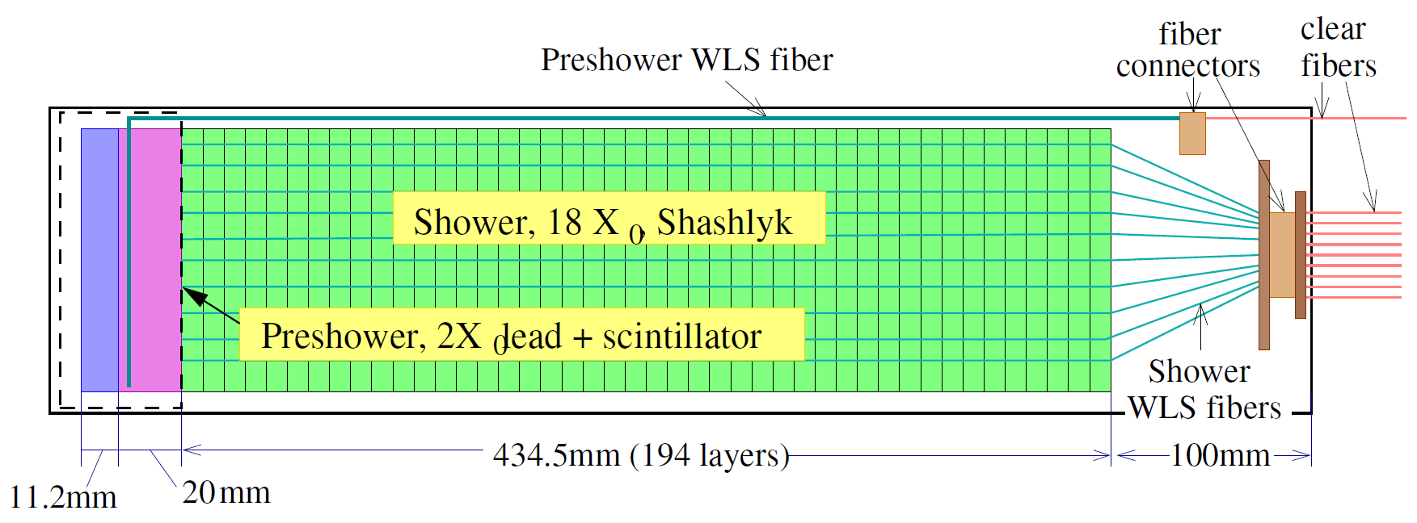
Default design for calorimeter modules
Scintillator Pad
Scintillator Pad (SPD)
Reject high energy photons for electron trigger and hadron trigger at SIDIS forward angle
Preshower (PS) – HERMES/LHCb style passive radiator + scintillator design
2 X0 lead radiator + 2 cm scintillator tile w/ WLS readout
Shower – COMPASS style Shashlyk calorimeter design
Layer structure : 0.5 mm lead + 1.5 mm scintillator + 0.12 mm gap x 2
X₀ = 24cm, R_{M} ~ 5 cm, 194 layers, 43 cm in depth

Slide 5
Requirement/Parameters | SIDIS LAEC | SIDIS FAEC | PVDIS FAEC | note
(Zmin, Zmax) (cm) | (-65,-5) | (405,465 | (320-380)
Polar angle (deg) | 15.7-24 | 7.5-14.85 | 21-36
Momentum (GeV) | 3-7 (SIDIS) 2-8 (Jpsi) | 1-7 (SIDIS) 0.6-2 (Jpsi) | 1.5-5
Area (m2) | 4.5 | 12 | 17
pi rejection | 10 | 100 | 100
e- efficiency | 95% | 95% | 95%
Radiation hardness (krad/year) | 500 | 500 | 500 | Based on PAC year
Position resolution (cm) | 1cm | 1cm | 1cm | Related to tracking
Energy resolution | 5%/sqrt(E) | 5%/sqrt(E) | 5%/sqrt(E) | Related to pi rejection
Time resolution (ps) | 300 | 300 | 300

Slide 6
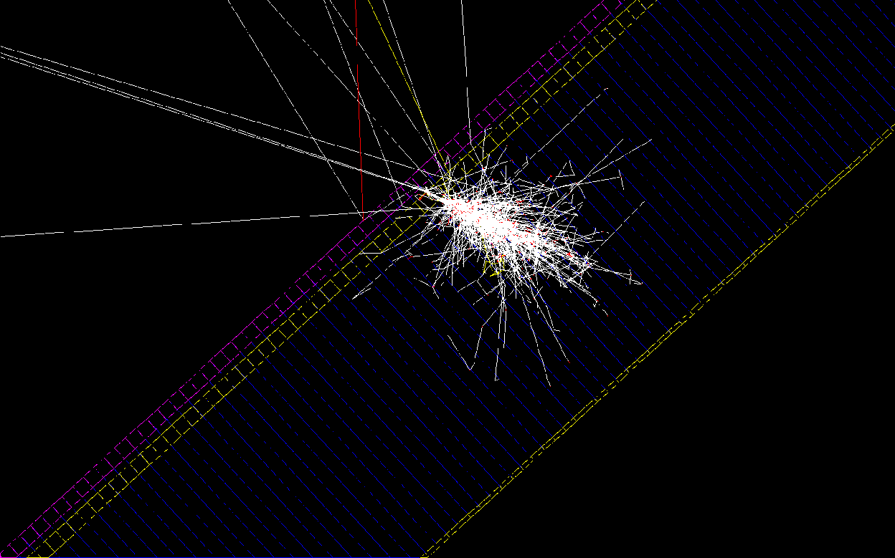
Scintillator for rejecting background photon
back scattering for high-E γ
γ
Scintillator
Thickness = 5 mm
(thicker version shown)
Preshower Pb
Preshower Scint

Slide 7
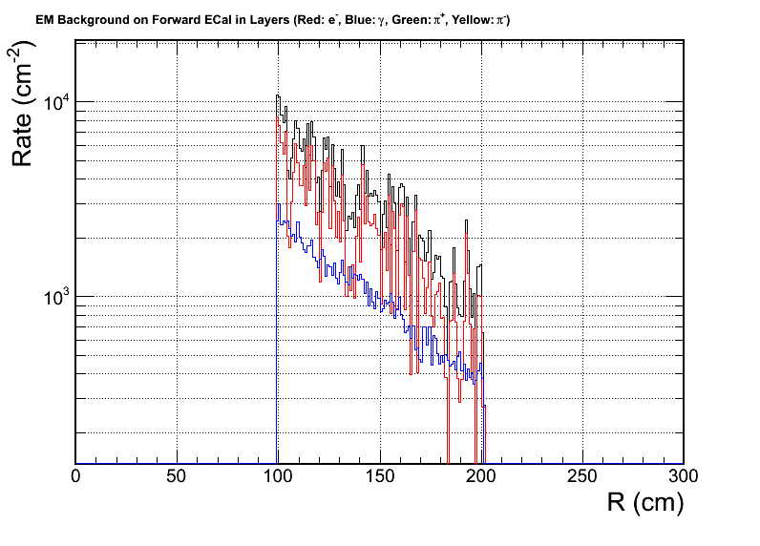
Thin scintillator pad to reject photons at trigger level
Features
Scintillator thickness of 5mm: simulation shows 2.3% of photons from SIDIS pi0 would deposit energy, the rejection factor estimated at least 20
Segment into fan shape for readout by WSL fiber or PMT directly
Background is important: dominated by low energy electrons
Source of low energy electrons
20% from end cap of heavy gas Cerenkov, other from more upstream
Have to be placed before MPRC, which have lots of material for conversion!
Rate: if 120 segment take 2MHz MIP per segment
Particle species at front surface:
Electron
Low energy gamma
All

Slide 8
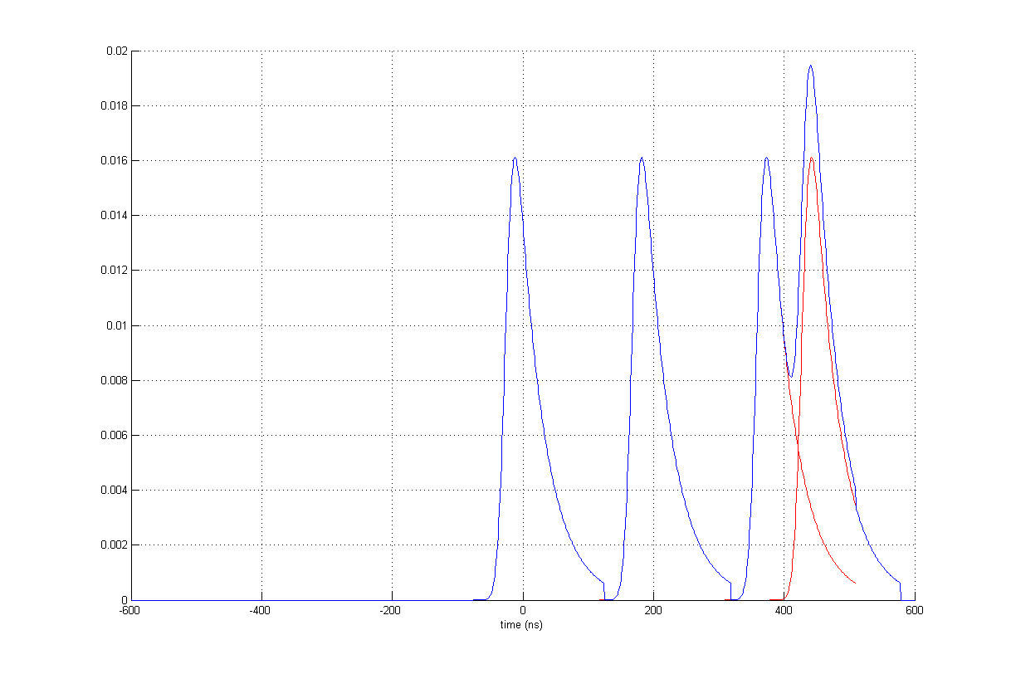
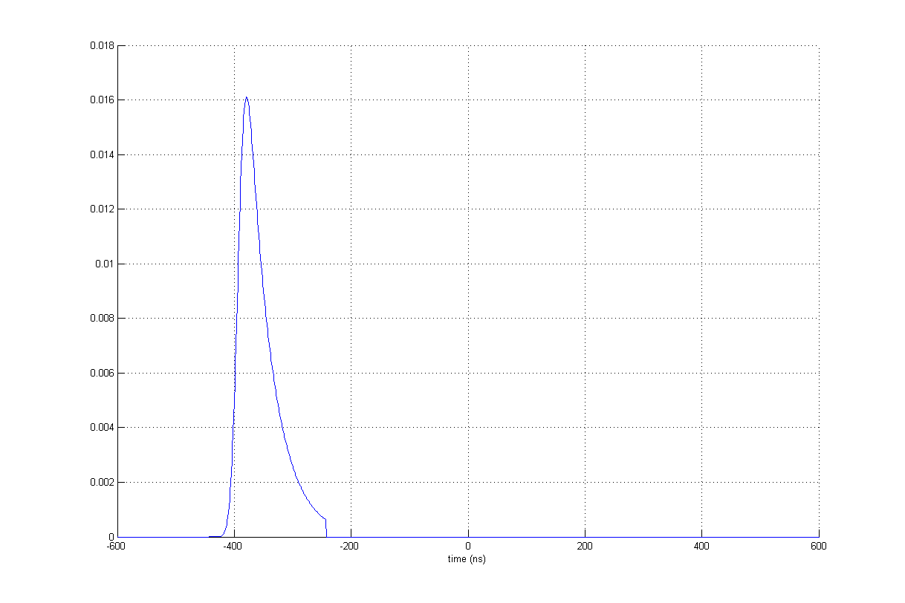
How signal looks like
30 sectors
8 MHz MIP
60 sectors
4 MHz MIP
Signal of each MIP hit (amp. variation not included)
Sum of all signals
240 sectors
1 MHz MIP

Slide 9
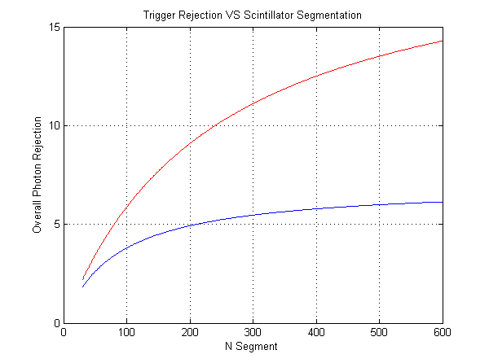
Optimizing the segment
Lower energy photon (1-2 GeV) are dominant, which we have higher rejection
Trigger require 5:1 rejection. Satisfied with margin at a 120 segments
A 50ns coincidental window with calorimeter assumed. Expect improvement in FPGA level
Low-E (1-2 GeV)
Full E range (1-7 GeV)

Slide 10
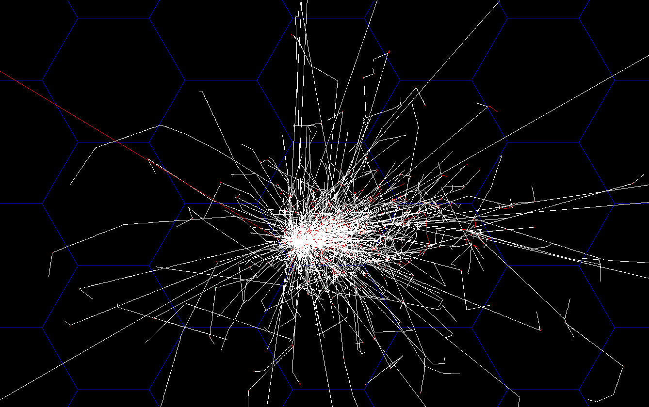
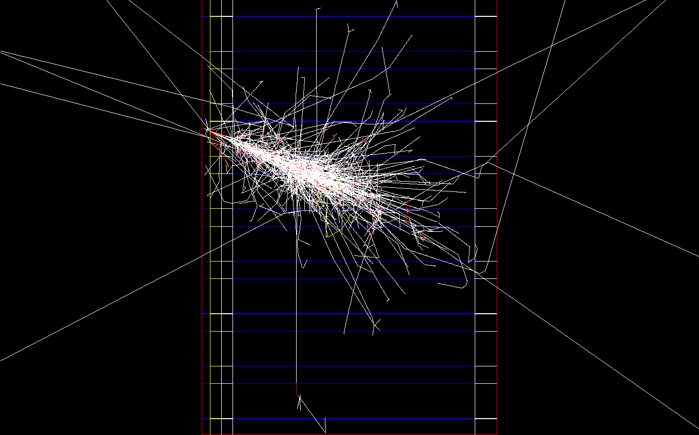
Hexagon Calorimeter Simulation
Orthographic projection along z axis
Orthographic projection along φ axis
3GeV e⁻
3GeV e⁻
2X₀ lead absorber
2cm pre-sh. scint
2cm Al frontplane
4cm Al backplane
3GeV electron shower
On hexagon calorimeter grid
The support Al plate was just added, not used in this study

Slide 11
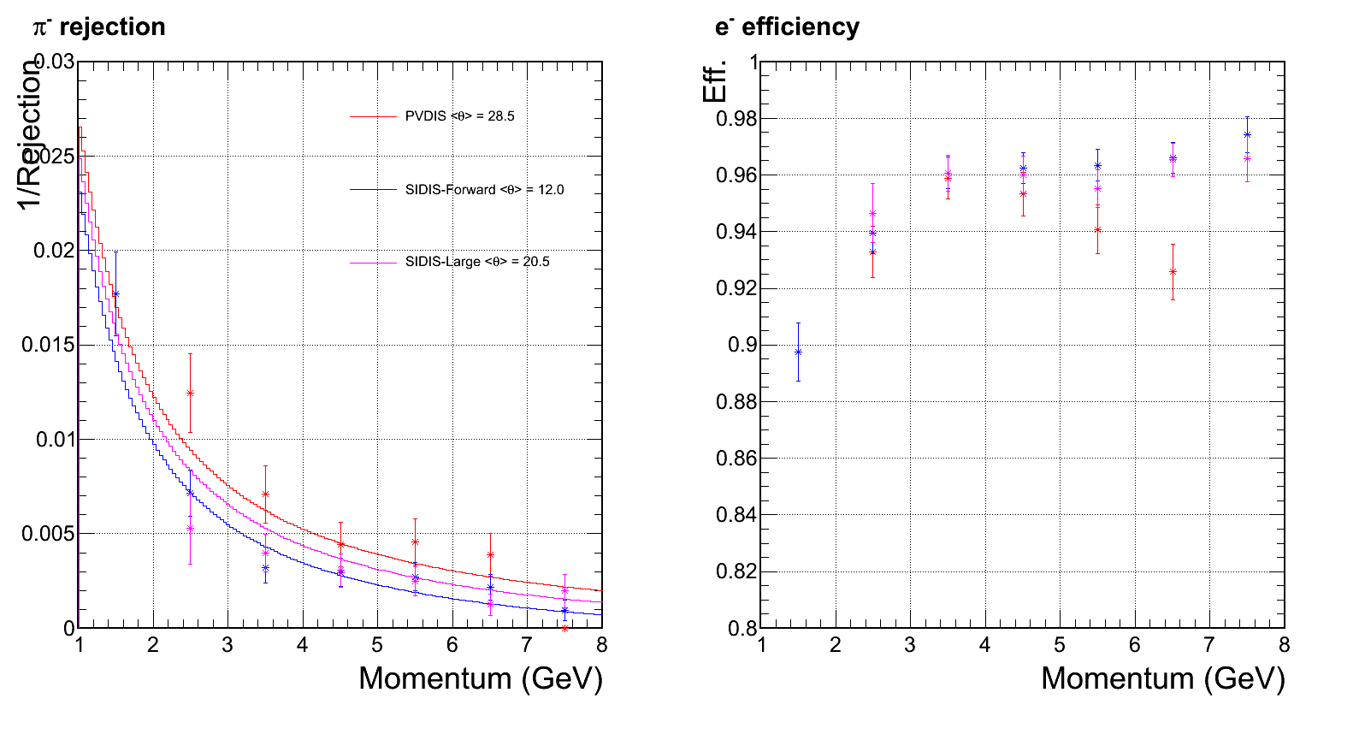
All rejection/efficiency reviewed with hexagon-shape calorimeter modules
From last meeting:
Pion rejection with
square module 3x3 clustering
94% electron efficiency
No background yet assumed at this step
Expect go high w/ higher stat.
Preshower ID power drop significantly at this bin

Slide 12
Review of Background Simulation
3rd iteration of GEMC + CaloSIM background study

Slide 13
Calorimeter background simulation with GEMC + CaloSIM
GEMC simulate spectrum and rate of background particle at the front surface of calorimeter (Zhiwen)
CaloSIM (standalone calorimeter simulation, on SoLID SVN) build calorimeter response from a wide range of incoming particle species and energy range
Combine above two and sum over all contributions (EM, DIS, pi0, pi+,pi-) stochastically within a 50ns coincidental window (assumed at this moment) -> background distribution at each trigger
Imbed background into the signal simulation (high energy e, pi) and perform analysis (clutering, e/pi separation, etc.)

Slide 14
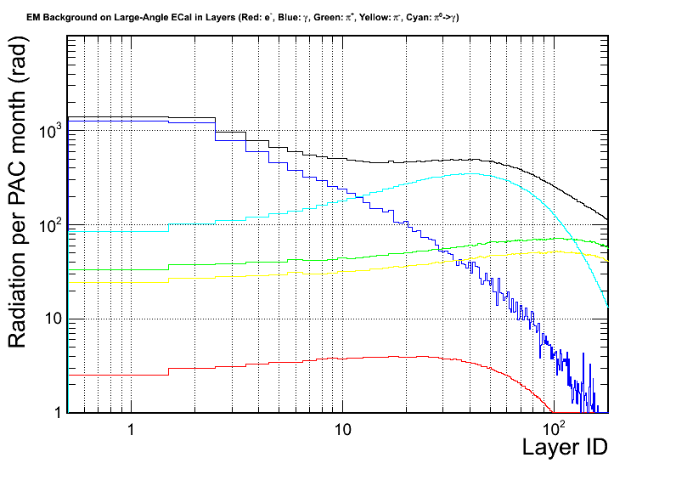
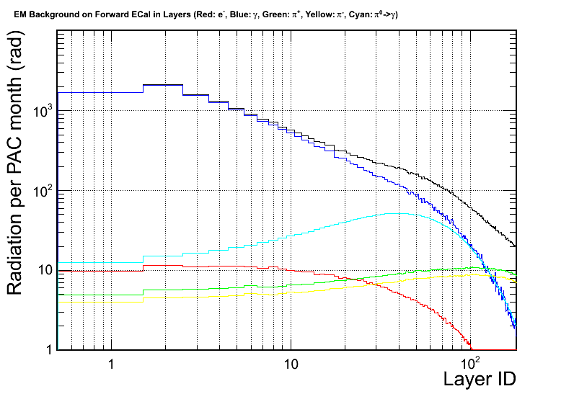
Radiation dose prediction remain stable
Dose is not a problem for SIDIS configuration.
Calorimeter design to stand >10⁵ radiation dose
Important to have this safty margin
Still missing final PVDIS radiation dose, need final baffle w/o direct line of sight
Particle species at front surface:
Electron
Low energy gamma
Pi- / pi+
pi⁰ -> gamma
SIDIS – He3– Large Angle Calorimeter
SIDIS – He3– Forward Calorimeter

Slide 15
Full background simulation For SIDIS Forward Calorimeter

Slide 16
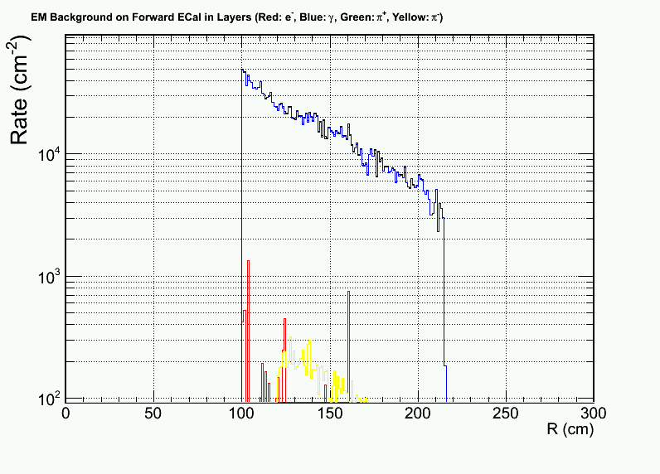
SIDIS forward background
We have good “shielding” with 2X0 preshower, save us from 1GHz/cm2 photon background
Dominated background: low energy photon 1-100 MeV, which lead to 10kHz/cm² MIP signal on preshower
The background on shower is small
Used in this study:
Most inner side (highest rate)
100 cm² segmented preshower -3 MHz MIP rate
For outer radius, rate is 10x lower, less segmentation can be used there
preshower MIP rate categorized with its source
Particle species at front surface:
Electron
Low energy gamma
Pi-

Slide 17
Compare background to signal
Electron
Background
Pions
Background
Pion
Electron
Background
Pion
Electron
Background
MIP Background is significant in preshower
Background is much less significant for shower

Slide 18
Offline: No change in eff., reduce rejection at low-p end
Rejection reduced due to preshower pile up
w/o background
w/ background

Slide 19
Hexagon Calorimeter Trigger
Hexagon Provide nice shower area cuts – can be used in both online and 1st-order offline analysis
clustering – contains ~96% of shower energy
FPGA-based pattern trigger (HEX 1+6 trigger)

Slide 20
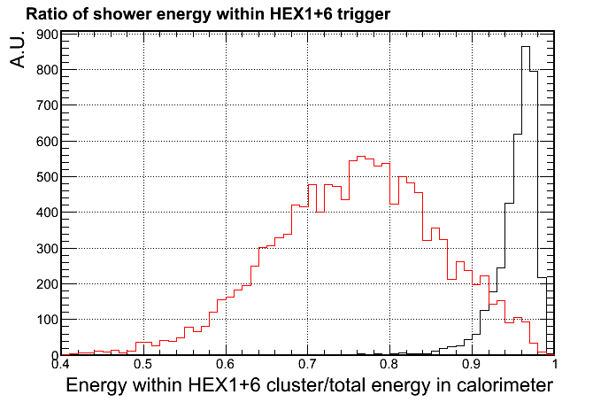
Online: Trigger with background
Hadronic shower which introduce a pion contamination, usually spread into larger area compared to EM shower
A localized trigger, e.g. HEX1+6 trigger can significantly suppress the hadron response, while maintaining high eff. for electrons
Ratio of EM shower contained
Ratio of Pion shower contained

Slide 21
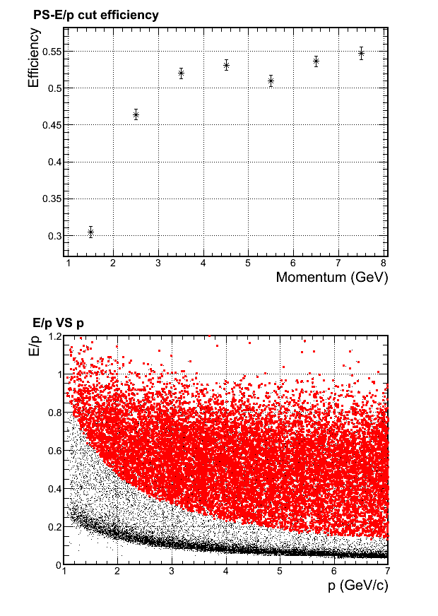
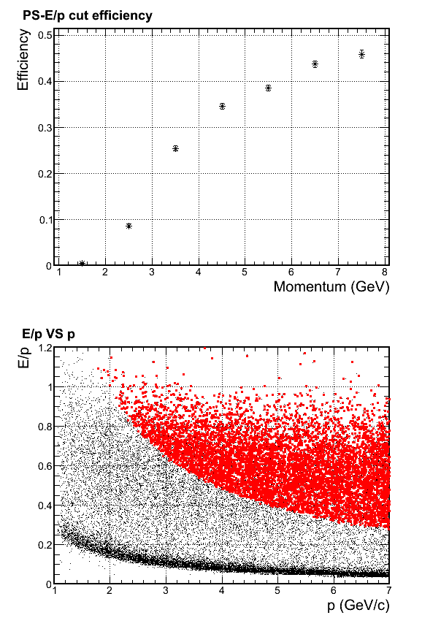
If we only trigger on total EM energy
Do receive very high electron efficiency in simulation
However, for SoLID, wide momentum range is used.
Therefore to accept lowest momentum electrons, the shower cut have to be low.
the rejection for high momentum pion will be very limited
From DAQ group (Xin, Alex): use position dependent threshold, consider plus preshower trigger
Simulated with background imbedding. The pion response is shown below:
HEX1+6 Trigger
> 0.95GeV
HEX1+6 Trigger
> 1.95GeV
* Accepted
* All

Slide 22
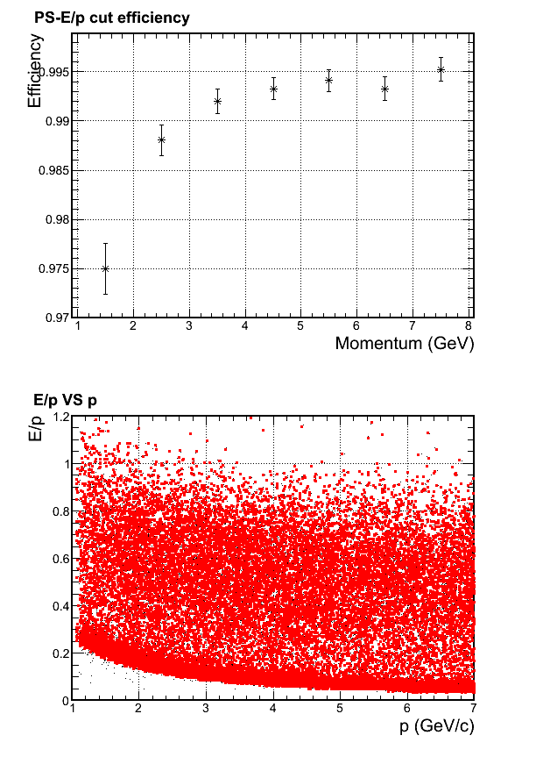
Charged Particle (Pion) trigger efficiency
Pion trigger response
* Accepted
* All
Full background simulation for pion efficiency shown on the right.
Trigger cut is HEX1+6 trigger raw signal is larger than 85% MIP (which is MIP – 2σ = 220MeV calibrated)
The background which pass this cut
rate ~20Mhz
is dominated by photon.
With an additional 1/5 suppression from scintillator, we get ~4MHz trigger rate, which fit in the DAQ limit (PR12-10-006)
Will join global DAQ study for final verification

Slide 23
Design Updates - Fiber connector

Slide 24
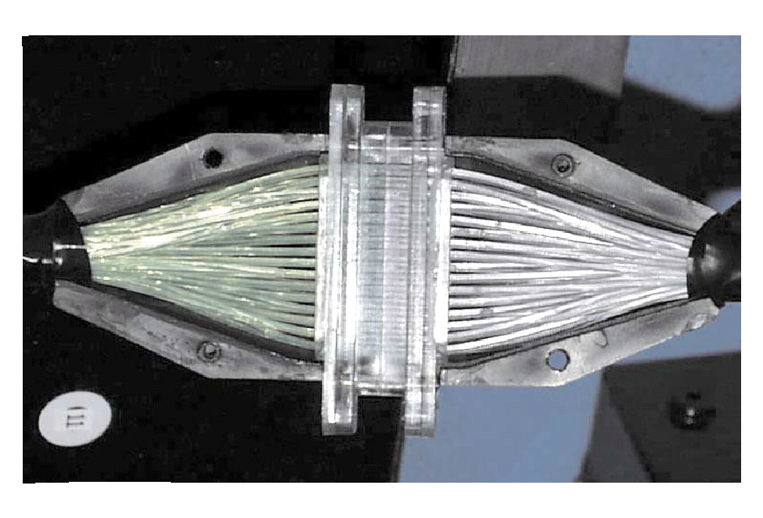
Fiber connection
Shower will use 1-1 bundle fiber connector.
Used in previous experiments (LHCb, Minos)
custom made fiber connector, quote by LEONI (see next slide)
Preshower will use comercial 1-1 single fiber connector, a few $ each.
LHCb shower
fiber bundle to PMT connector, cost estimate $25/module

Slide 25
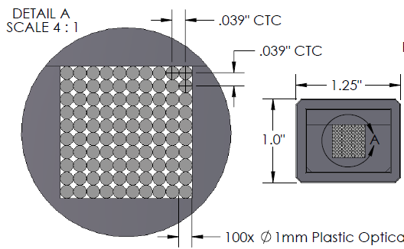
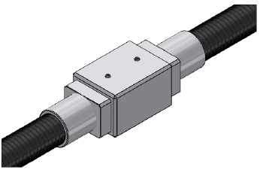
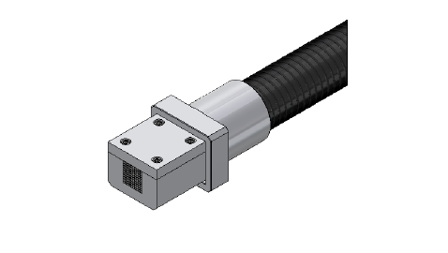
Fiber connector Concept design from LEONI
1 connector for 100
fiber pairing
made of Al
35% worst light loss
$100/each

Slide 26
Budget Update

Slide 27
Budget
 | Per module cost ($) | All module cost (M$)
Module material | 700(L)/250(S) | 1.26
Module production | 800(L)/500(S) | 1.49
Clear fiber | 260(L)/65(S) | 0.46
Fiber connectors | 150 | 0.27
PMTs | 600*2 | 2.34
Labor | 5 tech and 5 student years | 1.3
Total |  | 7.12
Total+30% contingency |  | 9.26
+ Prototyping ~ 0.3 M$
+ Support ~

Slide 28
backup

Slide 29
Shower – quick review
Choice of technology
Shashlyk design was chosen based on advantage of radiation resistance + cost + ease of readout
Features
Pb/Scint ratio 1:3 (V) : chosen to reach <5%/√E energy resolution and ~100:1 pion rejection
Scintillator thickness of 1.5mm: based past designs to balance sampling fineness VS lateral light transmission loss
Total length of 20 X₀ : contain 98% of shower and maximize pion-electron difference → MIP = 270 MeV (real) / 320 MeV (reconstructed)
Lateral size of 10x10 cm²: max size allowed (to reduce $$) before position resolution significantly deteriorates (σ~1 cm after cor.)

Slide 30
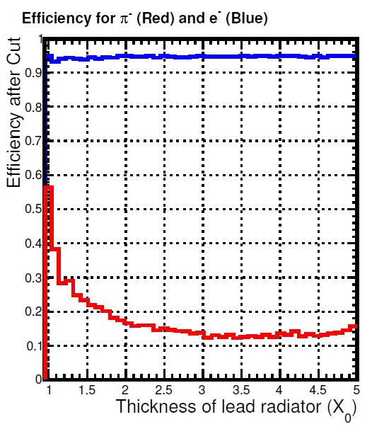
Preshower – quick review
Choice of technology
HERMES/LHCb style VS full Shashlyk design, former is much easier to readout and high in radiation resistance
Features
Absorber of 2 X₀ lead :
Thinner – loose preshower rejection
Thicker – loose shower resolution
Scanned for 1.5, 2 and 3 X₀; 2 X₀ serve SoLID best
Scintillator of 2 cm:
MIP = 4 MeV, electron cut ~ 3 MIP

Slide 31
Simulation setup with hexagon calorimeter modules

Slide 32
Back up 1/2 for previous slides
Electron eff. for SIDIS large angle calorimeter
All events
Accepted events w/ 3D cut

Slide 33
Back up 2/2 for previous slides
Pion eff. for SIDIS large angle calorimeter
All events
Accepted events w/ 3D cut

Slide 34
Backup - Simulated efficiency & rejection
Electron
Pion
Photon
Energy range: 1-7 GeV, flat phase space for SIDIS-forward
MIP peak
Efficiency
~1:7 γ-rej with cut below MIP peak
Cut on energy dep.

Slide 35
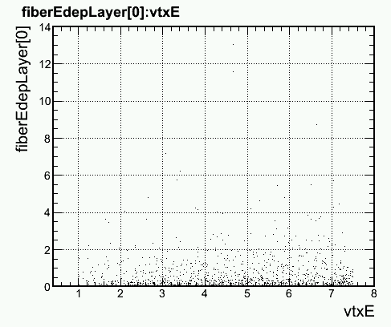
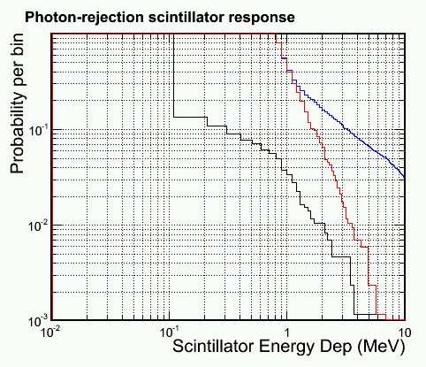
Backup - Simulated efficiency & rejection
Most photon focus on lower energy side (π₀ decay)
And lower energy photon produce less back scattering
Therefore, do the study again with 1<E_{γ}<2 GeV
Electron
Pion
Photon
1<E_{γ}<2 GeV
Efficiency
E dep for photons (MeV)
~1:20 γ-rej with cut below MIP peak
E_{γ} (GeV)
Cut on energy dep.

Slide 36
Design Updates - Shape

Slide 37
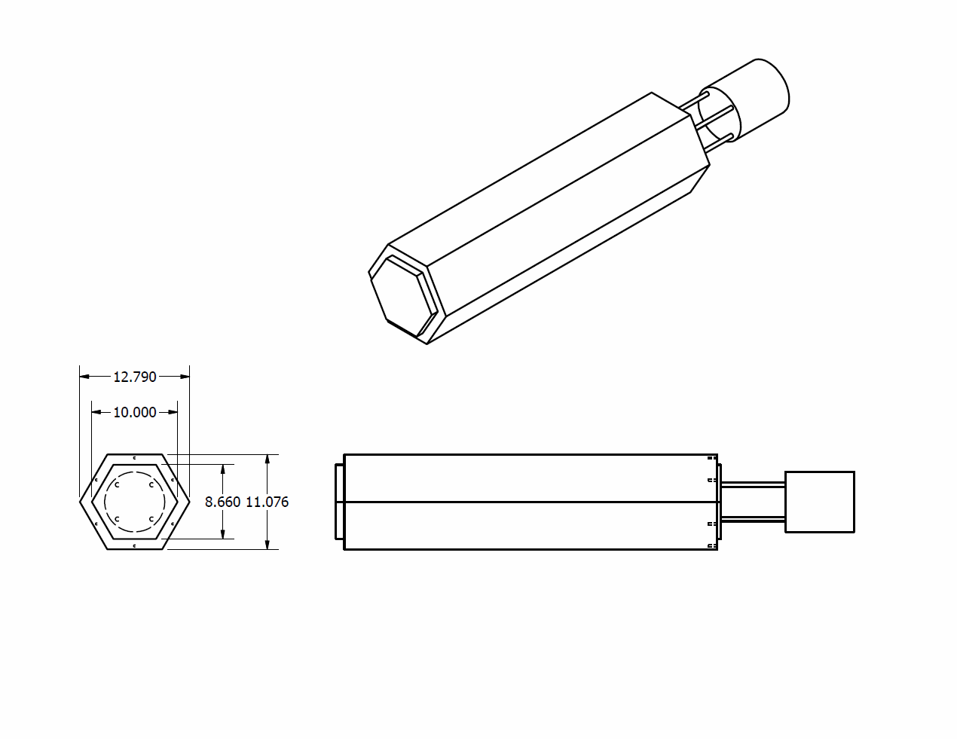
Change from square to hexagon
Main reason from supporting structure and layout (see Paul Reimer’s talk)
Physics feature should be similar to square shape and we will go through test and prototyping

Slide 38
Design Updates - Layout Update

Slide 39
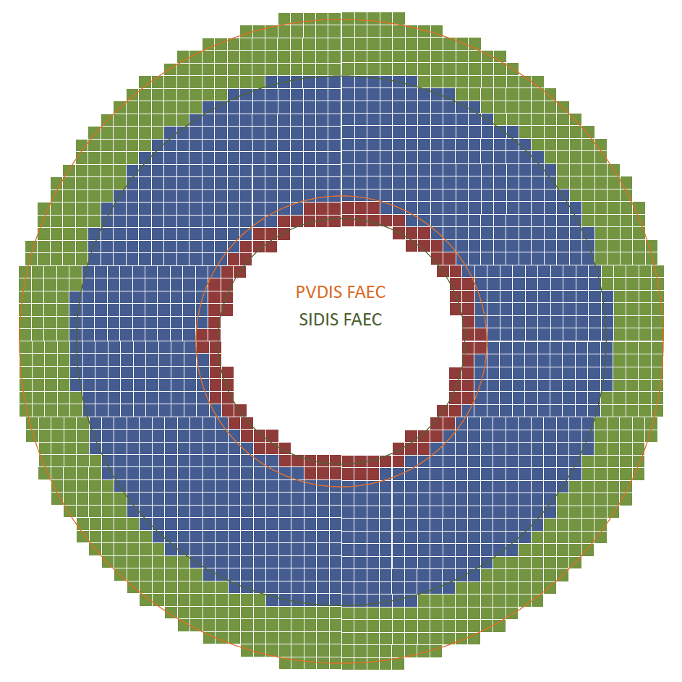
SIDIS and PVDIS FAEC (beam view)
Both can share supporting structure, only need to move along beam direction to change configuration
Supporting structure needs to be made from 100cm to 261cm
261cm
118cm
100cm
215cm
PVDIS FAEC (green + blue)
SIDIS LAEC (blue + red)

Slide 40
Ideas to minimize SIDIS LAEC Acceptance gap
We want to cover full azimuthal angle and leave no gap between modules, so module can not be tilted and need to be along Z axis
Prefer having short outer module so that the outer module area can cover more and inner module area can cover less
Inner module need to be special shape to avoid blocking acceptance. One way to solve it is to have smaller 5x5cm (like COMPASS) module with various length
600mm
assume 600mm full module length
Blue: LAEC acceptance angle
Orange : angle between inner and outer
10x10x60cm module
Outer module
(500mm in radius)
24º
5x5x41cm
inner module
(150mm in radius)
17.5º
5x5x22cm
600mm
14.7º
Reviewed using G4 simulation next few pages

Slide 41
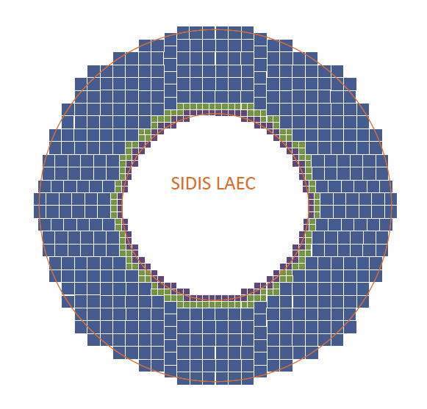
SIDIS LAEC (beam view)
Type I (10x10cm) module in blue, type II (5x5cm long) module in green, type III (5x5cm short) module in purple.
Supporting structure needs to be made from 75cm to 140cm
140cm
75cm

Slide 42
Design Updates - Edge effects for LAEC

Slide 43
LAEC layout in G4 Simulation

Slide 44
LAEC in full standalone G4 Simulation Track transportation provided by GEMC, CLEO field

Slide 45
How much does inner modules help?
LAEC catch 80% of shower
Go freely to forward acceptance
Minor improvement
Stand conf. 404 10x10 cm² modules
+ 116 5x5 cm² inner modules

Slide 46
Design Updates - Shower cluster size cut

Slide 47
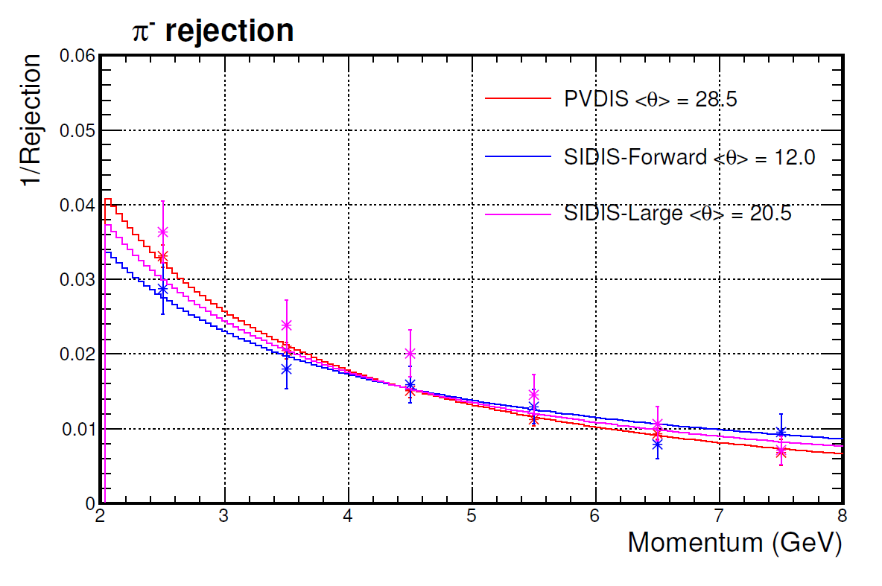
Previously showed pion rejection
94% electron eff.
PID selection used 3-D cut on PS, e/p and momentum
PS and e information come from sum signal in all non-zero modules
Enemy here is very specific: almost fully absorved hadronic shower with high energy deposition

Slide 48
Shower area difference
Electron shower
Hadronic shower (e/p>80%)
R spread (mm)
R spread (mm)
Φ - spread (mm)
Φ - spread (mm)
Notice the difference in color scale

Slide 49
Apply additional cut to limit max size of cluster around track projection
Limit cluster to be not larger than 3x3 modules around track projection to shower central depth
Minor cut on EM shower but effectively removed hadronic showers of very high energy deposition
w/ >=94% electron eff.
Pion
Miss identified
BIG improvement @ high p end
Flat phase space in PVDIS
acceptance

Slide 50
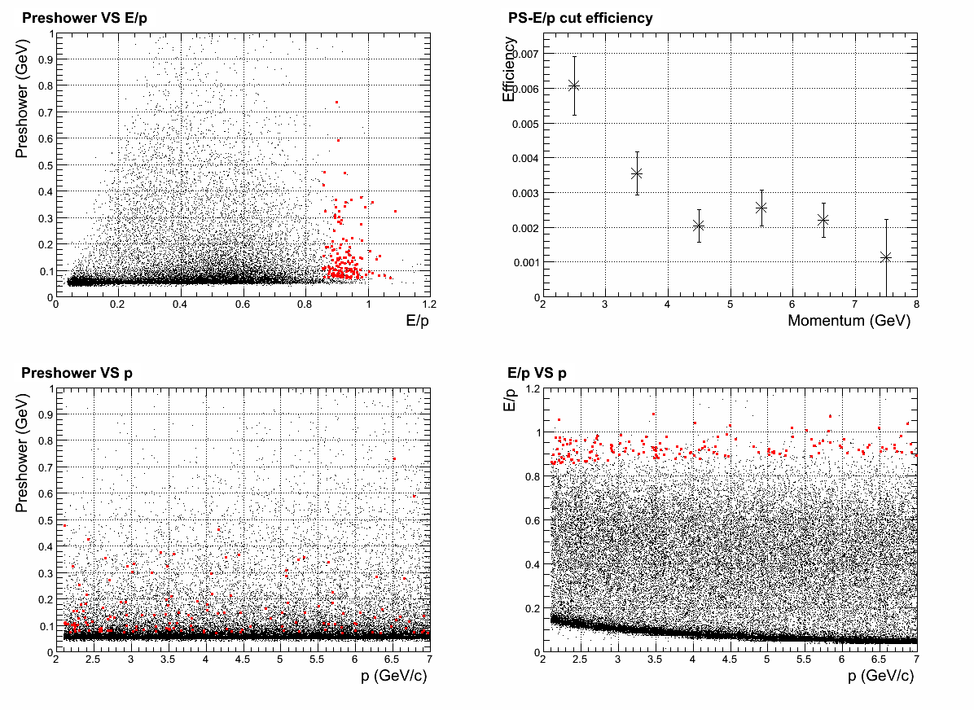
Can it be further improved?
Further limit cluster to be not larger than 2x2 modules around track projection to shower central depth
Now loose ~5% of EM shower, but hadron shower cuts faster
Change cut and maintain
>=94% electron eff.
All hadron rej. better than
100:1
Pion
Miss identified
Flat phase space in PVDIS
acceptance

Slide 51
Design Updates - Radiation dose

Slide 52
What’s new
LHCb/HERMES preshower, instead full Shashlyk preshower
As shown before, the preshower scintillator receive most of the radiation, due to the low energy backgrounds
This part radiation dose are now absorbed in 2X0 absorber, and we just see its EM tail now
Especially, lead absorber effectively kill all low energy electron background
New background distribution updated by Zhiwen
SIDIS:
With target collimator (suppress background by 4)
First large angle simulation
PVDIS: have option to remove direct photon sight (expected to be removed in the final baffle design)
Dominating background, photons 1-10 MeV
After preshower, which attenuate them a lot, they still penetrate ~10 layers in Shashlyk

Slide 53
PVDIS – current baffle (with direct γ)
γ dominate
But attenuated quickly
Layer #1 is 2cm preshower scint.

Slide 54
PVDIS – preview for a baffle w/o direct γ
γ get reduced by ~5
π⁻ become important here
Layer #1 is 2cm preshower scint.

Slide 55
SIDIS – Forward
γ dominate
But attenuated quickly
Layer #1 is 2cm preshower scint.

Slide 56
SIDIS – Large-Angle
γ dominate
But attenuated quickly
Layer #1 is 2cm preshower scint.

Slide 57
Light Readout

Slide 58
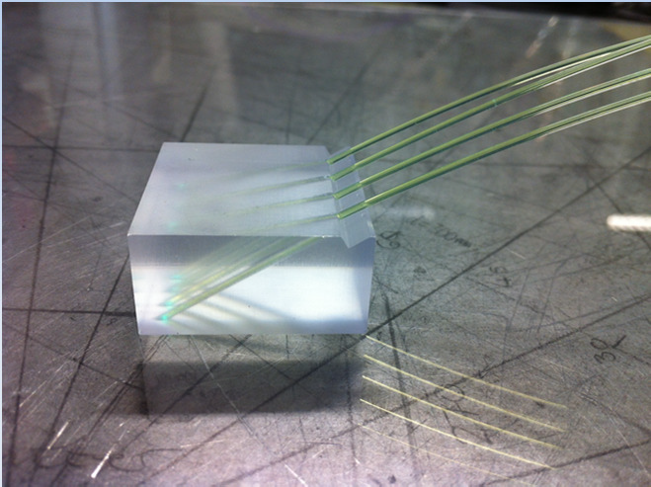
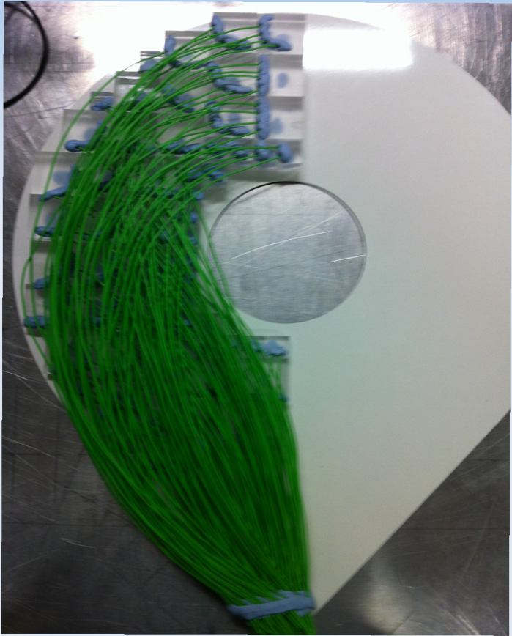
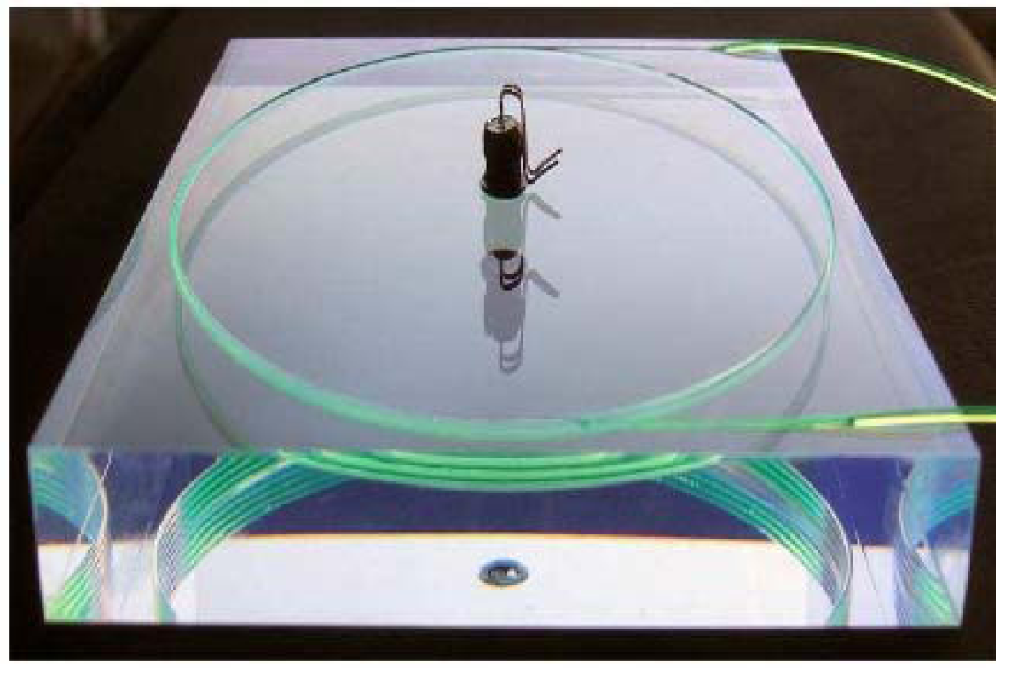
WLS fiber in scintillator pad
Drill on scintillator and glue WLS in
Used by LHCb etc.
Will use by CLAS12 FT-Hodo
CLAS12 FT-Hodo
LHCb Preshower

Slide 59
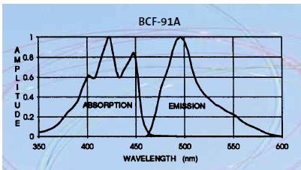
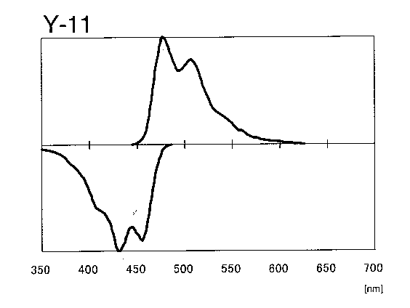
Fiber
WSL fiber in shower, 100/module
Bicron BCF-91A
multi-clad, 1/e length >3.5m
1mmD, bend 20cmD (?)
$0.87/m
less rad hard
WLS fiber in preshower pad, 1-2/module
KURARAY Y-11(200)MS
multi-clad, 1/e length >3.5m
0.5mmD, bend 5cmD
$1/m
more rad hard
Clear fiber for both, 101-102/module
Bicron BCF-98
$1/m

Slide 60
Fiber connection
Shower will use 1-1 bundle fiber connector.
Used in previous experiments (LHCb, Minos)
custom made fiber connector $175/module, quote by LEONI
Preshower will use comercial 1-1 single fiber connector, a few $ each.
LHCb shower
fiber bundle to PMT connector, cost estimate $25/module

Slide 61
Readout
PMT option - Hamamatsu R3998-02
28mmD Bialkali Photocathode
$600 each
Used by CLAS TPE calorimeter which has COMPASS module
As our baseline design
APD/SiPM option
High resistance to magnetic field
Need to be careful due to high neutron background
Contacting vendor for high radiation resistance designs (sensor + amp.)
Estimating neutron background @ photon detectors

Slide 62
Budget Update

Slide 63
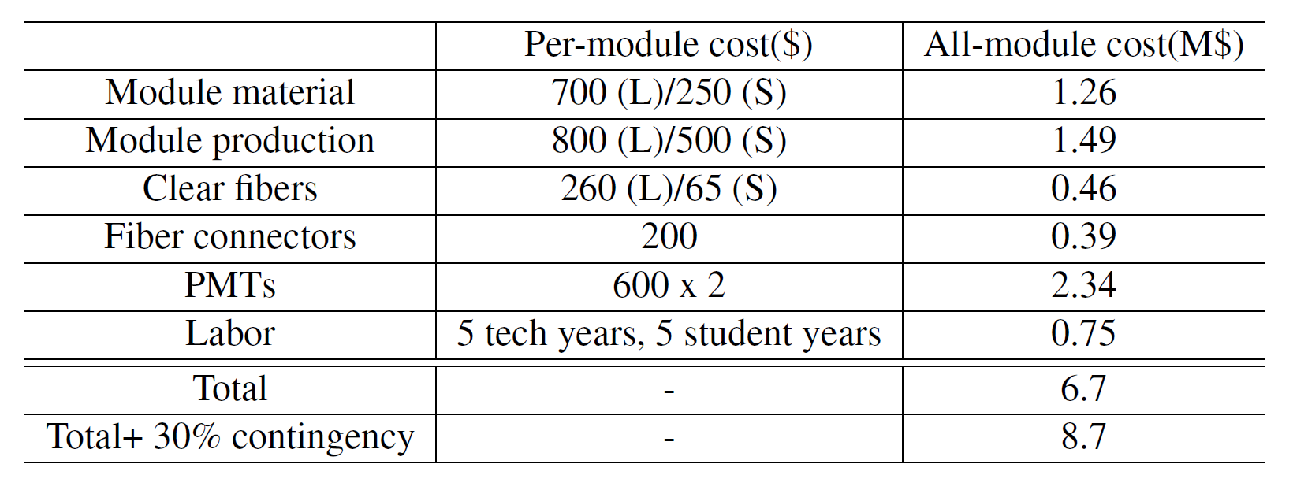
Budget table – calorimeter group version
+ Prototyping ~ 0.3 M$
Lab estimate : 5.7 (base)+3.8 (Labor)
JP : 6.2 (base) + 1.3 (Labor)

Slide 64
Budget Update

Slide 65
Budget table – calorimeter group version
+ Prototyping ~ 0.3 M$
Lab estimate : 5.7 (base)+3.8 (Labor)
JP : 6.2 (base) + 1.3 (Labor)

Slide 66
What we need

Slide 67
What we need
Engineering support (Zhiwen)
Support structure
How to do maintenance and install it back
Inquiries
IHEP (Xiaochao)
Fiber connection (Mehdi)
Photon detectors (Zhiwen)
Background effect (Jin)
Event mixing with signal and background simulation
Prototyping

Slide 68
Support structure ideas
Overview
One support for LAEC, one support
for FAEC
Only a few cm gap between outer radius of SIDIS LAEC and inner radius of cryo, is it enough?
Only a few cm gap between outer radius of FAEC and inner radius of nose cone, is it enough?
Need to consider the supporting with overall magnet cryo and yoke structure.
“super” Modules
Group 1-3 row of modules into supermodule
shift supermodule’s horizontal position to make layers

Slide 69
backup

Slide 70
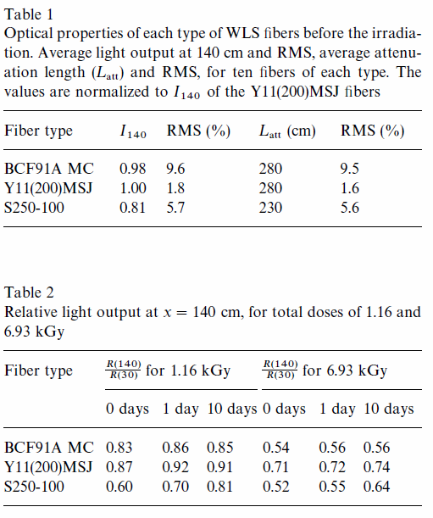
WLS radiation hardness

Slide 71
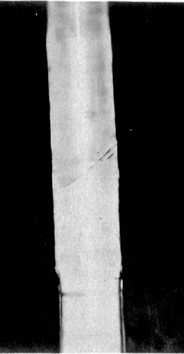
Fiber connection (Backup option)
Fiber splicing
Robust connection and excellent transmission (2%)
CLAS12 Forward Tagger Hodoscope will fuse WLS and clear fiber. Commercial vendor has been contacted and They are also developing their own method.
We will collaborate with them to examine the labor and cost requirement.
joint

