Slide 1
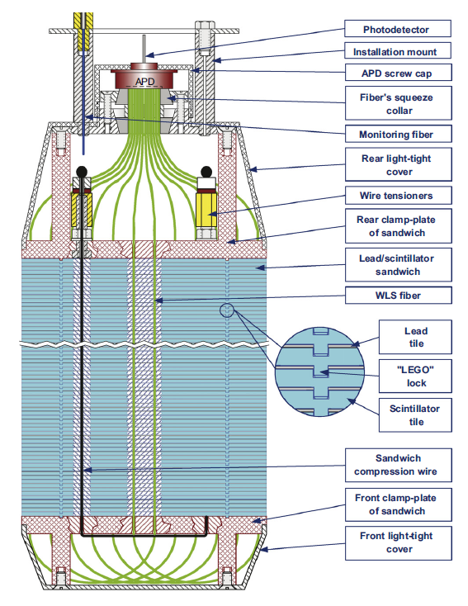
EC segmentation
KOPIO
Typical Shashlik
Polyakov, COMPASS Talk, 2010
Shashlyk calorimeter
Lead-scintillator sampling calorimeter
Fiber collects and reads out light
Satisfy the SoLID requirement
Good energy resolution (tunable)
Radiation hardness ~ 500kRad
Easier to collect and read out the light
Well developed technology, many experiments

Slide 2
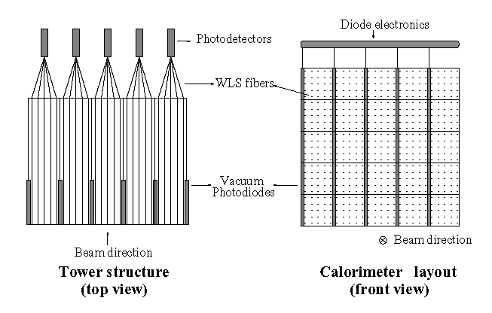
Option 1, readout preshower directly
Vacuum Photodiode or APD can’t survive high rate environment?
dead area?

Slide 3
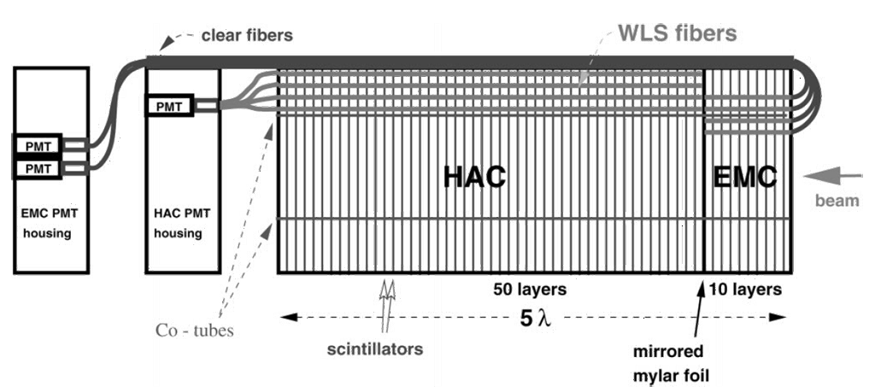
Option 2, let fibers go back
Fiber bending, how flexible it is? Dead area? High rate?
hiding in rod

Slide 4
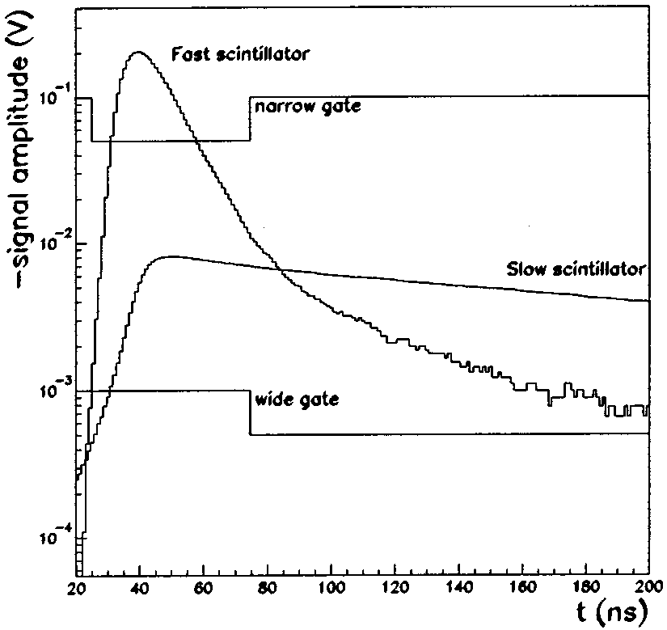
Option 3, slow/fast scintillator

Slide 5
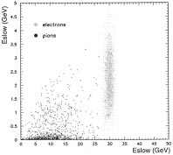
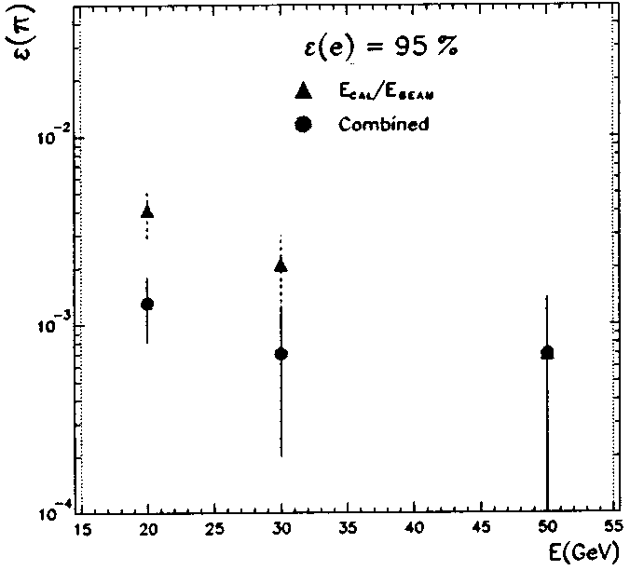
Option 3, fast/slow scintalator

Slide 6
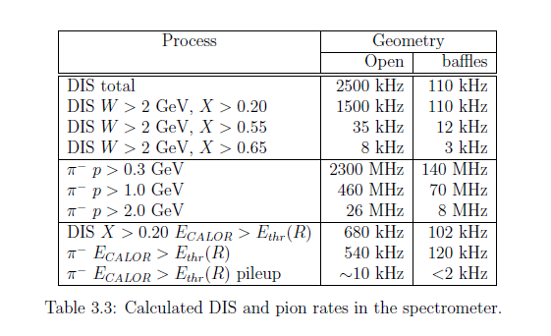
PVDIS rate

Slide 7
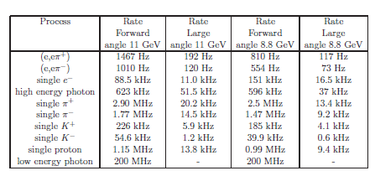
SIDIS rate

Slide 8
prototype
1. option 2, test manufacturing and performance.
2. option 3, test with flashADC and try to reach better energy resolution and e/pi speration

Slide 9
https://hedberg.web.cern.ch/hedberg/home/caleido/caleido.html

