Slide 1
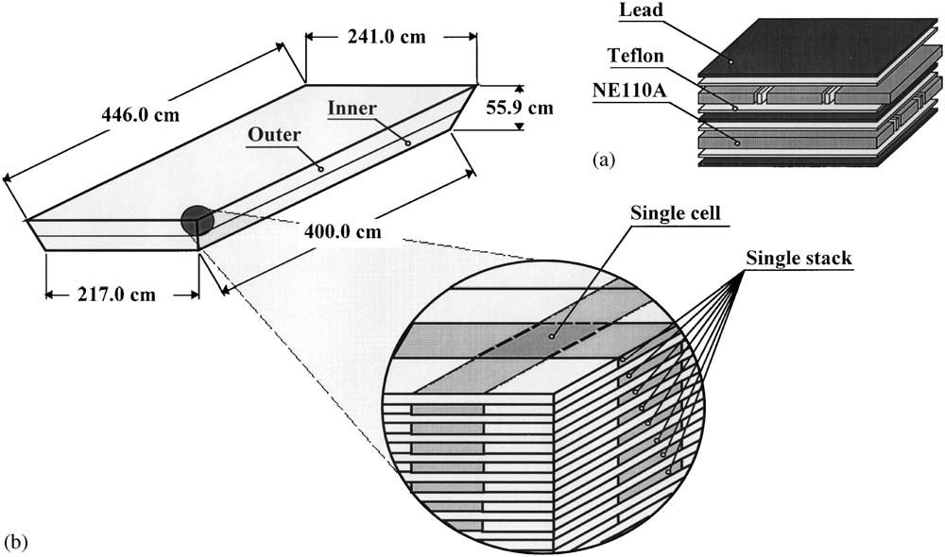
CLAS Large Angle EC
2 sectors, 33 layers each, 19 m² total area
0.2cm (0.35X₀) thick lead
1.5cm thick scintillator, 10cm wide, various length (2.2-4.5m)

Slide 2
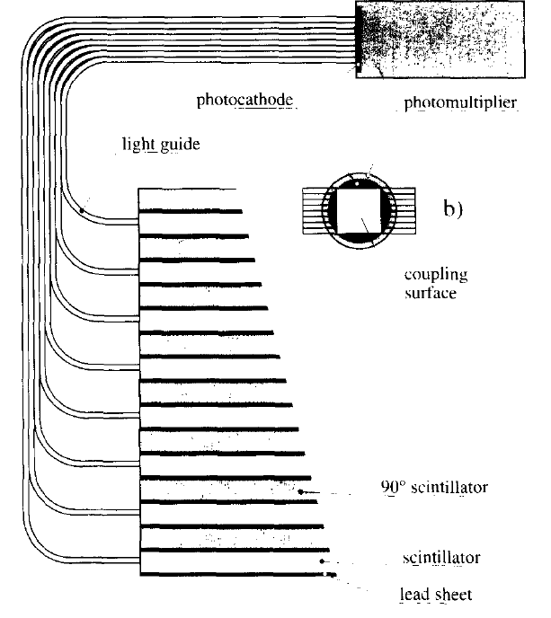

Slide 3
Can it be used for SoLID?
Possible way to do it
Total area similar
cut it into small sections and hold the structure
Separate preshower/shower stacks
Use clear fibers on side of scintillators for readout or use WLS fibers for readout
Concerns
Due to high rate, how small do the sections need to be? How many number of readout channel we can save?
Radiation hardness could be less (need 500krad)
Performance could be worse (need 100:1 rejection)
Cost? (comparing to about $2.5M for module)

Slide 4
Other things
Use scintillator for pad preshower
Use lead layer for pad preshower
318 EMI Thorn EMI 9954A 2” PMT
Any fiber to use?

