Slide 1
SoLID EC beamtest
Zhiwen Zhao (UVa)
Xiaochao Zheng (Uva)
Jin Huang (LANL), Mehdi Meziane (Duke),
Paul Reimer (ANL), Nuclear Physics Group (W&M)
HallB weekly meeting
2012/02/13

Slide 2
SoLID - Solenoidal Large Intensity Device
One of three major new equipments of Hall A 12GeV upgrade besides SuperBigBite and Moller
General purpose device.
proposals:
PVDIS (rate A, 169 days)
SIDIS with Transversely Polarized 3He (rate A, 90 days)
SIDIS with Longitudinally Polarized 3He (rate A, 35 days)
SIDIS with Transversely Polarized Proton (conditional approval)

Slide 3
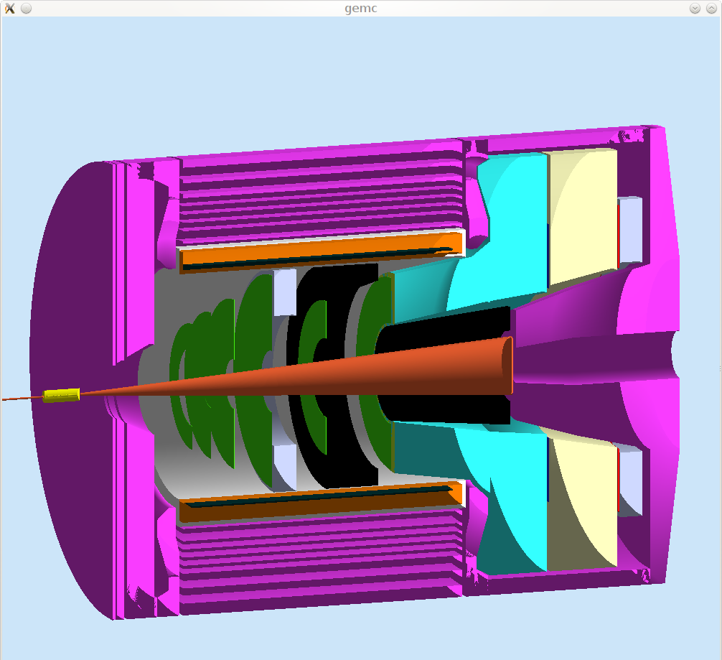
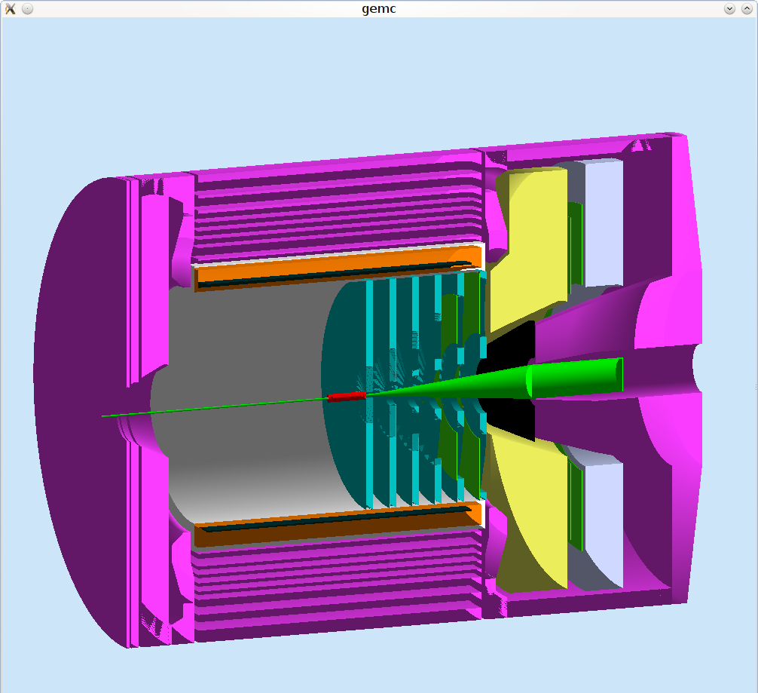
SoLID Calorimeter Overview
PVDIS forward angle
SIDIS forward angle
SIDIS large angle
Electron-hadron separation
100:1 pion rejection in electron sample
Energy resolution: σ(E)/E ~ 5%/√E
Provide shower Position
σ ~ 1 cm, for tracking initial seed / suppress background
Time response
σ <~ few hundreds ps
provide trigger/identify beam bunch (TOF PID)

Slide 4
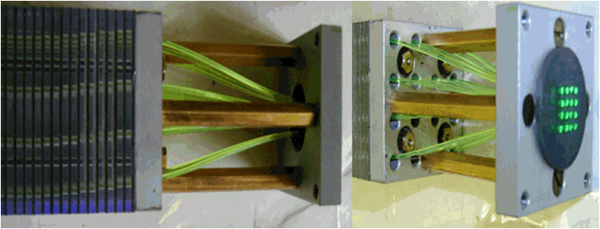
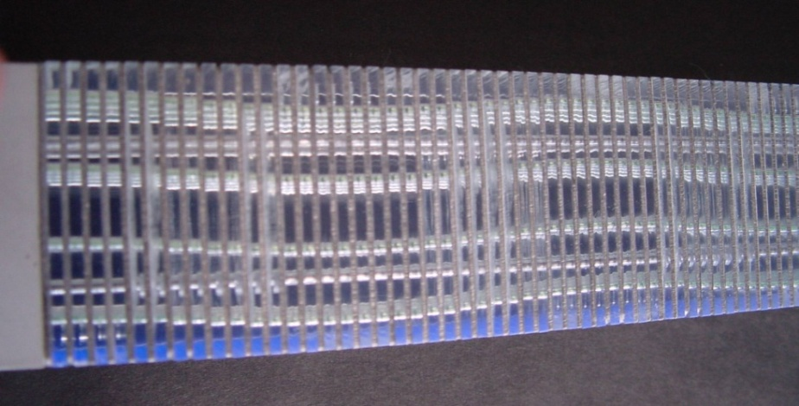
Best option: Shashlyk Calorimeter
IHEP, COMPASS Shashlik, 2010
Shashlyk calorimeter
Lead-scintillator sampling calorimeter
WLS Fiber collects and reads out light
Satisfy the SoLID requirement
Good energy resolution (tunable)
transverse size can be customized
Radiation hardness ~ 500kRad (improvable)
Easier to collect and read out the light
Well developed technology, used by many experiments
IHEP production rate about 200 per month

Slide 5
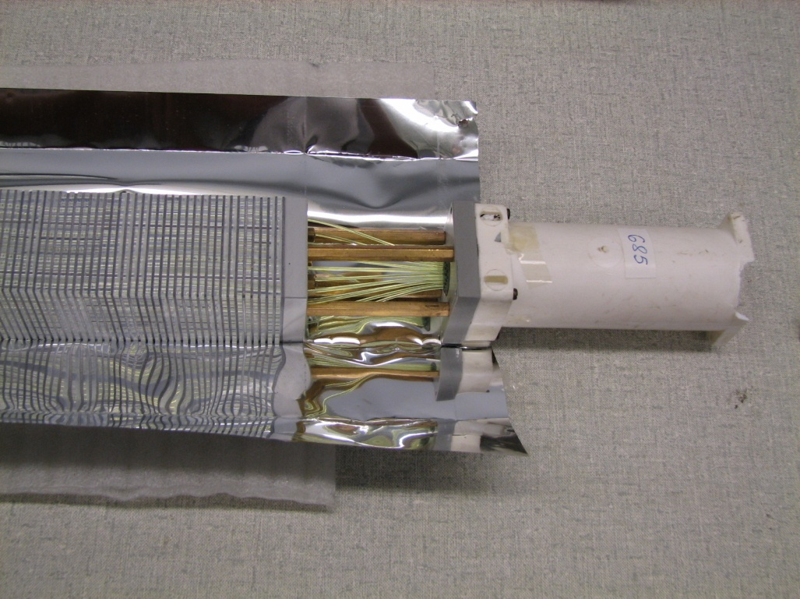
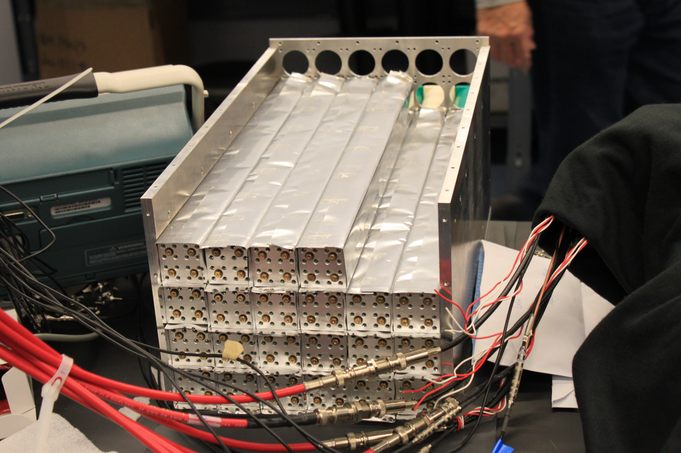
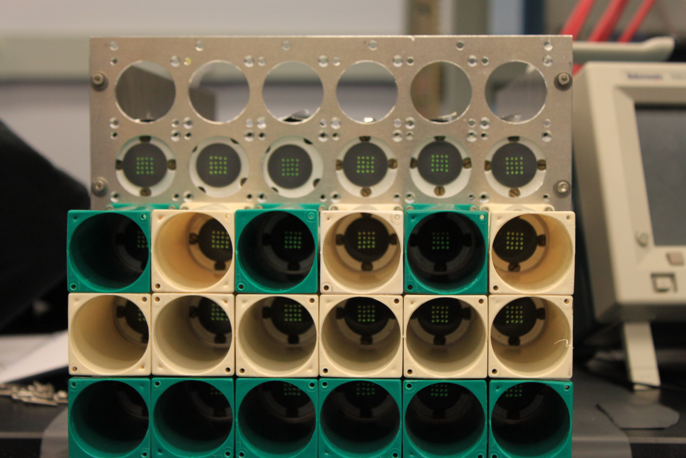
COMPASS modules used for TPE@CLAS

Slide 6
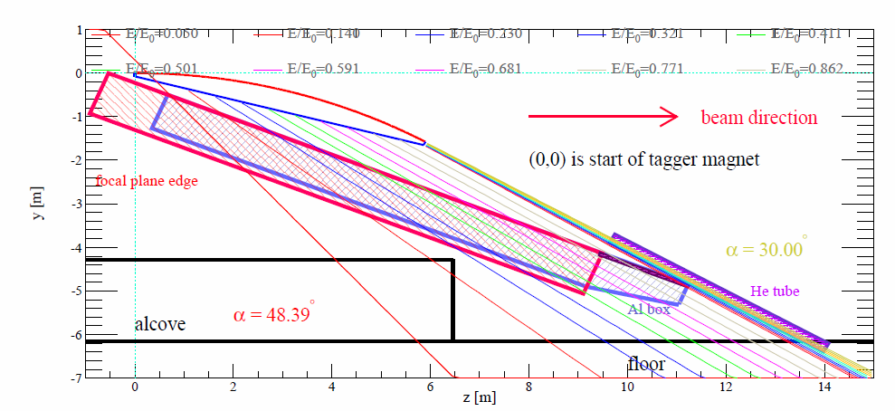
Main goal of the beamtest under CLAS tagger during g14 photon run
Gain direct experience with the modules.
Test energy and position resolution at different location (30%-80% of beam energy) and different incoming angles (0-40 degree).
Use test results to anchor the simulation.
SoLID EC

Slide 7
Details of the plan
1. Test Module
Use TPE 5x6 array of 3.8x3.8cm modules. PMT readout with mu metal shielding.
2. Trigger and DAQ
Independent DAQ, non-invasive to CLAS.
Use a small scintillator in front of a module for trigger.
May use another small scintillator at upstream for coincidence trigger to help determine trajectory and thus the electron energy and impact angle.
May use T-counter input for coincidence.
3. Test plan
Stay at different locations and tilt at different angles depending on time allowed.
Would love to have short special tagger runs if the g14 run plan allows.
4. Timeline
Preparation and bench test in Feb.
Move into HallB 3/3-6 or 3/11-14, and stay until May.

Slide 8
other tests under CLAS Tagger
CLAS12 Forward Tagger Calorimeter may move out around end of Feb?
HallD BCAL test will stay at more forward location for ~1GeV electrons.
HallD FCAL test and SoLID EC test will stay at higher energies and share locations.
HallD BCAL
HallD FCAL
SoLID EC

Slide 9
backup

Slide 10
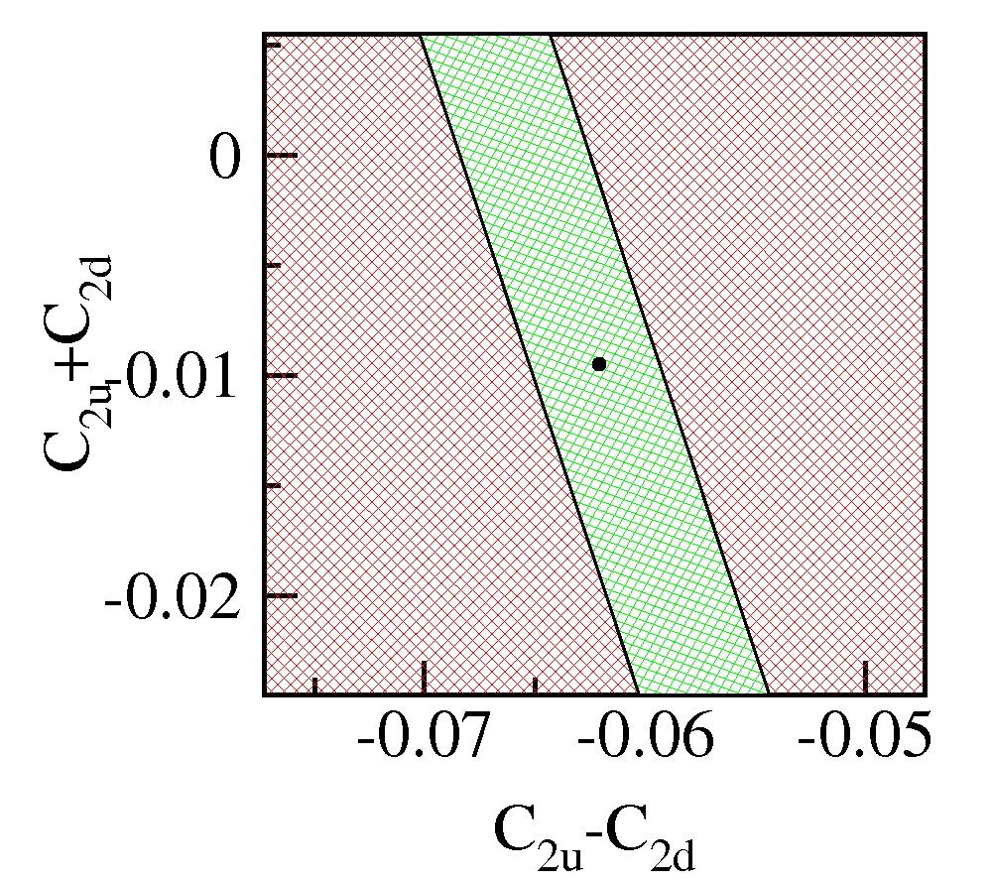
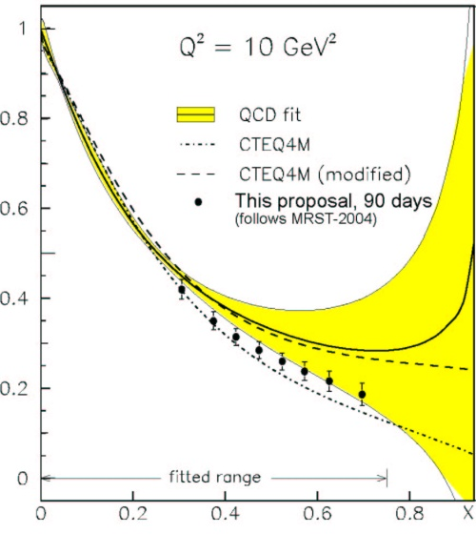
Motivation for PVDIS
Standard Model
d/u for
Hydrogen
No sin²θ_{W}
CSV at Quark Level
Di-quarks in
the nucleon
(Q² Dependence)

Slide 11
All Leading Twist TMDs
Nucleon Spin
Quark Spin
 |  | Quark polarization
 |  | Un-Polarized | Longitudinally Polarized | Transversely Polarized
Nucleon Polarization | U
 | L
 | T
f₁ =
h₁⊥ =
Boer-Mulder
g₁ =
h_{1L}⊥ =
Helicity
h_{1T} =
f _{1T}⊥ =
Transversity
g_{1T} ⊥ =
Sivers
h_{1T}⊥ =
Pretzelosity
Notes:
Beside the three parton distribution functions which survive the integration over the quark transverse momentum there are five more transverse momentum dependent distribution functions at leading twist.
Here is a table of all the 8 leading twist TMDs, the cartoons on the right hand side of each name tell you the meaning of each TMDs. Again, the virtual photon is supposed to go out of the paper and that’s our longitudinal direction. The red circle and arrow are the quark and it’s spin, and black circle and arrow are the nucleon and it’s spin. The blue arrow shows the momentum direction of the quark.
An important information these 5 new TMDs will tell you is the quark oribtal angular motion. They will vanish without orbital angular momentum.
In particular, the Sivers function directly tells you the quark orbital angular momentum in a transverse polarized target, Boer-Mulder tells you the correlation of the quark orbital momentum and it’s spin inside a unpolarized nucleon and Pretzelosity, in certain model context, direct measures the relativistic nature of the nucleon.
Blue: no kt dependence and T-even
Red: T-odd with kt dependence
Other: kt dependence and T-even

Slide 12
Physics Requirement
Electron-hadron separation
100:1 pion rejection in electron sample
Energy resolution: σ(E)/E ~ 5%/√E
Provide shower Position
σ ~ 1 cm, for tracking initial seed / suppress background
Time response
σ <~ few hundreds ps
provide trigger/identify beam bunch (TOF PID)
Radiation resistant
PVDIS forward angle
EM <=2k GeV/cm²/s + pion (GeV/cm²/s), total ~<60 krad/year
SIDIS forward angle
EM <=5k GeV/cm²/s + pion , total, total ~<100 krad/year
SIDIS large angle
EM <=20k GeV/cm²/s + pion, total, total ~<400 krad/year
Notes:
Back up slides pion/electron rate

Slide 14
module to readout connection
PMT entrance (1.13” D)
Shielding tube (1.4” D)
Spring (1.4” D)
Readout base (1.13”D)
Metal plate (dash line)
1st support plate
2nd support plate
3rd support plate

Slide 15
box and support
Side view
A: 4 wheels to move all direction
B: 2 long bars for bottom support
G: 2 short bars for bottom support
C: 2 bars for vertical support
D: 2 bars to lift the box
E: 4 bars to connect the box
F: the box
H: stopper (2 pieces at both ends or 1 bar across)
Features of the box:
weight about 250lb , height 25cm, width 21cm, length 80cm. At the bottom, 8 threaded holes with 0.22” diameter 0.39” depth for connection.
Features of the support:
It can support the box and be stable. Other pieces could be added to make it work.
D can move along C with some gears so the box can be easily tilted at angles from 0 to 40 degree
As compact as possible. the bottom of module to floor need to be less than 15cm, so that at largest angle 40 degree, it won’t go over the vertical clearance about 85cm.
E
F
E
C
D
E
E
H
G
A
B
G
A
C
G
C
E
E
Bottom view
D
F
D
E
E

Slide 16
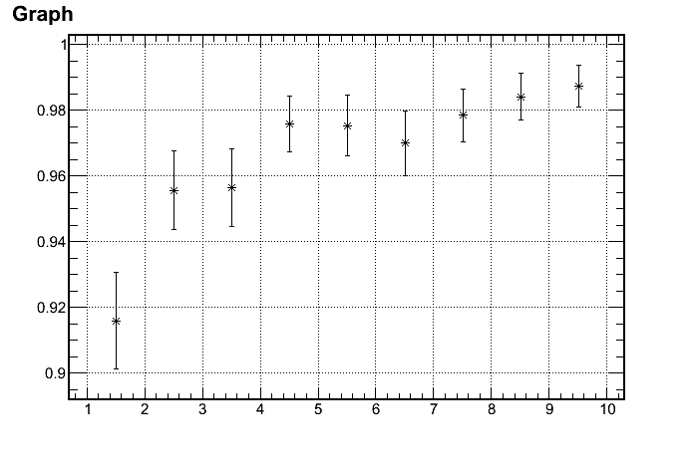
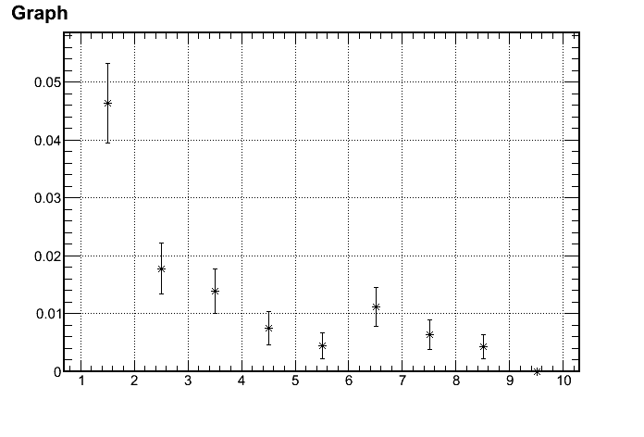
Pion rejections leads the design
Reach 100:1 pion rejection
0.6mm lead/1.5mm scintillator 200 layers, 42cm in length (20 X₀)
Electron Efficiency
1/(Pion rejection)
97%
1/100 Rejection
p (GeV)
p (GeV)
Active:
3~7 GeV

Slide 17
ECAL Design: Lateral Size
Good Balance
block Size (cm)

Slide 18
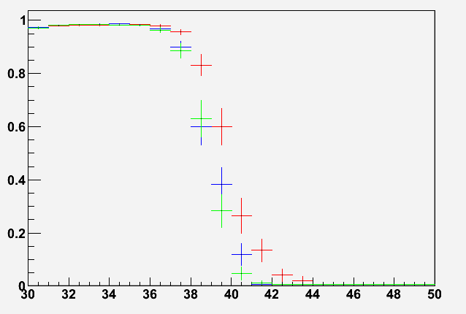
The edge effect - PVDIS
Have largest indenting angle
Calorimeter edge to target center -> 40 degree
P<4GeV
4GeV<P<8GeV
P>8GeV
Electron energy deposition in EC
Physics Need
Geometric limit
95% Contain
Azimuthal angle at target

Slide 19
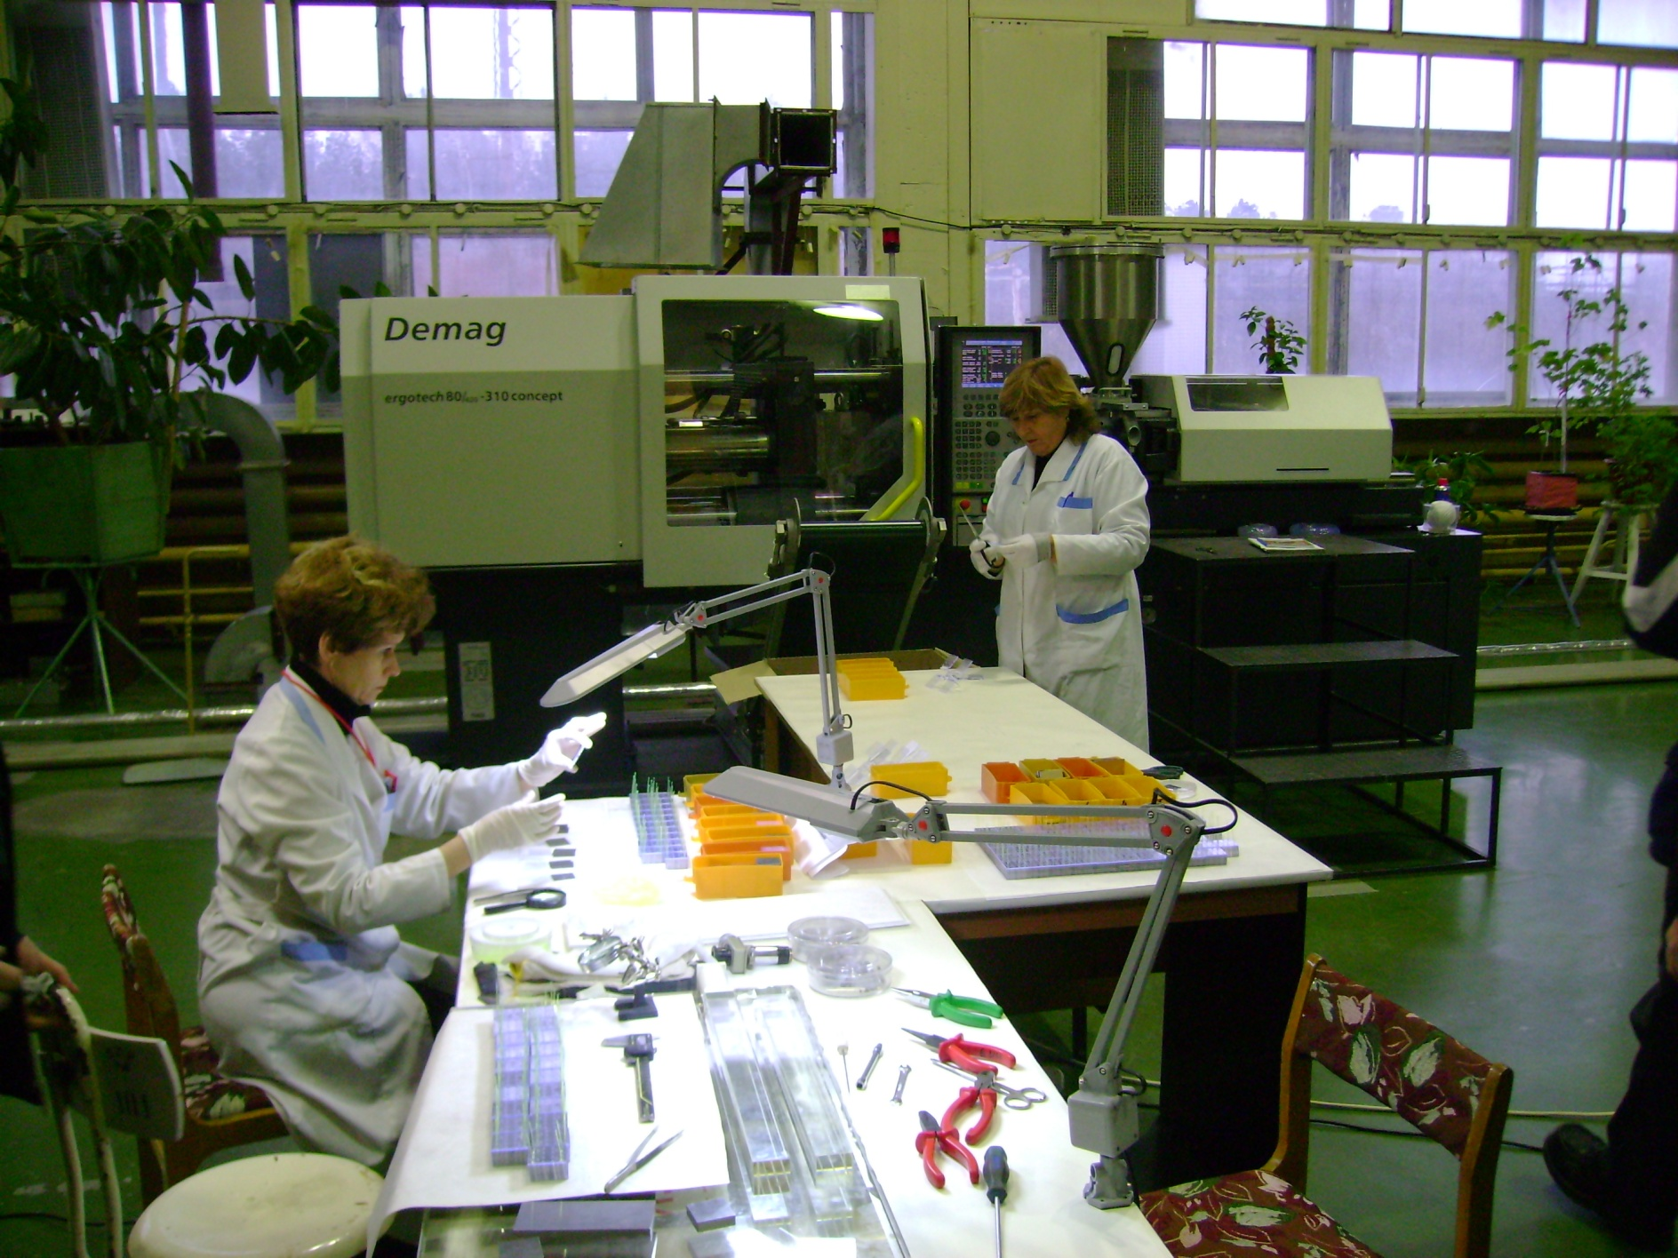
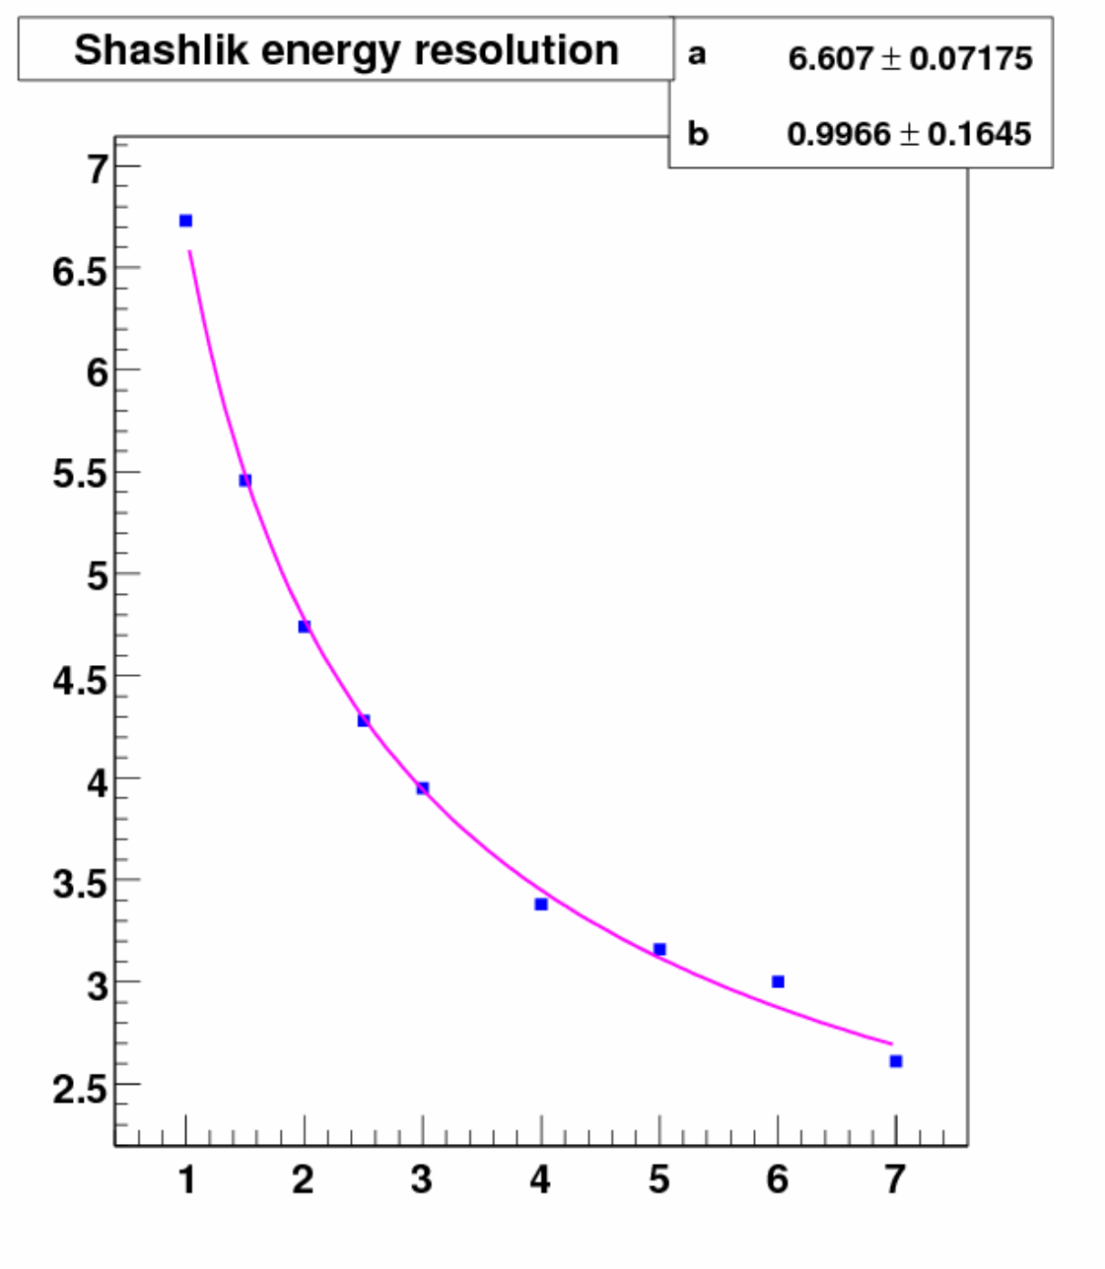
ECAL Shashlik
Dimensions 38.2x38.2 mm²
Radiation length 17.5mm
Moliere radius 36mm
Radiation thickness 22.5 X₀
Scintillator thickness 1.5mm
Lead thickness 0.8mm
Radiation hardness 500 krad
Energy resolution 6.5%/√E 1%

Slide 20
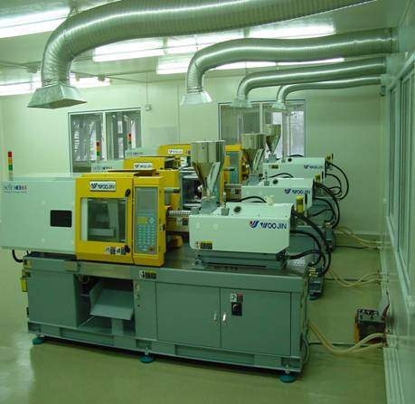
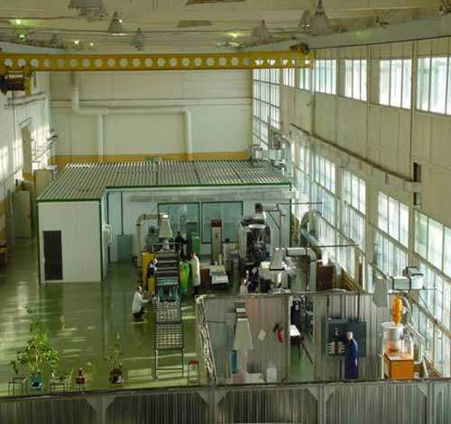
IHEP Scintillator Fasilities
www.ihep.ru/scint/index-e.htm

