Slide 1
SoLID EC Design for IHEP
2012/10

Slide 2
Basic Features of Preliminary Design
Based on COMPASS Shashlyk module design.
0.5mm lead/0.12mm air gap/1.5mm scintillator/0.12mm air gap
Assume Lead X₀=0.56mm, scintillator X₀=42.4cm, air gap needs to be replaced with actual wrapping or coating.
each layer 2.24mm(0.93X₀), total 216 layers, 48.3 cm in length (20 X₀)
Reach energy resolution of 5%/sqrt(E) with good linearity
Balance between resolution and longitudinal size
10x10cm of transverse size in square shape
reach 1cm position resolution
Balance between number of modules (cost), position resolution and background
Total about 2000 modules.
Splitting : preshower and shower
Maximizing e-pi separation (20:1 - 100:1 pion rejection depending on momentum)
100 WLS fibers/module
1/cm² fiber density to sample the EM shower
Use KURARAY Y11 for higher radiation hardness and longer attenuation length or use Bicron fibers to save cost.
Readout options in orders of preference:
Directly couple to PMT, if B-field permits
PMT readout with WLS to clear fiber extension (with lightguide or connector) to out-of-B-field region
APD/SiPM, if B-field is significant and if the radiation allows

Slide 3
Preshower/Shower Design 1(preferred)
Preshower has 1 layer of 11.2mm (2X₀) lead as passive radiator and 1 layer of 20 mm scintillator with embedded WLS fiber for readout
.
Preshower WLS fibers
clear fibers
connector
Shower WLS fibers
Shower, 18 X_{0,} Shashlik
Preshower (2X₀ lead + scintillator)
clear fibers
connector
11.2mm
20mm
434.5mm (194 layers)
100mm ?
Total length 569mm ?
Not shown
Supporting rod
Used by LHCb and Hermes
Good hadron rejection
No change to Shashlyk module prodution
Preshower lead layer work as radiation shielding
Significant reduction of the number of fibers for readout in preshower

Slide 4
Preshower/Shower Design 2
Preshower and shower have separate WLS for readout. Preshower WLS fibers bend and go back from the side.
clear fibers
Preshower (5X₀)
Shower (15X₀)
clear fibers
connector
70mm?
121mm (54 layers)
362mm (162 layers)
100mm ?
Total length 653mm ?
Not shown
Supporting rod
Only small change to current COMPASS module production method
preshower WLS fibers need to have bending radius > 70mm
Radiation damage on the fibers in front, need shielding?

Slide 5
Preshower/Shower Design 3
Preshower and shower have separate WLS for readout. Preshower WLS fibers go to back through hollow supporting rods. The number of preshower WLS fibers is limited by the hollow rod diameter.
Preshower WLS
Preshower
Shower
Shower WLS
hollow rod
Total length 583mm ?
change to COMPASS module production method
Same or less number of WLS fibers in preshower than shower.
0.7mm WLS fibers could be use instead of 1mm for preshower
Add more supporting rods to 9 or 16
Additional mold is required for preshower to allow WLS fibers to sample light
Need more R&D

Slide 6
Preshower/Shower Design 4
Preshower has thin WLS plate for readout and use embedded clear fibers to send signal at back. Shower has WLS for readout.
Preshower Clear fiber
Preshower
Shower
Shower WLS
WLS plate
Pros:
Significant reduce number of fiber for readout in preshower.
Concerns
change to COMPASS module production method
No enough light collected by the pad due to light transmission in the thin scintillator layers limited within around 1cm?

Slide 7
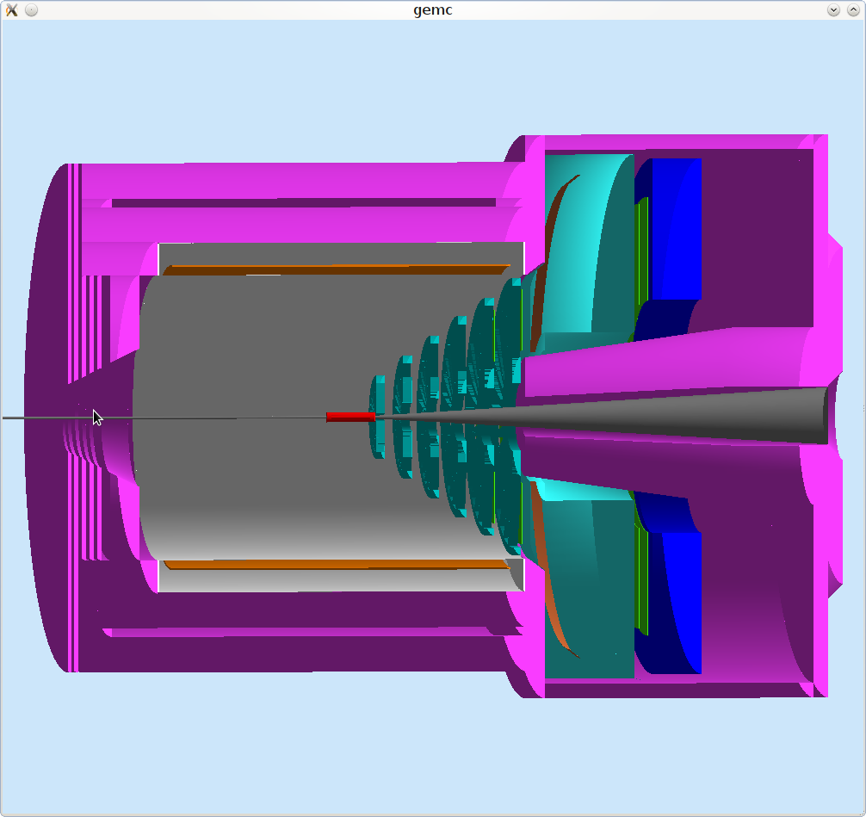
SoLID PVDIS
EM Calorimeter
(forward angle)
Cherenkov
Baffle
GEM
Target
CLEO II Coil and Yoke

Slide 8
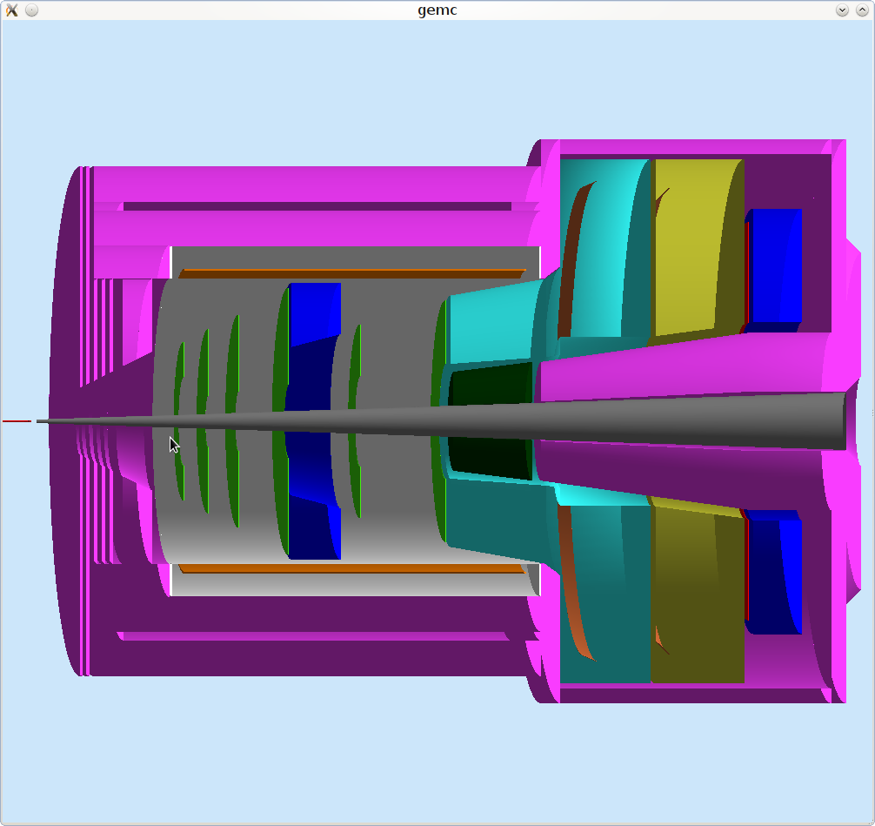
SoLID SIDIS and J/ψ
EM Calorimeter
(forward angle)
EM Calorimeter
(large angle)
GEM
MRPC
SC
Target
Collimator
CLEO II Coil and Yoke
Light Gas
Cherenkov
Heavy Gas
Cherenkov

Slide 9
Large Angle EC
We want to cover full azimuthal angle and leave no gap between modules, so module can not be tilted and need to be along Z axis
Prefer having short outer module so that the outer module area can cover more and inner module area can cover less
Inner module need to be special shape to avoid blocking acceptance. One way to solve it is to have smaller 4x4cm (like COMPASS) module with various length
600mm
assume 600mm full module length
Blue: LAEC acceptance angle
Orange : angle between inner and outer
10x10x60cm module
Outer module
(500mm in radius)
24º
4x4x43cm
4x4x32cm
inner module
(160mm in radius)
17.5º
4x4x27cm
600mm
14.7º

Slide 10
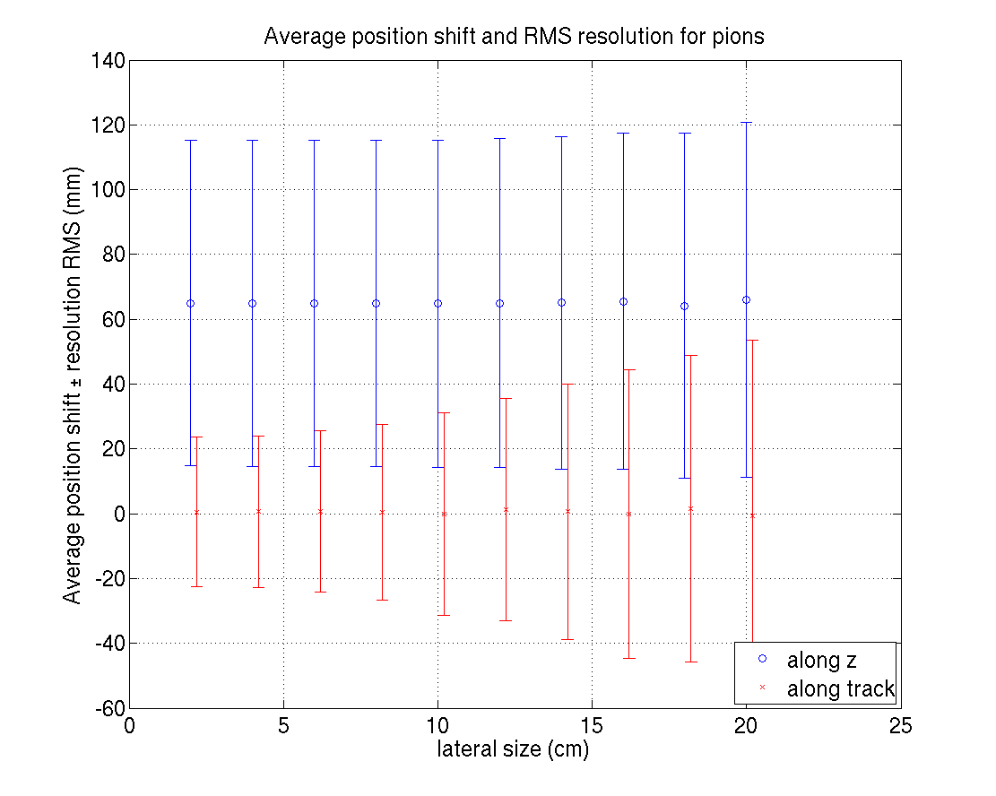
Position resolution VS lateral size
Calorimeter theta angle coverage PVDIS (22-35), SIDIS(8-15,15-24)
Blue: calorimeter modules along z axis
Red: calorimeter modules along central track
Electron
Hadron
Shifted pion ΔR

Slide 11
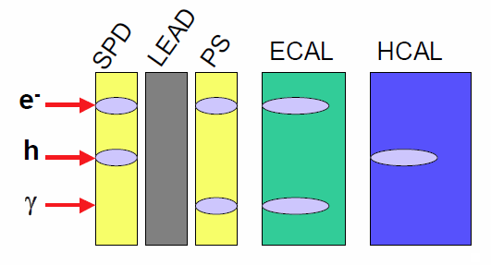
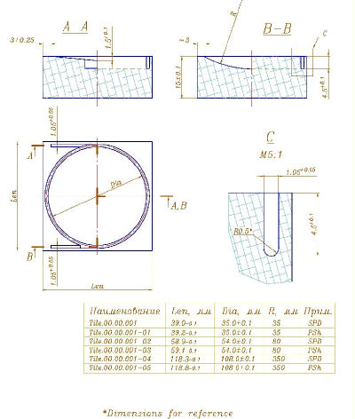
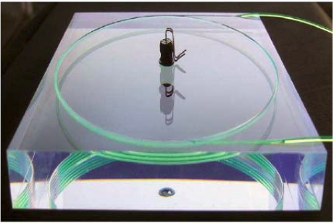
LHCb Calorimeter Preshower
LHCb used diamond mill to make curvy groove and glue WLS fibers in
Can curvy grooves be made with scintillator mold? Will it be cheaper compare to diamond mill cut?
Can straight grooves be made with scintillator mold? Will it be cheaper compare to diamond mill cut?

Slide 12
How to bend WLS fibers from preshower scintillator pad?
WLS fibers come out of preshower scintillator pad and go back along module for readout.
To have large bending angle, let fibers go transversely first and then go longitudinally to back.
20mm
Assume straight holes
100mm
Red: straight part of fiber inside pad
Orange: Curvy part of fiber outside pad

Slide 13
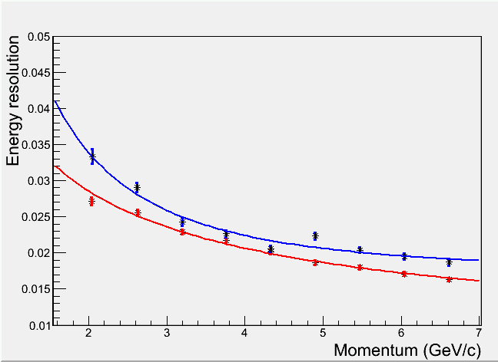
Impact to energy resolution from the passive preshower
Simulated with 2 X0 passive radiator and 2 cm scintillator as preshower
Minor degrade on energy resolution observed for our energy range
Passive preshower + 18 X₀ Shashlyk
20 X₀ Shashlyk

Slide 14
Pion rejection comparisons
Passive preshower show degrade on pion rejection for higher energy range
1/pion rejection with 94% electron eff.
Passive preshower + 18 X₀ Shashlyk
20 X₀ Shashlyk

