Slide 1
APD

Slide 2
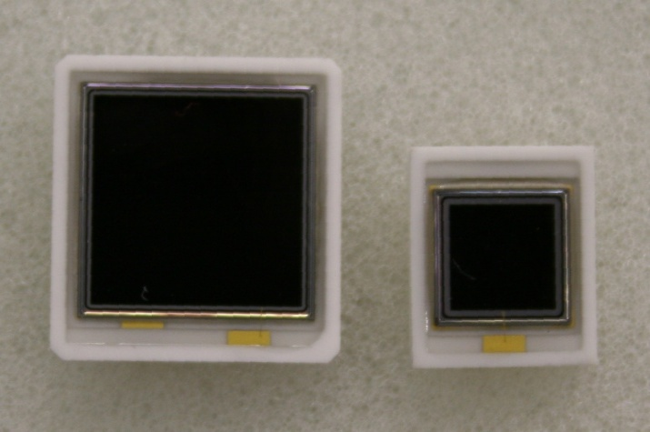
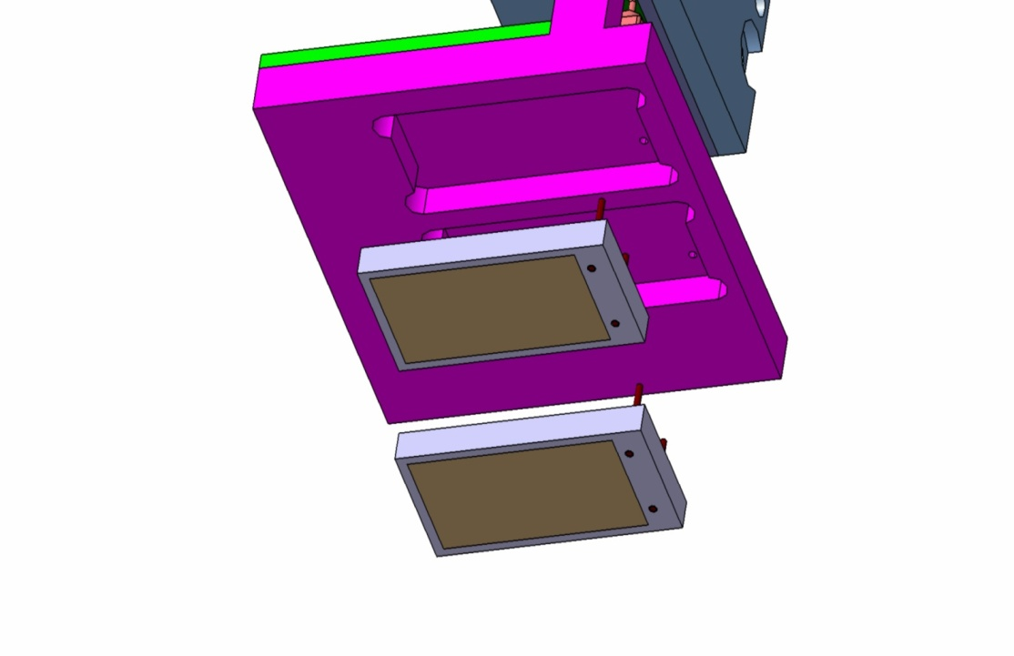
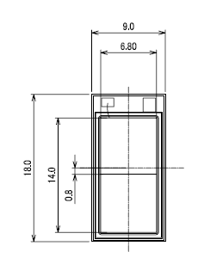
photosensors:
Large Area Avalanche Photo Diodes (LAAPD)
in collaboration with Hamamatsu Photonics
CMS
excellent performance
at RT and T = –25ºC
radiation resistent
up to 10¹³ protons
in particular at T = -25ºC
new
10x10mm²
5x5mm²
final concept: 2 LAAPDs/crystal,
separately readout
dimensions
7 x 14 mm²

Slide 3
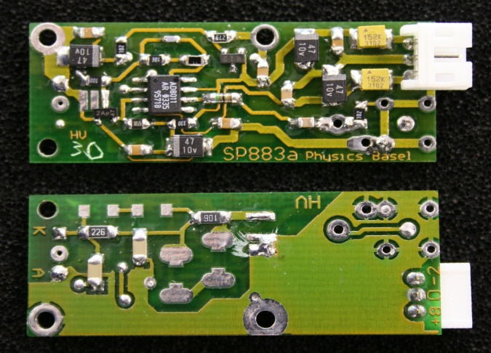
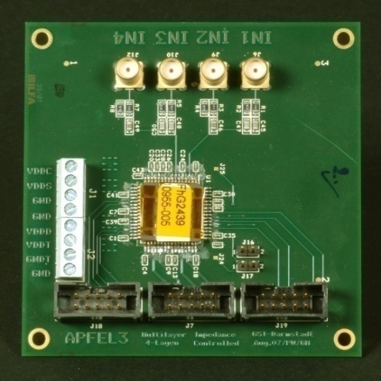
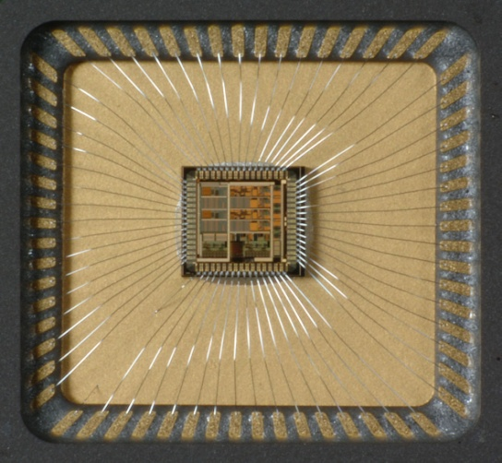
development of low noise, low power preamplifiers
design of descrete components
for prototype studies
18mm
ASIC (APFEL) large dynamic range
2 channels/ 2 ranges
overall range 1 – 10.000
noise level (cooled)
<< 2 MeV

Slide 4
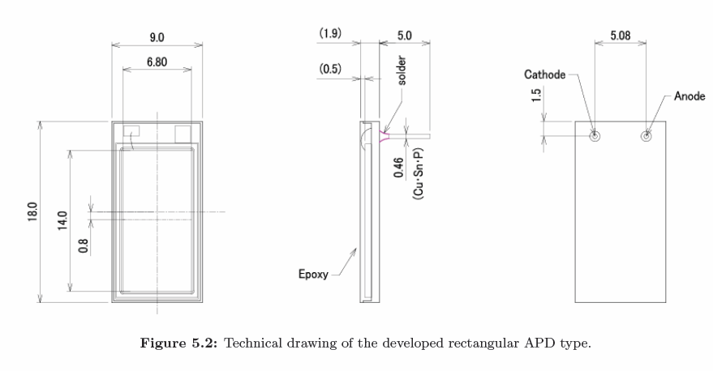
Panda APD size 7x14mm

Slide 5
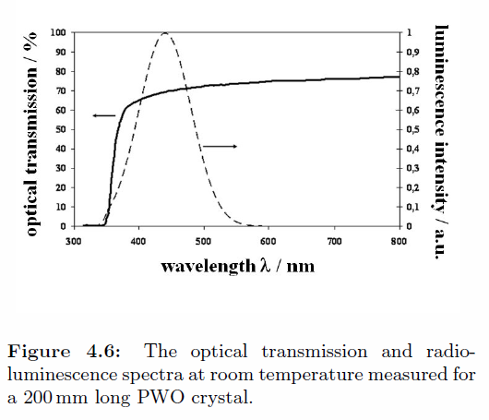
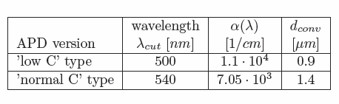
Panda APD see light below 500nm
Panda_EMC_TDR

Slide 6
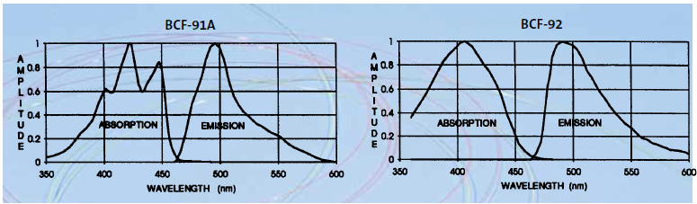
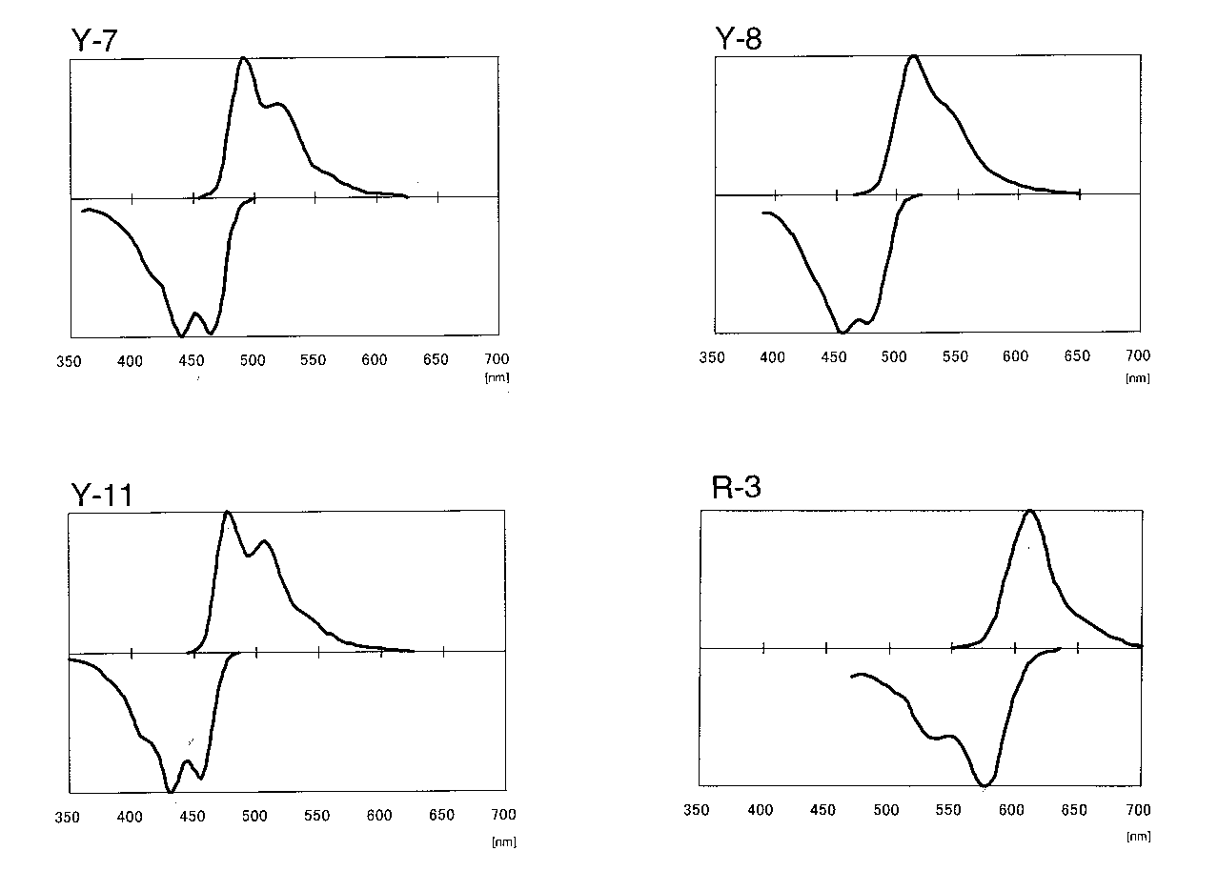
WLS has light around 500nm
http://www.detectors.saint-gobain.com/fibers.aspx

Slide 7
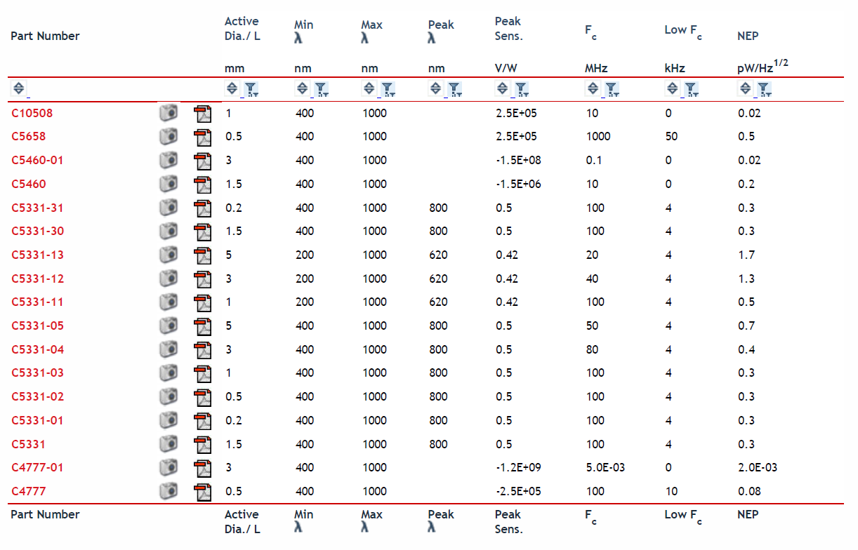
Hamamatsu has no APD for 500nm? http://sales.hamamatsu.com/index.php?id=13196302

Slide 8
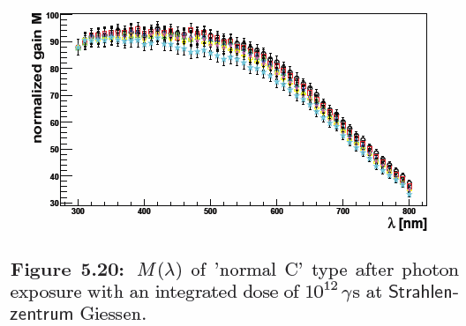
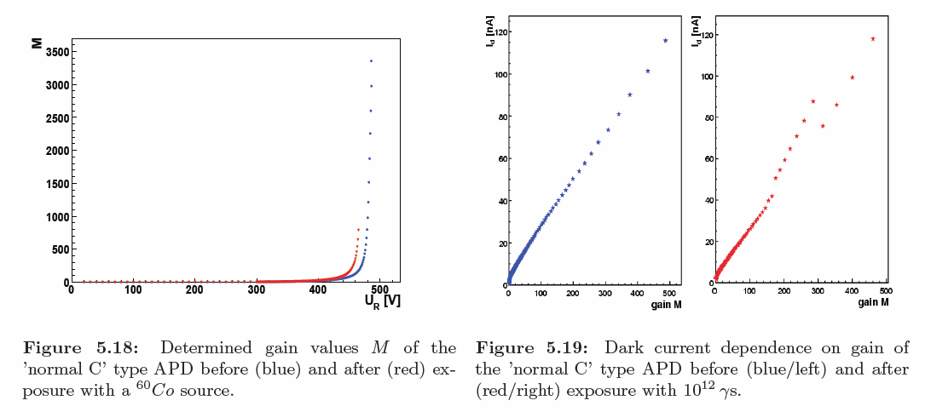
Photon radiation
⁶⁰Co photon 1.2MeV
1e12 photon is 1.2e9 GeV or 0.192 J
The remeasurements of the APD characteristics have been done after a storage of the diodes at room temperature in the order of one month

Slide 9
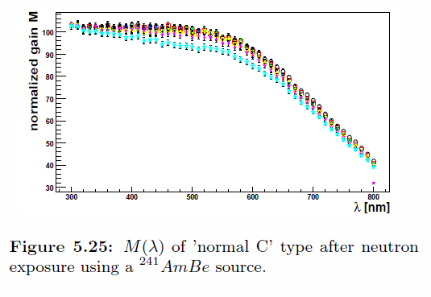
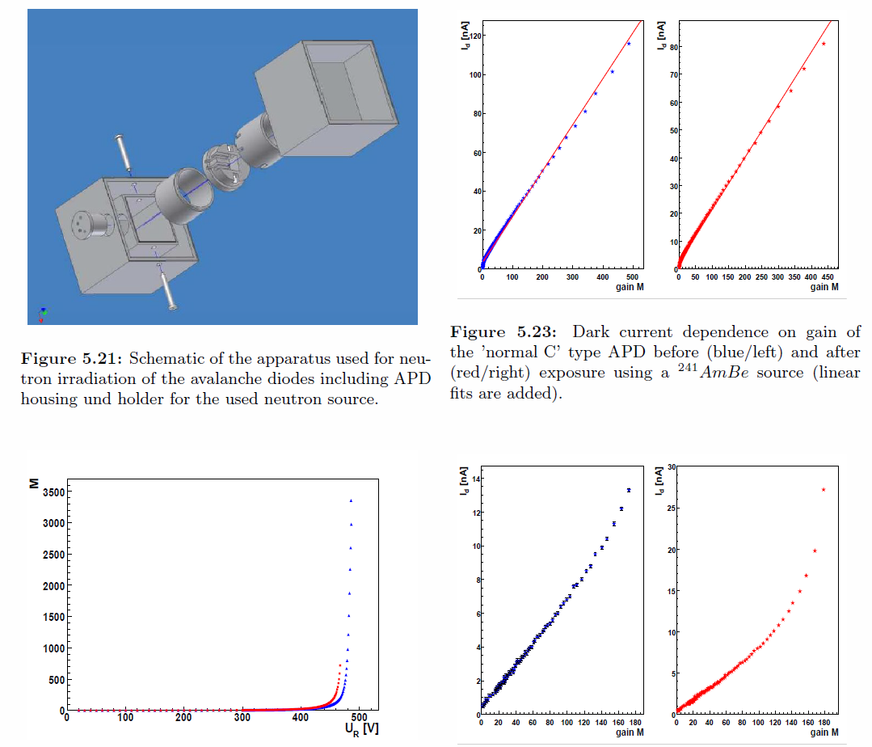
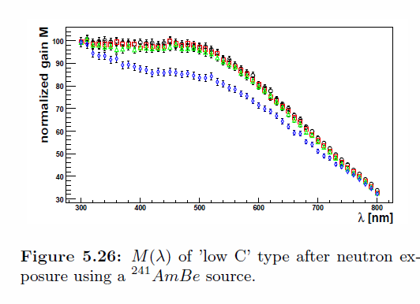
Neutron radiation

