Slide 1
SoLID EC
Zhiwen Zhao
2011/12/09

Slide 2
Outline
Configuration
Requirements
Calorimeter design
Beam Test plan
Help we need

Slide 3
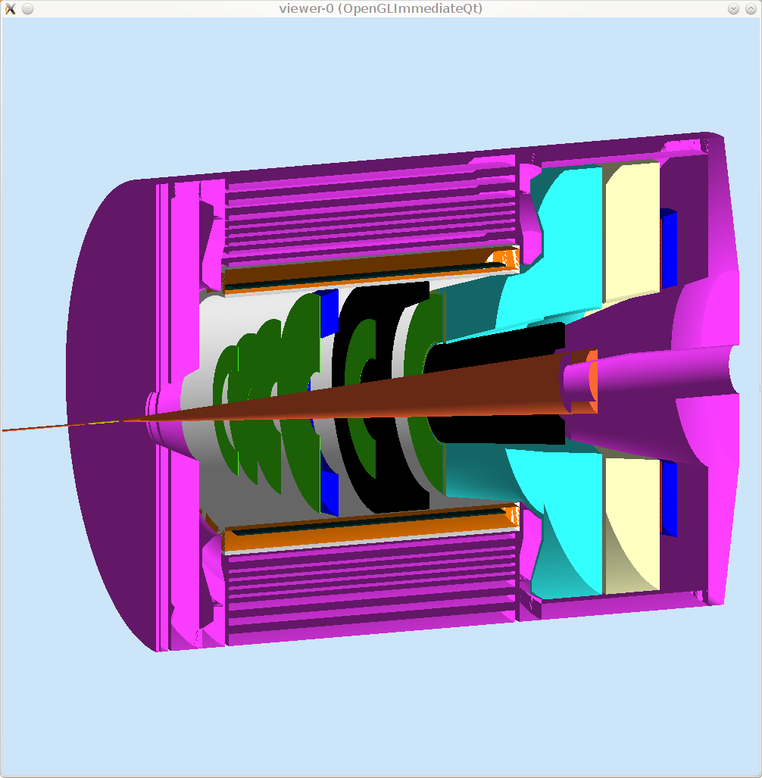
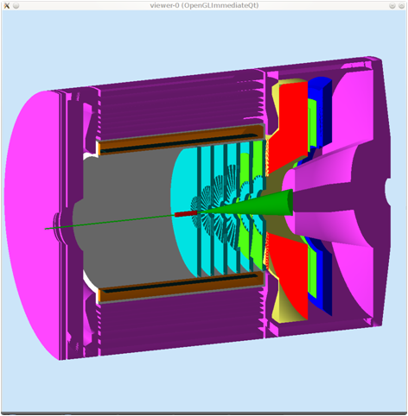
SIDIS/PVDIS CONFIGURATIONS
PVDIS Forward
Angle
SIDIS Forward
Angle
SIDIS Large Angle

Slide 4
Requirement
Pion rejection 100:1 (preshower/shower)
Energy resolution: 5~ 6%/√E
Position resolution: 1cm
Time resolution: 100-500ps
Radiation hardness: 400krad/year
Swap modules: layout
Readout outside of field: fiber connection

Slide 5
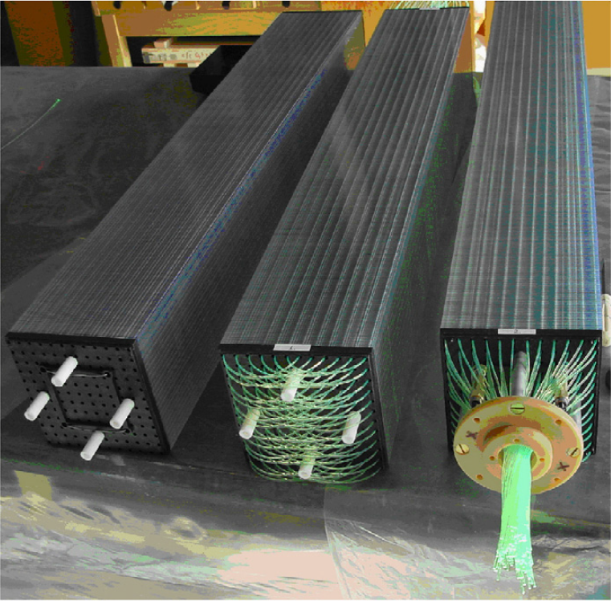
Calorimeter Design: Best Option
Lead-Scintillator Sampling Calorimeter:
Shashlyk Calorimeter
Fibers collect and read out the light
Great flexibility, tunable energy resolution: ~ 6%/√E is not a problem
Good radiation Hardness: ~ 500 krad
Well developed and mature technology: used previously
in other experiments

Slide 6
Calorimeter Design: Lateral Size
Good Balance
block Size (cm)

Slide 7
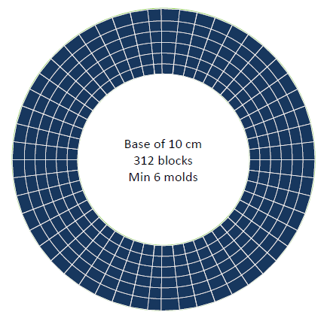
Calorimeter Design: Layout - Ring Sector
Excellent coverage
(no edge effect)
Small minimum number of
blocks but several molds
(~50 k each!)
Block size varies with the
radius, so does the position
resolution

Slide 8
Calorimeter Design: Fibers
Fibers:
Wave Length Shifting fibers (WLS):
KURARAY Y11: - good attenuation length (3.5-4m),
- good radiation hardness : <30% loss of
light output after a 693 krad irradiation.
- Recovery: few percents after 10 days
(M.J. Varanda et al. / NIM in Phys. Res. A 453 (2000) 255}258)
Clear Fibers:
KURARAY clear PS, Super Eska…, options under study.

Slide 9
Man power
Faculty
Xiaochao Zheng
Paul Reimer
Postdoc
Zhiwen Zhao (UVa) preshower/shower, beam test
Jin Huang (LANL) simulation
Mehdi MEZIANE (Duke) layout, fiber

Slide 10
Beam test plan
Goal
Learn the modules, train personnel
Test energy, position, time resolution
Anchor simulation
Time now till next summer
(May shoutdown, July/Aug return module)
Location HallB under photon tagger
(HallA option looked)
Stages
Preparation readout,electronics, mouting
Bench test gain match
Beam test

Slide 11
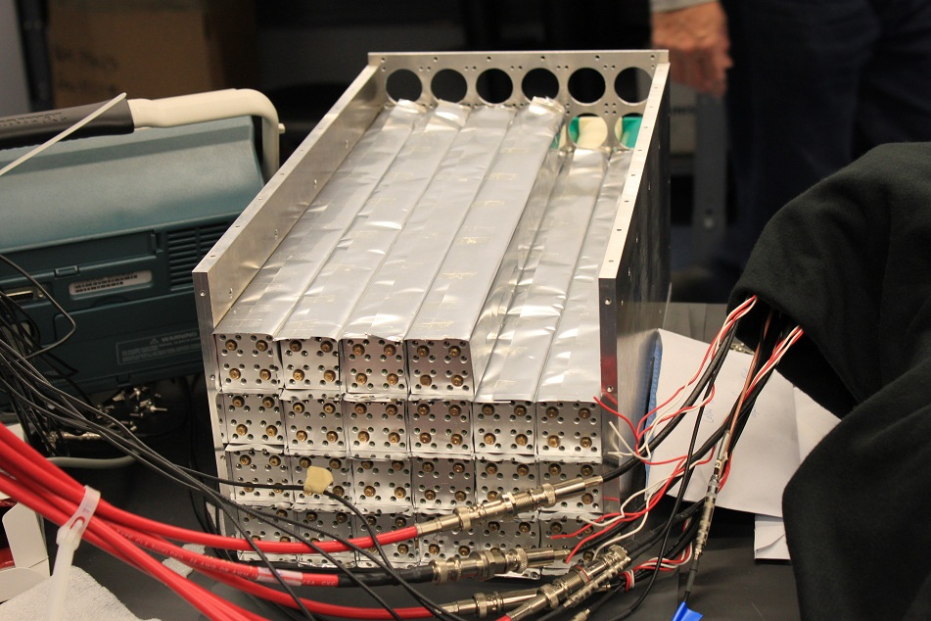
Test module
Used for CLAS TPE exp. Belongs to Will Brooks, located at ODU

Slide 12
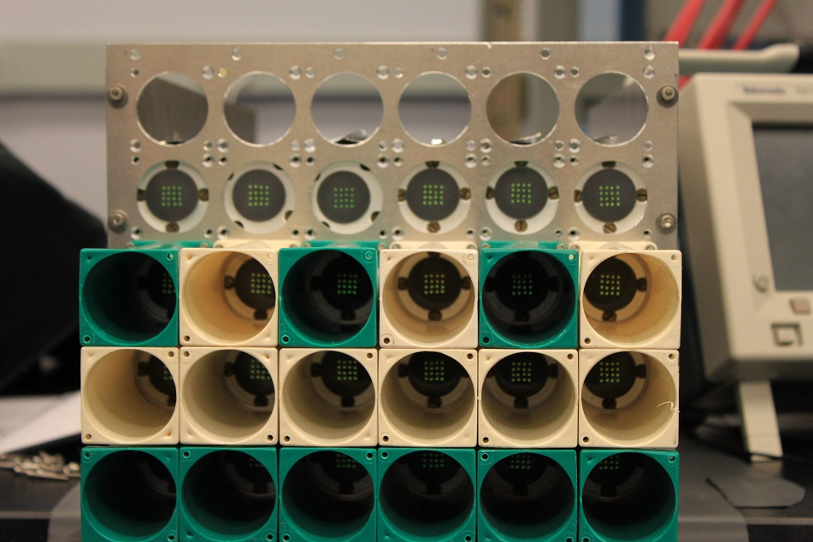
Old Readout housing
Used for CLAS TPE exp. Belongs to Will Brooks, located at ODU

Slide 13
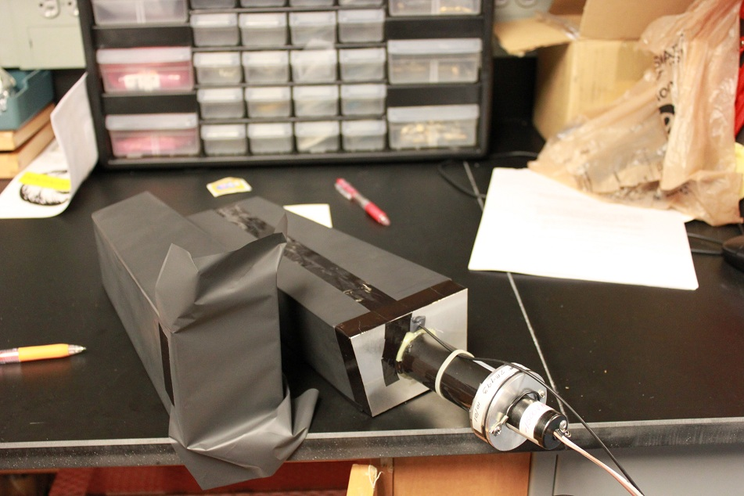
Readout
DVCS proton array readout, need to take them off
and make a adaptor or new housing because PMT is longer

Slide 14
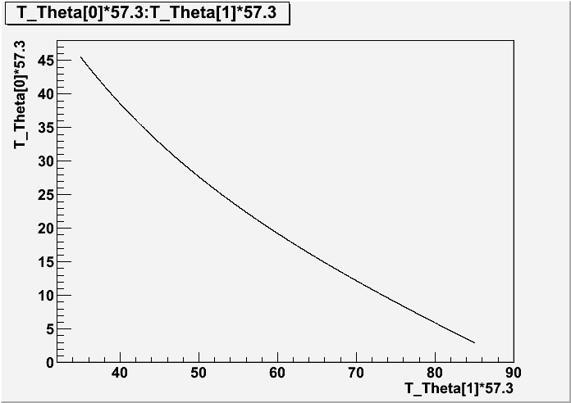
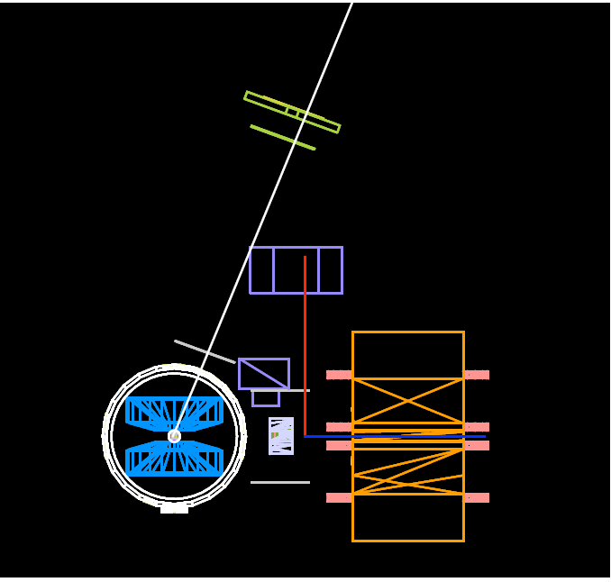
HallA test?

Slide 15
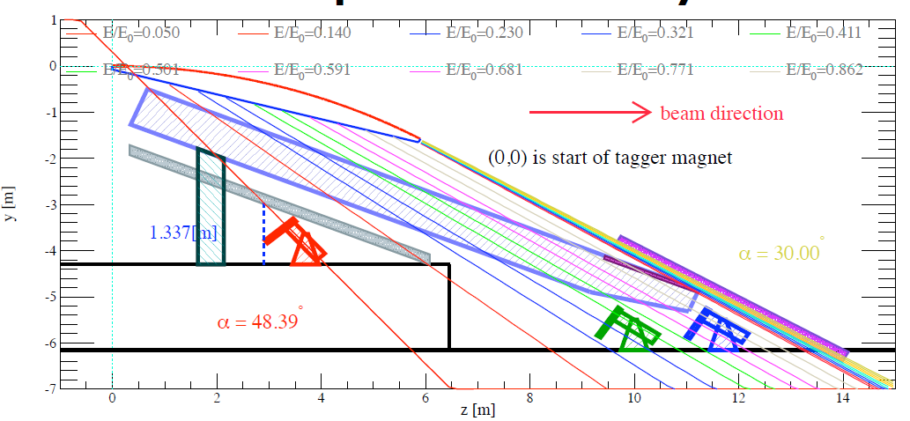
HallB test setup
G14 runs at 2,4,5 GeV, two rounds, first round ends at end of Mar
Setup is independent of CLAS
HallD FCAL running test now with FADC ( no ending data) yet.
May borrow supporting structure

Slide 16
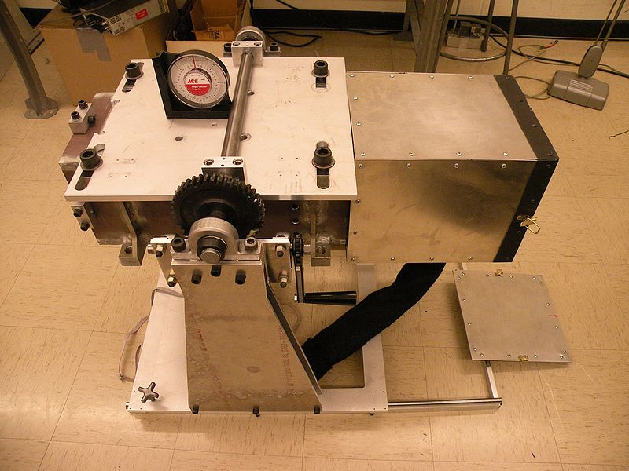
HallD test supporting structure

Slide 17
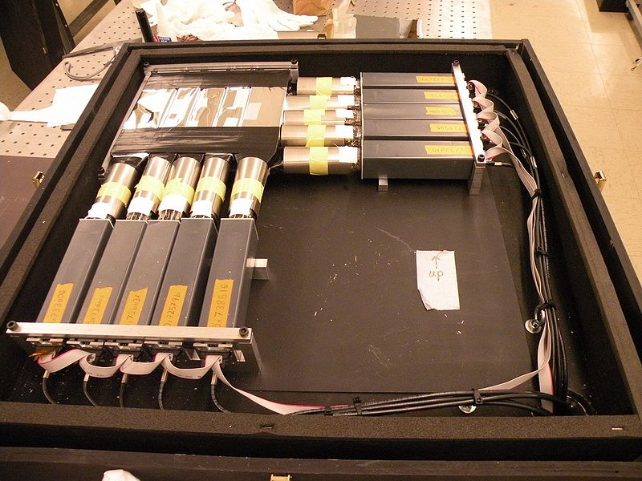
HallD test trigger box
http://www.flickr.com/photos/63927802@N02/6340030123/sizes/l/in/set-72157627993117345/
https://halldweb1.jlab.org/wiki/index.php/2011_Hall_B_FCAL_Beam_Test

Slide 18
What we need
Write up a plan, and ask HallB with OSP later, taking
into consideration of other tests (HallD BCAL etc)
Making the adaptor for readout
Take the readout off and assembly with module
Make the mounting or the whole supporting structure.
Get electronics
Do test

