Slide 1
SoLID EC Update
Zhiwen Zhao
2012/05/22

Slide 2
Beam test update
Coverage for PVDIS
Road map

Slide 3
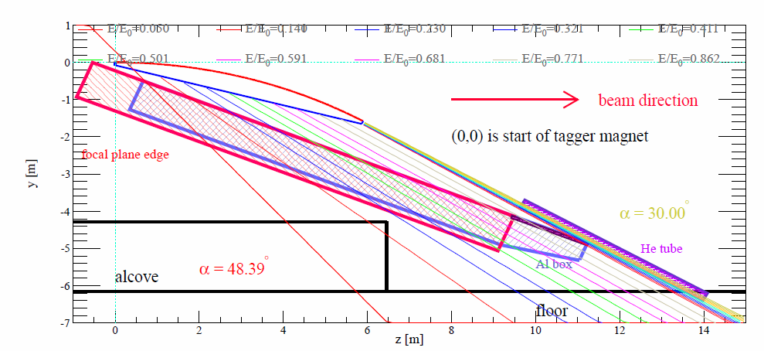
Test under CLAS photon tagger
Electron with known energy and impact angle
Variable energy, variable impact angle
HallD FCAL
SoLID EC
HallD BCAL

Slide 4
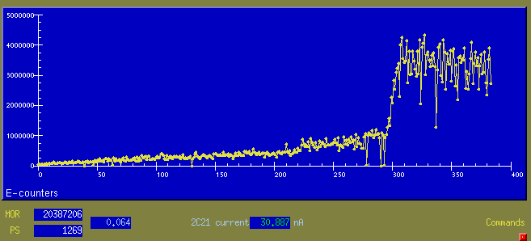
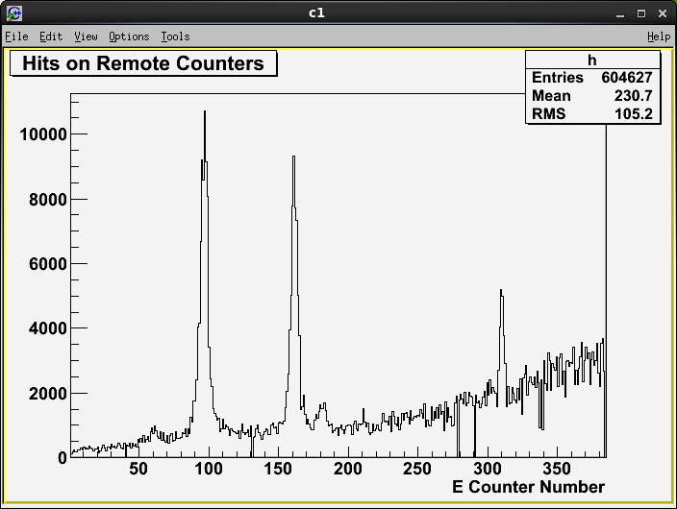
CLAS Tagger Scalers when running
linearly polarized photon by coherent
Bremsstrahlung.
Special Tagger run with three small scintilators to find out the electron energy at three test locations.
For 5 pass beam,:
1.3 GeV
2.1 GeV
3.6 GeV
The plan was to have tests at 2 and 3.
1
2
3

Slide 5
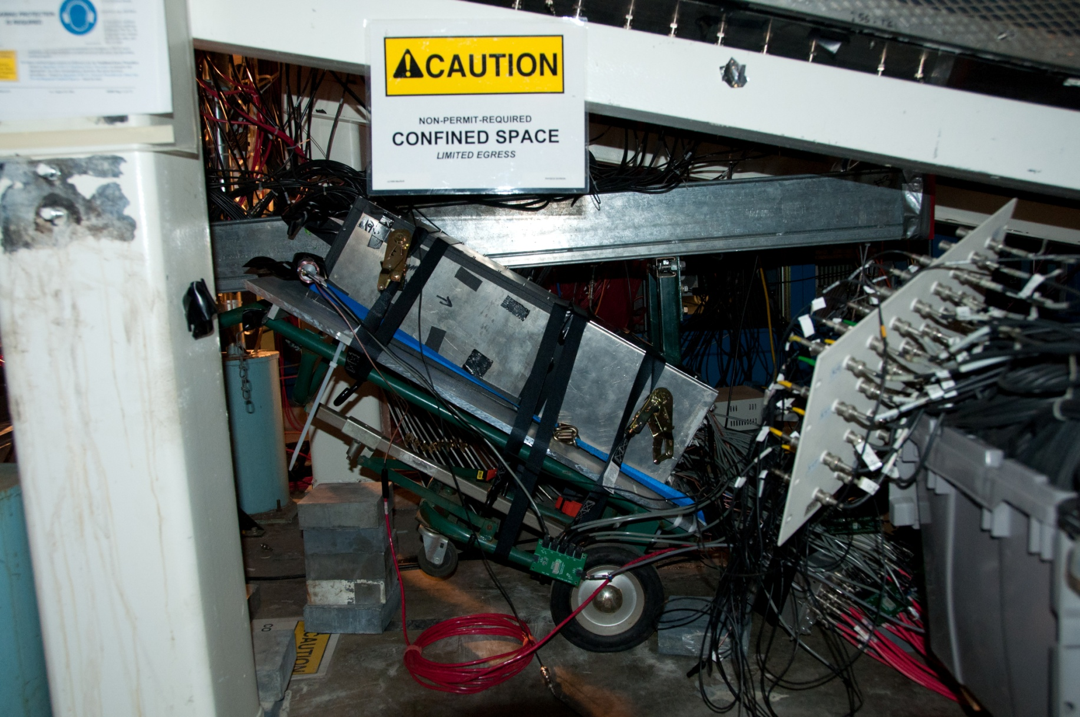
Tilting at about 32 degree to start with small angle beam impact
Electrons

Slide 6
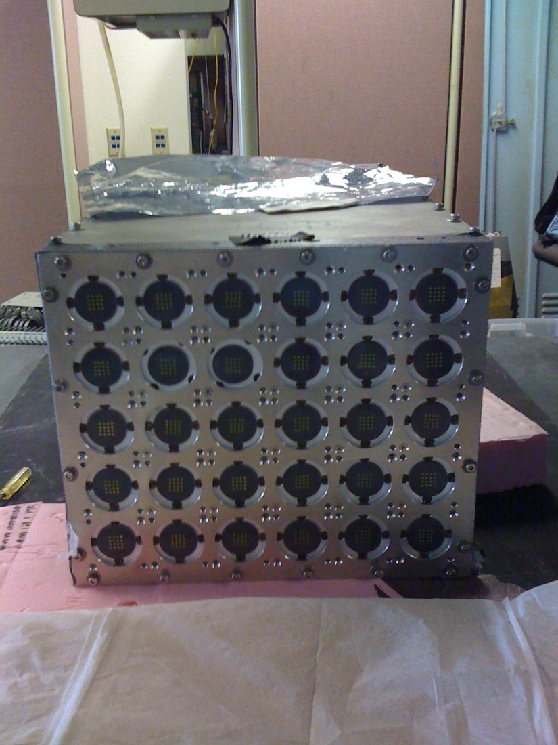
Noise Noise
What: large ground noise above 30mV appears after moving into HallB. It was not a problem on 2nd floor of counting house.
Why: PMT and base were not properly shielded.
Fix: wrap around every tube and cable with Al foil and grounding stripe to make it under 7mV
cost: it took long time to debug the source, take everything apart, wrap 30 tubes and assembly everything back with only limited access to the hall.

Slide 7
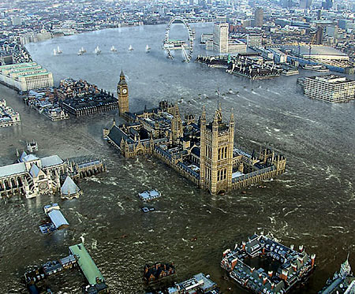
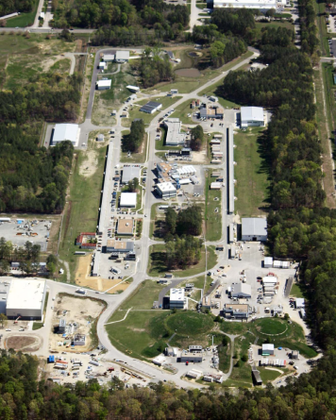
data set
Cosmic run in horizontal position
Cosmic run in vertical position
Beam data at location 2
Beam data at location 3
washed away by flood.
Cosmic run afterward
impossible due to damaged
equipment and scheduled
module disassembly.

Slide 8
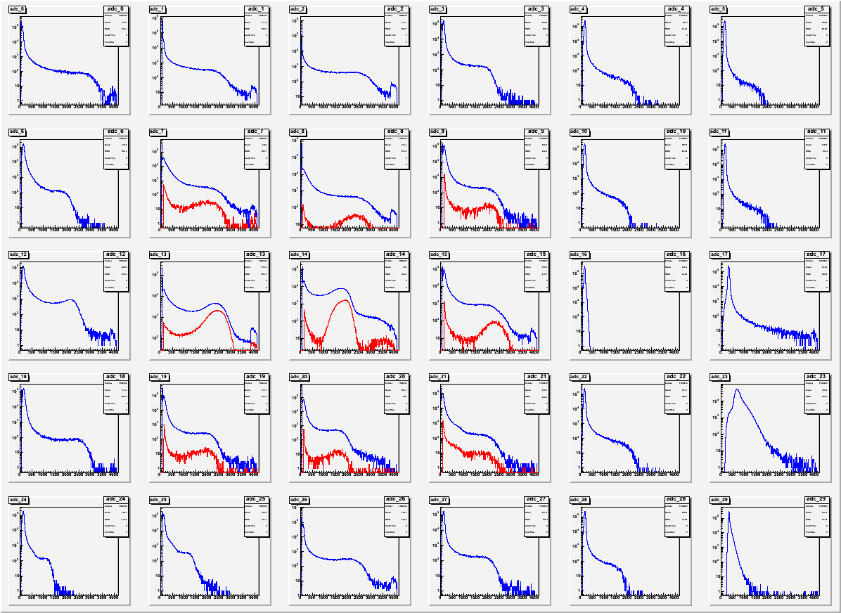
Raw ADC (Blue) cut (Red) by selecting module with most of energy depostion
Trigger
Scintillator
location

Slide 9
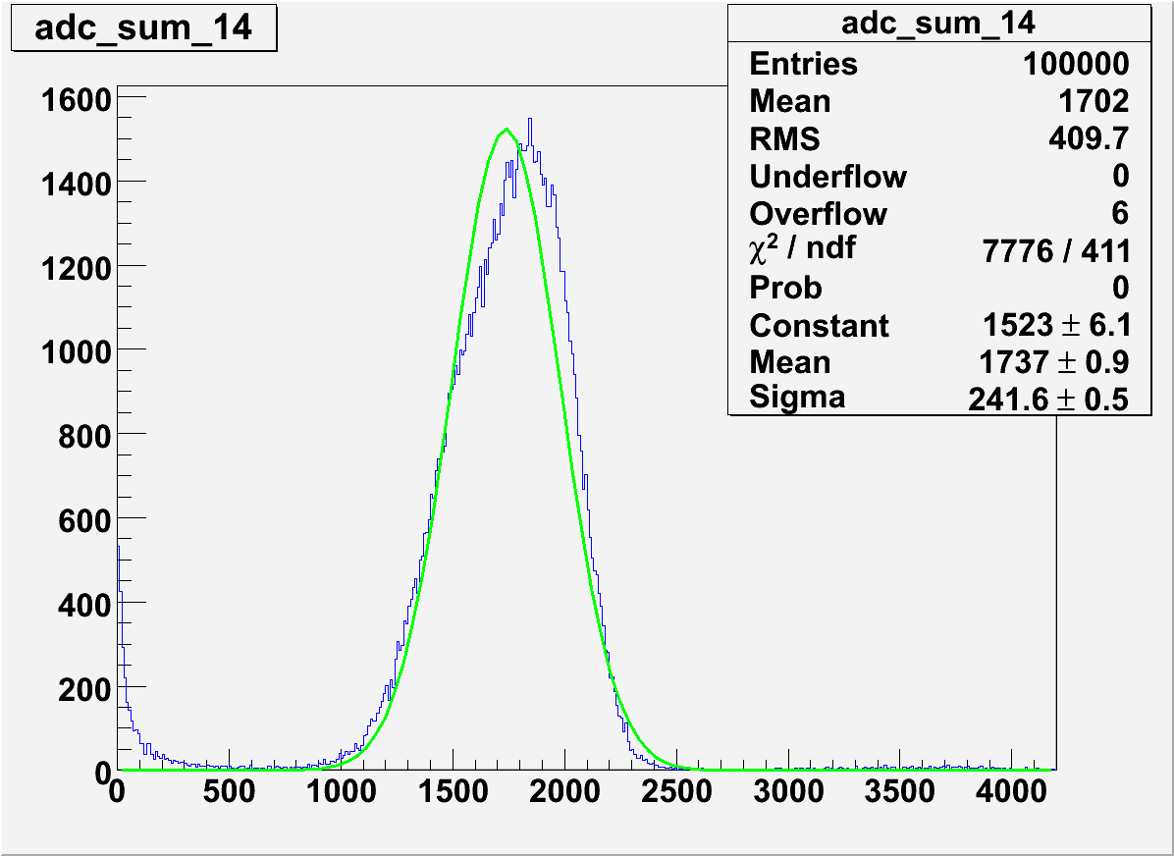
ADC Sum (need further study like software gain match to minimize the resolution)

Slide 10
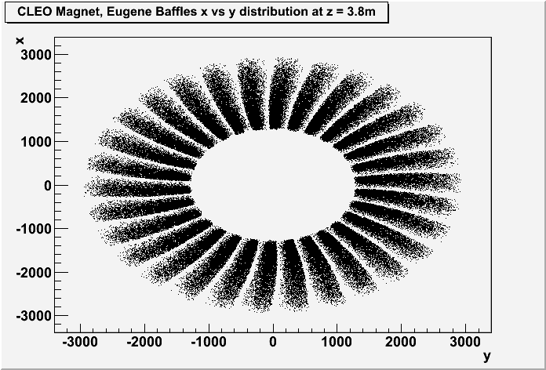
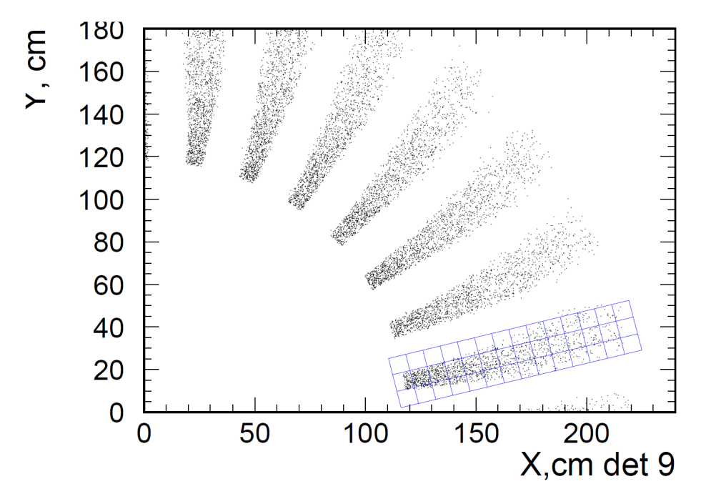
Coverage for PVDIS
Received major change in calorimeter hit pattern from Seamus,
~50% coverage (proposal) -> ~100% coverage needed
~25%?+ higher cost (by reusing SIDIS LC to PVDIS)
Calorimeter will be placed along beam axis
PAC34 proposal
New from Seamus

Slide 11
Outline / Road map to Dry run and Director’s review
Requirement for calorimeter
e/pi separation
What’s the final requirement in number? Need e/pi ratio (Zhiwen, Seamus) Need Cerenkov rejection/efficiency number
Can we achieve it? Improve with more realistic simulation. (Jin)
Radiation hardness, see next item
Radiation hardness and material choice
Final background distribution (Zhiwen) to finalize radiation dose distribution inside the calorimeter (Jin)
Need to simulate performance VS radiation dose (Jin)
Need to keep searching for possible better material, 10^6 rad (if possible) will be good (Mehdi)
Background on fibers outside calorimeter (Jin)
List of options to deal with it
Swapping modules with smaller R with larger R
Replacing preshower part of calorimeter after damage
Possibility, cost and labor (Zhiwen)
Replacing inner calorimeter modules after damage
Cost and labor (Zhiwen)
Redesign inner part of calorimeter with high quality PbWO4 crystal (Jin)
What type of calorimeter?
Shashlyk best fit because performance, easy to readout and mature in production
Give a table of popular calorimeter options (from Eugene’s slides) and why Shashlyk is the best

Slide 12
Continued
Energy resolution
Tuned by fraction of active material (scintillator)
Improve with more realistic simulation (Jin)
Preshower/shower separation
Polish detailed design and/or list realistic options (Zhiwen)
Lateral size
Balance readout cost and resolution (both position and energy)
Improve position resolution simulation w/ background (Jin)
Improve chart on lateral size (Jin)
Determine final lateral size (All)
Layout
Square shape calorimeter best fit our need (Mehdi)
For PVDIS: we can tilt calorimeter to face target (Jin)
Readout option
PMT readout in low field region
Improve options for connecting WLS fiber to clear fiber (Mehdi)
Cost
Polish cost estimation (Zhiwen, Mehdi)
Beam test
Summary slide (Zhiwen)
Work on data analysis (Zhiwen & Jin)

