Slide 1
CLEO Magnet and Yoke
Zhiwen Zhao

Slide 3
Note
In proposal, PVDIS and SIDIS have different yoke with BaBar magent and optimized individually.
Then we adopt the same BaBar yoke for PVDIS and SIDIS which essentially is SIDIS configuration because it needs large room. So it’s not optimized for PVDIS.
For CLEO, we will use two different yokes for SIDIS and PVDIS. The only difference though is SIDIS will have an additional 90cm wide donut shape which holds the heavy gas Cherenkov.

Slide 4
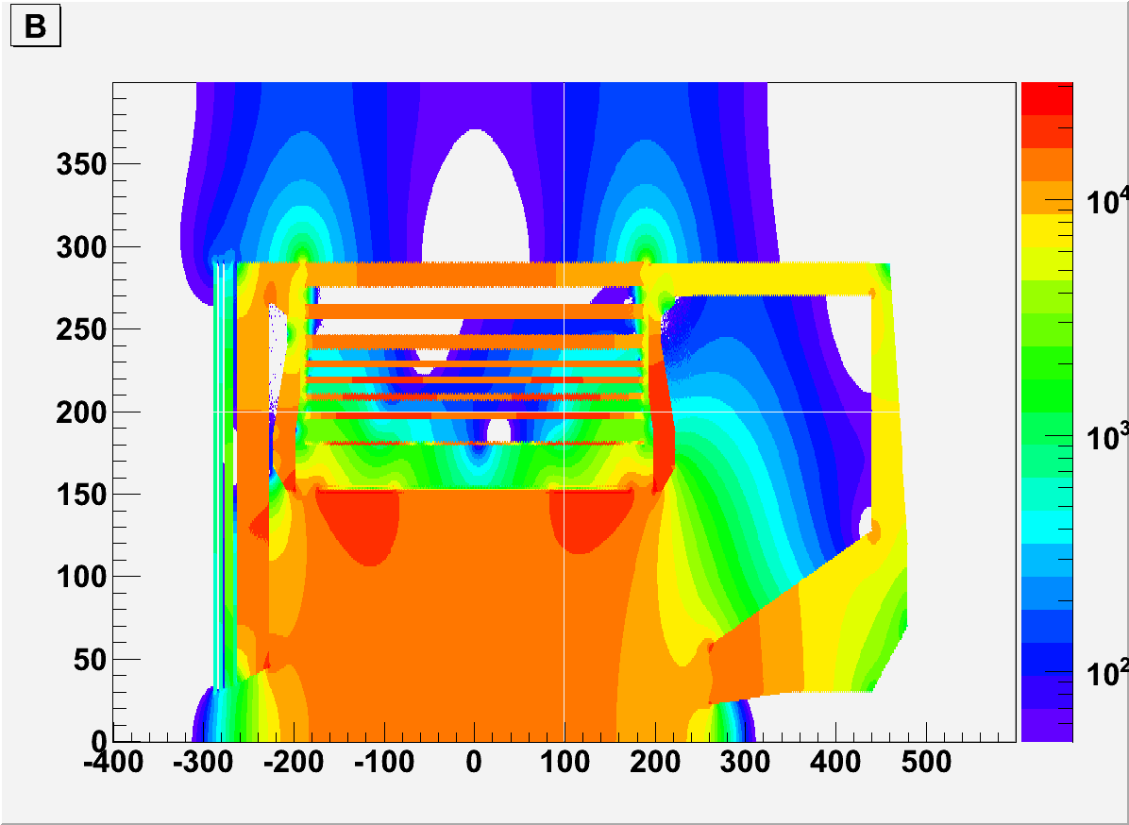
BABARv4 min 50G

Slide 5
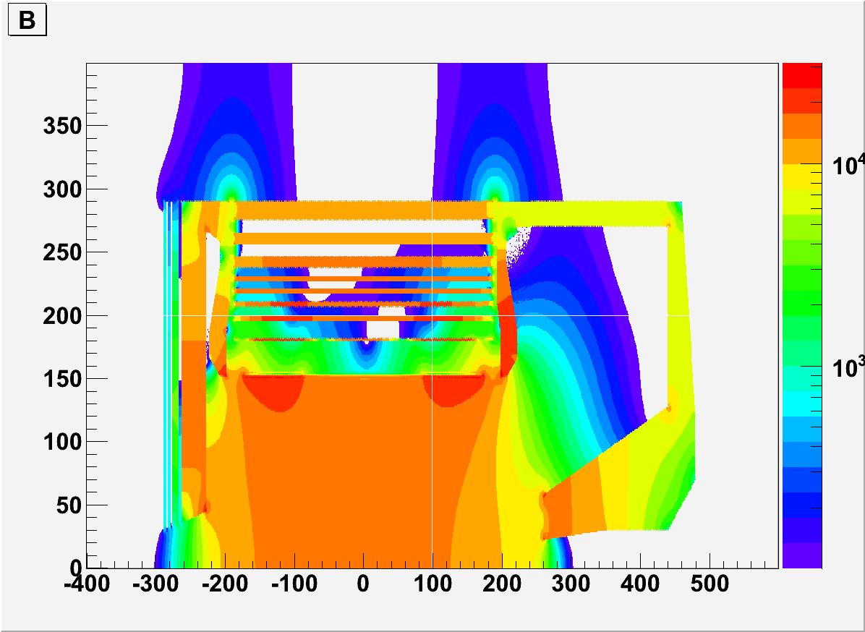
BABARv4 min 100G

Slide 6
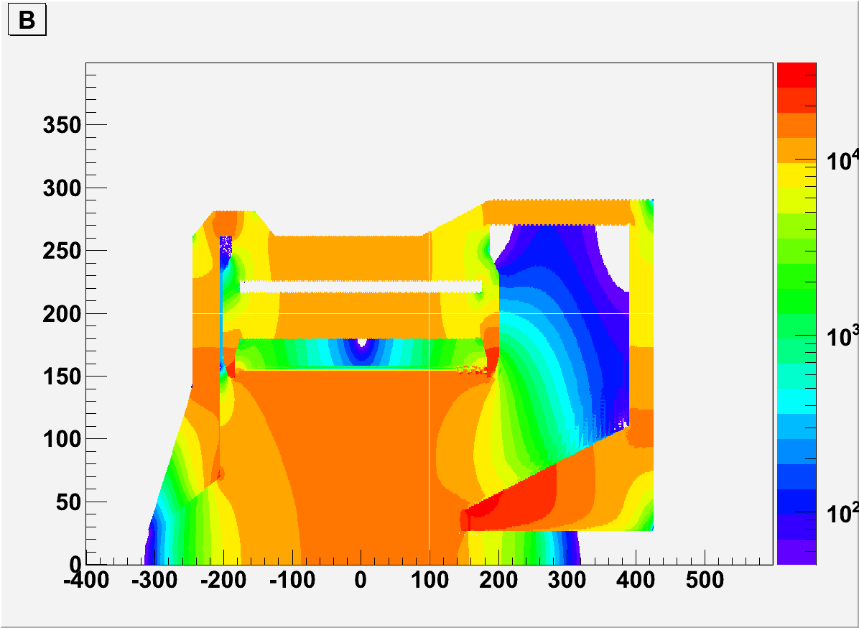
CLEOv6 PVDIS min 50G

Slide 7
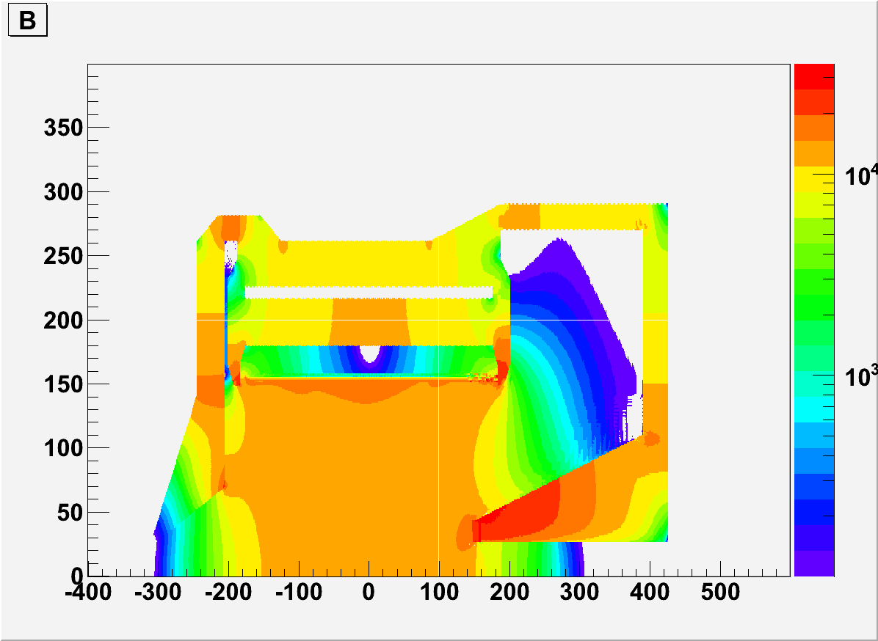
CLEOv6 PVDIS min 100G

Slide 8
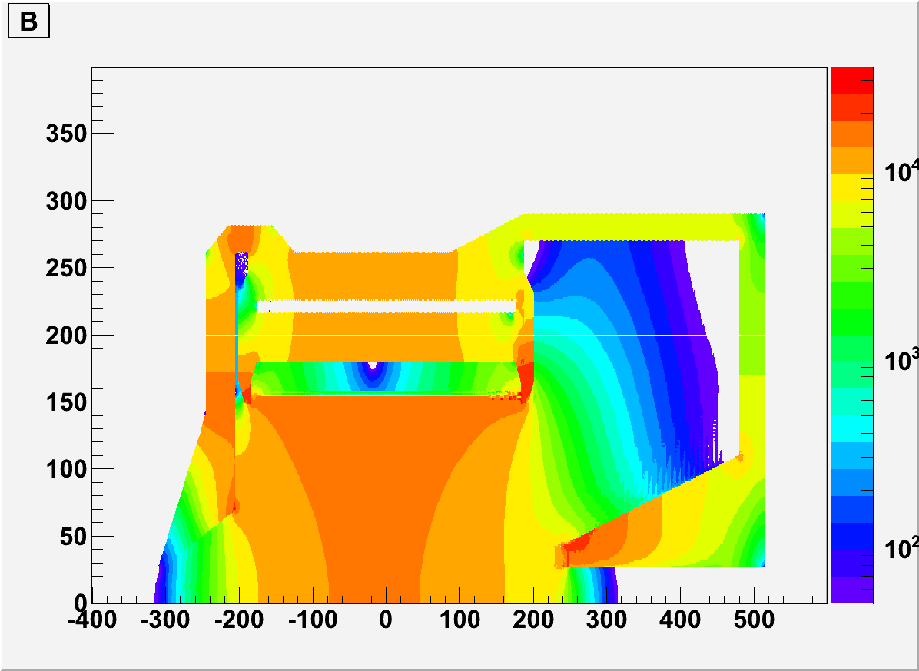
CLEOv6 SIDIS min 50G

Slide 9
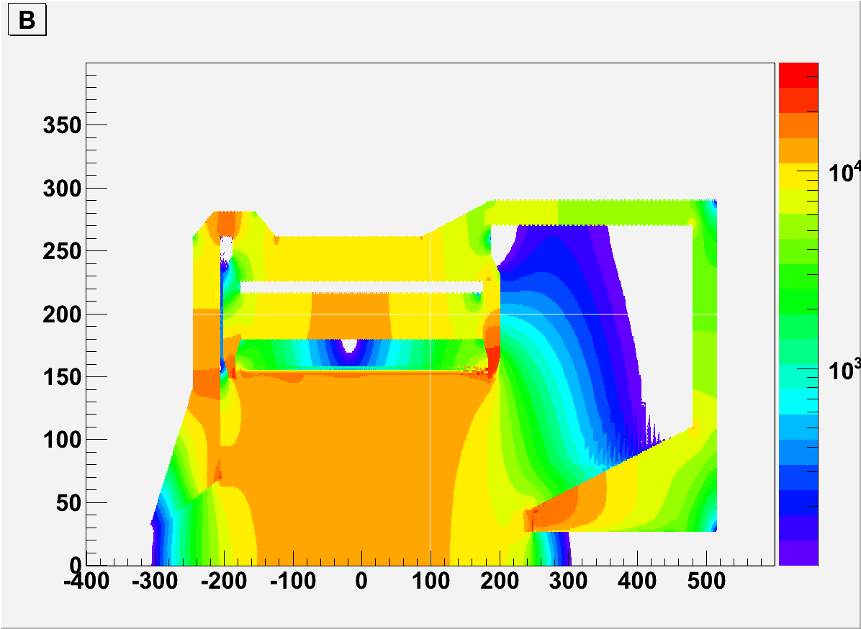
CLEOv6 SIDIS min 100G

Slide 10
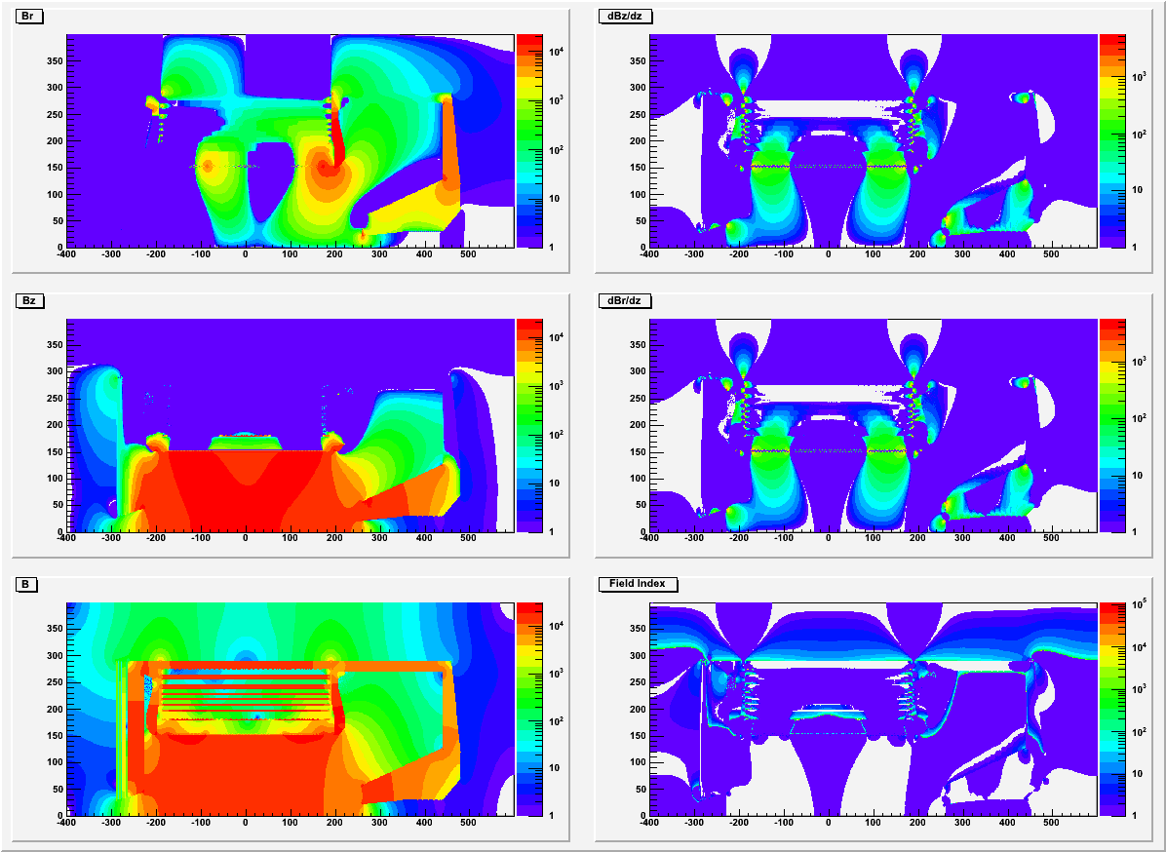
BABARv4

Slide 11
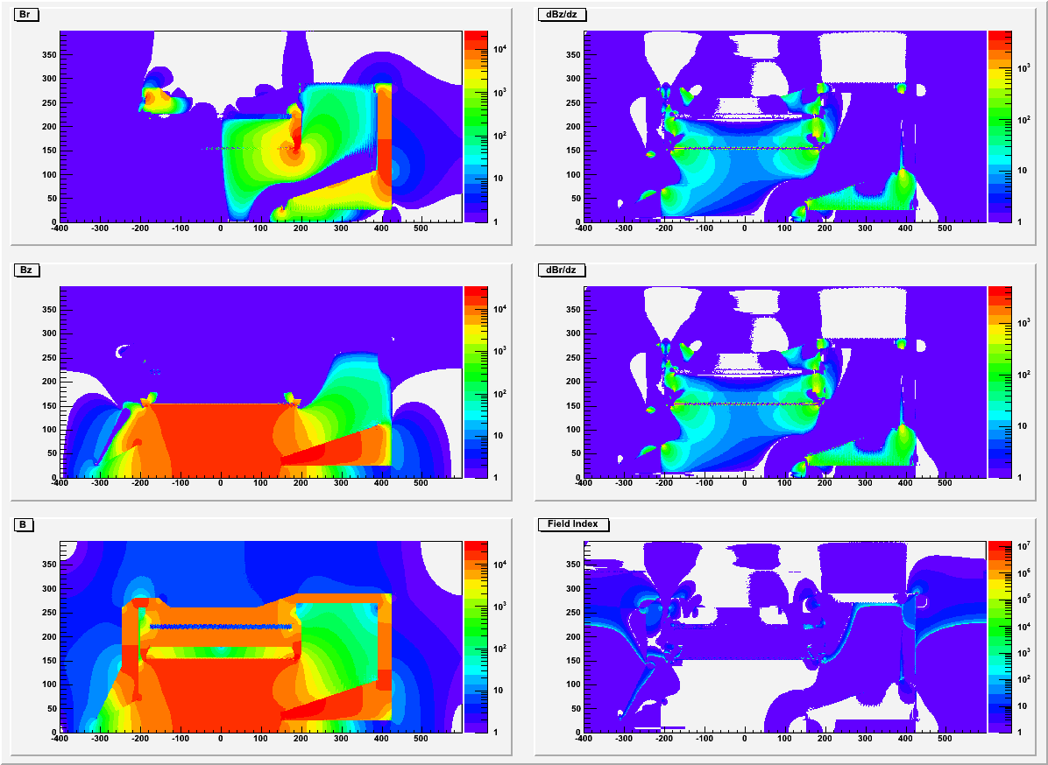
CLEOv6 PVDIS

Slide 12
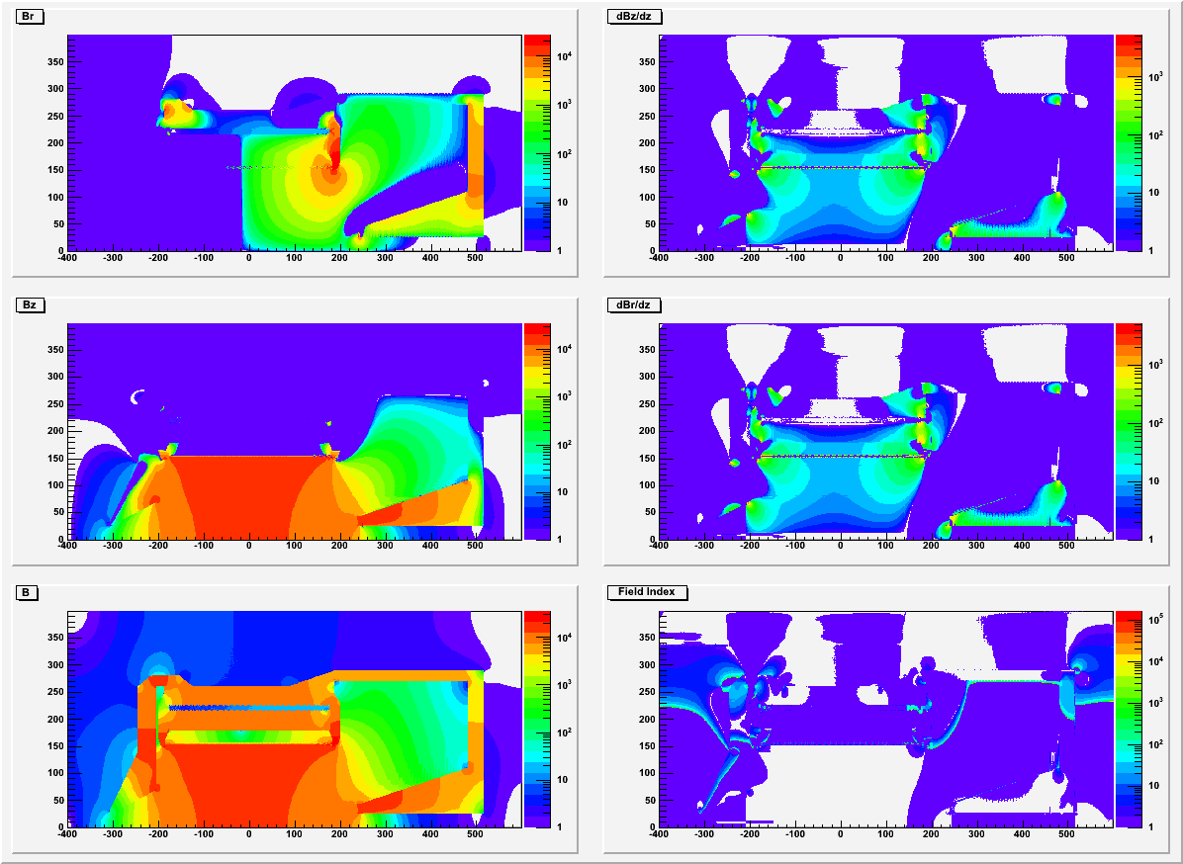
CLEOv6 SIDIS

Slide 13
Summary
CLEOv6 has smaller field than BABARv4 at the region where Cherenkov detectors will be.
CLEOv6 PVDIS has homogeneous region where the baffle is. We should try to make a baffle to match configuration.
The large Br could be a concern for the GEM, we need to look into it.
Magnetic Force need to be checked to make sure it’s ok for engineering.

