Slide 1
CLEO Magnet and Yoke
Zhiwen Zhao

Slide 2
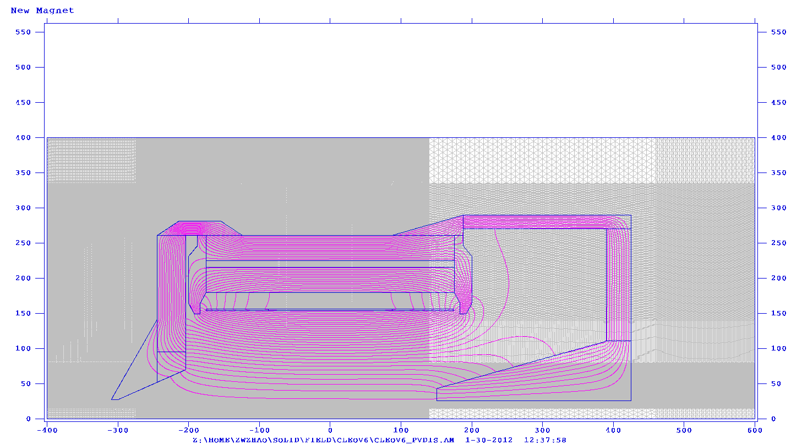
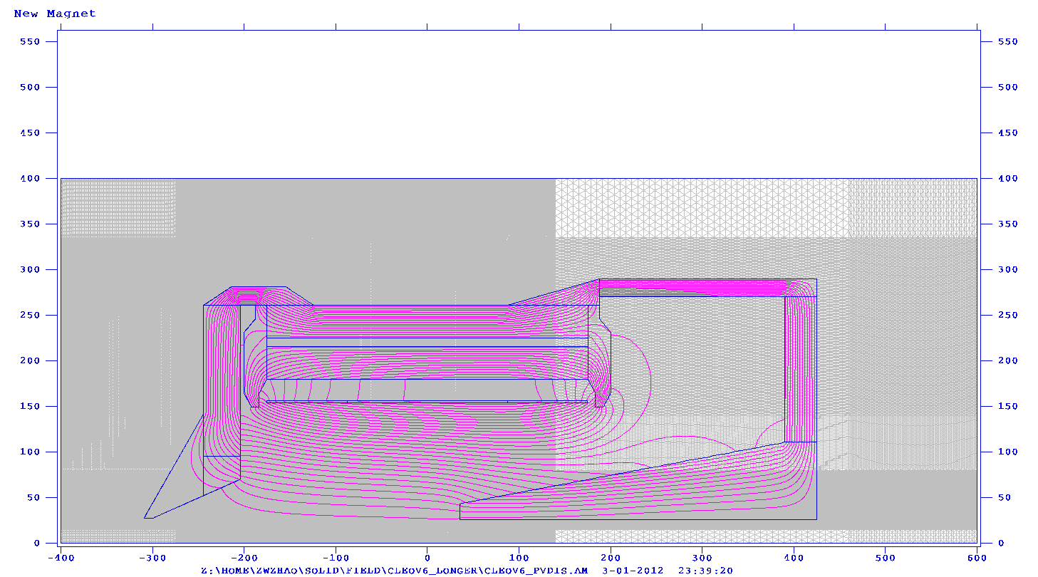
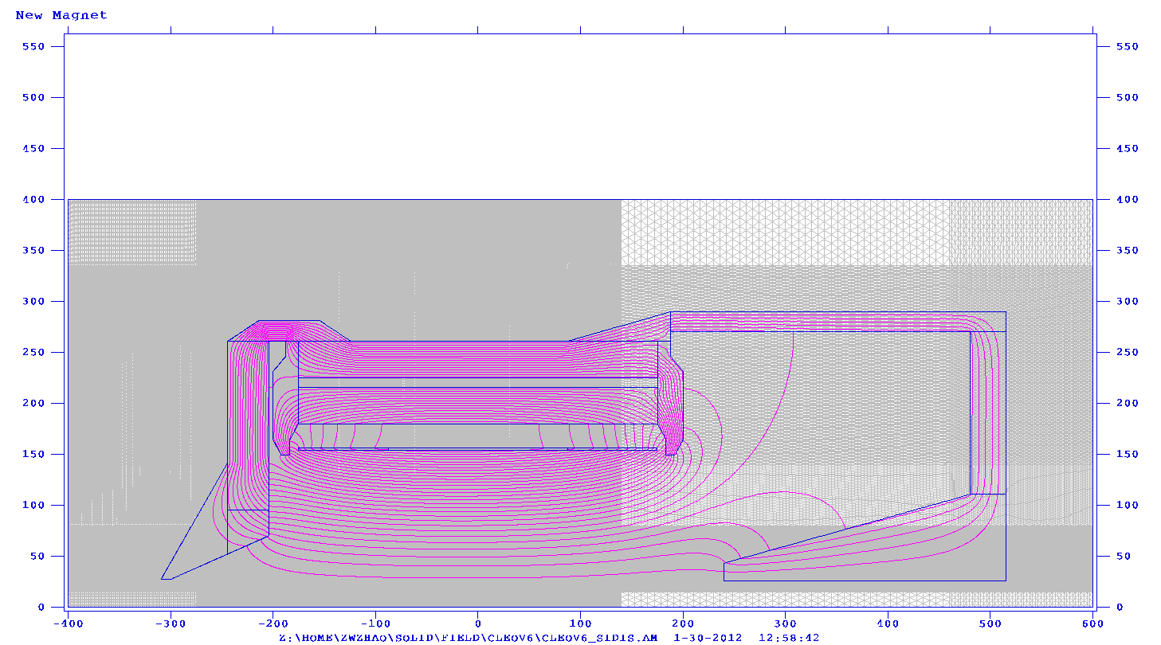
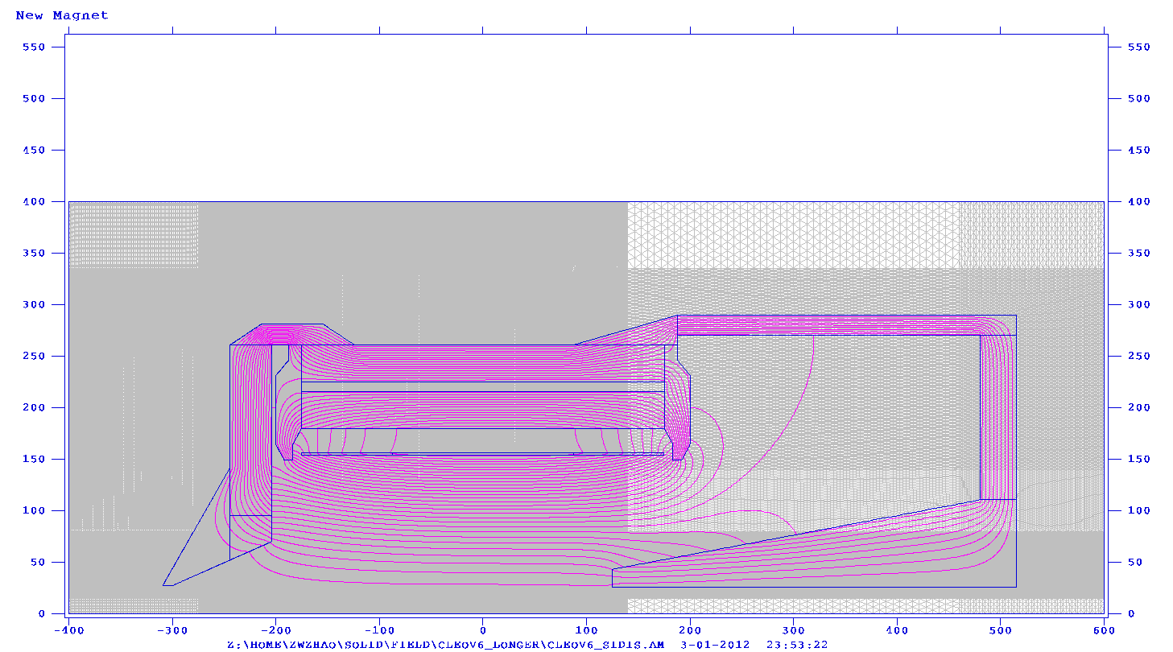
CLEOv6
PVDIS (short nose)
PVDIS (long nose)
SIDIS (short nose)
SIDIS (long nose)

Slide 3
Note
In proposal, PVDIS and SIDIS have different yoke with BaBar magnet and optimized individually.
Then we adopt the same BaBar yoke for PVDIS and SIDIS which essentially is SIDIS configuration because it needs large room. So it’s not optimized for PVDIS.
For CLEO, we will use two different yokes for SIDIS and PVDIS. The only difference though is SIDIS will have an additional 90cm wide donut shape which holds the heavy gas Cherenkov.
For CLEO, short nose reaches 5th baffle plane and long nose reaches 1st baffle plane.

Slide 4
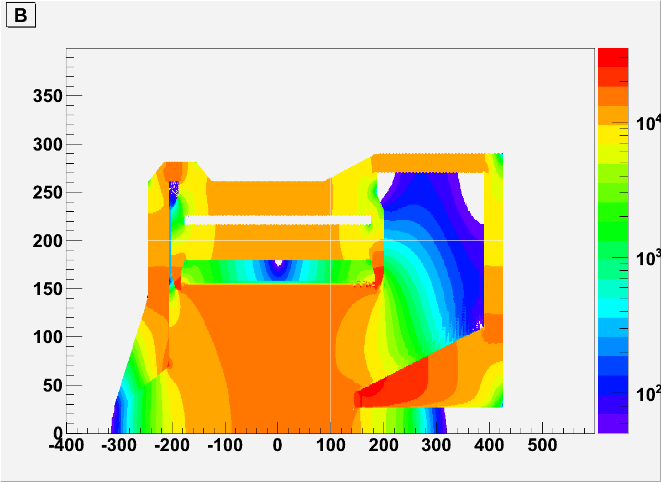
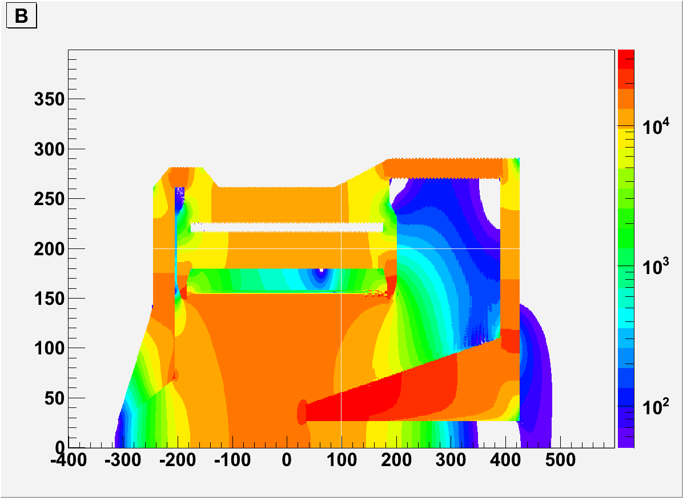
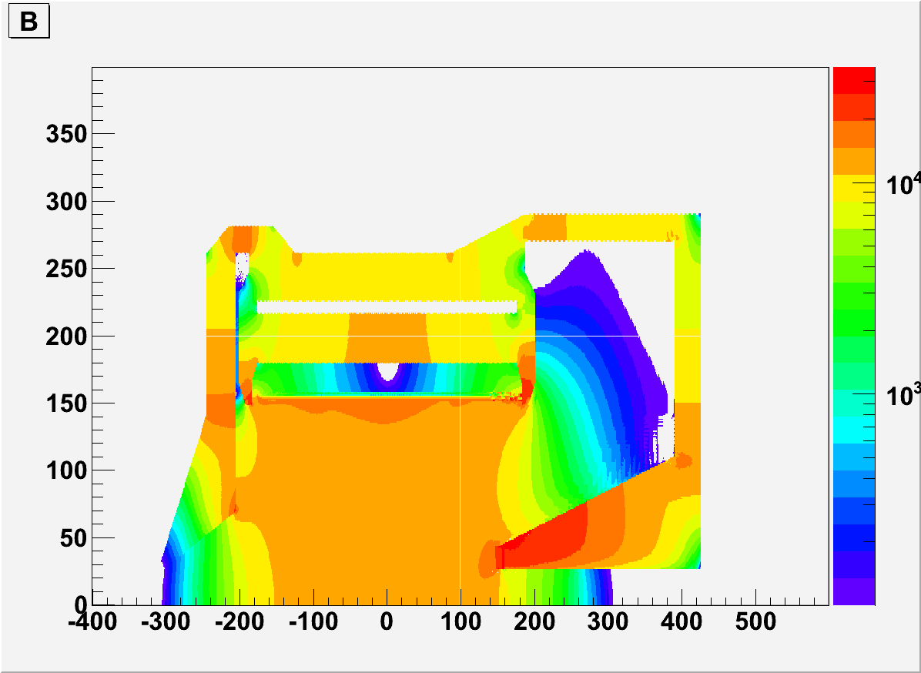
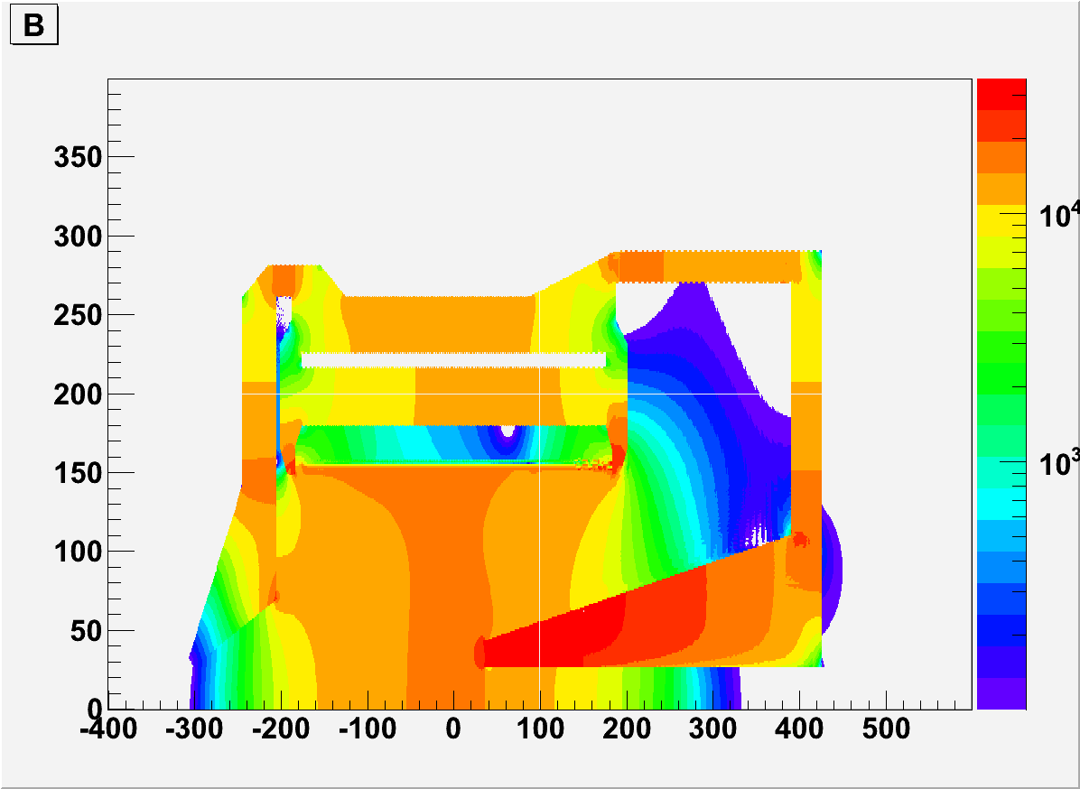
CLEOv6 PVDIS
Short nose, >50G
Long nose, >50G
Short nose, >100G
long nose, >100G

Slide 5
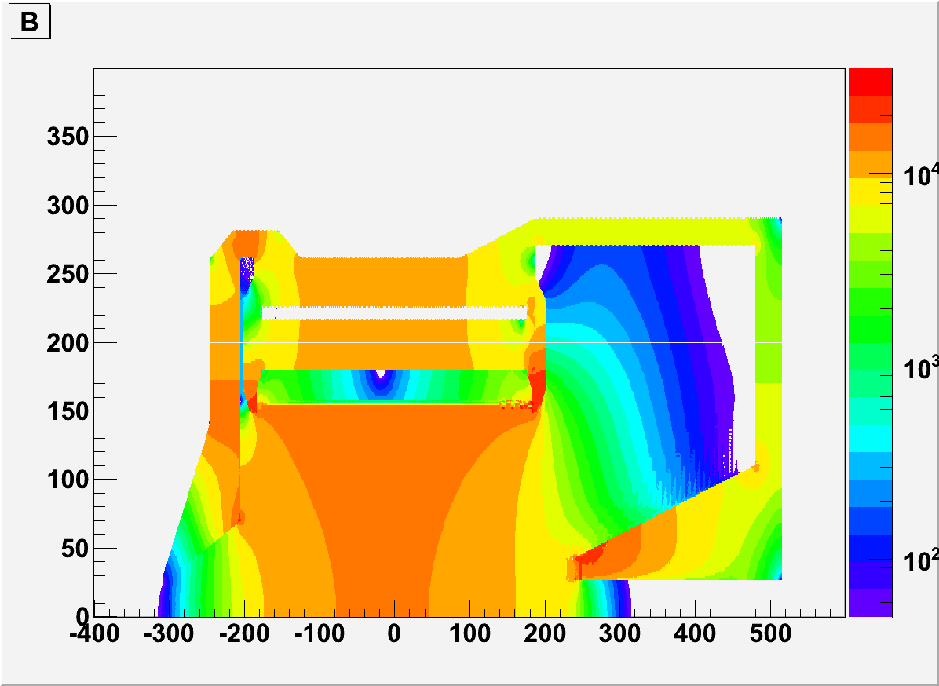
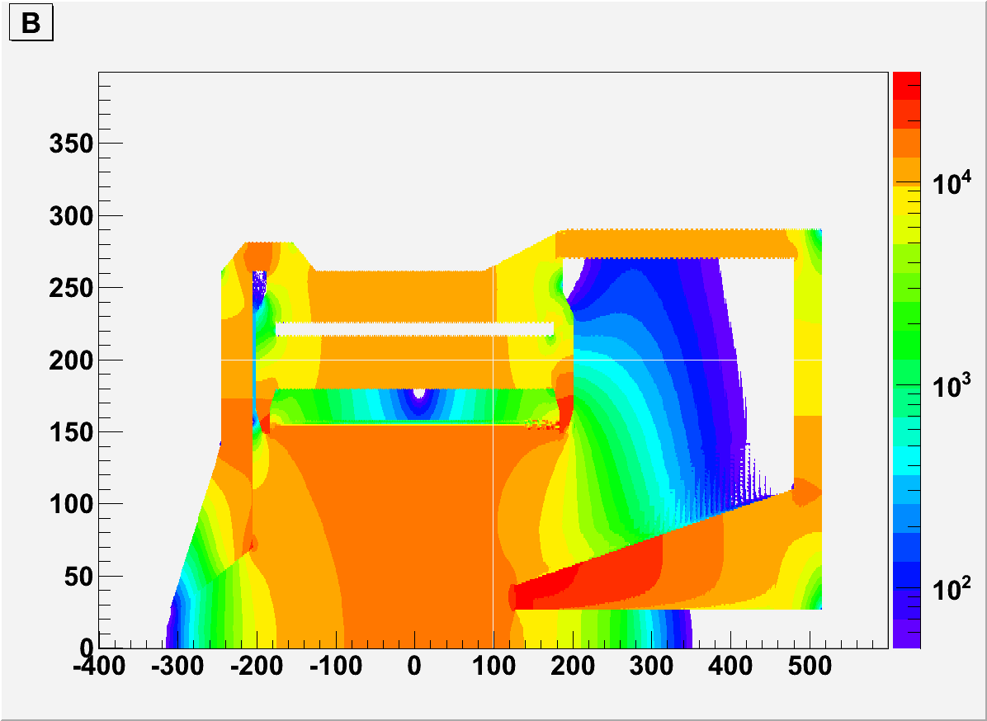
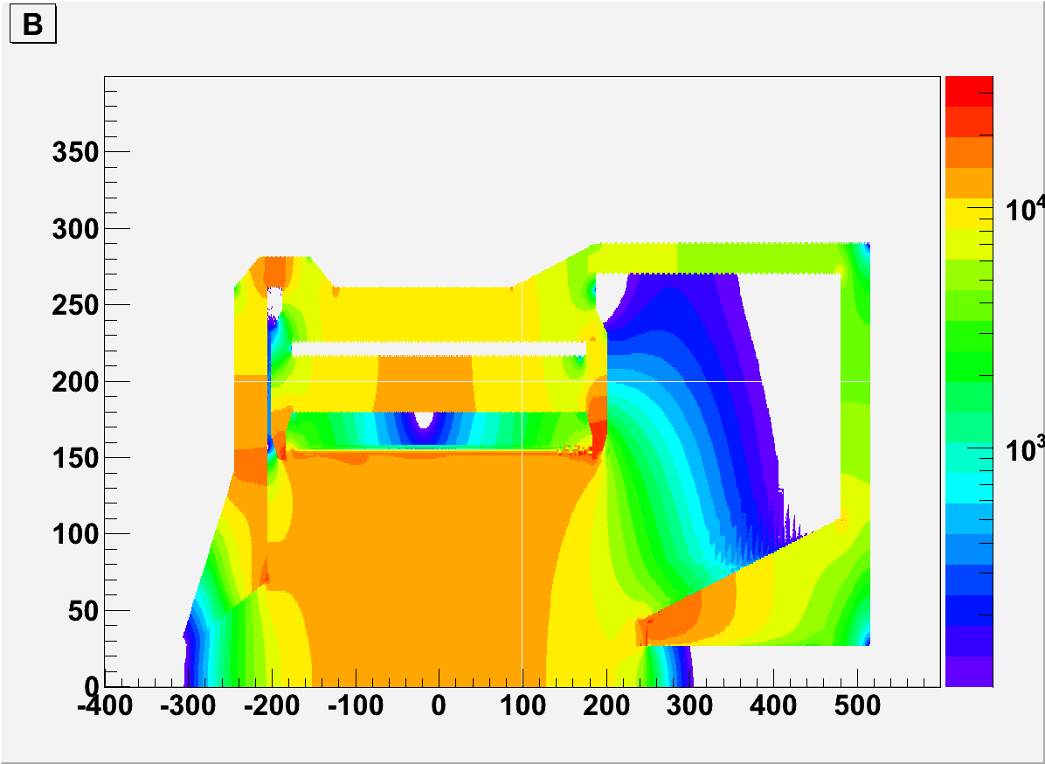
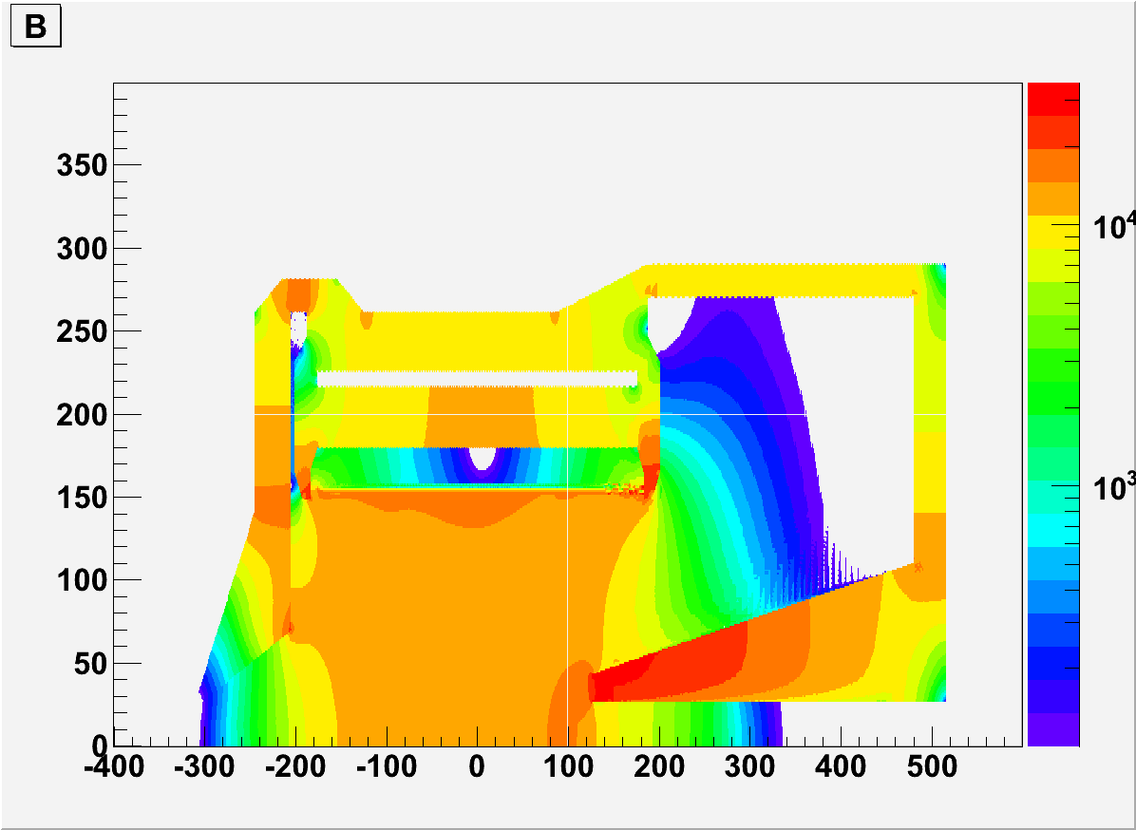
CLEOv6 SIDIS
Short nose, >50G
Long nose, >50G
Short nose, >100G
long nose, >100G

Slide 6
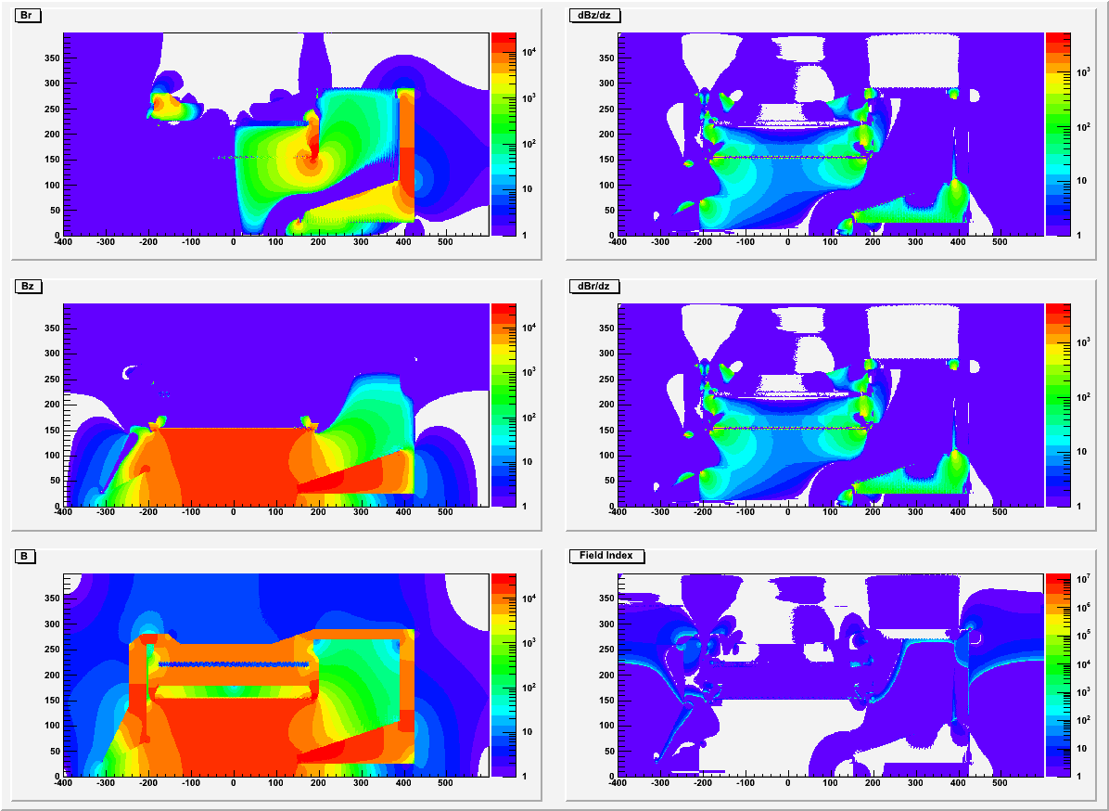
CLEOv6 PVDIS (short nose)

Slide 7
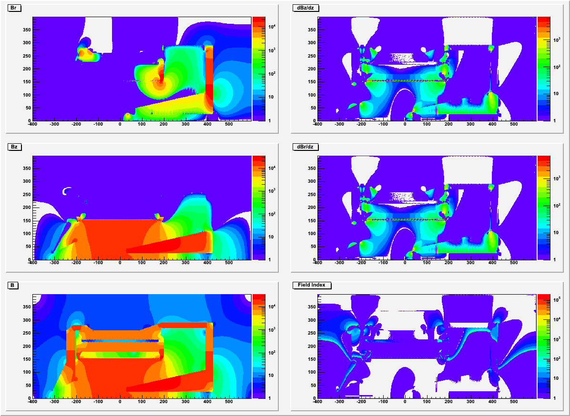
CLEOv6 PVDIS (long nose)

Slide 8
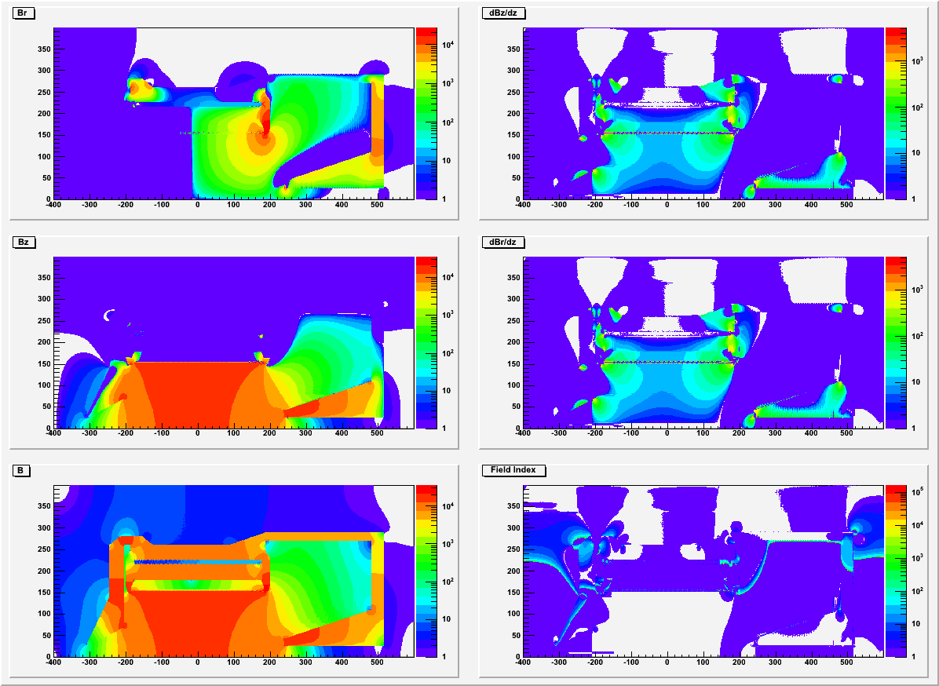
CLEOv6 SIDIS (short nose)

Slide 9
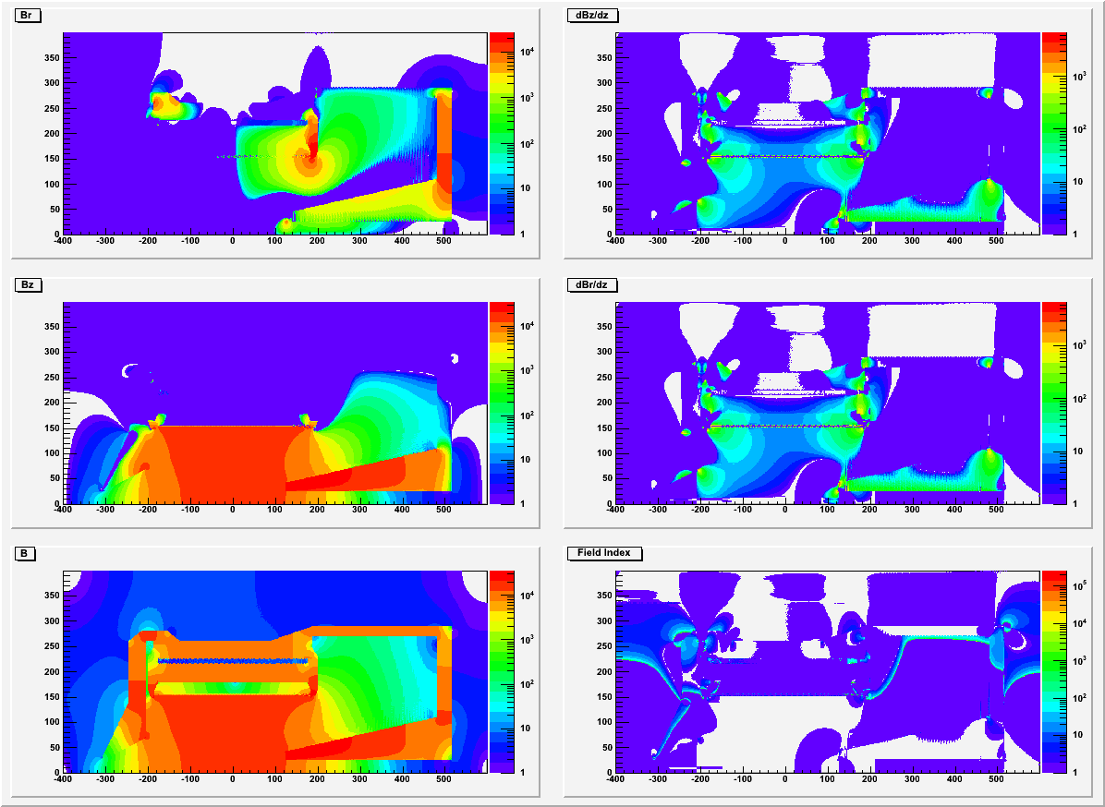
CLEOv6 SIDIS (long nose)

Slide 10
Summary
CLEOv6 has smaller field than BABARv4 at the region where Cherenkov detectors will be.
CLEOv6 PVDIS has homogeneous region where the baffle is. We should try to make a baffle to match configuration.
Short nose has better homogeneous region around baffle and better force balance than long nose.
The large Br could be a concern for the GEM, we need to look into it.
Magnetic Force need to be checked to make sure it’s ok for engineering.

Slide 11
backup

Slide 12
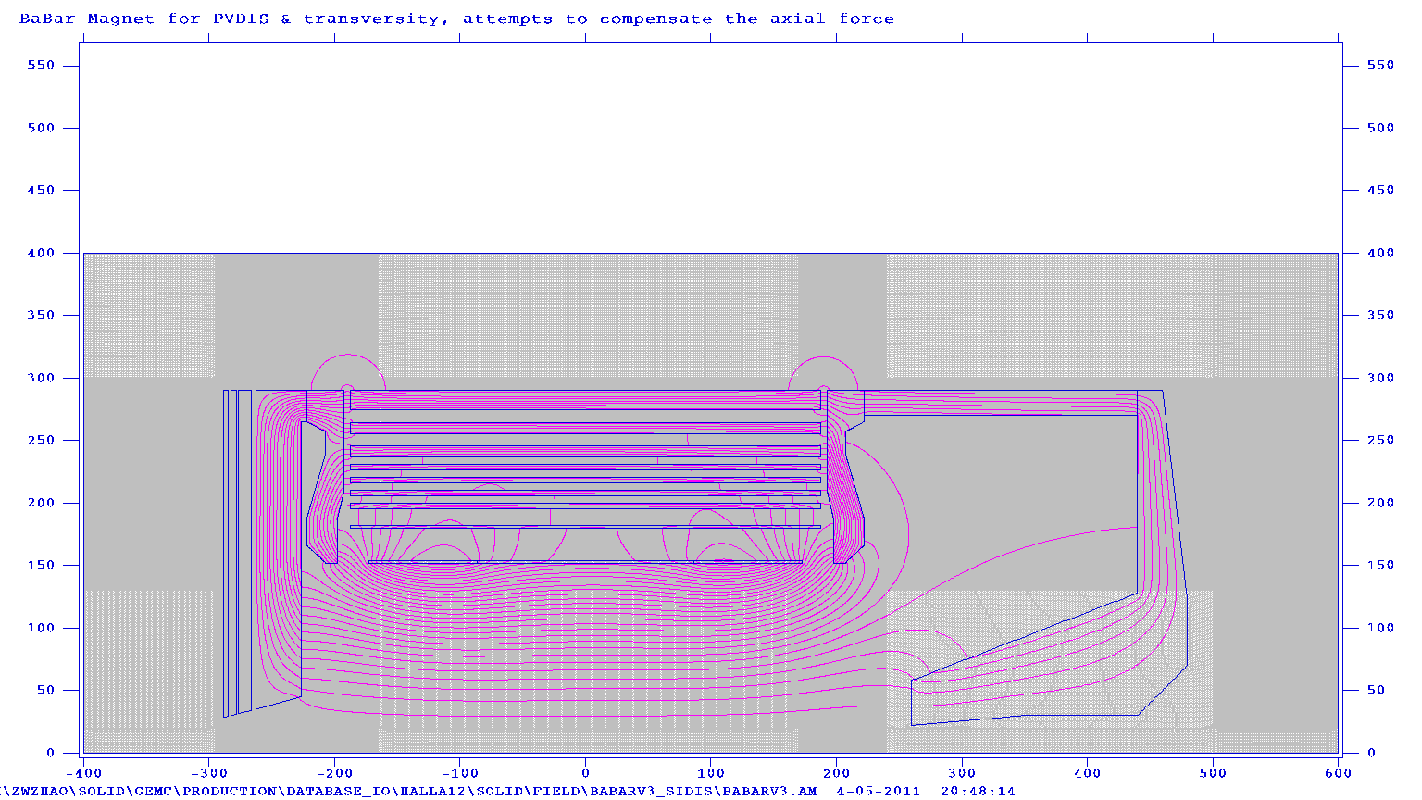
BABARv4

Slide 13
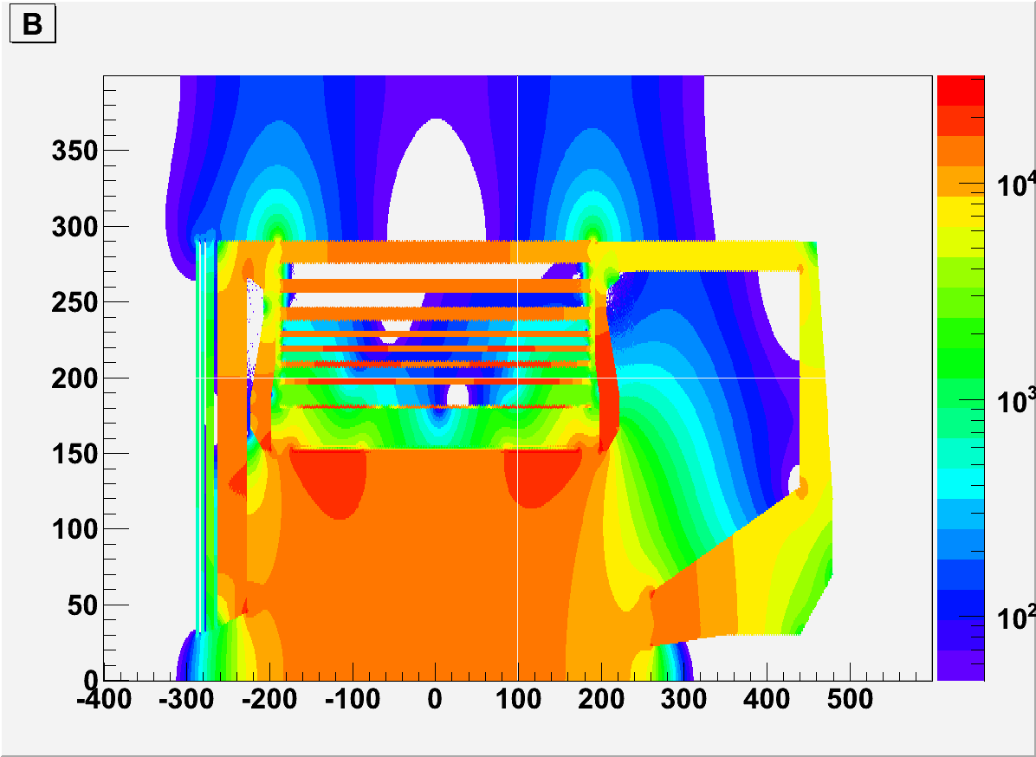
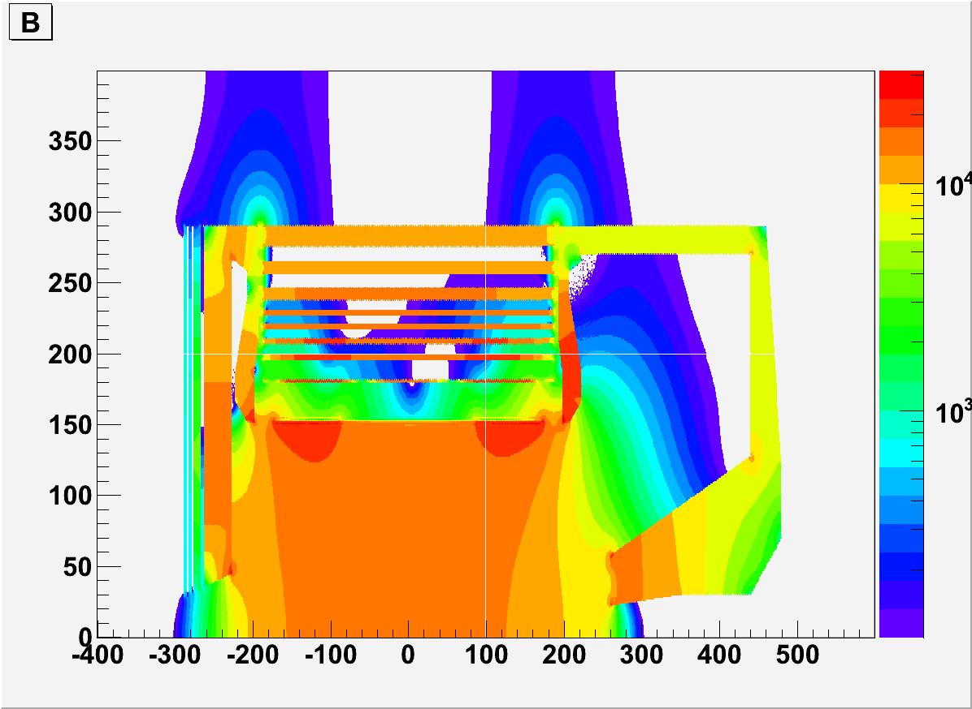
BABARv4
>50G
>100G

Slide 14
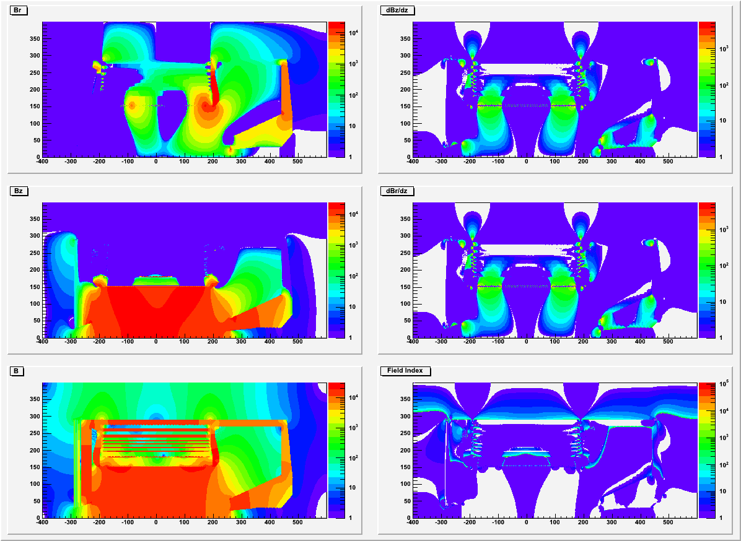
BABARv4

