Slide 1
SoLID magnet and yoke by using CLEO-II
Zhiwen Zhao
2012/07

Slide 2
Introduction
CLEO-II docs at https://hallaweb.jlab.org/wiki/index.php/Solid_Magnet#CLEO-II
All study were done in 2D with the Poisson Superfish program. https://hallaweb.jlab.org/wiki/index.php/Solid_Magnet#How_to_produce_the_filed_map
Eugene’s study at https://userweb.jlab.org/~gen/jlab12gev/cleo_mag/
Based on Eugene’s study, a design fitting both PVDIS and SIDIS/Jpsi is under work.

Slide 3
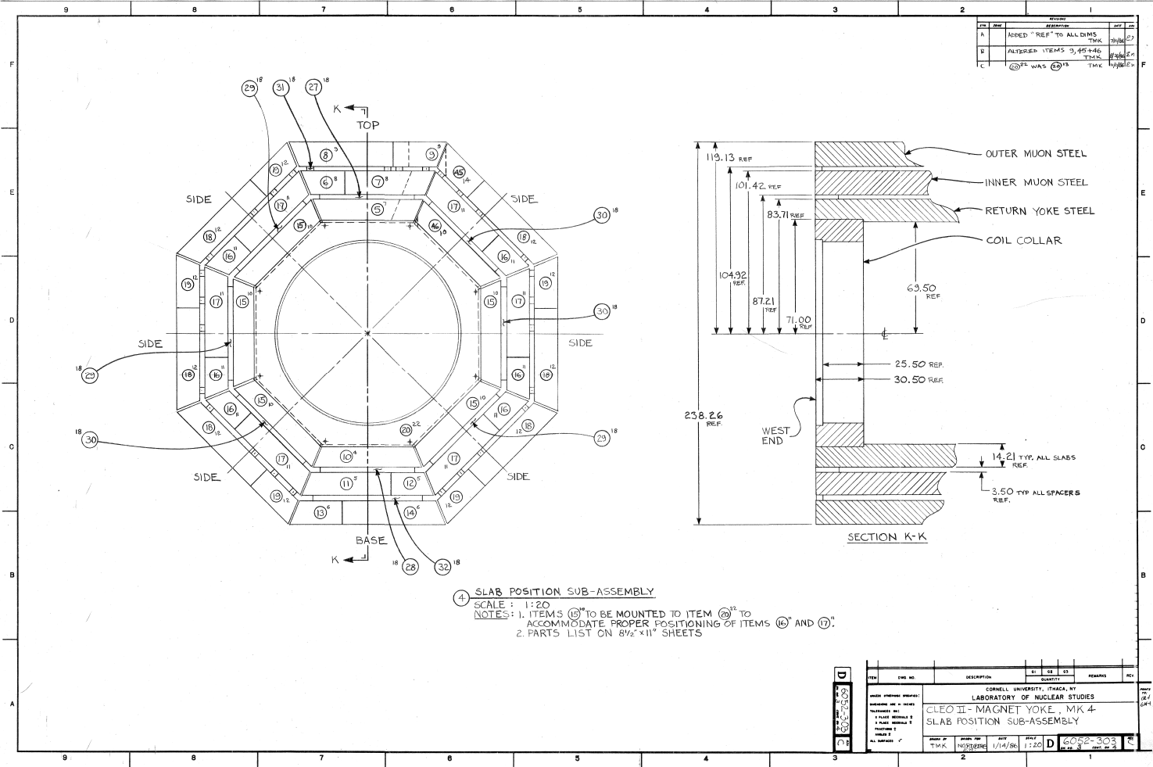
CLEO-II
3 section of coils, each one has two layers,
coil total 1282 turns. This includes 166,309,166 turns per layer for section upstream, middle, downstream. The result current density in two side section are 4% higher than in the middle section,
max operate current at 3266A and average current density of 1.2MA/m, this reach 1.5T field
2 collars holding 4 coil rods
3 layers of barrel yokes with spacers, in octagon

Slide 4
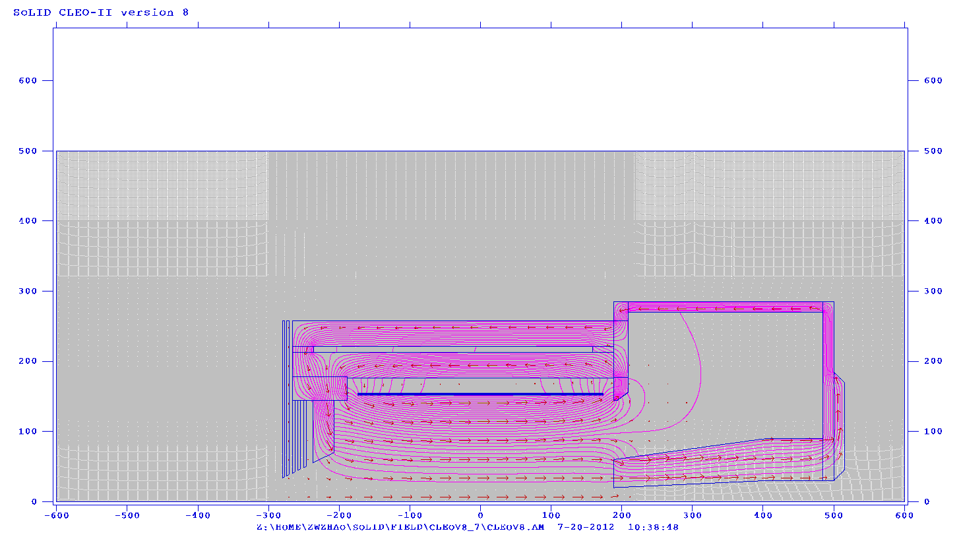
From CLEO-II to SoLID (reused parts)
Reuse coil and cryostat
Take two layers of barrel yoke and spacer, keep the upstream ends unchanged, cut the downstream ends (75cm) to our need.
Take the upstream collar unchanged, and cut the downstream collar or make a new one to satisfy the acceptance requirement. Make sure the coil rods can still be supported by two collars under axial force
All other parts of yokes are new.
Endcap Donut
Barrel Yoke Outer
Collar Downstream
Endcap Bottom
The parts from CLEO-II is in the red box
Spacer
Barrel Yoke Inner
Spacer
Collar Upstream
Coil
shield
Front Piece
Endcap Nose

Slide 5
From CLEO-II to SoLID (new parts)
All new parts need to be customized made.
But it’s unclear if they will be made of newly machined iron ($6/lb) or we can get some unused CLEO-II iron machined (cost?)
We might try to use some “stock” parts to save machining cost.
Endcap donut: 15cm thick and has 15cm clearance to HallA floor (10 feet high)
Endcap bottom: two 15cm plates
Endcap nose: flat at back to give clearance for SIDIS forward angle EC and has slope at front to give clearance for cherenkov.
Collar downstream: 20cm thick and can be in one piece
Front Piece: 30cm thick and can move along z to adjust force on coil
shielding: a few 4cm thick plates with gaps in between.
Endcap Donut
Barrel Yoke Outer
Collar Downstream
Endcap Bottom
The parts from CLEO-II is in the red box
Spacer
Barrel Yoke Inner
Spacer
Collar Upstream
Coil
shield
Front Piece
Endcap Nose

Slide 6
Acceptance
PVDIS physics requires opening angle from 22 - 35º
target at z= 10cm
geometry openings is 21 - 36º
clearance to endcup nose at endcup entrance (z=189cm) is 12cm for 22º and 8cm for 21º
clearance to endcup donut at forwardangle EC back (z=370cm) is 10cm for 35º and 5cm for 35.5º
beamline opening angle at endcup bottom is 3.5º
SIDIS physics requires opening angle from 8 - 24º, JPsi physics requires opening angle from 8 - 26º
target at z= -350cm
geometry openings is 7.5 – 26.3º
clearance to endcup nose at endcup entrance (z=189cm) is 15cm for 8º
clearance to endcup nose at forwardangle EC front (z=405cm) is 15cm for 8º
beamline opening angle at endcup bottom is 2º
PVDIS 36º
SIDIS 26º
SIDIS 14.7º
PVDIS 21º
SIDIS 8º
SIDIS 2º
PVDIS 3.5º

Slide 7
Detector Layout (SIDIS/JPsi)
Unit in cm, coil center at z=0
Red for change
 | BaBar setup | CLEO-II setup | Comment
Target | Z (-350) L (40) | Z (-350) L (40) for SIDIS Z(-350) L(15) for JPsi
GEM | Z(-175, -150, -119, -68, 5, 92) Rin(50,28,31.5,39,50,64) Rout(80,93,107.5,135,98,122) | Z(-175,-150,-119,-68,5,92) Rin(45,26,30,37,46,58) Rout(80,93,107.5,135,98,122) | Layer 1 – 4, 14.7º - 26.3º Layer 2-6 7.5º - 15.5º
Large angle EC | Z (-65.5, -15.5) Rin (82) Rout (141) | Z (-65, -15) Rin (75, 88) Rout (140, 140) | 50cm long module cover 14.7º - 26.3º at front (SIDIS) Cover ???º - ???º at front (JPsi)
absorber | Z(95,220) Rin(30,45) Rout(40,75) | Z(100,180) Rin(16,19) Rout(50,60) | In front of endcap nose, 80cm thick lead
Lightgas Cherenkov | Z(97,200,225,301) Rin(62,78,82,90) Rout(127,142,160,265) | Z(97,194,209,301) Rin(58,65,67,85) Rout(127,144,155,265) | same length 204cm, covers 7.5º – 14.7º
SC | Z(304) | removed | Don’t need anymore
Heavygas Cherenkov | Z(306,396) Rin(96,104) Rout(265,265) | Z(306,396) Rin(86,98) Rout(265,265) | same length 90cm covers 7.5º - 15º
MRPC | Z(398) Rin (115) Rout (195) | Z(400) Rin (99) Rout (201) | 1cm thick covers 7.5º - 15º
Forward angel EC | Z(400,450) Rin (120) Rout (202) | Z(405,455) Rin (100,100) Rout (215,215) | 50cm long module, covers 7.5º - 15º
Space at back | some | Z(450,485) | 30cm for EC readout and other room if needed
Beamline upstream |  | Z(-675,-375) Rin(1.22,1.22) Rout(1.25,1.25) | No change
Beamline downstream |  | Z(-325,500) Rin(1.7,28.9) Rout(1.8,29.0) | match endcap nose opening

Slide 8
Detector Layout (PVDIS)
Unit in cm, coil center at z=0
Red for change
 | BaBar setup | CLEO-II setup | comment
Target | Z (10) L (40) | Z (10) L (40) | Cherenkov can’t have target further upstream
baffle | Z(40,68,96,124,152,180) Rin(3.9,15.3,26.6,37.9,49.2,60.4) Rout(34.7,54.3,73.8,93.3,112.8,132.0) | No change | 9cm thick lead plates needs study
GEM | Z (157.5,185.5,306,321) Rin(55,65,105,115) Rout (115,140,200,215) | Z (157.5,185.5,306,315) Rin(56,67,113,117) Rout (108,129,215,222) | 0.5cm thick covers 21º - 36º
Cherenkov | Z(200,225,301) Rin(78,82,90) Rout(142,160,265) | Z(194,209,301) Rin(65,67,85) Rout(144,155,265) | Use the same back chamber from SIDIS lightgas Cherenkov, length 107cm (6 cm more), covers 21º – 36º
Forward angel EC | Z(325,375) Rin (110) Rout (265) | Z(320,370) Rin (118) Rout (261) | 50cm long module, covers 21º – 36º
Space at back | some | Z(371,485) | 114cm for EC readout and other room needed
Beamline upstream |  | Z(-675,-15) Rin(1.22,1.22) Rout(1.25,1.25)
Beamline downstream |  | Z(35,500) Rin(1.4,28.9) Rout(1.5,29.0) | match endcap nose opening

Slide 9
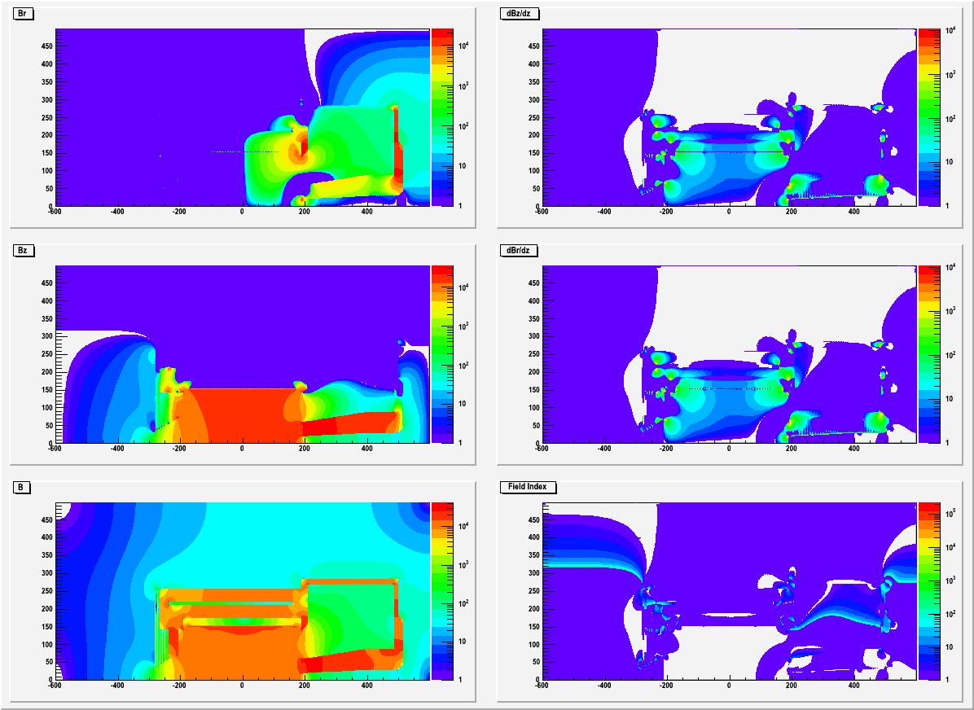
Field
The radial field Br can reach a few thousand gauss where PVDIS GEM are.

Slide 10
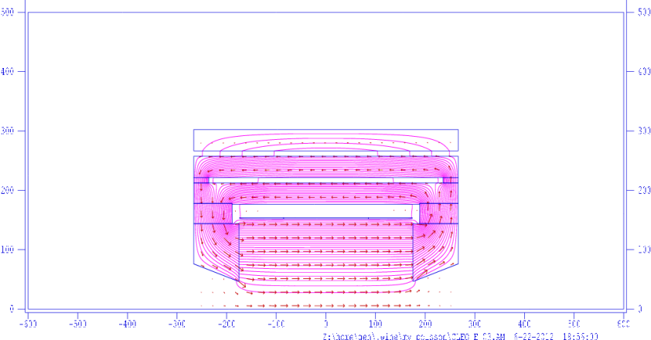
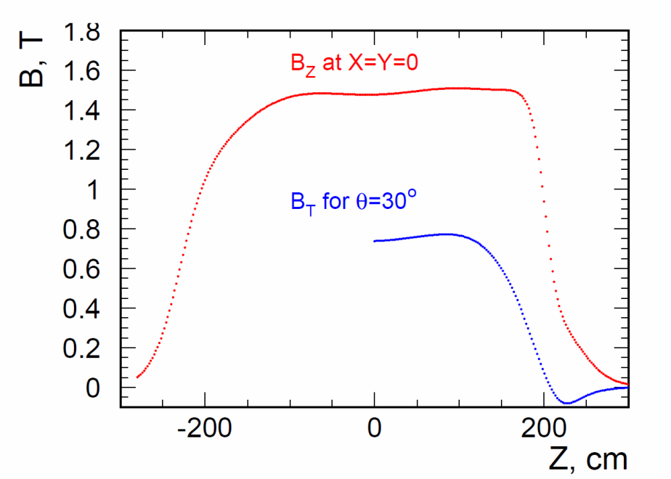
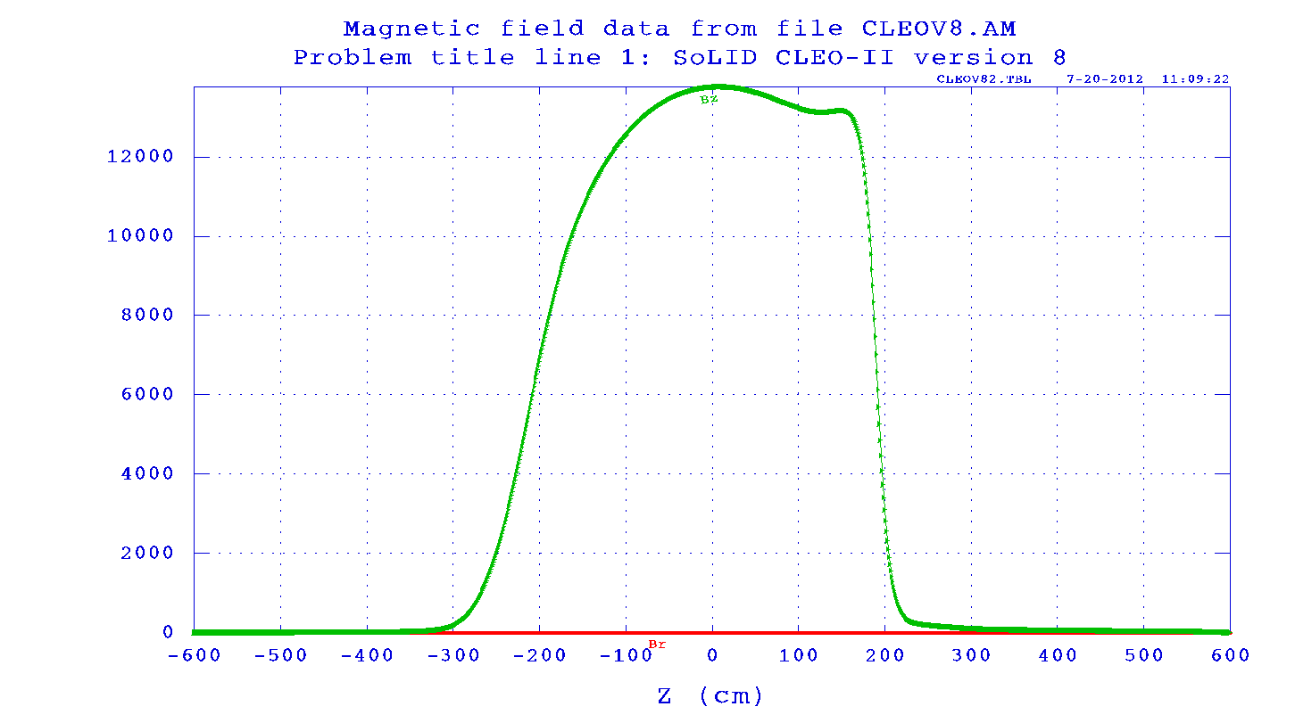
Bz along beam
SoLID BaBar total current 5119200A, CLEO-II total current 4187012A (current 3266A in 1282 turn). Their length is about same, so the current density is 20% less for CLEO-II
CLEO-II can still reach 1.48T similar to SoLID BaBar
But SoLID CLEO only reaches 1.38T, due to large opening, asymmetric yoke design
could ask if CLEO-II can run higher current (unlikely)?
According to Eugene, the field integral dropped about 20% comparing to BaBar, PVDIS baffle needs to be optimized accordingly.
Eugene’s reproduction of CLEO-II
SoLID BaBar
SoLID CLEO

Slide 11
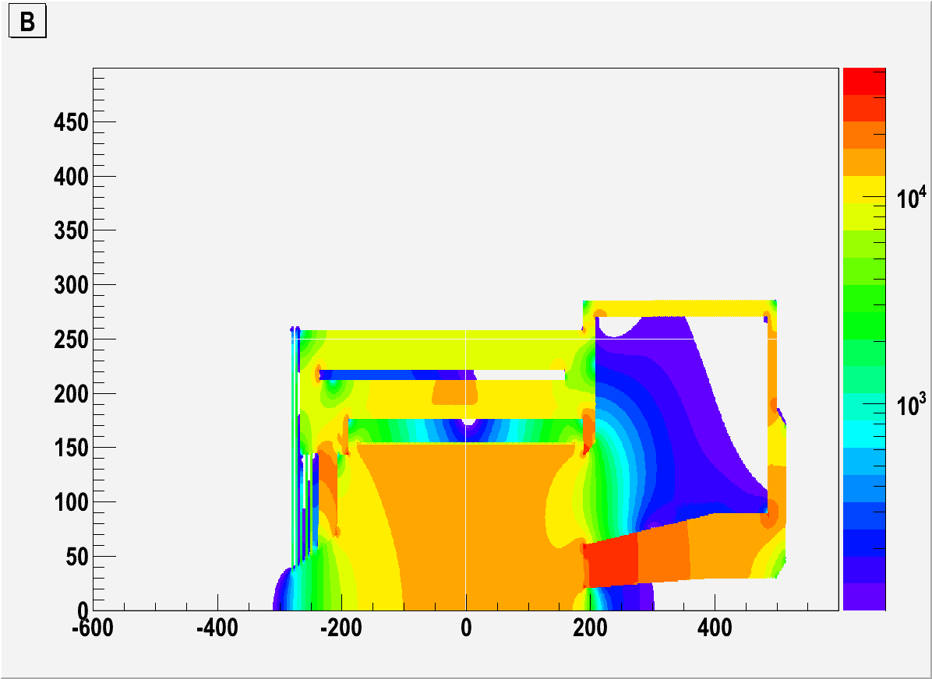
field in endcup
B at nominal Cherenkov photon sensor location are around 120G and 50G
B at SIDIS forward angle EC photon sensor location is below 100G
B at PVDIS forward angle EC photon sensor location is below 500G
B > 100G

Slide 12
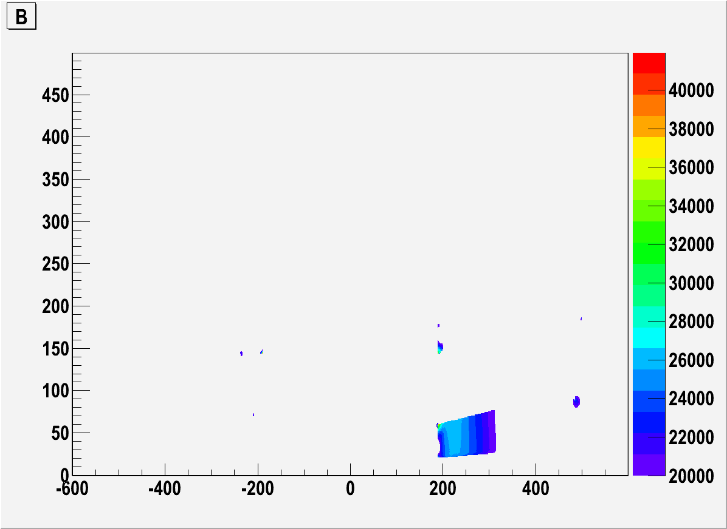
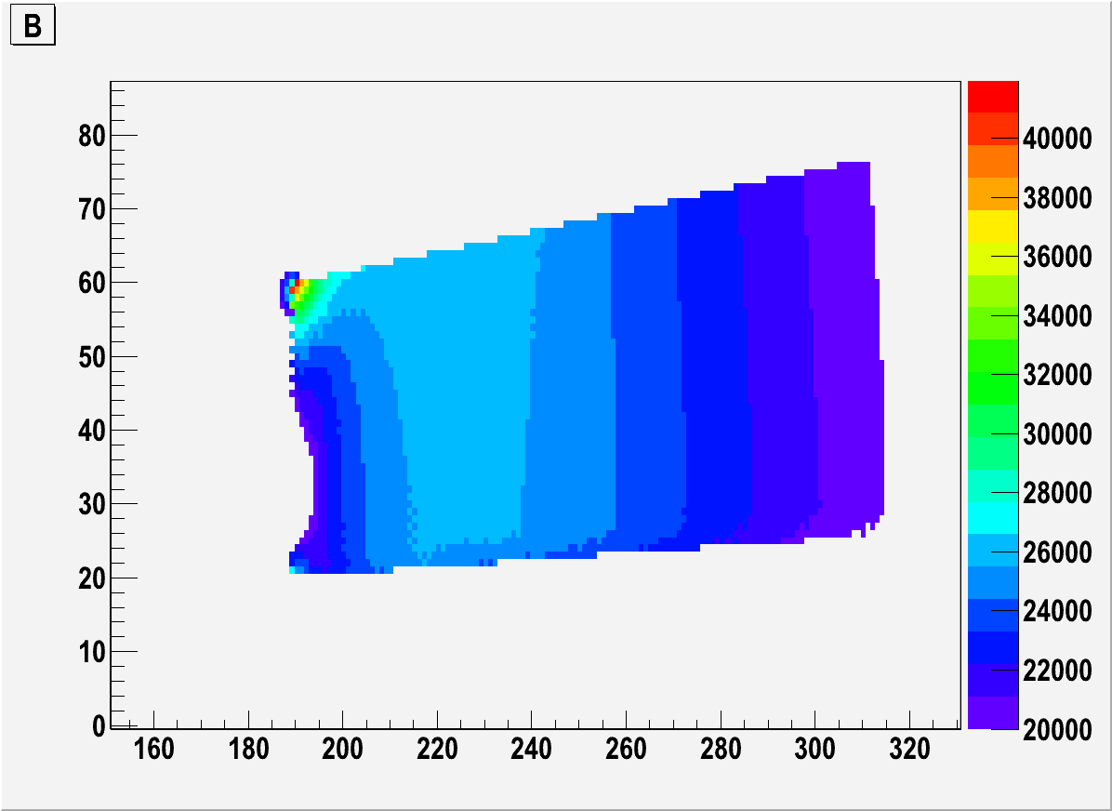
saturation in Iron
Most of saturation (B>2T) is at the endcup nose, we might use iron with more field tolerance.
The physics acceptance is still 8-15cm away from the tip.
The worry is when current changes, magnetic force balance may change too. Eugene shows when current ramps up, the force change by quadratically and the force on coil doesn’t change sign.
B > 2T
B > 2T, zoom-in

Slide 13
Force on coil
unit in t | upstream | middle | downstream | total
inner 2piFz | 154.1 | 3.6 | -159.1 | -1.4
outer 2piFz | 154.7 | 3.5 | -159.6 | -1.4
Total 2piFz | 308.8 | 7.1 | -318.7 | -2.4
inner Fr/radian | 87.9 | 170.2 | 87.2 | 345.3
outer Fr/radian | 24.8 | 54.5 | 24.2 | 103.5
Total Fr/radian | 112.7 | 224.7 | 111.4 | 448.8
Axial force on coil and cell cylinder are squeezing from both sides and it can be balanced under 10t.
could leave some net force to avoid accidental force direction change.
Preferred direction is negative so upstream collar (unchanged from CLEO-II) can take the force (?)
Moving the frontcup piece in z to adjust force (moving upstream, the positive force increase, vice verse.) with gradient 3-5t/cm (It’s very sensitive)
Radial force are on the Aluminum shell cylinder
From Eugene “If all the force goes to the shell, the azimuthal tension is about 30MPa. The yield limit of aluminum is about 100MPa (to be verified for 4°K)”
305.4
6.3
-316.5
frontcup

Slide 14
Force on yoke (axial force only)
2piFz (unit in t) represents the axial force integrated over the whole part in 2pi.
positive direction in black, negative direction in Red
The opposite force meets at two locations where the endcup connects.
Some analysis of potential problems with the coil and yoke mechanical integrity should be done.
Not sure how to calculate the radial force yet.
-20.3
171.2
122.9.4
-269.0
8.1
0.7
-238.4
110.2
108.6
-119.2
0.008
-79.6
0.2
165.5
0.7
0.2
38.9
0.04

Slide 15
Yoke weight
assume steel density is 7.9g/cm3 , weight unit is in t
material from CLEO-II 376t
new material 200t ($2.7M if assume $6/lb machined iron)
total 576t
7.4
57
195
30
3
3
17
154
21
4.4
5
10.4
6
12.5
2
2
40
2

Slide 16
Fringe field at SIDIS pol He3 target location
Z (cm) | Bz(G) | Br(G) | dBz/dr (mG/cm) | dBr/dz (mG/cm) | dBz/dz (mG/cm) | dBr/dr (mG/cm)
-330 | 46.1 | 0.7 | 40 | 40 | 1500 | 744
-350 | 27.3 | 0.3 | 12 | 12 | 500 | 288
-370 | 19.1 | 0.1 | 4 | 4 | 300 | 142
Multilayer of iron plates and gaps have good shielding effect
The distance between first shielding plate to the target coil is a few cm.
pol He3 holding field is 25G and we need field gradient below 100mG/cm
We need some correction coil
Pol He3 target
2 Helmholtz coils
Longitudinal R=75.8cm
Vertical R=66.7cm

Slide 17
Fringe field at SIDIS pol He3 target location (with correction coil)
Z (cm) | Bz(G) | Br(G) | dBz/dr (mG/cm) | dBr/dz (mG/cm) | dBz/dz (mG/cm) | dBr/dr (mG/cm)
-330 | -0.4 | 0.11 | 42 | 42 | 170 | -106
-350 | 1.6 | 0.05 | 7 | 7 | -100 | 54
-370 | 0.8 | 0.08 | 4 | 4 | 164 | -81
Add a pair correction coil at the same position of longitudinal coil with current -3465A and -645A
Both field and field gradient are under control
It can be tweaked further
No effect on the force on coil
Pol He3 target
2 Helmholtz coils
Longitudinal R=75.8cm
Vertical R=66.7cm

Slide 18
Change from SIDIS to PVDIS (or Vice Versa)
Within coil
take out SIDIS GEM, large angle EC, collimator and front chamber of SIDIS light gas Cherenkov, then put in PVDIS GEM and baffle.
They all are need different supporting structure.
Within endcup
keep the back chamber of SIDIS light gas Cherenkov unchanged, remove heavy gas Cherenkov, remove MRPC, add PVDIS GEM, then move forward angle EC upstream and add large angle EC module to enlarge radius coverage.
light gas Cherenkov supporting structure unchanged. heavy gas Cherenkov structure removed, MRPC and Gem may share supporting structure, PVDIS EC and SIDIS EC should share supporting structure and be movable.

Slide 19
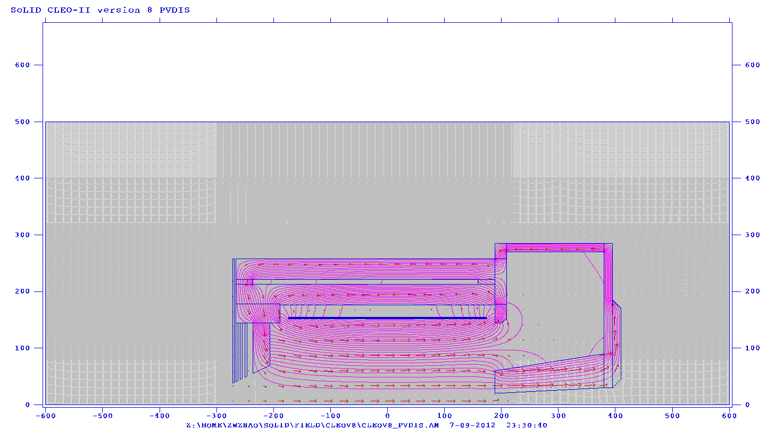
Change Yoke from SIDIS to PVDIS (?)
By moving 90cm long section of endcup donut and nose (flat part) away.
Advantage:
If forward angle EC photon sensor need to be outside of yoke, it’s shorter distance for fibers go through.
If Heavy gas Cherekov supporting on this part of endcup donut, it can be simply moved away.
Concerns:
the coil axial force become -1.2t comparing to -3.7tfor SIDIS, the change is only 2t but could be a problem if it changes sign.
Force on endcup part will change also.
Field mapping need to be redone.

Slide 20
Beamline Consideration
PVDIS beamline opening angle at endcup bottom is 3.5º
SIDIS beamline opening angle at endcup bottom is 2º
Moller electrons for PVDIS, SIDIS He3 target and JPsi
For SIDIS proton target setup, there are
synchrotron radiation around 3º due to chicane before target (need shielding)
Bremsstrahlung around 1.5º due to 5T target field. (within beamline)
Moller electrons are bended around 4º (need shielding)

Slide 21
Summary
Overall we have a preliminary design
Baffle needs to be revisited
Need input and check from all sub-systems
It’s good to have more engineering input

