Slide 1
Solid/EIC GEM prototype assembling @UVa
Yuxiang Zhao, Kondo Gnanvo, Xinzhan Bai, Chao Gu, Nilanga K.Liyanage

Slide 2
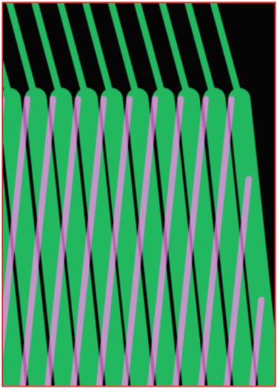
Design of Solid/EIC prototype
First 2D readout Chamber with this size
COMPASS-like 2D stereo angle (12°) U/V readout
Pitch = 550 μm, top strips = 140 μm, bottom = 490 μm

Slide 3
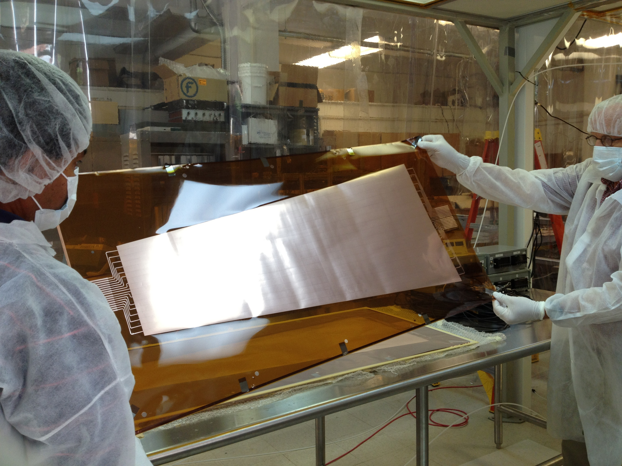
Frames and GEM foil
Spacers: 300μm
Extra frame material for the alignment and
to hold the tension on GEM foil during assembly
➔ cut out after
GEM foil: 32 sectors on top, 16 each on 2 sides
2 sectors on bottom, 1 each on 2 sides

Slide 4
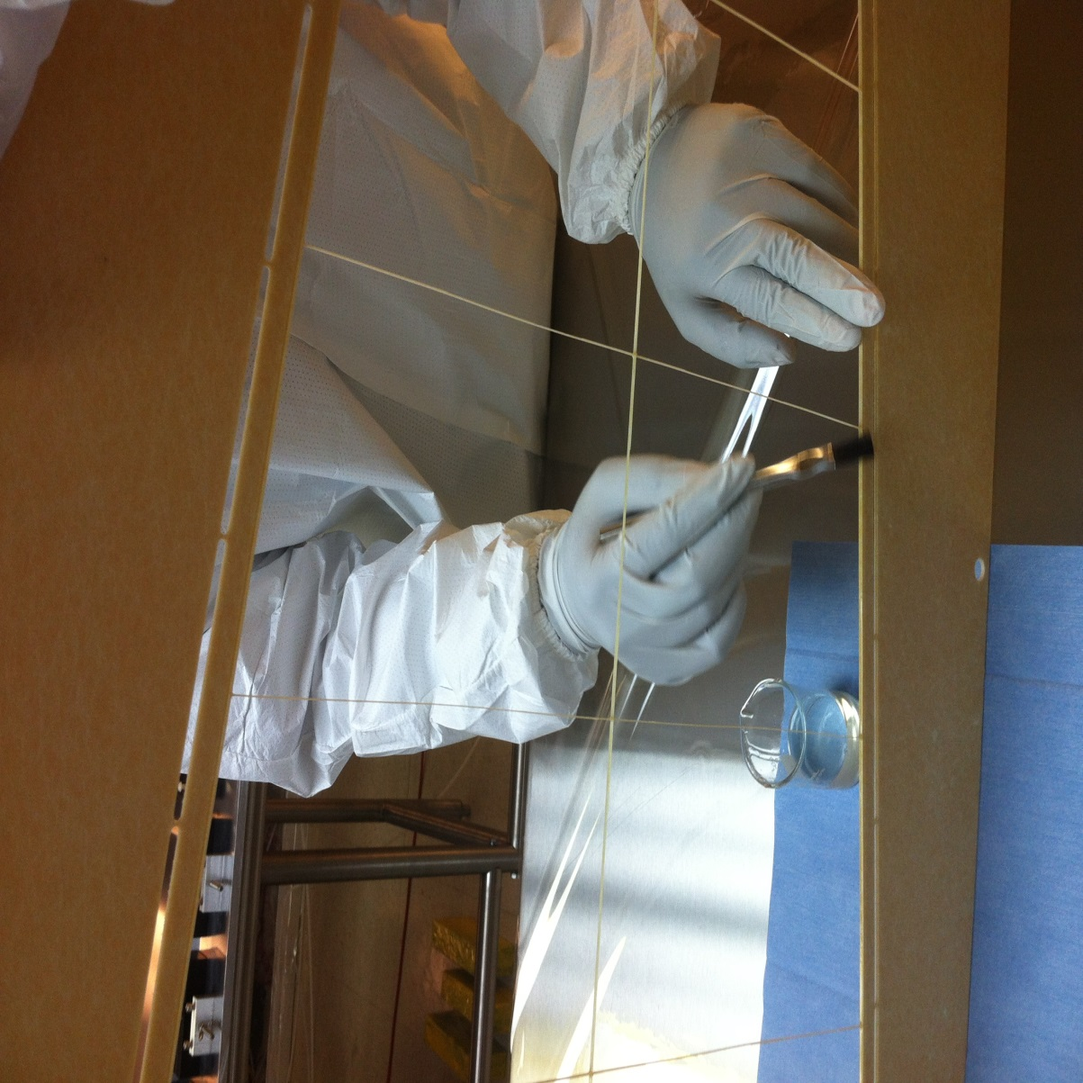
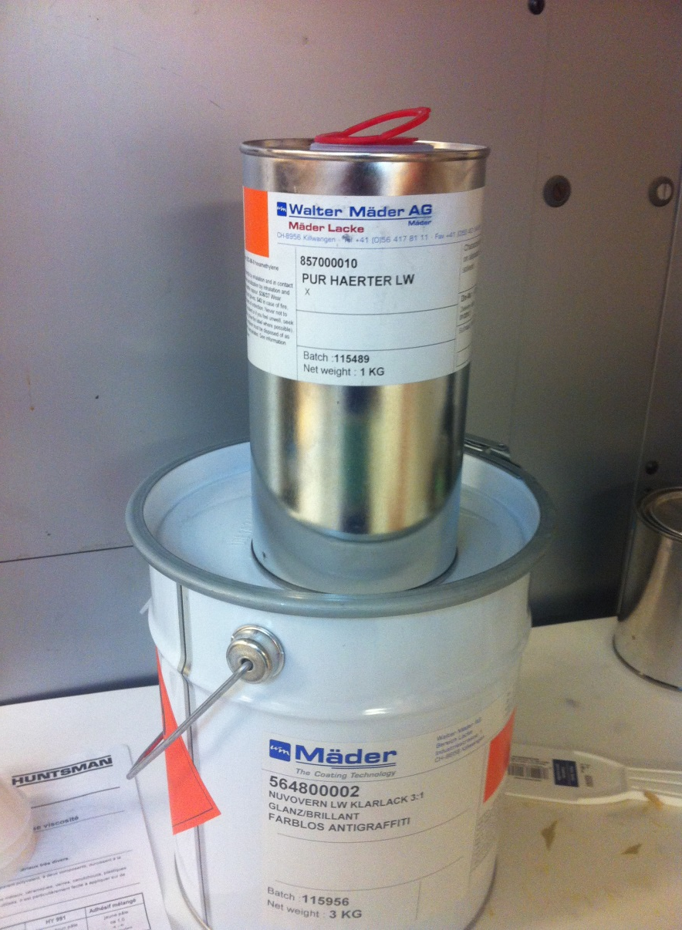
Preparation for assembling---I
Clean and Coat the epoxy frames

Slide 5
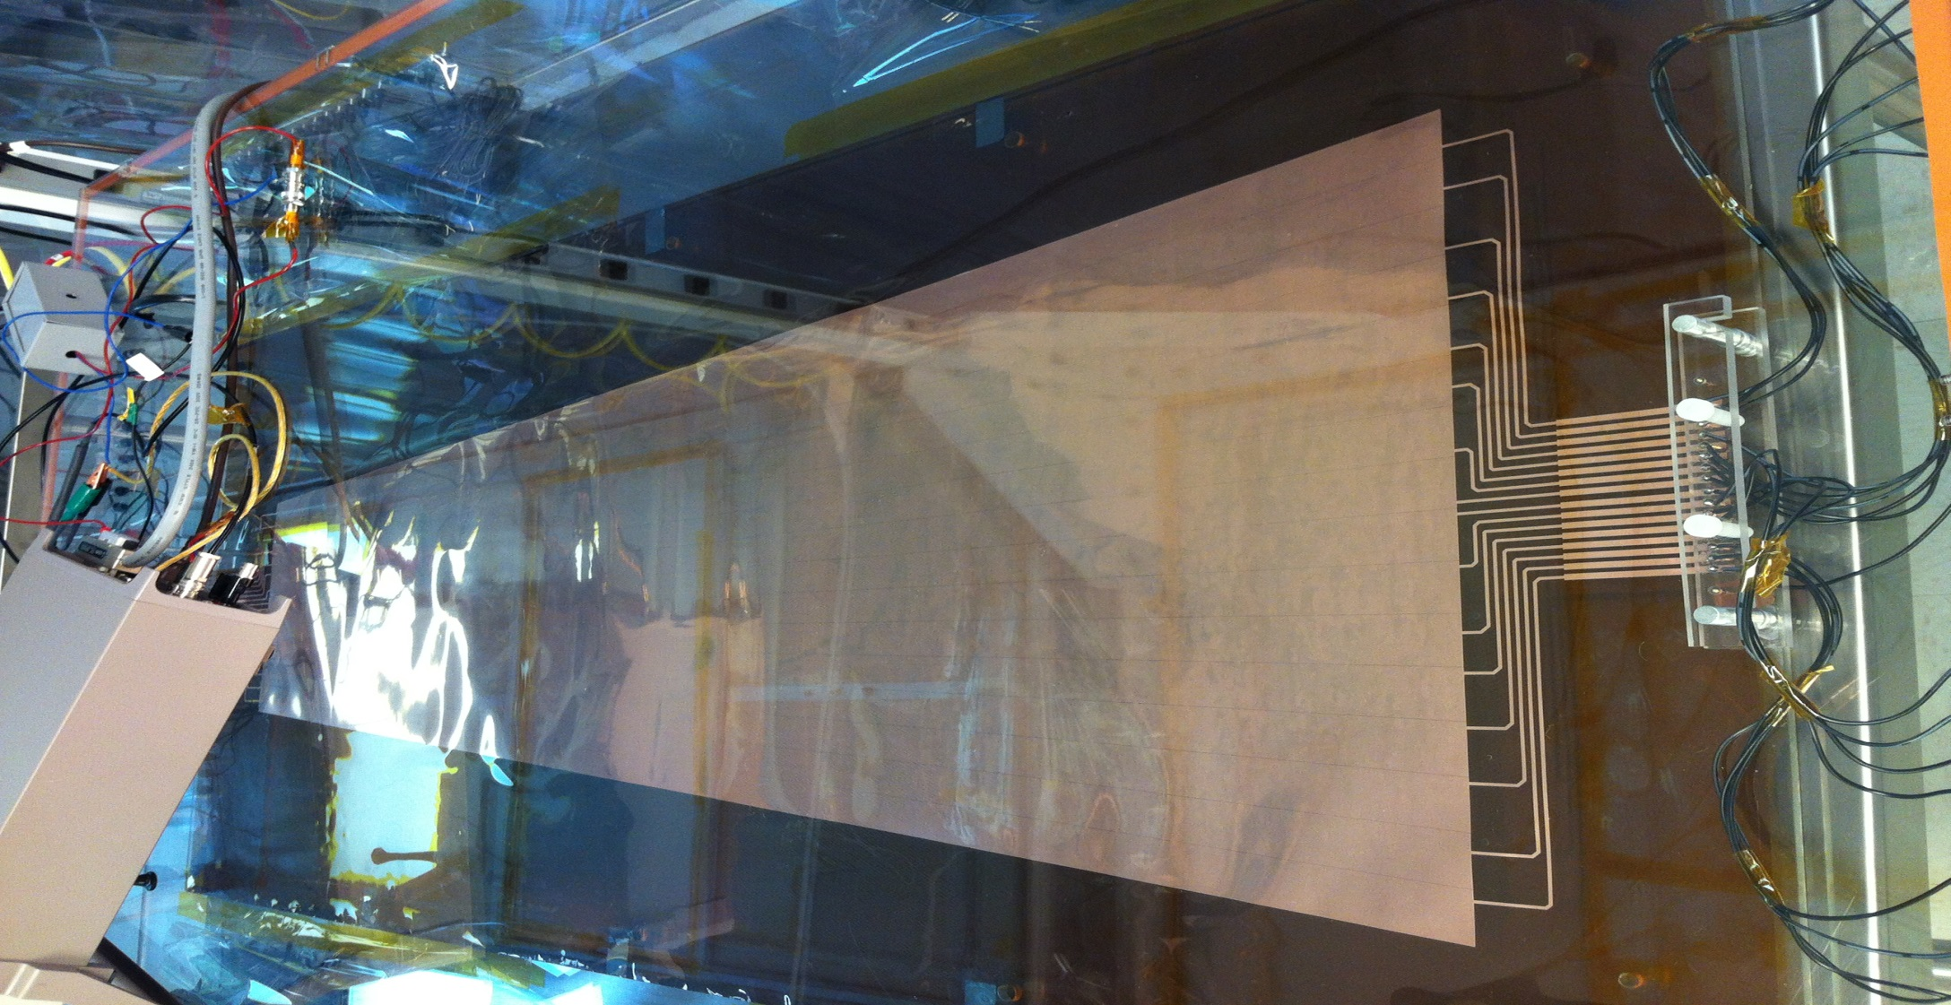
Preparation for assembling---II
HV test for GEM foil in a box filled with N2
For each sector, 550V → ~1nA

Slide 6
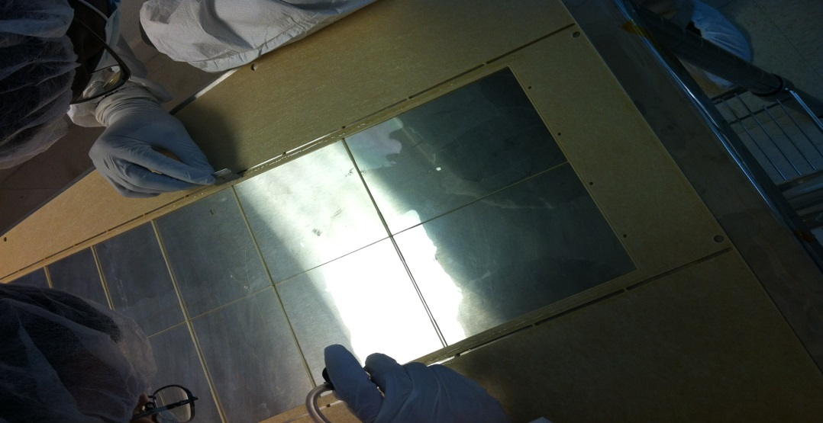
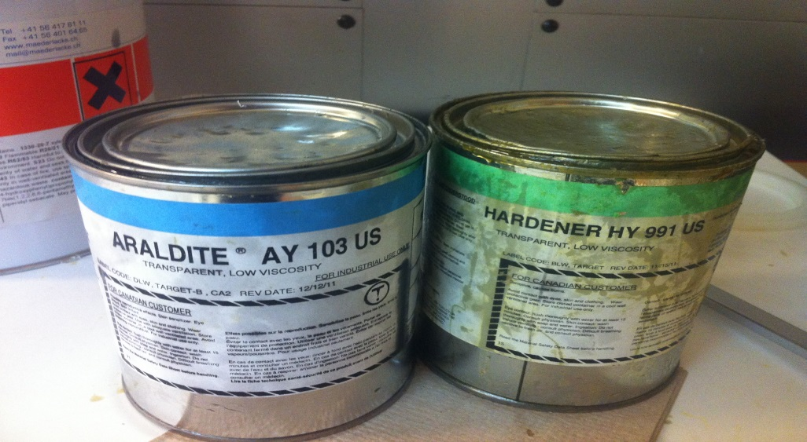
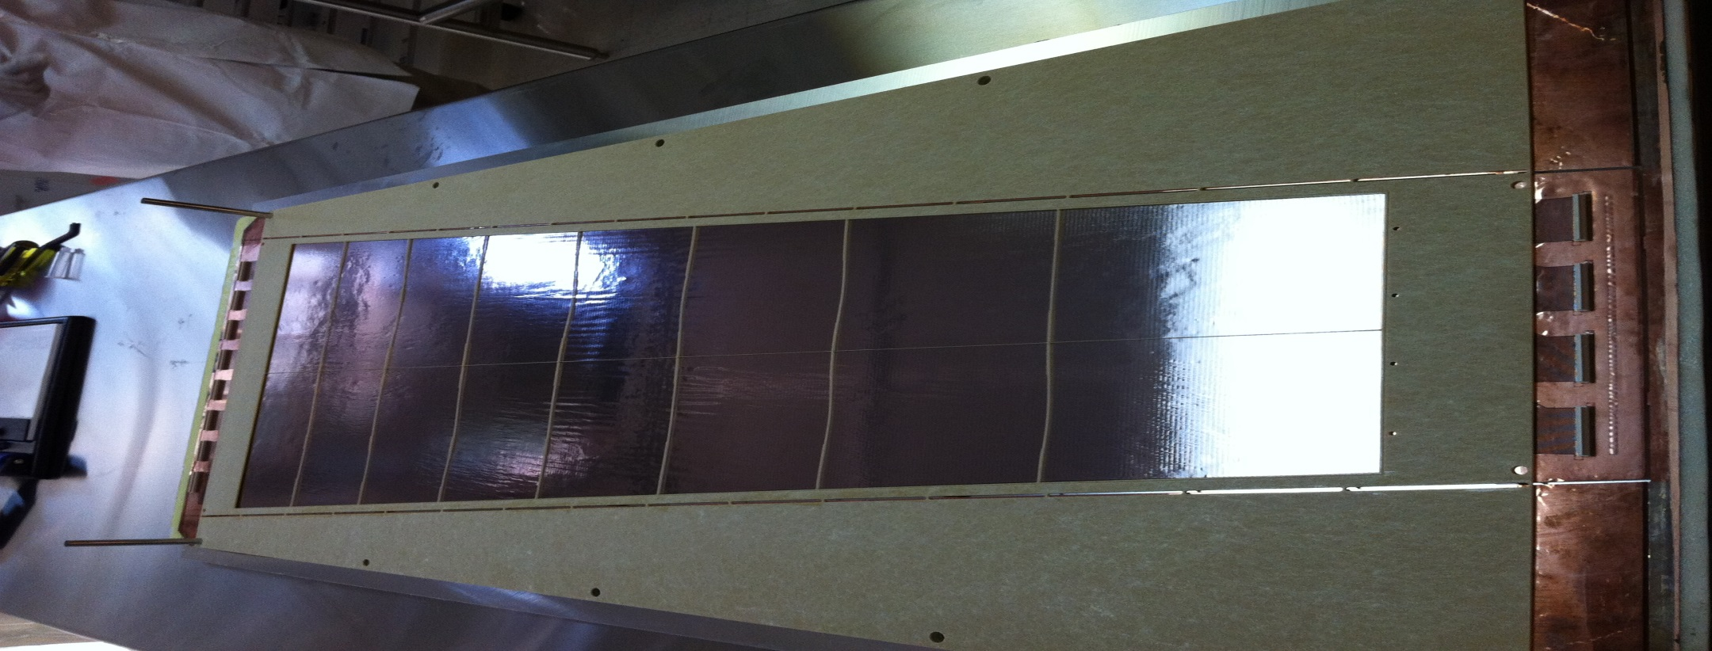
Assembling ---step 1: paste the 2mm frame onto the readout board

Slide 7
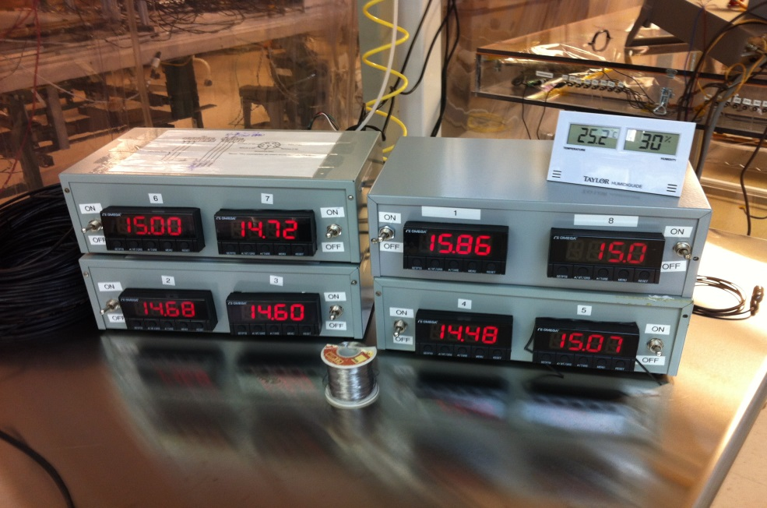
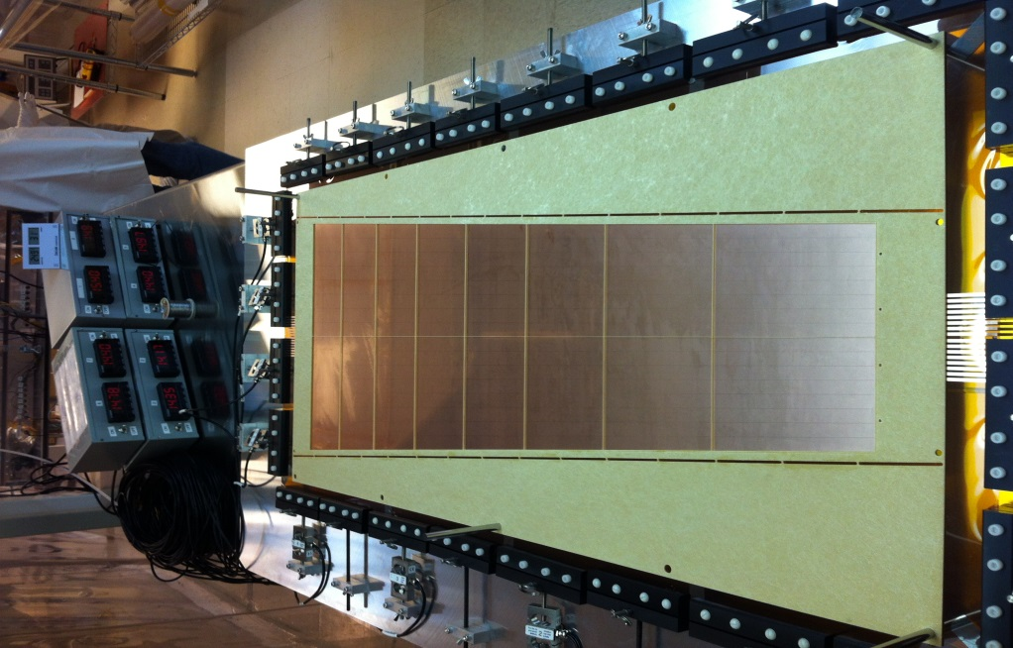
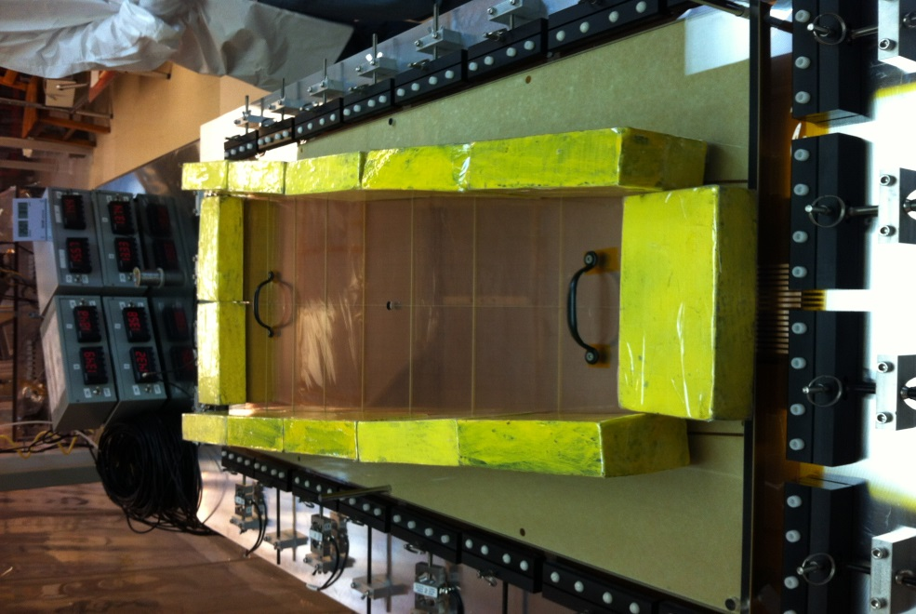
Assembling ---step 2: stretch the GEM foil and paste 2mm frame onto the foil

Slide 8
Assembling ---step 3: HV test for the foil again and paste it onto the base got in step 1

Slide 9
Assembling processes
Step 1: page 6
Step 2: page 7
Step 3: page 8

Slide 10
Solid/EIC prototype
HV Divider
And HV distribution board

Slide 11
Gas flow
Gas
Mylar foil
Drift cathode
3mm
GEM 1
2mm
GEM 2
GEM 3
2mm
2mm
2D Readout foil

Slide 12
Status of Solid/EIC prototype
Just arrived at Fermi lab
Will flow with N2 gas for several days
Setup for the beam test beginning at 1st OCT.

