Slide 1
GEM geometry
Zhiwen Zhao
2013/09/13

Slide 2
Intro
PVDIS decide to add 1 more plane before Cherenkov to make total 5 planes.
PVDIS proposal has 22-35 degree as required acceptance
GEM size in PVDIS proposal was not optimized to accepted 22-35 degree from the full target.
Current CLEO PVDIS setup have room to allow EC accept 21-36 degree from full target, even though the performance at the edges can be somewhat degraded
Both GSM and EC need to decide to accept 22-35 or 21-36 degree and optimize for target center or full target after examining performance and cost.

Slide 3
PVDIS GEM
Assume 21-36 degree acceptance
id | Z (cm) | PVDIS target center |  |  | PVDIS target full
 |  | R_in (cm) | R_out(cm) | Area (m2) | R_in (cm) | R_out(cm) | Area (m2)
1 | 157.5 | 56 | 107 | 2.611612 | 48 | 122 | 3.952133
2 | 185.5 | 67 | 128 | 3.736933 | 59 | 143 | 5.330667
3 | 190 | 69 | 130 | 3.813588 | 65 | 143 | 5.096932
4 | 306 | 113 | 215 | 10.51054 | 105 | 230 | 13.15545
5 | 315 | 117 | 222 | 11.18253 | 109 | 237 | 13.91352
total |  |  |  | 31.8552 |  |  | 41.4487
CLEO coil center at 0.
PVDIS 40cm long target with center at 10cm
PVDIS angle 21-36 degree by EC nominal acceptance R(110,250)cm
Considering the CLEO baffle, plane 1,2,3 are directly behind baffle and only need partial coverage (70-80%?), plane 4,5 are between Cherenkov and EC and need full coverage 157.5,185.5,190,306,315
To cover full target, GEM needs to increase by 30% from cover target center only
Largest GEM size in R 128cm

Slide 4
PVDIS GEM
Assume 22-35 degree acceptance
id | Z (cm) | PVDIS target center |  |  | PVDIS target full
 |  | R_in (cm) | R_out(cm) | Area (m2) | R_in (cm) | R_out(cm) | Area (m2)
1 | 157.5 | 59 | 104 | 2.304364 | 51 | 118 | 3.557234
2 | 185.5 | 70 | 122 | 3.136573 | 62 | 136 | 4.603072
3 | 190 | 72 | 126 | 3.358999 | 65 | 140 | 4.83021
4 | 306 | 119 | 207 | 9.012622 | 111 | 221 | 11.47312
5 | 315 | 123 | 213 | 9.500198 | 115 | 228 | 12.17653
total |  |  |  | 27.31276 |  |  | 36.64017
CLEO coil center at 0.
PVDIS 40cm long target with center at 10cm
PVDIS angle 22-35 degree by EC nominal acceptance R(117,240)cm
Considering the CLEO baffle, plane 1,2,3 are directly behind baffle and only need partial coverage (70-80%?), plane 4,5 are between Cherenkov and EC and need full coverage 157.5,185.5,190,306,315
To cover full target, GEM needs to increase by 34% from cover target center only
Largest GEM size in R 113cm

Slide 5
PVDIS Err_Apv(%) (based on current baffle “more1” before trig cut)
Assume 21-36 degree acceptance
x | 0.20-0.30 | 0.30-0.35 | 0.35-0.40 | 0.40-0.45 | 0.45-0.50 | 0.50-0.55 | 0.55-0.60 | 0.60-0.67 | 0.67-0.80
EC | 0.262 | 0.284 | 0.275 | 0.286 | 0.314 | 0.354 | 0.427 | 0.468 | 0.641
GEM 5 (full target) | 0.262 | 0.284 | 0.275 | 0.286 | 0.314 | 0.355 | 0.428 | 0.469 | 0.641
GEM 5 (target center) | 0.287 | 0.304 | 0.292 | 0.303 | 0.331 | 0.376 | 0.450 | 0.496 | 0.668
Err_Apv studied according to e DIS hits on different detectors.
EC nominal acceptance R(110,250)cm
GEM 5 (full target) acceptance R(109,237)cm
GEM 5 (target center) acceptance R(117,222)cm
If we use GEM 5 (target center) configuration, it will increase Err_Apv

Slide 6
PVDIS Err_Apv(%) (based on current baffle “more1” before trig cut)
Assume 22-35 degree acceptance
x | 0.20-0.30 | 0.30-0.35 | 0.35-0.40 | 0.40-0.45 | 0.45-0.50 | 0.50-0.55 | 0.55-0.60 | 0.60-0.67 | 0.67-0.80
EC | 0.282 | 0.300 | 0.286 | 0.297 | 0.324 | 0.366 | 0.439 | 0.482 | 0.649
GEM 5 (full target) | 0.280 | 0.298 | 0.285 | 0.296 | 0.324 | 0.367 | 0.441 | 0.485 | 0.653
GEM 5 (target center) | 0.316 | 0.328 | 0.311 | 0.325 | 0.353 | 0.403 | 0.481 | 0.529 | 0.707
Err_Apv studied according to e DIS hits on different detectors.
EC nominal acceptance R(117,240)cm
GEM 5 (full target) acceptance R(115,228)cm
GEM 5 (target center) acceptance R(112,213)cm
If we use GEM 5 (target center) configuration, it will increase Err_Apv

Slide 7
Err_Apv(%) (based on current baffle “more1” before trig cut)
Assume 21-36 degree acceptance
x | 0.20-0.30 | 0.30-0.35 | 0.35-0.40 | 0.40-0.45 | 0.45-0.50 | 0.50-0.55 | 0.55-0.60 | 0.60-0.67 | 0.67-0.80
GEM 5 | 0.262 | 0.284 | 0.275 | 0.286 | 0.314 | 0.355 | 0.428 | 0.469 | 0.641
GEM 4 | 0.261 | 0.284 | 0.274 | 0.286 | 0.314 | 0.354 | 0.427 | 0.467 | 0.641
GEM 3 | 0.26 | 0.283 | 0.274 | 0.285 | 0.313 | 0.353 | 0.426 | 0.466 | 0.641
GEM 2 | 0.259 | 0.283 | 0.274 | 0.285 | 0.313 | 0.353 | 0.426 | 0.466 | 0.641
GEM 1 | 0.219 | 0.261 | 0.26 | 0.275 | 0.304 | 0.344 | 0.414 | 0.451 | 0.623
Err_Apv studied according to e DIS hits on different GEM planes (full target)
GEM 1 has more hits because it’s between baffle planes
Overall the sizes of GEM planes have matching acceptance.

Slide 8
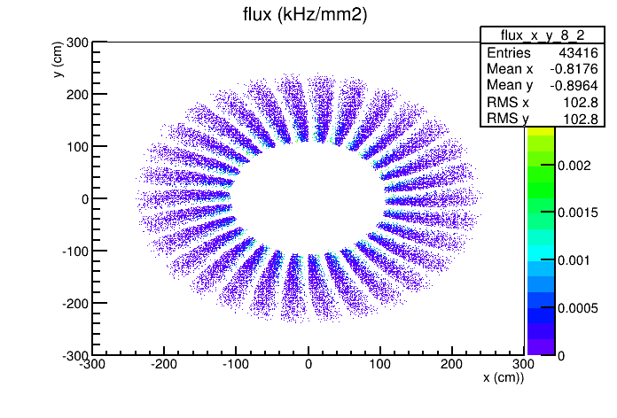
PVDIS e DIS hit on EC
Based on current “more1” baffle
Pattern is similar on GEM 4,5 plane because they are close by in Z.
This suggests almost full coverage in phi.

Slide 9
SIDIS/JPsi GEM
id | Z (cm) | SIDIS target center |  | SIDIS target full |  | JPsi target center |  | Overall
 |  | R range (cm) | Area (m2) | R range (cm) | Area (m2) | R range needed (cm) | Area needed (m2) | R range (cm) | Area (m2)
1 | -175 | 46-78 | 1.2466 | 41-87 | 1.8498 | 36-67 | 1.0031 | 36-87 | 1.9707
2 | -150 | 26-91 | 2.3892 | 23-98 | 2.8510 | 21-80 | 1.8720 | 21-98 | 2.8786
3 | -119 | 30-103 | 3.0502 | 27-112 | 3.7118 | 25-97 | 2.7595 | 25-112 | 3.7445
4 | -68 | 37-126 | 4.5575 | 34-135 | 5.3624 | 32-123 | 4.4312 | 32-135 | 5.4039
5 | 5 | 46-95 | 2.1705 | 44-100 | 2.5334 | 42-90 | 1.9905 | 42-100 | 2.5874
6 | 92 | 58-118 | 3.3175 | 55-123 | 3.8026 | 55-115 | 3.2044 | 55-123 | 3.8026
total |  |  | 16.7315 |  | 20.1110 |  | 15.2607 |  | 20.3877
CLEO coil center at 0.
Plane (1,2,3,4) cover large angle and plane (2,3,4,5,6) cover forward angle
SIDIS 40cm long target with center at -350cm, SIDIS angle 7.5-14.85-24 degree accepted by EC
JPsi 15cm long target with center at -300cm tentatively, JPsi angle 8- 16.28-28 degree accepted by EC
Jpsi coverage is only optimized by target center as it’s length is smaller
Overall GEM size determined by “Jpsi target center” inner and “SIDIS target full” outer
PVDIS has more than enough GEM for SIDIS/JPsi to cover full target

