Slide 1
Jefferson Lab: Notes
Hugh Montgomery
January 28, 2011

Slide 2
Outline
Preamble 12 GeV Project Status/Schedule Hall A Moller SOLID

Slide 3
Jefferson Lab Strategic Plan
E-mail to Division Leaders, Senior Management on December 22, 2010
Dear All,
As you know, each year we develop a plan, which is officially called the Department of Energy Laboratory Plan – TJNAF, for submission and presentation to the DOE Office of Science. This we expect to do again in FY2011 and we will soon receive the adjustments which are desired for this year’s process. A year ago, in developing that plan, we laid out for the Laboratory community, the sense of the different programs or components of programs. This consisted of a series of presentations in the CEBAF center auditorium.
This year, we have ambitions to go further in an exercise, which, in its initial edition, will be independent of the Office of Science process.

Slide 4
Jefferson Lab Strategic Plan
I have asked Bob McKeown to lead the development of the Jefferson Lab Strategic Plan. The goal is to produce a concise document, perhaps not more than 20 pages, which would start with a vision statement and a set of goals for the laboratory as a whole and would then delve deeper into what we do, developing visions, goals, and outcomes at multiple levels. The intent is that we engage our owners, both the science and operations components of the lab, the laboratory leadership more broadly, the staff, and the user community, essentially all of our stakeholders, in the process.
While for the lab as a whole, we imagine a vision which is robust against the winds of fortune, one can also imagine that what we do becomes something that could be readily updated on an annual basis. We look forward to your participation in the development of the plan.

Slide 5
Strategy To Modernize JLab
Facilities: Resolve critical shortage and poor quality of space by constructing 278,000 sq ft and refurbishing 280,000 sq ft of work space; addressing safety and building code issues by updating outdated building systems; reducing deferred maintenance; and increasing energy efficiency.
Technology Engineering Development Facility (TEDF) (SLI) provides 38% of new and 31% of refurbished space (CD-3A approved 3/26/10)
CEBAF Center Expansion and Rehab (SLI 2016) ~ 34% of new space
Lab’s $32M GPP investment provides ~28% of new space.
Utilities: Replace/upgrade 20-40 year old site utilities to meet SC mission requirements by increasing cryogenics capability; increasing capacity and adding redundancy to the power distribution system; increasing cooling water capacity to meet mission requirements and replacing site cooling towers.
Utility Infrastructure Modernization Project (SLI 2011)
Communications: Upgrade 1960s subsurface communications systems with 627 miles of fiber optic cable and 42 miles of building computer cable (SLI 2011).

Slide 6
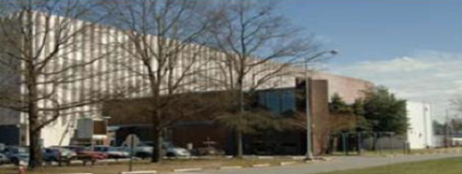
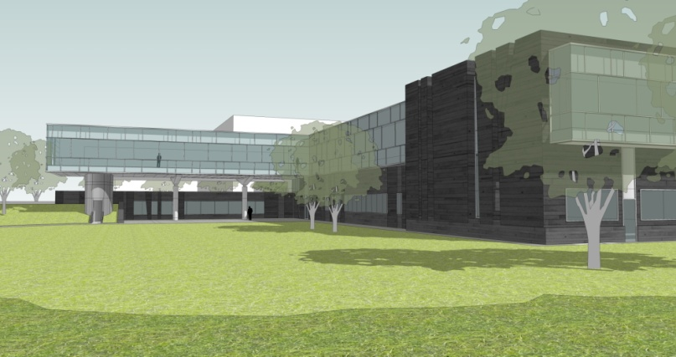
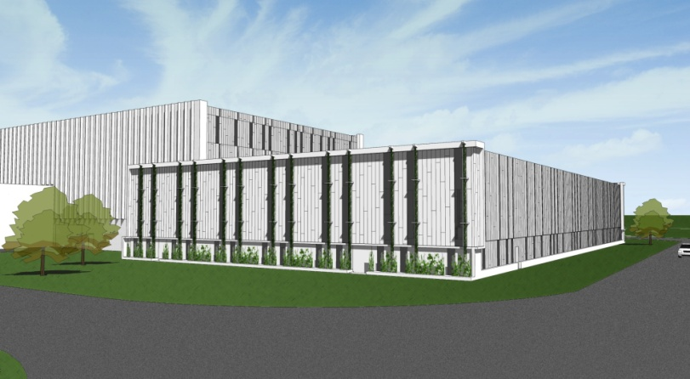
Technology and Engineering Development Facility
Addition to Test Lab for SRF
TED Bldg for Engineering & Shops
Rehab Test Lab
Eliminate Unsuitable Space
Test Lab Rehab
TED Building
SRF Addition

Slide 7
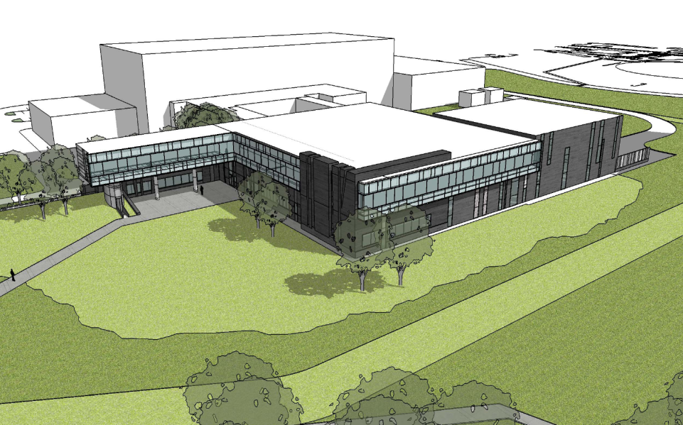
TEDF+ Project Status
Status
Project Construction Phase is underway
Schedule
CD-1 Sep 08 (complete)
CD-2 Jul 09 (done)
CD-3 A
2nd Qtr FY 2010 (done)
CD-3 B
4th Qtr FY 2010 (done)
CD-4
New construction 4th Qtr FY 2012
Rehab 4th Qtr FY 2014
General Plant Project ARRA Funding from Office of Nuclear Physics
Important ancillary work on buildings such as End Station Refrig. Buiilding

Slide 8
6 GeV Program Status
~3/4
~3/4
~40%
~3/4
____~3/4 ____
~3/4
0%
~2/3
○ = Running Completed to date;  = Remaining Scheduled Runs (and downs)
Note: Beamtime available in FY11-12 still depends on uncertain future budgets

Slide 9
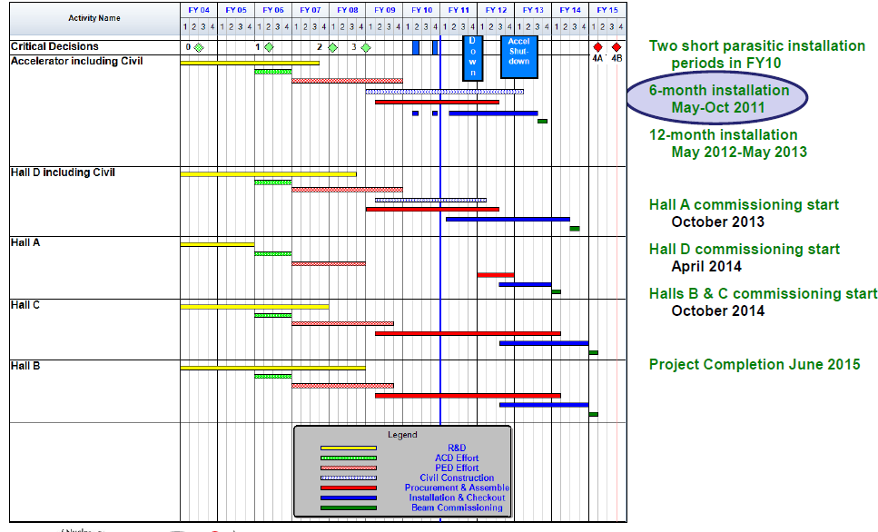
12 GeV Upgrade Schedule
Start of Commissioning:
Hall A October 2013
Hall D April 2014
Halls B and C October 2014

Slide 10
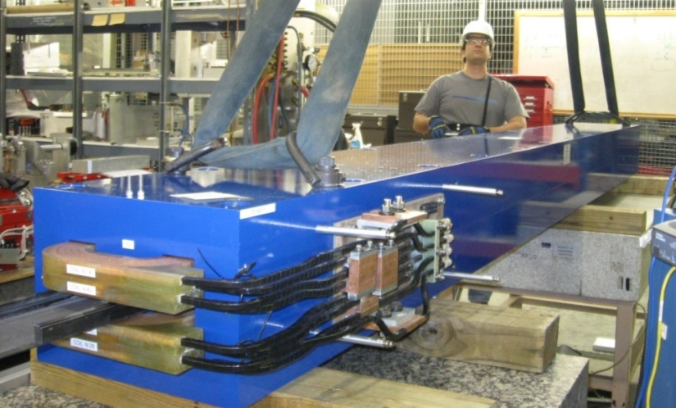
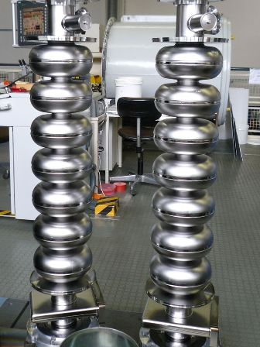
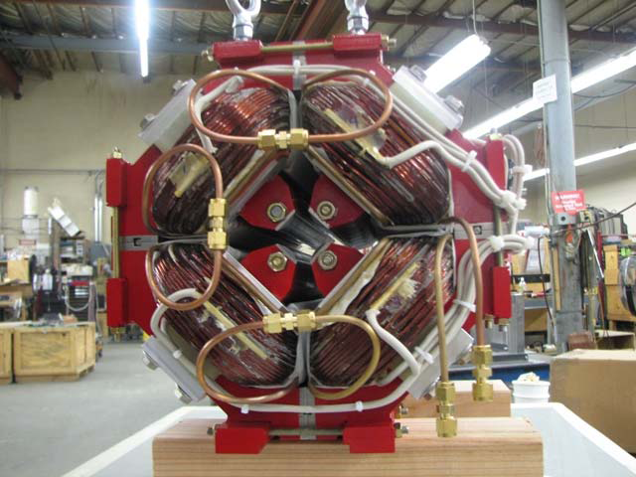
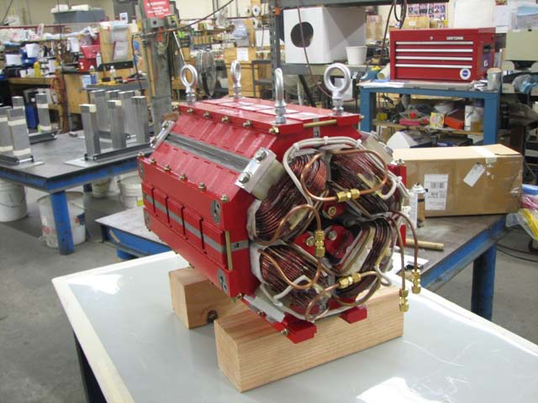
ACCELERATOR CONSTRUCTION
Major Procurements (> $500K) nearly complete:
cryomodule cavities
beam transport magnets
cryogenics coldbox
vacuum valves
cold tuner
etc. etc. etc.
Cryomodule Cavities
(12 of 80 ordered on site)
4-meter Dipole Magnets
(23 of 37 ordered on site)
Beam Transport
Quadrupole Magnets
(114 - total order - on site)

Slide 11
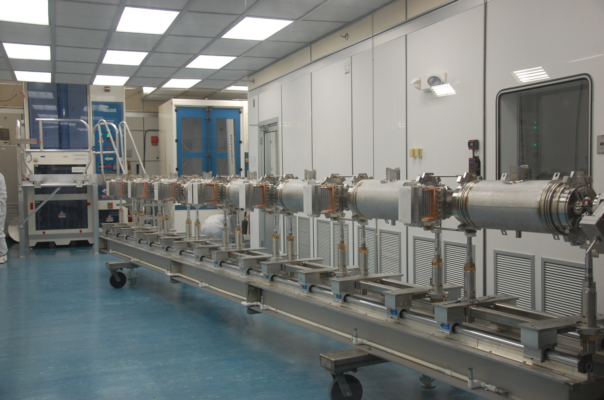
12 GeV Upgrade – Cryomodule Cavity String
January 4, 2011

Slide 12
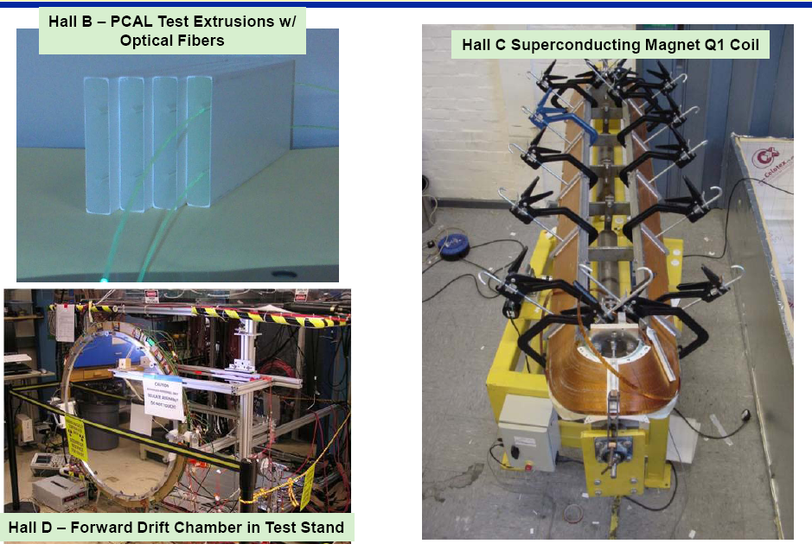
Physics Equipment Construction

Slide 13
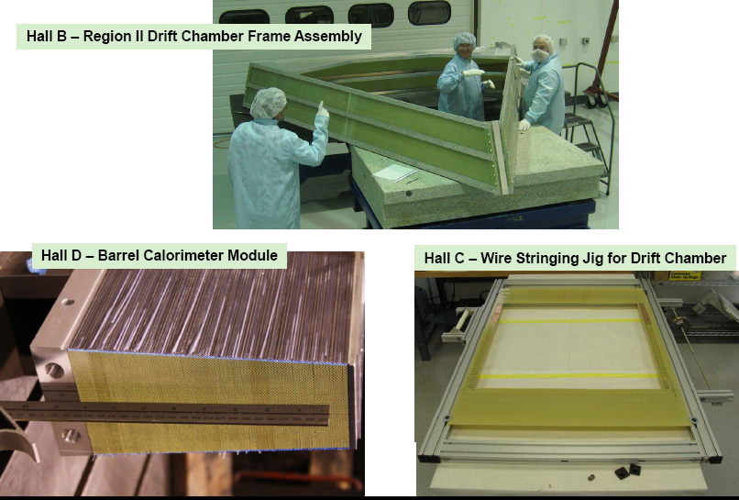
Physics Equipment Construction

Slide 14
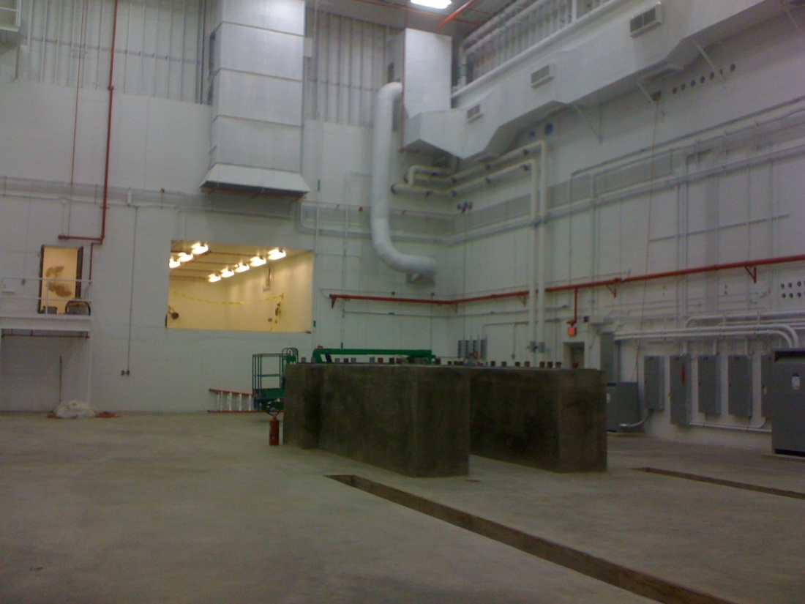
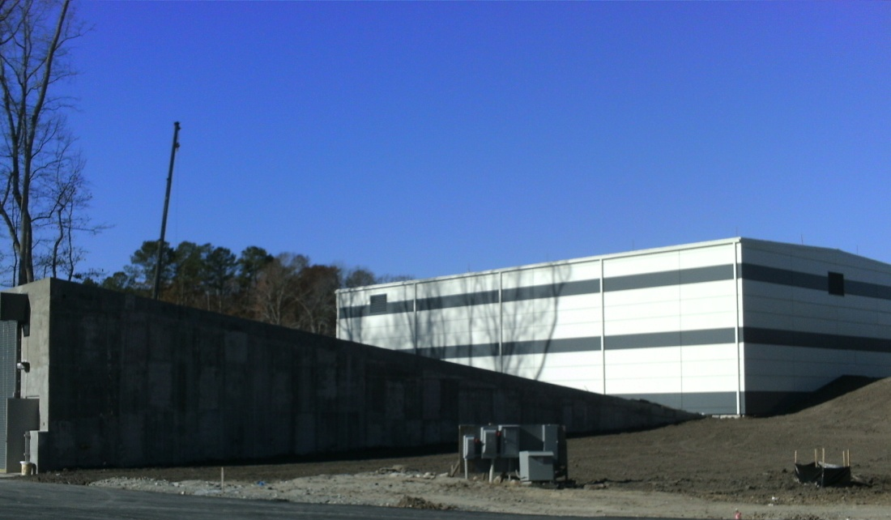
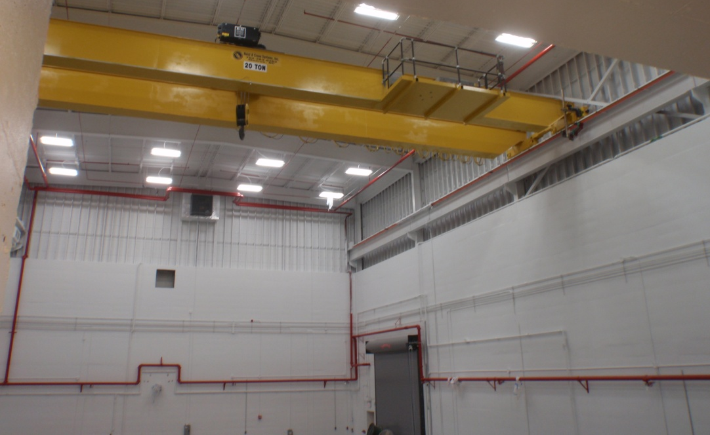
Hall D Status – Dec. 2010
Ready For Equipment (RFE)
Dec. 28, 2010

Slide 15
Super Bigbite Spectrometer (SBS) in Hall A
Third tracker
Second tracker
Hadron calorimeter
First tracker
Vacuum snout
Scattering chamber
Beam line Pb shield
CH2 analyzer
Beam
48D48 magnet
Magnetic shield
MIE Funding and schedule under discussion with DOE
15

Slide 16
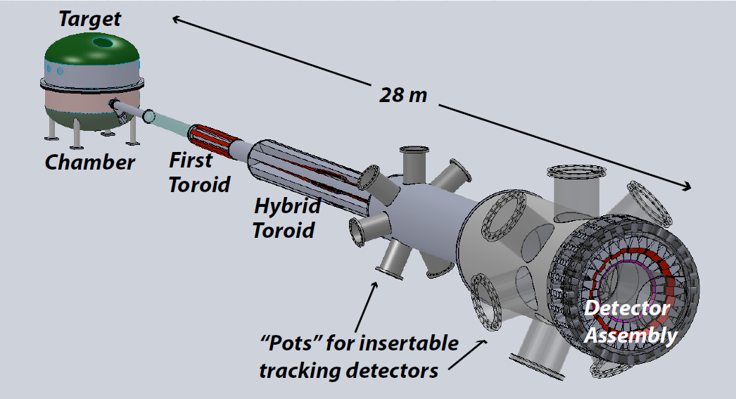
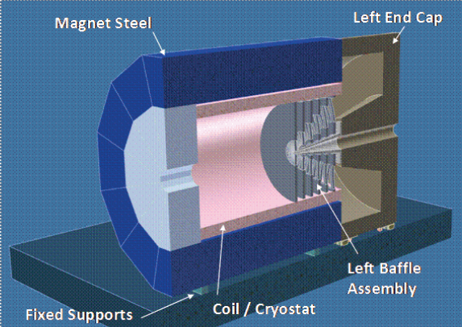
Møller & Deep Inelastic Scattering Parity Violation
Dedicated Møller Experiment
(successor to SLAC E158)
DOE MIE proposal → Physics Review
SoLID: general purpose deep inelastic parity violating experiment with solenoid
Broad scope semi-inclusive deep inelastic physics
Chinese contribution
Notes:
Low Energy Tests of the Standard Model and Fundamental Symmetries

Slide 17
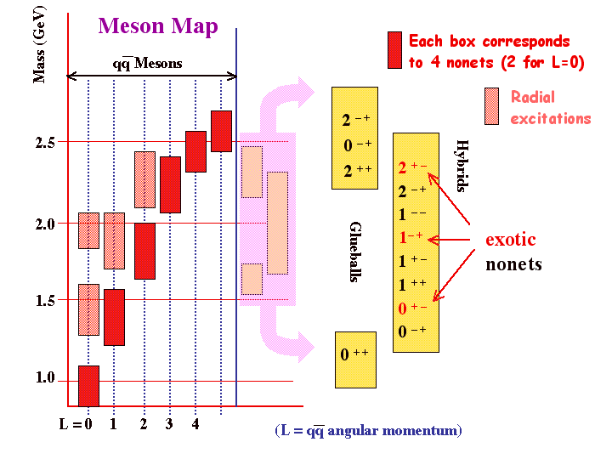
Moller
Assuming Success Director’s Review Submission of “proposal” by Moller Consideration by Office of Nuclear Physics of the Physics Case CD0 Inclusion in Budget Request by ONP Construction Money “+2 years”

Slide 18
Solid
for discussion Director’s Review(s) (of what?) Submission of “proposal” by “collaboration” Likely should be a combined effort Consideration by Office of Nuclear Physics of the Physics Case CD0 Inclusion in Budget Request by ONP Construction Money “+2 years”

