Slide 1
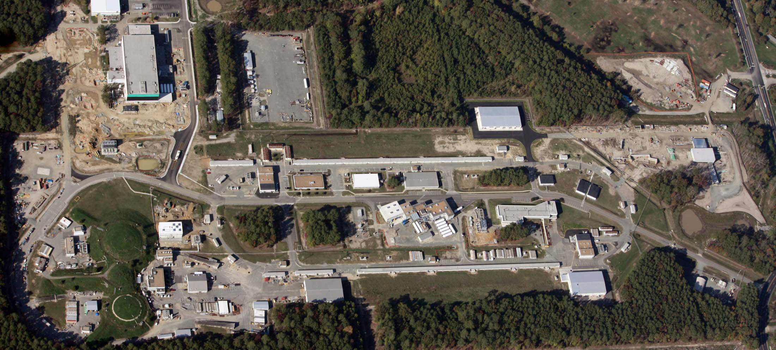
Report from Jefferson Lab Management
R. D. McKeown
Deputy Director for Science
SoLID Collaboration Meeting
March 25, 2011

Slide 2
Outline
Present 6 GeV Nuclear Physics Program
- Progress and Plans
- Highlights
12 GeV Project and Future Research Program
Towards an Electron Ion Collider

Slide 3
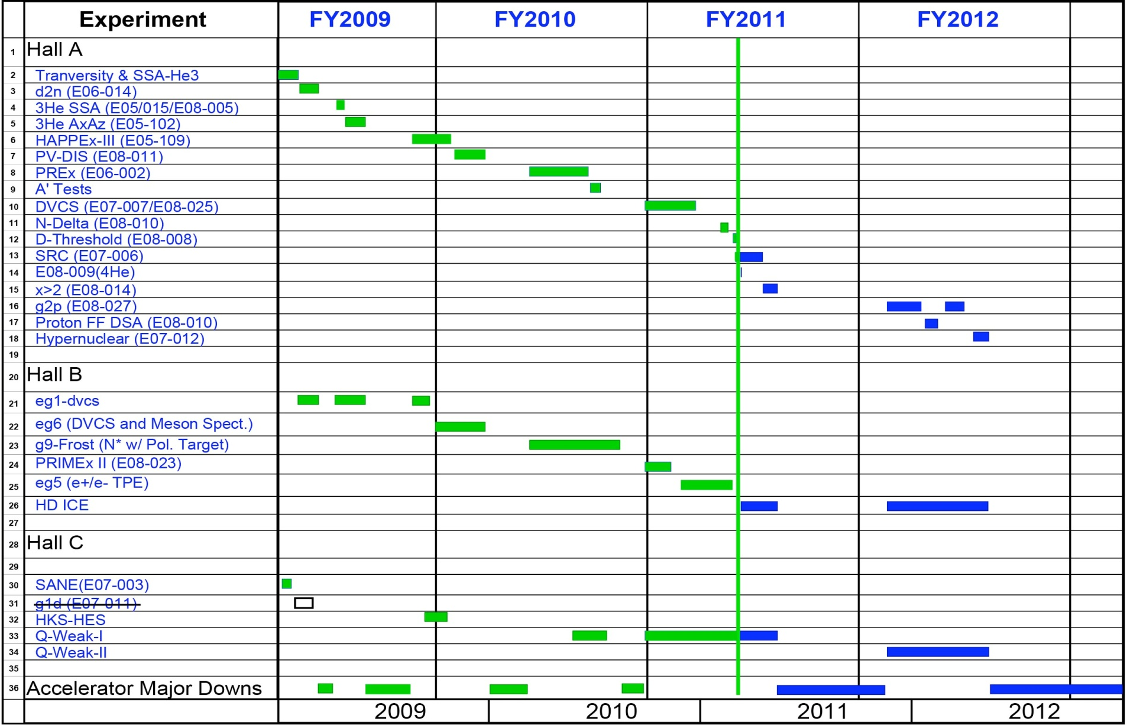
6 GeV Program Status
Issues remaining:
Tentative schedule for 6 weeks running in April/May on 2011 (budget?)
Completion of preparations for HDIce remain a challenge
The Hall A 2012 program requires completion of the g₂^{p}/G_{E}^{p} apparatus
X
Revisions to expt. transitions
will stretch g₂^{p} and G_{E}^{p} to fill
available beamtime & drop
E07-012 (hypernuclear)

Slide 4
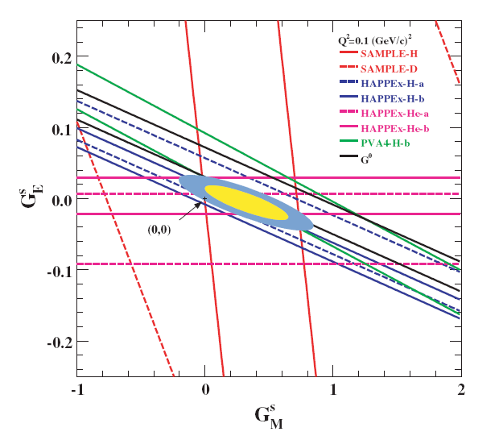
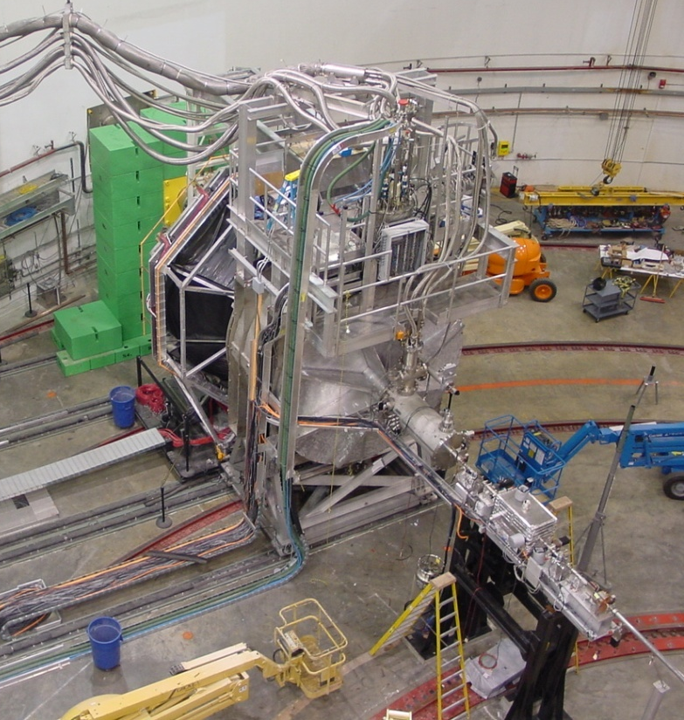
Strange Quarks in the Nucleon
Strange quarks-antiquarks virtual pairs produced by gluons
Contribution to proton’s magnetism (Stern’s discovery)?
- QCD analog of Lamb shift in atoms
Study using small (few parts per million) left-right difference
in electron-proton force – challenging experiments

Slide 5
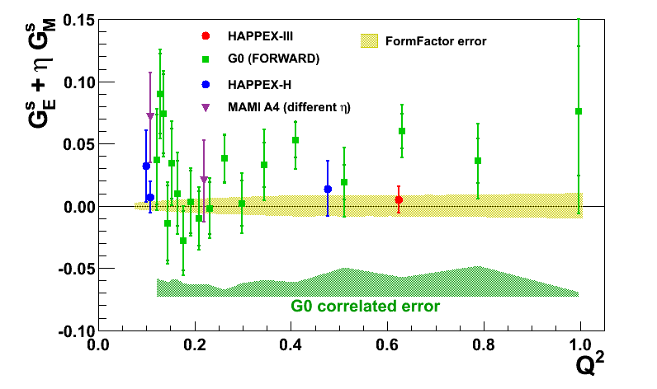
HAPPEX-III Results
preliminary
A_{PV} = -23.742 ± 0.776 (stat) ± 0.353 (syst) ppm
preliminary
A(G^{s}=0) = -24.158 ppm ± 0.663 ppm
G^{s}_{E} + 0.52 G^{s}_{M} = 0.005 ± 0.010_{(stat)} ± 0.004_{(syst)} ± 0.008_{(FF)}

Slide 6
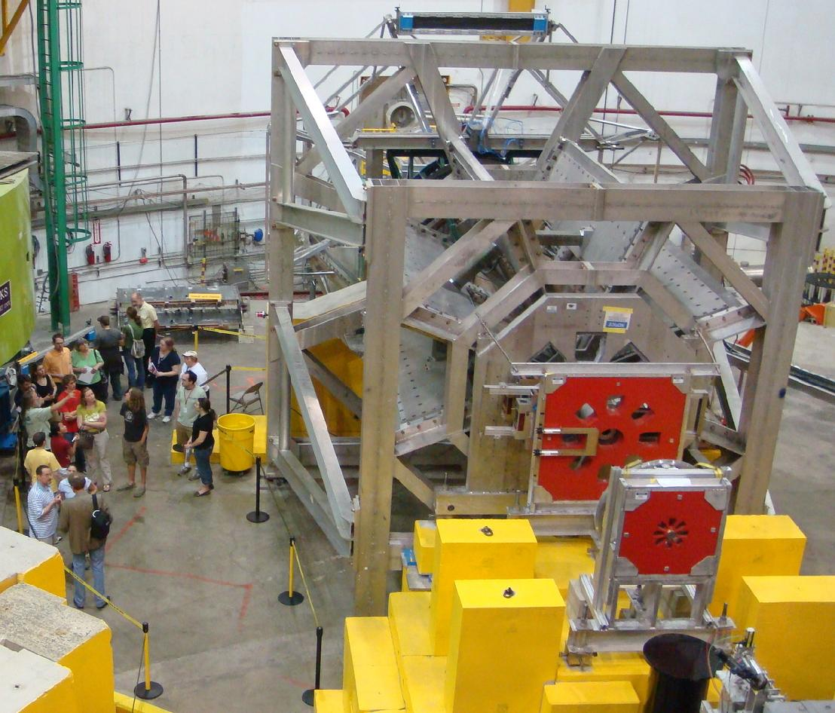
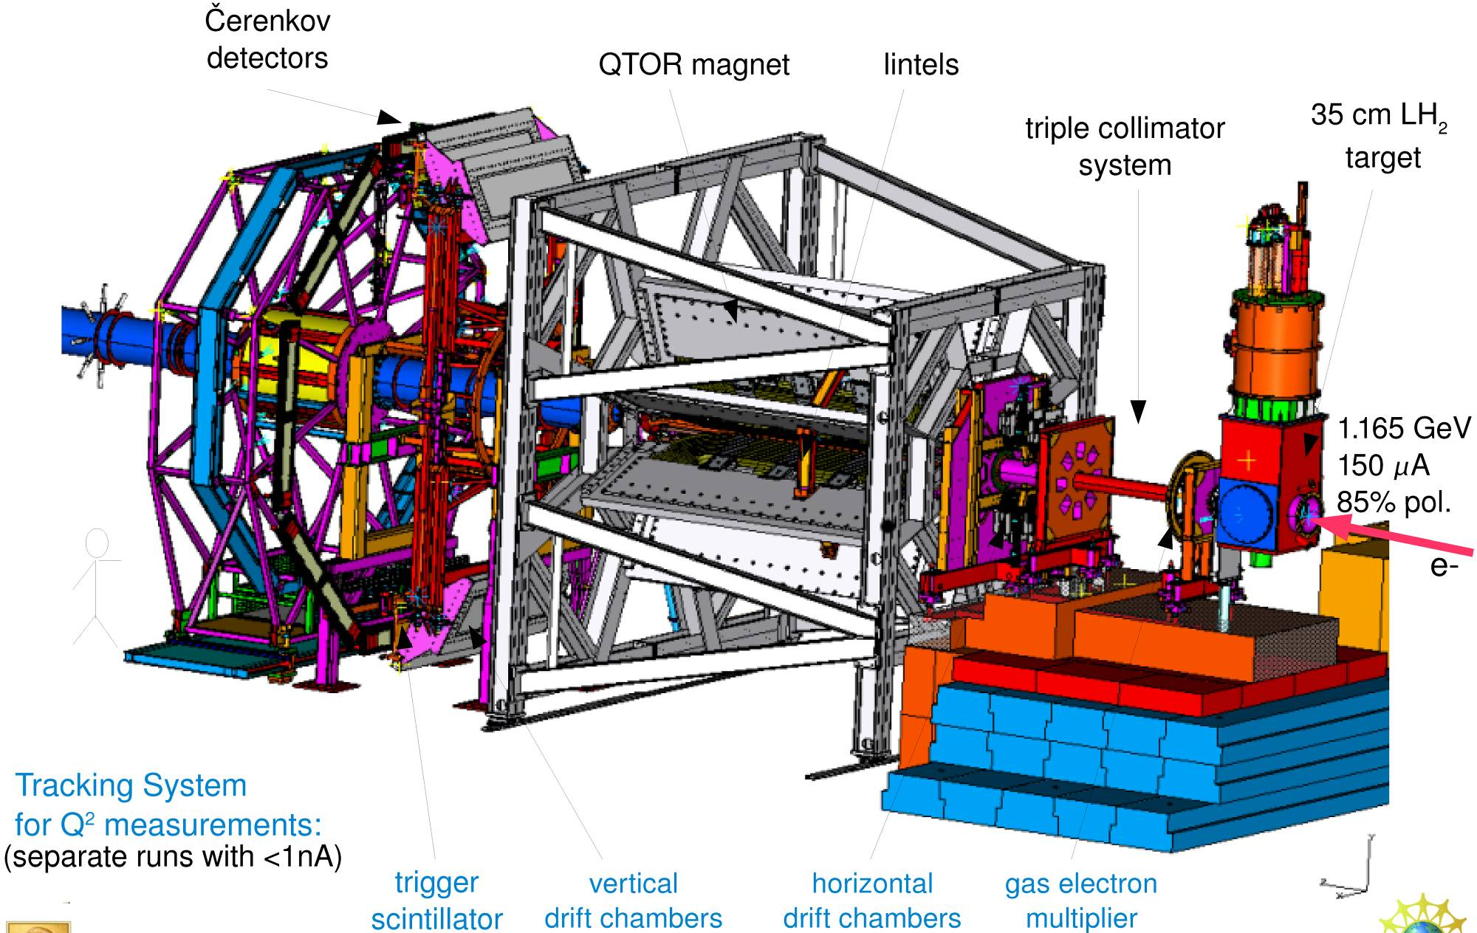
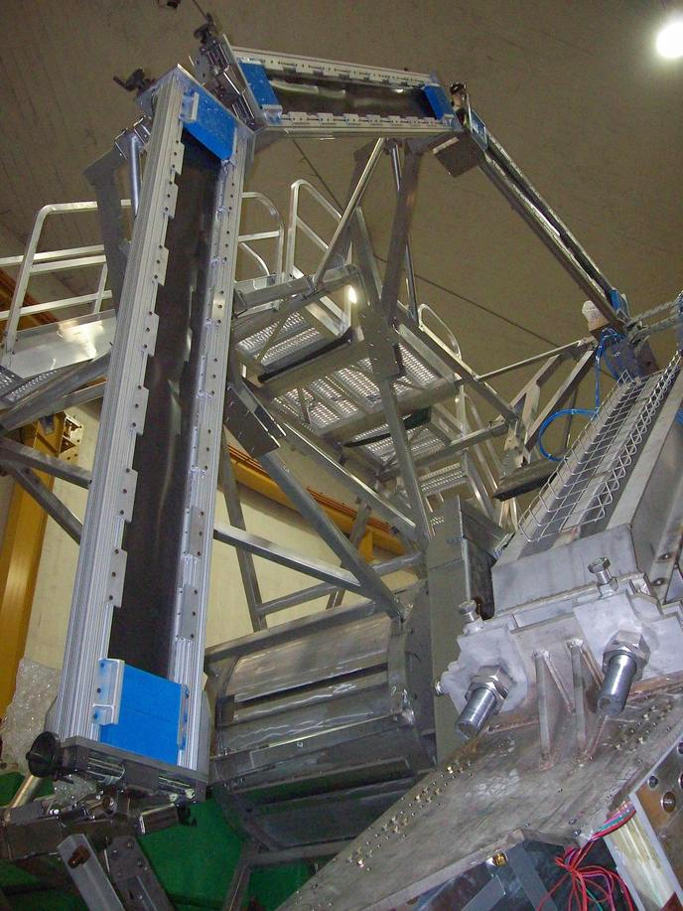
Qweak
Measuring the weak charge of the proton
Q_{w}= (1 – 4 sin² θ_{W})
Now taking data in Hall C
Luminosity
monitors
Luminosity
monitors
scanner

Slide 7
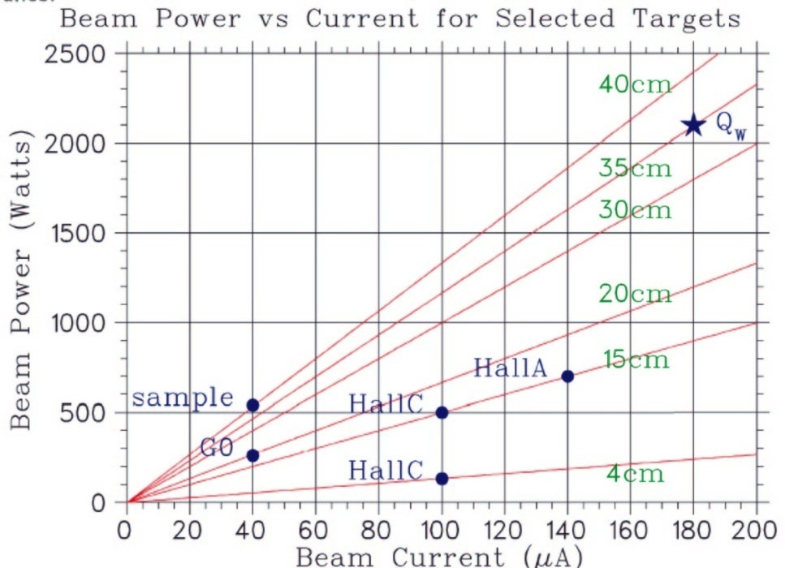
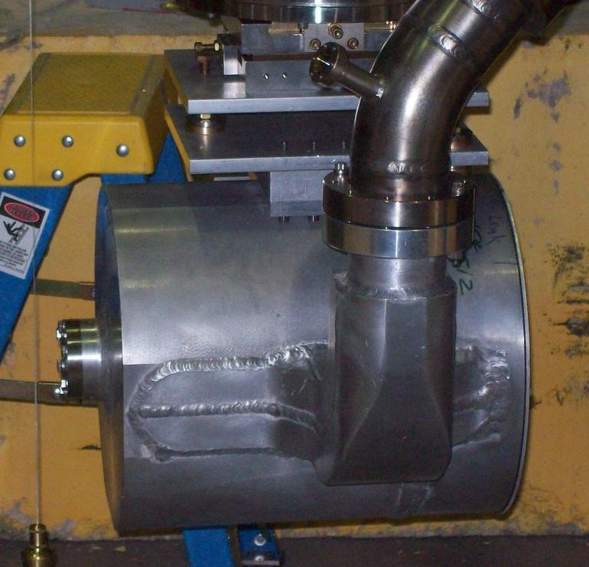
Qweak LH₂ Cryotarget
35 cm target cell, designed with CFD
Target tested and stable up to 160 μA. Sufficient reserve cooling power to easily reach 180 μA. Highest power LH2 target.
When using 960Hz spin flip rate, the target density fluctuations (an unknown before commissioning) appear to be small compared to expected counting statistical uncertainty (per quartet) of ~220 ppm.
Target cell

Slide 8
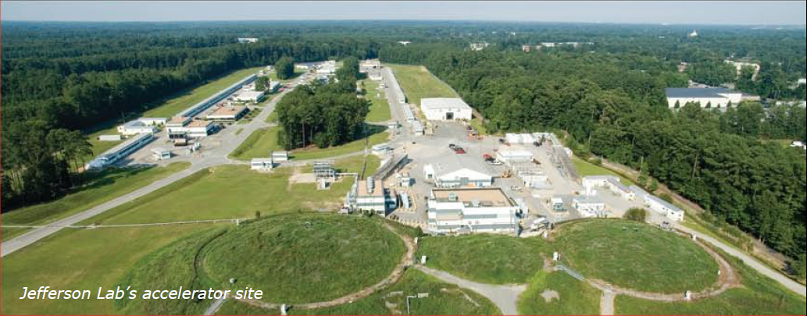
Accelerator Performance for Qweak
CEBAF delivered a record
170 μA
at 89%
polarization !

Slide 9
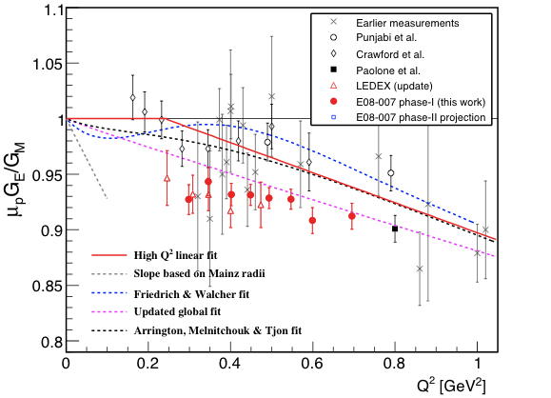
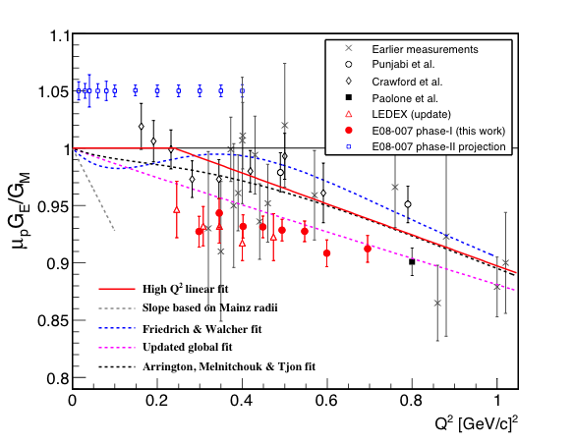
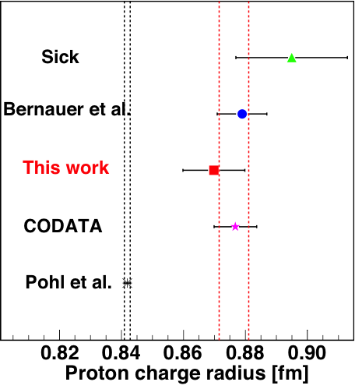
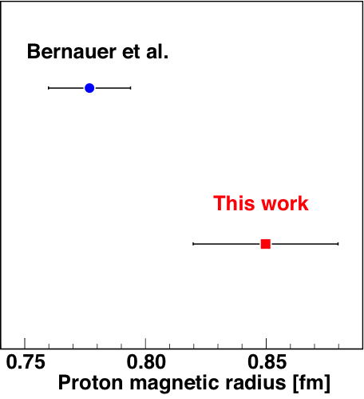
E08-007: G_{E}^{p}/G_{M}^{p} at low Q²
New Hall A polarization-transfer data show gradual decrease of G_{E}^{p}/G_{M}^{P} in good agreement with calibration datum of E03-104 at 0.8 GeV²
Submitted to PRL
Good agreement for charge radius with other existing data, except for recent muon Lamb shift result
However, significant disagreement for magnetic radius with recent Mainz result (PRL 105, 242001 (2010))
Dispersive or other radiative corrections?
E03-104
Will be clarified by upcoming Hall A measurement with polarized target

Slide 10
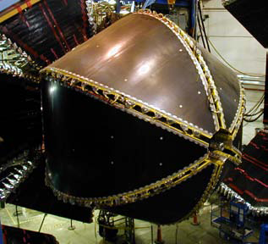
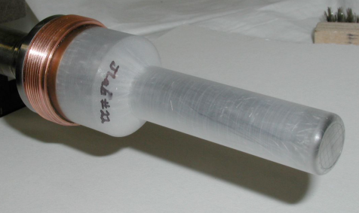
The CLAS N* Program
Status of single meson production on protons & neutrons
✔ - published, ✔ - acquired, ✔ - planned
 | σ | Σ | T | P | E | F | G | H | T_{x} | T_{z} | L_{x} | L_{z} | O_{x} | O_{z} | C_{x} | C_{z}
pπ⁰ | ✔ | ✓ | ✓ |  | ✓ | ✓ | ✓ | ✓
nπ⁺ | ✔ | ✓ | ✓ |  | ✓ | ✓ | ✓ | ✓
pη | ✔ | ✓ | ✓ |  | ✓ | ✓ | ✓ | ✓
pη’ | ✔ | ✓ | ✓ |  | ✓ | ✓ | ✓ | ✓
pω | ✔ | ✓ | ✓ |  | ✓ | ✓ | ✓ | ✓
K⁺Λ | ✔ | ✓ | ✓ | ✔ | ✓ | ✓ | ✓ | ✓ | ✓ | ✓ | ✓ | ✓ | ✓ | ✓ | ✔ | ✔
K⁺Σ⁰ | ✔ | ✓ | ✓ | ✔ | ✓ | ✓ | ✓ | ✓ | ✓ | ✓ | ✓ | ✓ | ✓ | ✓ | ✔ | ✔
K^{0*}Σ⁺ | ✔ | ✓ |  |  |  |  |  |  |  |  | ✓ | ✓
pπ⁻ | ✔ | ✓ | ✓ |  | ✓ | ✓ | ✓ | ✓
pρ⁻ | ✓ | ✓ | ✓ |  | ✓ | ✓ | ✓ | ✓
K⁻Σ⁺ | ✓ | ✓ | ✓ |  | ✓ | ✓ | ✓ | ✓
K⁰Λ | ✓ | ✓ | ✓ | ✓ | ✓ | ✓ | ✓ | ✓ | ✓ | ✓ | ✓ | ✓ | ✓ | ✓ | ✓ | ✓
K⁰Σ⁰ | ✓ | ✓ | ✓ | ✓ | ✓ | ✓ | ✓ | ✓ | ✓ | ✓ | ✓ | ✓ | ✓ | ✓ | ✓ | ✓
K^{0*}Σ⁰ | ✓ | ✓
Proton targets
Data taking completed
Neutron targets
HDice, 2011-12

Slide 11
12 GeV Science Program
The physical origins of quark confinement (GlueX, meson and baryon spectroscopy)
The spin and flavor structure of the proton and neutron (PDF’s, GPD’s, TMD’s…)
The quark structure of nuclei
Probe potential new physics through high precision tests of the Standard Model
Defining the Science Program:
  Six Reviews: Program Advisory Committees (PAC) 30, 32, 34, 35, 36, 37
  2006 through 2011
  Results: 45 experiments approved; 14 conditionally approved
  PAC38 scheduled August 2011: consider new proposals, continue rankings
Exciting slate of experiments for 4 Halls planned for
initial five years of operation!

Slide 12
12 GeV Upgrade Project
Upgrade is designed to build on existing facility: vast majority of accelerator and experimental equipment have continued use
New Hall
Add 5 cryomodules
Upgrade arc magnets
and supplies
CHL upgrade
Maintain capability to deliver lower pass beam energies:
2.2, 4.4, 6.6….
20 cryomodules
Add arc
20 cryomodules
Add 5 cryomodules
Scope of the project includes:
Doubling the accelerator beam energy
New experimental Hall and beamline
Upgrades to existing Experimental Halls
Enhanced capabilities
in existing Halls

Slide 13
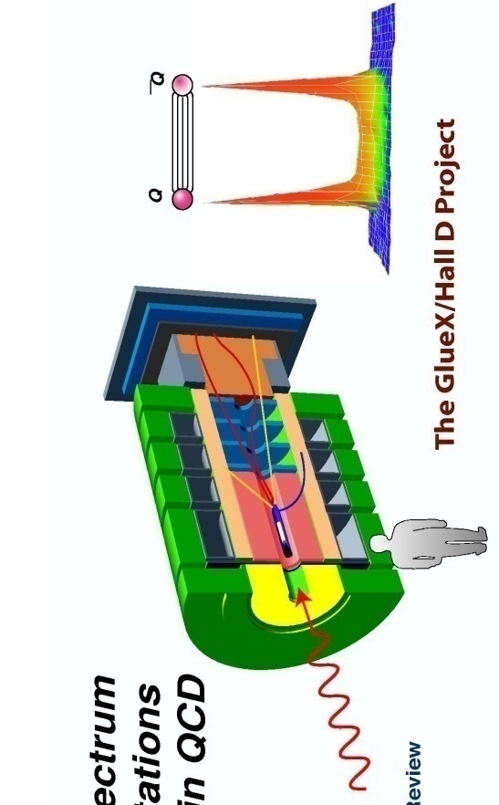
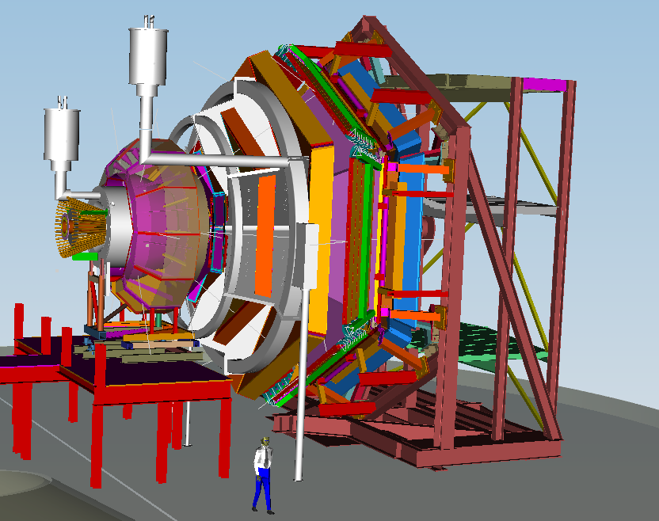
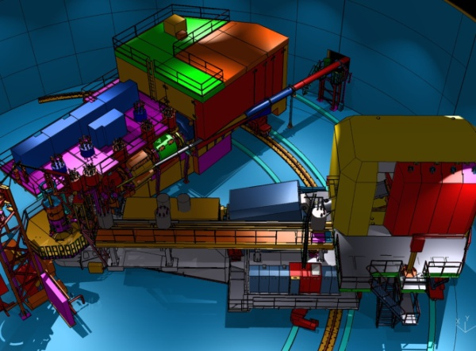
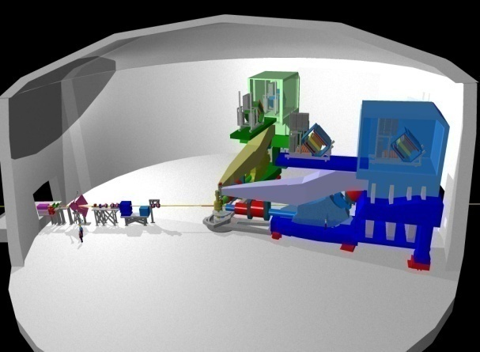
12 GeV Scientific Capabilities
Hall D – exploring origin of confinement by studying exotic mesons
Hall B – understanding nucleon structure via generalized parton distributions
Hall C – precision determination of valence quark properties in nucleons and nuclei
Hall A – short range correlations, form factors, hyper-nuclear physics, future new experiments (e.g., PV and MOLLER)
Notes:
13
Note BSM not included in project

Slide 14
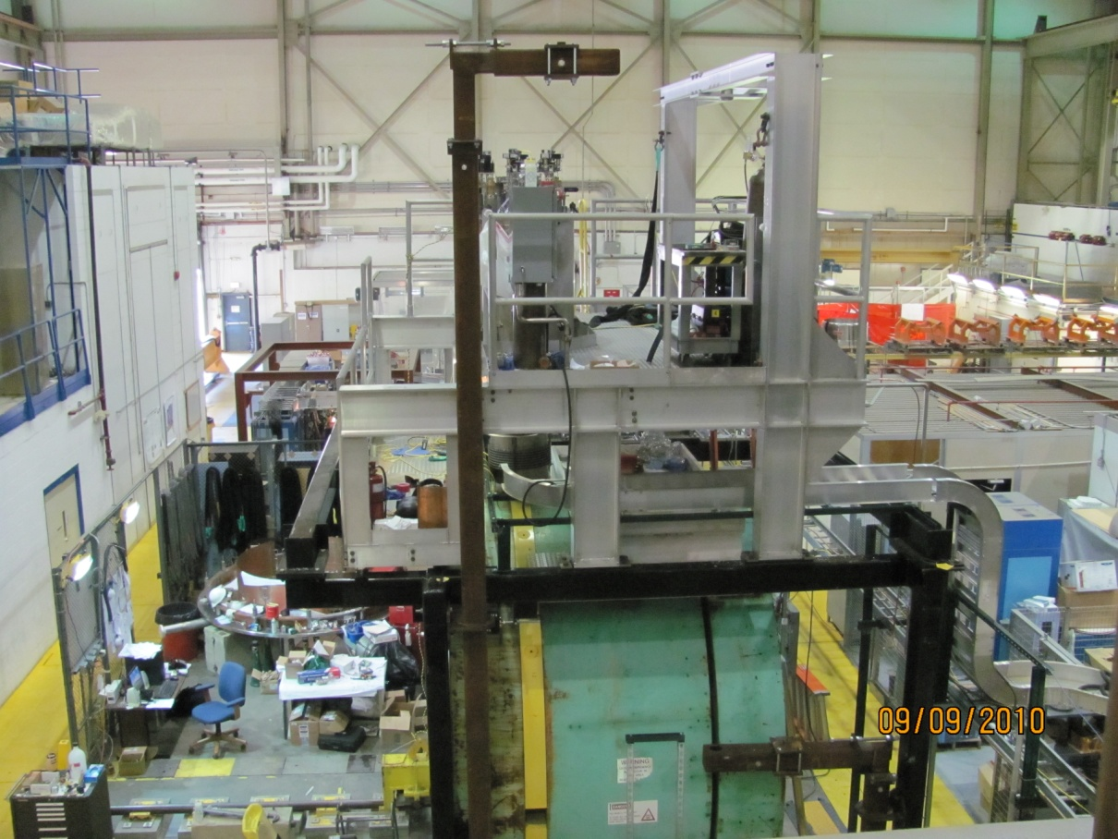
Hall D Solenoid Test
Coil 1 test at 1200A 
Coil 4 test at 1500A 

Slide 15
PAC 12 GeV Science Categories
The Hadron spectra as probes of QCD
(GlueX and heavy baryon and meson spectroscopy)
The transverse structure of the hadrons
(Elastic and transition Form Factors)
The longitudinal structure of the hadrons
(Unpolarized and polarized parton distribution functions)
The 3D structure of the hadrons
(Generalized Parton Distributions and Transverse Momentum Distributions)
Hadrons and cold nuclear matter
(Medium modification of the nucleons, quark hadronization, N-N correlations,
hypernuclear spectroscopy, few-body experiments)
Low-energy tests of the Standard Model and Fundamental Symmetries
(MOLLER, PVDIS, PRIMEX, …..)

Slide 16
12 GeV Approved Experiments by Physics Topics
 | Topic | Hall A | Hall B | Hall C | Hall D | Total
 | The Hadron spectra as probes of QCD (rated) (GluEx and heavy baryon and meson spectroscopy) |  | 1 |  | 1 | 2
 | The transverse structure of the hadrons (rated) (Elastic and transition Form Factors) | 4 | 2 | 3 |  | 9
 | The longitudinal structure of the hadrons (rated) (Unpolarized and polarized parton distribution functions) | 2 | 2 | 4 |  | 8
 | The 3D structure of the hadrons (unrated) (Generalized Parton Distributions and Transverse Momentum Distributions) | 3 | 8 | 4 |  | 15
 | Hadrons and cold nuclear matter (rated) (Medium modification of the nucleons, quark hadronization, N-N correlations, hypernuclear spectroscopy, few-body experiments) | 1 | 2 | 5 |  | 8
 | Low-energy tests of the Standard Model and Fundamental Symmetries (rated at PAC 37) | 2 |  |  | 1 | 3
 | TOTAL | 12 | 15 | 16 | 2 | 45

Slide 17
 | Topic | Hall A | Hall B | Hall C | Hall D | Total
 | The Hadron spectra as probes of QCD (rated) (GluEx and heavy baryon and meson spectroscopy) |  | 119 | 0 | 120 | 239
 | The transverse structure of the hadrons (rated) (Elastic and transition Form Factors) | 144 | 70 | 168 |  | 382
 | The longitudinal structure of the hadrons (rated) (Unpolarized and polarized parton distribution functions) | 65 | 120 | 118 |  | 303
 | The 3D structure of the hadrons (unrated) (Generalized Parton Distributions and Transverse Momentum Distributions) | 225 | 891 | 134 |  | 1250
 | Hadrons and cold nuclear matter (rated) (Medium modification of the nucleons, quark hadronization, N-N correlations, hypernuclear spectroscopy, few-body experiments) | 5 | 100 | 139 |  | 244
 | Low-energy tests of the Standard Model and Fundamental Symmetries (to be rated at PAC 37) | 513 |  |  | 79 | 592
 | TOTAL | 952 | 1300 | 559 | 199 | 3010
 | Days in red are the requested days to be reviewed at PAC38
12 GeV Approved Experiments by PAC Days

Slide 18
PAC38
Scheduled for week of August 22, 2011
Consider new proposals and letters of intent
Complete “grading” by rating 11 previously approved proposals in the category:
The 3D structure of the hadrons

Slide 19
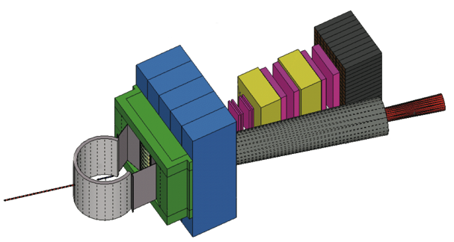
Super Bigbite Spectrometer (SBS) in Hall A
Third tracker
Second tracker
Hadron calorimeter
First tracker
Vacuum snout
Scattering chamber
Beam line Pb shield
CH2 analyzer
Beam
48D48 magnet
Magnetic shield
MIE funding proposal submitted

Slide 20
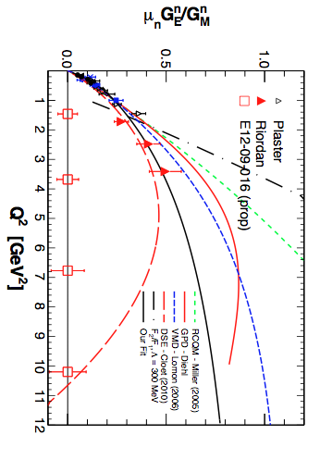
SBS: Extension GE^{n} to High Q²
The dramatic turnover of the Argonne DSE model would be clearly visible.
If the turnover is seen, it would provide strong evidence for the importance of diquark degrees of freedom in the nucleon form factors.

Slide 21
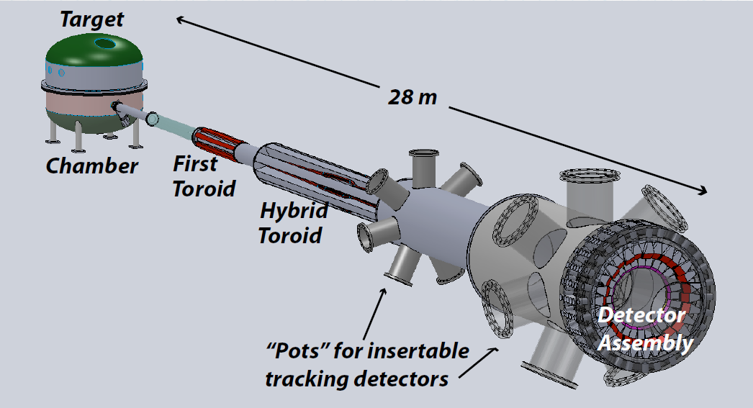
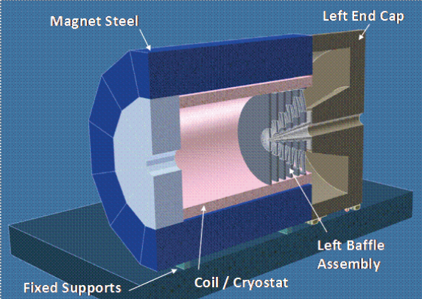
MOLLER & Deep Inelastic Scattering Parity Violation in Hall A
Dedicated MOLLER Experiment
(successor to SLAC E158)
DOE MIE proposal → CD-0
SoLID (solenoidal large intensity device):
general purpose deep inelastic parity violating experiment with solenoid
Chinese contribution
Notes:
Low Energy Tests of the Standard Model and Fundamental Symmetries

Slide 22
SoLID Developments
Solenoid options
- Babar
- CDF
- ZEUS
- CLEO
- Spare Hall D
- New Procurement?
Chinese collaboration
- Participation in exptal program
- GEM detectors
DOE – funding scenario, MIE
- should consider a meeting with DOE, Jlab mgmt, and
collaboration leaders in the near future.

Slide 23
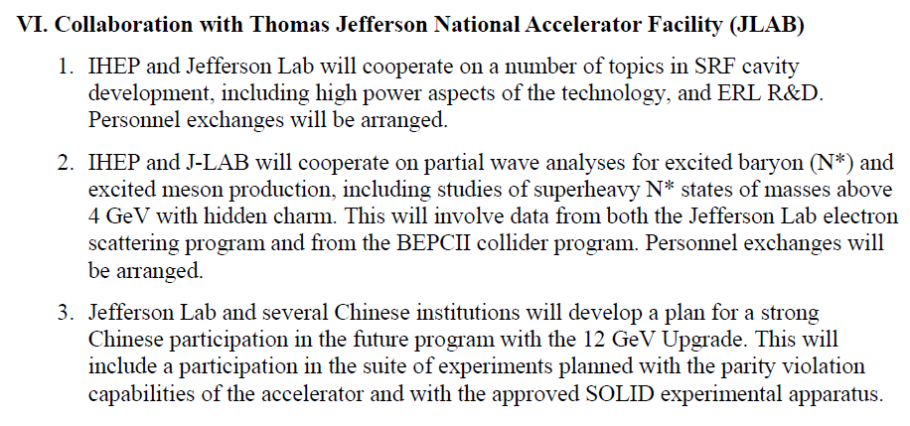
Chinese Collaboration
Visibility @ US-China meeting in November
From minutes:

Slide 24
Chinese Collaboration
Support and encouragement from Wenlong Zhan, VP Chinese Academy of Sciences
MOST 973 Proposal under preparation
- CIAE (lead), USTC, Tsinghua, Beijing, …
“International Collaboration” Proposal also
in progress
- USTC (leader), …

Slide 25
Outlook for 12 GeV Era
Physics program is well developed and expanded
“Beyond Standard Model” program is growing
  Parity violation
  New gauge boson searches
Construction Project is on track, including TEDF
New equipment requirements (Hall A)
  Super Bigbite Spectrometer (SBS)
  MOLLER
  SoLID

Slide 26
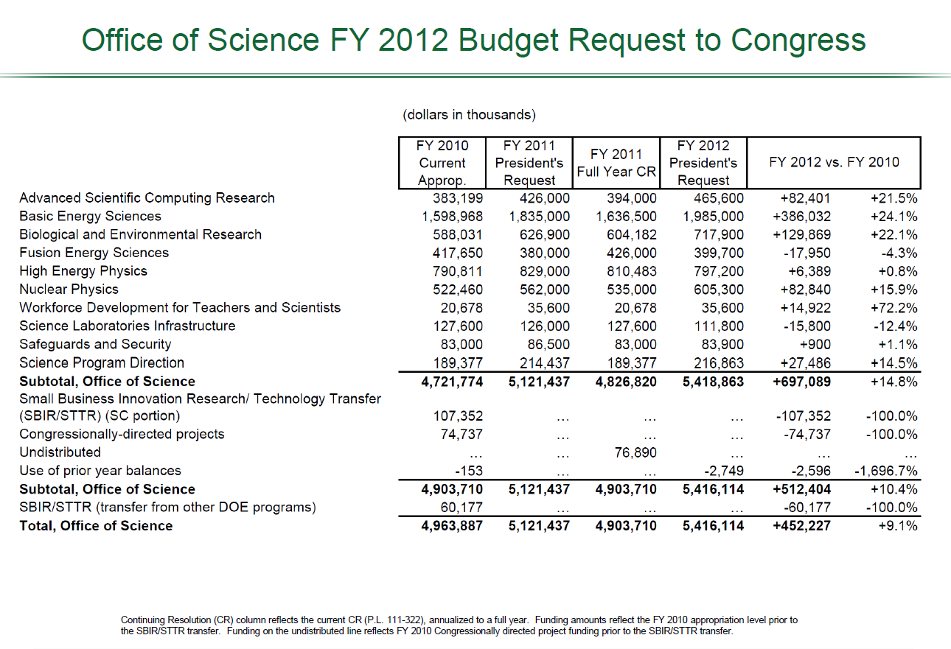

Slide 27
FY11 Budget Situation
House bill HR1 contains $1.1B cut in DOE Office of Science for remainder of year
This implies a ~15% annual reduction or ~30% for the remainder of FY11
This would be a major disruption with significant impact on our staff and projects (already some press coverage)
We continue to monitor the situation and are hopeful that the actual budgets for the remainder of FY11 will have a manageable impact on Jlab and the 12 GeV upgrade

