Slide 1
GEM/MRPC/Chinese Collaboration
Haiyan Gao
Duke University
March 25, 2011

Slide 2
E-10-006: Update to PR-09-014 (PAC35)
Nucleon Transversity at 11 GeV Using a Polarized ³He Target and SOLid in Hall A
Peking U., CalState-LA, CIAE, W&M, Duke, FIU, Hampton, Huangshan U.,
Cagliari U. and INFN, INFN-Bari and U. of Bari, INFN-Frascati, INFN-Pavia,
Torino U. and INFN, JLab, JSI (Slovenia), Lanzhou U, LBNL, Longwood U,
LANL, MIT, Miss. State, New Mexico, ODU, Penn State at Berks, Rutgers,
Seoul Nat. U., St. Mary’s, Syracuse, Tel aviv, Temple, Tsinghua U, UConn,
Glasgow, UIUC, Kentucky, Maryland, UMass, New Hampshire, USTC, UVa
and the Hall A Collaboration
Strong theory support, Over 130 collaborators, 40 institutions,
8 countries, strong overlap with PVDIS Collaboration
(
New since PAC35
Shangdong University, Huazhong Univ. of Science and Technology, Inst. of Modern Physics of CAS

Slide 3
Responsibilities
CO₂ gas Cerenkov detector: Temple U.
Heavy Gas Cerenkov: Temple U.
ECal: W&M, UMass, JLab, Rutgers, Syracuse
GEM detectors:UVa, Miss State, W&M, Chinese Collaboration (CIAE, Huangshan U, PKU, LZU, Tsinghua, USTC), UKY, Korean Collaboration (Seoul National U)
Scintillator: Chinese Cobllaboration, Duke
MRPC: Tsinghua Univ., Duke
Electronics: JLab
DAQ: LANL, UVa and JLab
Magnet: JLab and UMass
Simulation: JLab and Duke
Blue: common with
PVDIS
Black: part in common with
PVDIS
Red: This experiment only
Groups have experience with GEM already in China: IMP, Lanzhou U, Tsinghua U
Groups interested in GEM: USTC/Huangshan, Lanzhou U, CIAE, Shangdong U,
Tsinghua U, PKU, and IMP
USTC: detectors, electronics and readout
MRPC: Tsinghua University

Slide 4
Chinese Collaboration
Form a strong collaboration in China
Organize annual China-US hadron physics workshop, 3rd one will be in Weihai, Shangdong, China, August 8-11, 2011
(http://hepg.sdu.edu.cn/THPPC/conference/weihai2011/Home.html)
Encourage Chinese physicists to pursue their own physics interests at JLab
Communications with NSFC, CAS and MOST
Goal is to have strong joint support from CAS, NSFC and MOST
  SoLID is highlighted in the program for activities for PRC-US Cooperation in High Energy Physics (Nov 2010-Oct 2011)

Slide 5
Status on funding applications in China
National Science foundation of China (NSFC)
  Major international collaborations 2-3 M (RMB) over a period of 3-4 years, proposal by Ma and Gao submitted in March 2011
Ministry of Science and Technology (MOST)
  973 program: large scale science project over a funding period of 5 years: total ~10M (RMB), proposal to be submitted March 2011, led by CIAE
  International Collaboration (led by Zhengguo Zhao, USTC, to be submitted 2011)

Slide 6
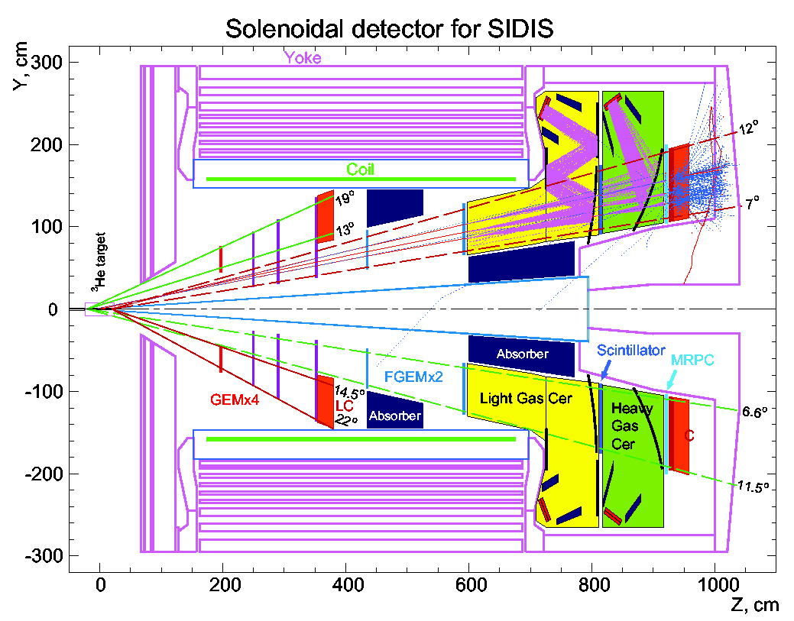
Experiment E12-10-006
(study done with CDF magnet, 1.5T)
GEMs
Study done with CDF and BarBar magnets (CDF shown here)

Slide 7
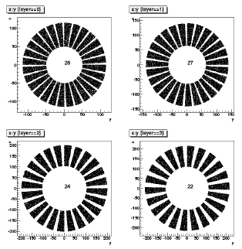
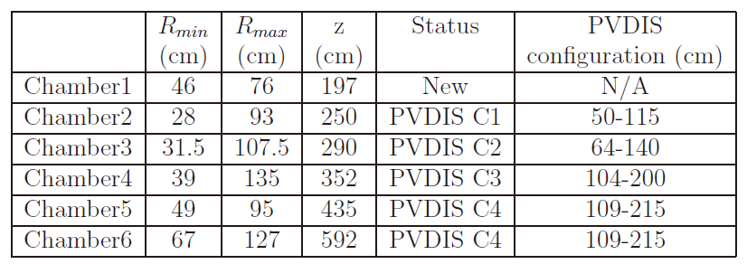
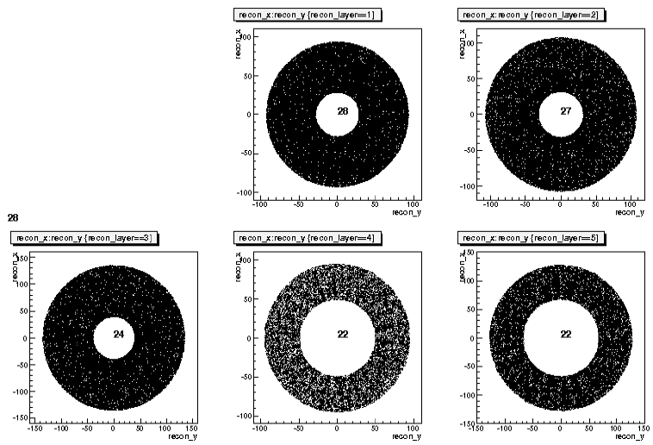
Tracking with GEM detectors
5 planes reconfigured from PVDIS GEM detectors (23 m²)
Total surface for this experiment ~ 18 m²
Need to build the first plane 1.15 m²
Electronics will be shared
PAC 34 report

Slide 8
Status on GEM
Prototypes for testing
  USTC (Wenbiao Yan, Z-G. Zhao)
  Tsinghua (Zhigang Xiao)
    Placed order with INFN on AVP FEE recently
    All other hardware components in house
    Present preliminary test results at Weihai workshop
USTC: readout electronics and detector hardware
CIAE: interest in developing and fabrication of GEM foils, and detector hardware
Tsinghua, Lanzhou U: detector hardware
See Nilanga Liyanage’s talk on GEM

Slide 9
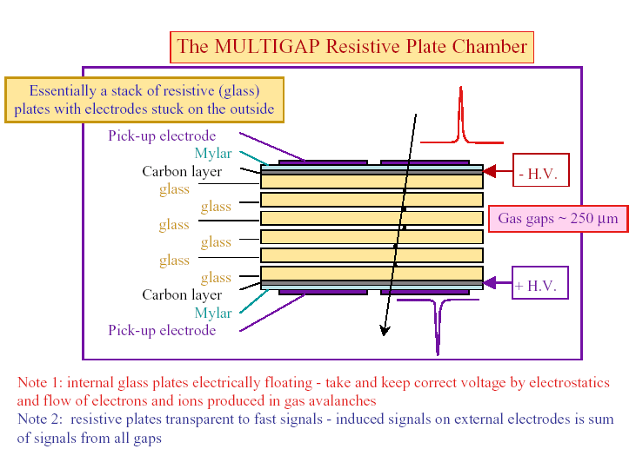
Introduction of MRPC
Large area, high granularity
Good time resolution<100ps
High efficiency> 95%
Low cost
Was used or will be used in ALICE, STAR, FOPI, HADES HARP, CBM and NICA-MPD
Slide from Yi Wang

Slide 10
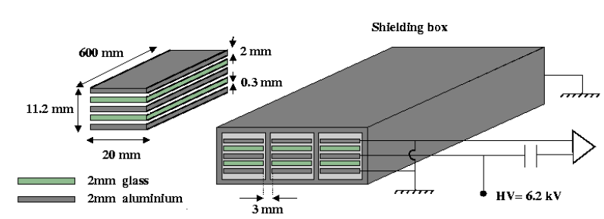
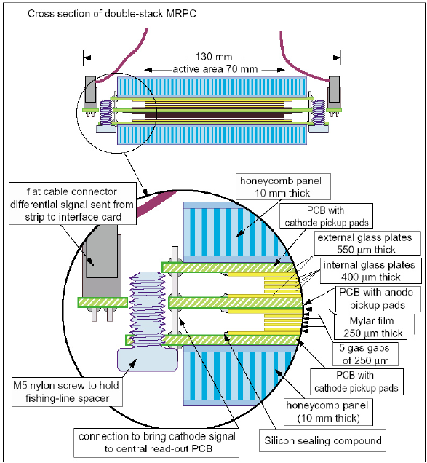
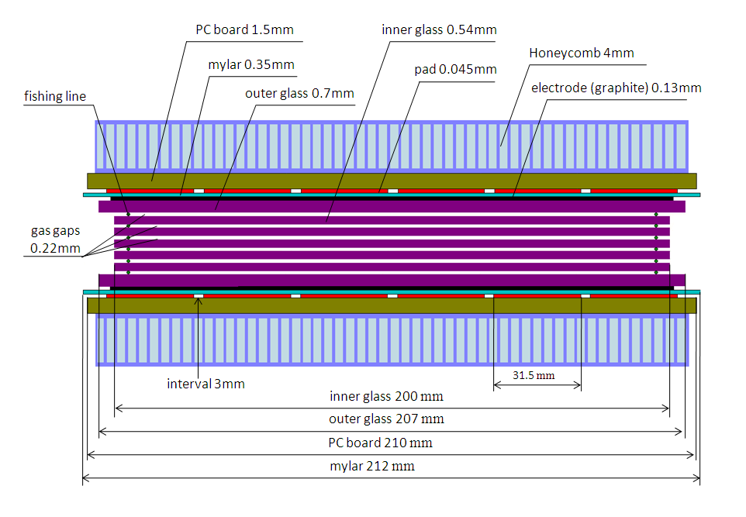
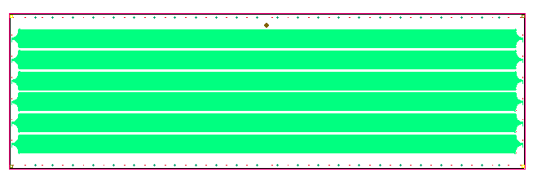
Four kinds of MRPC prototypes
4 gaps, used in HADEs-TOF
10 gaps, used in ALICE-TOF
Gap 6mm
3.8cm
6 gaps, used in STAR-TOF
90cm
6gaps, used in STAR-MTD
Slide from Yi Wang

Slide 11
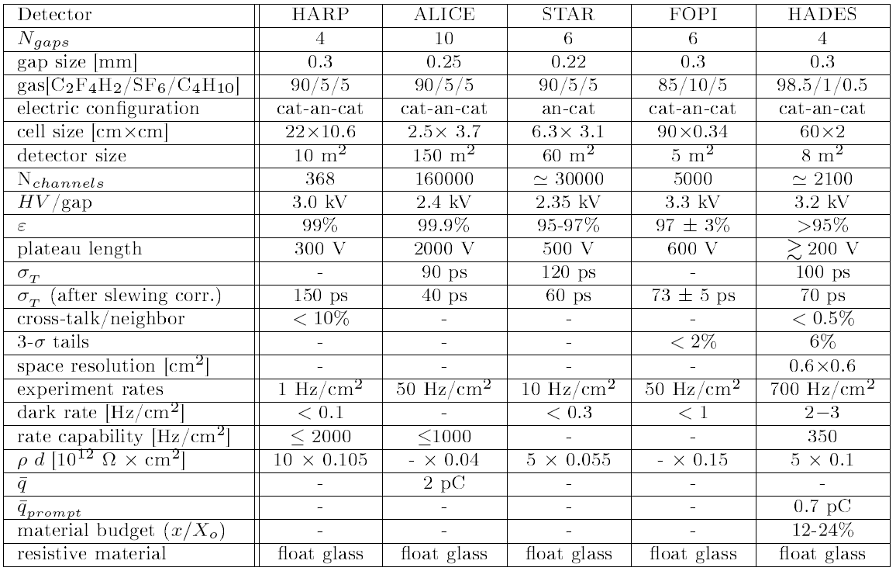
MRPCs used in hadron experiment
95/0/5
23040
Slide from Yi Wang

Slide 12
Performance of high rate MRPC
Efficiency and time resolution as a function of high voltage at a rate of about 800Hz/cm²
When the particle flux increases every 5 kHz/cm², the efficiency decreases by 1% and the time resolution deteriorates by 4 ps.
SoLID SIDIS rate estimated: 10KHz/cm²
Slide from Yi Wang

Slide 13
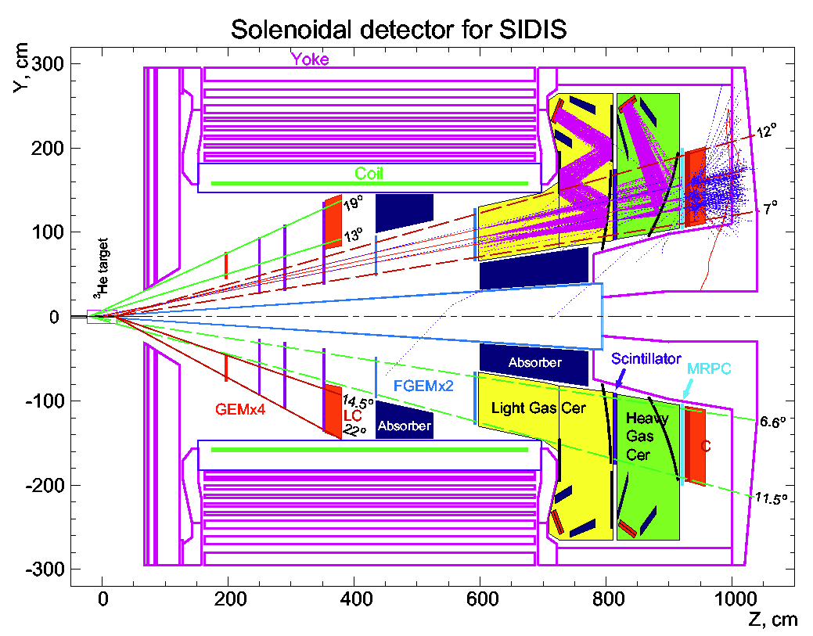
SoLID TOF
The total area with MRPC: ~8.5 m².
360 degrees starting form 105 cm to 195 cm of the radius
850 high rate MRPCs, each MRPC detector is 10 cm x 10 cm, consists of 3 readout pads. 10gaps, gap width is 0.25mm.
2550 channels
FEE
FEE
FEE
3
10
Slide from Yi Wang
30
Structure of MRPC

Slide 14
Amplifier, TDC and DAQ system
IN+
FPGA TDC
IN-
Ethernet
MRPC
CAD ASIC
DAQ Board
FEE Board
Digitizer Board
MRPC technology will be used to construct TOF. Combine ASIC FEE and FPGA TDC and Ethernet DAQ s
Slide from Yi Wang

Slide 15
Cost
Item | Cost ($)
MRPC modules | 180K
Electronics and DAQ | 250K
Total | 430K
Cost estimate from Yi Wang
MPRC prototype test plan at JLab :
Yi Wang and group will bring the prototype
detector and FEE to JLab
JLab provide additional electronics and DAQ
Test in November, 2011

