Slide 1
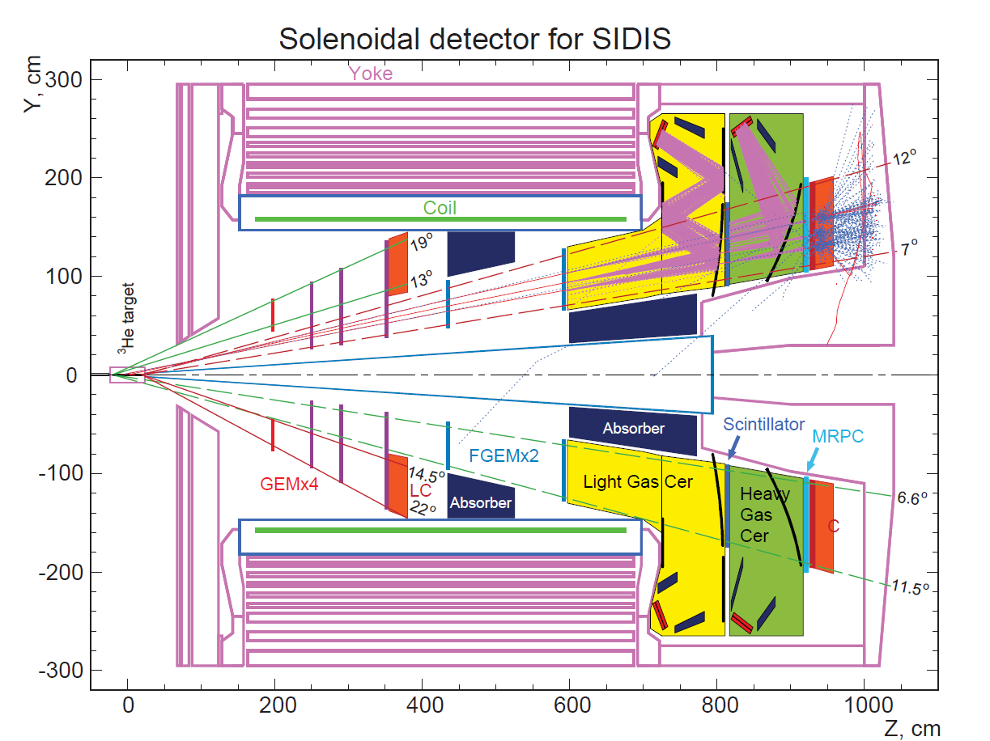

Physics Opportunities with SSA at SoLID with Transverse Polarized ³He
Xin Qian
KRL
Caltech

Slide 2
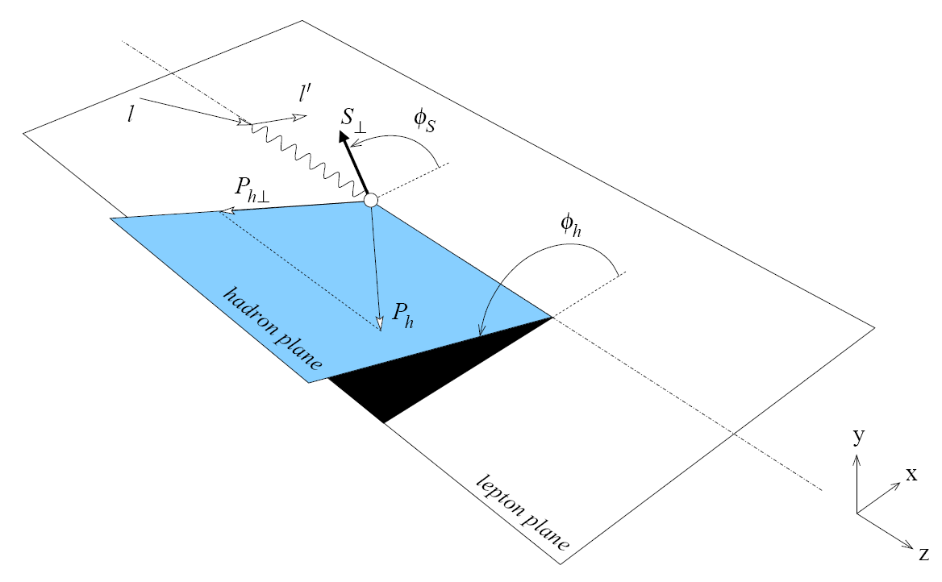
Measure Collins, Sivers and Pretzlosity Asymmetries on Neutron for pions
UT: Unpolarized lepton + Transversely polarized nucleon
Transversity

Slide 3
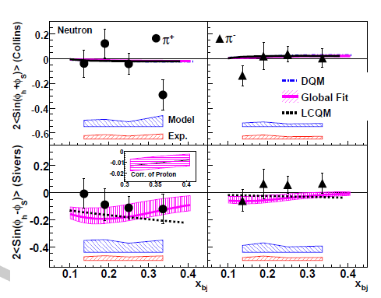
Results of 6 GeV Experiment
Large Collins asymmetry at large x for π⁺?
Negative Sivers asymmetries for π⁺
Significant contribution from model due to limited angular coverage.
Huge improvement in azimuthal angular coverage with SoLID.
Large stat. enable multi-term fitting with SoLID.

Slide 4
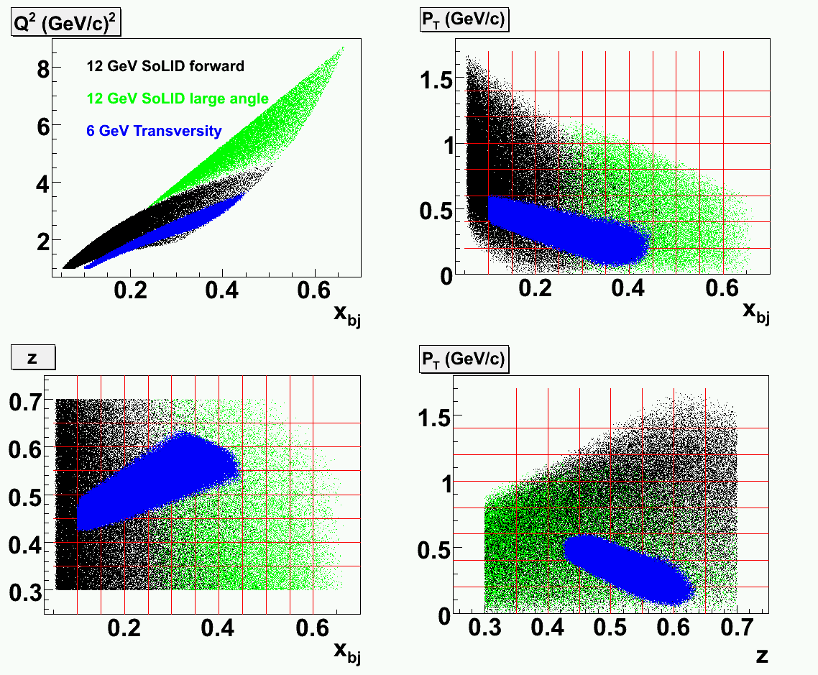
Phase Space (much large z coverage)
Low z: for target fragmentation analysis
High z: for exclusive channel, nuclear effect

Slide 5
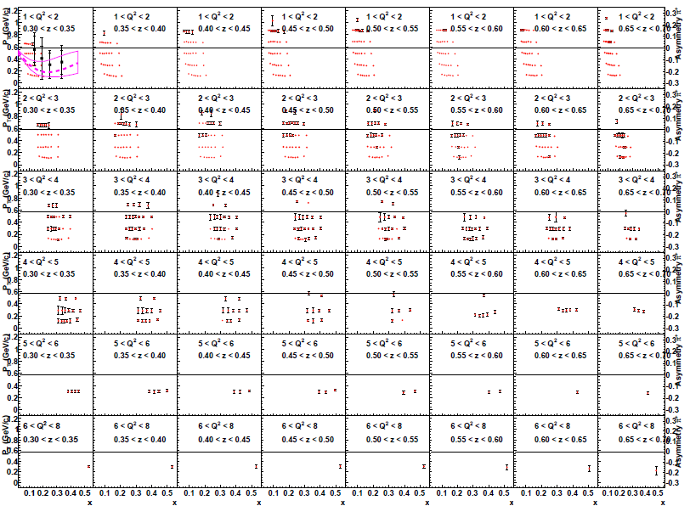
Map Collins, Sivers and Pretzlosity asymmetries in a 4-D (x, z, Q², P_{T})

Slide 6
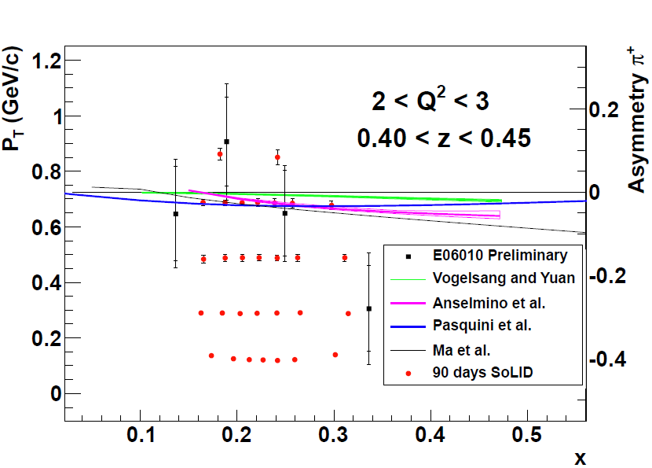
10% Measurement on d quark tensor charge

Slide 7
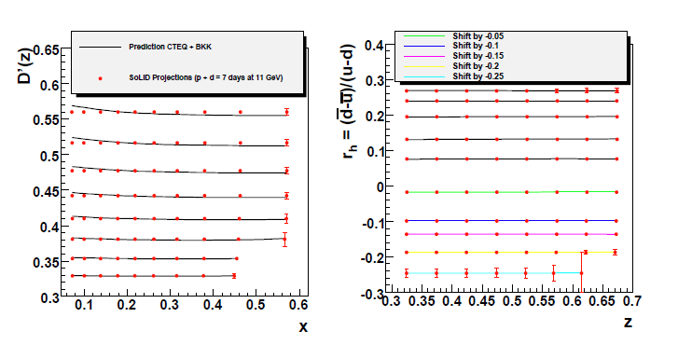
What else?
  With proton/deuteron/³He unpolarized data in a large phase space coverage.
    Understand SIDIS process itself (Factorization , P_{T} dependence)
    Understand the Nuclear effect in the light nuclei.

Slide 8
Transversity: Soffer Bound Violation?
Soffer bound: |h_{1T}| <= (f₁+g_{1L})/2
  PRL 74, 1292 (1995).
NLO QCD evolution will not break Soffer bound, if it is satisfied at one scale.
  Phys.Rev. D57 (1998) 1886
Doubts has been casted on this inequality
  J. P. Alston: arxiv:0810.0871, also spin08 talk
    “…Soffer bound on transversity is not a valid fact of QCD…”
    Understand QCD confinement through study of spin effect.

Slide 9
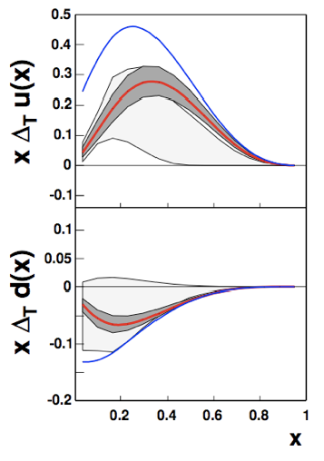
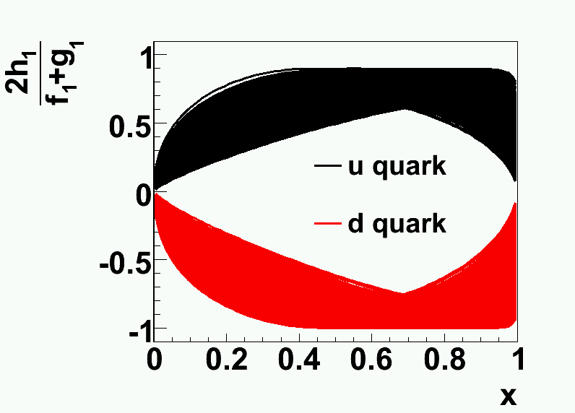
Current Knowledge (Torino)
Close to the bound, bound is required in the fit. As N_{d} = -1, current fitting favors a result violating the bound. (arxiv:0812.4366)

Slide 10
Results of 6 GeV Experiment
Large Collins asymmetry at large x for π⁺?
Negative Sivers asymmetries for π⁺
Significant contribution from model due to limited angular coverage.
Huge improvement in azimuthal angular coverage with SoLID.
Large stat. enable multi-term fitting with SoLID.

Slide 11
Test Violation of Soffer Bound
Precision measurement of Collins asymmetry at large x can provide an unique opportunity to test Soffer’s bound.
Transversity Distribution:
  Possible sign change in x dependence?
  Possible sign change in k_{T} dependence?
  10% measurement of d quark tensor charge.

Slide 12
Pretzlosity Asymmetry
Non-zero Pretzlosity require interference of LCWFs different by 2 units of OAM.
Direct measurement of relativistic effect of quark?
  PRD 78, 114024 (2008)
Direct measurement of OAM?
  PRD 58, 096008 (1998)
Spin densities, deformation of nucleon shape etc

Slide 13
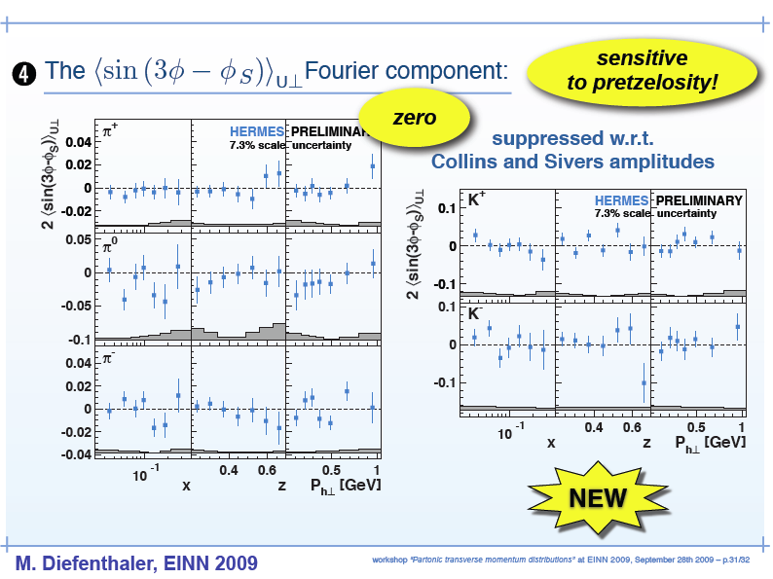
Zero so far from Experiments!

Slide 14
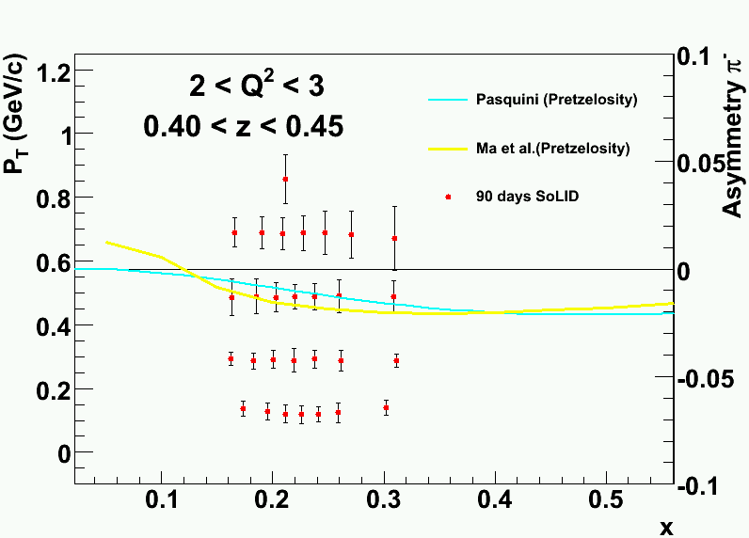
First non-zero Pretzlosity Assymetry at SoLID?

Slide 15
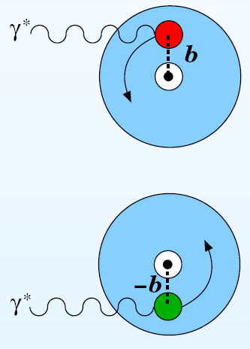
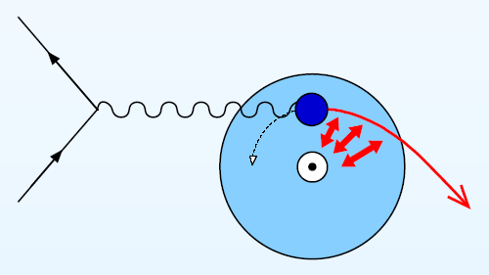
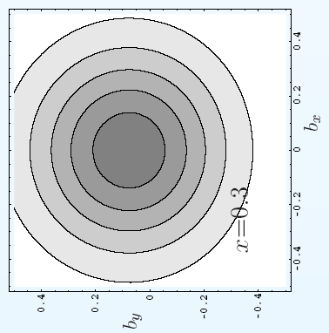
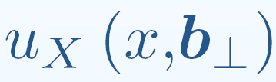
Rich Physics in Sivers Function
Correlation between nucleon spin with quark orbital angular momentum
Burkhardt :
chromodynamic
lensing
Important test for
Factorization
Final-State-Interaction

Slide 16
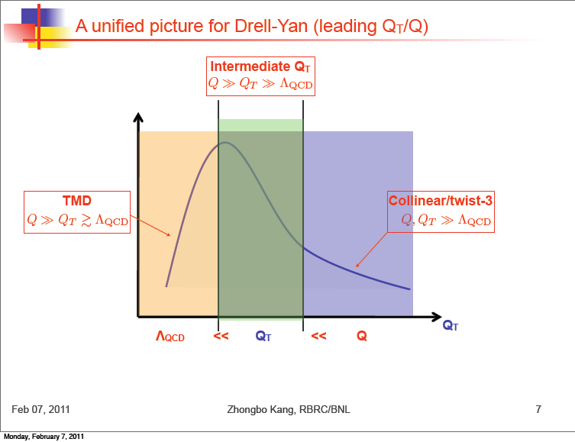
Physics at medium P_{T}

Slide 17
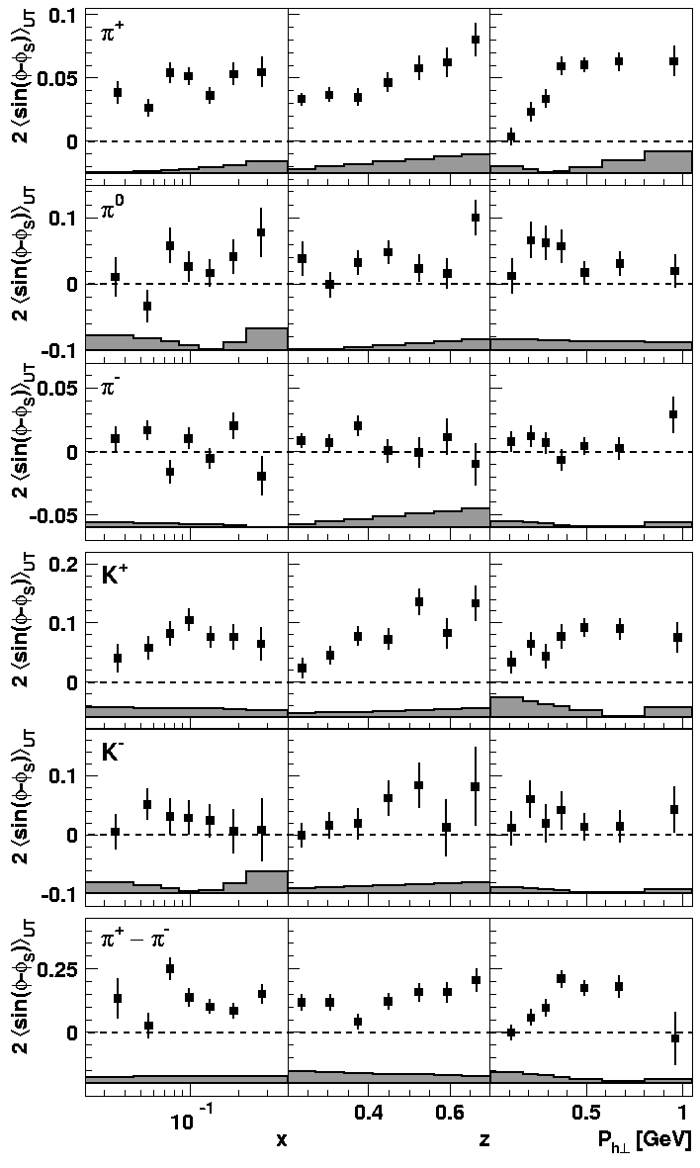
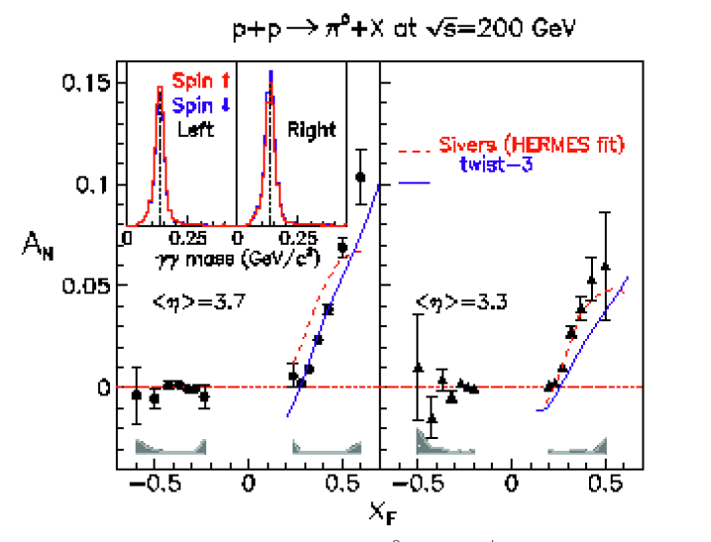

Sivers vs. Twist-3
PRL 97 082002 (2006)
SIDIS

Slide 18
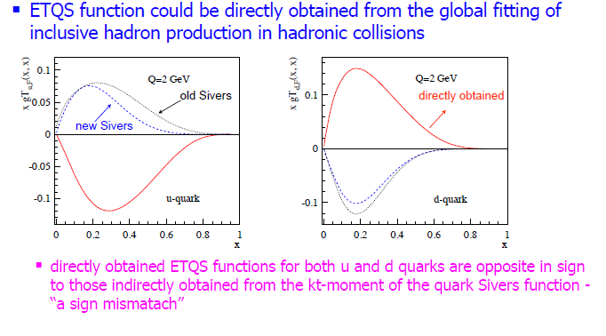
Sign Mismatch?
From Z. B. Kang

Slide 19
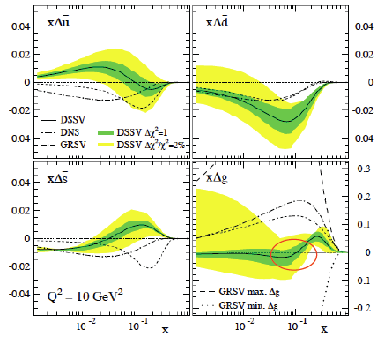
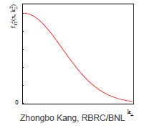
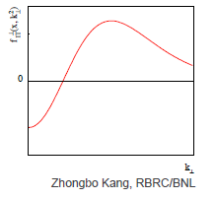
Is there a problem?
Kang, Qiu, Vogelsang and Yuan: arxiv: 1103.1591
  k_{T} dependence of Sivers function?
  A node in x, sign change of Sivers function at large x? (A. Prokudin)
  Complications in A_{N} (PDF vs. FF)
SoLID can provide some inputs to this “puzzle”!
This is not New!

Slide 20
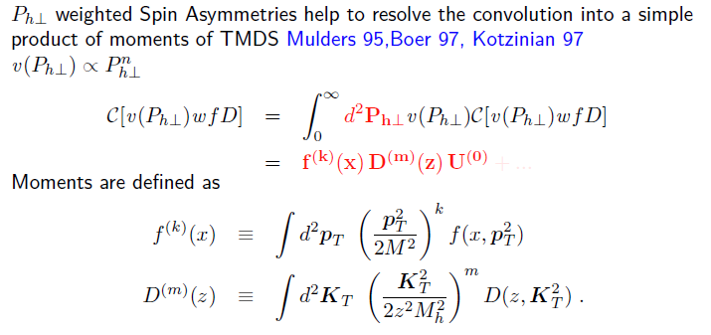
Opportunities of P_{T} Weighted Asymmetry
Large Contribution from large P_{T}
Experiment always have limited range in P_{T}
From A. Prokudin

Slide 21
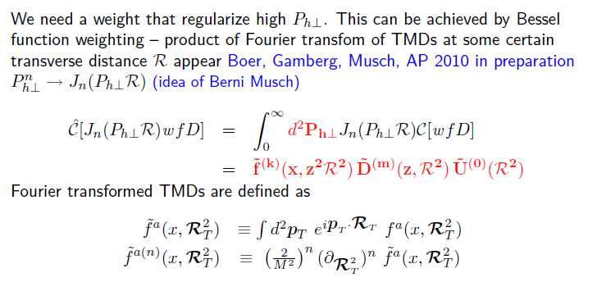
Such method will give k_{T} dependence of TMD
Require measurements on both asymmetry and unpolarized cross section.

Slide 22
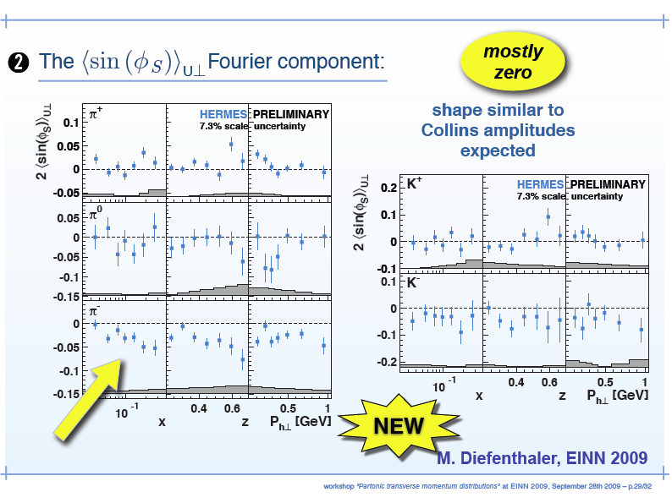
What about Higher Twist?

Slide 23
Summary
Goals of SoLID:
  4-D mapping of TSSA
  Test SIDIS factorization, PT dependence at JLab12
Selected topics covered in this talk.
  Test Soffer bound of transversity distribution!
  Non-zero pretzlosity?!
  Search for Sign change in x or k_{T} dependence of Sivers function!
  PT weighted asymmetry.
  Higher Twist measurements.
Acknowledgement: A. Prokudin, B. Musch

Slide 24
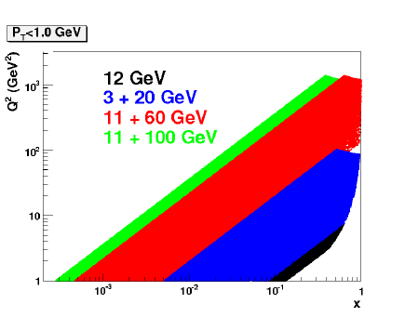
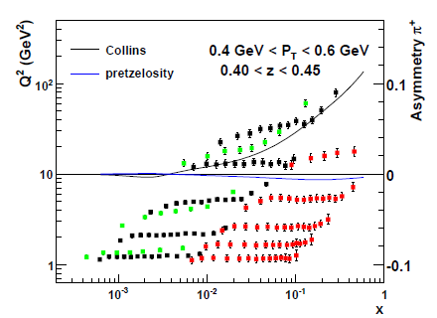
Bright Future for TMDs
Golden channel of Electron-Ion Collider
Dream!

Slide 26
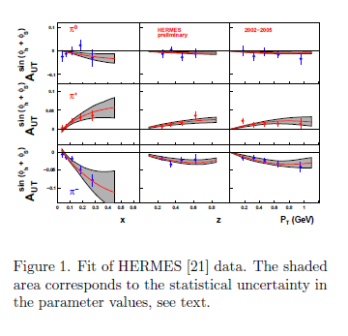
From arXiv:0812.4366

Slide 27
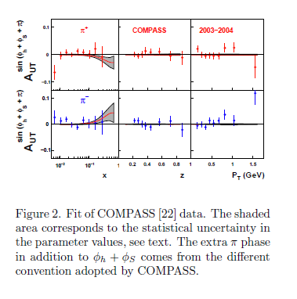
Require a sizable asymmetry due to bound.

Slide 28
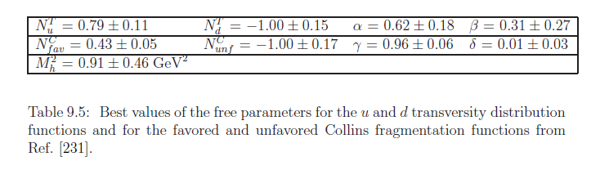
Current Knowledge (Torino)
Close to the bound, bound is required in the fit. As N_{d} = -1, current fitting favors a result violating the bound. (arxiv:0812.4366)

Slide 29
Discussion:
The theorist favor a “positive” asymmetry for deuteron, since
Proton cross section is much larger than neutron, so a zero A_{D} require a large negative A_{n}
  However, there is soffer bound, d quark transversity is already saturated in the fit.
  In addition, at our kinematics the Collins asymmetry is suppressed by about 0.5 (y~0.8 vs. y~0.54) (1-y)/(1-y+y*y/2.)=0.4 when y=0.8

Slide 30
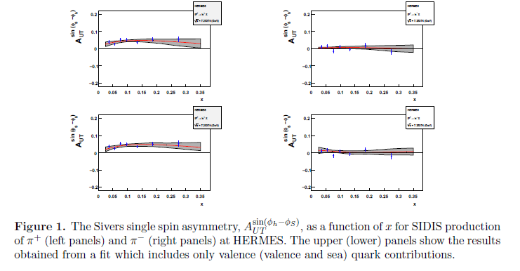
Comparison to Sivers Case
From 1012.3565

Slide 31
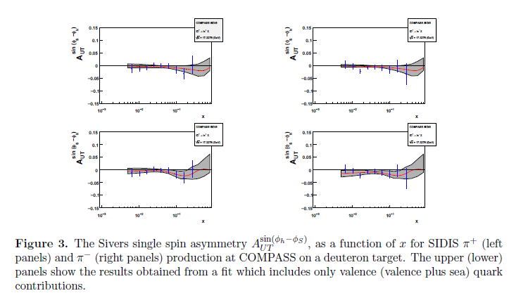

Slide 32
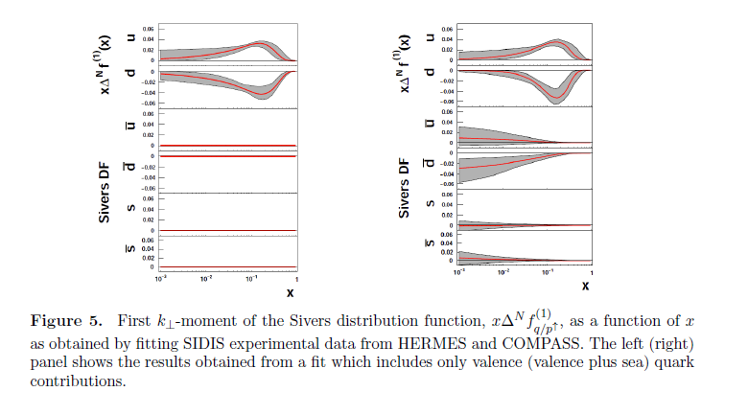
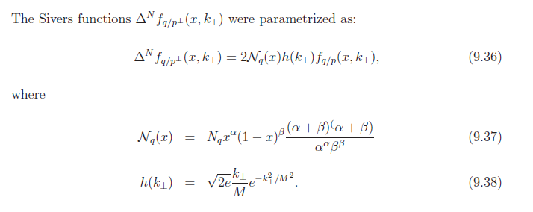
Whern there is sea, d quark Sivers is more negative.

Slide 33
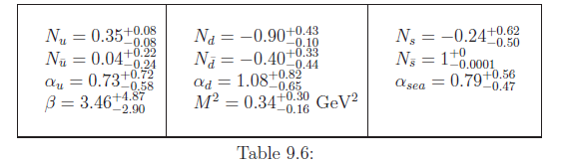
Discussion
The Sivers function is modeled directly from unpolarized cross section.
  So d quark can be larger.
  There is no Soffer bound for it.
    Or we can say the distribution is far away from the bound. (N in the following table)

Slide 34
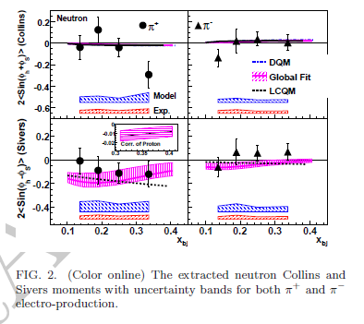
Naively
Quark distribution gives a factor of 4 (compare d/u transversity and d/u Sivers) and a factor of 0.4 from kinematics, so 2% - > 20% effect (Collins -> Sivers)

