Slide 1
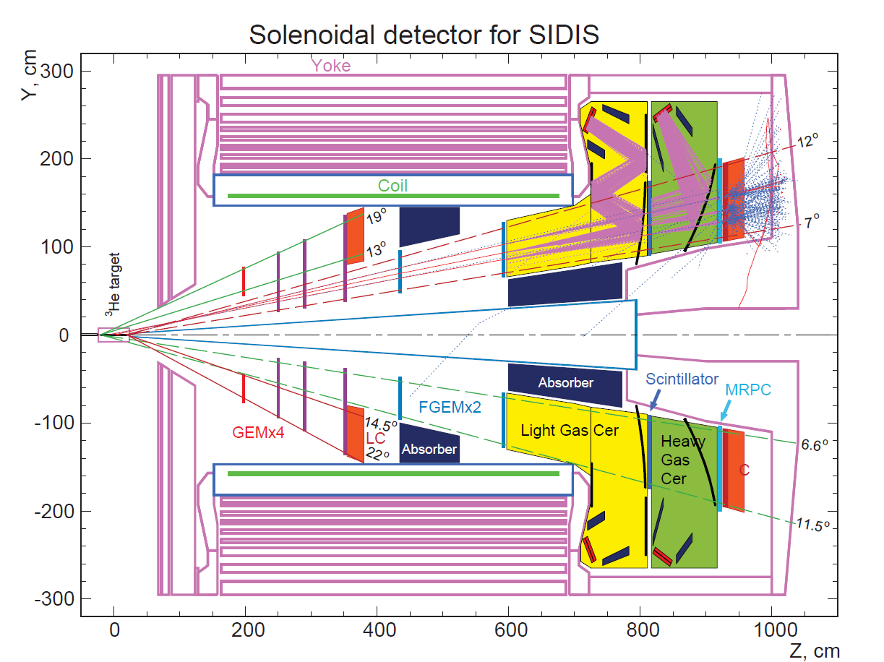

Optics, Tracking, and TOF Status/Update/Roadmap
Xin Qian
KRL
Caltech

Slide 2
Optics
Current Optics
  Is based on COMGEANT simulation with magnetic field generated by Poisson.
  is used to study the detector resolution.
  Is used in “progressive tracking”, as one needs to predict the hitting locations.
200 um GEM position resolution with u/v orientation 10º separation.
  1% momentum resolution.
  Polar angular resolution 0.3 mr.
  Azimuthal angular resolution is 5 mr.
  0.8 cm vertex resolution.

Slide 3
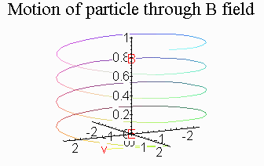
Starting Model:
Along z, the trajectory is a circle.
With Radius R, and distance along z
  One can get P_{T}/P_{L} -> polar angle
  Combine R and Magnetic field, one can get P_{T} -> Momentum
  Azimuthal angle can be determined at the point when the particles enter magnetic field + theta angle
  Vertex can be determined by
  unfolding the trajectory +
  polar angle + hit positions.

Slide 4
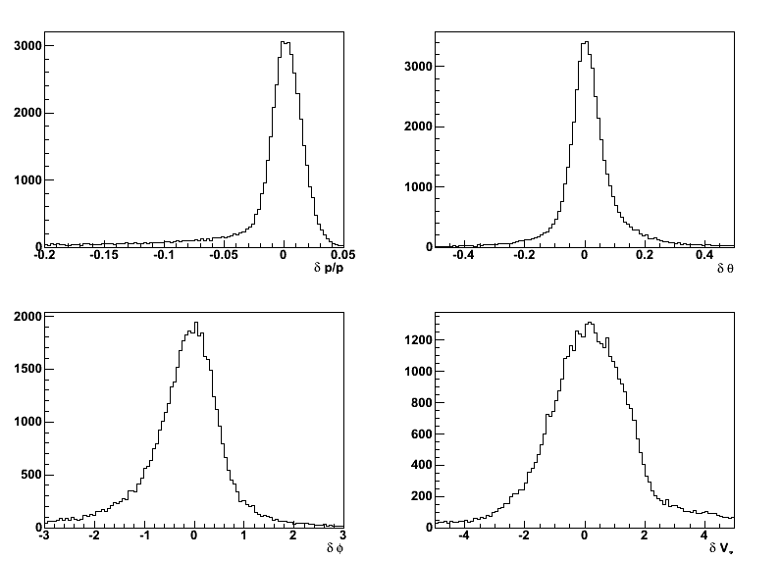
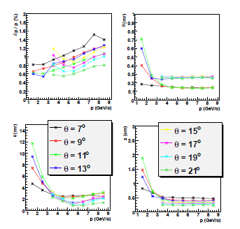
Quality of Optics
All momentum, no resolution (example)
Show that we can do reconstruction.
We know both input and output
Resolution included, optics is performed at each momentum/angle separately.

Slide 5
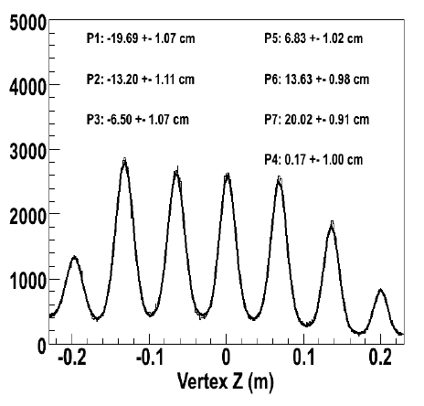
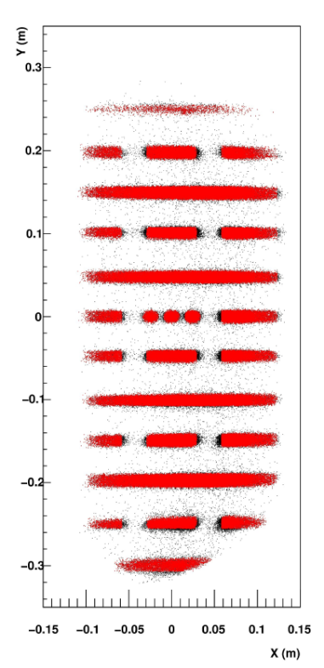
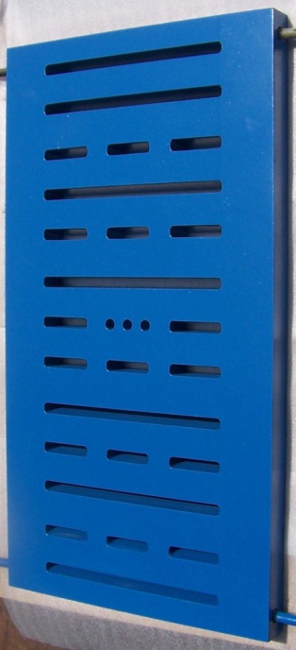
Initial Idea of Optics Calibration
Similar to BigBite:
Multi-Carbon foils
for vertex reconstruction.
Sieve for Angular calibration
e-p elastic scattering
for momentum
calibration
at 1 and 2 pass.
Need lower mag.
field setting for
SoLID
Other ideas?
BigBite Sieve Slit

Slide 6
Optics Working Plan (With Future Manpower)
Current Optics Model is good for director review etc.
Future working plan includes:
  Work out a single unified optics model for several baseline design (magnetic field, angle etc)
  Design the detailed optics working plan (beam energies/current, beam time, target, settings, and checks)
  Generate simulated data to demonstrate optics reconstruction according to optics working plan.
  We MUST achieve this before data taking, since tracking needs this information as input (online).

Slide 7
Tracking: Progressive Method
Start with one seed in the first plane.
Loop over hit in the second plane
Predict/Check hit in the next plane (combining the optics information)
  3.1 If succeed, predict/check hit in the next plane with better optics information.
  3.2 If not succeeded, go back to second step.
  Use the optics information, trajectories are closely related momentum angle etc.

Slide 8
Tracking Algorithm
5 planes in forward angle + 4 planes in large angle:
  Require 4/5 and 3/4 to increase tracking efficiency gives 6+5=11 different combinations
    separate treatments.
  Sort all the found tracks by quality of fit (can be improved):
  Ensure no hits were used twice to de-ghost the false track.
  Still need to connect final track with optics and also for TOF.

Slide 9
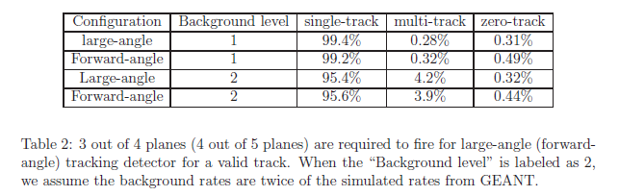
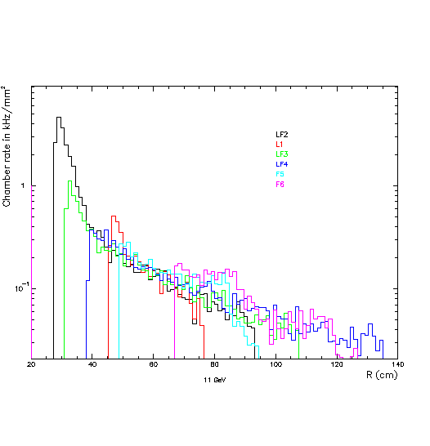
Count rate in kHz/mm²
LF3
L1
LF2
6
26
20
LF4
F5
F6
25
18
20
11 GeV, R(cm)
Multiplicity

Slide 10
Tracking Development Plan:
Major uncertainties: Background on GEM
  Need further beam test to fully understand background. Impact on
    Tracking Speed
    Number of GEM chambers (Currently 5 and 4, also hit efficiency)
  Need to work together with SBS GEM test.
Online Tracking:
  Speed: need multi-thread tracking.
  Need a Good and Quick Optics Model .
    Also Low luminosity run + event display
  A good student with great computer skill can help on this part.

Slide 11
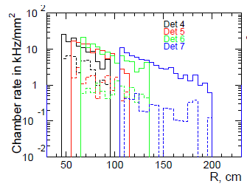
PVDIS Tracking
Condition:
  COMGEANT simulation based on realistic magnetic field simulation (energy loss included)
  200 um smearing of position in GEMs
  Background added from
  simulation. (50 ns TDC window)
  Add in false hit based
  on 10 degree strip
  separation.
  Factor of 4 reduction
  assumed for false hits.
  98% hitting efficiency

Slide 12
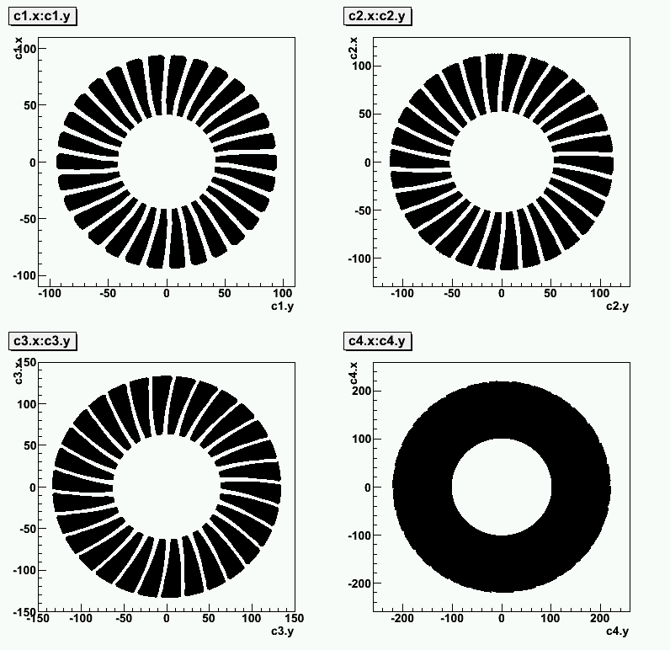
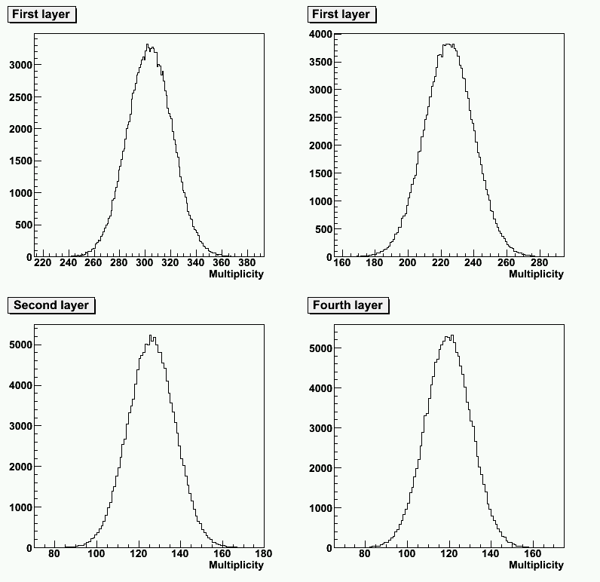
Illustration

Slide 13
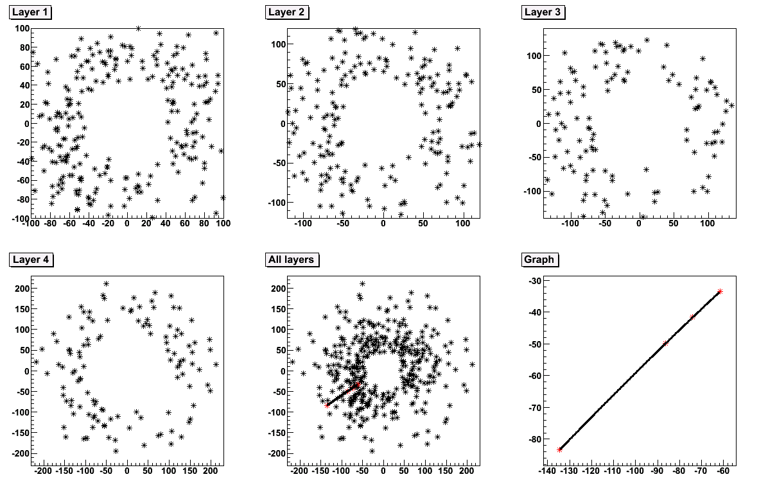
Event Display

Slide 14
Tracking Algorithm
Similar to that of SIDIS
  Progressive Search (coarse search)
  Four planes: require ¾ or 4/4 to compare (5 methods)
  Use optics information to reduce false track (fine search)
  Final step to de-ghost the tracks
  total 50000 tracks
  No fine tuning yet due to limited time.
  Code available @ /w/work5602/transversity/xqian/PVDIS_tracking @ central disk.

Slide 15
Results (50000 events, 92% for 4/4)
Conf. | Coarse (Single/Multiple) | Fine (Single/Multiple) | 4/4 (Coarse) (Single/Multiple) | 4/4 (Fine) (Single/Multiple)
No BG 100% eff. | 99.30%/- | 99.16%/- | 95.3%/- | 89.0%/-
Track With BG 98% eff PVDIS BG | 82.8/16.3% 2532s | 86.9/11.6% 2496s | 88%/- 797s | 82.1%/- 785s
Only BG 98% eff PVDIS BG | 14.5/1.5% 2488s | 10/0.3% 2520s | -/- 770s | -/- 704s
65% for 4/4 at 90% hitting efficiency.

Slide 16
Discussion
Motivation:
  to demonstrate the principle of tracking and give the preliminary requirement for GEM trackers
  No fine tuning at this point for optics etc
  Speed is slow
    Can use multi-thread
    Can use calorimeter to significantly reduce speed (/30 for sectors) and provide redundancy to eliminate false track.
Observation:
  Without Background, tracking efficiency is very high.
  With Background, need at least 4 planes to reduce multi-tracks.
  Four GEM planes is not enough (At least five?)

Slide 17
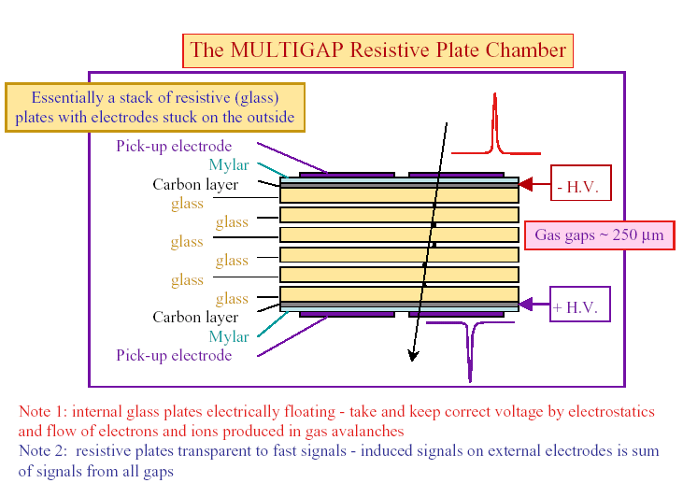
Time-of-Flight (TOF)
Large area, high granularity. Good time resolution<100ps
High efficiency> 95% .Low cost

Slide 18
Background Rates
@GSI
Predicted rate
SoLID @ JLab12

Slide 19
TOF Requirement
Goal: 20:1 kaon rejection up to 2.5 GeV/c
~ 9 m, flight path
  0.55 ns separation @ 2.5 GeV/c
  Considering tail: requiring about 100 ps (200 ps with a gaussain)
BaBar: 7m, with same requirement, need <75 ps (150 ps). Will need to improve the tail with better optics, tighter TOF cut

Slide 20
Naïve Estimation:
0.8 cm vertex resolution
0.3 mr polar angular resolution
5 mr polar angular resolution
9 m flight distance
4m distance outside field
80 ps at c gives 2.4 cm on travel length.
It is possible to reach the desired TOF resolution

Slide 21
TOF Developing Roadmap:
MRPC Design for SoLID:
  Beam test on MRPC to demonstrate rate limit.
  Also beam test for background prediction.
  How to Eliminate Gap?
  Electronics integration (DAQ)
Goal TOF resolution: 100 ps
  Intrinsic resolution capable of 40~ 60 ps.
    Determine the cell size
  Need to study the path length correction in simulation together with optics to determine what is the limit in TOF

Slide 22
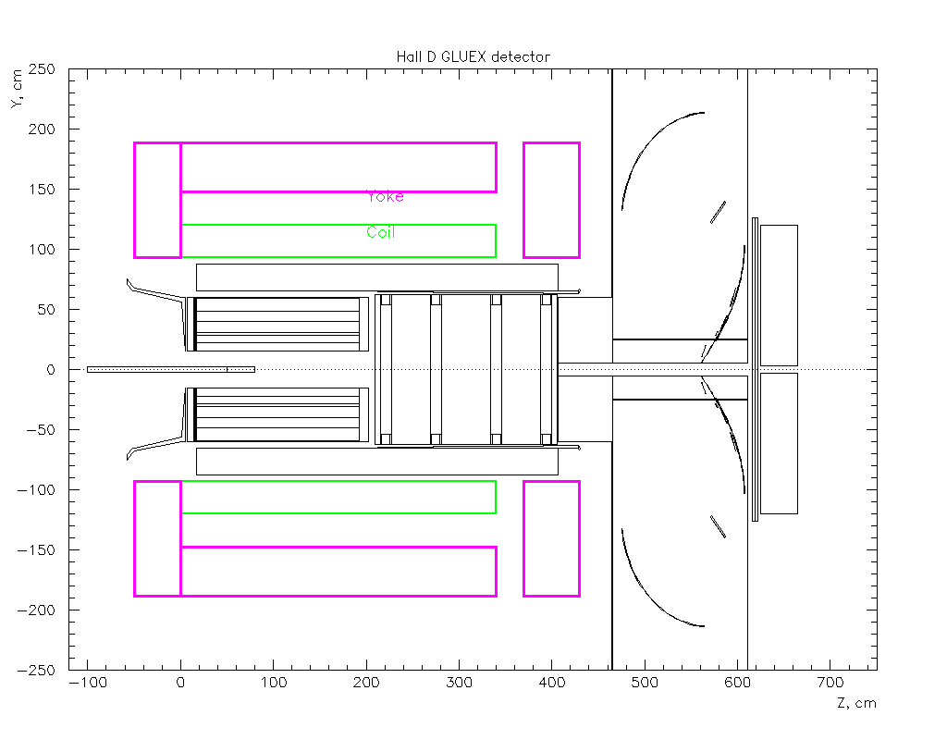
Hall D Magnet Study (Preliminary)
The uniformity of magnetic field is not a big issue for SIDIS
The strength of the integrated BdL will be related to the momentum resolution.
Current number: 90 cm radius x 340 cm length
  Similar ratio of CDF magnet 150 cm radius x 550 cm.
  Similar size to ZEUS: 86 cm radius x ~ 300 cm length
Things not likely to be changed:
Distance between target and magnet
Length of calorimeter, gas Cerenkov detectors.
TOF are needed, so the distance between MRPC and target.
BABAR and CLEO Magnet can work for SIDIS
CDF will give slightly worse phase space, but can work too.
ZEUS and Hall D are similar,
Probably ZEUS will give a better phase space?

Slide 24
Discussion
Most of forward angle detectors will be ok.
  Largest limitation will be on the yoke, need to have enough room to hold the detectors.
  Background will not change much.
Will phase space got affected?
  Depending on the thickness of front york (also back)
  Shorter target, but higher density to improve the phase space?
  Slightly shorter magnet possible?
Current design of large angle detector will not work.
  Need new design for GEMs and large angle calorimeter (barrel shape for both)

