Slide 1
EC Forward Angle
Zhiwen Zhao
UVa
2011/03/25

Slide 2
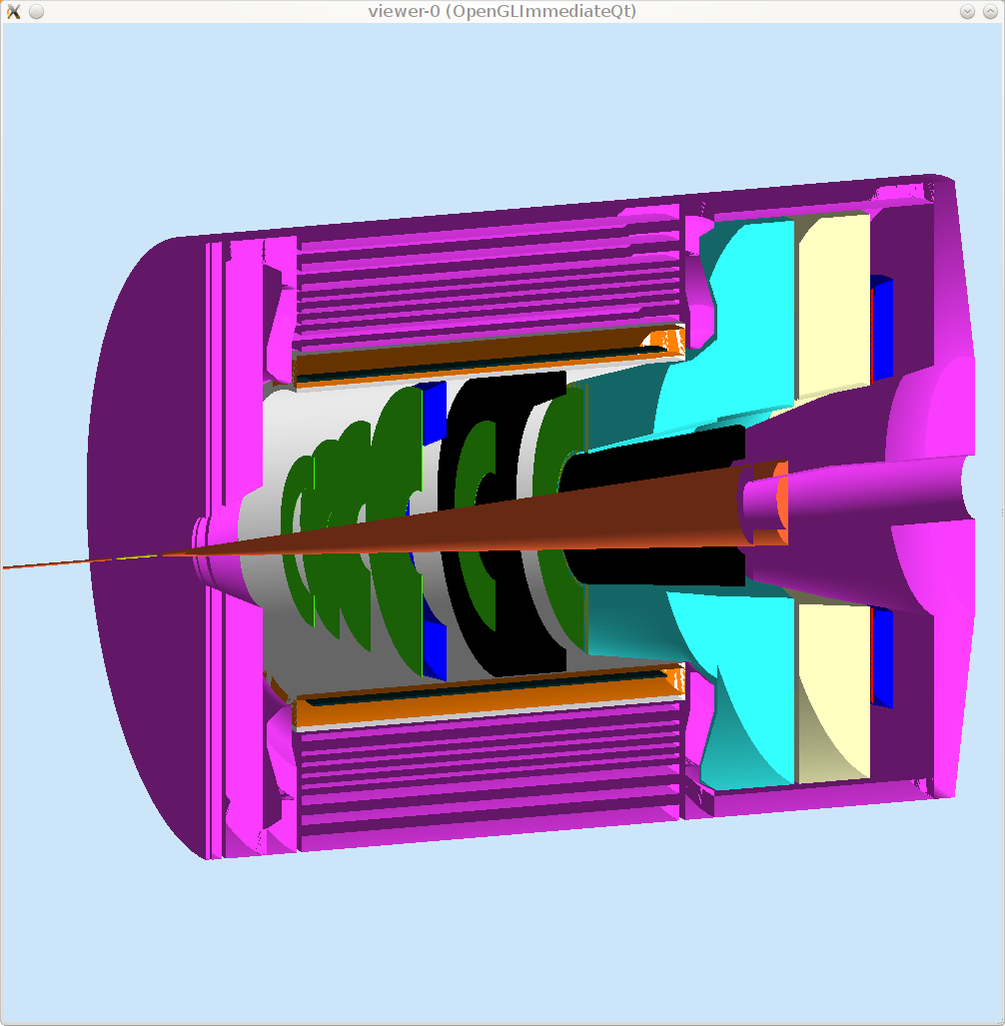
EC forward angle

Slide 3
Requirement
PVDIS rate 2000GeV/cm2/s, 60krad/year
SIDIS rate 500GeV/cm2/s, 15krad/year
Resultion
Pion rejection 200:1 at E > 3.5 GeV, 100:1 at E > 1.0 GeV
Fast time response, provide a trigger
Good position resolution for tracking

Slide 4
The Menu
Lead glass (can’t hold such radiation)
Shashlyk
SciFI

Slide 5
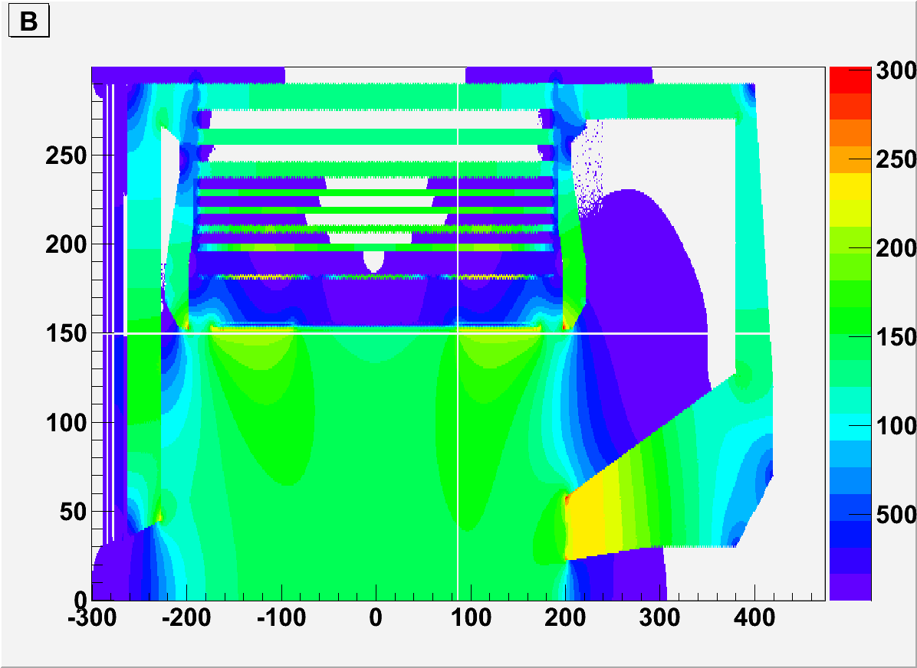
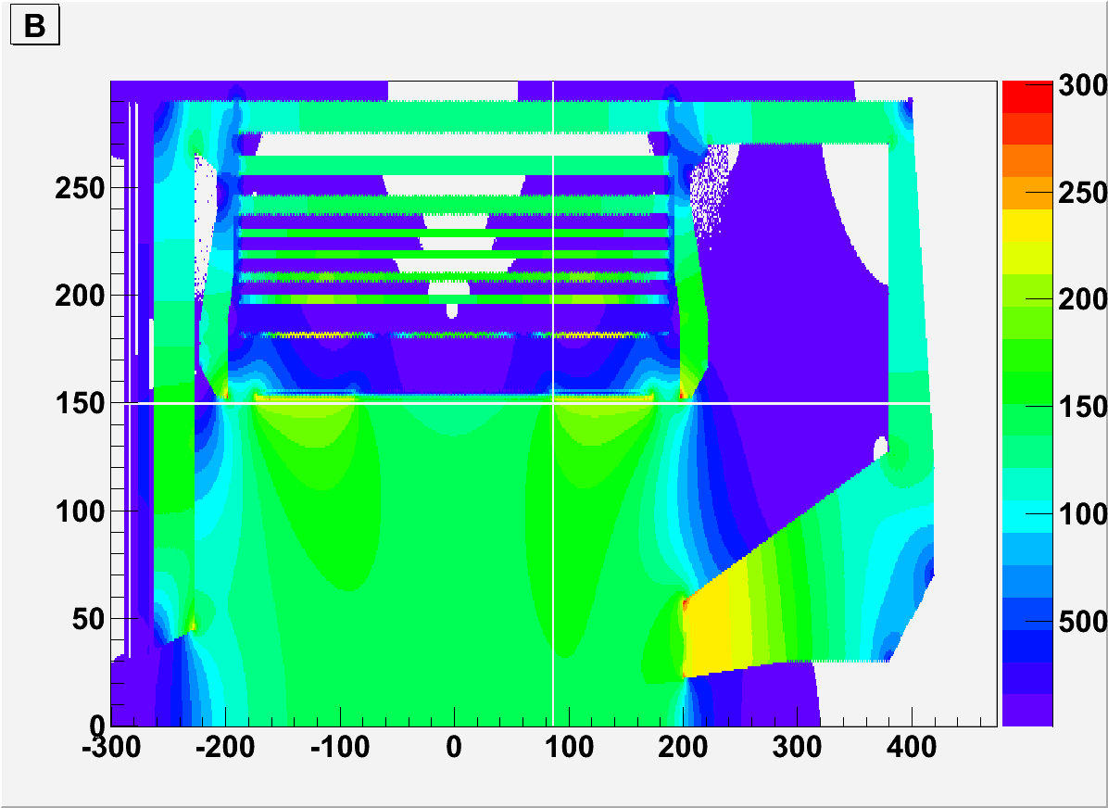
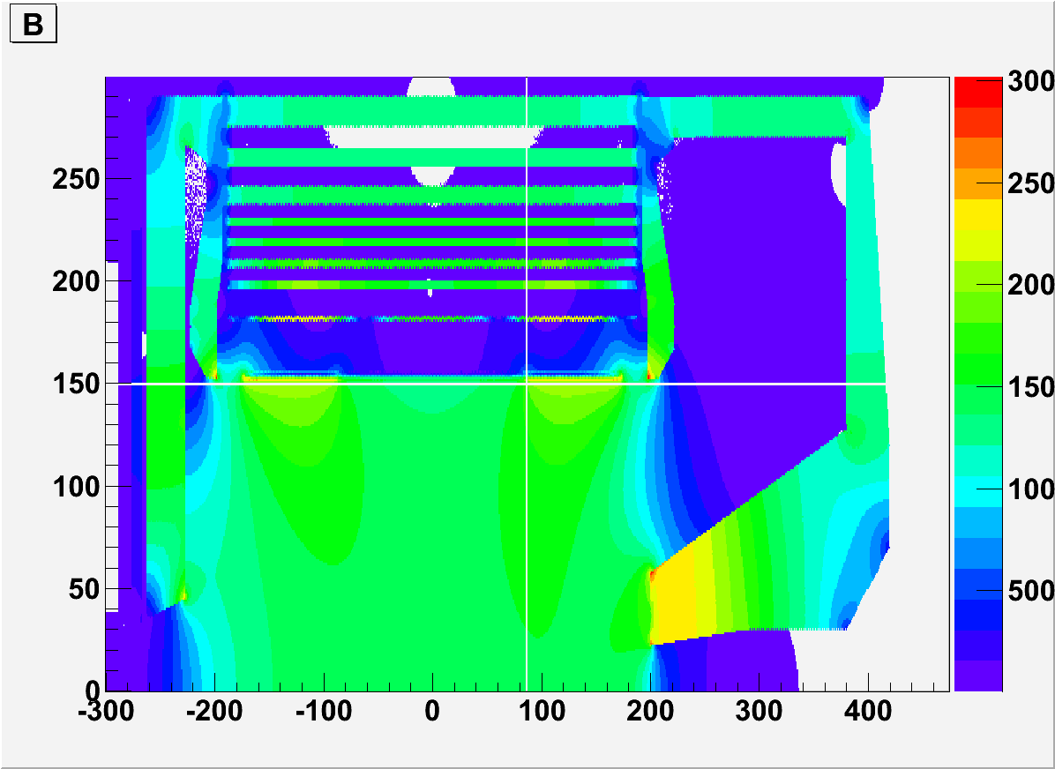
BaBar field
100g
50g
20g

Slide 6
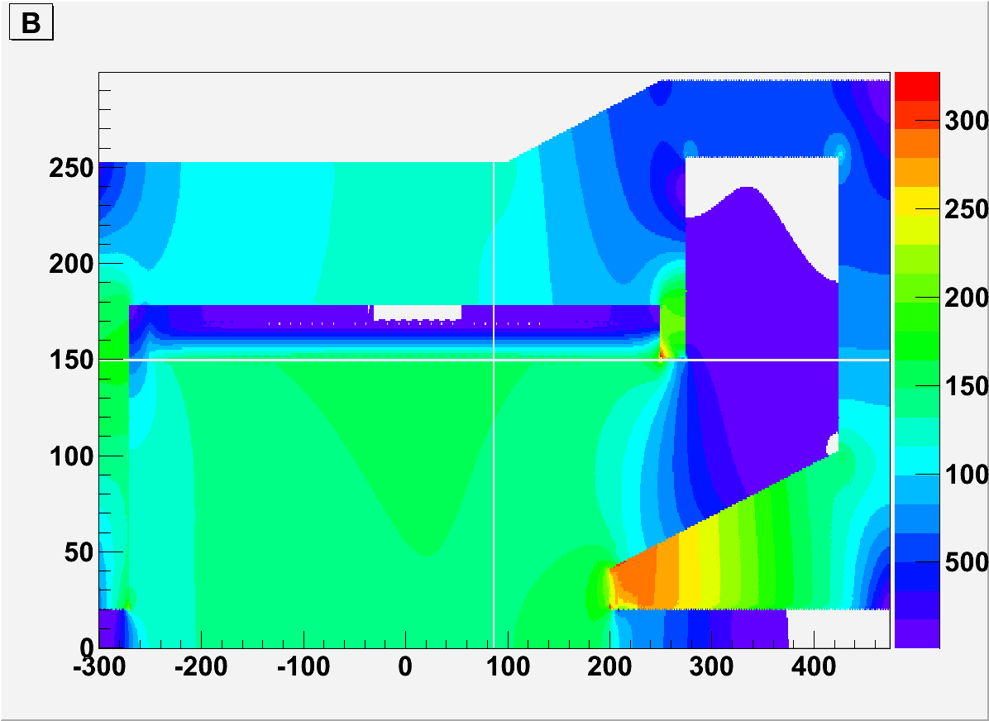
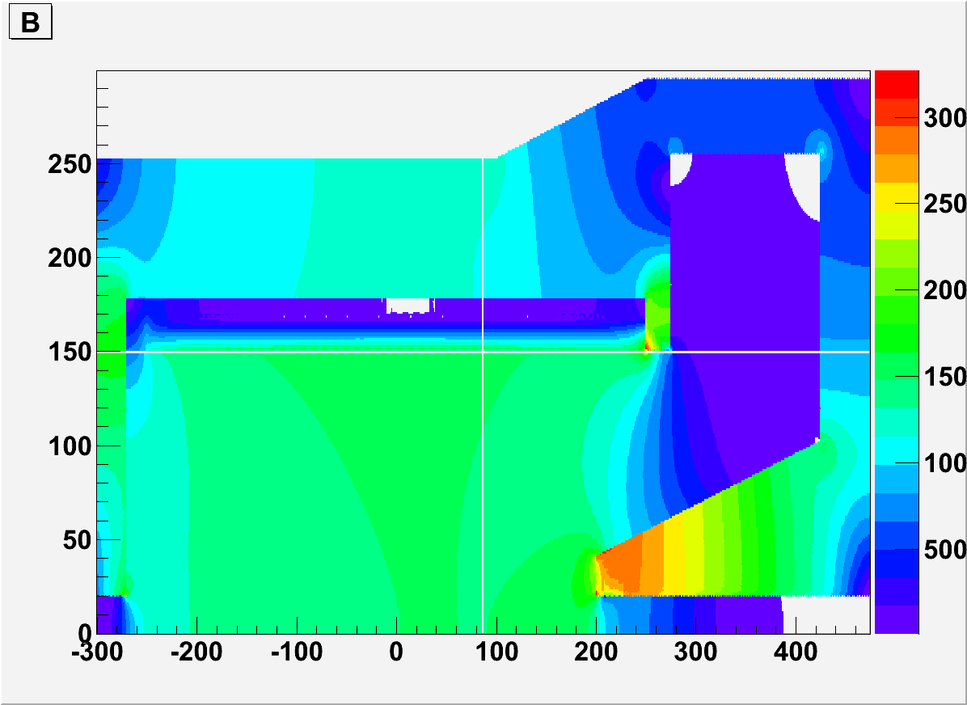
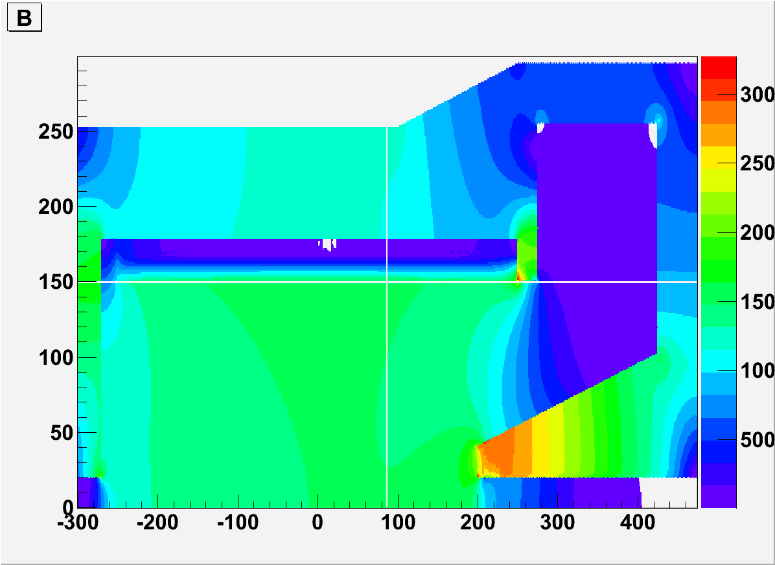
CDF field
100g
50g
20g

Slide 7
Shashlyk prototype module parameters
9 modules assembled in matrix 3x3
380 layers of 0.3-mm lead and 1.5-mm scintillator, total length 680 mm
Transverse size 110x110 mm²
Effective Moliere radius: R_{M}=59 mm
Effective radiation length: X₀=34 mm
Total radiation length: 20X₀
Light collection: 144 (12×12) fibers BCF-91A (∅1.2 mm)
PMT Hamamtsu R5800 as photodetectors

Slide 8
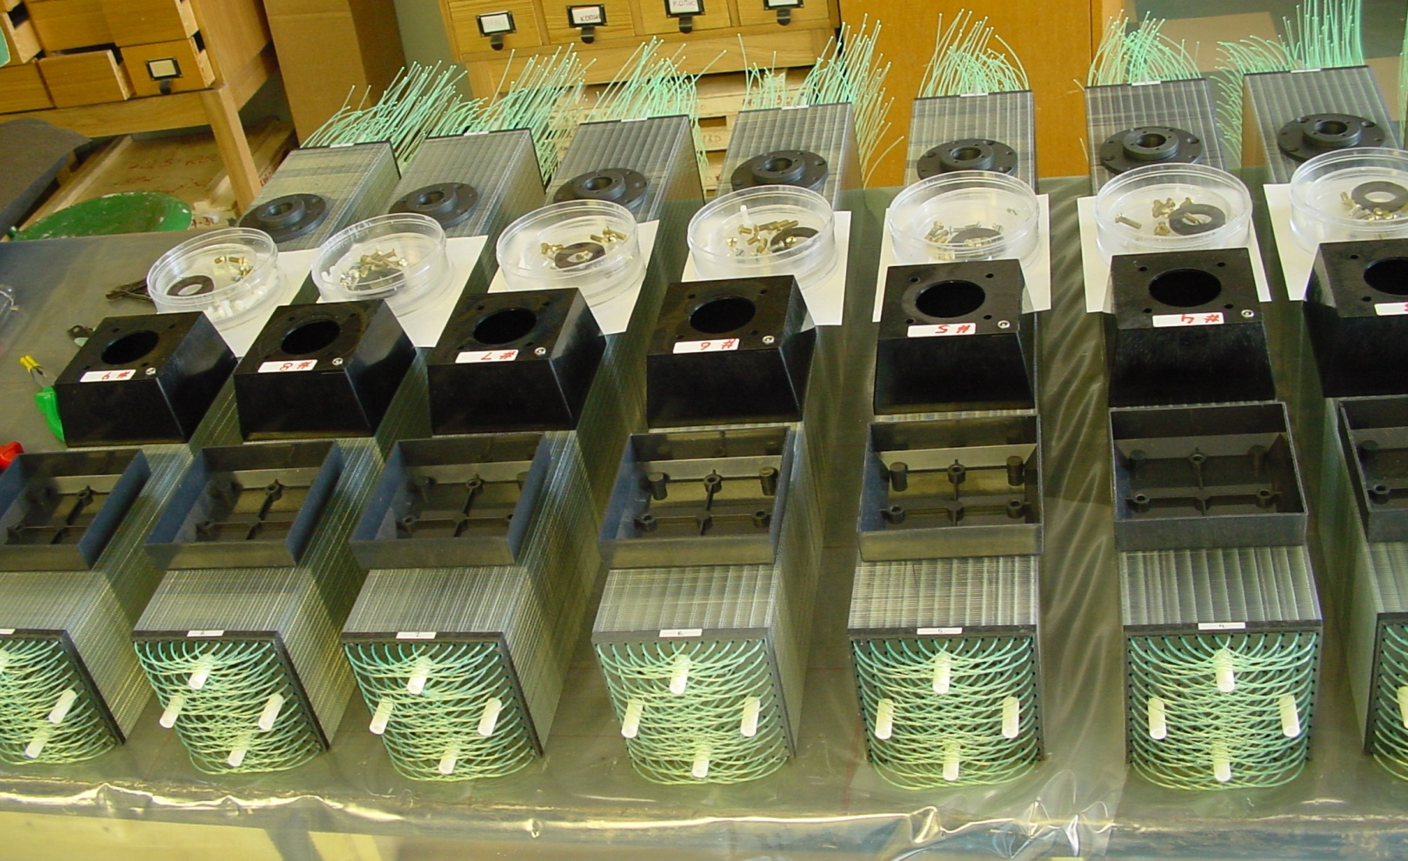
Shashlyk modules production

Slide 9
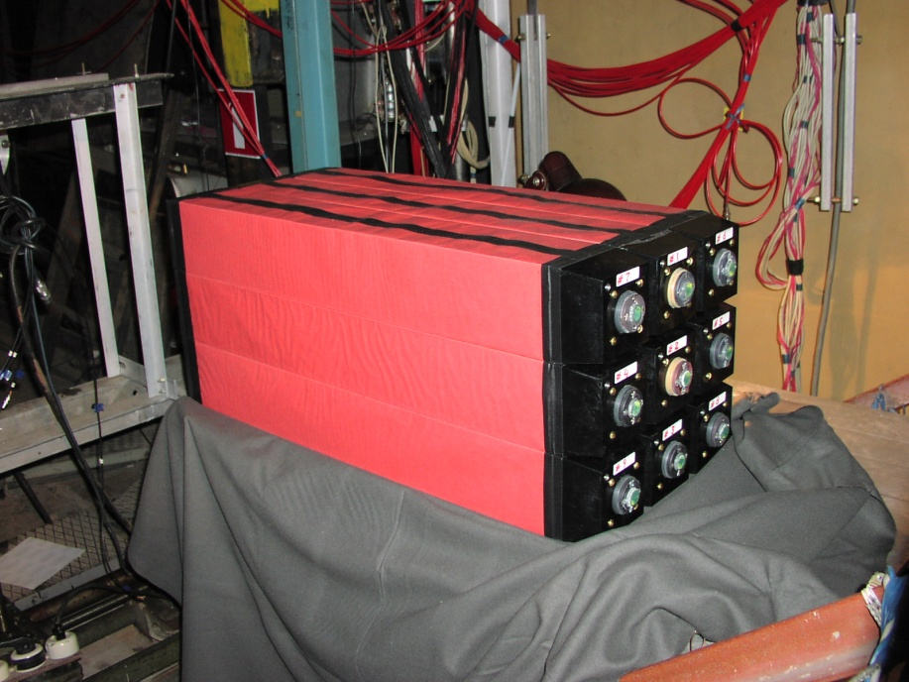
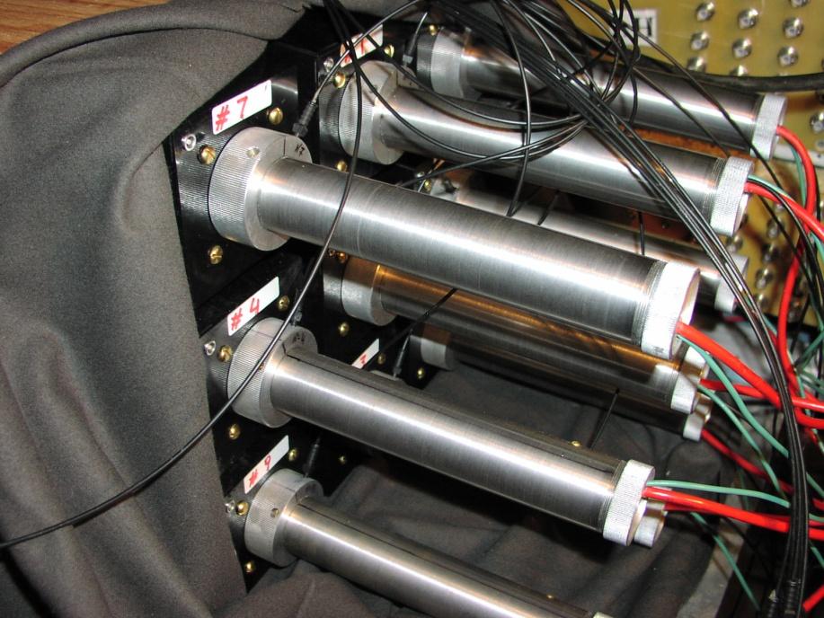
Shashlyk prototype pictures
3x3 matrix of shashlyk modules and PMT attached to the modules

Slide 10
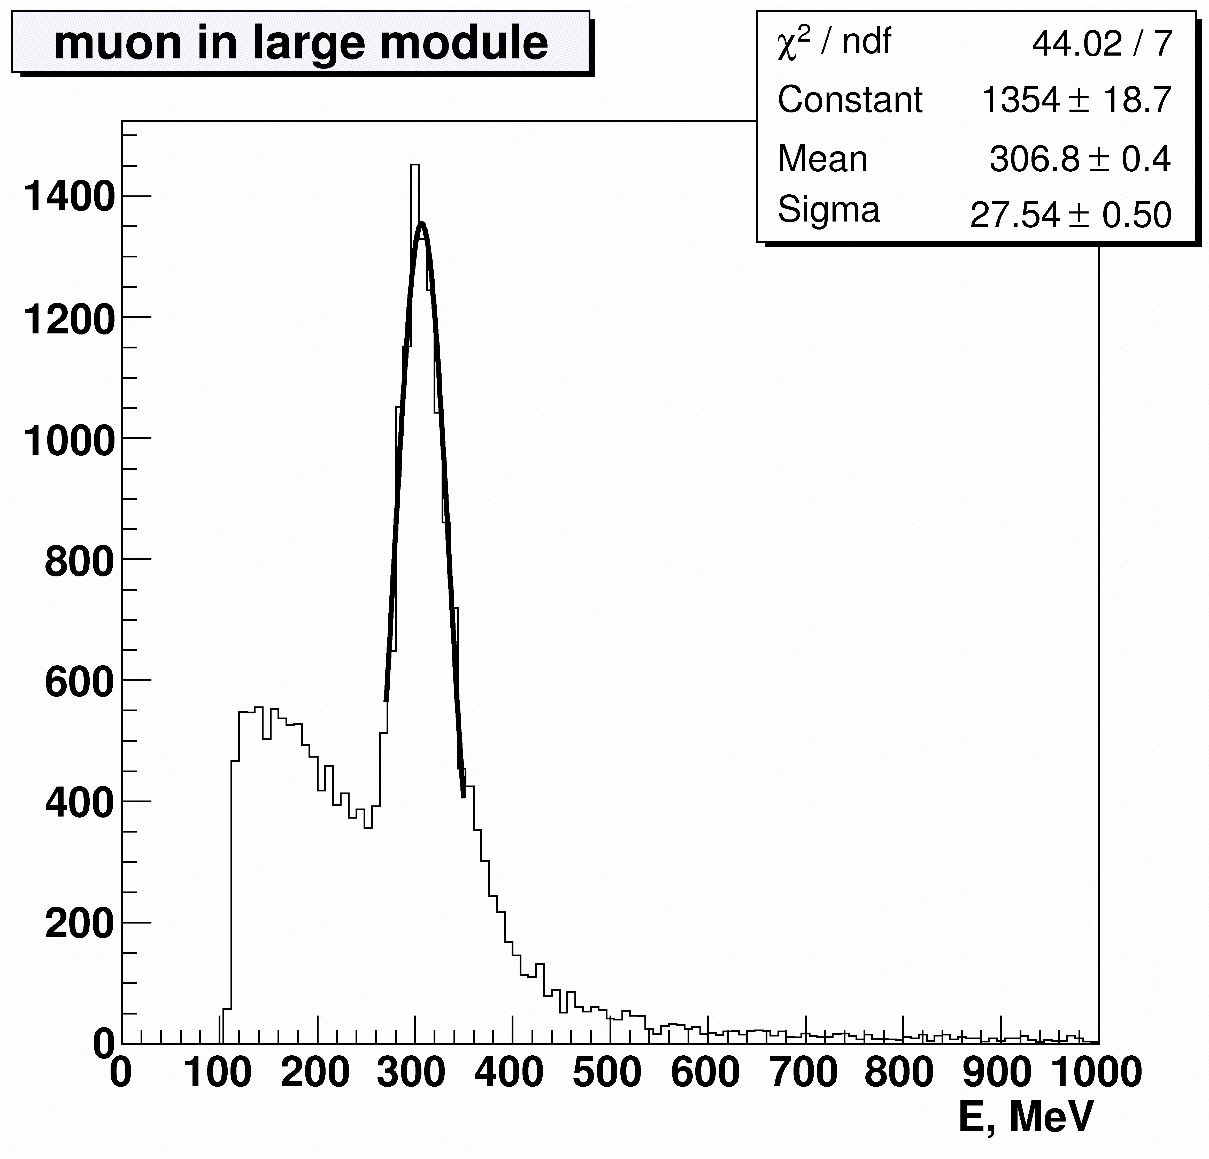
Minimum ionizing particle peak

Slide 11
Energy Resolution dependence on energy

Slide 12
Energy Resolution parameterization
σ_{E} /E = a/E ⊕ b/√E ⊕ c [%], E in GeV
Experiment data fit: MC data fit:
a = 3.5 ± 0.3 a = 0.0
b = 2.8 ± 0.2 b = 3.0 ± 0.3
c = 1.3 ± 0.04 c = 1.1 ± 0.7
Good agreement with MC without noise term.
Good agreement with previous studies of similar sampling modules at lower energies (2.9%/ √E at 220-370 MeV: Test beam study of the KOPIO shashlyk calorimeter prototype, G.Atoian, S.Dhawan,V.Issakov et al. CALOR-2004 Proceedings )

Slide 13
Position resolution (center) dependence on energy

Slide 14
Position resolution parameterization
σ_{x} = a/√E ⊕ b [mm], E in GeV
Experiment data fit: MC data fit:
a = 17.6 ± 0.9 a = 14.2 ± 0.6
b = 4.6 ± 0.9 b = 5.5 ± 0.9
Worst case – resolution at the module center.
Resolution near the module edge is 3 times better

Slide 15
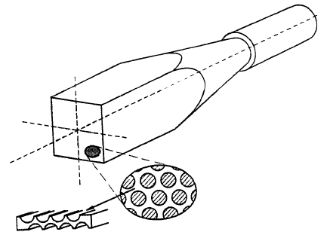
Calorimeter in Solenoid Flux Return
How to get the light from the calorimeter to a photosensitive detector?
APD’s
Light Guides out of field region
Use flux return for calorimeter
PMT in >10 G
Calorimeter

Slide 16
Calorimeter in Solenoid Flux Return
Open Questions:
What does magnetic field do the shower?
My guess is that charged particles in the EM shower will curl up causing the shower to become shorter and wider
How does magnetic field affect resolution in Energy and in space? Is this a strong function of field strength or direction?
What resolution do we need? [Pb:SciFi at ~1:1 gives 4.5%/sqrt(E)]
Is Iron dense enough?
How does the fiber affect the Magnetic flux return?
My guess is that we use and “effective” μ which is about half that of Fe.
Require detailed MC; Have contacted D. Hertzog about simulations.
How do we cost this?
D Hertzog—driving cost is amount of fiber—Fe less dense than Pb thus need more fiber.
PMT in >10 G
Calorimeter

Slide 17
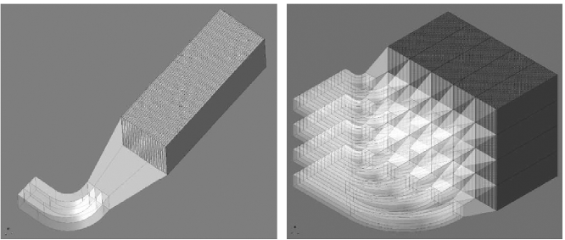
Mixture of radiation material and scintillator fiber(glue)
g-2 W/SciFi prototype

Slide 18
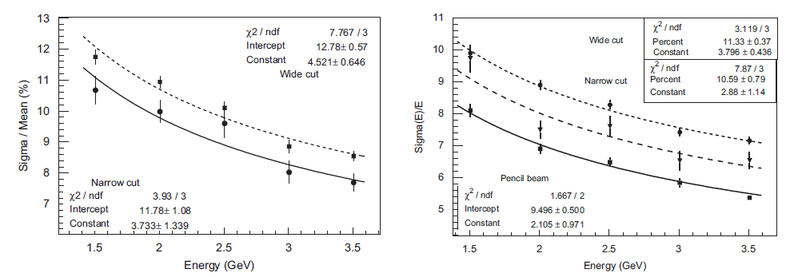
g-2 prototype test run
Data Simulation

Slide 19
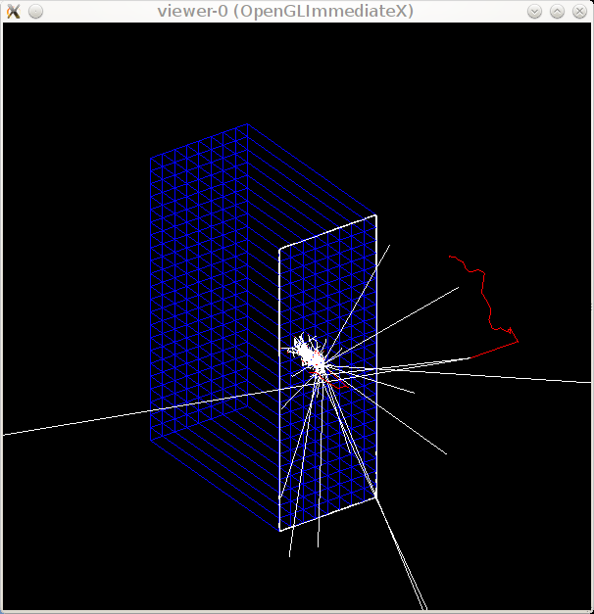
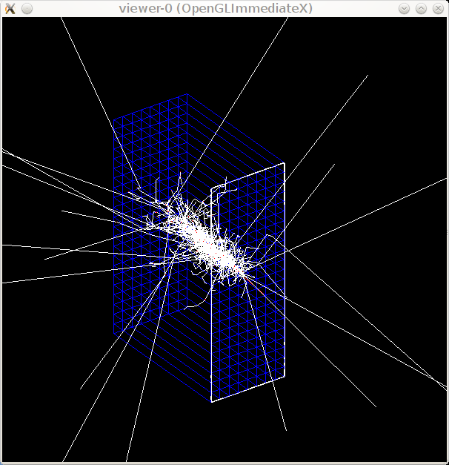
Test module simulation
90cm(height)x32cm(width)x60cm(depth),
material:(fiber+flue)=1:1,
fiber along Z, layer along Y, optional 2T field along Y
W/SciFi Fe/SciFi

Slide 20
Test module simulation hit distribution (No Field)
W/SciFi
Fe/SciFi

Slide 21
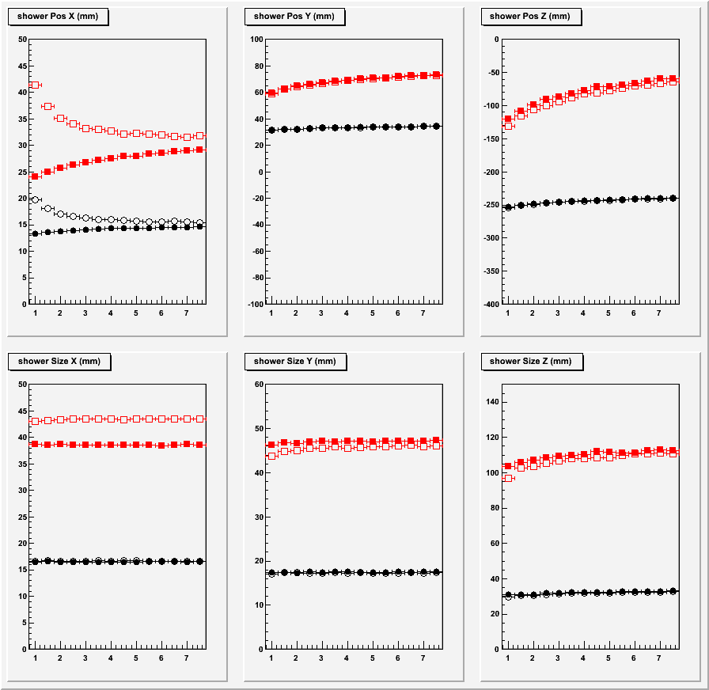
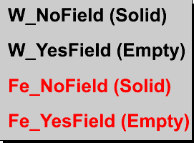
Test module simulation shower position and size

Slide 22
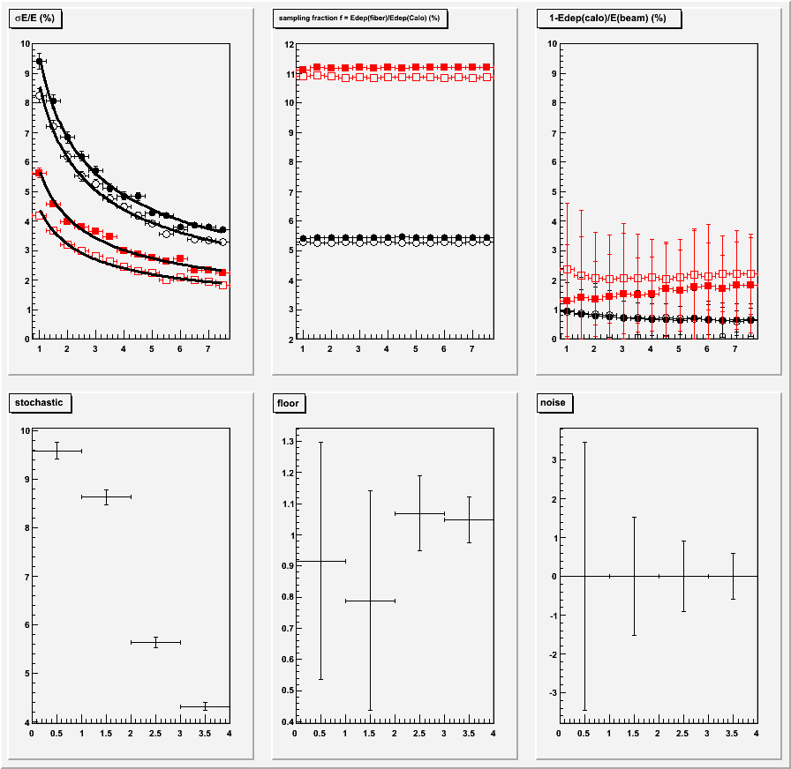
Test module simulation
resolution
Sampling fraction
loss
Stochastic
floor
noise

Slide 23
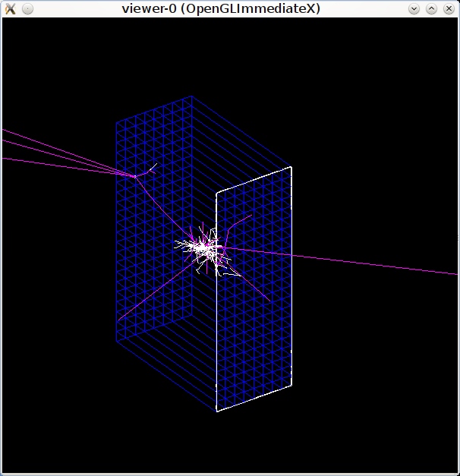
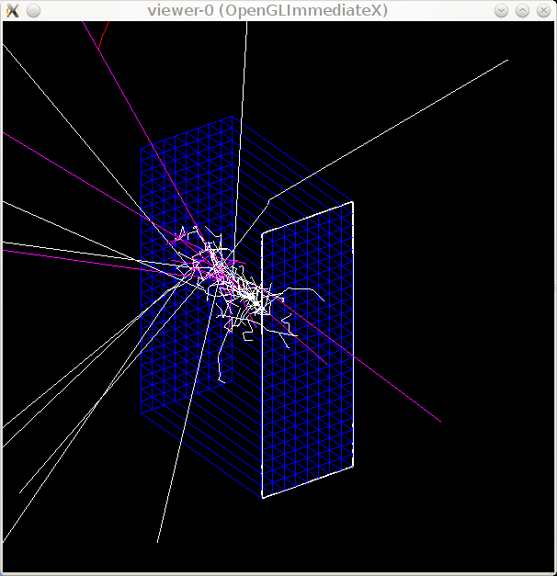
Test module simulation pion response
W/SciFi Fe/SciFi

Slide 24
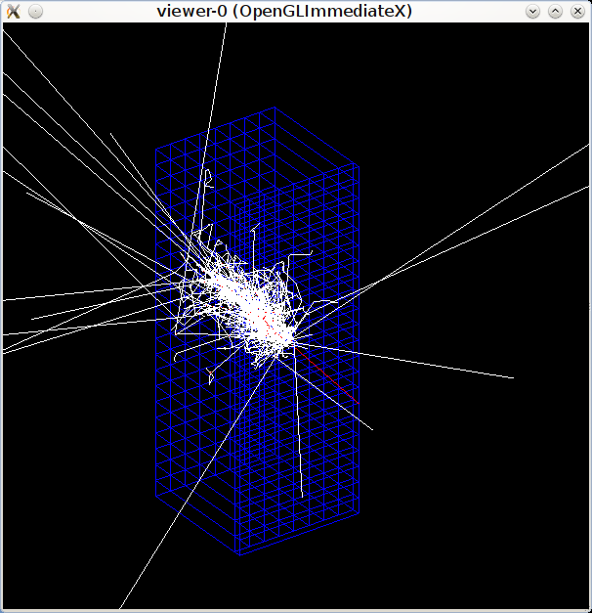
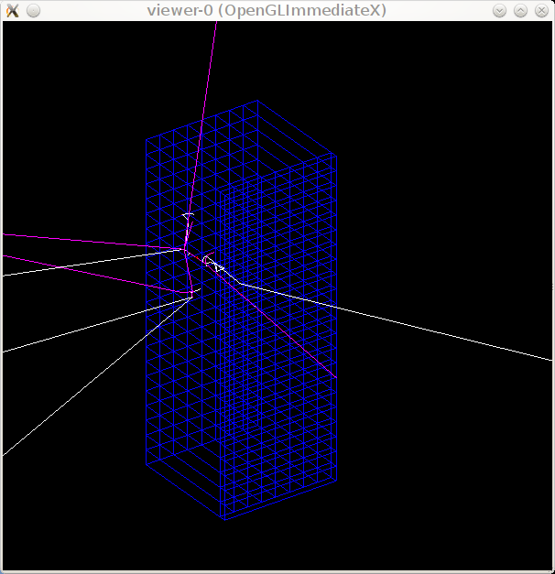
Test module simulation add 4cm W preshower
Fe/SciFi, electron Fe/SciFi, pion

Slide 25
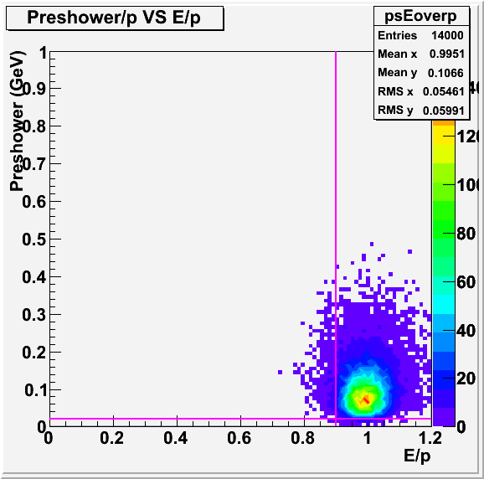
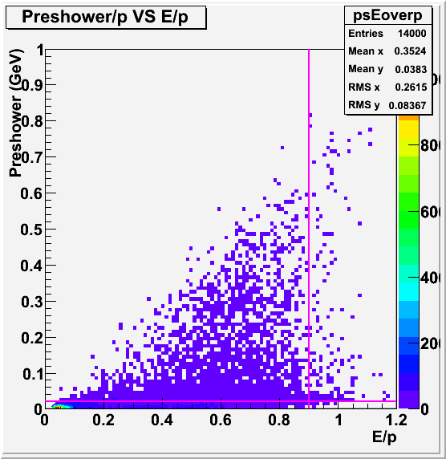
Test module simulation add 4cm W preshower
electron eff 95% pion rejection 50:1

Slide 26
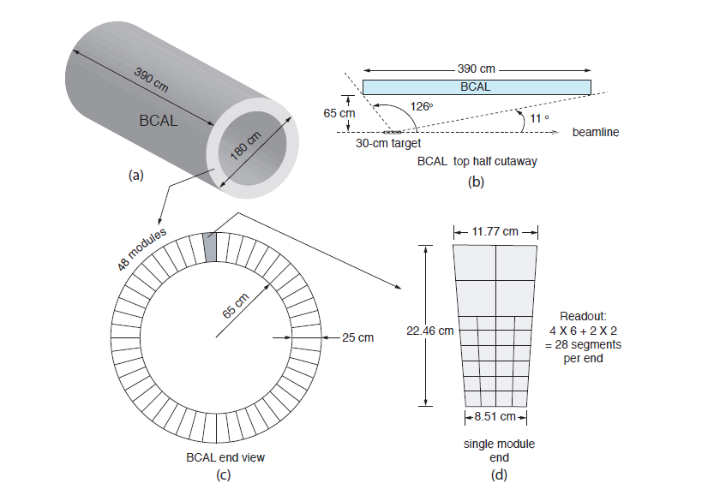
HallD Pb/SciFi BCAL optimazed for photon detection

Slide 27
Summary
Shashlyk need more study.
Fe/SciFi seems a promising candidate.
Still need more study, particular emerging side about how to implement it into endcup.
Some expertise can be used within Jlab.

