Slide 1
SoLID simulation
Zhiwen Zhao
UVa
2011/03/25

Slide 2
GEMC, written by Maurizio Ungaro, used for CLAS12

Slide 3
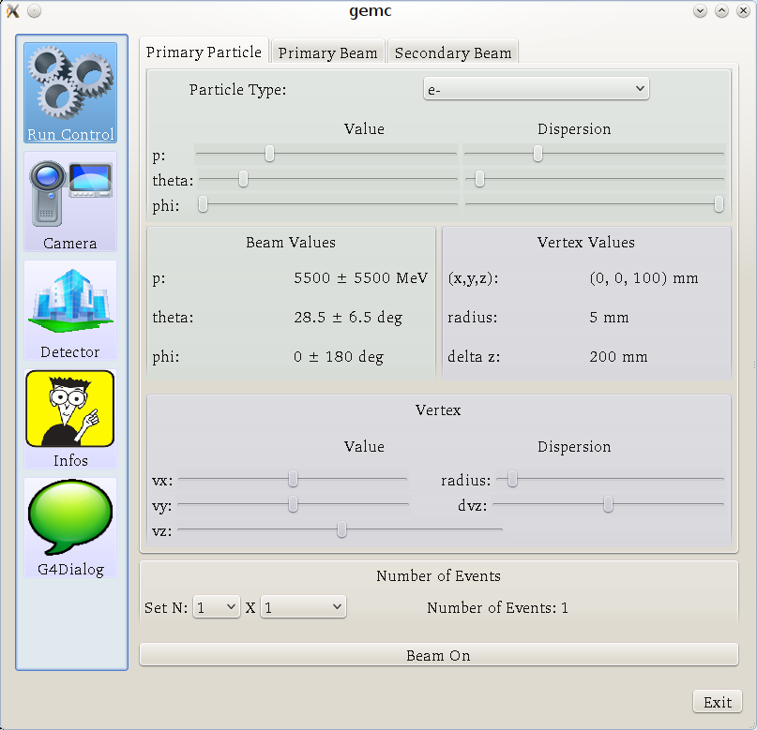
GUI (Run control)

Slide 4
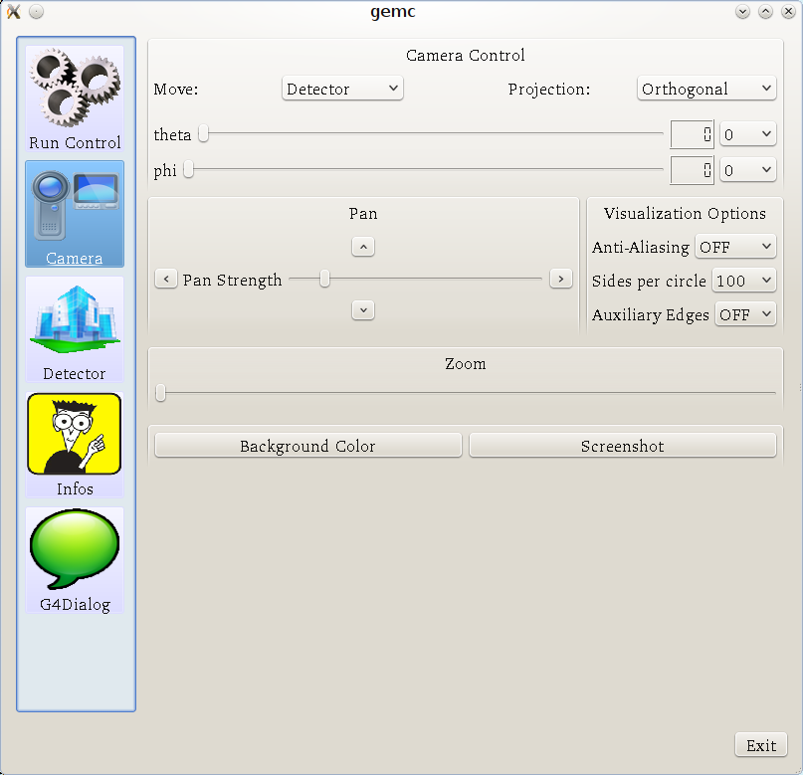
GUI (Camera)

Slide 5
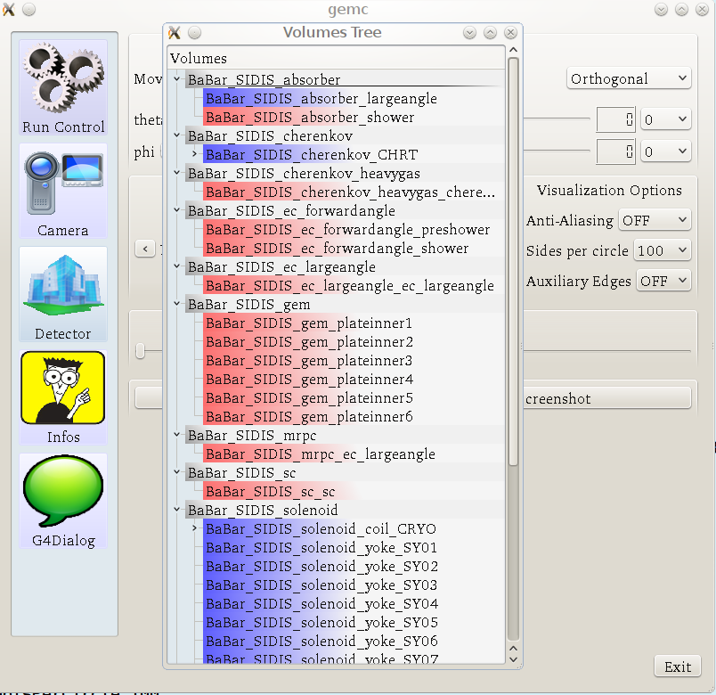
GUI (Detector)

Slide 6
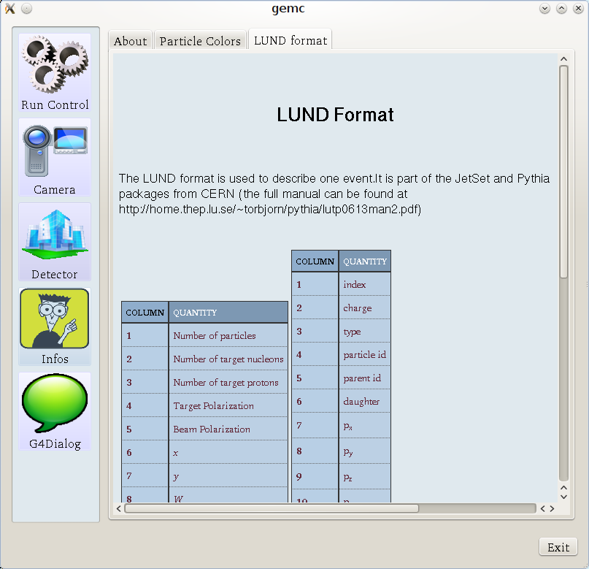
GUI (Info)

Slide 7
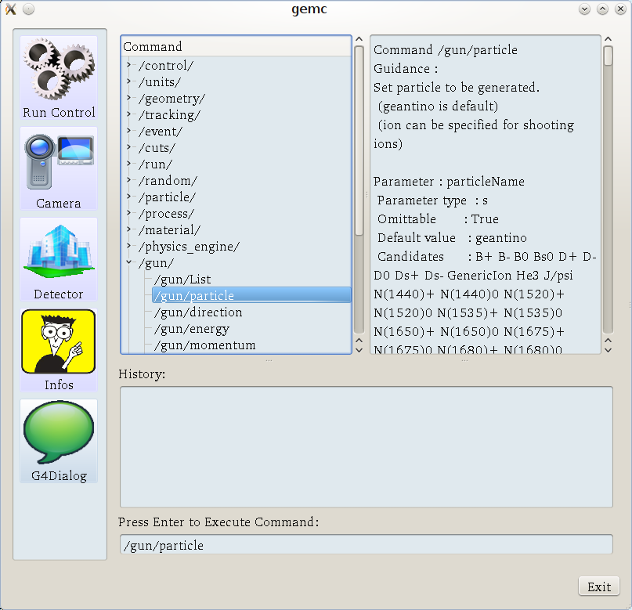
GUI (G4Dialog)

Slide 8
Command Line Options

Slide 10
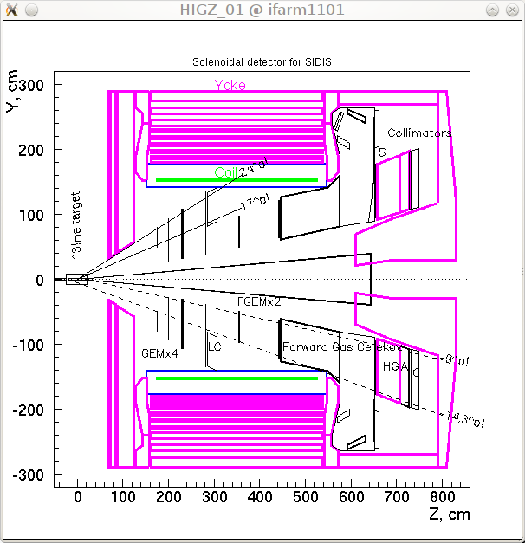
SoLID for SIDIS with BaBar Magnet

Slide 11
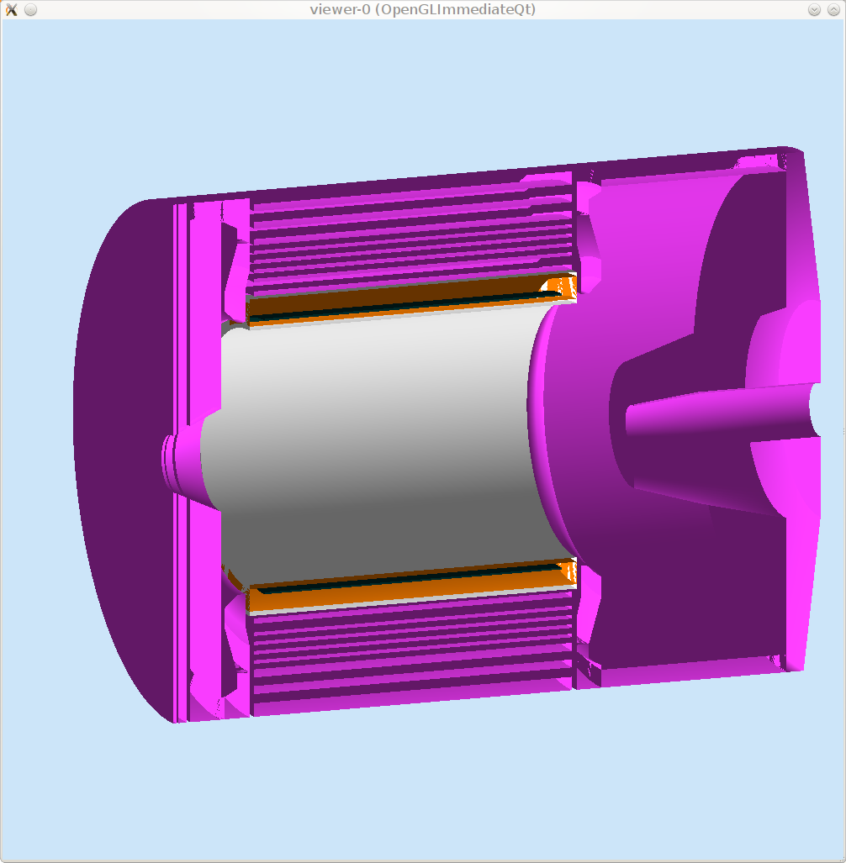
Magnet/coil/yoke

Slide 12
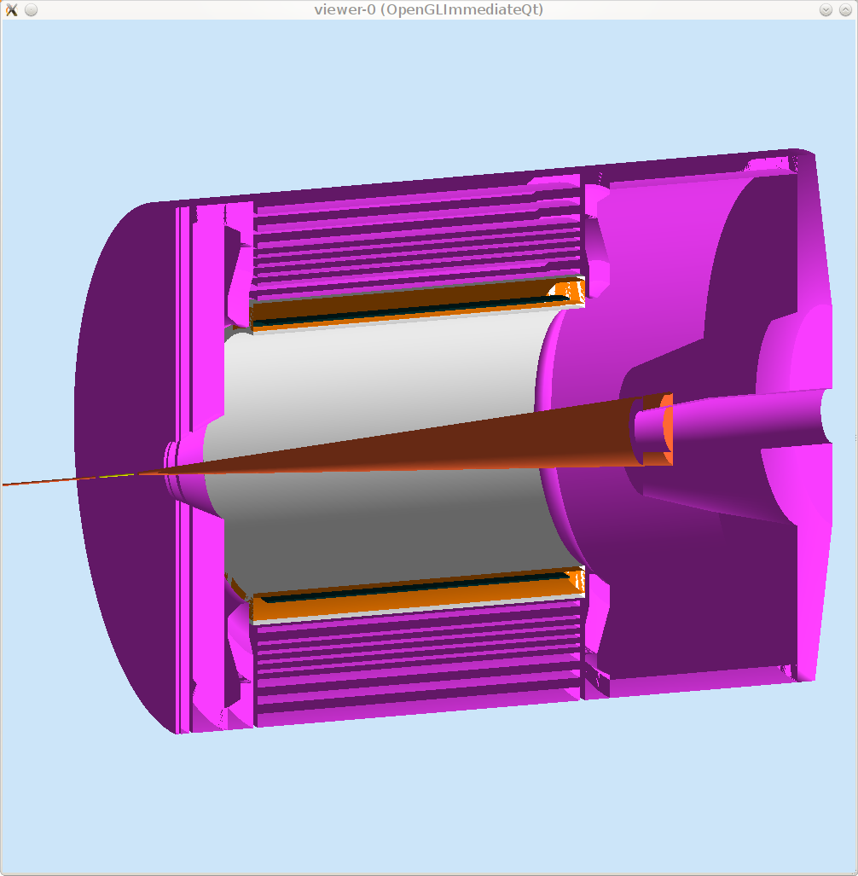
Target/Beam line

Slide 13
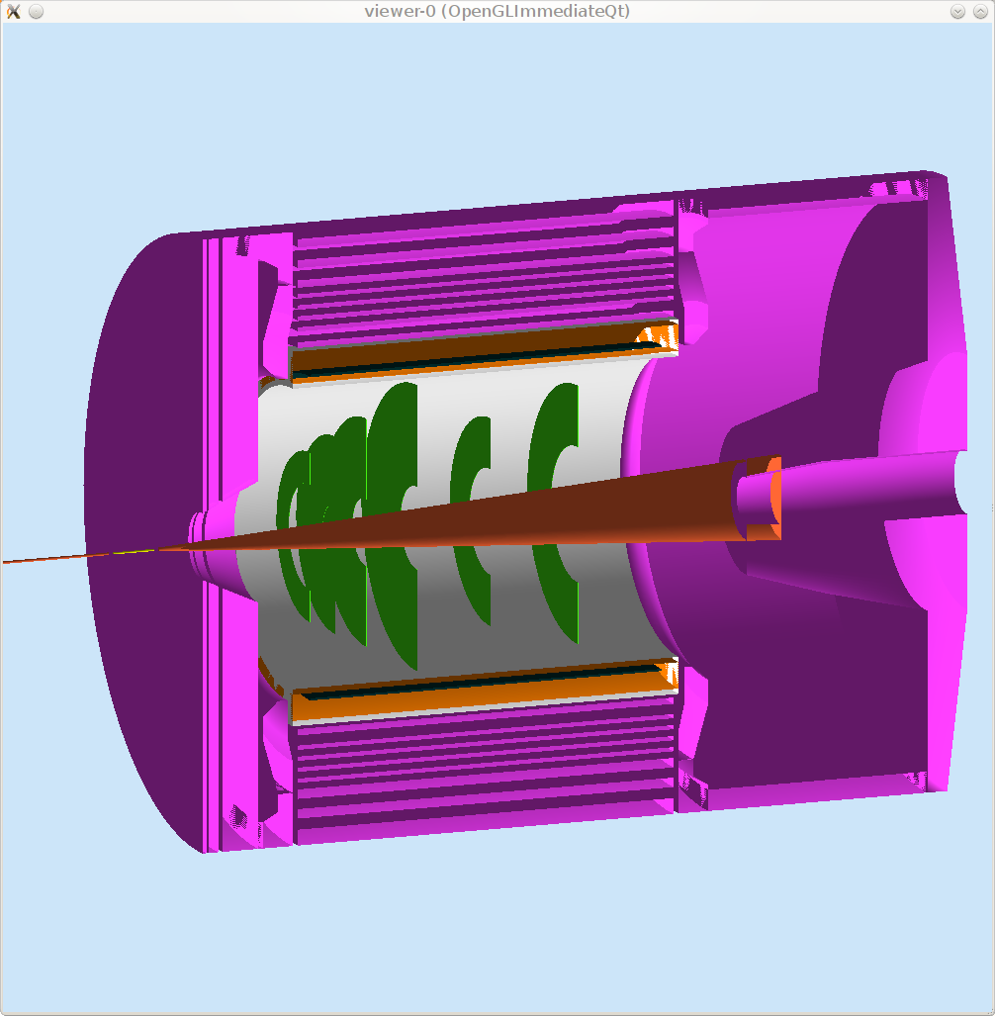
GEM

Slide 14
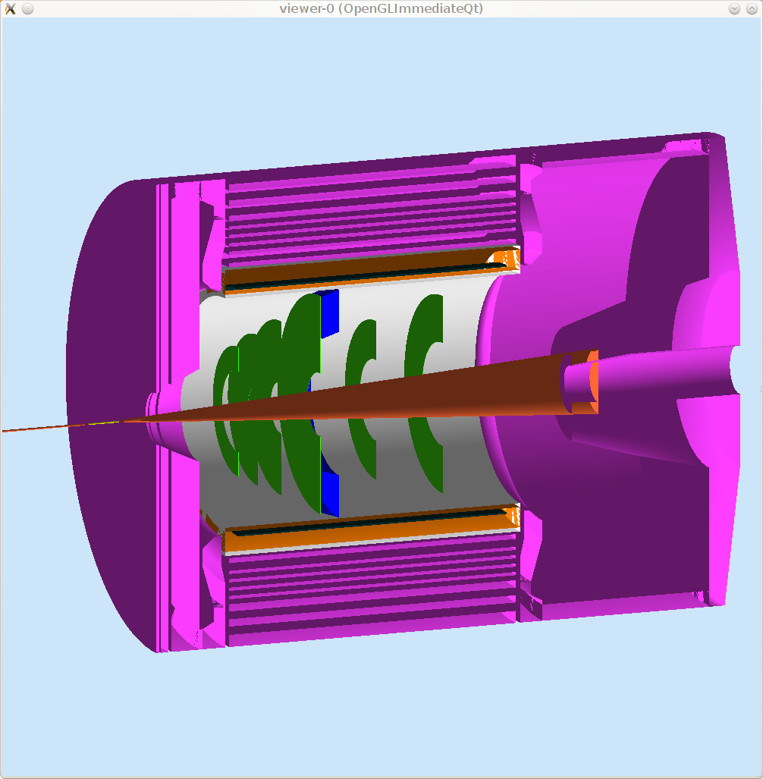
EC, large angle

Slide 15
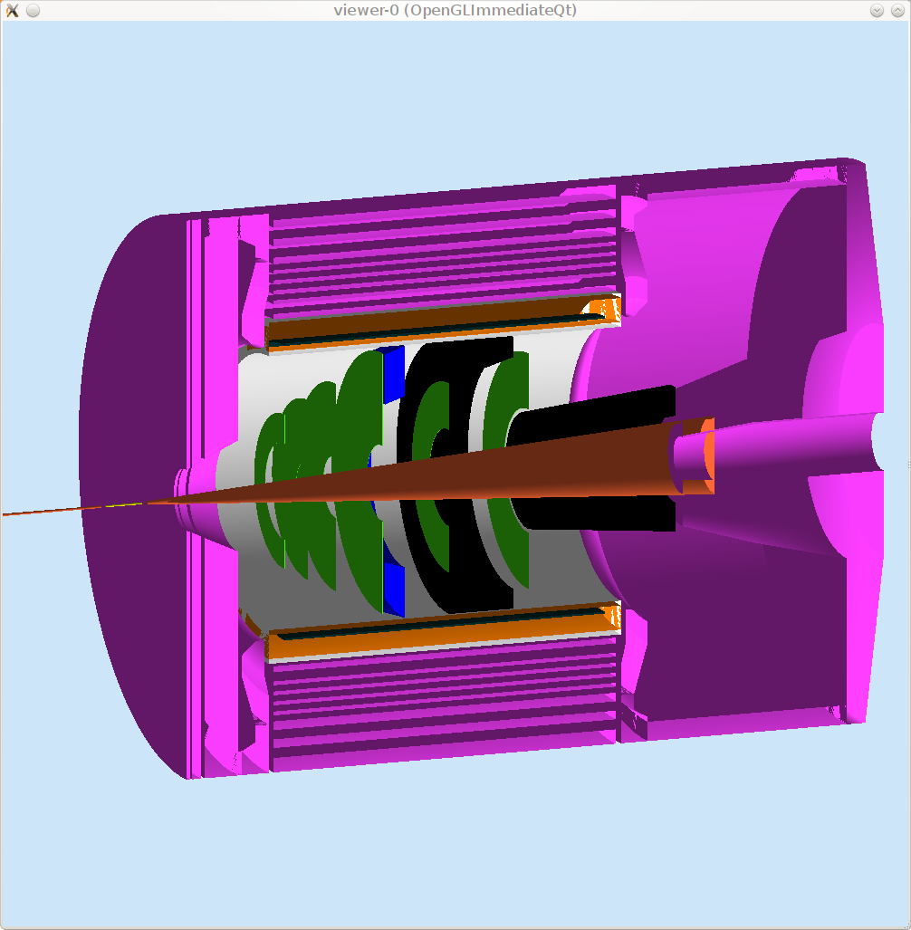
Collimator

Slide 16
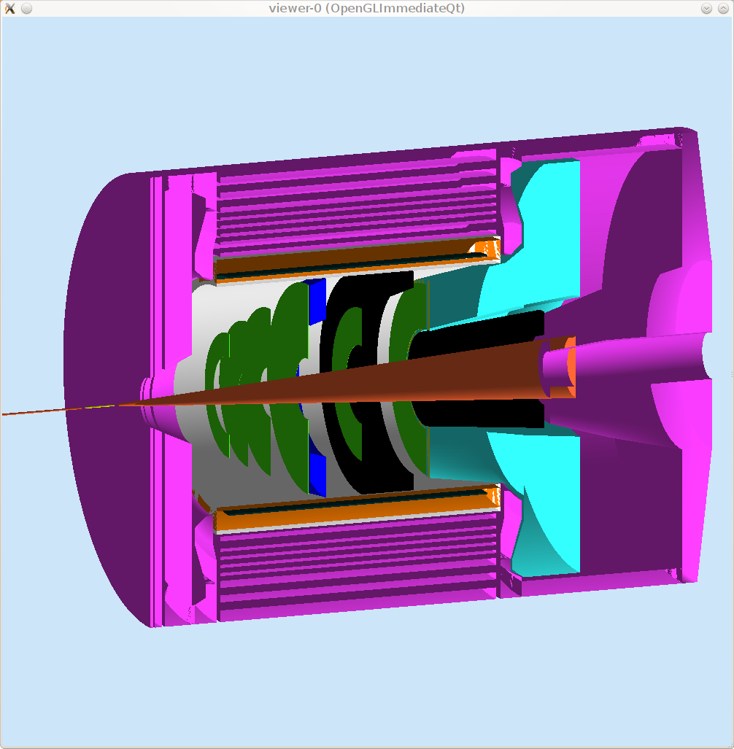
Cherenkov, light gas

Slide 17
Scintillator

Slide 18
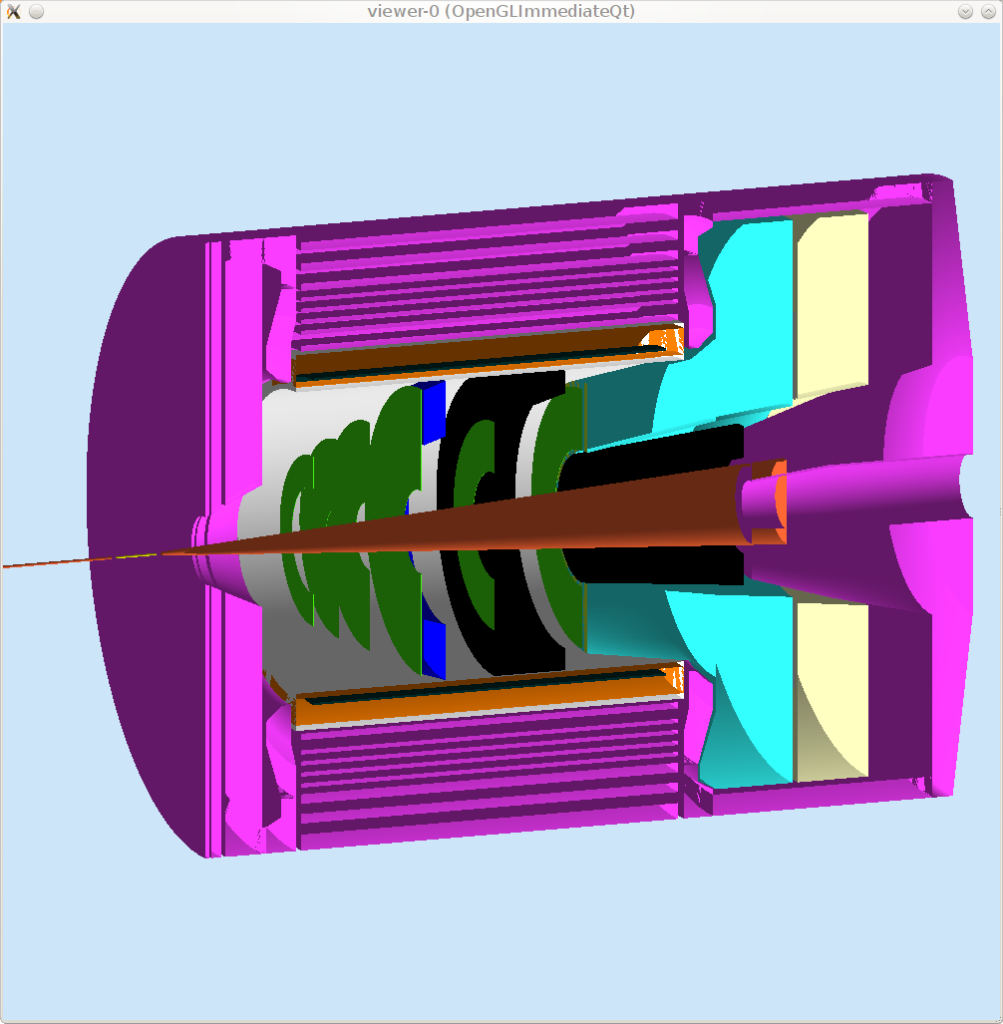
Cherenkov, heavy gas

Slide 19
MRPC

Slide 20
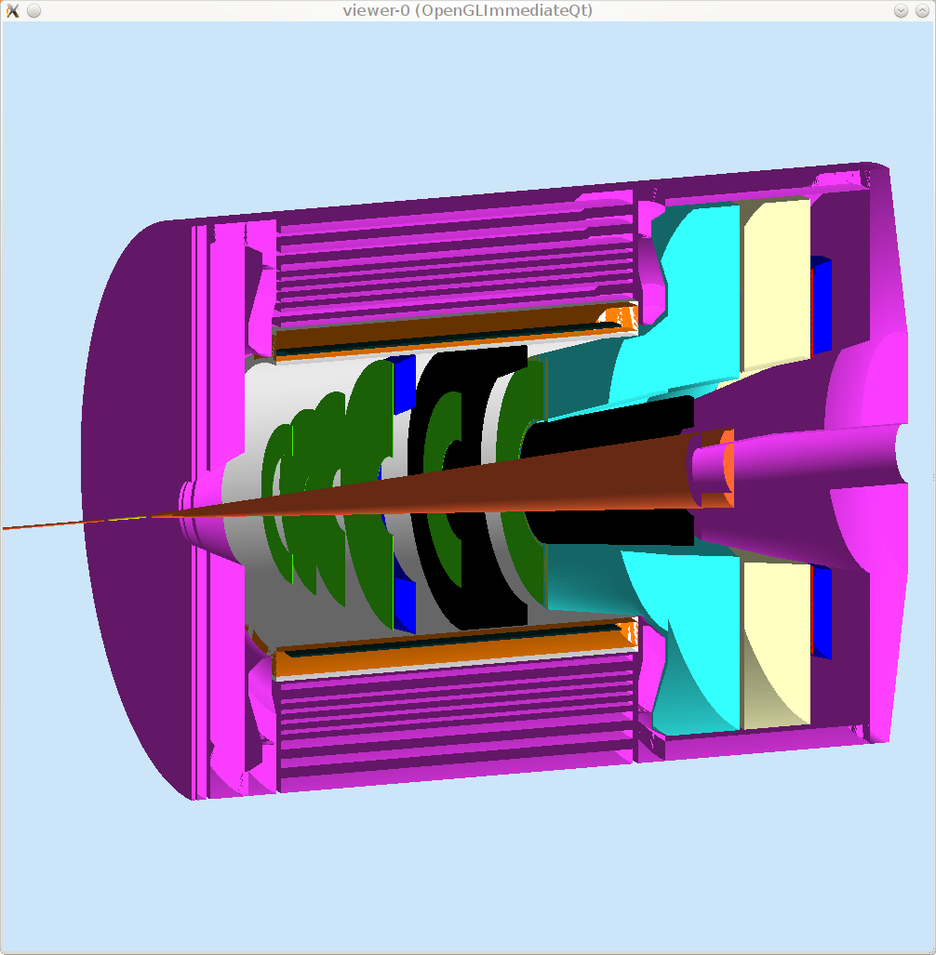
EC, forward angle

Slide 21
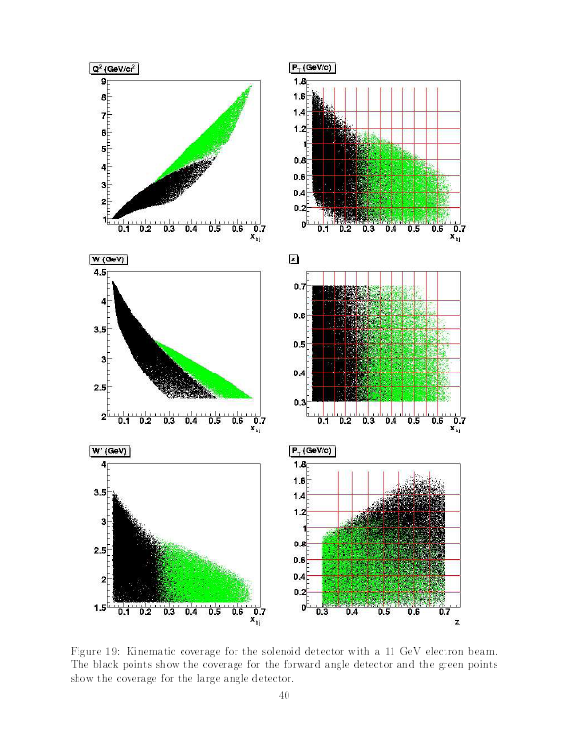
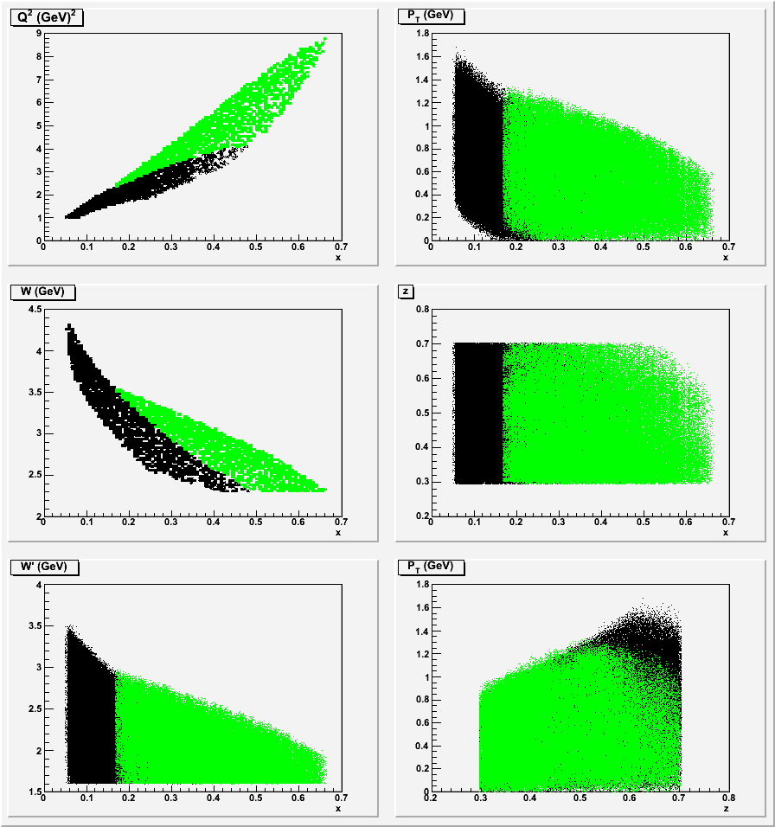
kinematics for BaBar SIDIS Comparing to geant3 sim

Slide 22
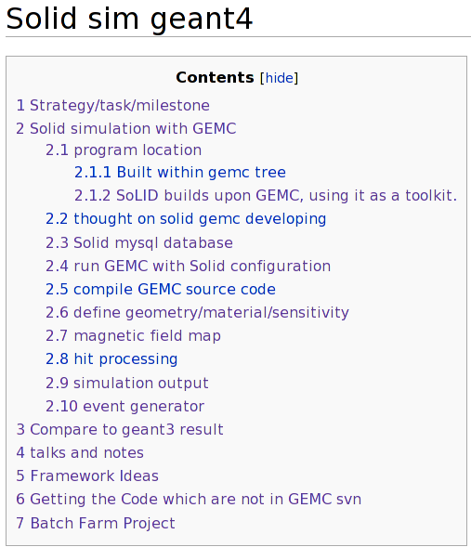
The Wiki

Slide 23
Advantage
Central outside location of geometry/sensitivity/field/digitization
Customized hit processing for various detectors
Unifed indvidual detector simulation and the whole SoLID simulation

Slide 24
The Things Completed
Various magnet coil, yoke, detector geometry generated.
Various field maps generated and converted to GEMC format
“soliddb.jlab.org” database set up
PVDIS generator with output converted to LUND format
Simple detector hit response

Slide 25
The Work Ongoing
Cherenkov and EC are in standalone packages due to historical reasons, need to be implemented into GEMC.
PVDIS baffle design
GEM and tracking
SC and MRPC response
SIDIS event generator.
Better root output support
Study acceptance, kinematics and resolution for various configuration
Rate estimation and low energy background.
Unified SoLID simulation

Slide 26
Is it ready?
The framework is ready.
Need to compare to geant3, dedicate persons to do it for SIDIS and PVDIS, may complete in a month or two.
Individual detectors, it’s better for developer to estimate time.

Slide 27
Thanks
Maurizio Ungaro
Paul Reimer
Seamus Riordan
Lorenzo Zana
Simona Malace
Eugene Chudakov
Xin Qian
Zhiwen Zhao

