Slide 1
Example 3 Slides for PAC

Slide 2
Measurement of Target Single Spin Asymmetry in Semi-Inclusive Deep Inelastic Scattering with ³He
E12-10-006 Spokespersons: J.-P. Chen, H. Gao, X.-D. Jiang, J. C. Peng and X. Qian
(50 days at 11 GeV, 22 days at 8.8 GeV, 10 days on H/D, 8 days calibrations) 90 days
Map Collins, Sivers, and Pretzelosity Asymmetries on Neutron in 4-D (x,Q²,z,P_{T}) phase space
Map Collins moments to provide neutron data for a 10% d quark tensor charge extraction (Spin)
  Search for violation of Soffer’s inequality |h_{1T}| <= (f₁+g_{1L})/2 at high x
Map Sivers moments in the valence region at low Q² (4-D, OAM)
  Provide data for evolution studies (combined with EIC measurement)
  Provide data to test TMD factorization
  Search for sign change of Sivers function
  in x or P_{T} dependence
Search for first non-zero pretzelosity moments
  Effect of OAM, relativistic effects, model calculations
Measurement Cross section ratio on p, d and ³He
  Understand SIDIS factorization, P_{T} dependence, and FSI in the proposed kinematics
All moments
are measured at same time!

Slide 3
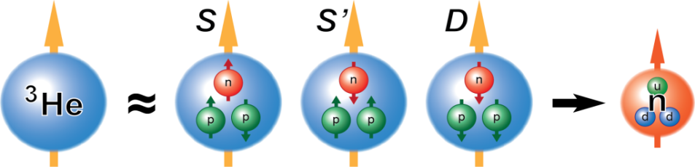
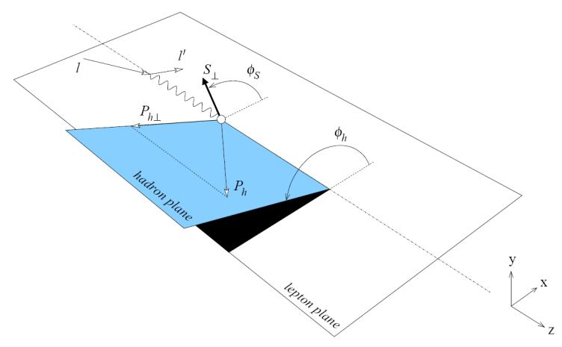
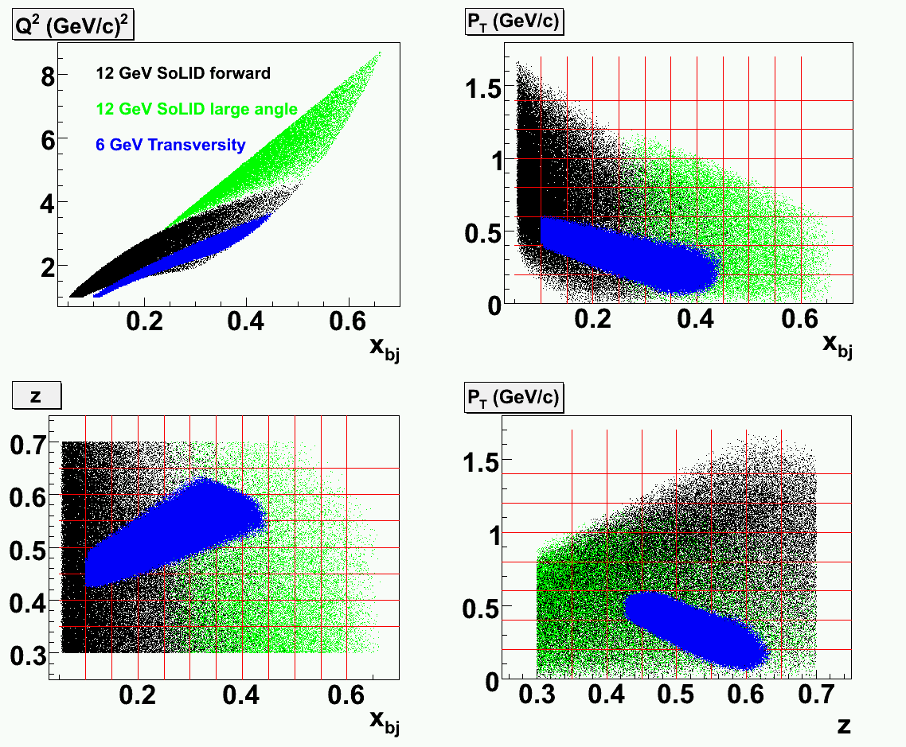
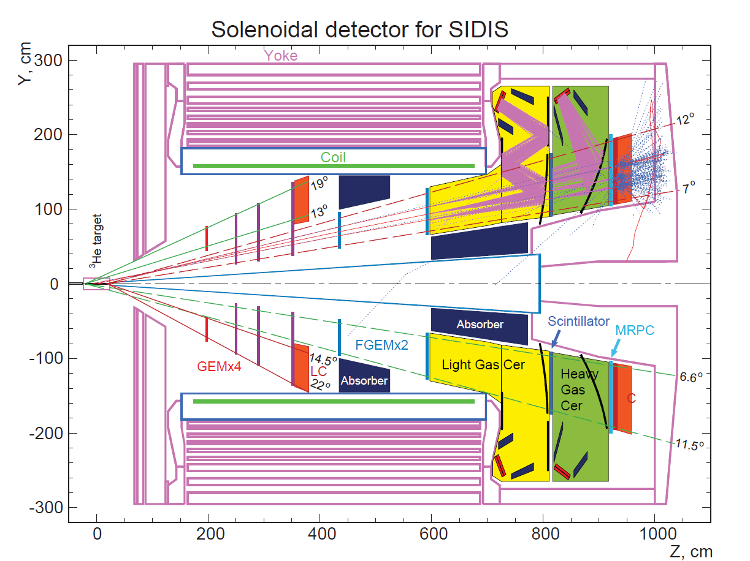
SoLID for SIDIS on ³He
10³⁶ N/cm²/s polarized luminosity
Achieved Target Performance:
  Transverse/Vertical Polarized
  >60% polarization + Fast Spin Flip
Large acceptance enables 4-D mapping
Full azimuthal-angle coverage
-> smaller systematic uncer.
~90% ~1.5% ~8%
Eff. pol. neutron target

Slide 4
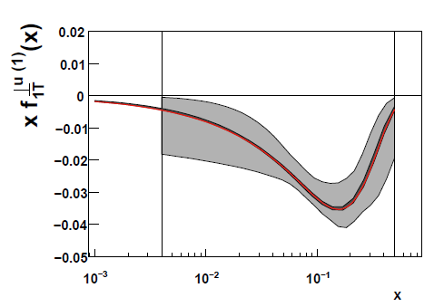
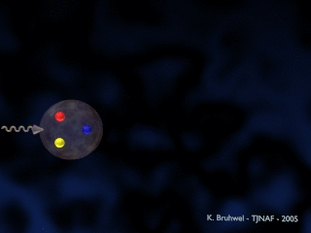
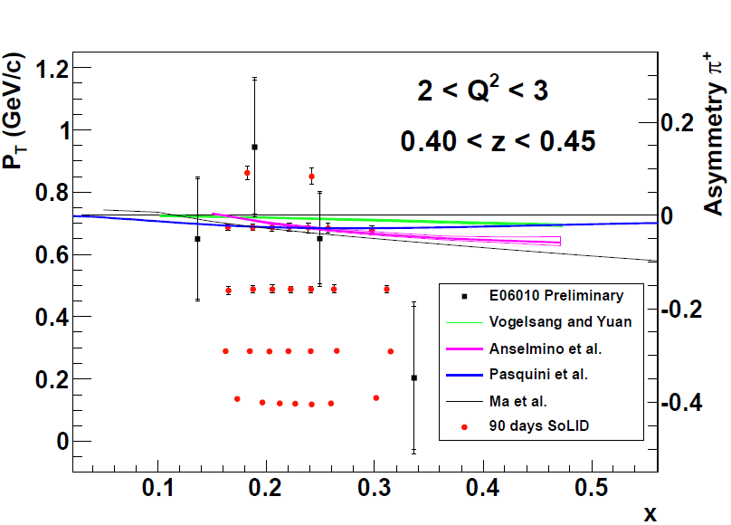
Collins Effect
Sivers Effect
Place Holder!!!
Improve in Sivers?
Systematic : 0.1% (abs.) + ~6% (rel.)
50 days @ 11 GeV + 22 days @ 8.8 GeV (Coverage + RC) + 10 days on H/D (Dilution, FSI, SIDIS mechanism) + 8 days on calibration of new device = 90 days!
These data will provide ultimate precision mapping of Neutron SSA in the valence region at low Q2!
Example projections of Neutron Collins moments, 1/48 bins in z vs. Q².
Goal: 10% precision on d quark tensor charge!

Slide 5
Backup about Physics (next 2 slides)
Do we need backup for developments on hardware?
What about Software?
What about milestones?
What about schedule?
Collaboration issues, such as responsibility?
Combined 6 slides for SSA/DSA
  E.g 1 more slide here, and 2 slides for DSA?
What do we need to write?

Slide 6
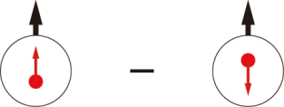


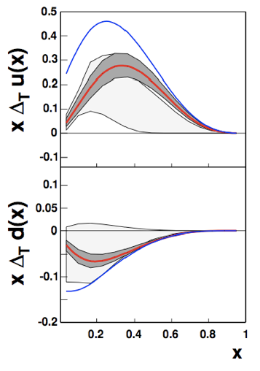
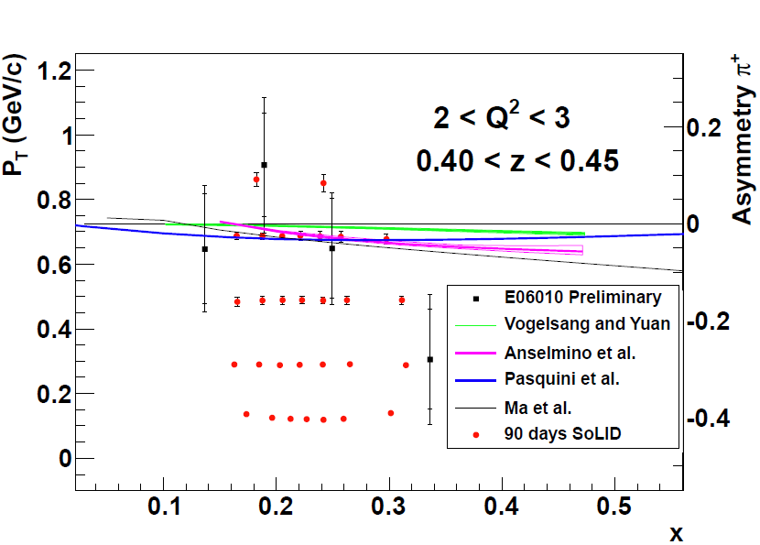
Transversity
h_{1T} =
The third PDFs in addition to f₁ and g_{1L}
10% d quark tensor charge with world data
Test Soffer’s inequality |h_{1T}| <= (f₁+g_{1L})/2 at large x

Slide 7
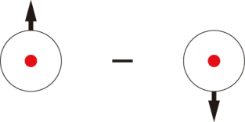
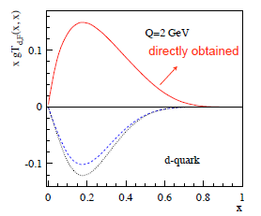
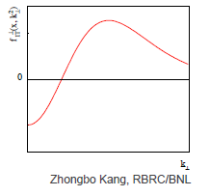

Sivers Function
f _{1T}⊥ =
Correlation between nucleon spin with quark angular momentum
Important test for factorization
Different sign with twist-3 quark-gluon corr. dis. at high P_{T}?
  Kang, Qiu, Vogelsang and Yuan: arxiv: 1103.1591
  Search for sign change, also P_{T} weighted moments (Boer, Gamberg, Musch)
Also in x

Slide 8
Discussion about FSI
A theoretical issues,
  Need to be solved by theorists/calculations.
  For a simple estimation, see:
  https://hallaweb.jlab.org/dvcslog//transversity/645

