Slide 1
Large Angle Calorimeter
Followup study on Shashlik EC
Jin Huang
MIT
SoLID Collaboration Meeting
June 03, 2011, Jefferson Lab

Slide 2
Outline
Concept
Choice of Calorimeter
Choices of Light Read Out
Goal
General Features
SciFi Cal. (W based/Pb Based)
Shashlyk Calorimeter
Discussions
Shashlyk Tuning
General Performance
Total Shower Thickness
Preshower Thickness
Transverse Size
Outside Readout
APD
Rough cost esitmation
Pb thickness/layer

Slide 3
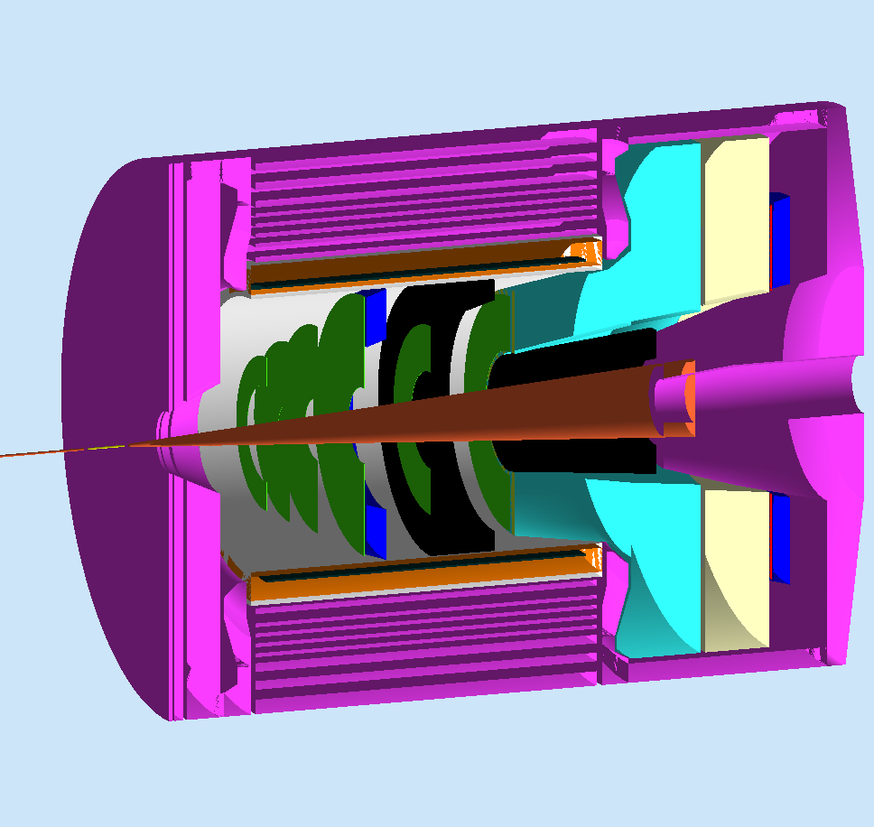
Large Angle Cal.
Plot by Z.W. Zhao

Slide 4
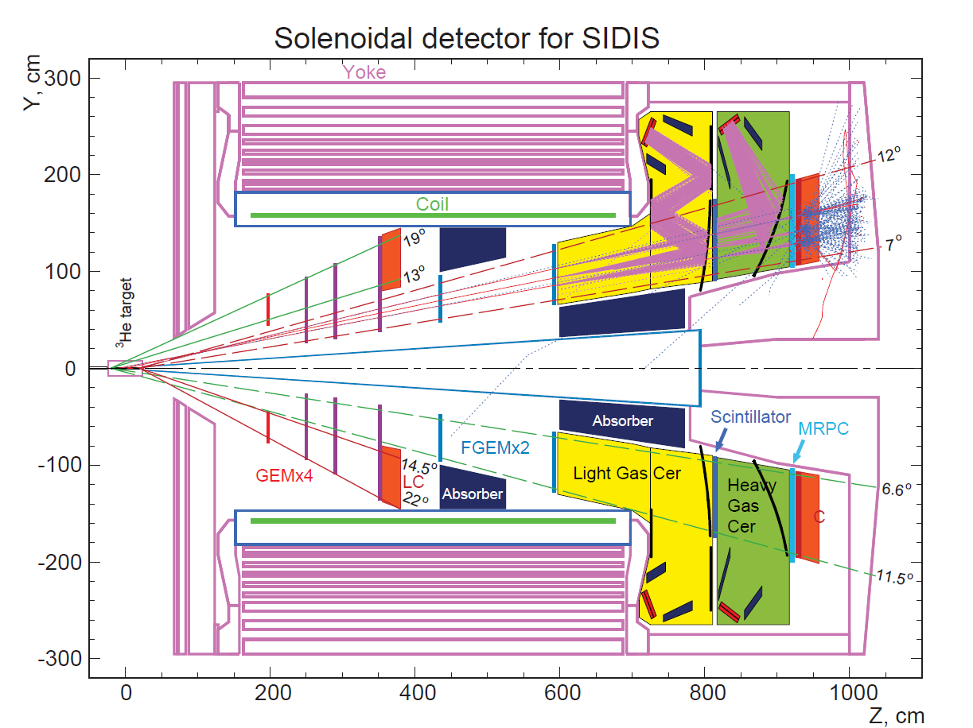
Concept
Purpose
  Provide trigger
  e/ π separation
    π:e <1.5
General features
  Coverage
    13~22 degree
    ~4m² coverage
    3~7GeV
  120kHz (high p)/11kHz (e⁻)
  In ~1.5T field
    Mostly along track
  Radiation hard
    ~10Gy for high p part
Large Angle Cal.
13º
→
22º
e⁻

Slide 5
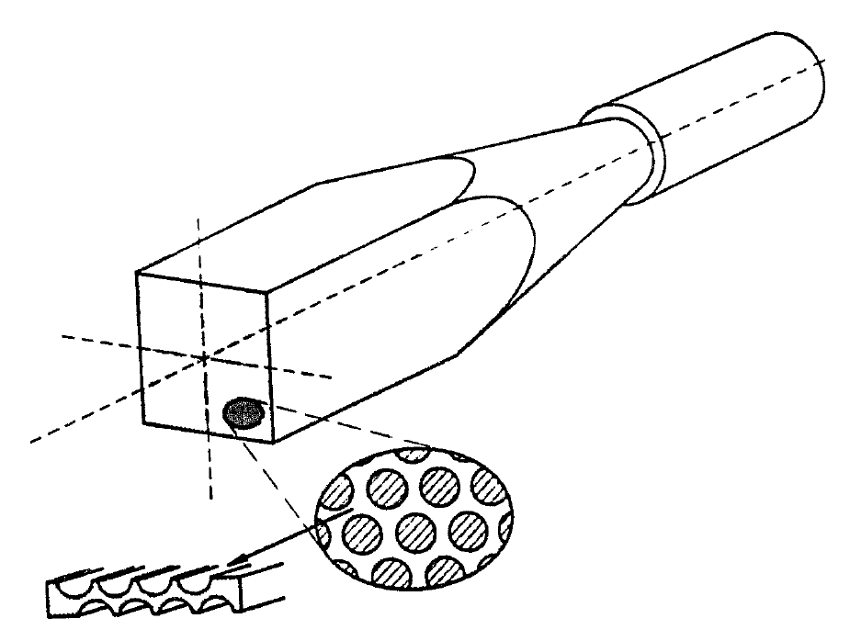
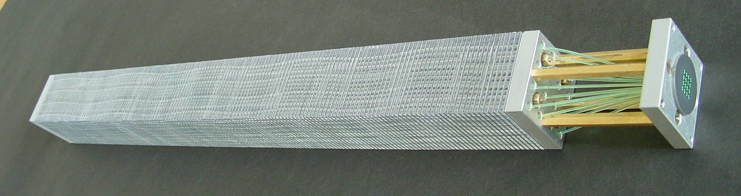
Choice of Calorimeter
Typical Pb SciFi
Hertzog, NIM, 1990
Two main choices
  High resolution, radiation hardness, 100ps timing
SciFi ECal
  Simulation shown in last meeting
    W-Ecal resolution is not enough
    Pb-Ecal (with >50% SciFi ratio) works
  Require large area light readout
  Not cheap (See Zhiwen’s talk)
Shashlik Type
  Pickup/Readout photon with wave-length shifting fiber, small light read out area
  More simulation this talk
Typical Shashlik
Polyakov, COMPASS Talk, 2010

Slide 6
Examples of Shashlik Detectors
Collaborated with IHEP (Russia)
Experiment | COMPASS | PANDA | KIPIO
Pb Thick/ Layer (mm) | 0.8 | 0.3 | 0.28
Sci Thick/ Layer (mm) | 1.5 | 1.5 | 1.5
Energy Res. a/sqrt(E) | 6.5% | ~3% | ~3%
Rad. Length, X₀ (mm) | 17.5 | 34 | 35
Total Rad. Length (X₀) | 22.5 | 20 | 16
Moliere radius (mm) | 36 | 59 | 60
Typical Detecting Energy | 10¹~10²GeV? | <10GeV | <1GeV
Trans. Size (cm) | ~4x4 | 11x11 | 11x11
Active depth(cm) | 400 | 680 | 555
For us:
What’s best Pb thickness?
What’s best rad length?
How to setup preshower?
What’s the Trans. size
W/ new spiral technique to improve uniformity
not crucial for us (with large indenting angle)
Similar in energy range as ours

Slide 7
Rough Cost Estimation
  If PVDIS calo. is not full-backplane coverage (likely), then there will not be enough PVDIS modules to be reconfigured for both calorimeters of SIDIS.
  Need to order new module for large angle cal.
Detector
  Assuming Shashlik calorimeter, 8x8cm modules
  Cost ~ ($0.7k/modules ) x (600 modules) + $50kUSD (1 set mold)
  ~ $500k
Photon detector
  Assuming radiation-hard APD, including cabling/electronics:
  Cost ~ ($1.25k/Chan) x (2 Chan/module [PS/SH]) x (600 modules)
  ~ $1.5M
DAQ - FADC type wave form digitalizer
  Cost ~ ($0.2k/Chan) x (2 Chan/module [PS/SH]) x (600 modules)
  ~ $240k
Support structure : cost ~ 100k

Slide 8
Rough cost summary
Rough Cost ~ ($3.6k/modules ) x (600 modules) + $150k
~ $2.3M
  Dominated by photon detector costs,
  similar cost for choices of FM-PMT (moved to a weaker field location)
  Can look for options of using PMT in an even lower field location, which will pay for light transportation.
Manpower (More rough), assuming purchased module
  Engineer
    designing support structure
    ~ 0.5 Man*year?
  Technician
    Assembly and heavy lifting
    ~ 1 Man*year?
  PhD Student & Post Doc
    Assembly, Testing and Calibration
    ~ 5 Man*year?

Slide 9
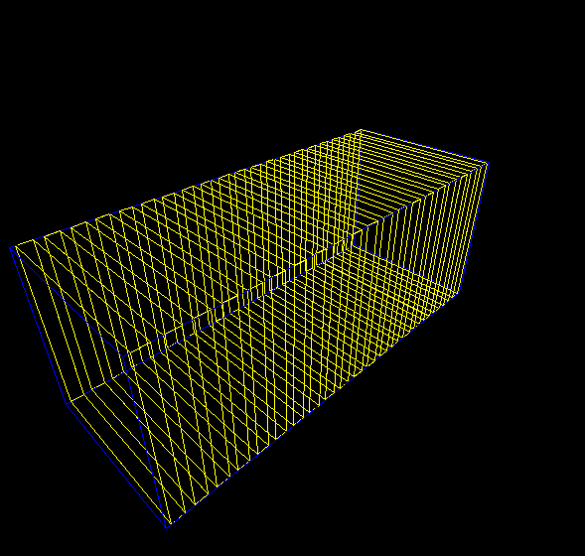
Tuning of Shashlik Parameters for Large angle ECal
Tuning
  Thickness for Pb/layer
  Total Shower Thickness
  Pre-shower Thickness
  Transverse Size
Tools
  Geant4 code improved from CaloSIM
  (CaloSIM was used in last talk)
  No simulation on photon transportation yet
  Phase space (position, angle)
  Generated by Z. Zhao w/SIMC
Figure of Merit
  Pion rejection
  with 97% electron eff.
Example plot w/ 20 layer
electron

Slide 10
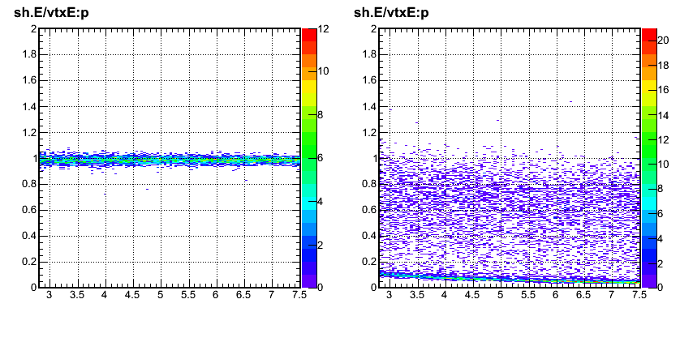
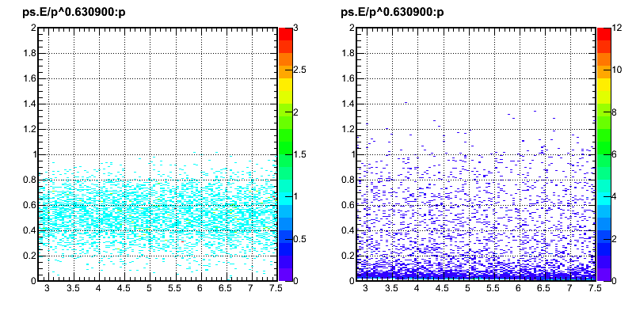
Get Figure of Merit (FOM)
electron
Pion
Make cut on normalized preshower & E/p
Fix electron effciency ~ 97%, look for pion rejection
Average
Pion rejection
in acceptance
-> FOM
E/p
~3σ Cut
P (GeV)
P (GeV)
Normalized preshower
~2σ Cut
P (GeV)
P (GeV)

Slide 11
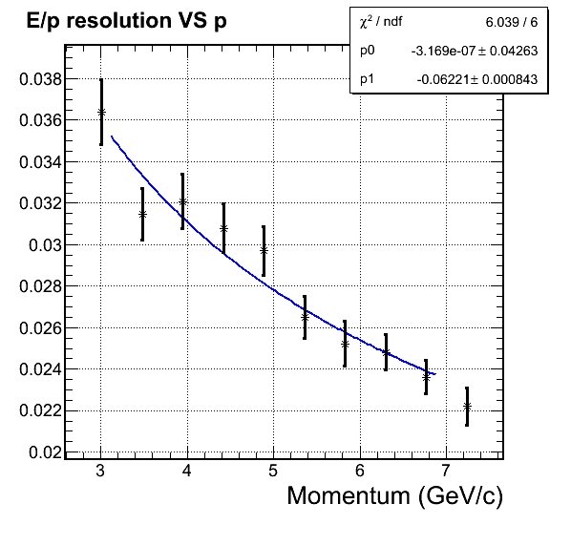
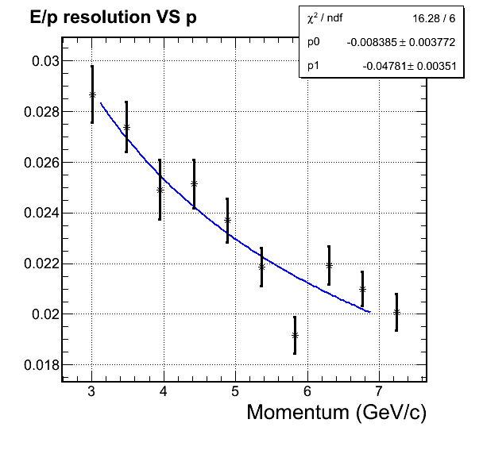
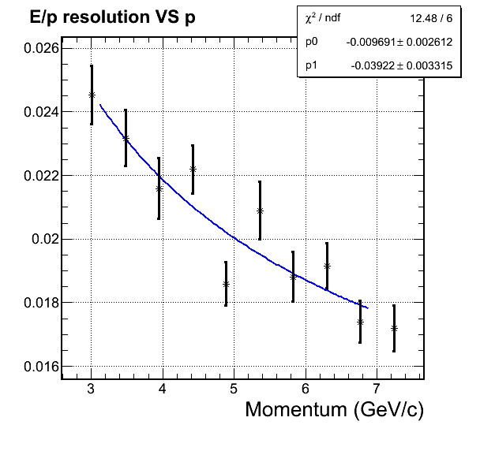
Thickness of Pb layer
Thinner Pb layer:
  more sampling fraction & better energy resolution
  Thicker module for same rad length
  More costly
Thinner Pb, better sampling, better resolution
1.0 mm Pb/layer
ΔE~6%/sqrt(E)
0.8mm Pb/layer
ΔE~5%/sqrt(E)
0.6mm Pb/layer
ΔE~4%/sqrt(E)

Slide 12
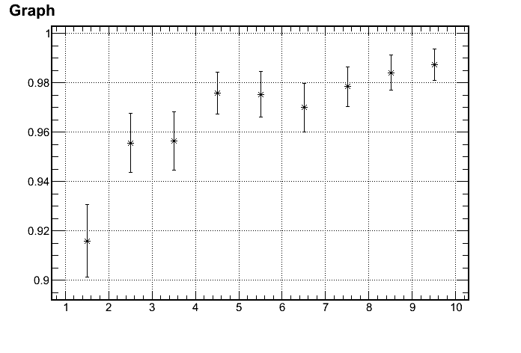
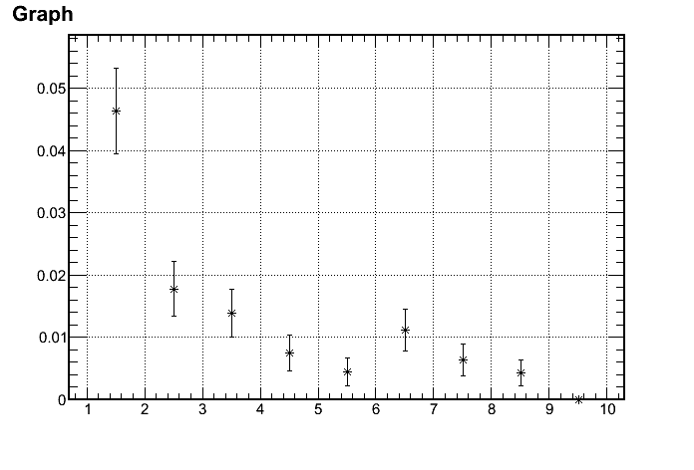
Pion Rejections
  Reach 100:1 pion rejection w/ Pb =0.6mm/Layer
  Single point source simulated
Electron Efficiency
1/(Pion rejection)
97%
1/100 Rejection
p (GeV)
p (GeV)
Active:
3~7 GeV

Slide 13
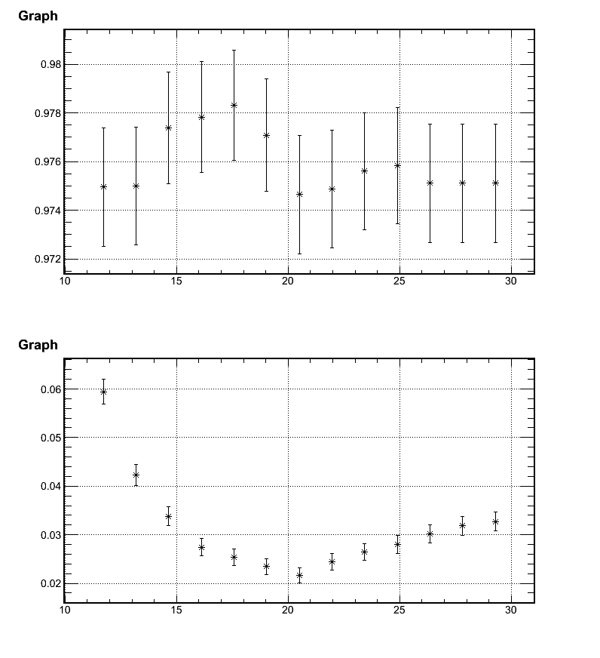
Scan for best total shower thickness
Tested w/ Pb = 0.8mm/Layer
Electron Efficiency
0.6mmPb w/ 20 rad length
-> 180Layer 420cm
Default depth~ 0.5m
Total rad length
Reach Best rejection @ ~20 rad length
1/ (Pi rejection)
Minimal is best
Can not contain EM shower
More hadron shower
Total rad length

Slide 14
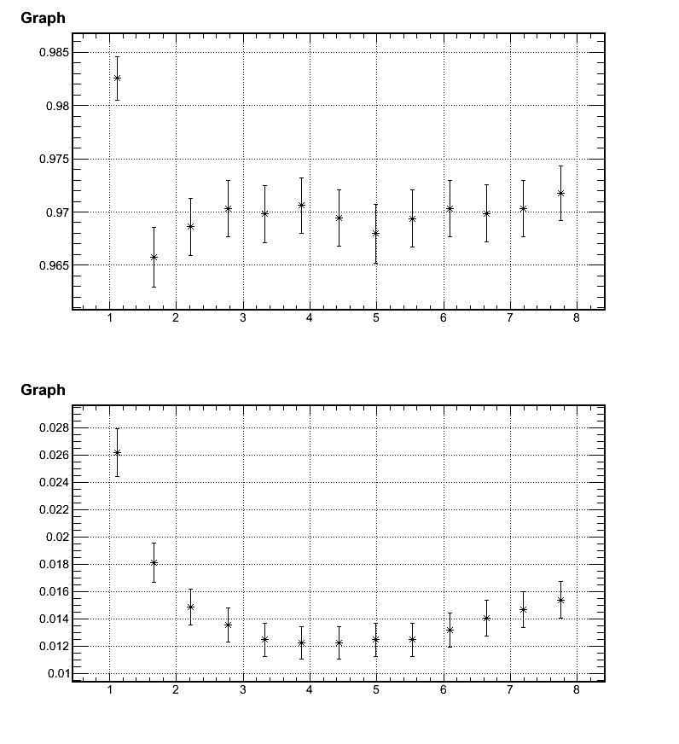

Scan for best preshwoer shower thickness
Tested w/ Pb = 0.6mm/Layer
Electron Efficiency
No preshower separation
Total rad length
Reach Best rejection @ 3~5rad length
1/ (Pi rejection)
Minimal is best
Total rad length

Slide 15
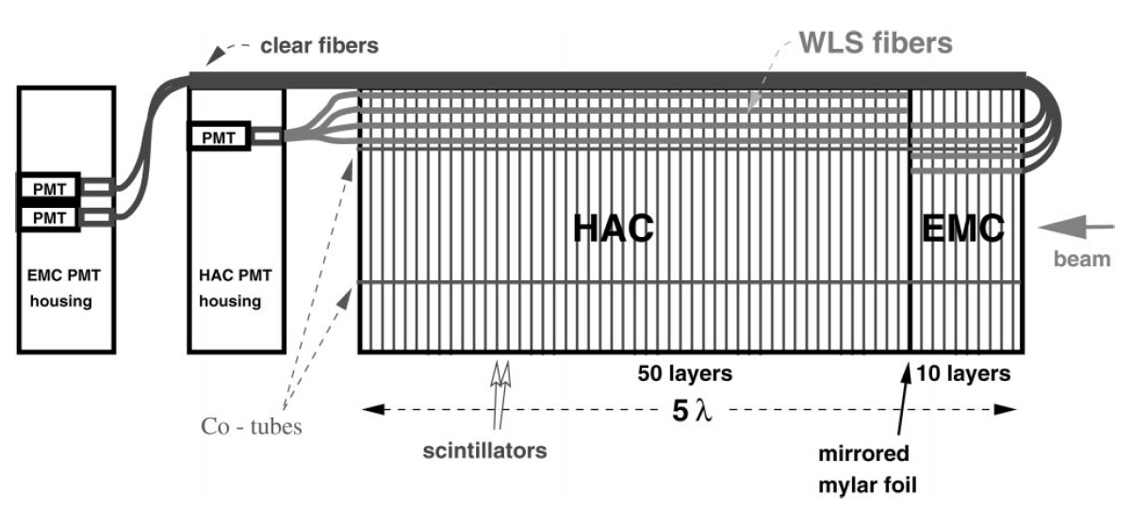
Preshower – Readout options
More difficult to arrange wavelength shifting fiber (WSF) for preshower
Options
  Curve fiber from front, example (ZEUS) below
  Run fiber through shower part within light-protected tube
    R & D needed
  Run preshower fiber (separately) to outside magnetic field
ZEUS forward Cal.
Bamberger, NIM, 2000

Slide 16
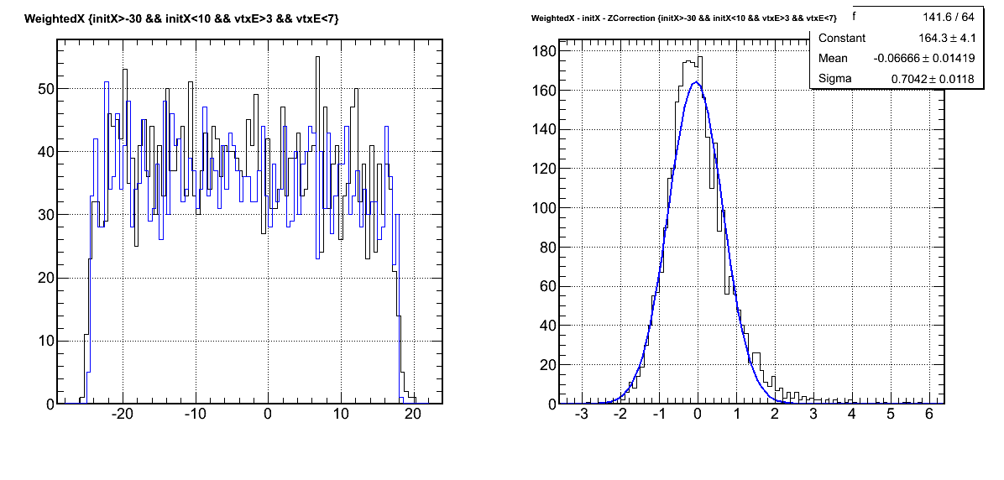
Transverse Size
Larger Transverse Size means
  Less position resolution, position become discrete
  More background
  Less Cost
Illustration w/ 2x2cm model (intrinsic res.)
Energy deposition weighted position average
Integrated over working momentum range
Reconstructed
– (Track projection)
σ(ΔR)~0.7cm
Electron Track Projection
Reconstructed
R (cm)-1(cm)
ΔR (cm)

Slide 17
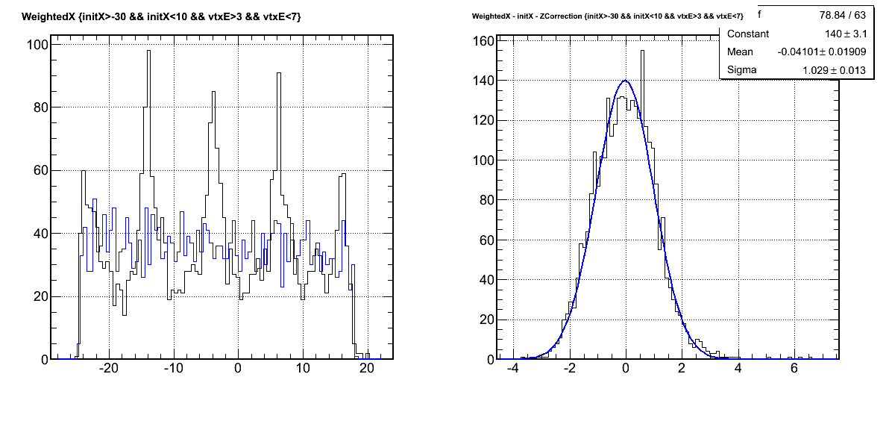
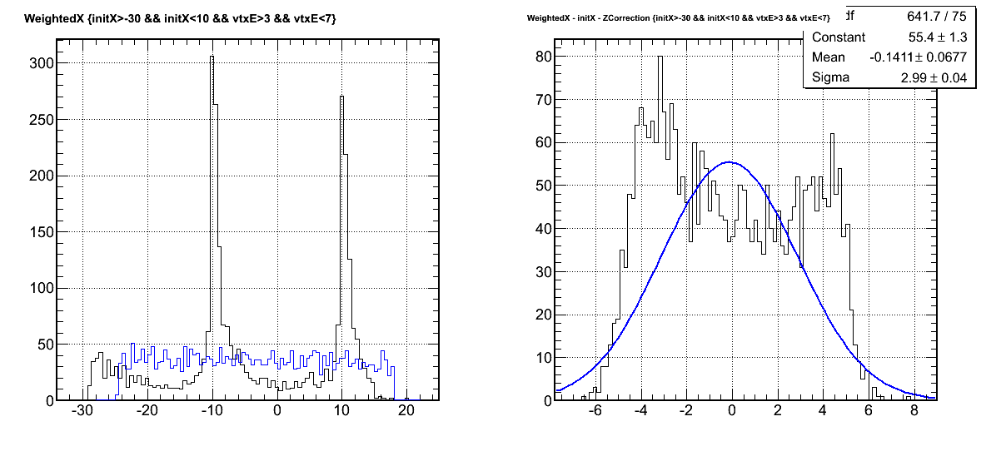
Electron Track Projection
Reconstructed
Difference
10x10 cm block size
Noticeably discrete
σ(ΔR)~1.0cm
R (cm)-1(cm)
ΔR (cm)
Electron Track Projection
Reconstructed
Difference
20x20 cm block size
Discrete effect dominant
σ(ΔR)~3.0cm
R (cm)-1(cm)
ΔR (cm)

Slide 18
More consideration on transverse size
Rough numbers only
w/ 50ns ADC gate
block Size (cm)

Slide 19
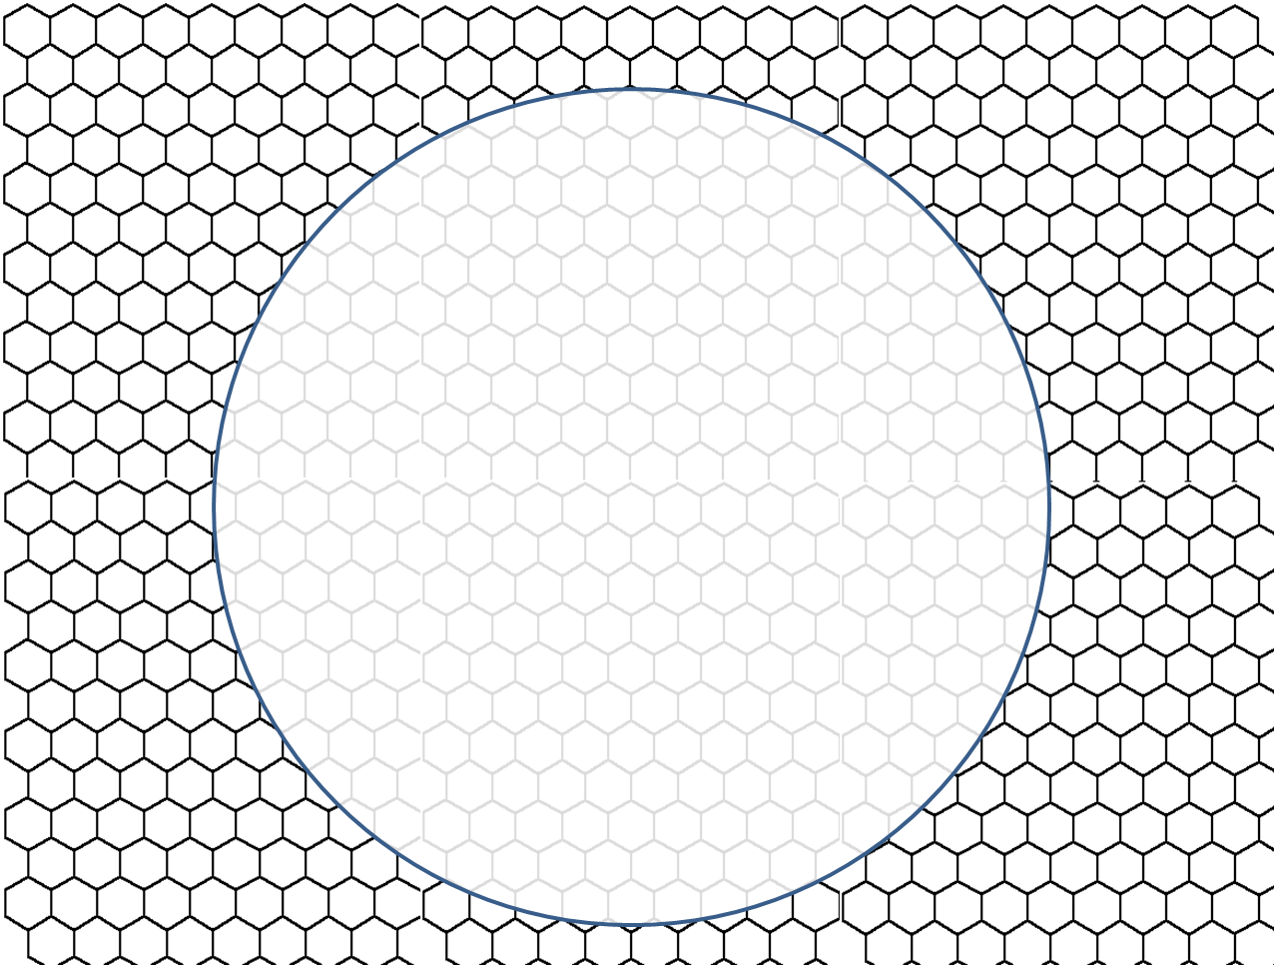
Put blocks together
Pattern: Square shape or Hexagon shape (below)
In sectors: need more molds

Slide 20
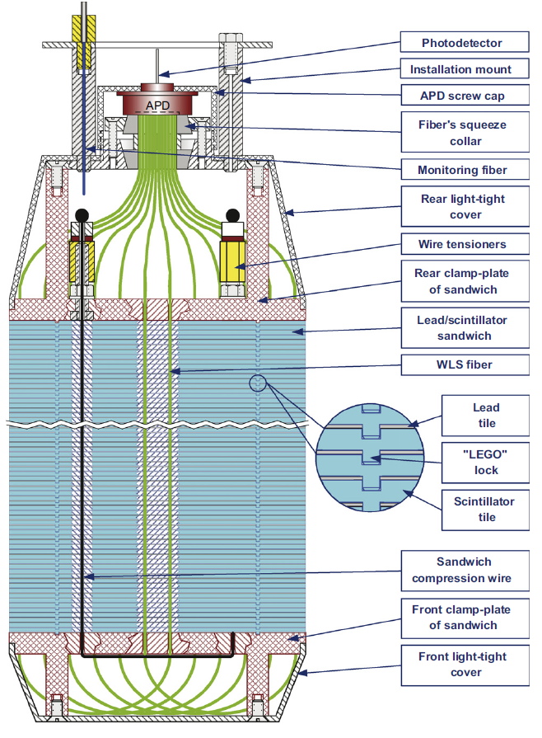
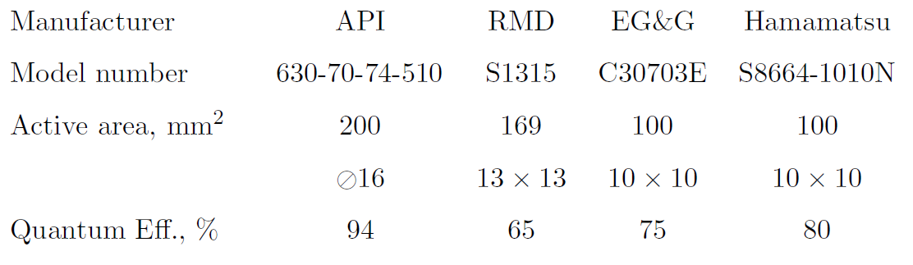
Choice of Light Read Out
In field (1.5T) readout
  Avalanche Photo Diode (APD)
  used by KIPIO with Shashlik
  More rad resistant than SciPM
  But test needed
  GEMs read out?
Out field readout
  Next two slides

Slide 21
Choice of Light Read Out
No field, use PMT
Fiber/light guild read out: 3m in CDF design
PMT Read out
13º
→
22º
e⁻

Slide 22
Choice of Light Read Out
small field, use gap in
Fiber/light guild read out: 1m in CDF design
PMT Read out
13º
→
22º
e⁻

Slide 23
Summary
Shashlik calorimeter is appealing
  Less area to readout light
  Established technology
  Need further study to finalize setup
  Looks good:
  0.6mm Pb/layer, 20X₀(Totoal Shower)/4X₀(preshower)
Readout technique is still challenging
  Need test on APD, exploring out-field readouts
Total cost ~ a few M$
  Dominated by readout detector

