Slide 1
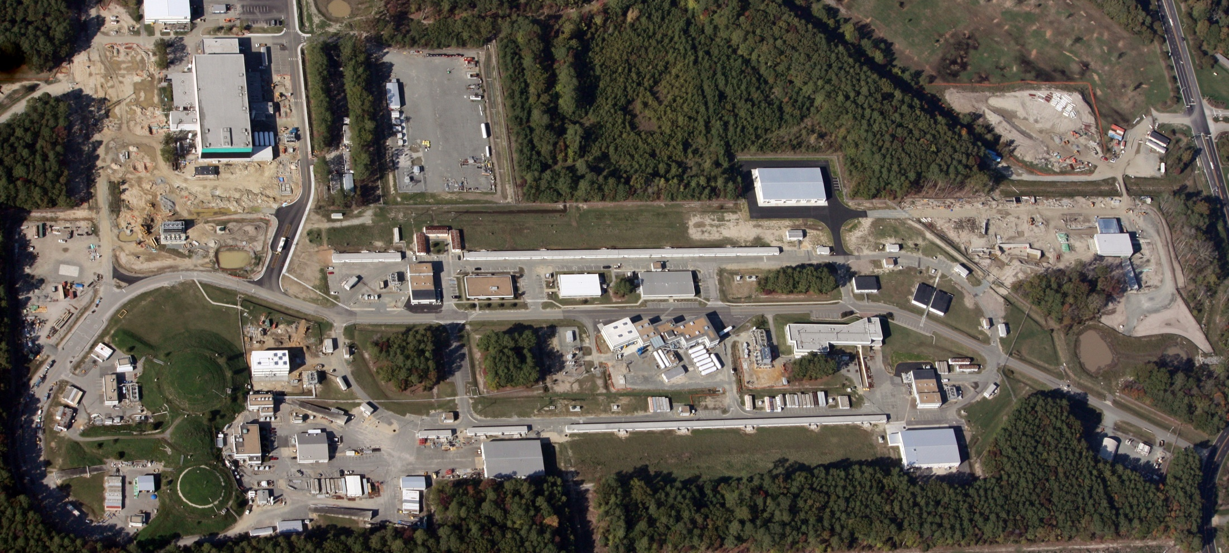
Jefferson Lab
Hugh Montgomery
SOLID Collaboration Meeting
June 2, 2011

Slide 2
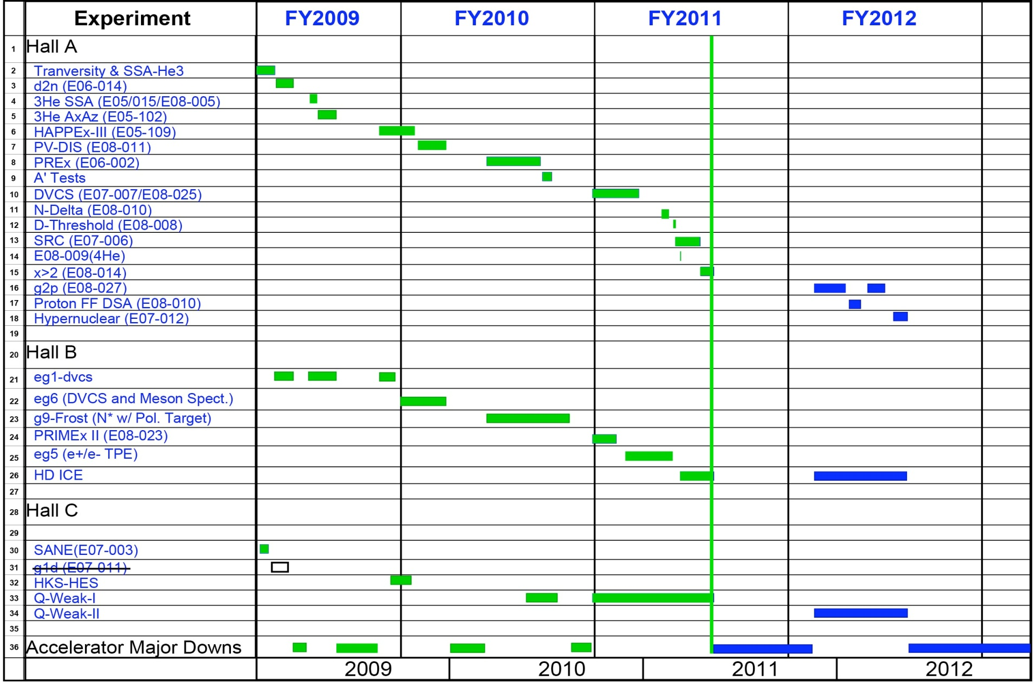
Experimental Nuclear Physics Program
X

Slide 3
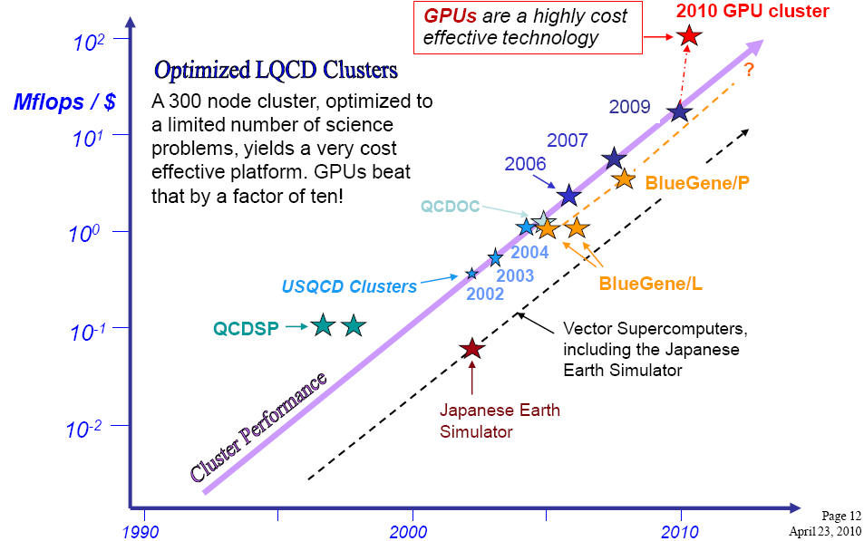
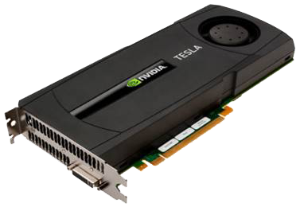
Theoretical and Computational Physics
Strongly coupled to local universities through joint appointments which support 50% of effort
Strongly coupled to Jefferson Lab experimental program
  Radiative Corrections
  Excited Baryon Analysis Center
  Imaging of the nucleon
  Lattice Gauge calculations of QCD

Slide 4
12 GeV Upgrade Project
Upgrade is designed to build on existing facility: vast majority of accelerator and experimental equipment have continued use
New Hall
Add 5 cryomodules
Upgrade arc magnets
and supplies
CHL upgrade
Maintain capability to deliver lower pass beam energies:
2.2, 4.4, 6.6….
20 cryomodules
Add arc
20 cryomodules
Add 5 cryomodules
Scope of the project includes:
Doubling the accelerator beam energy
New experimental Hall and beamline
Upgrades to existing Experimental Halls
Enhanced capabilities
in existing Halls

Slide 5
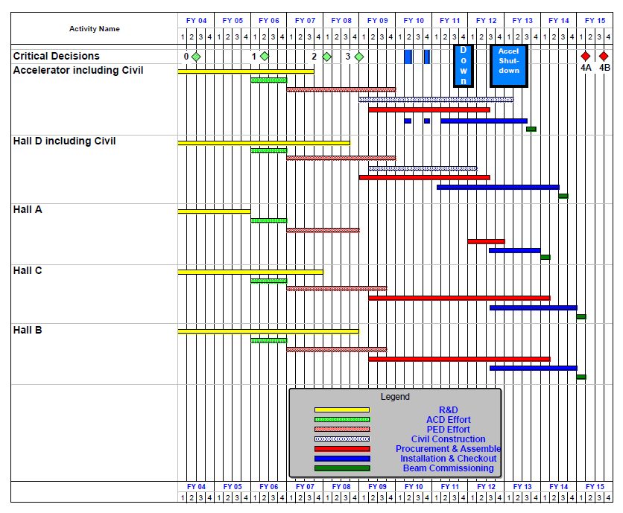
12 GeV Upgrade Schedule
Two short parasitic installation
periods in FY10
6-month installation
May – Oct 2011
12-month installation
May 2012 – May 2013
Hall A commissioning start
October 2013
Hall D commissioning start
April 2014
Halls B/C commissioning start
October 2014
Project Completion
June 2015

Slide 6
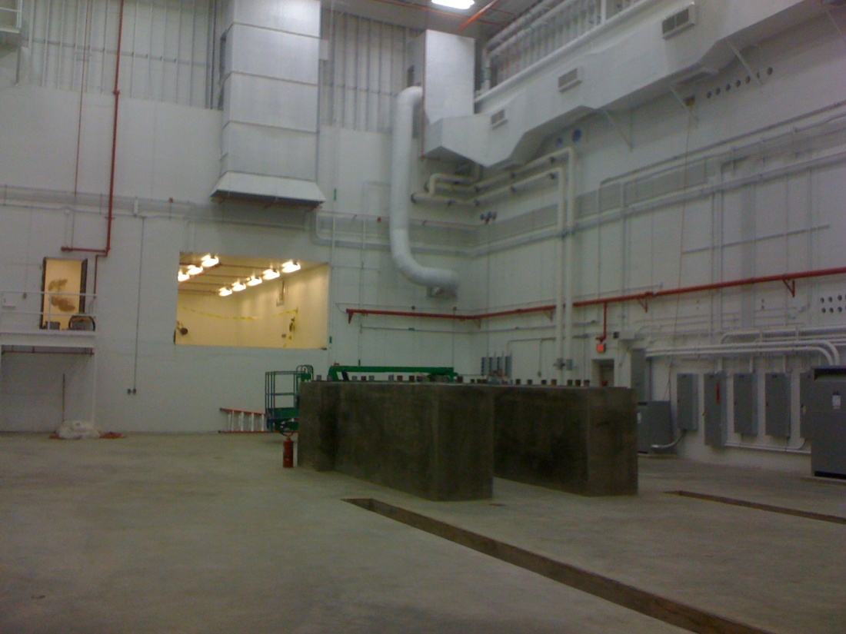
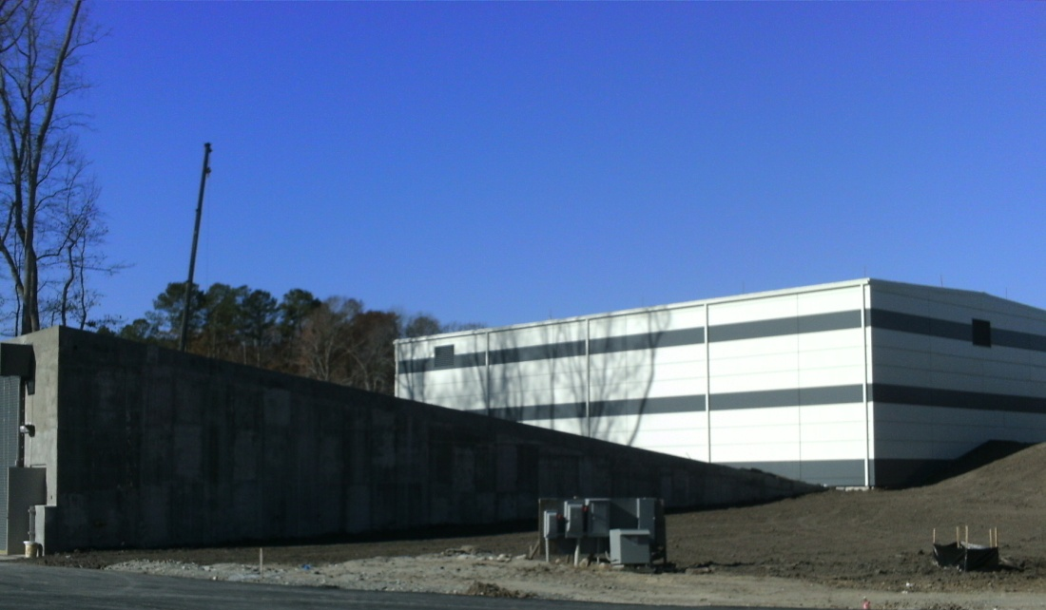
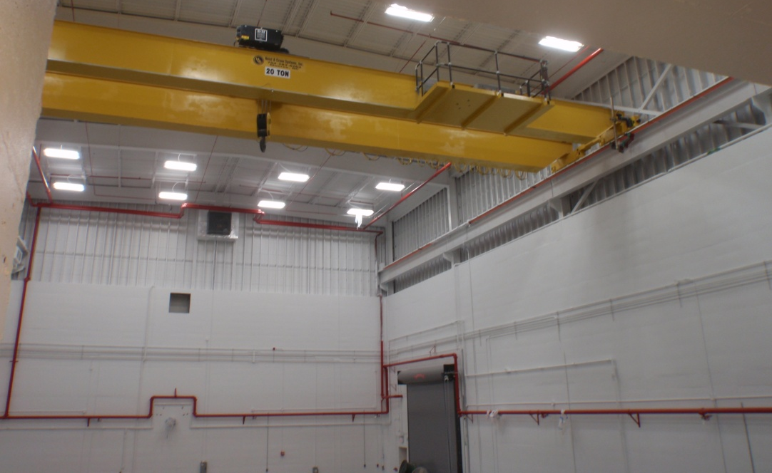
Hall D Status – Dec. 2010
Ready For Equipment (RFE)
Dec. 28, 2010

Slide 7
Jefferson Lab 12 GeV Upgrade
An exciting scientific opportunity
Explore the physical origins of quark confinement (GlueX)
New access to the spin and flavor structure of the proton and neutron
Reveal the quark/gluon structure of nuclei
Potential new physics through high precision tests of the Standard Model
Strong User community involvement
NSF MRI and NSERC funding to universities for detector elements
Strong international collaborations and contributions
> 32 PAC-approved experiments – ranking in progress
Accel-Civil-Physics scope leverages the existing facility
Construction is well underway!
Notes:
Upgrade Project Status

Slide 8
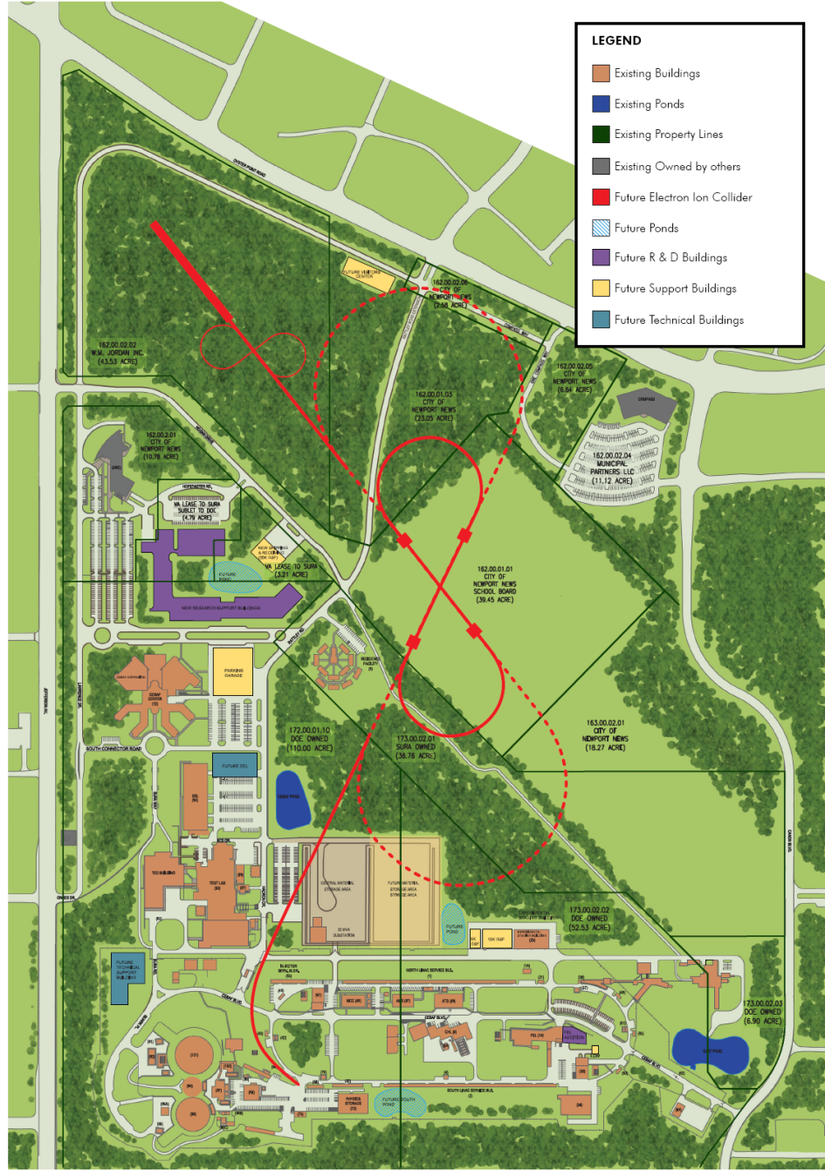
Electron Ion Collider at Jefferson Lab Site
 | Energies | s | Design Luminosity
(M)EIC@JLab | Up to 11 x 60+ | 240-3000 | Close to 10³⁴
Future ELIC@JLab | Up to 11 x 250 (20? x 250) | 11000 (20000?) | Close to 10³⁵
Staged eRHIC@BNL | Up to 5 x 250 | 600-5000 | Close to 10³⁴
eRHIC@BNL | Up to 20 x 325 (30 x 325) | 26000 (39000) | Close to 10³⁴
ENC@GSI | Up to 3 x 15 | 180 | Few x 10³²
LHeC@CERN | Up to 150 x 7000 | 4200000 | Close to 10³³

Slide 9
Electron Ion Collider Realization Imagined
Activity Name | 2010 | 2011 | 2012 | 2013 | 2014 | 2015 | 2016 | 2017 | 2018 | 2019 | 2020 | 2021 | 2022 | 2023 | 2024 | 2025
12 GeV Upgrade
FRIB
EIC Physics Case
NSAC LRP
EIC CD0
EIC Machine Design/R&D
EIC CD1/Downsel
EIC CD2/CD3
EIC Construction

Slide 10
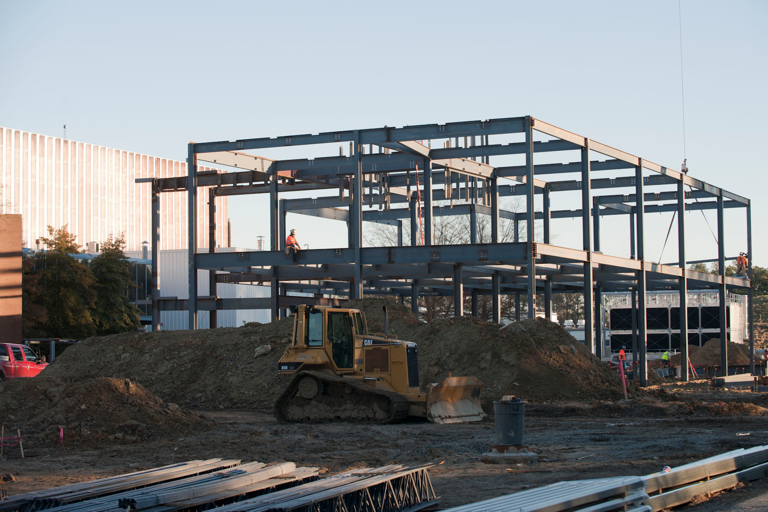
Infrastructure Construction
Superconducting electron accelerator provides 100% duty factor beams of unprecedented quality, with high polarization at energies up to 6 GeV.

Slide 11
Jefferson Lab
Experimental and Theoretical Nuclear Physics Programs Scope expanding – Electroweak, New Phenomena 12 GeV Upgrade Project. Accelerator science, superconducting radio-frequency and cryogenic techniques Synergistic R&D and science program using the Free Electron Laser facility Laboratory infrastructure (TEDF Project) Accelerator based future in science Welcome to Jefferson Lab

