Slide 1
Quick Review for E12-11-007
Asymmetries in SIDIS (e, e’π±)
on a Long. Pol. ³He Target
For SoLID Collaboration Meeting
Spokespersons
Jian-Ping Chen (JLab)
Jin Huang (MIT)
Yi Qiang (JLab)
Wenbiao Yan (USTC, China)
Notes:
! One of the leading group will be China institute …
! Slow down for important points
! Say: China institute in Spokes person. Play major role
+ FFs. Harut talk BNL
+ Naomi talk for animation

Slide 2
Overview
Azimuthal Asym. in SIDIS π± production
  longitudinally polarized ³He target
  SoLID spectrometer (Same setup as E12-10-006)
  High precision, Multi-dimensional mapping of
  A_{UL}, A_{LT} , A_{LL} for neutron
To study
  Quark spin-orbit correlations through
  “worm-gear” TMD PDFs
Beam requests
  35 PAC days of 11GeV and 8.8GeV Beam, 15uA
  Beam pol. = 85%, same for E12-10-006
Notes:
! Introduce related experiments, He-3

Slide 3
Major Setup Difference
Comparing to PVDIS (same for 12GeV Transversity)
  SIDIS SoLID detector package
    Reconfiguration for the forward region
    Add large angle electron detection
  Polarized He-3 Target
    Achieved performance quoted
Comparing to 12GeV Transversity
  Longitudinal polarization of He-3 target
    Already used in 6GeV program: Target support both Longitudinal & Transverse polarization
  Polarized beam is important for both experiment
    Standard Hall A pol. already satisfy requirement
SoLID
e’
11/8.8GeV
CEBAF Beam
P
³He
Polarimetry:
Moller & Compton
π±
Beam
Helicity
Target
Spin

Slide 4
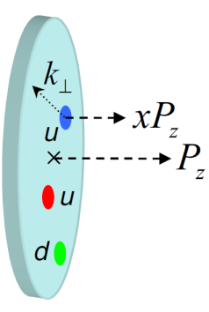
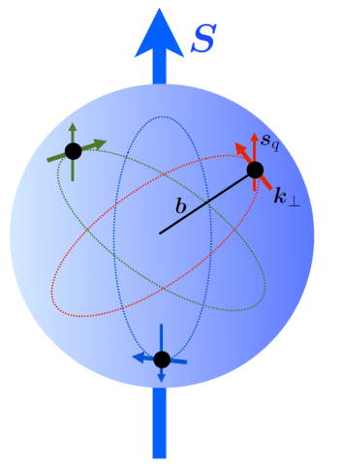
Transverse Momentum Dependent (TMD) Parton Distributions
TMD PDFs link
  Intrinsic motion of partons
  Parton spin
  Spin of the nucleon
Multi-Dimension structure
  Probes orbital motion of quarks
A new phase of study, fast developing field
  Great advance in theories (factorization, models, Lattice ...)
  Not sys. studied until recent years
    Semi-Inclusive DIS (SIDIS): HERMES, COMPASS, Jlab-6GeV, ...
    p-p(p_bar) process : FNAL, BNL, ...
in DIS
Nucleon -> Plate
L ≠? 0
→Transverse motion
Notes:
! Read experiment names
A crucial innovation in this new phase of investigation of the fundamental structure of matter is looking at, and studying, physical observables which are sensitive to the transverse structure of the nucleon. This information is encoded in the so-called Transverse Momentum Dependent partonic Distributions or TMDs, which link the intrinsic motion of partons to their spin and the spin of the parent nucleon.
TMDs can be used to construct a three-dimensional picture of partons inside hadrons in momentum space and may be related to the orbital angular momentum of partons. Here is a naïve picture why OAM and TMD are correlated: in DIS, since the momentum transfer is large, nucleon contracts into a pancake. However, on the transverse plane, which is perpendicular to that of virtual photon momentum transfer, transverse motion of the quark is conserved. Therefore if quark carries OAM in side this polarized nucleon, transverse momentum will be non-zero.
Therefore TMD opened a new phase of study. There was few studies of TMD until a decade ago. But this field are fast developing in both theory and experimental ways ...

Slide 5




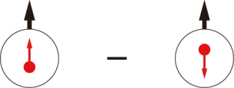
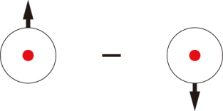
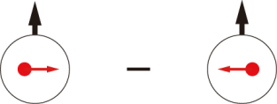
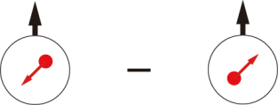
Leading-Twist TMD PDFs
Nucleon Spin
Quark Spin
 |  | Quark polarization
 |  | Unpolarized (U) | Longitudinally Polarized (L) | Transversely Polarized (T)
Nucleon Polarization | U
 | L
 | T
f₁ =
h₁⊥ =
Boer-Mulders
h_{1L}⊥ =
g₁ =
Worm Gear
(Kotzinian-Mulders)
Helicity
h₁ =
f _{1T}⊥ =
Transversity
g_{1T} =
Sivers
h_{1T}⊥ =
Worm Gear
Pretzelosity
: This proposal, T-even
Notes:
! TMD helicity distribution
! He-3 experiments on Sivers… has been approved/ CA
! Boer-Mulders approved in Hall B.
! Say Sivers and BM are T-odd

Slide 6
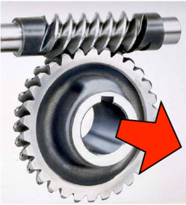
“Worm-Gear” Functions
h_{1L}⊥ =
Leading twist TMD PDFs
Dominated by real part of interference between
L=0 (S) and L=1 (P) states
  Imaginary part -> Boer-Mulders effect, Sivers effect
No GPD correspondence
  a genuine sign of intrinsic transverse motion
g_{1T} =
Worm Gear
h_{1L}^{⊥(1)}
P-D int.
S-P int.
Light-Cone CQM by B. Pasquini
B.P., Cazzaniga, Boffi, PRD78, 2008
Notes:
! Say Boer-Mulders, Sivers measured, complementary picture

Slide 7
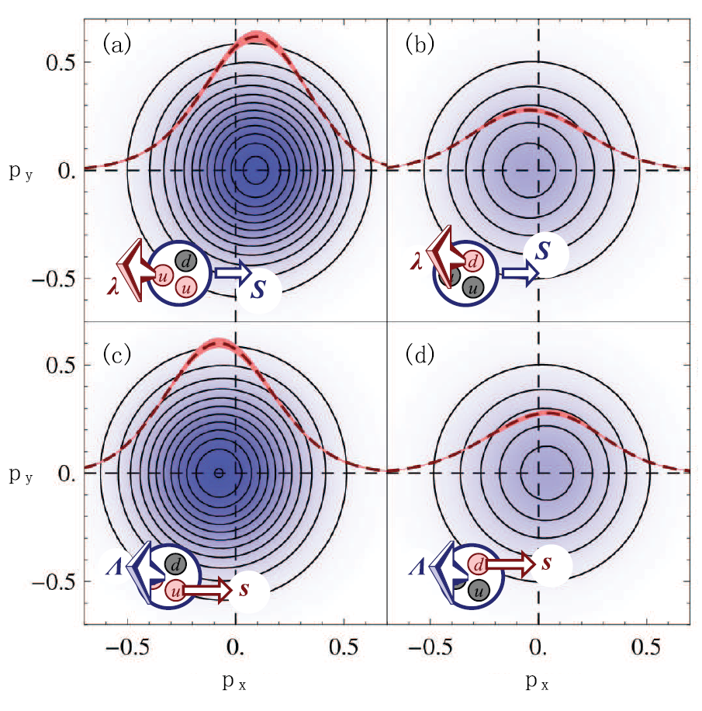
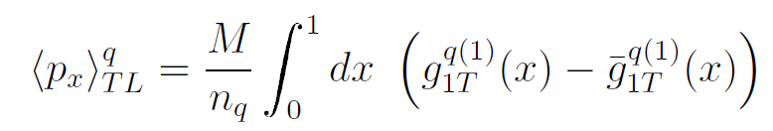
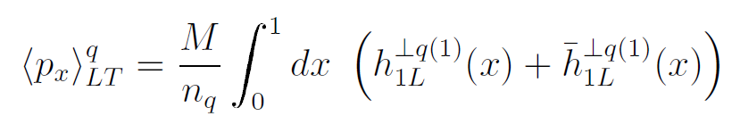
Lattice Calculations
So far using simplified straight gauge links
“Worm-gear” TMDs → dipole shift @ Trans Mom.
B. Musch, et. al. arXiv:0908.1283; 1011.1213, m_{π}~500GeV
u
d
Spin: Nucleon (T), Quark (L)
u
d
Spin: Nucleon (L), Quark (T)
-
Notes:
Prepare to answer questions, back up slides

Slide 8
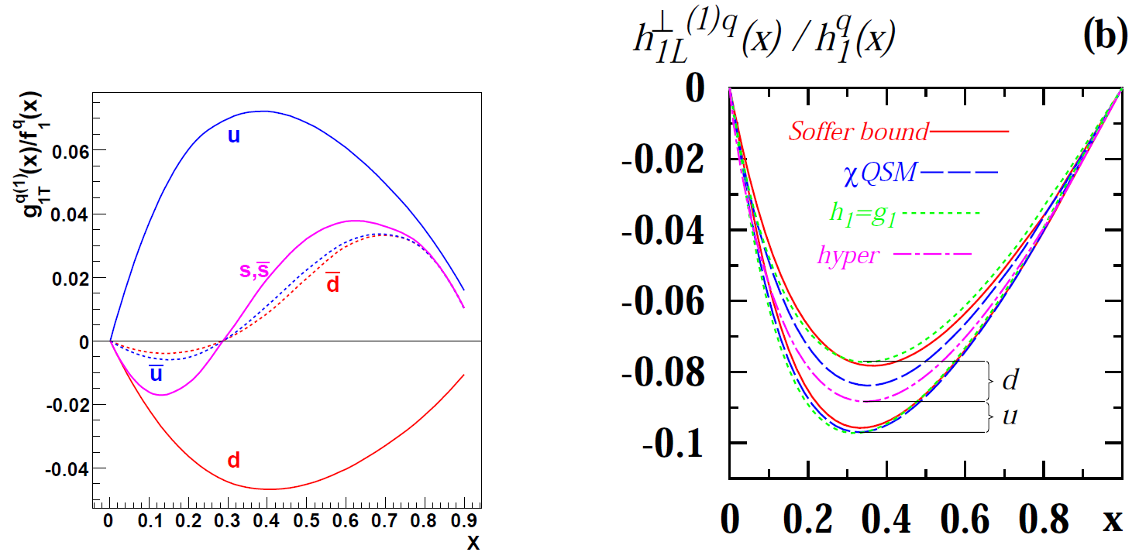
Model Predictions
Generic features of model predictions:
  max @ valence x region
  ~ a few percent w.r.t. unpolarized f₁
  u & d quarks take opposite signs
h_{1L}⊥ =? -g_{1T}
  Supported by many models and favored by current Lattice
Kotzinian, PRD73, 2006
Avakian, PRD77, 2008

Slide 9
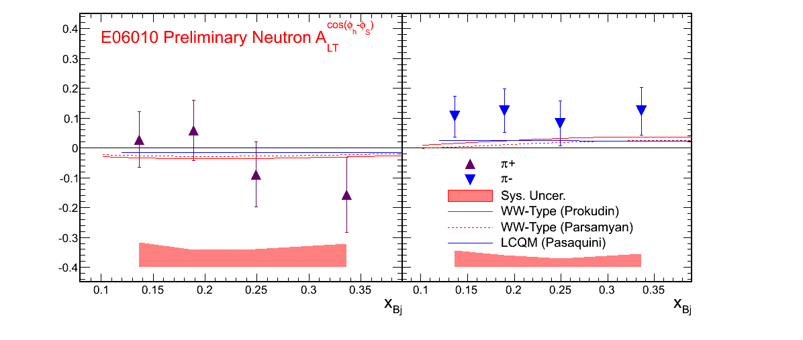
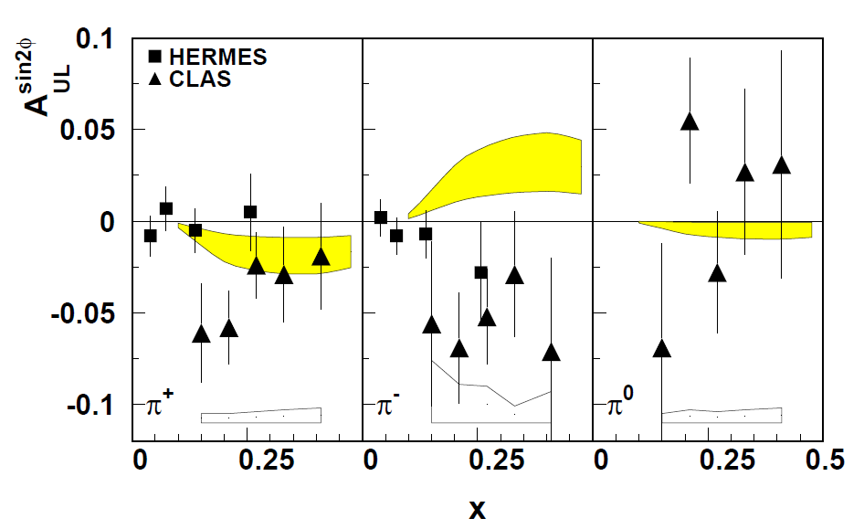
h_{1L}⊥ = -g_{1T} favored (naively)
This experiment: Test at identical kinematics
Flip Sign?
⊥u
g_{1T}^{u} >?0
h_{1L} <?0
d quark in neutron dominant A_{LT}(n→π⁻)
u in proton dominant
A_{LT}(n→π⁻)
π⁻
π⁺
Hall A A_{LT} on ³He
CLAS A_{UL} on proton
Notes:
Need charge symmetry

Slide 10
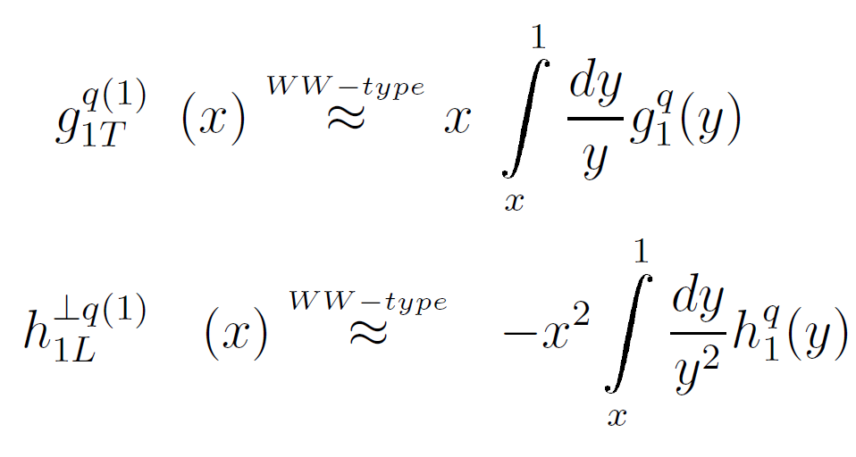
WW-type Approx.
“Worm-gear” TMDs → collinear PDFs through
  Lorentz Invariance Relations (LIR)
  Wandzura-Wilczek (WW) approximation
  Assumptions: q-g correlation small, m_{q} small
Test with collinear PDFs to probe q-g correlation
Indirect information on Transversity, h₁
and

Slide 11
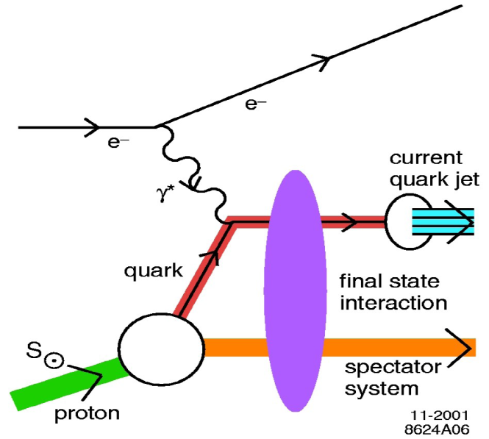
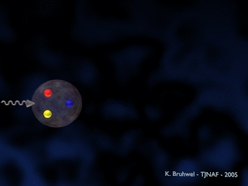
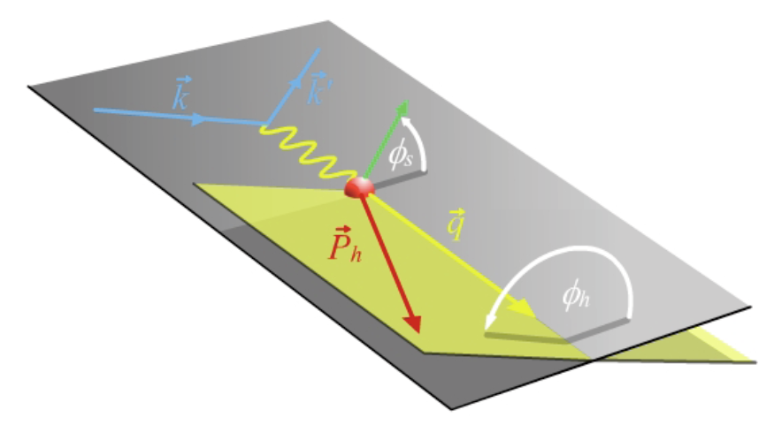
Semi-inclusive DIS (SIDIS)
k’
Access new TMDs
not accessible in inclusive DIS (m_{quark}=0)
Variables:
x, q, Q², z, W, W’
k
q, Q²
P_{h}/z
xP
W
W’
P
Scattering Plane
Notes:
! SIDIS -> conv. PDF & FF
Introduction to DIS and its variables
Introduction to azimuthal angle
Factorized at Q^2>>p_T>>QCD scale

Slide 12
SIDIS is Gold Mine for TMD
f₁ =
Boer-Mulder
h₁⊥ =
Worm Gear
h_{1L}⊥ =
Helicity
g₁ =
Worm Gear
g_{1T} =
Transversity
h_{1T} =
Sivers
f _{1T}⊥ =
Pretzelosity
h_{1T}⊥ =
S_{L}, S_{T}: Target Polarization; λ_{e}: Beam Polarization
Notes:
TMDs could be accessed through cross sections of SIDIS. Each TMD is related with a term of characteristic target-beam spin combinations and angular modulation.
TO BE simplified

Slide 13
Observables
Scattering Plane
Systematic uncertainty improved with
Fast spin/helicity flips
Large & Symmetric acceptance
  A_{UL} →h_{1L}
  A_{LT} →g_{1T}
Single Beam Asymmetry:
Double Spin Asymmetry:
e’
e’
e
n
e
n
X
X
π
π
Target
Spin
Beam
Helicity
Target
Spin
Φ_{h} coverage is important

Slide 14
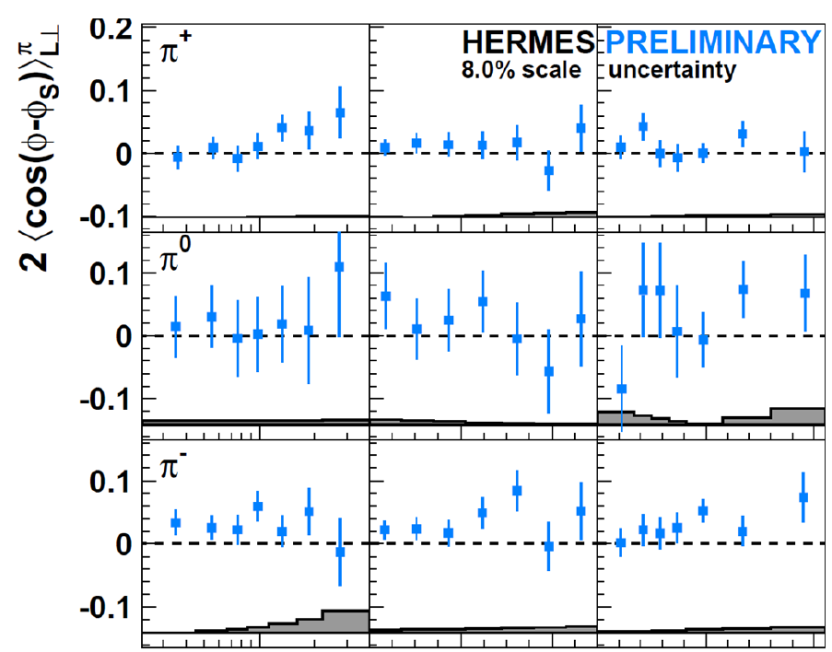
Existing data
A_{UL} (→ h_{1L}⊥)
  No neutron data to date
  Proton (HERMES, CLAS)
  Deuteron (COMPASS, HERMES)
A_{LT} (→ g_{1T})
  First Neutron A_{LT}:
  6GeV Transversity
  Deuteron A_{LT}:
  COMPASS
  New proton data
  reported in Apr
New: HERMES Proton ALT
Pappalardo, DIS2011

Slide 15
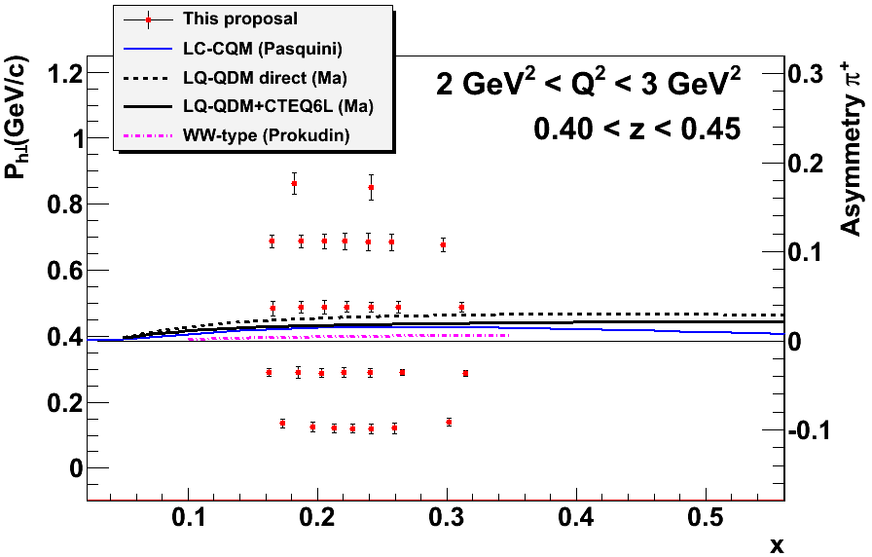
Data Projection/A_{UL} (Partial)
Projection of a single Q²-z bin for π⁺ (35 PAC day)
Center of points:
Scale for error bars:
Notes:
+ bound

Slide 16
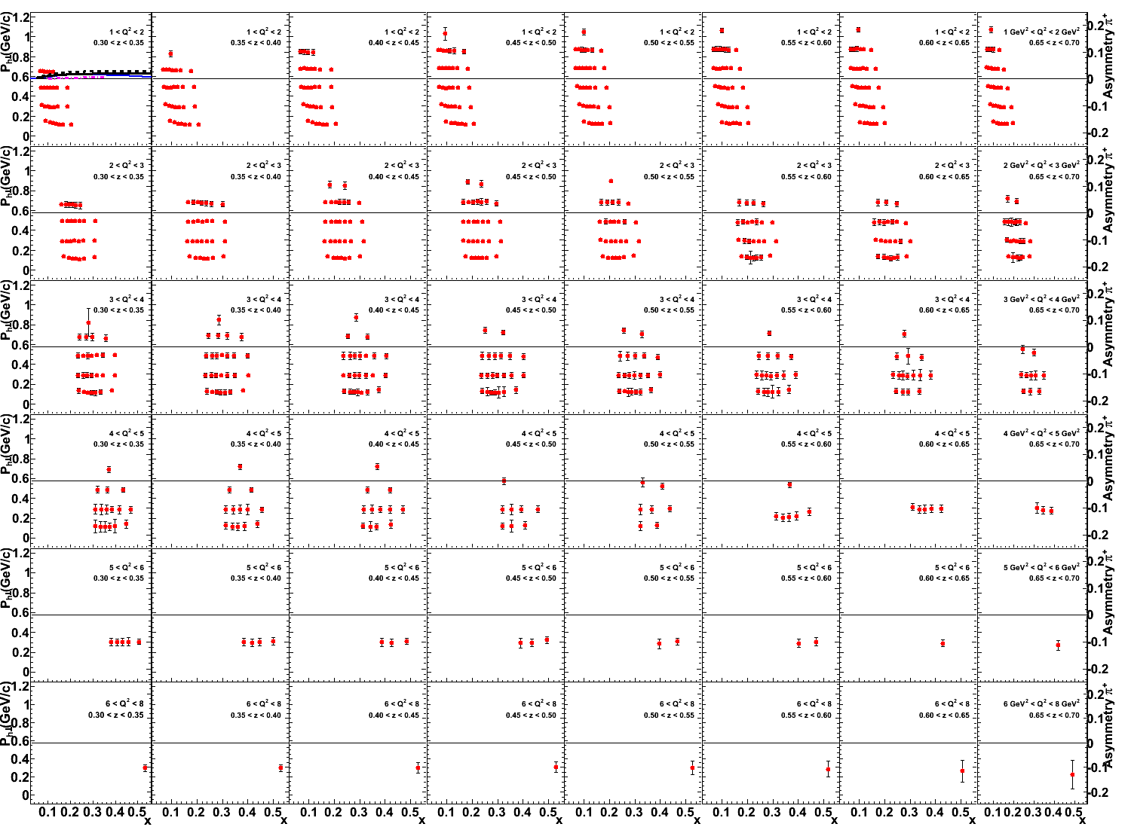
>1000 bins: critical for studying multi-D structure
z= 0.3~0.7
x_{bj}
P_{h⊥} (GeV/c)
Q² = 1~8 GeV²
Scale for error bars : π⁺ A_{UL}
Notes:
! Slow

Slide 17
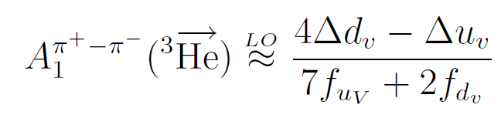
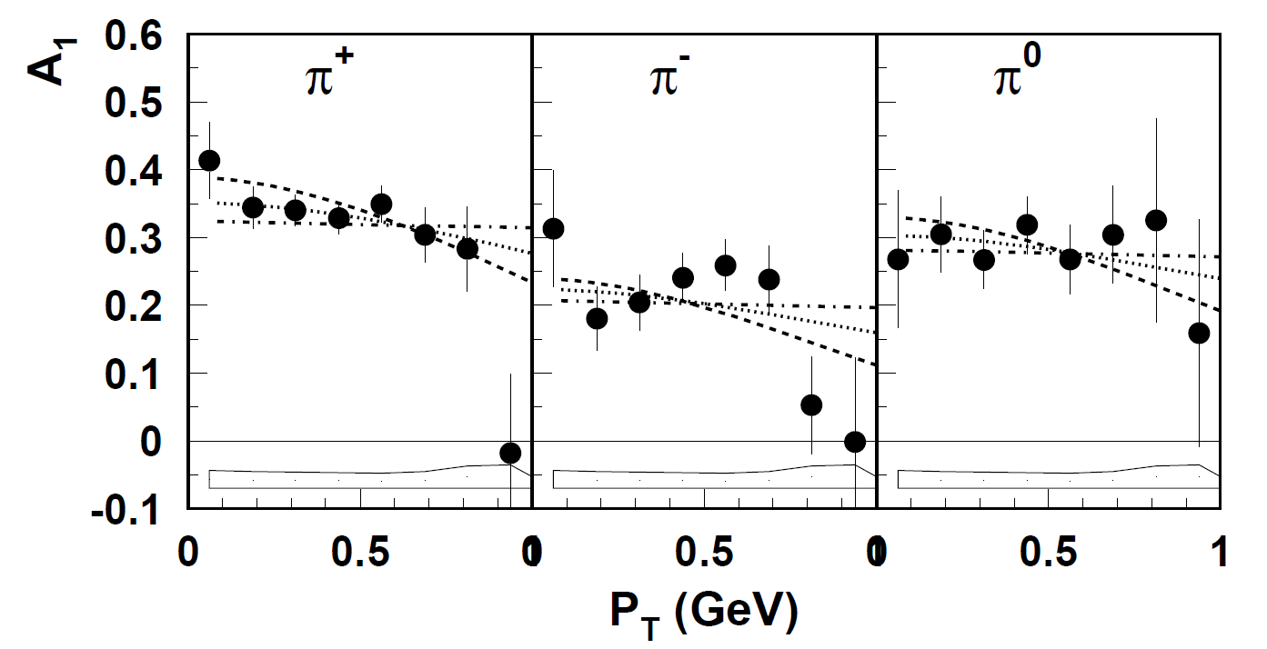
p_{T} Dep. Helicity Distribution
DSA on long. pol. ³He, A_{LL} → helicity g₁(x,p_{T})
Contribute to global analysis
  Quark flavor tagged by detected meson
  Significantly reduce uncertainty on Δd
p_{T} dependency of A_{LL}
  flavor dep. of p_{T} width
  ~ different OAM of quarks
  arXiv:0705.1553
CLAS proton A_{LL} , arXiv:1003.4549

Slide 18
Conclusion
SIDIS charged pion production
ultimate precision 4D mapping of asym.
Extraction of novel TMDs
  A_{UL} →h_{1L}
  A_{LT} →g_{1T}
  A_{LL} →g_{1L} : p_{T} dep. helicity distribution, Δd
Major role in worldwide efforts
  Spin-orbit effects & 3D structure of nucleon
Long. pol. ³He target + SoLID
35-day pol. beam
“worm-gear” distribution, Re[(L=0)_{q} × (L=1)_{q}]
Notes:
+ icon
! 12GeV project

Slide 19
Proposal Update
Slides1: Summarize physics case
  Introducing from spin problem
  “worm-gear” distribution, Re[(L=0)_{q} × (L=1)_{q}]
  Feature of setup
    polarized beam, long. polarized target
    35PAC day for a meaningful measurement of small h_{1L}
Slides2: More details
  Lattice calculation
  Model prediction, testing h_{1L}⊥ =? -g_{1T}
  WW-relations, connection to g₁, h₁
One/two slides on technical progress

