Slide 1
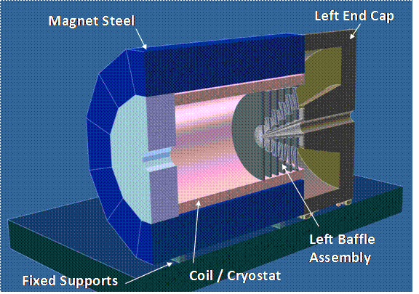
SoLID Magnet Options
Paul E. Reimer
06 June 2011
Physics Division
Argonne National Laboratory
The real work has been done not by me but by a growing Monte Carlo Group including:
Simona Malace, Seamus Riordan, Lorenzo Zana, Zhiwen Zhao and many others.

Slide 2
Magnet Principles
Must be affordable
Coils already exist
Hopefully comes with useable material for the barrel and upstream flux return yoke
Large enough to give reasonable acceptance
For both PV- and SI-DIS experiments
1.5m radius seems to work
Smaller may work
Additional current density at coil ends is desirable

Slide 3
Magnet Principles
Flux Return Design Constraints
Up and down stream coil forces must balance
PV- and SI-DIS angular acceptance
Low Field Detector Area
How large? Extension Ring for reconfiguration?
Max field I this area?
Length of Nose cone?
Must be affordable
Coils already exist
Hopefully comes with useable material for the barrel and upstream flux return yoke
Large enough to give reasonable acceptance
For both PV- and SI-DIS experiments
1.5m radius seems to work
Smaller may work
Additional current density at coil ends is desirable

Slide 4
Magnet Principles
Flux Return Design Constraints
Up and down stream coil forces must balance
PV- and SI-DIS angular acceptance
Low Field Detector Area
How large? Extension Ring for reconfiguration?
Max field I this area?
Length of Nose cone?
Must be affordable
Coils already exist
Hopefully comes with useable material for the barrel and upstream flux return yoke
Large enough to give reasonable acceptance
For both PV- and SI-DIS experiments
1.5m radius seems to work
Smaller may work
Additional current density at coil ends is desirable

Slide 5
Magnet Principles
Flux Return Design Constraints
Up and down stream coil forces must balance
PV- and SI-DIS angular acceptance
Low Field Detector Area
How large? Extension Ring for reconfiguration?
Max field I this area?
Length of Nose cone?
Must be affordable
Coils already exist
Hopefully comes with useable material for the barrel and upstream flux return yoke
Large enough to give reasonable acceptance
For both PV- and SI-DIS experiments
1.5m radius seems to work
Smaller may work
Additional current density at coil ends is desirable

Slide 6
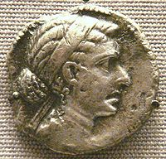
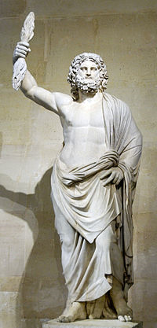
Magnets under consideration or “The usual suspects”
Babar
CLEO
ZEUS
CDF
MEGA (Hall D)
New Hall D design

Slide 7
Magnet Comparison
 | BaBar | CLEO | ZEUS | CDF | Glue-X |  | New
 |  |  |  |  | Old SLAC | New
Cryostat Inner Radius | 150 cm | 150 cm | 86 cm | 150 cm |  |  | Whatever we need
Length | 345 cm | 350cm | 245cm | 500 cm
Central Field | 1.49T | 1.5T | 1.8T | 1.47T
Flux Return Iron | Yes | Yes | No | No
Cool Icon | Yes | Yes | Yes | No | No
Variation in Current density with z? | 2x more in end than central | 4.2% more in end than central | 40% more in end than central | No | Yes | Yes
Available | Probably Not?? | Probably | Probably | Probably | One will be available |  | Wild guess--$5M

Slide 8
Last collaboration meetings and plan of action
Determine if any of the magnets will work
Proof of principle for BaBar magnet from Eugene
Worry: Other magnets do not have current density gradient of BaBar—may cause acceptance problems
Plan
Generate other magnets’ field maps with Poisson
Quick test of “Worry” above by looking at field integral
Check acceptance with Monte Carlo for these field maps
Switch to GEANT 4 Monte Carlo
Validate GEANT 4 Monte Carlo by comparison with Eugene’s GEANT 3 Monte Carlo of BaBar
Generate baffle designs for alternate coils
Compare a Figure of Merit (after deciding what the FOM is)
Decide which magnet to pursue and get it!

Slide 9
Progress since Last set of meetings
Plan
Generate other magnets’ field maps
with Poisson
Complete for BaBar, CLEO, CDF, ZEUS

Slide 10
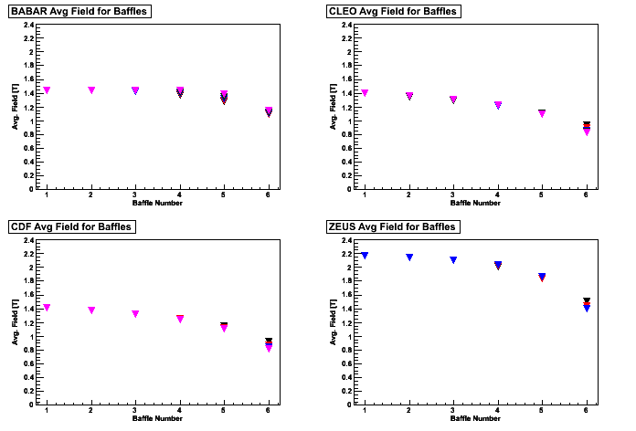
Progress since Last set of meetings
Plan
Generate other magnets’ field maps with Poisson
Quick test of “Worry” above by looking at field integral
Note: These plots are deliberately too small for you to read the details—Please wait for the next two talks
Credit: Zhiwen and Seamus
https://hallaweb.jlab.org/wiki/index.php/Solid_Magnet#Field_Integrals_for_Baffles
Qualitatively as expected—Those with less even current density have fields that fall off faster.
How does this affect the acceptance?
BaBar
CLEO
CDF
ZEUS
Paul E. Reimer

Slide 11
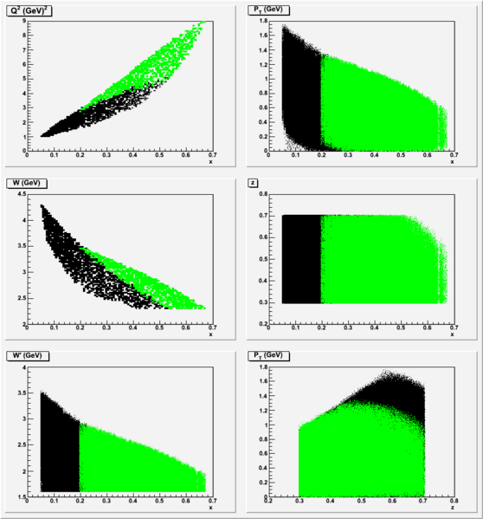
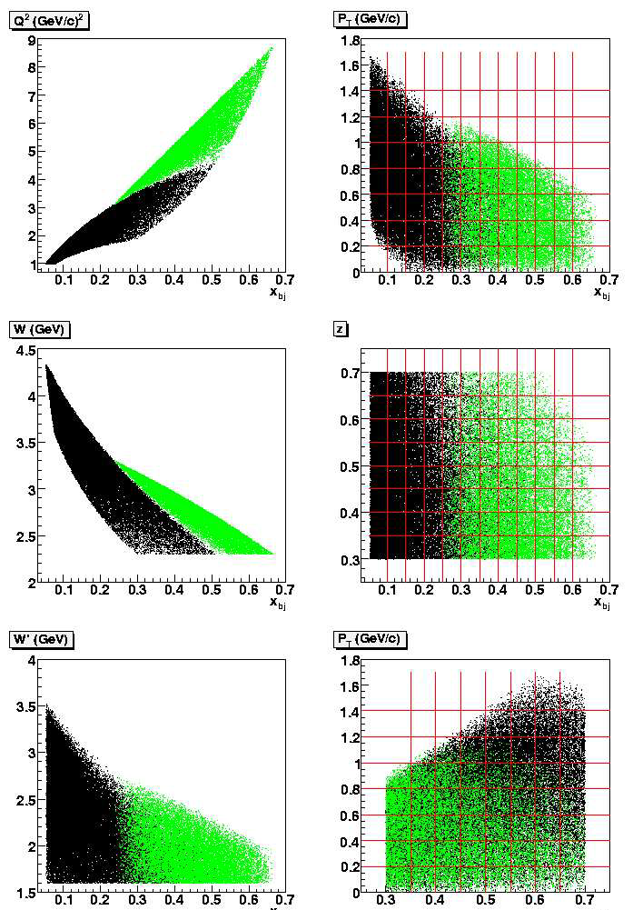
Progress since Last set of meetings
Plan
Generate other magnets’ field maps with Poisson
Quick test of “Worry” above by looking at field integral
Check acceptance with Monte Carlo for these field maps
Switch to GEANT 4 Monte Carlo
Validate GEANT 4 Monte Carlo by comparison with Eugene’s GEANT 3 Monte Carlo of BaBar
These two steps involved the most effort and represent a major milestone in this project, but I have no good plot to show you here. https://hallaweb.jlab.org/wiki/index.php/Compare_to_geant3_result
Note: These plots are deliberately too small for you to read the details—Please wait for the next two talks
SIDIS Proposal GEANT 3
GEANT 4

Slide 12
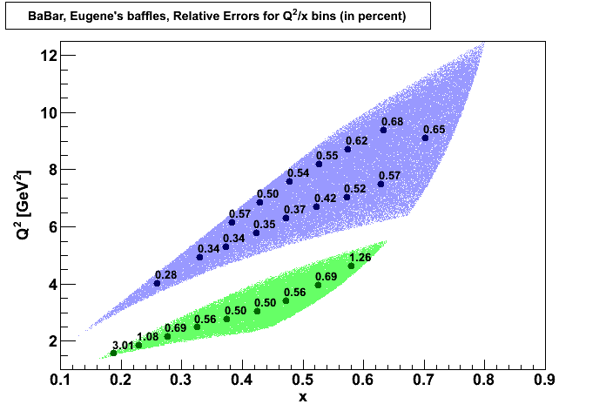
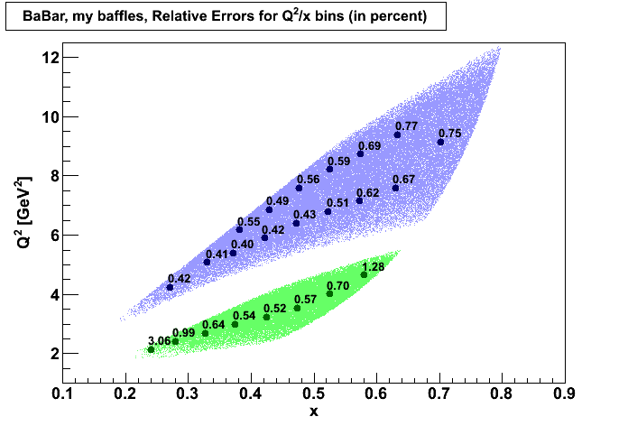
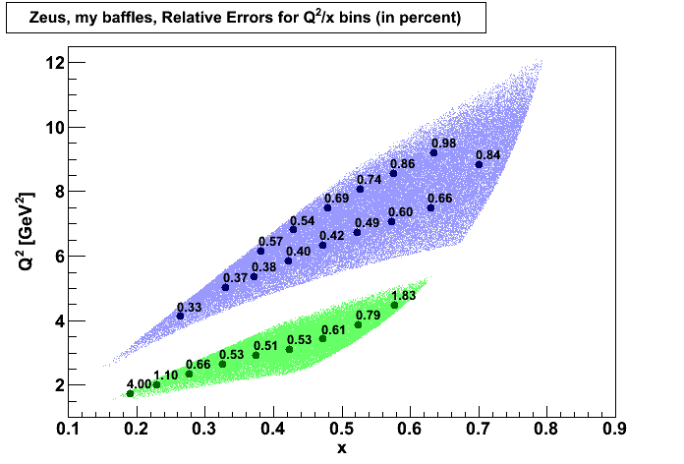
Progress since Last set of meetings
Plan
Generate other magnets’ field maps with Poisson
Quick test of “Worry” above by looking at field integral
Check acceptance with Monte Carlo for these field maps
Switch to GEANT 4 Monte Carlo
Validate GEANT 4 Monte Carlo by comparison with Eugene’s GEANT 3 Monte Carlo of BaBar
Generate baffle designs for alternate coils
Compare a Figure of Merit (after deciding what the FOM is)

Slide 13
Conclusion
The status of the magnets in which we are interested has not changed
We now have a tool based in GEANT 4 which will allow for quantitative decisions on magnet acceptance.
Based on results and benchmarks from this tool we can choose a primary magnet to pursue.

