Slide 1
GEM/MRPC/Chinese Collaboration
Haiyan Gao
Duke University
SoLID Collaboration meeting
June 2-3, 2011

Slide 2
E-10-006: Update to PR-09-014 (PAC35)
Nucleon Transversity at 11 GeV Using a Polarized ³He Target and SOLid in Hall A
Peking U., CalState-LA, CIAE, W&M, Duke, FIU, Hampton, Huangshan U.,
Cagliari U. and INFN, INFN-Bari and U. of Bari, INFN-Frascati, INFN-Pavia,
Torino U. and INFN, JLab, JSI (Slovenia), Lanzhou U, LBNL, Longwood U,
LANL, MIT, Miss. State, New Mexico, ODU, Penn State at Berks, Rutgers,
Seoul Nat. U., St. Mary’s, Syracuse, Tel aviv, Temple, Tsinghua U, UConn,
Glasgow, UIUC, Kentucky, Maryland, UMass, New Hampshire, USTC, UVa
and the Hall A Collaboration
Strong theory support, Over 130 collaborators, 40 institutions,
8 countries, strong overlap with PVDIS Collaboration
(
New since PAC35
Shangdong University, Huazhong Univ. of Science and Technology, Inst. of Modern Physics of CAS

Slide 3
Responsibilities
CO₂ gas Cerenkov detector: Temple U.
Heavy Gas Cerenkov: Temple U.
ECal: W&M, UMass, JLab, Rutgers, Syracuse
GEM detectors:UVa, Miss State, W&M, Chinese Collaboration (CIAE, Huangshan U, PKU, LZU, Tsinghua, USTC), UKY, Korean Collaboration (Seoul National U)
Scintillator: Chinese Cobllaboration, Duke
MRPC: Tsinghua Univ., Duke
Electronics: JLab
DAQ: LANL, UVa and JLab
Magnet: JLab and UMass
Simulation: JLab and Duke
Blue: common with
PVDIS
Black: part in common with
PVDIS
Red: This experiment only
Groups have experience with GEM already in China: IMP, Lanzhou U, Tsinghua U
Groups interested in GEM: USTC/Huangshan, Lanzhou U, CIAE, Shangdong U,
Tsinghua U, PKU, and IMP
USTC: detectors, electronics and readout
MRPC: Tsinghua University

Slide 4
Chinese Collaboration
Form a strong collaboration in China
Organize annual China-US hadron physics workshop, 3rd one will be in Weihai, Shangdong, China, August 8-11, 2011
(http://hepg.sdu.edu.cn/THPPC/conference/weihai2011/Home.html)
Encourage Chinese physicists to pursue their own physics interests at JLab
Communications with NSFC, CAS and MOST
Goal is to have strong joint support from CAS, NSFC and MOST
  SoLID is highlighted in the program for activities for PRC-US Cooperation in High Energy Physics (Nov 2010-Oct 2011)

Slide 5
Status on funding applications in China
National Science foundation of China (NSFC)
  Major international collaborations 2-3 M (RMB) over a period of 3-4 years, proposal by Ma and Gao submitted in March 2011
Ministry of Science and Technology (MOST)
  973 program: large scale science project over a funding period of 5 years: total ~10M (RMB), proposal to be submitted March 2011, led by CIAE
  (did not make 2nd round this year), will submit again in
  2012
  International Collaboration (led by Zhengguo Zhao, USTC, to be submitted 2011)

Slide 6
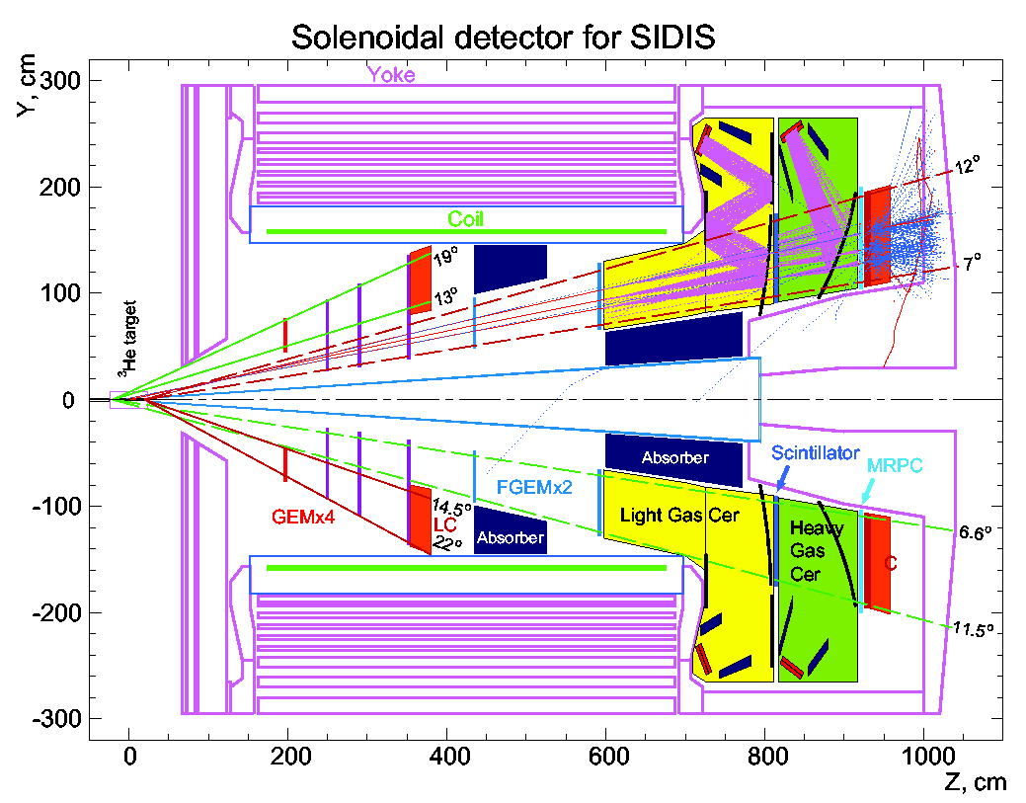
Experiment E12-10-006
(study done with CDF magnet, 1.5T)
GEMs
Study done with CDF and BarBar magnets (CDF shown here)

Slide 7
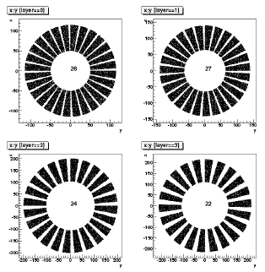
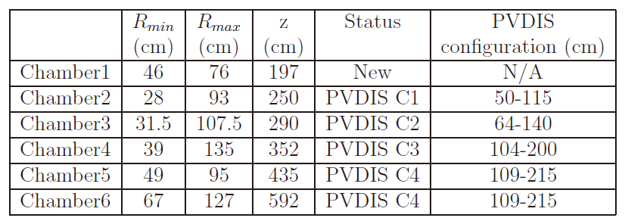
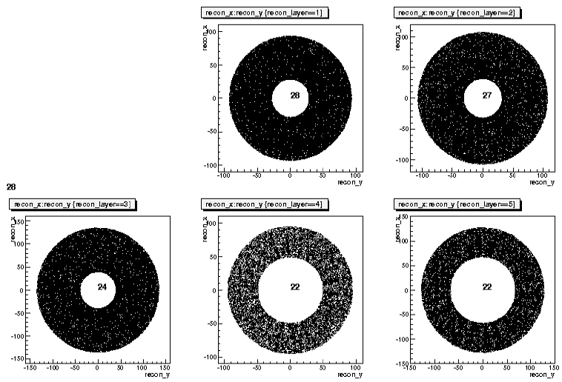
Tracking with GEM detectors
5 planes reconfigured from PVDIS GEM detectors (23 m²)
Total surface for this experiment ~ 18 m²
Need to build the first plane 1.15 m²
Electronics will be shared
PAC 34 report

Slide 8
Status on GEM
Prototypes for testing
  USTC (Wenbiao Yan, Z-G. Zhao)
  Tsinghua (Zhigang Xiao)
    Placed order with INFN on AVP FEE recently
    All other hardware components in house
    Present preliminary test results at Weihai workshop
USTC: readout electronics and detector hardware
CIAE: interest in developing and fabrication of GEM foils, and detector hardware
Tsinghua, Lanzhou U: detector hardware
See Nilanga Liyanage’s talk on GEM

Slide 9
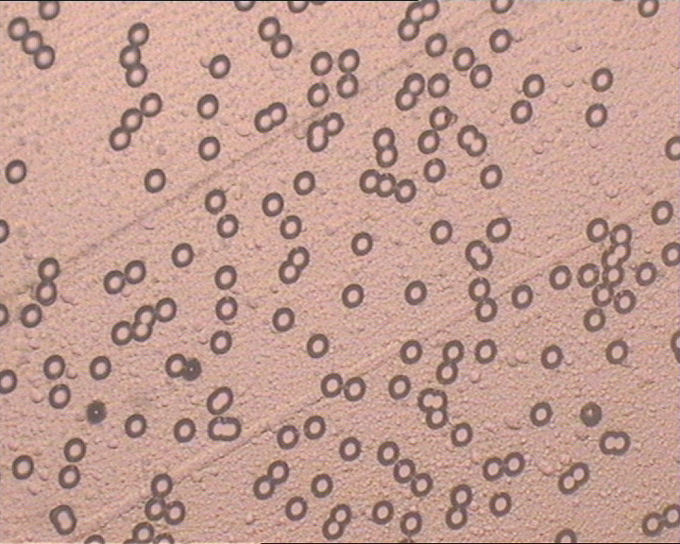
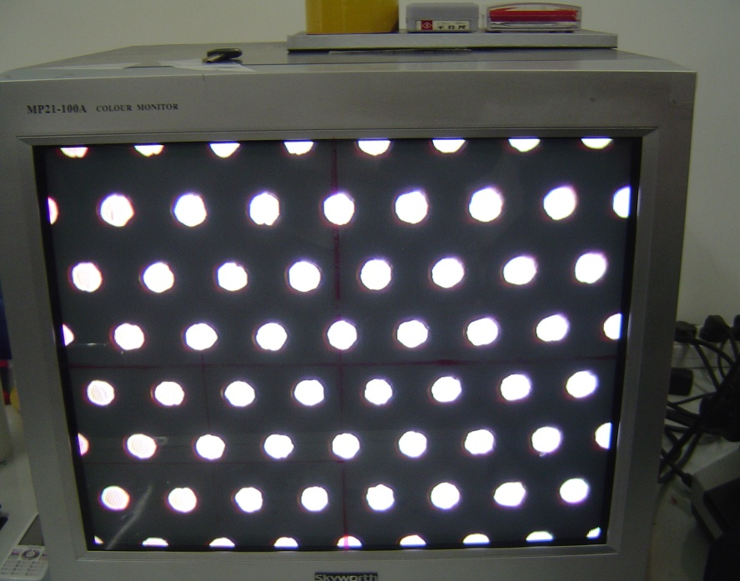
CIAE:GEM Foil R&D
(Collaborated with CERN)
CIAE Current Nuclear Pore Foil
CERN GEM Foil
Thickness, hole diameter and most of technologies are the same.
Slide from Xiaomei Li

Slide 10
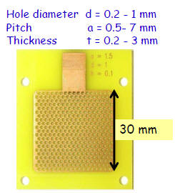
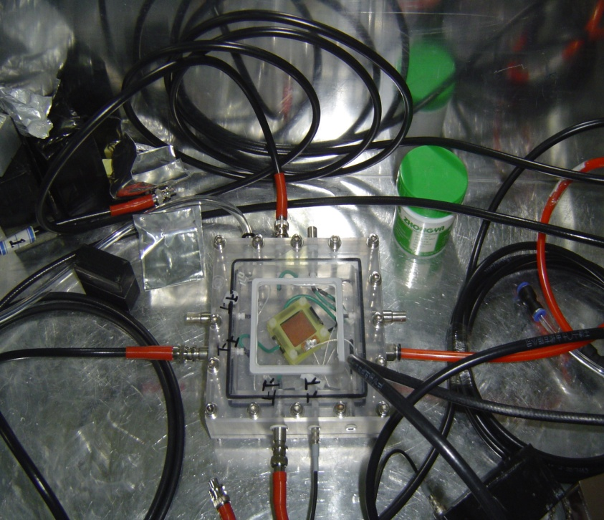
CIAE: Study of THGEM Position Resolution
(Collaborated with IHEP)
THGEM foil
THGEM
Advantage: durable, high gain, easy and cheap
Disadvantage: the position resolution is not as good as GEM
Next Step: Design new readout panel
Study of THGEM Position Resolution
Slide from Xiaomei Li

Slide 11
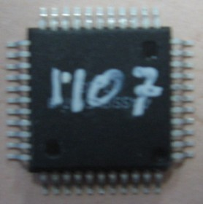
LZU: GEM Electronics (Gassiplex)
Gassiplex Chip
Front Electronics
LZU made GEM electronics with gassiplex chips. CIAE, THU, USTC and LZU are ordering GEM electronics with APV25 chips from Italia.
Slide from Xiaomei Li

Slide 12
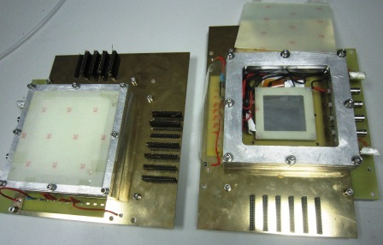
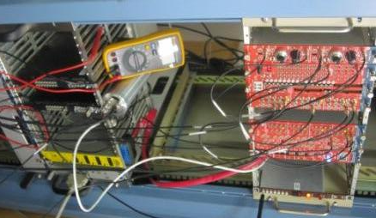
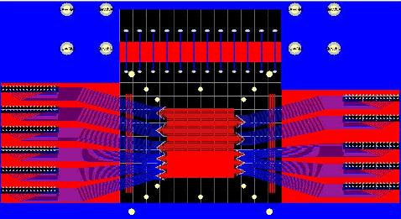
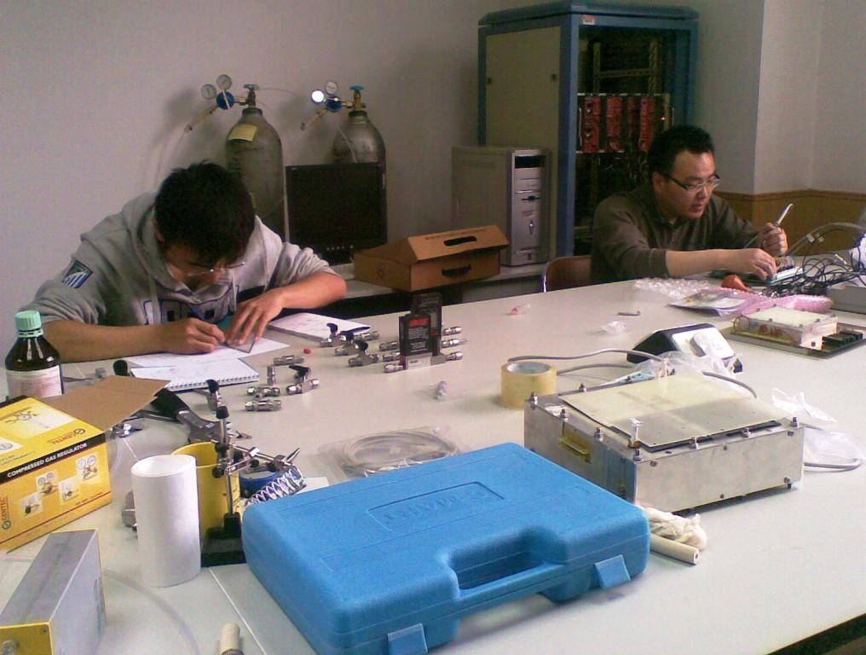
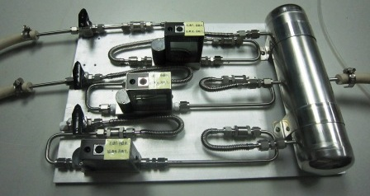
Test Bench Setup at Tsinghua Univ.
Hardware Preparation:
Two prototypes ready for test, 1D and 2D respectively;
Electronics for 16 channels test all prepared;
APV electronics ordered, 1024 channels, VME DAQ system hardware-wise ready;
CAMAC DAQ ready, VME DAQ under developing.
Two GEM prototypes
Read Out Plate Design
Electronics for 16 Chs
GAS Mixture System
Zhigang Xiao, THU

Slide 13
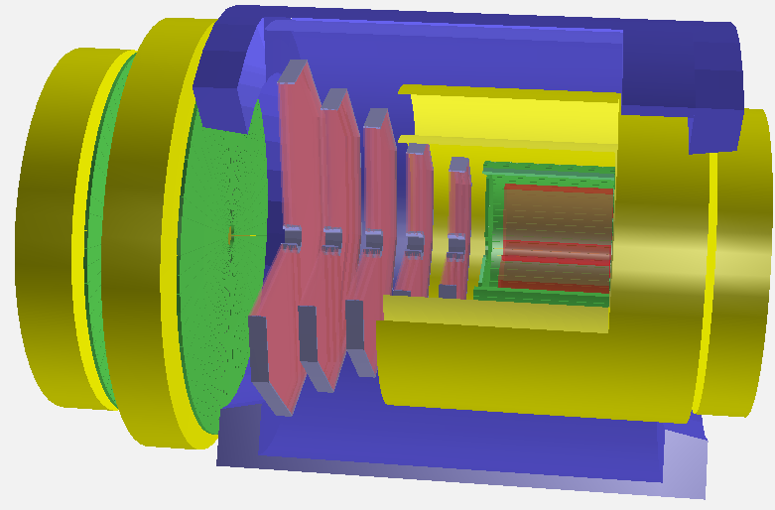
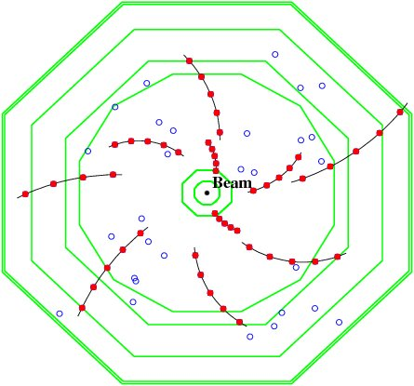
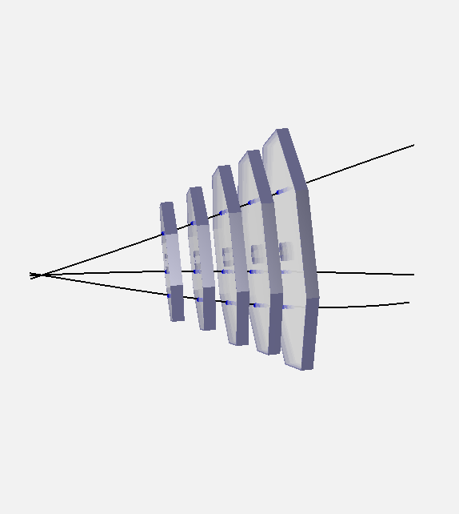
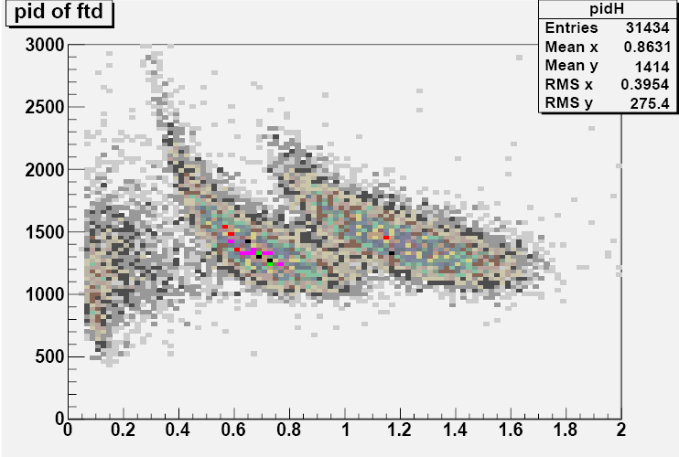
Software Preparation
Constructed HPLUS spectrometer
Track Finding and fitting
pp→ppφ events
K-/K+
Event Display for its forward tracking
Reconstructed PID for pp→ppφ
→Doing the G4 simulation for HPLUS (Hadron Physics LanzhoU Spectrometer);
→Local tracker (similar to tree search) developed for forward tracking detector,
likely extendable to the application in SOLID GEM system.

Slide 14
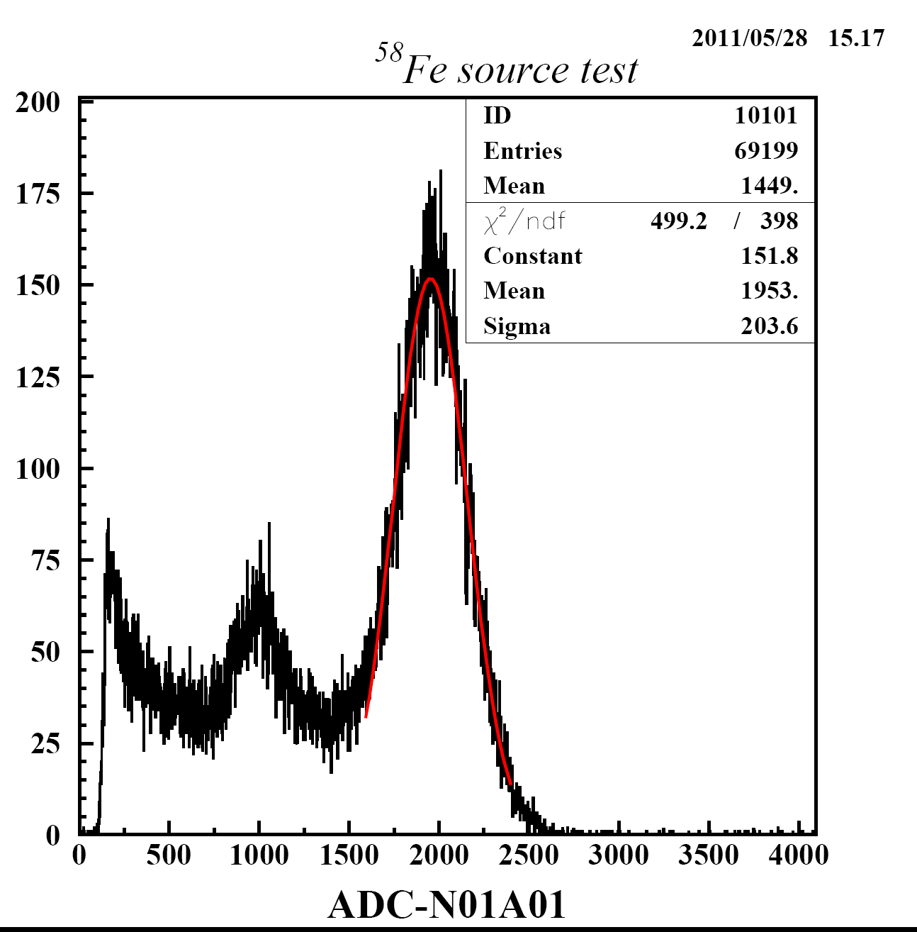
Day 1# plot for GEM prototype test
Test with ⁵⁸Fe gamma source
16 channels connected together;
Energy resolution ~10%
Zhigang Xiao, THU

Slide 15
Plans and problems
Plans
Test with 16 channels starting soon,
to study the cluster size, dark rate and efficiency with HV etc
With APV electronics, to test the position resolution (APV ordered. Time schedule depends on how the import issues are going with the custom)
With three detectors, tracking the cosmic ray in Lab.
Problems:
Normally the import activities take very long time in China;
Team members suffer from lack of experience, need closer collaboration with JLAB
Need more team members (2 students + 1 engineer ) involved in the project
Zhigang Xiao, THU

Slide 16
Collaboration
USTC physicists (Wenbo Yan and Zhengguo Zhao) short-term visit JLab and UVa (March, May), and then Wenbo Yan visit Duke/JLab August-Oct.
Tsinghua Univ. (Zhigang Xiao visited Duke and JLab)
A student from CIAE is visiting JLab/UVa to work on the GEM
Huangshan U. (Hai-jiang Lu) visit JLab, May-June.
A visiting scholar from Tsinghua to work on GEM?
Possibly to have a prototype GEM be sent to China to do test.

Slide 17
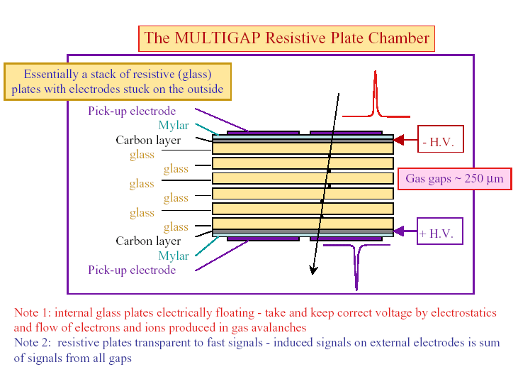
Introduction of MRPC
Large area, high granularity
Good time resolution<100ps
High efficiency> 95%
Low cost
Was used or will be used in ALICE, STAR, FOPI, HADES HARP, CBM and NICA-MPD
Slide from Yi Wang

Slide 18
Cost
Item | Cost ($)
MRPC modules | 180K
Electronics and DAQ | 250K
Total | 430K
Cost estimate from Yi Wang
MPRC prototype test plan at JLab :
Yi Wang and group will bring the prototype
detector and FEE to JLab
JLab provide additional electronics and DAQ
Test in November, 2011

