Slide 1
EC Forward Angle
Zhiwen Zhao
UVa
SoLID Collaboration Meeting
2011/6/2

Slide 2
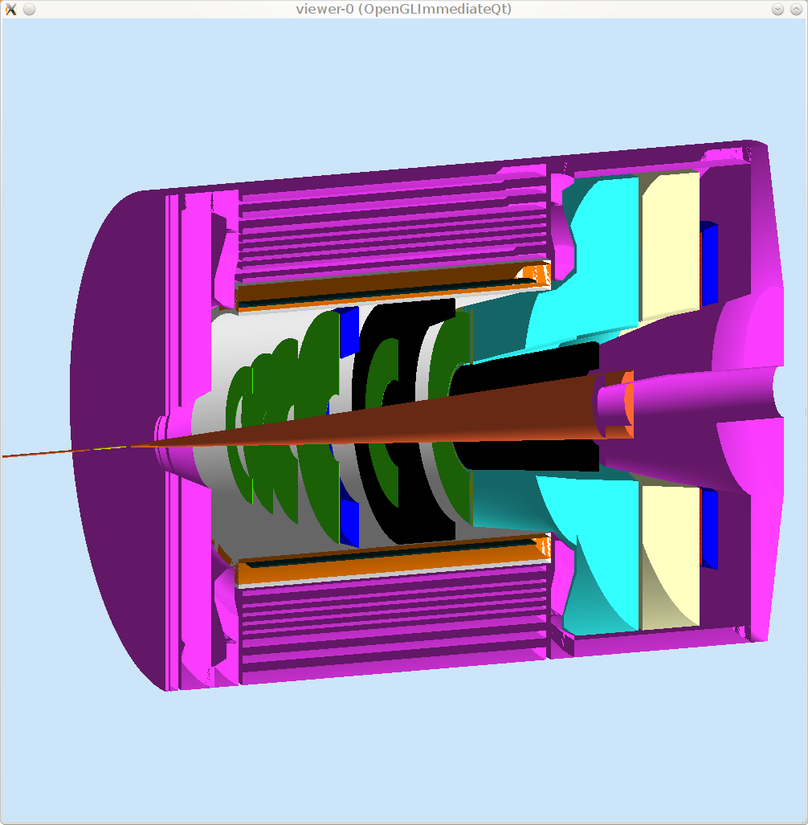
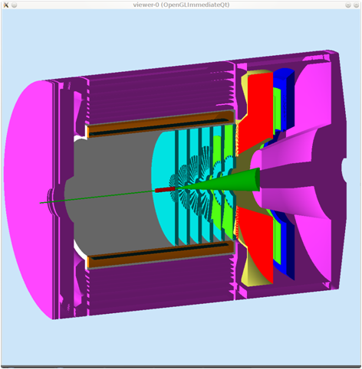
EC forward angle

Slide 3
Requirement
PVDIS rate 2k GeV/cm2/s, 60 krad/year
SIDIS rate 0.5k GeV/cm2/s, 15krad/year
Resolution
SIDIS Pion rejection 200:1 at E > 3.5 GeV,
100:1 at E > 1.0 GeV
Fast time response, provide a trigger
Good position resolution for tracking

Slide 4
The Menu
Lead glass
Shashlyk
SciFi

Slide 5
Radiation hard Shashlik calorimeter for COMPASS experiment
Vladimir Polyakov
Institute for High Energy Physics, Protvino
Ready to Order

Slide 6
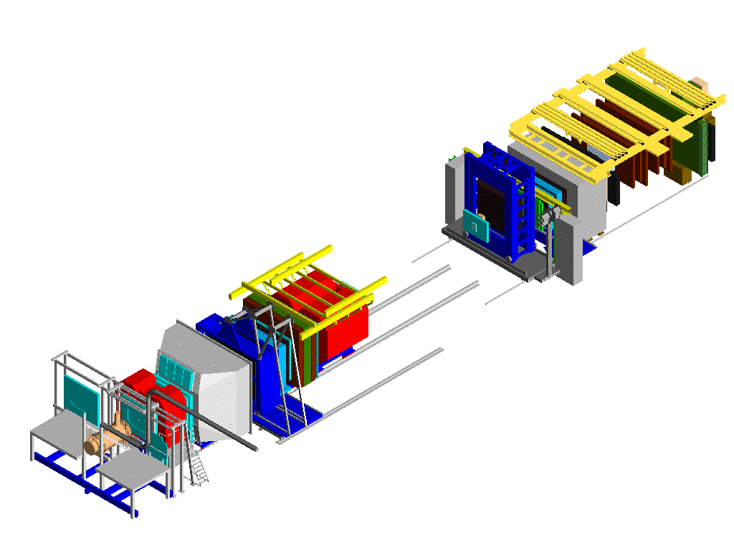
The COMPASS experiment Common Muon Proton Apparatus for Structure and Spectroscopy
Muon beam:
data taking 2002-2007
Intensity 2x10⁸ spill⁻¹
Hadron beam:
data taking 2008-2009
Intensity 5x10⁷ spill⁻¹
2nd spectrometer
SM2 magnet
Second electromagnetic calorimeter
(GAMS-4000 detector, since 1980 at CERN, NA12 and WA102)
dimension: 2.6 x 2.0 m^{2,}; 3000 channels;
Spiral Shashlik and lead glass blocks, 38x38 mm²;
1st spectrometer
SM1 magnet
50 m
ECAL2
First electromagnetic calorimeter
dimension: 4.0 x 2.9 m^{2,}; 1500 channels,
three types of lead glass blocks 38x38 mm², 75x75 mm², 142x142 mm²;
central hole 1.1x0.6 m²;
angular acceptance 180x130 mrad
ECAL1

Slide 7
Spiral Shashlik module
Dimensions 38.2x38.2 mm²
Radiation length 17.5mm
Moliere radius 36mm
Radiation thickness 22.5 X₀
Scintillator thickness 1.5mm
Lead thickness 0.8mm
Radiation hardness 0.5 Mrad
Energy resolution 6.5%/√E 1%

Slide 8
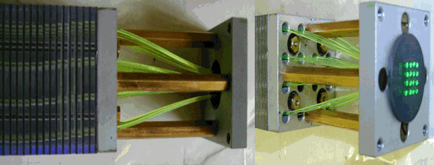
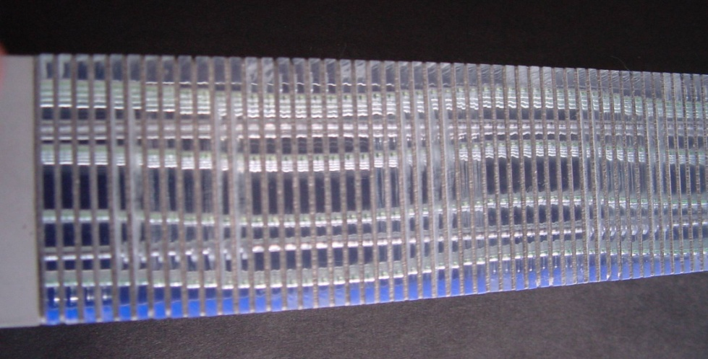
Spiral Shashlik module

Slide 9
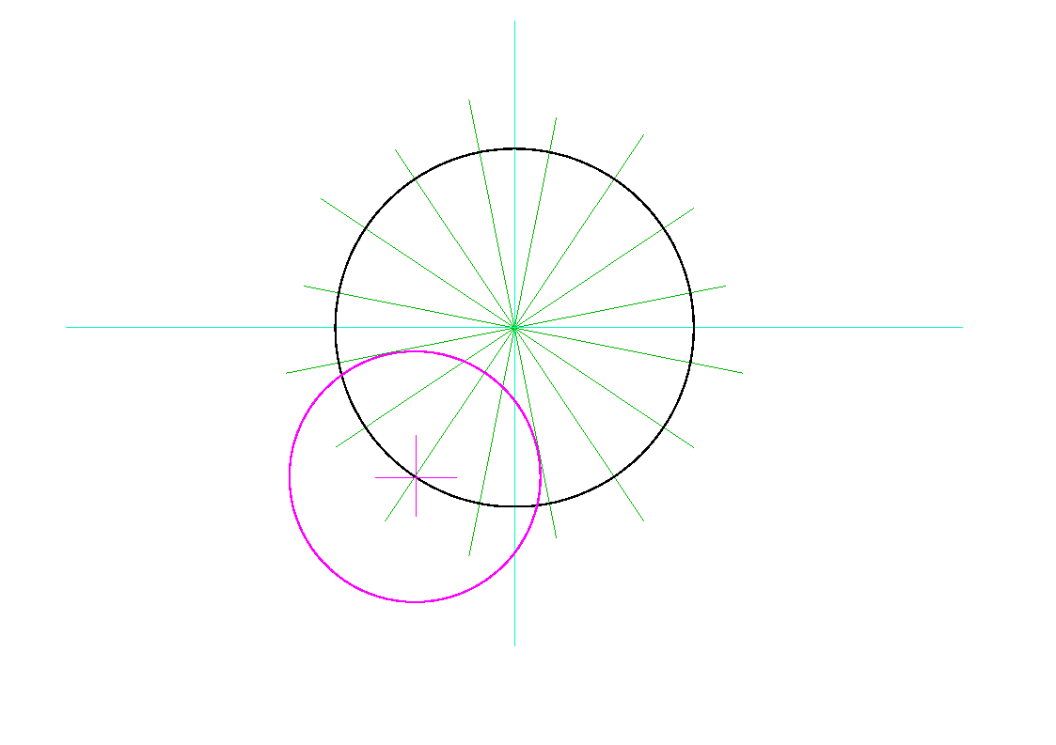
Spiral Shashlik
Sampling – 0.8 mm lead and 1.5 mm scintillator; 4x4 fibers, 4 steel rods; 155 layers
4 types of scintillators and 2 types of lead plates
2mm
22.5⁰
1.4mm
1mm

Slide 10
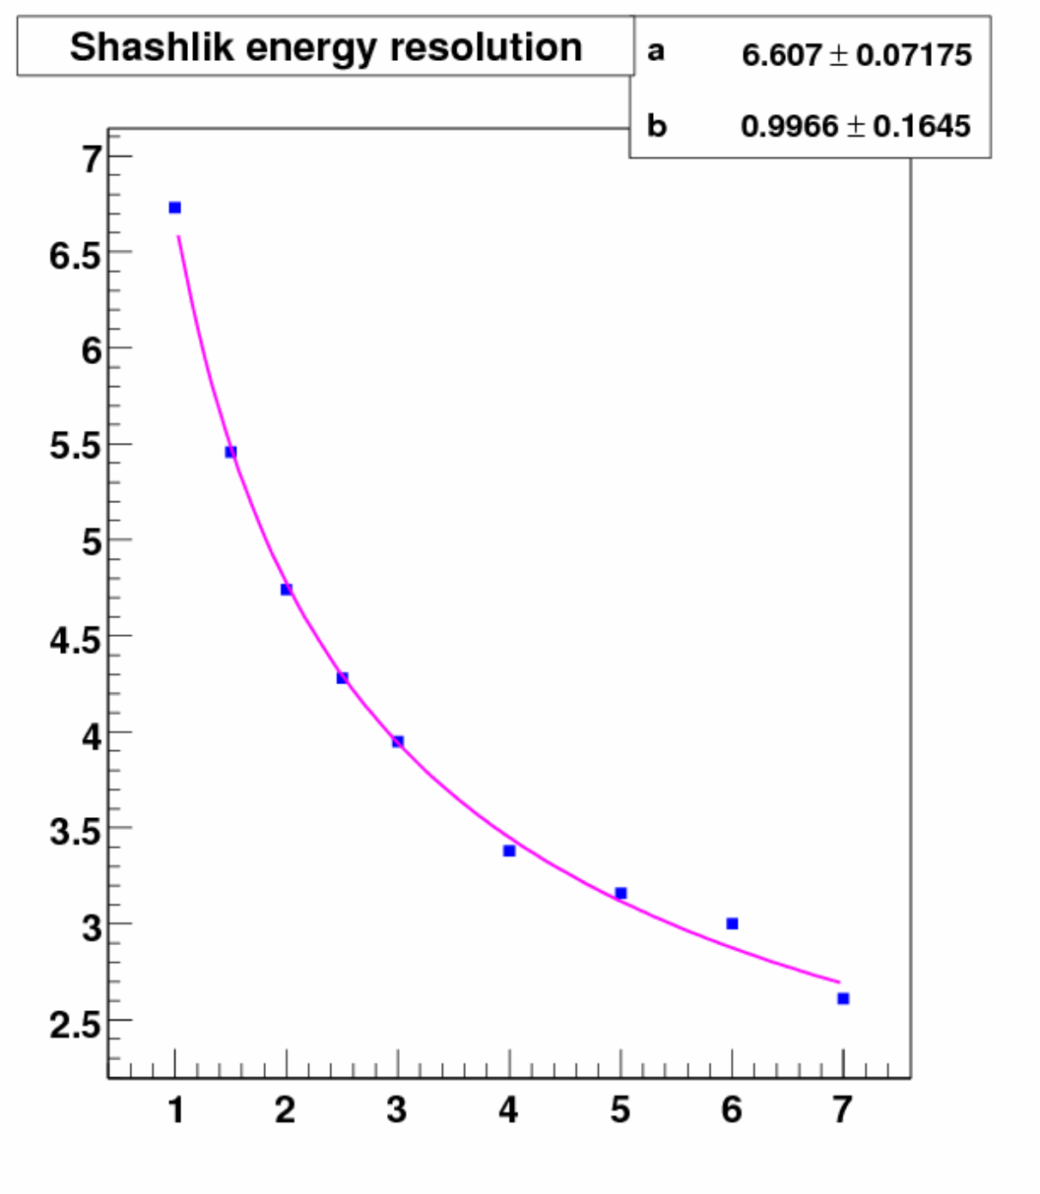
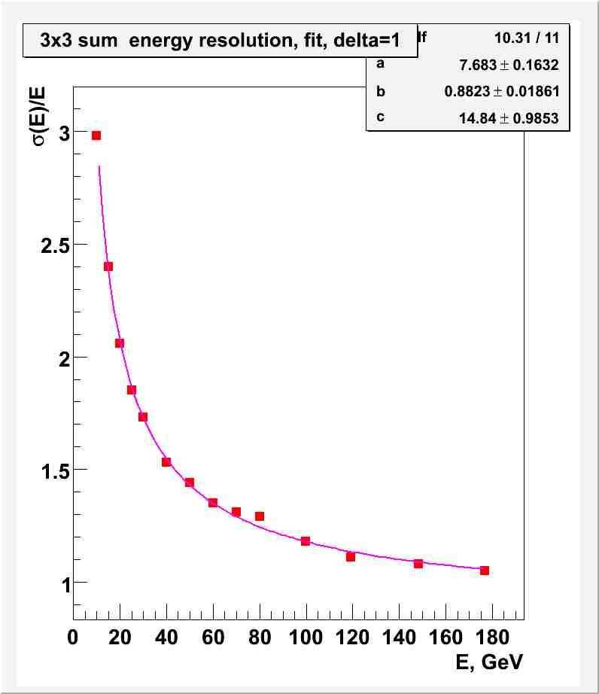
Energy resolution (T9 and H4 beam tests)
σ_{E}/E = a/√E b
σ_{E}/E = a/√E b c/E

Slide 11
Uniformity, 4GeV electrons

Slide 12
Mass production
Radiation hardness of scintillators was measured up to 250 krad
Loading test
No changes in light yield and attenuation after 4 month of loading with 120 kg
Online control:
The spread of light yield for scintillators is less than 3%
The spread of the thickness of lead is less than 80μk ( 10%)
Measurements of light yield and attenuation length for each spiral Shashlik modules
Attenuation length > 1.7m
Light yield > 400 photoelectrons per MIP
Production speed – 200 modules per month

Slide 13
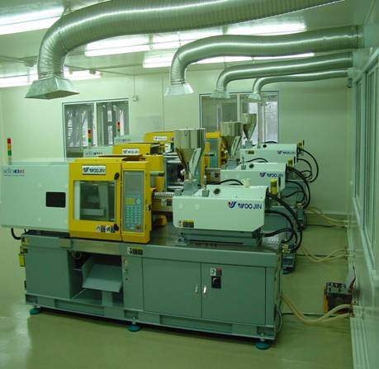
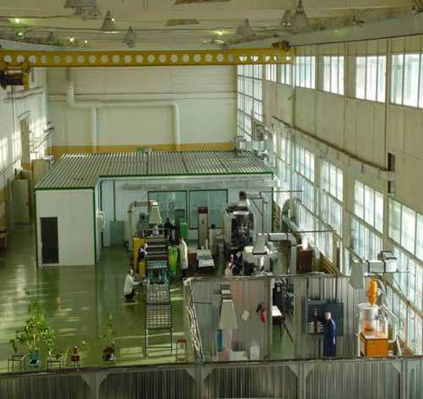
IHEP Scintillator Fasilities
www.ihep.ru/scint/index-e.htm

Slide 14
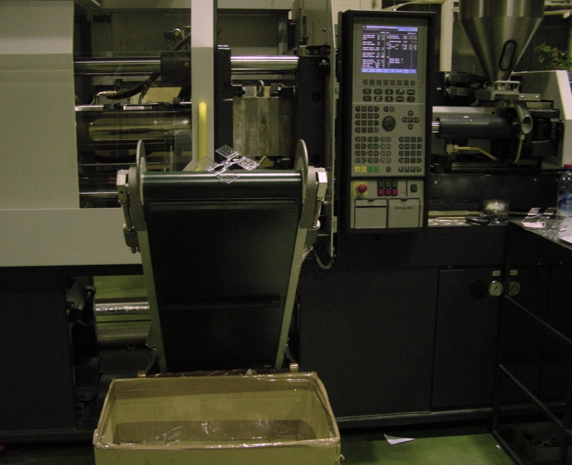
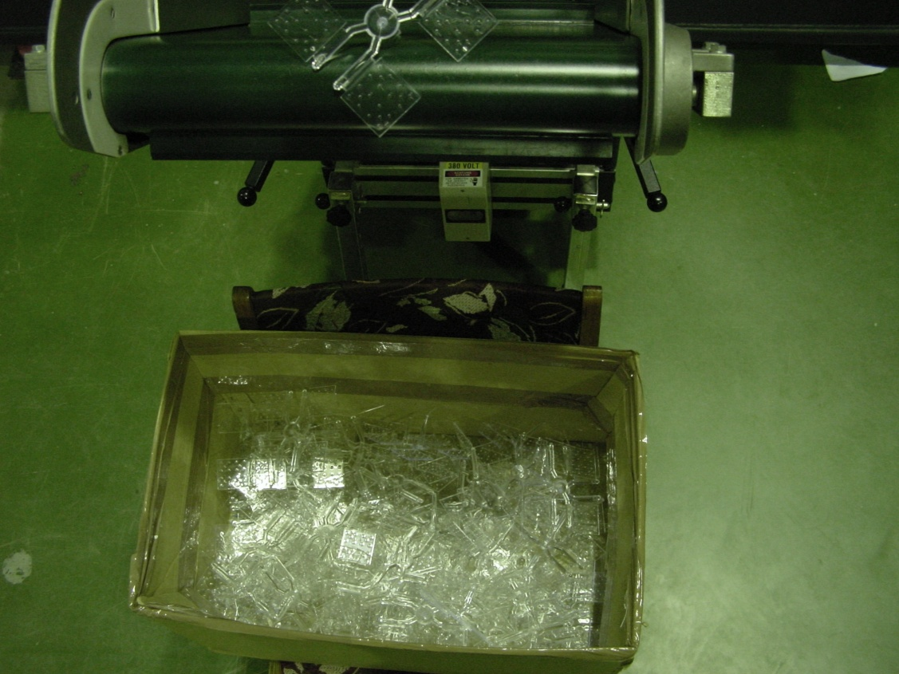
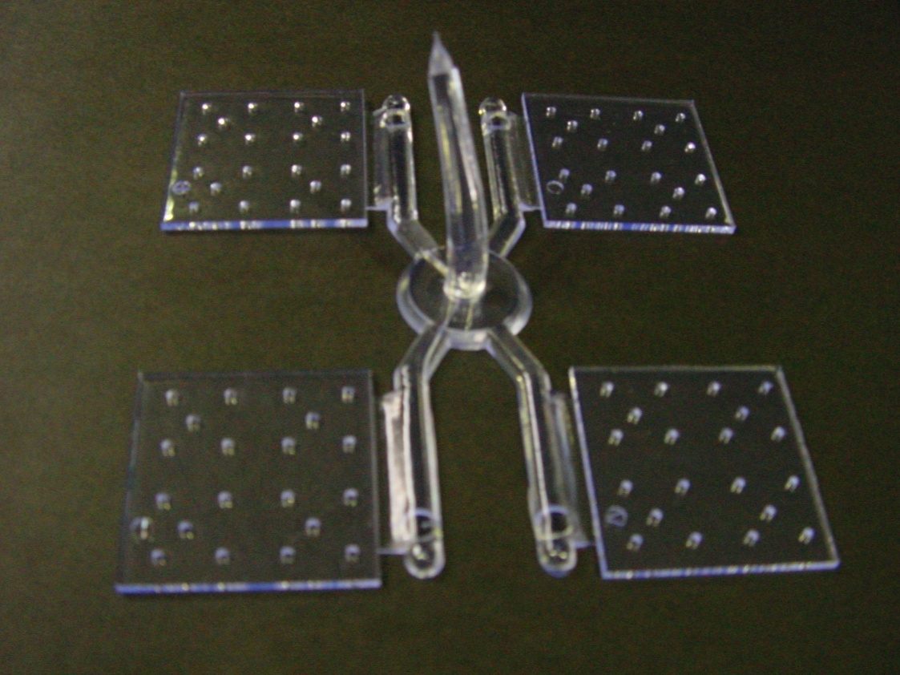
Mould
Scintillators

Slide 15
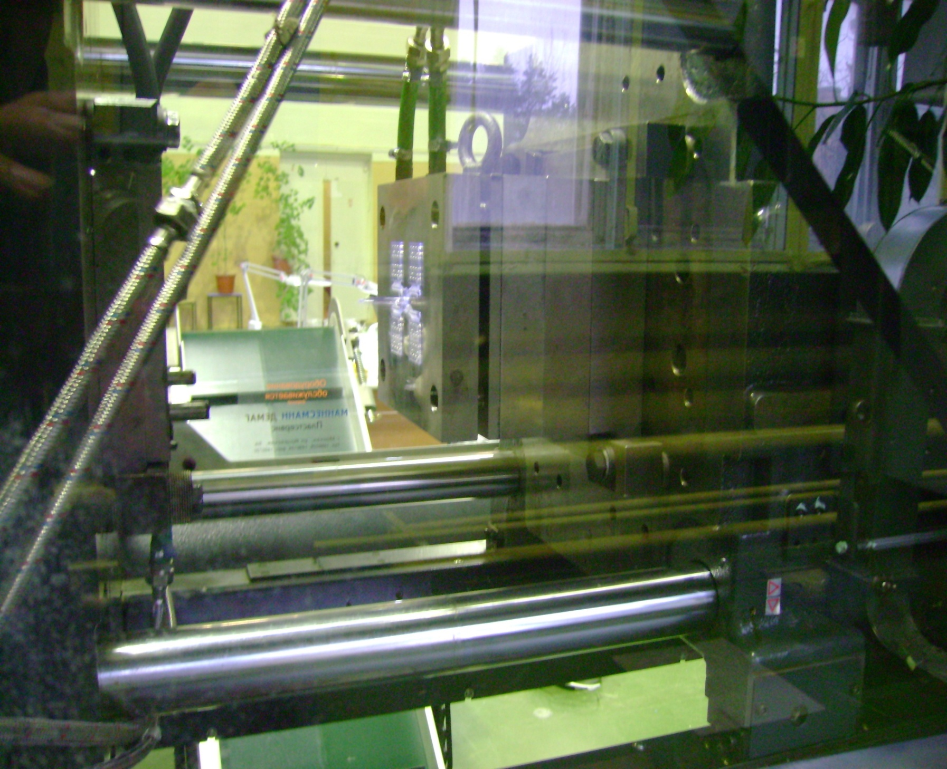
Scintillators

Slide 16
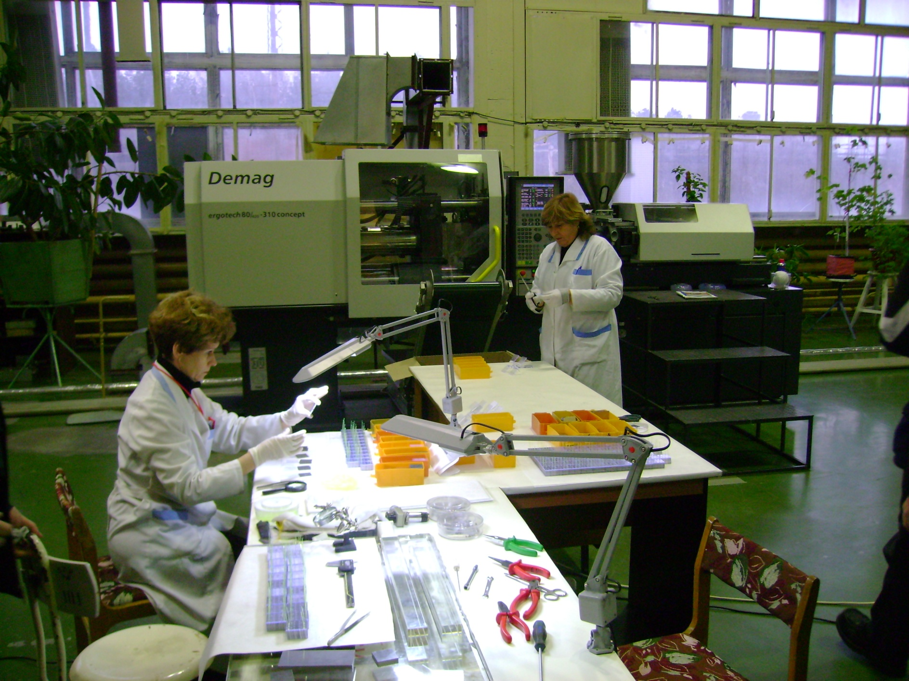

Slide 17
Our module?
* Our requirement (see Jin’s talk)
similar total length, 20 radiation length, 40cm
Lead < 0.6mm for better resolution
New stamp and molds, $50K
material cost 20%, production 80%
1. 4x4cm, $370,
8x8cm, $370*(0.8+0.2*4) = $700
11x11cm, $370*(0.8+0.2*8.5) = $1000
15x15cm, $370 *(0.8+0.2*15) = $1400

Slide 18
Coverage
Experiment | Angle(degree) | Radius(cm) | Area(cm2)
PVDIS | 22-35 | 120-280 | 2e5*0.5=1e5
SIDIS | 7-12 | 120-220 | 1.1e5
Factor 0.5 for PVDIS with current baffle design
Both areas are similar if we can rearrange the modules

Slide 19
Shashlyk Type Cost (IHEP)
$4M
module size (cm2) | number of module | module cost ($) | total module cost ($) | Fine Mesh PMT cost ($) | Total PMT cost ($) | Total cost
15x15 | 450 | 1400 | 0.65M | 2x1.5k | 1.4M | 2M
11x11 | 900 | 1000 | 0.9M | 2x1.5k | 2.7M | 3.6M
8x8 | 1700 | 700 | 1.2M | 2x1.5k | 5.1M | 6.3M
4x4 | 6700 | 370 | 2.5M | 2x1.5k | 20M | 22.5M

Slide 20
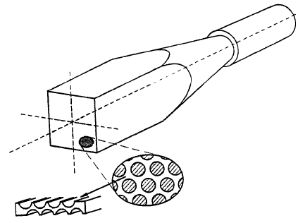
Calorimeter in Solenoid Flux Return
How to get the light from the calorimeter to a photosensitive detector?
APD’s
Light Guides out of field region
Use flux return for calorimeter
PMT in >10 G
Calorimeter

Slide 21
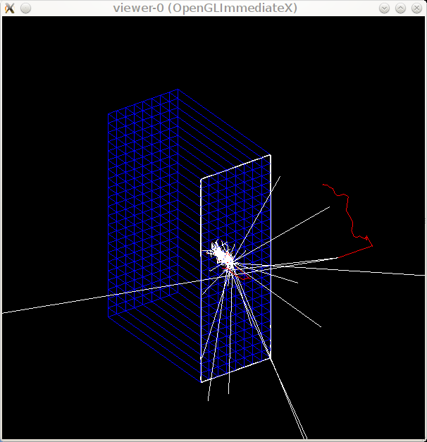
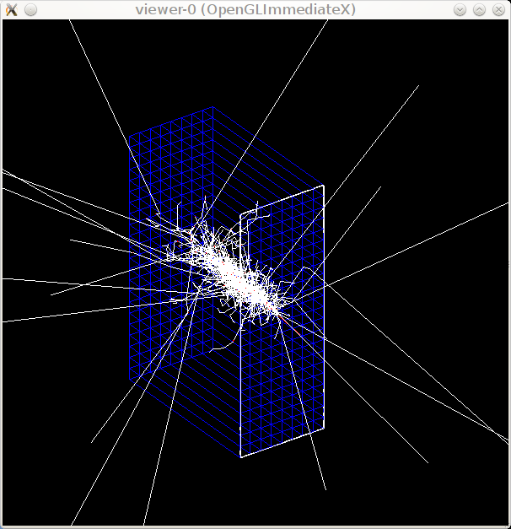
Test module simulation
90cm(height)x32cm(width)x60cm(depth),
material:(fiber+absorber)=1:1,
fiber along Z, layer along Y, optional 2T field along Y
W/SciFi Fe/SciFi

Slide 22
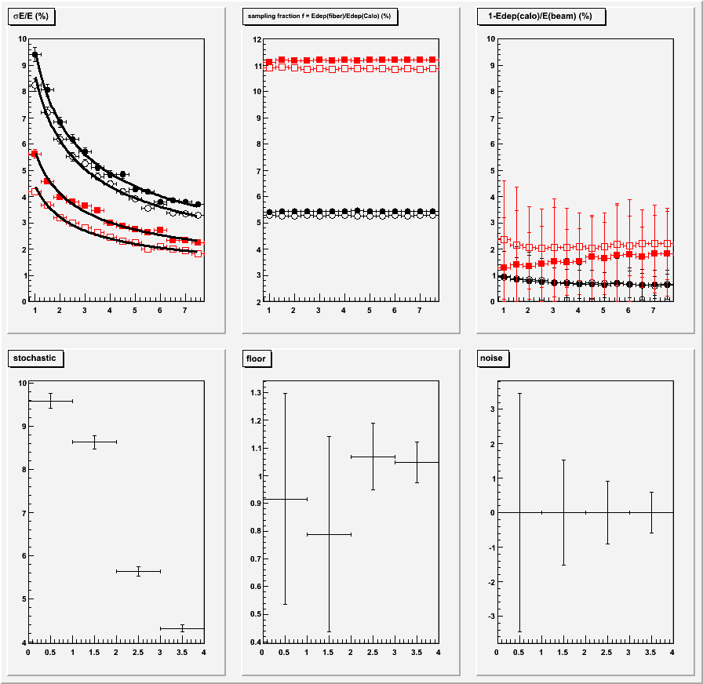
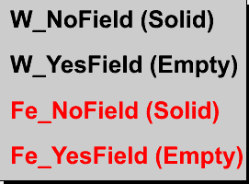
Test module simulation
resolution
Sampling fraction
loss
Stochastic
floor
noise

Slide 23
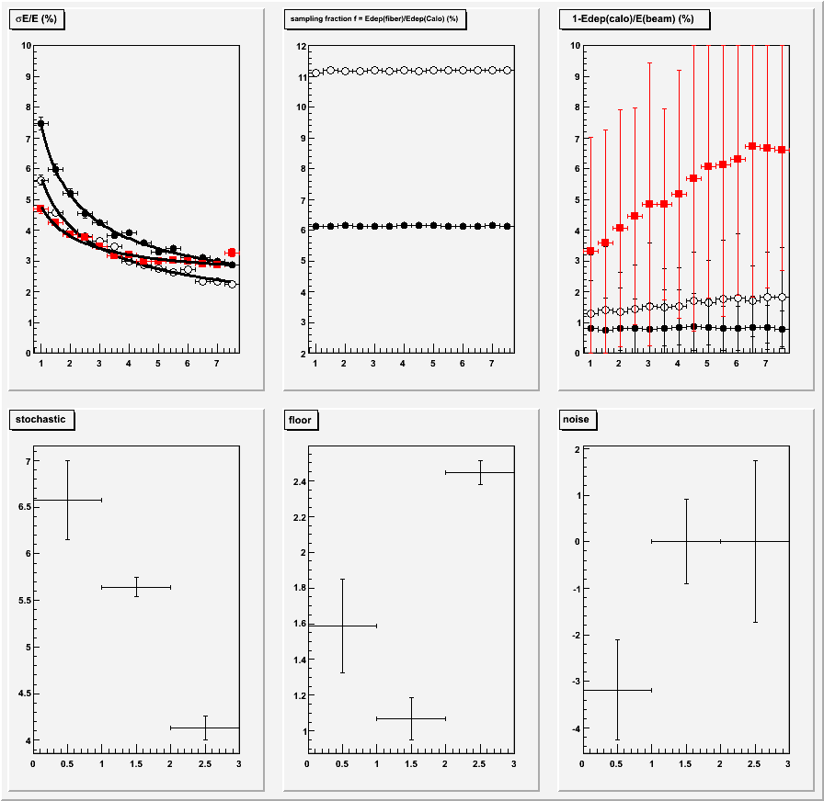
Test module simulation
resolution
Sampling fraction
loss
Iron:fiber area ratio
2.55 (solid black)
1.27 (empty black)
0.64 (solid red)
Iron:fiber thickness ratio
1:2 (solid black)
1:1 (empty black)
2:1 (solid red)
Stochastic
floor
noise

Slide 24
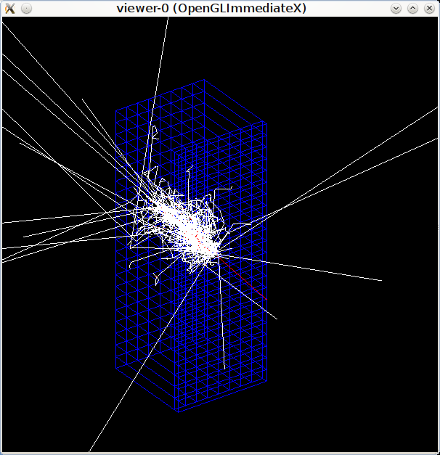
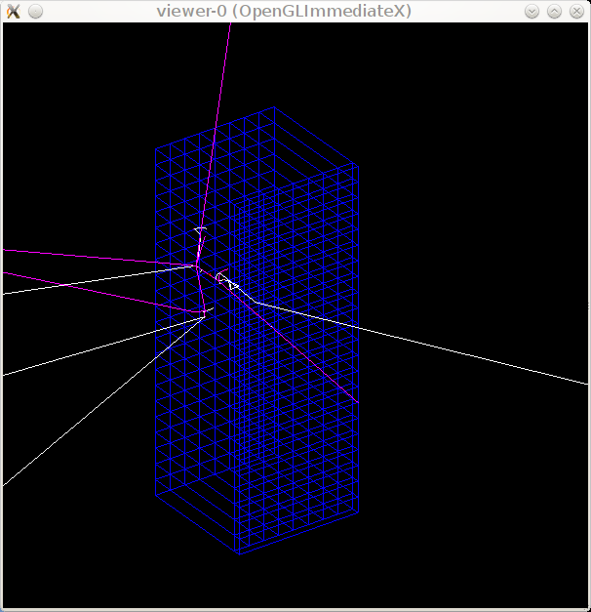
Test module simulation 30cm shower with Iron, 4cm preshower with Tungsten
Fe/SciFi, electron Fe/SciFi, pion

Slide 25
SciFi Module Cost
Kuraray SCSF-78 Mutilclad fiber 0.5mm, $1/m.
Assume iron fiber thickness ratio 1:1. Each fiber is 30cm in length.
Fiber cost about $1.5M
Iron cost in magnet yoke?
Number PMT depends on segmentation, suppose 11x11cm with regular PMT 900*0.5k=$0.5M
R&D, production $0.5M?
Total cost $2.5M?

Slide 26
Which One to Choose?
SciFi in flux return.
Need more R&D, use cheaper PMT and cost less. Easy to maintain.
Shashlyk
easier to get, Less R&D, use expensive field resistive PMT.

Slide 27
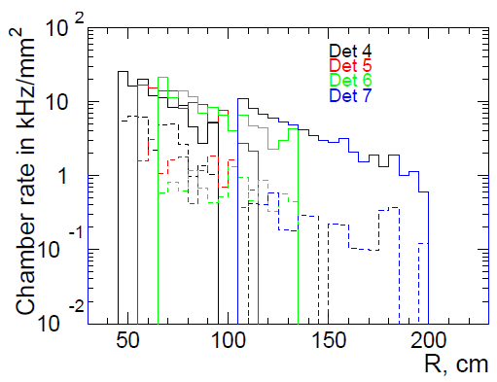
Energy flux estimatation
400krad/y

Slide 28
Backup
.

Slide 29
Total cost
For 11x11 segmentation, with DAQ, cable, electronics, support structure, we have about $4M
Engineer and technician: 2 men year
Student: 5 men year
Some will be shared with large angle EC
Manpower

Slide 30
Shashlyk prototype module parameters
9 modules assembled in matrix 3x3
380 layers of 0.3-mm lead and 1.5-mm scintillator, total length 680 mm
Transverse size 110x110 mm²
Effective Moliere radius: R_{M}=59 mm
Effective radiation length: X₀=34 mm
Total radiation length: 20X₀
Light collection: 144 (12×12) fibers BCF-91A (∅1.2 mm)
PMT Hamamtsu R5800 as photodetectors

Slide 31
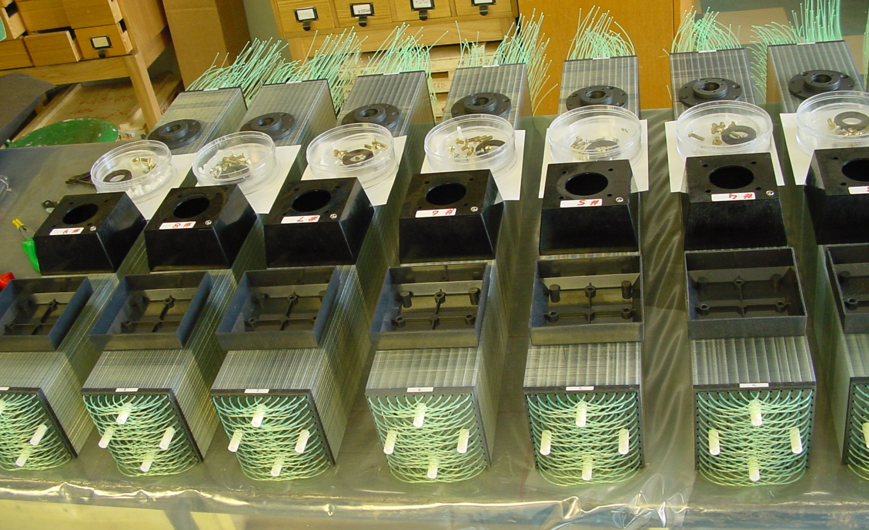
Shashlyk modules production

Slide 32
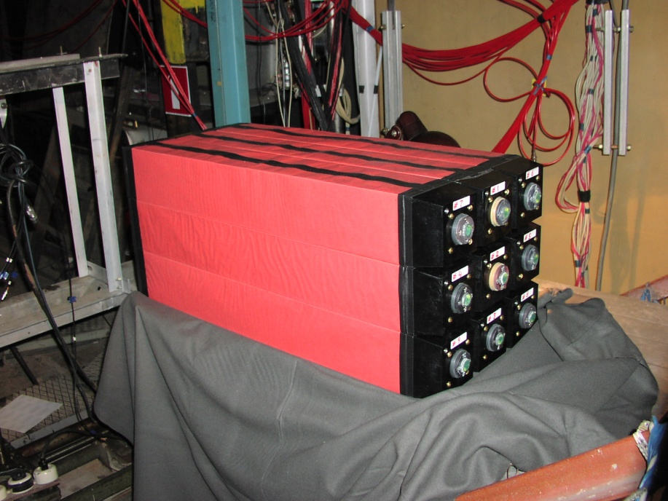
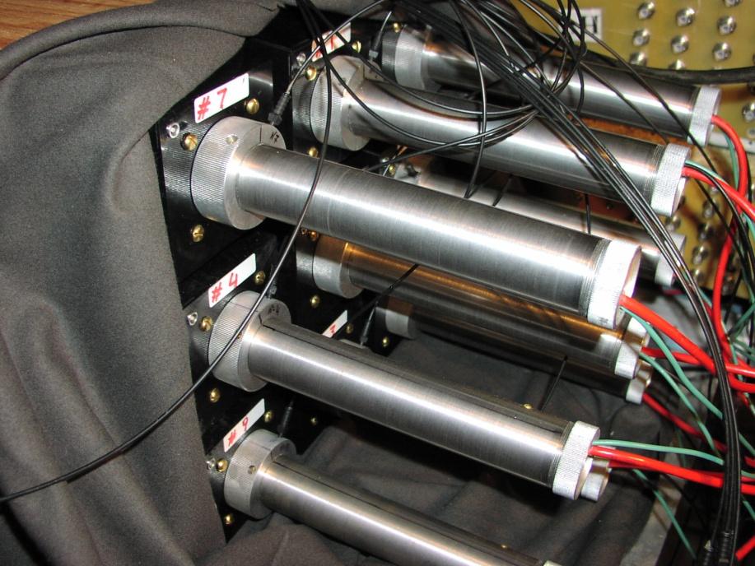
Shashlyk prototype pictures
3x3 matrix of shashlyk modules and PMT attached to the modules

Slide 33
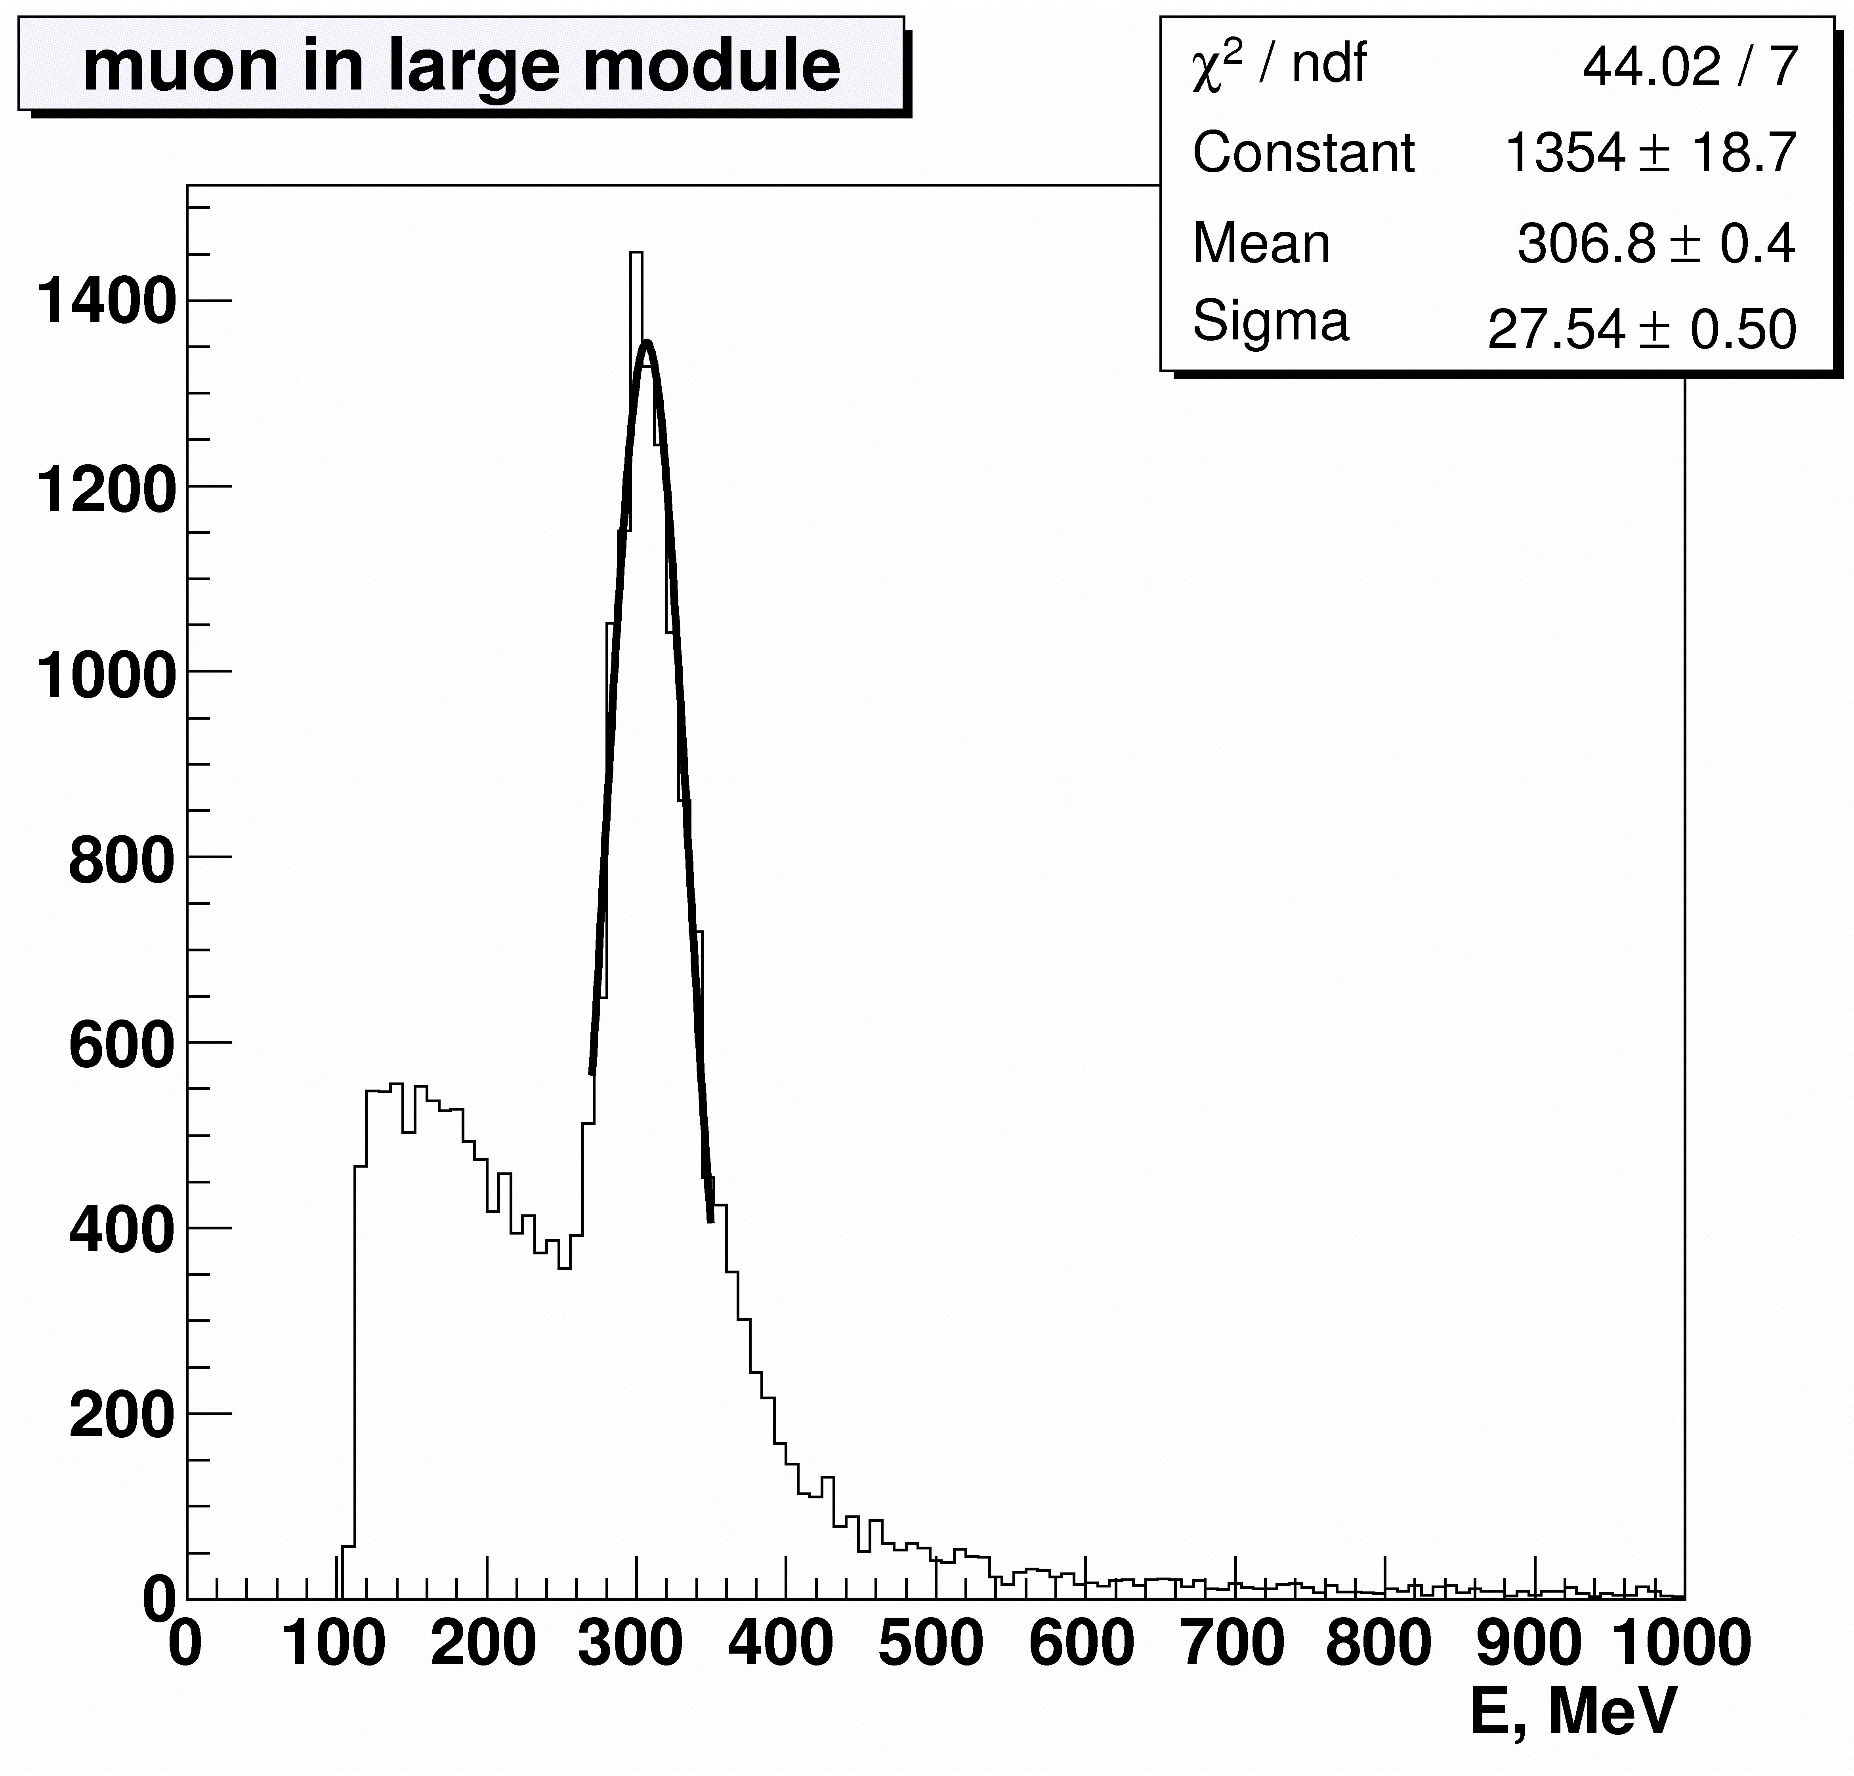
Minimum ionizing particle peak

Slide 34
Energy Resolution dependence on energy

Slide 35
Energy Resolution parameterization
σ_{E} /E = a/E ⊕ b/√E ⊕ c [%], E in GeV
Experiment data fit: MC data fit:
a = 3.5 ± 0.3 a = 0.0
b = 2.8 ± 0.2 b = 3.0 ± 0.3
c = 1.3 ± 0.04 c = 1.1 ± 0.7
Good agreement with MC without noise term.
Good agreement with previous studies of similar sampling modules at lower energies (2.9%/ √E at 220-370 MeV: Test beam study of the KOPIO shashlyk calorimeter prototype, G.Atoian, S.Dhawan,V.Issakov et al. CALOR-2004 Proceedings )

Slide 36
Position resolution (center) dependence on energy

Slide 37
Position resolution parameterization
σ_{x} = a/√E ⊕ b [mm], E in GeV
Experiment data fit: MC data fit:
a = 17.6 ± 0.9 a = 14.2 ± 0.6
b = 4.6 ± 0.9 b = 5.5 ± 0.9
Worst case – resolution at the module center.
Resolution near the module edge is 3 times better

Slide 38
Calorimeter in Solenoid Flux Return
Open Questions:
What does magnetic field do the shower?
My guess is that charged particles in the EM shower will curl up causing the shower to become shorter and wider
How does magnetic field affect resolution in Energy and in space? Is this a strong function of field strength or direction?
What resolution do we need? [Pb:SciFi at ~1:1 gives 4.5%/sqrt(E)]
Is Iron dense enough?
How does the fiber affect the Magnetic flux return?
My guess is that we use and “effective” μ which is about half that of Fe.
Require detailed MC; Have contacted D. Hertzog about simulations.
How do we cost this?
D Hertzog—driving cost is amount of fiber—Fe less dense than Pb thus need more fiber.
PMT in >10 G
Calorimeter

Slide 39
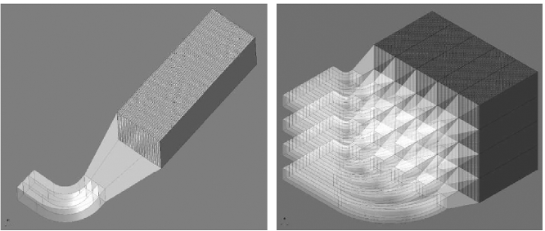
Mixture of radiation material and scintillation fiber(glue)
g-2 W/SciFi prototype

Slide 40
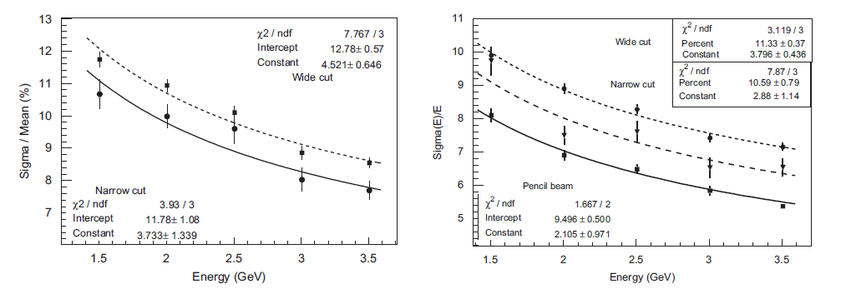
g-2 prototype test run
Data Simulation

Slide 41
Test module simulation
90cm(height)x32cm(width)x60cm(depth),
material:(fiber+flue)=1:1,
fiber along Z, layer along Y, optional 2T field along Y
W/SciFi Fe/SciFi

Slide 42
Test module simulation hit distribution (No Field)
W/SciFi
Fe/SciFi

Slide 43
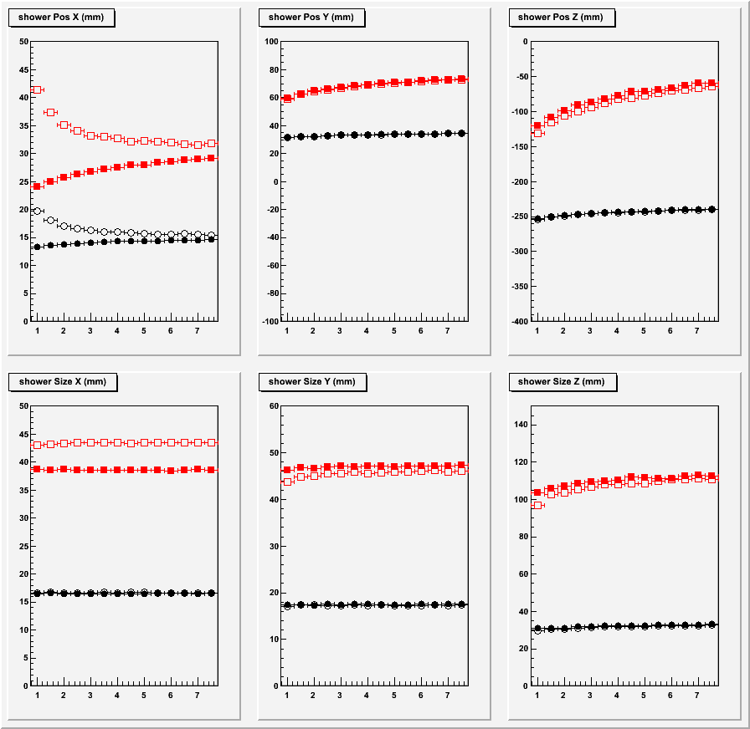
Test module simulation shower position and size

Slide 44
Test module simulation
resolution
Sampling fraction
loss
Stochastic
floor
noise

Slide 45
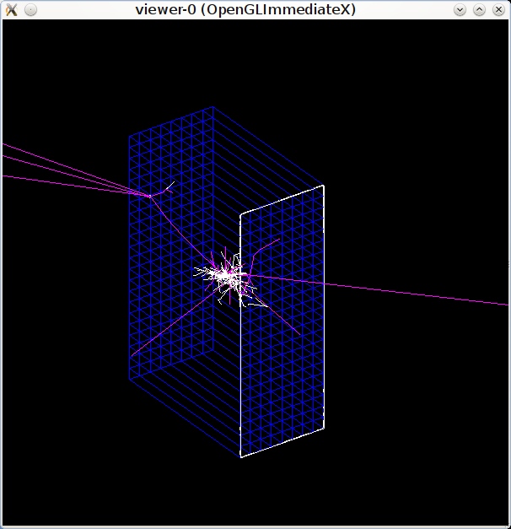
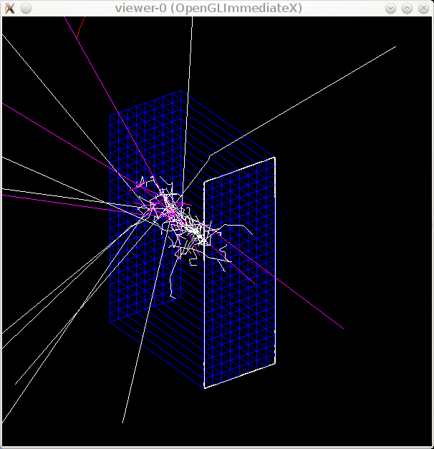
Test module simulation pion response
W/SciFi Fe/SciFi

Slide 46
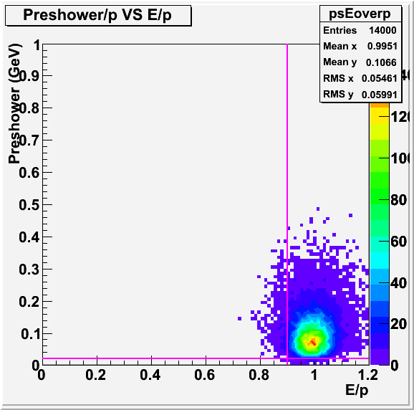
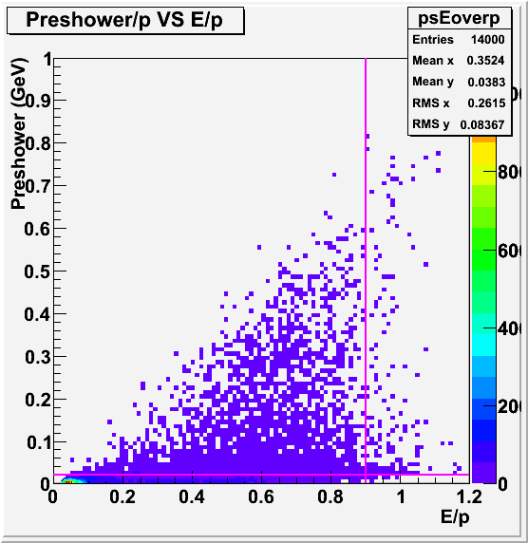
Test module simulation add 4cm W preshower
electron eff 95% pion rejection 50:1

Slide 47
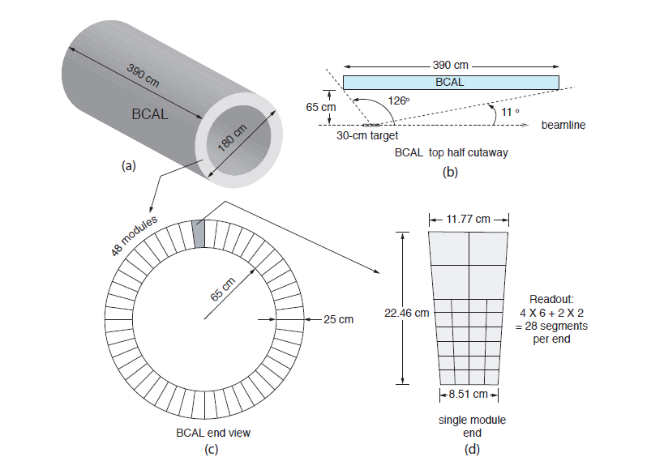
HallD Pb/SciFi BCAL optimazed for photon detection

