Slide 1
SoLID simulation
Zhiwen Zhao
Uva
SoLID Collaboration Meeting
2011/6/2

Slide 2
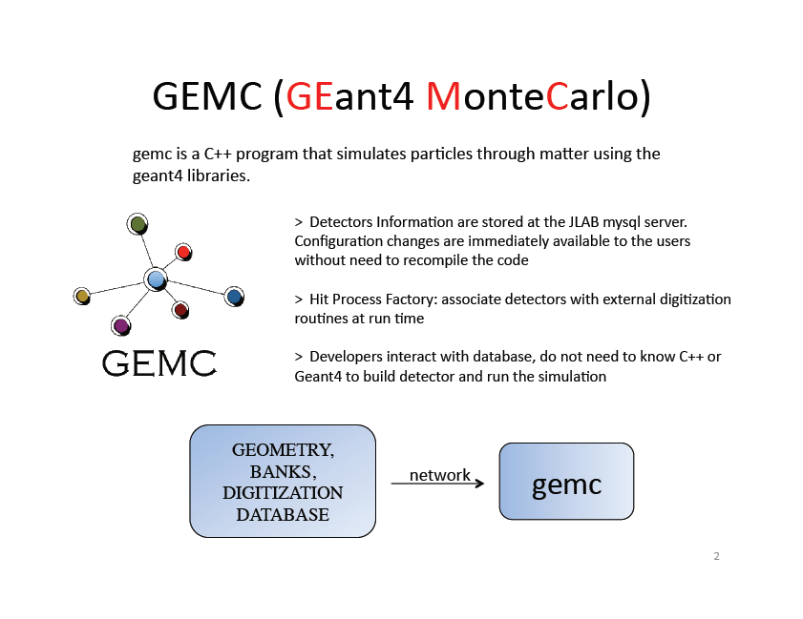
GEMC written by Maurizio Ungaro, used for CLAS12

Slide 3
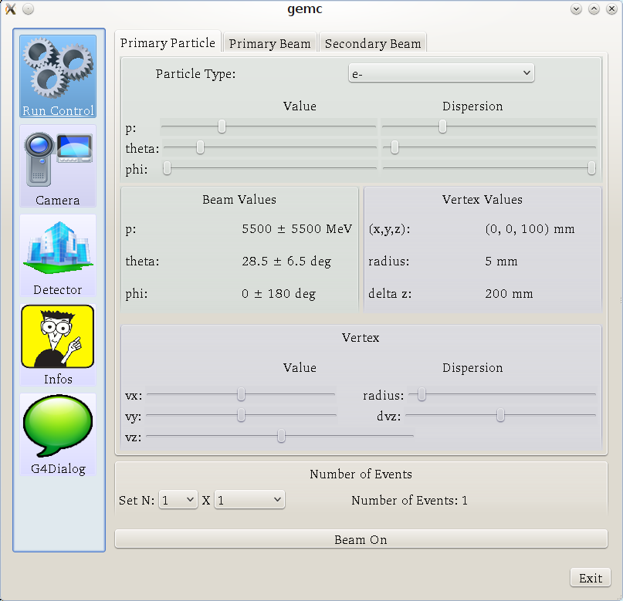
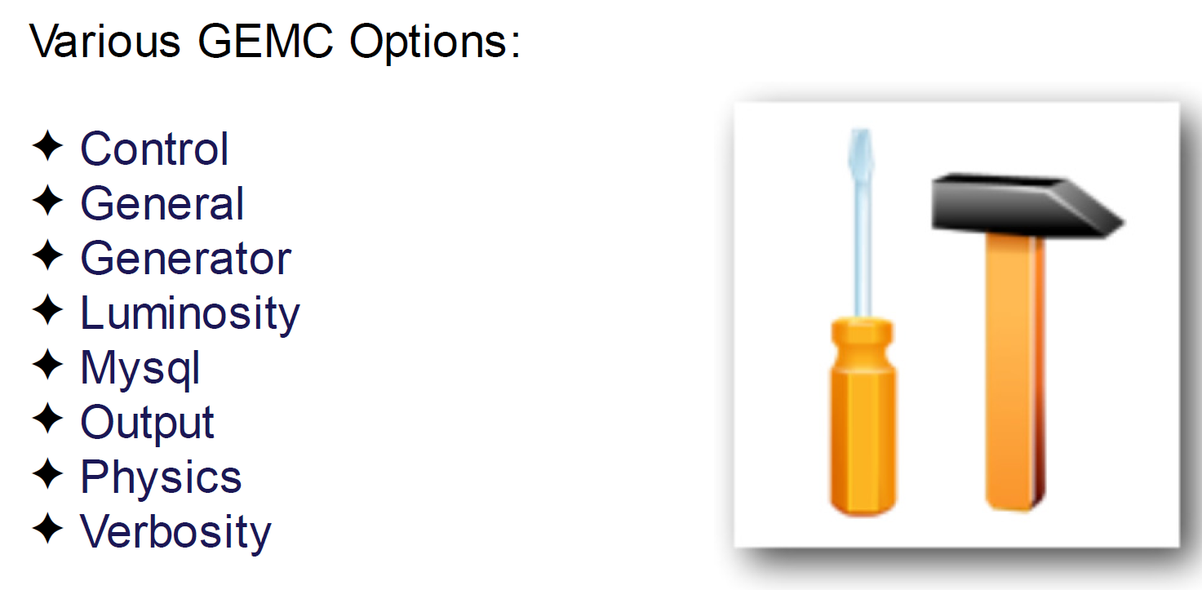
GUI (Run control)
Command Line Options

Slide 4
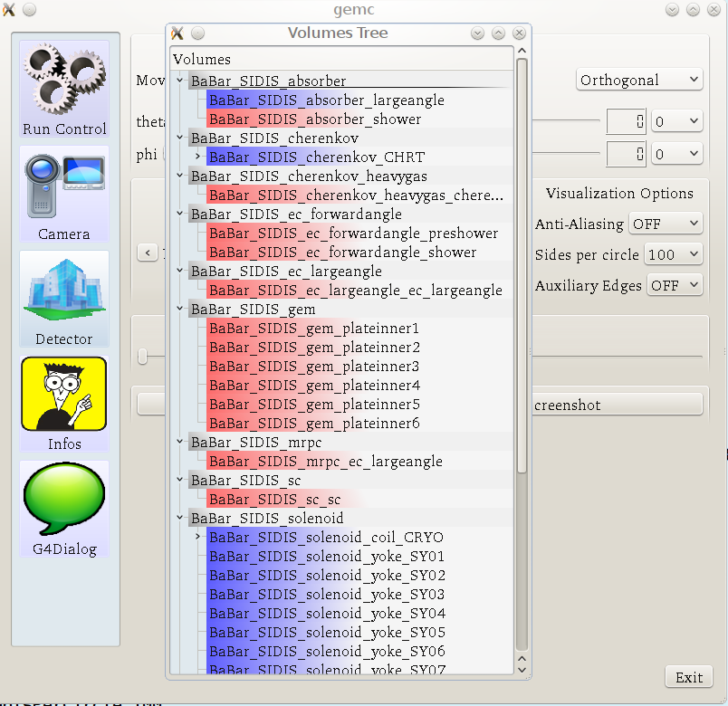
GUI (Detector)

Slide 5
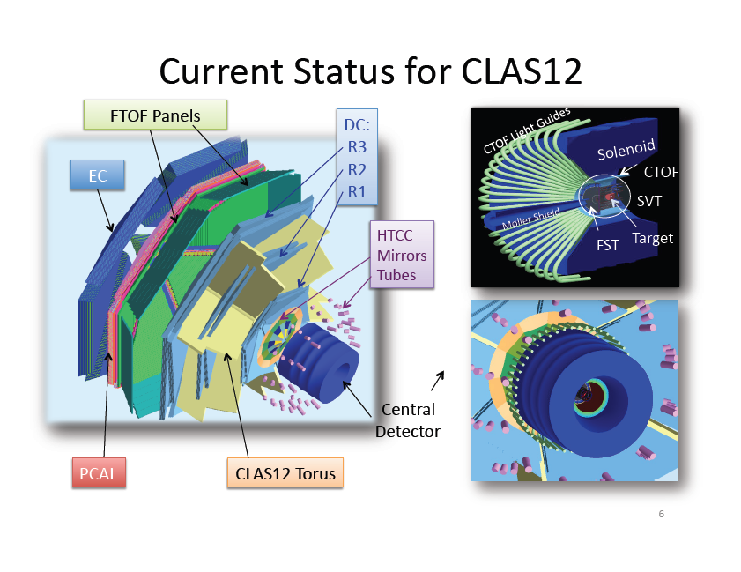

Slide 6
How To: new detector, hits
$detector{"pos"} = ”10*cm 20*cm 305*mm";
$detector{"rotation"} = "90*deg 25*deg 0*deg";
$detector{"color"} = "66bbff";
$detector{"type"} = "Trd";
$detector{"dimensions"} = ”1*cm 2*cm 3*cm 4*cm 5*cm";
$detector{"material"} = "Scintillator";
$detector{"mfield"} = "no";
$detector{"ncopy"} = 12;
$detector{"pMany"} = 1;
$detector{"exist"} = 1;
$detector{"visible"} = 1;
$detector{"style"} = 1;
$detector{"sensitivity"} = "CTOF";
$detector{"hit_type"} = "CTOF";
$detector{"identifiers"} = "paddle manual 2";
16th: Bank
17th: Digitization Routine
In general, 1 bank ←→ 1 digitization routine… but not necessary

Slide 7
Factory Method for Hit Processes
Hit Process, Digitizations External
Routines
SVT
CTOF
Automatic Process
Routines Still External
Easy to:
add new routine
debug
modify
gemc DC
gemc FTOF
Notes:
Factory method is a plug-in type approach.
A template is made for all hit routines. It’s c++ so called virtual class with pure virtual methods.
This is the empty box you see here.
The advantage of this is that the I/O to the code is already taken care of, so the routines are stand alone code (i.e. plug-in) with fixed input and dynamic output.
Programmers don’t have to look in the code for anything, just worry on how to process and digitized the hit based on position, energy, timing, etc of each step.
They just have to “fill the box”

Slide 8
Digitization
Available For every G4 step Hit Process Example
Hit Position
Volume Local Hit Position
Deposited energy
Time of the hit
Momentum of the Track
Energy of the track
Primary Vertex of track
Particle ID
Identifier
Mother Particle ID
Mother Vertex
Average (x,y,z)
Average (lx, ly, lz)
Total E
Average t
Average p (final p)
Energy
Primary Vertex of track
Particle ID
Strip, Layer, Sector

Slide 9
Event Generation
Particle gun built in, two luminosity beams can be added
LUND Format (txt) for physics events
Data Output
evio, bank alike binary format by Jlab DAQ group
Root tree, convert from evio
text

Slide 10
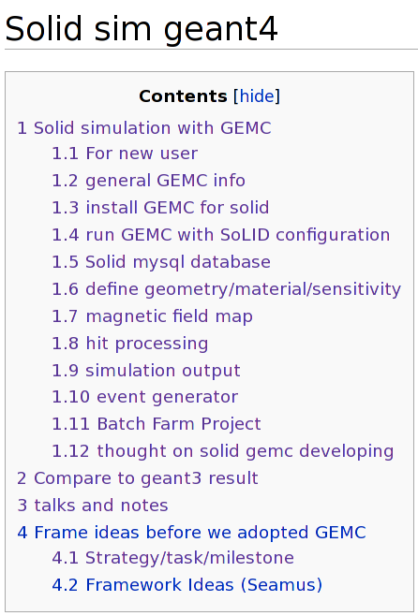
Documentation
gemc.jlab.org
https://hallaweb.jlab.org/wiki/index.php/Solid_sim_geant4

Slide 11
Advantage
Central outside location of geometry/sensitivity/field/digitization
Customized hit processing for various detectors
Unified individual detector simulation and the whole SoLID simulation

Slide 12
GEMC update
Progress
Mirrors, done in the “identifiers” entry of the geometry, control optical property on fly.
Right click to output geometry in GDML format.
Mother particle tracking becoming optional to optimize speed.
Todo list
Move material definition into database also.
Move svn repository out of clas12svn and restructure.
Improve database I/O.
Adapt to Geant4.9.4.

Slide 13
SoLID GEMC update
Progress
Add “solid” HIT_PROCESS_LIST
More database added in soliddb.jlab.org to allow for the full SoLID, its subsystems simulation. Also database for individual developers.
PVDIS and SIDIS yoke designs and field maps are unified
More materials added for our setup.
More instructions on wiki
Rewrote many geometry to avoid overlap and added more
EC simulation in GEMC is under work.
Baffle redesign for various magnets
Event generators updated for PVDIS and SIDIS
Study configuration with ZEUS magnet.
Todo list
Move subsystem simulation to GEMC
Customize hit routine
Direct root output

Slide 14
Compare geant4 to geant3 results
Progress
SIDIS kinematics and angle distribution
SIDIS and PVDIS low energy background rate.
Todo list
Acceptance
Detector resolution

Slide 15
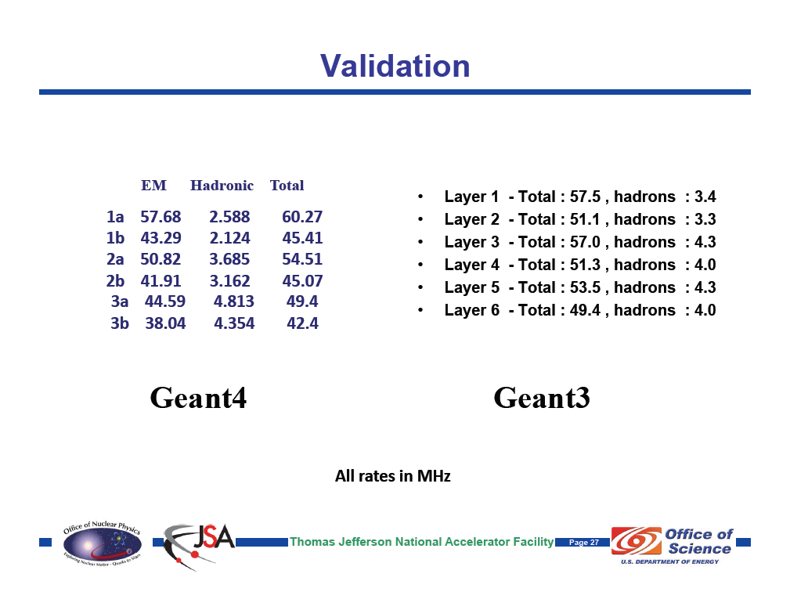
CLAS12 SVT

Slide 16
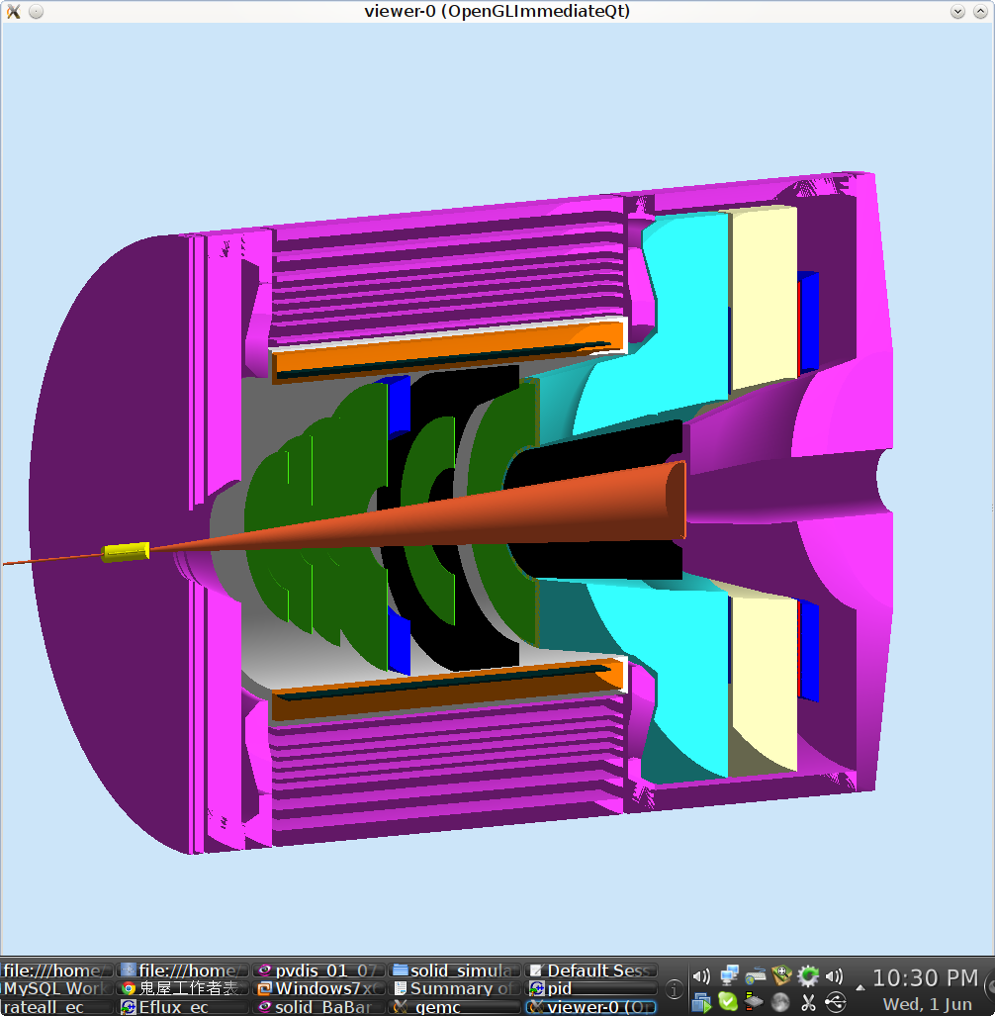
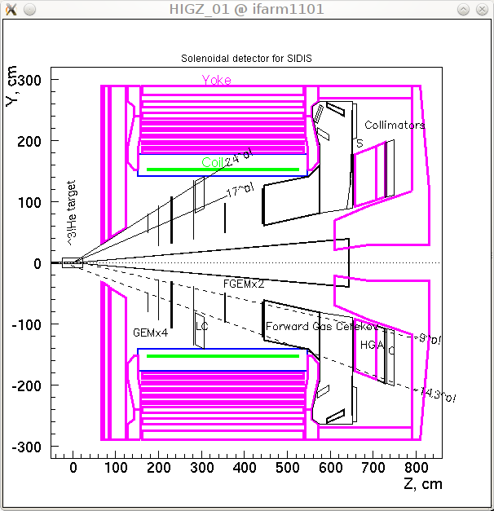
SIDIS with BaBar Magnet
geant4
geant3

Slide 17
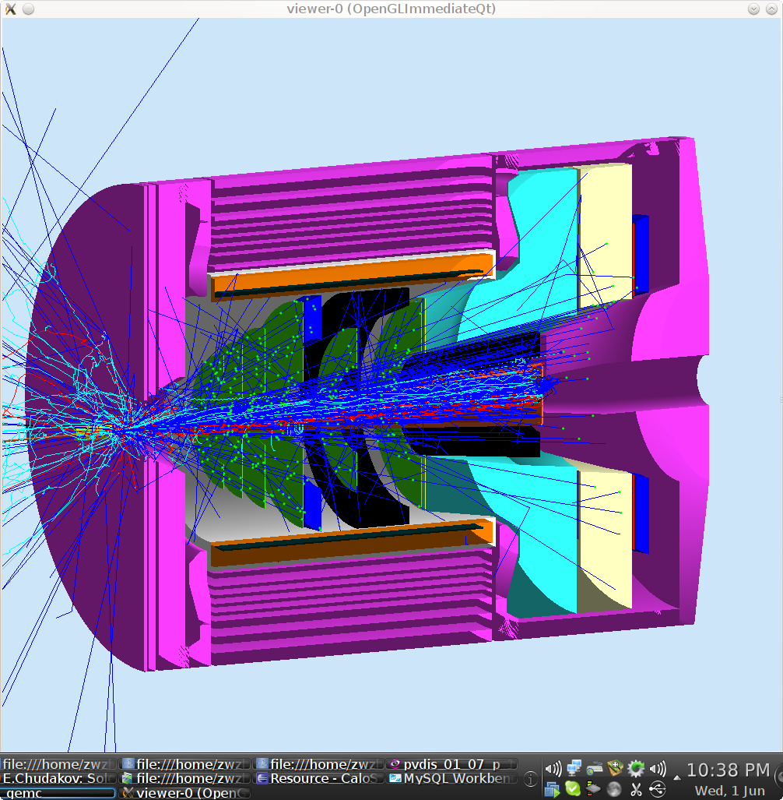
SIDIS with BaBar Magnet
geant4
geant3

Slide 18
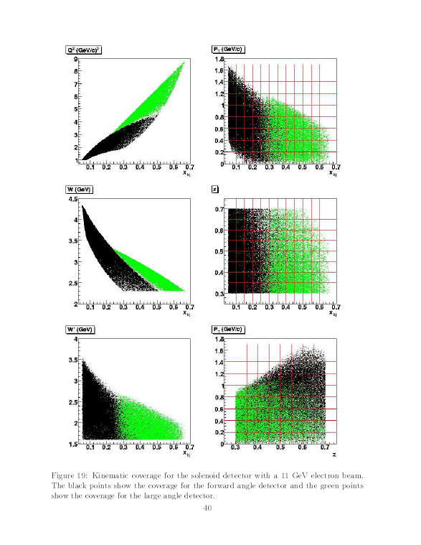
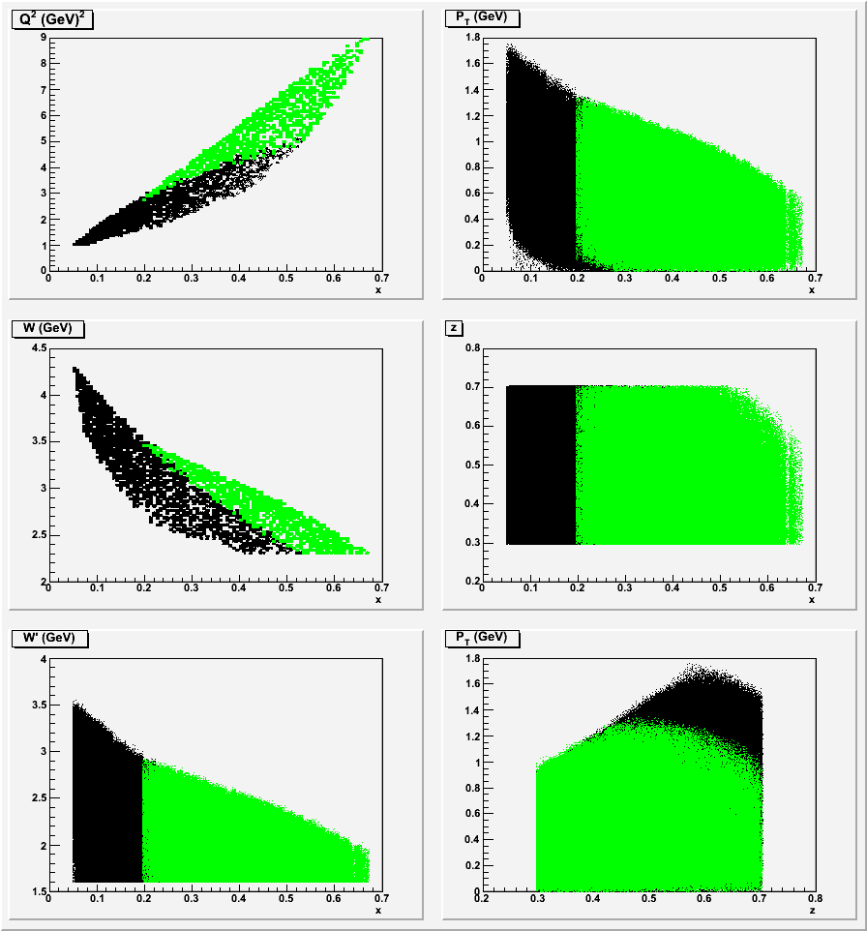
Kinematics for SIDIS with BaBar
geant4
geant3

Slide 19
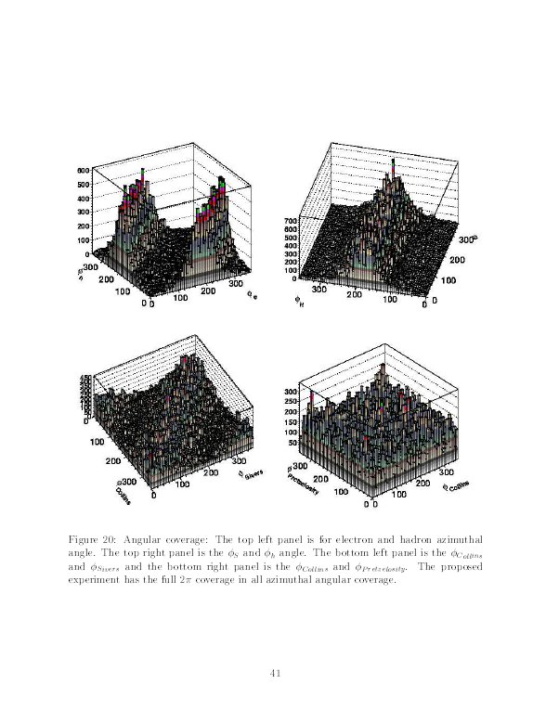
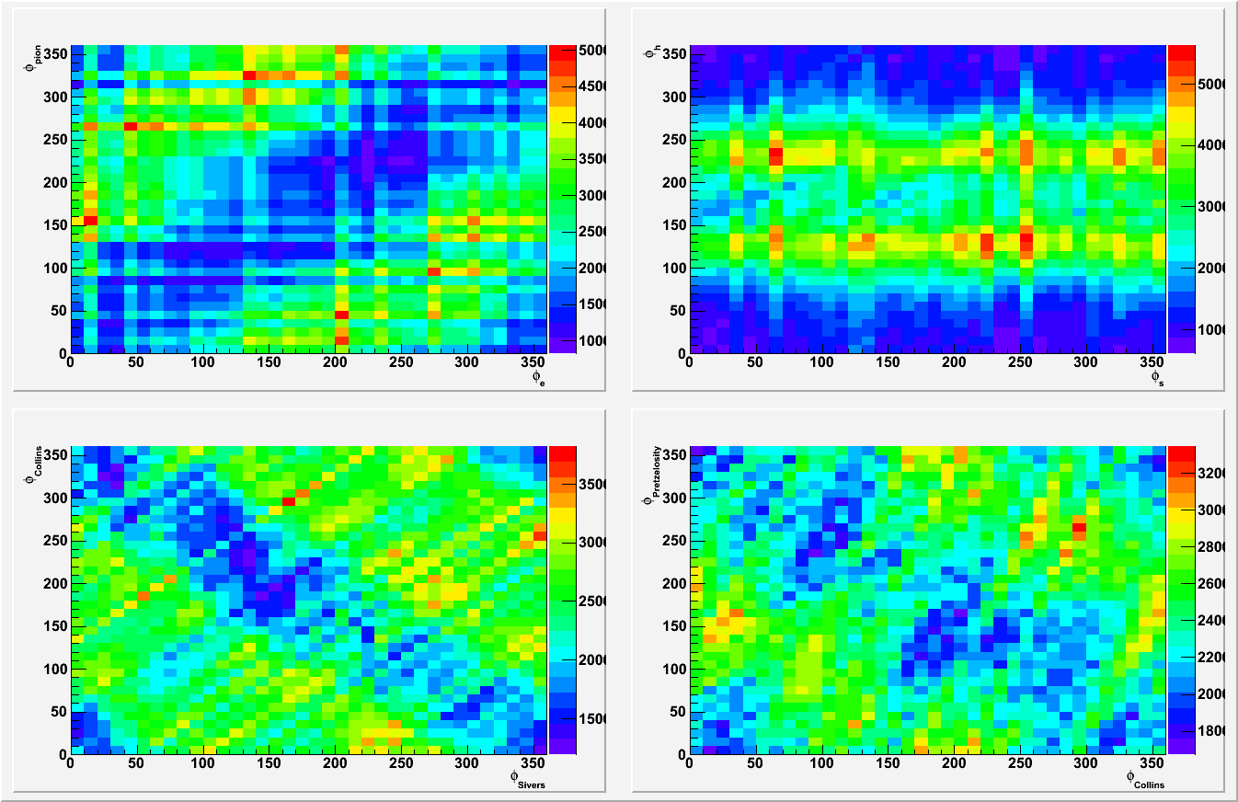
Phase Space, Collins and Sivers Angle Coverage for SIDIS with BaBar
geant4
geant3

Slide 20
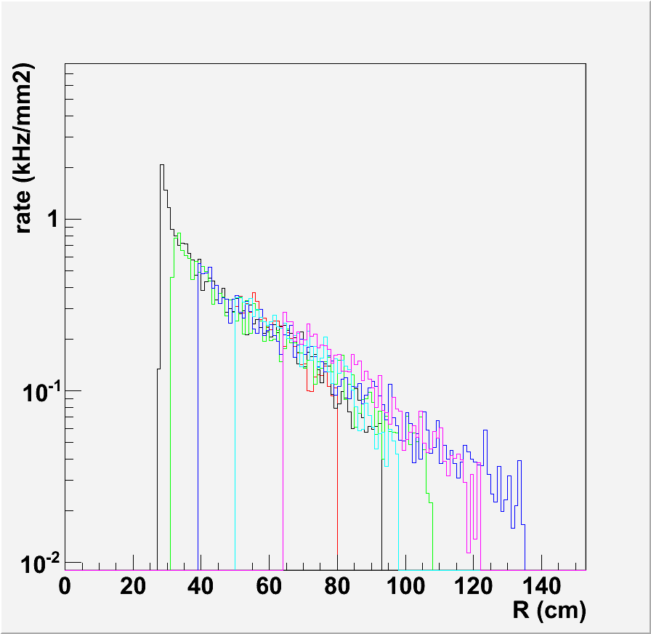
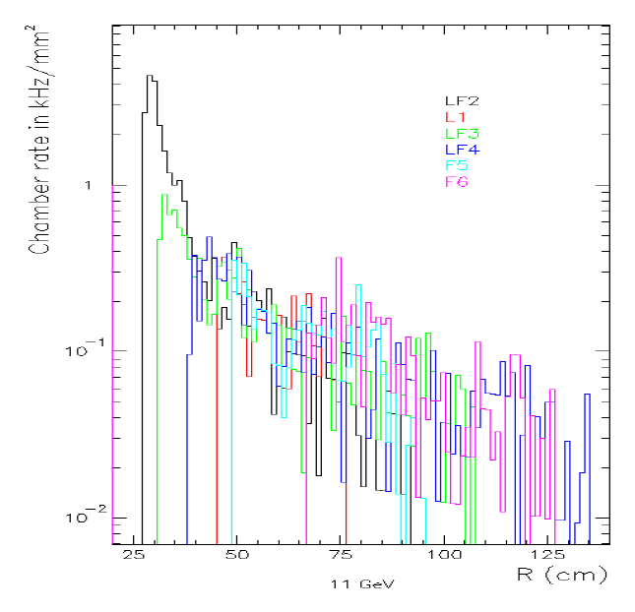
Background rate on GEM for SIDIS with BaBar
geant4
geant3
CDF
Condition: 15uA 11GeV e- beam, 40cm 3He 10amg gas target
Result: geant4 is about 1/2 of geant3 with a different magnet

Slide 21
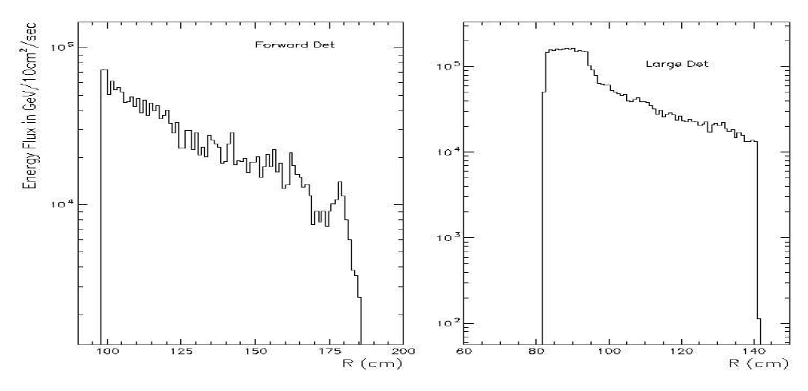
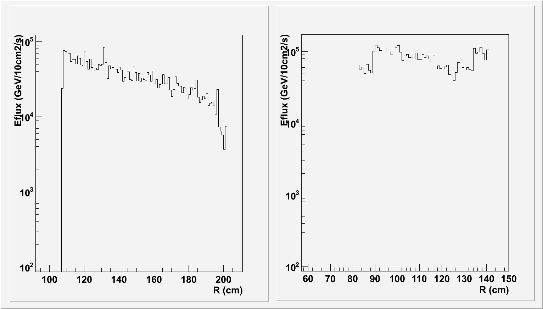
Energy flux rate on EC for SIDIS with BaBar
geant3
geant4
Condition: 15uA 11GeV e- beam, 40cm 3He 10amg gas target
Result: geant4 is close to geant3 with the same magnet

Slide 22
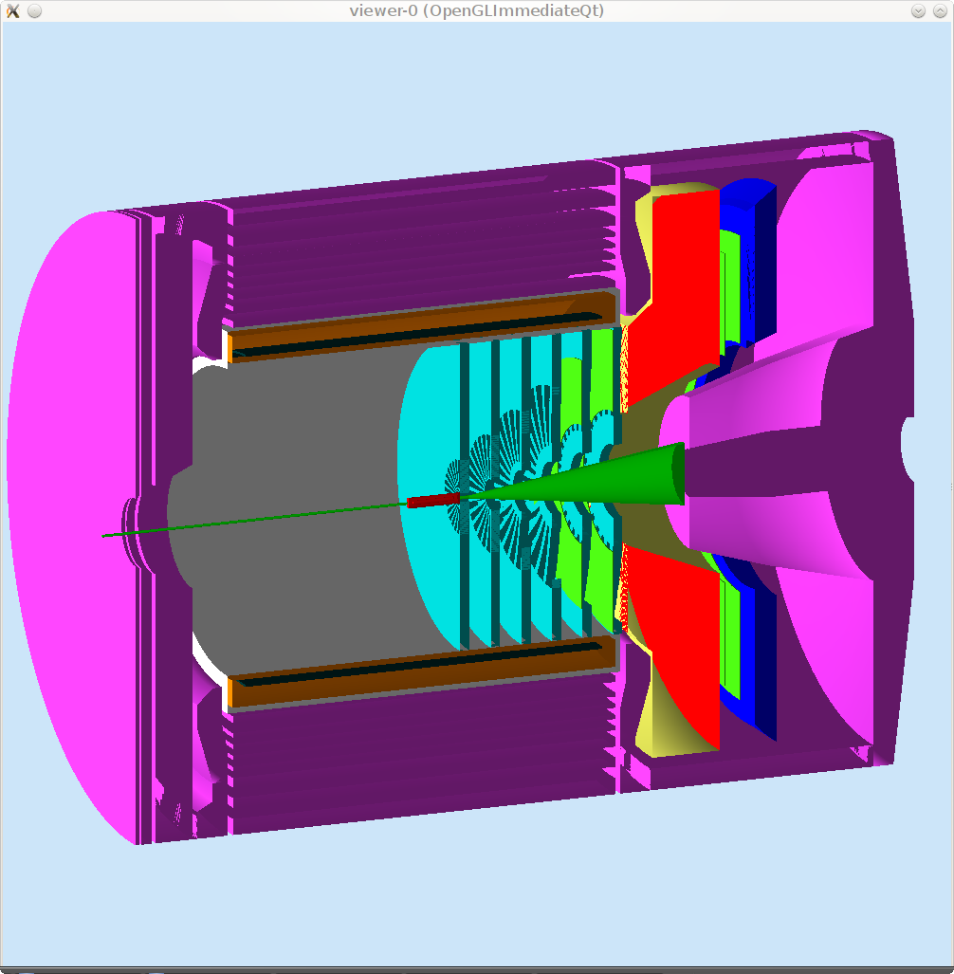
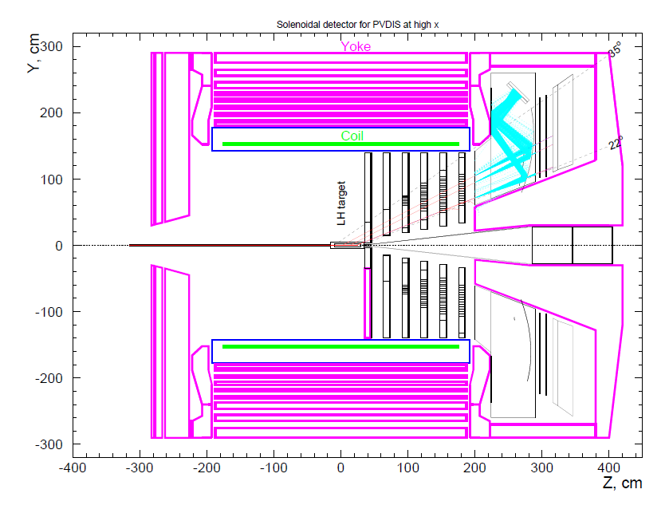
PVDIS with BaBar Magnet
geant4
geant3

Slide 23
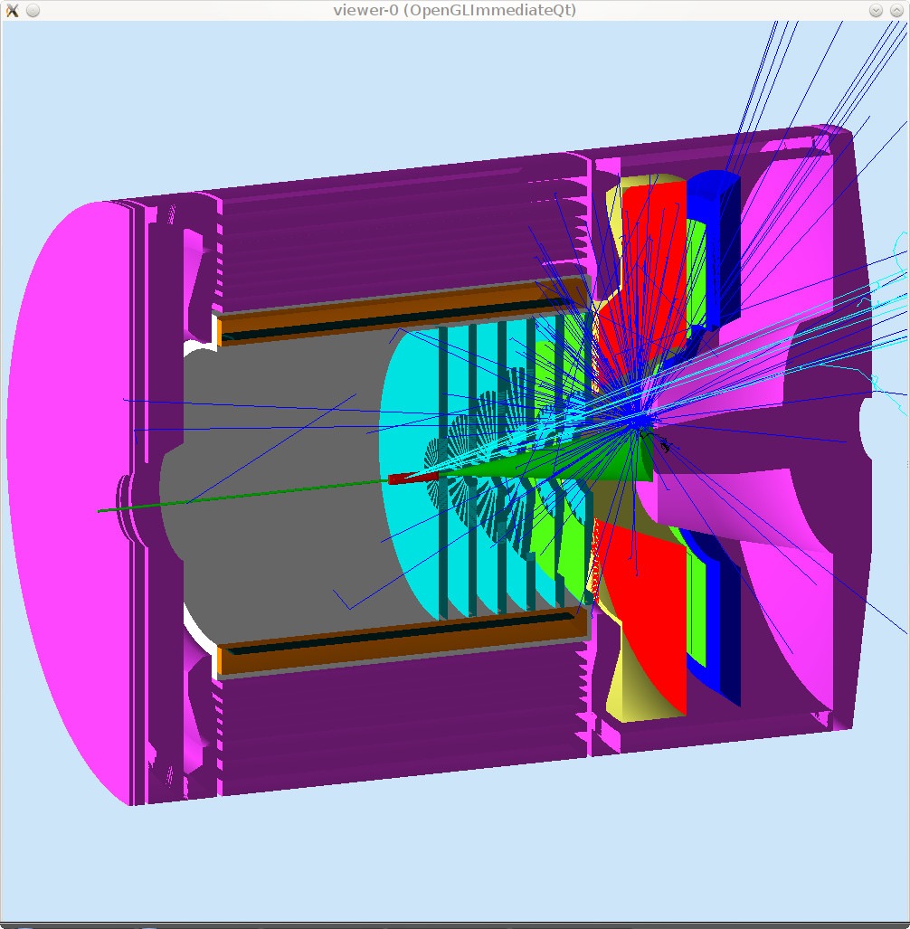
PVDIS with BaBar Magnet
geant4
geant3

Slide 24
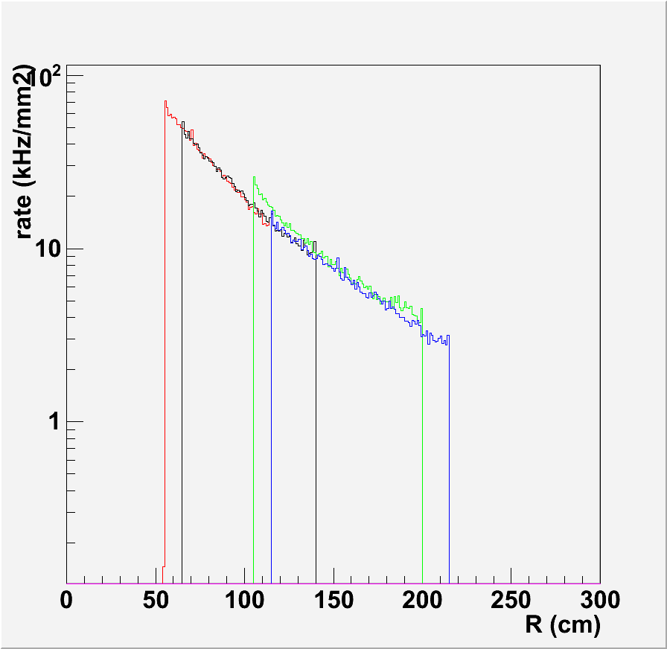
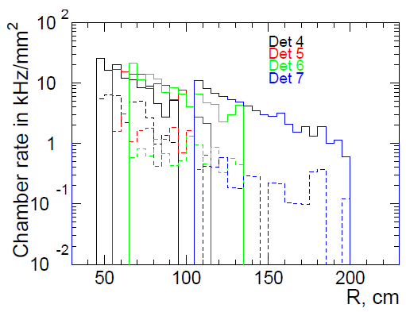
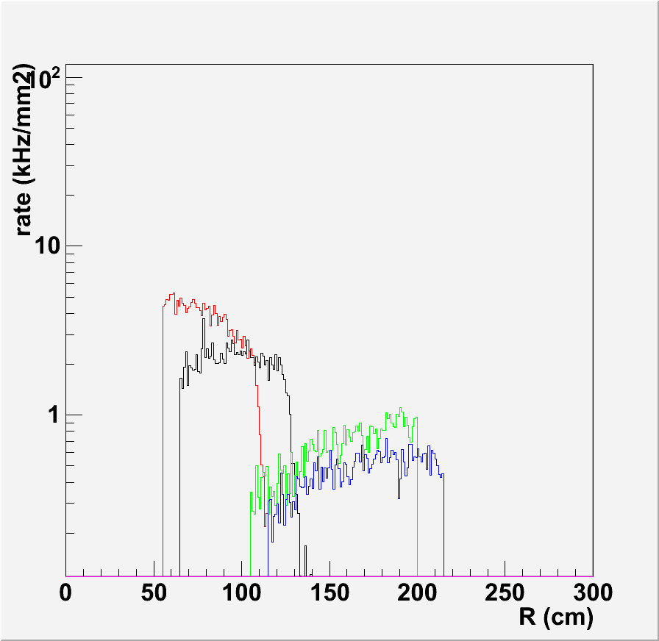
Background rate on GEM for PVDIS with BaBar
geant4
geant3
open
baffle
Condition: 50uA 11GeV e- beam, 40cm LD2 target
Result: geant4 is about 2 times of geant3 with LH2 target.

Slide 25
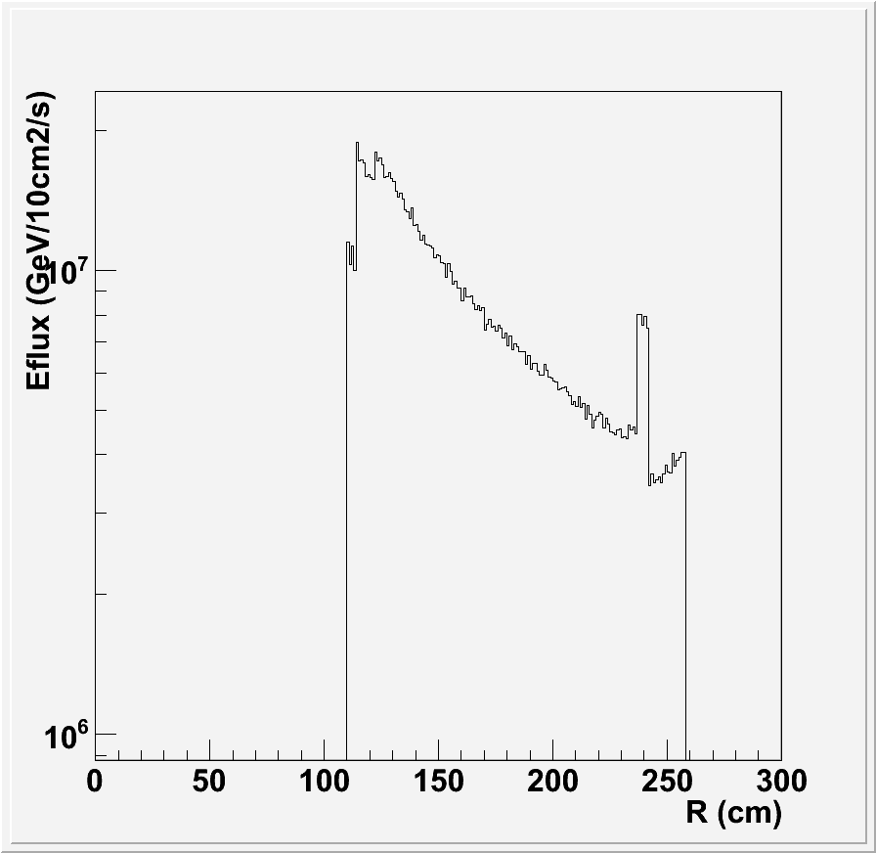
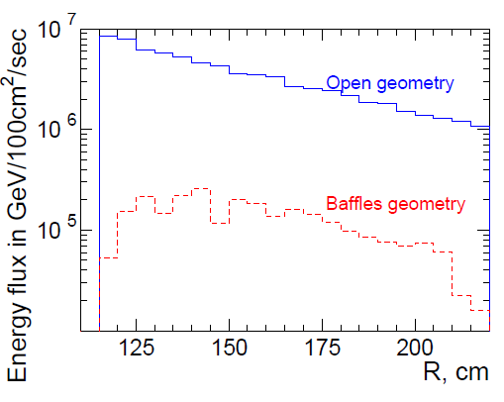
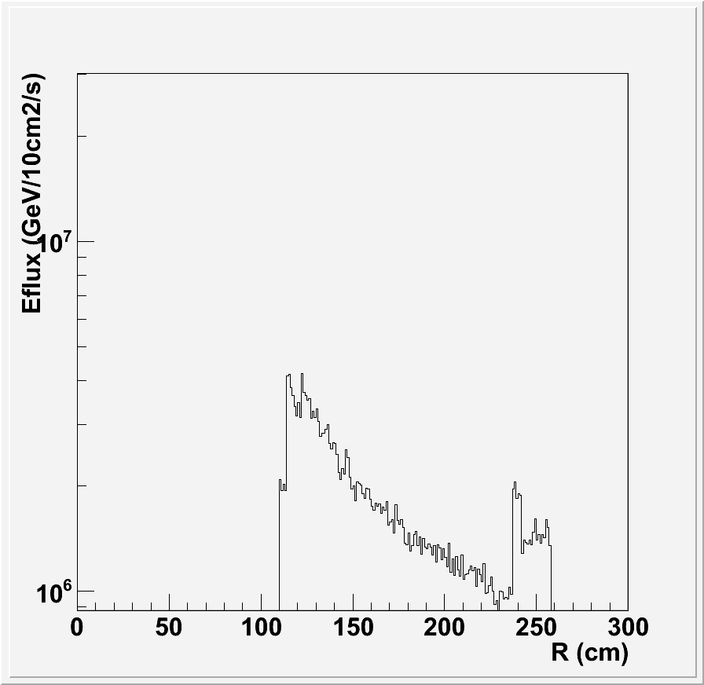
Energy flux rate on forward EC for PVDIS with BaBar
geant4
geant3
open
baffle
Condition: 50uA 11GeV e- beam, 40cm LD2 target
Result: geant4 is about 2 times of geant3 with LH2 target.

Slide 26
Summary
Solid Simulation is making progress.
Geant4 physics is under control.
The program is ready to be used for various studies to help design.
Subsystem simulation should take advantage of the framework.

Slide 27
Thanks
Maurizio Ungaro
Paul Reimer
Seamus Riordan
Lorenzo Zana
Simona Malace
Yang Zhang
Eugene Chudakov
Xin Qian
Zhiwen Zhao

