Slide 1
Solid SIDIS
DAQ
Solid collaboration meeting
June 2nd /3rd 2011
Alexandre Camsonne

Slide 2
Outline
Detector layout
Expected detector rates
Readout electronics
Trigger
L2 / L3 trigger
Time Line
  Hall A HRS upgrade
Open questions / Issues
Conclusions

Slide 3
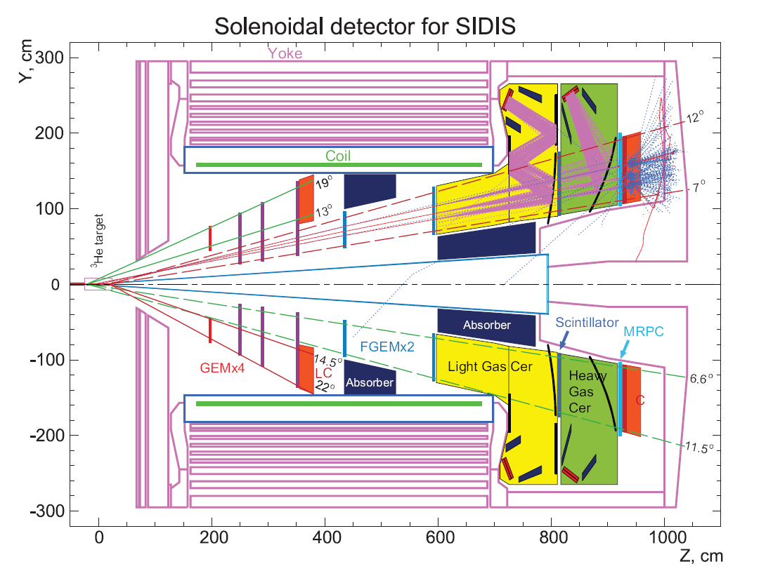
Detector layout for SIDIS

Slide 4
Estimated Channels
Detector | Total Channel | Front End Module | Number of Modules
GEM | 300 k ? | Customized VME | ?
LC | 180 | FADC250/F1-ADC | 12/6
FC | 360 | FADC250/F1-ADC | 23/12
LGC | 30 | FADC250 | 2
HGC | 30 | FADC250 | 2
MRPC | 3000 | Customized VME | ?
SC | 30 | FADC250/F1-ADC | 2/1
From Yi’s previous talk

Slide 5
GEM readout
APV25 or better
  40 MHz sampling rate
  12 bit
  Pipelined
Readout prototype board VME64X/VXS by INFN
  Possibility of adding crude tracking to trigger ?

Slide 6
Cost Estimation
Module Name | Unit Price | # of Modules | Total Cost
FADC250 | $ 4,000 | 41 | $ 164,000
FADC125 | $ 4,000
F1-TDC | $ 4,000 | 19 | $ 76,000
CTP | $ 5,000 | 6 + ?? (4) | $ 30,000 + ??
SSP | $ 5,000 | 1 + ? (1) | $ 5,000 + ?
GTP | $ 5,000 | 1 | $ 5,000
TS | $ 5,000 | 1 | $ 5,000
TID | $ 3,000 | 10 + ?? (4) | $ 30,000 + ??
SD | $ 2,500 | 8 + ?? (4) | $ 20,000 + ??
VXS Crate | $ 8,000 | 8 + ?? (4) | $ 64,000 + ??
Total |  |  | $ 401,000 + ??? ($ 79,000)
From Yi’s previous talk

Slide 7
SoLID SIDIS Detector Rates
In 50 ns windows, 11 GeV
Detector | Rate | Hits | Type | Data Size per hit
GEM | 4.4 GHz | 220 | Hits (time) | 4 Byte x 2 (X/Y)
LC | 120 kHz | 1 | Energy, Hits | 8 Byte x 2 (PS/SH)
FC | 200 MHz | 10 | Energy, Hits | 8 Byte x 2 (PS/SH)
LGC | 40 MHz | 3 | Energy, Hits | 8 Byte x 2 (split)
HGC | 60 MHz | 4 | Energy, Hits | 8 Byte x 2 (split)
MRPC | 850 MHz | 45 | Hits | 4 Byte
SC | 300 MHz | 15 | Energy, Hits | 8 Byte
Total |  |  |  | 2.5 kB
With header and other over head
event size is ~ 4 kB
From Yi’s previous talk

Slide 8
L1 Trigger
Electron Singles Trigger:
  LC > 400 MeV|| (FC > 400 MeV && LGC)
  Total event rate: 190 - 240 kHz
  Frontend data rate: 800 – 1000 MB/s
  ROCs can barely handle this rate
    Assuming 10 VME crates, 100 MB/s per ROC
    add more crates since PVDIS uses > 30
  Maybe a little bit too much to write to the tape
  Not much room for improvement, already very close to electron yield.
From Yi’s previous talk

Slide 9
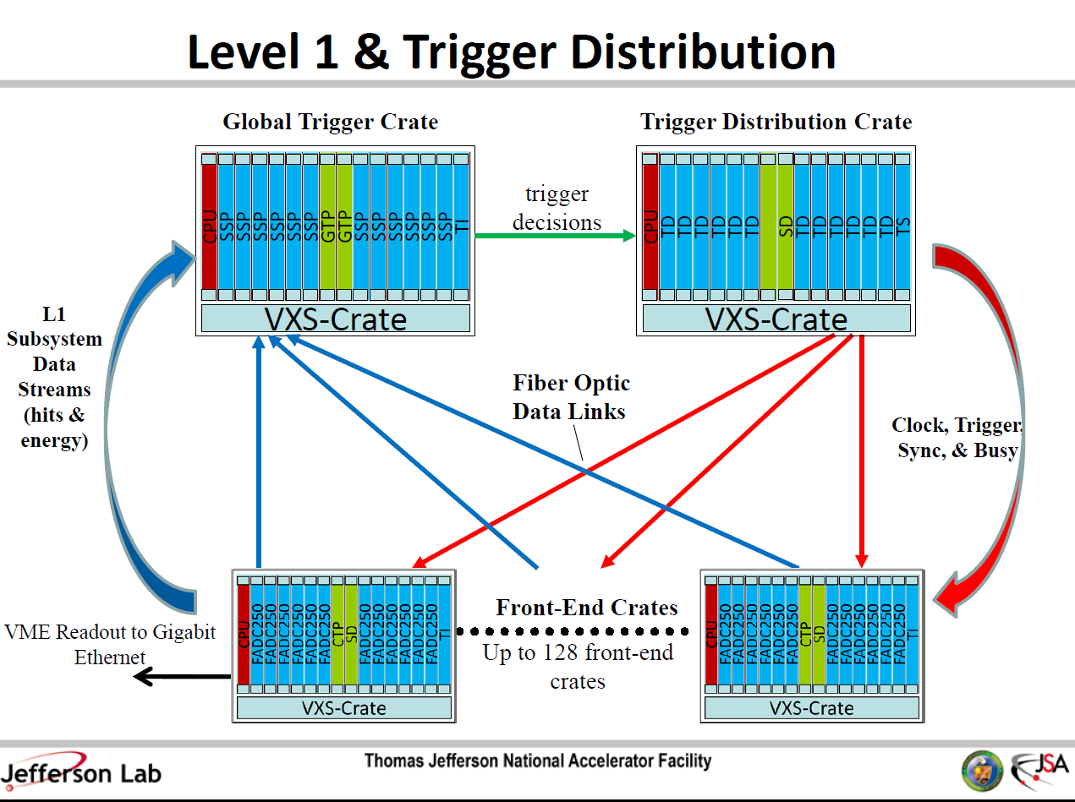
Ben Raydo
Talk
https://www.jlab.org/exp_prog/electronics/trigdaq/PipelineTriggerElectronics_S&T09.pdf

Slide 10
L3 Farm
blocked event fragments
partially recombined event fragments
full events
All nodes connected with 1GB/s links
Switches connected with 10GB/s fiber optics
ROC
EB1
Event Builder
stage 1
ROC
L3 Farm
EB2
Event Builder
stage 2
ROC
node
node
ROC
EB1
Event Builder
stage 1
node
Read Out Controllers
ER
Event Recorder
ROC
Raid Disk
ROC
EB2
Event Builder
stage 2
node
node
ROC
node
EB1
Event Builder
stage 1
node
ROC
ROC
Front-End Crates
Staged Event Building
Level-3 Trigger and monitoring
Event Recording
~60 crates
~50MB/s out per crate
N x M array of nodes (exact number to be determined by available hardware at time of purchase)
300MB/s in
300MB/s out

Slide 11
L2 Trigger
Level 2 trigger
  Coplanarity through lookup table -> Reduce region of interest by a factor of 2 ( used in Hall A DVCS with smaller scaler detector )
  Additionnal PID information

Slide 12
L3 Trigger
Add computer nodes to do quick reconstructions
  Access to crude physics variable for event selection
  More advanced PID
Limitation
  Decision needs to be done in less than 8 us ( pipeline length )
  Efficiency and systematic uncertainty of trigger needs to be carefully studied

Slide 13
Pipelined electronics roadmap
Now up to November 2011
  JLAB FADC for positron Transmission Compton polarimeter, implementation of integrated method similar to Hall A Compton.
APV 25 ordered, should be delivered this summer
  Test GEM with APV25 during g2p : November 2011
MRPC prototype possibly available for beam test

Slide 14
HRS 12 GeV Hall A DAQ upgrade milestones
Milestone Planned
Implement 1190 and 1290 TDCs on HRS Oct-11
Implement Fastbus upgrade with Intel Quad cpus Nov-11
Complete the Design of Test Stand for Pipelined Electronics Dec-11
Obtain prototype TIR boards, new ROC and EB components for CODA 3 Jan-12
Complete the Design of the Delay Modules (Ben Raydo) Feb-12
Parts for Test Stand Delivered (FADC, TDCs, TIR, etc) Mar-12
Test of Delay Module Prototype Completed Apr-12
Initial Testing of Pipelined Electronics, informing final design May-12
Preliminary Design of DAQ and Trigger Jun-12
Order Delay Modules and other Trigger Modules Jul-12
Completed Tests of Pipeline Electronics Aug-12
Final Design of DAQ and Trigger Sep-12
Order ADCs and TDCs (at this point, looks like Jlab FADC and CAEN 1190) Oct-12
Order Crate Trigger Supervisor, Subsystem Decision Modules, etc. Nov-12
Order Fibers and Gigabit Ethernet Dec-12
All DAQ and Trigger modules delivered Jan-13
Analysis Software Upgrades Completed (based on Test Stand) Feb-13
Assembly of Full DAQ System Complete Mar-13
Preliminary Tests of Full DAQ System Apr-13
Final Tests of Full DAQ System May-13
Can start to work on SoLID trigger

Slide 15
SoLID DAQ testing / development
2013 : Procure additionnal components
  Global Trigger Processor and Sub System Processor
Explore VXS readout with APV25 for L2 trigger
Prototype L3 node
Small scale setup by 2014 for parasitic test with beam

Slide 16
Open questions / Issues
Simulation of background to determine event size
  Multiple samples
  Efficiency
Integration of MRPC read-out
Trigger development / optimization
  Reduce data on tape : 200 KHz of trigger hard to manage

Slide 17
Man power
Alexandre Camsonne
Yi Qiang
Rory Miskimen
DAQ /Electronics : requested 0.3 FTE a year until 2018 for trigger / frontend developments
Additionnal manpower welcome to get experience with hardware/software

Slide 18
Conclusion
Challenging experiment
  Large rate and background
Simulation and small scale prototype needed
  Most part available by 2012/2013
L3 needed to have manageable data rates
Work to define and refine triggers to reduce data
Development fits well in Hall A DAQ upgrade plane for HRS and SBS

Slide 19
Backup Slides

Slide 20
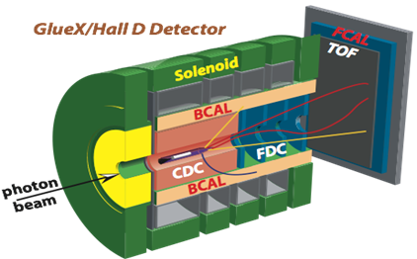
Hall D L1 Trigger-DAQ Rate
Low luminosity (10⁷ γ/s in 8.4 < E_{γ} < 9.0 GeV)
  20 kHz L1
High luminosity (10⁸ γ/s in 8.4 < E_{γ} < 9.0 GeV)
  200 kHz L1
  Reduced to 20 kHz L3 by online farm
Event size: 15 kB; Rate to disk: 3 GB/s
SC
Detectors which can be used in the Level-1 trigger:
Forward Calorimeter (FCAL) | Energy
Barrel Calorimeter (BCAL) | Energy
Start Counter (SC) | Hits
Time of Flight (TOF) | Hits
Photon Tagger | Hits
Electromagnetic background
Hadronic E_{γ} < 8 GeV
Hadronic E_{γ} > 8 GeV
Energy BCAL (GeV)
Energy BCAL (GeV)
Energy BCAL (GeV)
Basic Trigger Requirement:
E_{BCAL} + 4 ∙ E_{FCAL} > 2 GeV
and a hit in Start Counter
Energy FCAL (GeV)
Energy FCAL (GeV)
Energy FCAL (GeV)

Slide 21
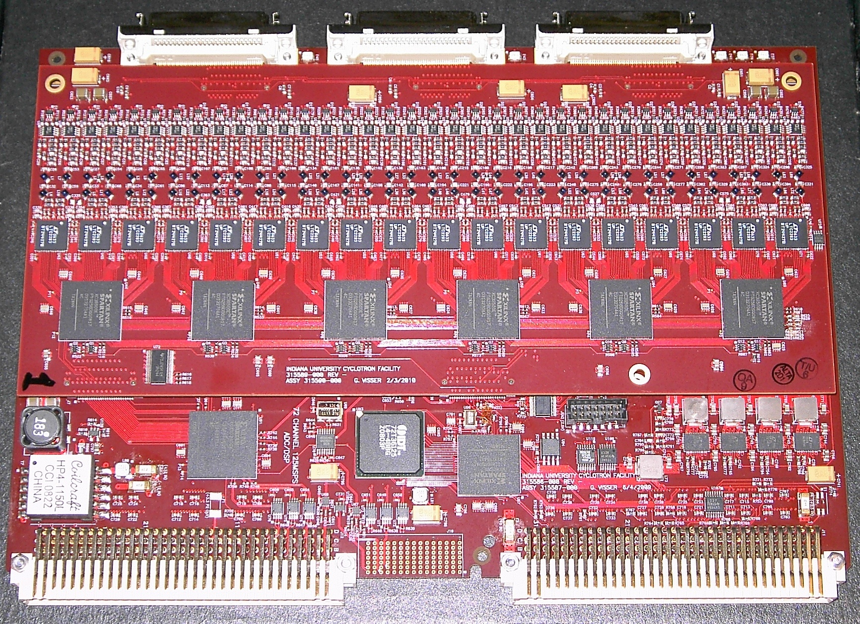
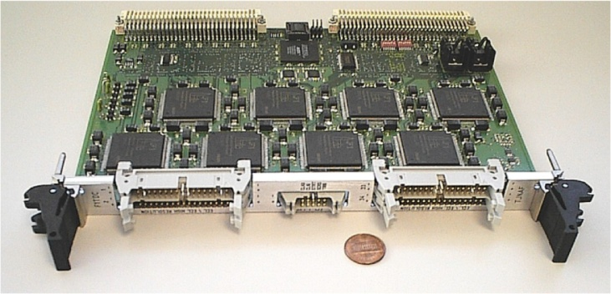
Custom Electronics for JLab
VME Switched Serial (VXS) backplate
  10 Gbps to switch module (J₀)
  320 MB/s VME-2eSST (J₁/J₂)
All payload modules are fully pipelined
  FADC125 (12 bit, 72 ch)
  FADC250 (12 bit, 16 ch)
  F1-TDC (60 ps, 32 ch or 115 ps, 48 ch)
Trigger Related Modules
  Crate Trigger Processor (CTP)
  Sub-System Processor (SSP)
  Global Trigger Processor (GTP)
  Trigger Supervisor (TS)
  Trigger Interface/Distribution(TI/D)
  Signal Distribution (SD)
FADC125
F1-TDC

Slide 22
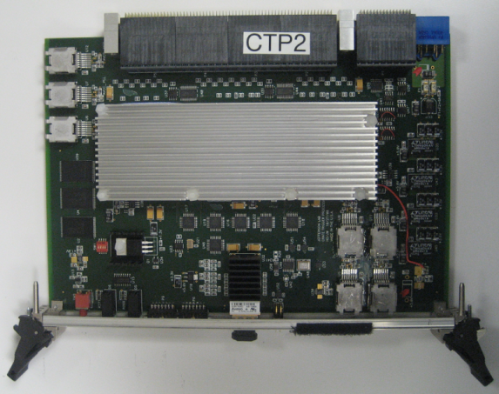
L1 Trigger Diagram
CPU
SSP
SSP
SSP
SSP
SSP
SSP
SSP
GTP
SD
SSP
SSP
SSP
SSP
SSP
SSP
SSP
TI
CPU
TD
TD
TD
TD
TD
TD
SD
SD
TD
TD
TD
TD
TD
TD
TS
VXS Crate
CTP
VXS Crate
FADC250
12 bit @ 250 MHz, 16 ch
Sums amplitude from all channels
Transfer total energy or hit pattern to CTP
Fiber Optics
64 bit @ 125 MHz
CPU
FADC
FADC
FADC
FADC
FADC
FADC
CTP
SD
FADC
FADC
FADC
FADC
FADC
FADC
TI
Crate Trigger Processor
Sums energies from FADCs
Transfer total energy or hit pattern to SSP
VXS Serial Link
16 bit @ 250 MHz: 4 Gbps
VXS Crate

Slide 23
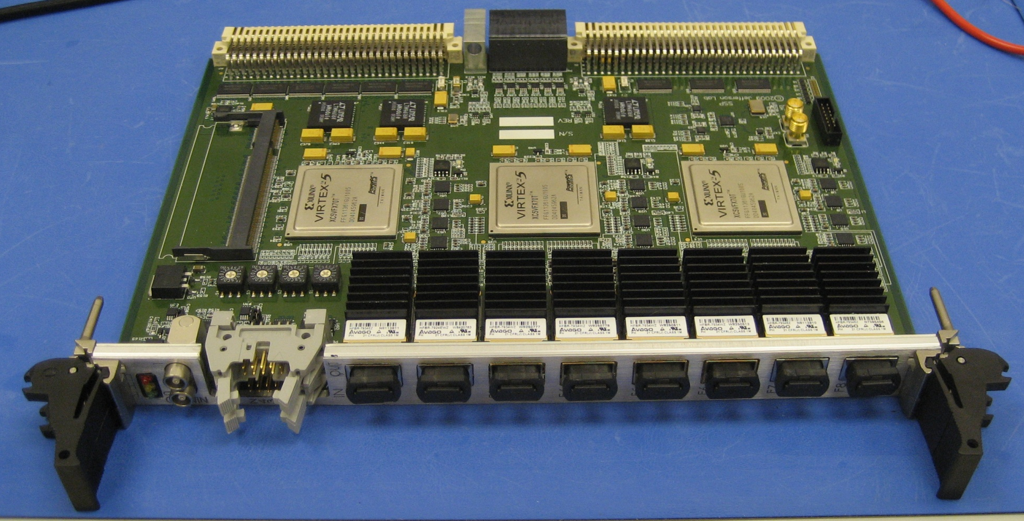
L1 Trigger Diagram
CPU
SSP
SSP
SSP
SSP
SSP
SSP
GTP
SD
SSP
SSP
SSP
SSP
SSP
SSP
SSP
TI
CPU
TD
TD
TD
TD
TD
TD
SD
SD
TD
TD
TD
TD
TD
TD
TS
TS
SSP
VXS Crate
VXS Crate
Sub-System Processor
Consolidates multiple crate subsystems
Report total energy or hit pattern to GTP
Copper Ribbon Cable
32 bit @ 250 MHz: 8 Gbps
CPU
FADC
FADC
FADC
FADC
FADC
FADC
CTP
CTP
SD
FADC
FADC
FADC
FADC
FADC
FADC
TI
Global Trigger Processor
Collect L1 data from SSPs
Calculate trigger equations
Transfer 32 bit trigger pattern to TS
VXS Serial Link
32 bit @ 250 MHz: 8 Gbps
VXS Crate

Slide 24
L1 Trigger Diagram
CPU
SSP
SSP
SSP
SSP
SSP
SSP
GTP
GTP
SD
SSP
SSP
SSP
SSP
SSP
SSP
SSP
TI
CPU
TD
TD
TD
TD
TD
TD
SD
SD
TD
TD
TD
TD
TD
TD
TS
VXS Crate
VXS Crate
Trigger Distribution
Distribute trigger, clock and synchronize signals to TI in each Crate
VXS Serial Link
16 bit @ 62.5 MHz: 1 Gbps
CPU
FADC
FADC
FADC
FADC
FADC
FADC
CTP
SD
FADC
FADC
FADC
FADC
FADC
FADC
TI
TI
Trigger Supervisor
Calculate 8 bit trigger types from 32 bit trigger pattern
Prescale triggers
Transfer trigger and sync signal to TD (16 bit total)
Fiber Optics
16 bit @ 62.5 MHz: 1 Gbps
VXS Crate

Slide 25
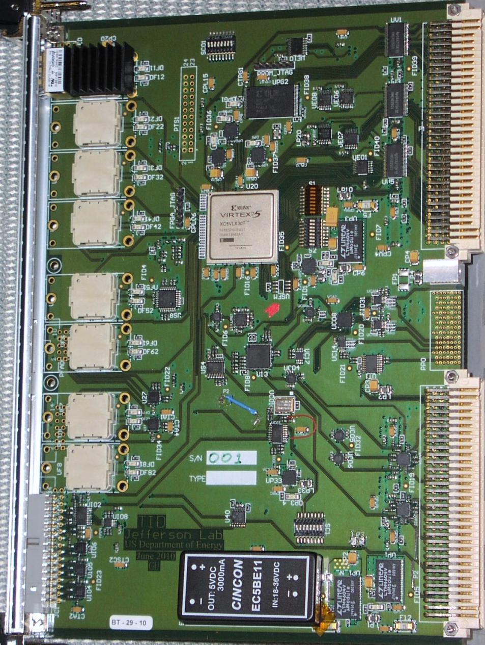
L1 Trigger Diagram
CPU
SSP
SSP
SSP
SSP
SSP
SSP
GTP
SD
SSP
SSP
SSP
SSP
SSP
SSP
SSP
TI
CPU
TD
TD
TD
TD
TD
TD
SD
SD
TD
TD
TD
TD
TD
TD
TD
TS
VXS Crate
VXS Crate
TID
VME Readout Controller
Gigabit ethernet
Trigger Interface
Receive trigger, clock and sync signals from TD
Make crate trigger decision
Pass signals to SD
CPU
FADC
FADC
FADC
FADC
FADC
FADC
CTP
SD
FADC
FADC
FADC
FADC
FADC
FADC
TI
Signal Distribution
Distribute common signals to all modules: busy, sync and trigger 1/2
VXS Crate
VXS Serial Link
4 bit @ 250 MHz: 1 Gbps

Slide 26
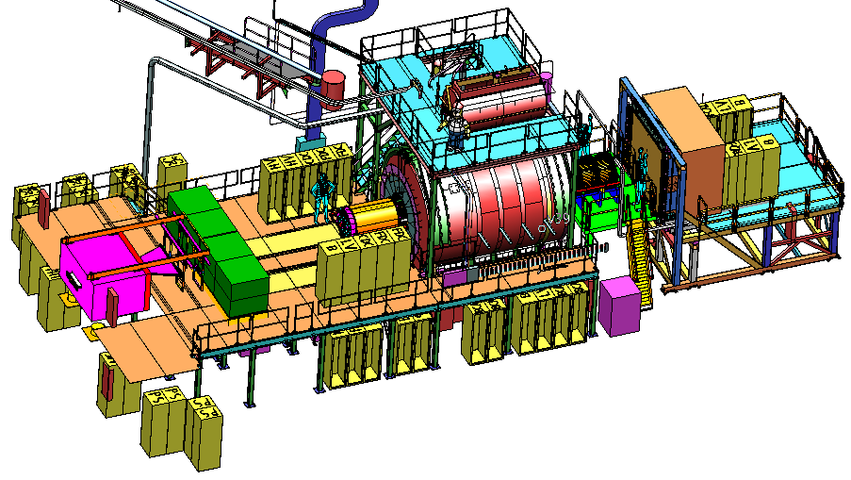
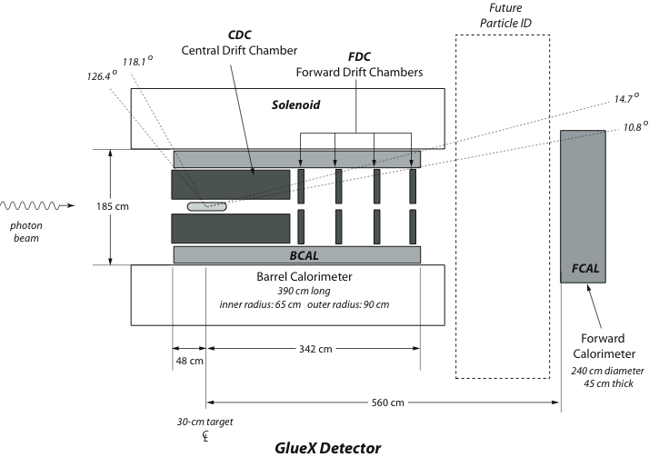
The GlueX Detector
2.2 Tesla
Solenoid
2.2T superconducting solenoidal magnet
Fixed target (LH₂)
10⁸ tagged γ/s (8.4-9.0GeV)
hermetic
TOF
time of flight
SC
start counter
Charged particle tracking
Central drift chamber (straw tube)
Forward drift chamber (cathode strip)
Calorimetry
Barrel Calorimeter (lead, fiber sandwich)
Forward Calorimeter (lead-glass blocks)
PID
Time of Flight wall (scintillators)
Start counter
Barrel Calorimeter

Slide 27
GlueX Data Rate
 | Front End DAQ Rate | Event Size | L1 Trigger Rate | Bandwidth to mass Storage
GlueX | 3 GB/s | 15 kB | 200 kHz | 300 MB/s
CLAS12 | 0.1 GB/s | 20 kB | 10 kHz | 100 MB/s
ALICE | 500 GB/s | 2,500 kB | 200 kHz | 200 MB/s
ATLAS | 113 GB/s | 1,500 kB | 75 kHz | 300 MB/s
CMS | 200 GB/s | 1,000 kB | 100 kHz | 100 MB/s
LHCb | 40 GB/s | 40 kB | 1000 kHz | 100 MB/s
STAR | 50 GB/s | 1,000 kB | 0.6 kHz | 450 MB/s
PHENIX | 0.9 GB/s | ~60 kB | ~ 15 kHz | 450 MB/s
private comm.
JLab
CHEP2007 talk
Sylvain Chapelin
LHC
BNL
*
**
* Jeff Landgraf Private Comm. 2/11/2010
** CHEP2006 talk MartinL. Purschke

Slide 28
Level-1 Trigger Electronics
Front-End Crate
Trigger Distribution Crate
Custom Designed
Boards at JLAB
VXS Crate
VXS Crate
Detector
Signals
TD
TS
Fiber Optic Links
Clock/Trigger
(16bits @ 62.5MHz
TS
(16)
(12)
(1)
(1)
(1)
(1)
(1)
VXS Crate
( ) – Number in parentheses
refer to number of modules
Fiber Optic Link
(~100 m)
(64bits @ 125 MHz)
SSP
GTP
fADC250
(8)
CTP Crate Trigger Processor
(2)
(1)
Copper Ribbon Cable
(~1.5 m)
(32bits @ 250 MHz)
SD Signal Distribution
Global Trigger Crate
TI Trigger Interface
Trigger Latency ~ 3 μs
(F1TDC pipeline ~3.9 μs)
Pipelined detector readout electronics:
fADC and F1TDC
VXS Backplane

Slide 29
CODA3 – What’s different
CODA 2.5 | CODA 3
Run Control (X, Motif, C++) (rcServer, runcontrol) | Experiment Control – AFECS (pure JAVA) (rcPlatform, rcgui)
Communication/Database (msql, cdev, dptcl, CMLOG) | cMsg – CODA Publish/Subscribe messaging
Event I/O C-based simple API (open/close read/write) | EVIO – JAVA/C++/C APIs Tools for creating data objects, serializing, etc…
Event Builder / ET System / Event Recorder (single build stream) | EMU (Event Management Unit) Parallel/Staged event building
Front-End – vxWorks ROC (Interrupt driven – event by event readout) | Linux ROC, Multithreaded (polling – event blocking)
Triggering: 32 ROC limit, (12 trigger bits -> 16 types) TS required for buffered mode | 128 ROC limit, (32 trigger bits -> 256 types) TI supports TS functionality. Timestamping (4ns)

Slide 30
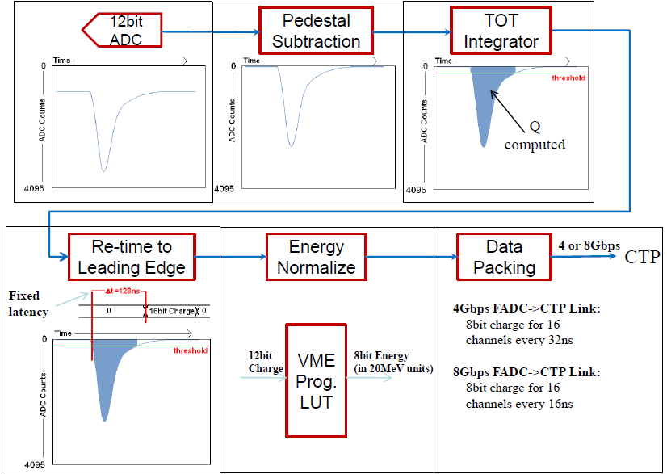
FADC Encoding Example

Slide 31
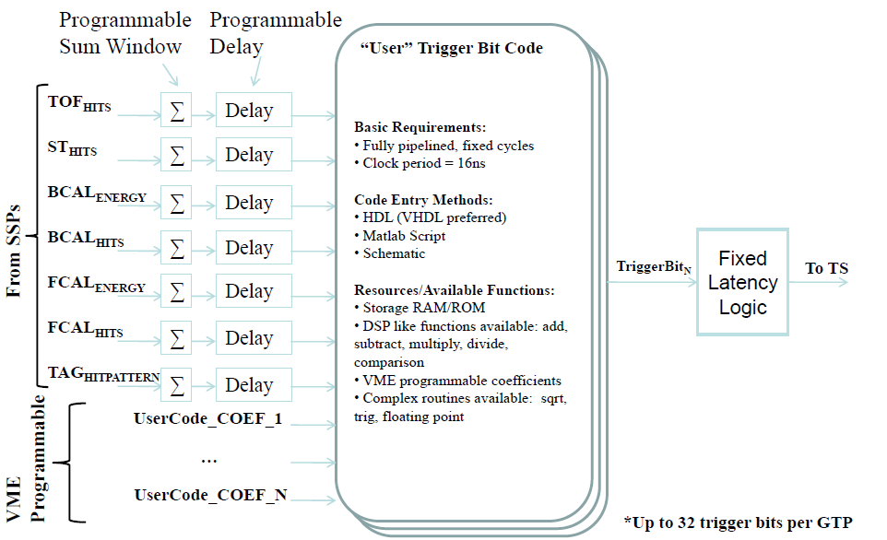
GTP Trigger Bit Example

