Slide 1
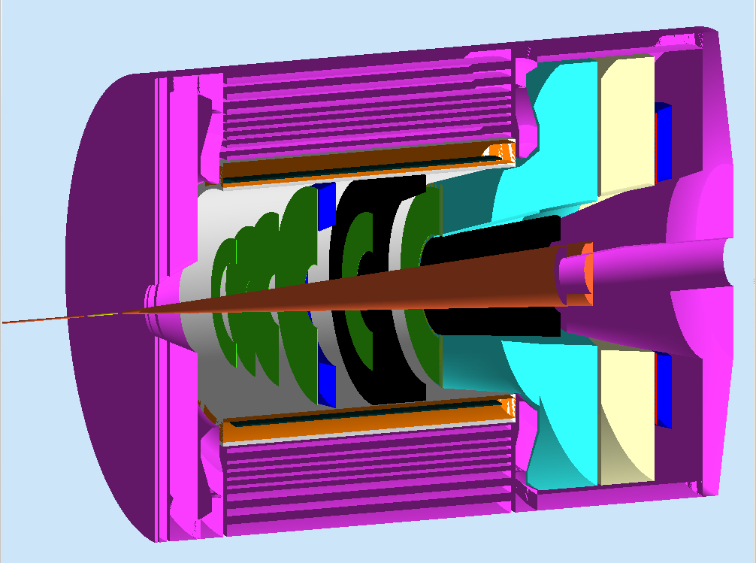
Updates on Progressive Tracking for SoLID
Xin Qian
Caltech

Slide 2
Introduction to Progressive Tracking
TDCs/ADCs
Responses from GEMs: ADCs and TDCs from readout strips.
Hits
Formed from strips, include both real and false hits.
False hits will be reduced by a factor of 3-5 from matching amplitudes
Tracking
Progressive Tracking is a black box: starts from hits of detectors, output is tracks
Can be used when the trajectory is not linear.
Other Detectors
Hits from other detectors can also be added into progressive tracking
Help to reduce false tracks (Optional).
Times and Amplitudes to match hit

Slide 3
Approximations
In real world, we start with readout of strips.
In simulation, we start with hits.
In real world, hits sometimes are correlated between different planes (e.g. short tracks)
In simulation, as we do not directly simulate background, we assume that background hits are uncorrelated.
In real world, lots of work are needed to understand the magnetic field (the most difficult part).
In simulation, we know the true information.

Slide 4
How do we model the effect of False hit now?
False Hit
Start with real hits.
Add the background hits according to simulated spectrum (r, z dependence).
Reduce total number of hits according to assumed efficiency.
Generate false hits
Randomly reduce the false hits by a factor of 4.
Real Hit
Real Hit
False Hit
Room to improve:
Order of applying efficiency + reduction of false hits
Correlation of false hits (Seamus)
For SIDIS, the geometry of strips etc.
A better way is to generate amplitudes with efficiencies from the real hits, and then match the amplitudes to get all hits.

Slide 5
Procedure of Tracking Code Now
Input
Use COMGEANT to generate tracks (real hits)
Use COMGEANT to generate background spectrum
Mix
Generate real background hits according to spectrum
Mixed with real hits from tracks, apply hit efficiency
Tracking
Generate the false hits in the decode stage + false hit reductions
Start progressive tracking

Slide 6
What have we learnt?
Tracking is doable at the projected background rates.
We roughly took in account all the main features of the GEMs/backgrounds etc.
Knowledge to be improved:
Efficiencies of GEM, false hit reduction of GEM, background on GEMs
Room to improve:
Speed of tracking, model amplitudes…
Strategy:
Need a plan to understand the magnetic field quickly (combine data taking with simulation, training etc).
This is clearly not the final tracking code!

Slide 7
Impact of 90% efficiency on SIDIS case.
At 98% hit efficiency (no background):
99.6% at forward angle.
99.9% at large angle.
At 90% hit efficiency (no background):
91.6% at forward angle.
94.6% at large angle.
Need to (effectively) increase the hitting efficiency.
Adding additional GEM planes or more layers in each GEM plane?

Slide 8
Impact of 90% hitting efficiency on PVDIS case
98% efficiency:
98.4% tracking efficiency
90% efficiency:
91.5% tracking efficiency
Same conclusion as in previous slide:
Add additional planes or increase the hitting efficiency of GEM planes.

Slide 9
About Adding Calorimeter to Tracking
In SIDIS case, we need to do tracking for both electrons and pions.
Calorimeter is not very useful for pions
Both positive and negative charged particles
GEMs is far from calorimeter for forward angle.
So from design point of view, we need a tracking code which can work without calorimeter.
Can definitely add in additional detectors to reduce false tracks, as a check with software cuts (as E06-010).
In PVDIS case, only electrons are needed, so calorimeter should be designed in the tracking.
We can use it as seeds of progressive tracking.
Assume 1.5 cm position resolution in this study (1cm from proposal).

Slide 10
In this study
We just added the shower counter as an additional point.
By using it as seed, and reverse the progressive tracking
Now it is from first plane to the last plane
After reversing, start from the last plane to the first plane
We can further improve the speed
Current approach only reduce the false tracks.
Already improve speed by a factor of 25, as the shower gives the sector number.
Only consider hits with the correct sector number.

Slide 11
Performance:
98% hit efficiency with BG (old):
Single/Multi: 82.8/16.3% time: 2532s
New @ 98% hit efficiency with BG + Calorimeter
Single/Multi : 97.5/0.27% time: 100 s
New @ 90% hit efficiency with BG + Calorimeter
Single/Muiti: 90.9%/ 0.08% time: 85s
Note:
Can further improve by at least a factor of 5~10 if do progressive tracking from back.
Additional multi-thread technology?
Can further tune the fine track etc.
Further optimization of speed, by remove redundant checks
Adding additional planes will not significantly reduce the speed.

Slide 12
Summary
Including calorimeter largely reduces false tracks.
Significantly speed up the tracking speed -> reached 0.5 kHz.
Should be no problem at 5 kHz @1 CPU per sector. (16kHz trigger rate x 30)
Comparison: SIDIS tracking speed: 1kHz @ 1CPU (200 kHz for all sectors)
Future plan:
Model amplitudes in strips
Better “fine tracking” to increase efficiency/reduce false tracks!
Increase tracking speed:
Reduce redundant checks (balance between speed and efficiency)
Optimization of configurations (needs input from hardware side)
Multi-Thread!
Strategy in understanding magnetic field/optics property.

