Slide 1
SoLID Cherenkov detectors: SIDIS & PVDIS
Simona Malace (Duke), Zein-Eddine Meziani (Temple)
Collaborators: Haiyan Gao, Gary Swift
SoLID Collaboration Meeting, June 2-3 2011, Jefferson Lab, Newport News VA

Slide 2
Outline
Light-Gas Cherenkov SIDIS
Optical system and focusing
Photon detector options:
PMTs
GEMs + CsI
Estimation of signal for both options
PVDIS Cherenkov
Optical system and focusing
Estimation of signal for the PMT option

Slide 3
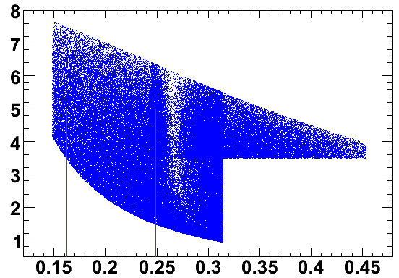
SIDIS L.-G. Cherenkov: Kinematics
Electron identification at forward angle
CO₂ @ 1 atm
Electrons with p > 0.017 GeV will fire
Pions with p > 4.653 GeV will fire
Electron-pion separation: 1.5 – 4.7 GeV
Forward Angle
9.3 deg
14.3 deg
With the BaBar magnet:
Momentum (GeV)
Identification of electrons with polar angle ~ (9.3, 14.3) deg and momentum ~ (1.5, 4.7) GeV + 2π coverage in azimuthal angle
Polar angle (rad)

Slide 4
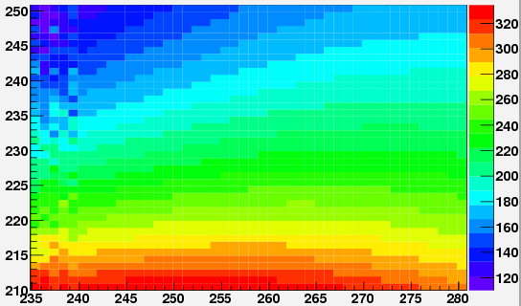
SIDIS L.-G. Cherenkov: Requirements
It has to work in a “non-negligible magnetic field” environment
an example
BaBar B field (gauss) in the region where the photon detector would sit (L.-G. SIDIS & PVDIS)
y (cm)
Good coverage in azimuthal angle
z (cm)
Withstand high rates, “quiet”

Slide 5
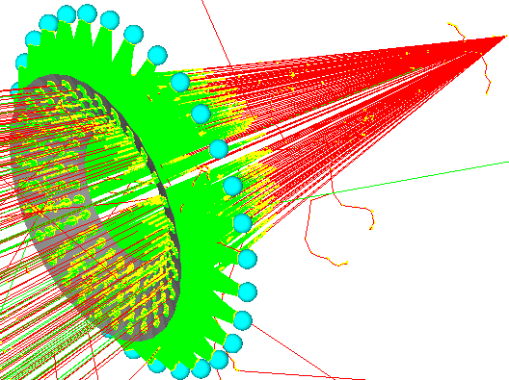
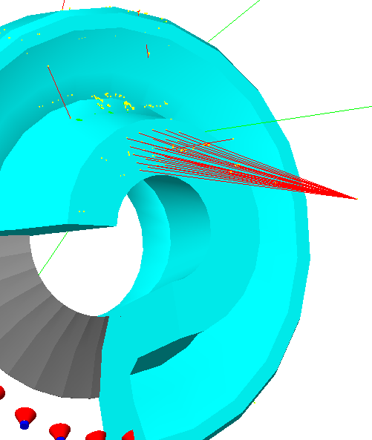
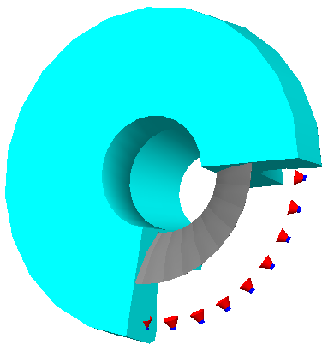
SIDIS L.-G. Cherenkov: Optical system
One spherical mirror
Focusing optimized for central ray:
for SIDIS kinematics (BaBar) => (9.3 + 14.3)/2 = 11.8 deg
Assumes small angle between central ray and rays corresponding to min and max polar angles

Slide 6
SIDIS L.-G. Cherenkov: Focusing
Near perfect collection efficiency if we assume a 12” x 12” observer, no Winston cones
(BaBar field implemented)

Slide 7
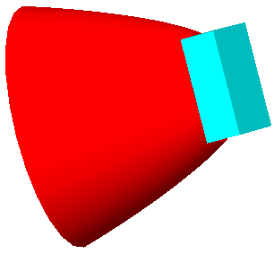
SIDIS L.-G. Cherenkov: Focusing
Near perfect collection efficiency if we assume a 6” x 6” observer with Winston cones
Winston cone dimensions:
Entrance aperture: 13.6”
Exit aperture: 6”
Length: 9.5”

Slide 8
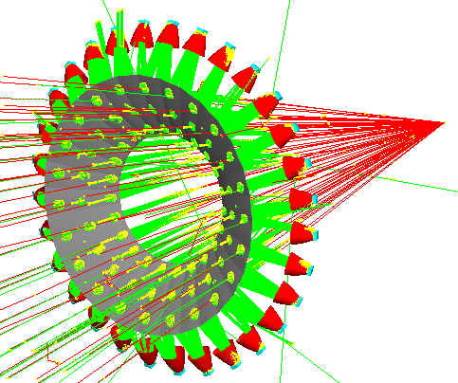
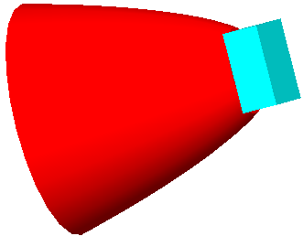
SIDIS L.-G. Cherenkov: Focusing
Very good collection efficiency if we assume a 4.5” x 4.5” observer with Winston cones
Winston cone dimensions:
Entrance aperture: 12.7”
Exit aperture: 4.5”
Length: 11.4”

Slide 9
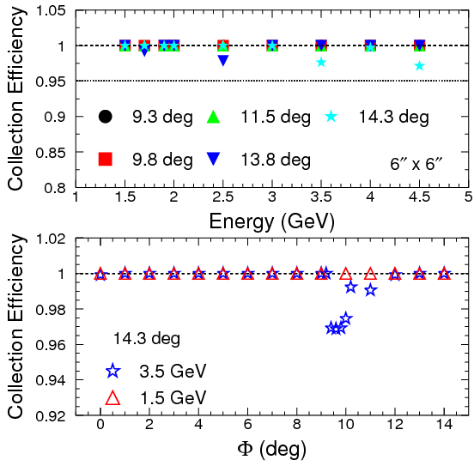
SIDIS L.-G. Cherenkov: Focusing
“Φ-scan”: at fixed polar angle check collection efficiency as a function of the azimuthal angle
Example: 14.3 deg & 3.5 GeV
Example: 14.3 deg & 1.5 GeV
Collection efficiency dependence of Φ: small effect at isolated kinematics

Slide 10
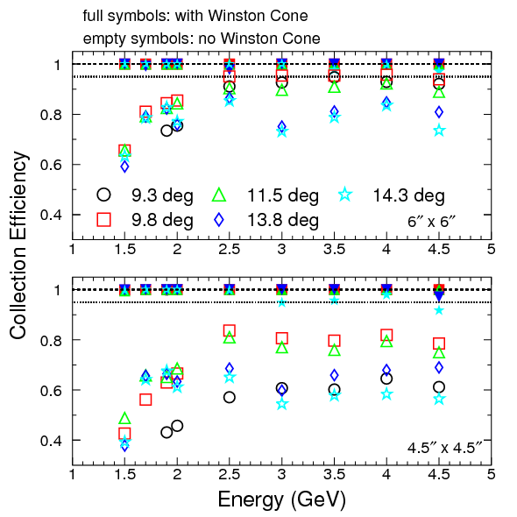
SIDIS L.-G. Cherenkov: Focusing
Both options could work
6” x 6” my preferred one: we won’t rely too much on
Winston cones ⬄ avoid significant absorption of photons by cones
What shall we put here?

Slide 11
SIDIS L.-G. Cherenkov: Photon Detector
(Some) Requirements: 1) resistant in magnetic field
3) decent size
2) “quiet”
not much
almost
?
?
Photomultiplier Tubes
5” PMT: data from Hamamatsu
It could be shielded better but could be a mechanical challenge
SoLID field: too close to this PMT limit

Slide 12
SIDIS L.-G. Cherenkov: Photon Detector
(Some) Requirements: 1) resistant in magnetic field
3) decent size
2) “quiet”
yes
no
?
Photomultiplier Tubes
Fine-mesh PMT (2” the largest): resistant in magnetic field
Only 1.54” photocathode “area” (75% of total)

Slide 13
SIDIS L.-G. Cherenkov: Photon Detector
(Some) Requirements: 1) resistant in magnetic field
3) decent size
2) “quiet”
possibly good enough
yes if tiled
?
?
?
Photomultiplier Tubes
Multi-anode 2” PMT: fairly resistant in magnetic field; it can be tiled (data from Hamamatsu)
1.93” effective area (94%)
Square shaped and 94% effective area: ideal for tiling
2.05”
Drew Weisenberger (JLab) lent us one such PMT for tests
PMT now at Temple for initial magnetic field tests
Could be too noisy; we need to test it

Slide 14
SIDIS L.-G. Cherenkov: Photon Detector
(Some) Requirements: 1) resistant in magnetic field
3) decent size
2) “quiet”
possibly good enough
yes if tiled
?
?
?
Photomultiplier Tubes
Multi-anode 2” PMT: fairly resistant in magnetic field; it can be tiled (data from Hamamatsu)
No shielding

Slide 15
SIDIS L.-G. Cherenkov: Photon Detector
(Some) Requirements: 1) resistant in magnetic field
3) decent size
2) “quiet”
possibly good enough
yes if tiled
?
?
?
Photomultiplier Tubes
Multi-anode 2” PMT: fairly resistant in magnetic field; it can be tiled (data from Hamamatsu)
There are versions of multi-anode 2” PMT with good quantum efficiency at low wavelength
I am in the process of getting a cost estimate from Hamamatsu…

Slide 16
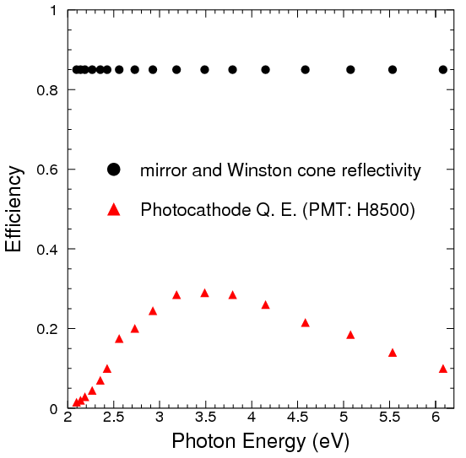
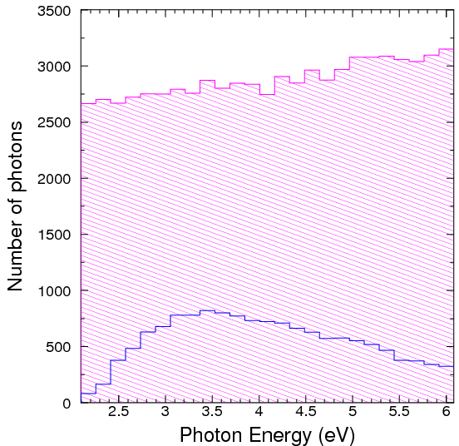
SIDIS L.-G. Cherenkov: Signal
Effective area of 1 maPMT
The PMT option
6”
Use an array of 3 x 3 2” maPMT to cover a 6” area
6”
Wavelength-dependent corrections
Mirror
PMT

Slide 17
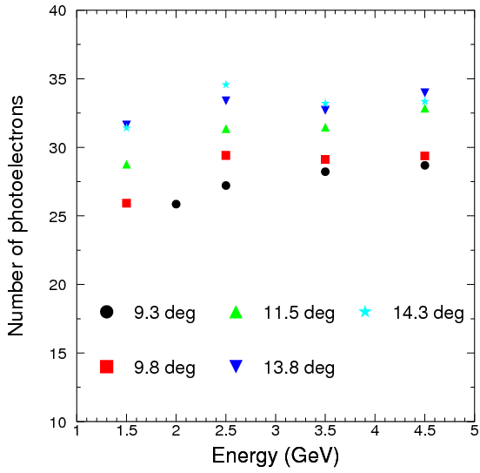
SIDIS L.-G. Cherenkov: Signal
The PMT option
Effective area of 1 maPMT
Use an array of 3 x 3 2” maPMT to cover a 6” area
6”
Dead zone
6”
Takes into account: wavelength dependent corrections (mirrors and cones reflectivities and Q.E. of the PMT) + an additional 0.8 correction to account for dead zones which result from tiling
This option is pending on:
Magnetic field tests
Noise tests
Cost
Background estimates

Slide 18
SIDIS L.-G. Cherenkov: Photon Detector
(Some) Requirements: 1) resistant in magnetic field
3) decent size
2) “quiet”
yes
yes
?
Gaseous Electron Multiplier + CsI
GEMs + CsI: resistant in magnetic field, size is not a problem
Consists of 3 layers of GEMs, first coated with CsI which acts as a photocathode
First GEM metallic surface overlayed with Ni and Au to ensure stability of CsI (CsI not stable on Cu)

Slide 19
SIDIS L.-G. Cherenkov: Photon Detector
Gaseous Electron Multiplier + CsI: lessons from PHENIX
Used by PHENIX successfully in the no-mirror configuration
arXiv:1103.4277v1 [physics.ins-det] 22 Mar 2011

Slide 20
SIDIS L.-G. Cherenkov: Photon Detector
Gaseous Electron Multiplier + CsI: lessons from PHENIX
The photocathode operates in UV (lower wavelengths or larger energies than for a typical PMT )
Humidity and other impurities can cause decay in the photoemission properties of CsI
For PHENIX the CsI coating was done at Stony Brook (with great care)
GEMs assembled in clean (dust-free) and dry (H₂O < 10 ppm) environment
arXiv:1103.4277v1 [physics.ins-det] 22 Mar 2011
B. Azmoun et al., IEEE TRANSACTIONS ON NUCLEAR SCIENCE, VOL. 56, NO. 3, JUNE 2009

Slide 21
SIDIS L.-G. Cherenkov: Photon Detector
Gaseous Electron Multiplier + CsI: lessons from PHENIX
The gas purity is very important: impurities can affect the gas transmittance
Water and Oxygen: strong absorption peaks for Cherenkov light where CsI is sensitive (120 nm to 200 nm)
Small levels of either impurity => loss of photons and therefore loss of photoelectrons
PHENIX had an independent monitoring system to detect low levels of
contamination
arXiv:1103.4277v1 [physics.ins-det] 22 Mar 2011

Slide 22
SIDIS L.-G. Cherenkov: Photon Detector
Gaseous Electron Multiplier + CsI: lessons from PHENIX
The gas purity is very important: impurities can affect the gas transmittance
Recirculating gas system used to supply and monitor pure CF4 gas to PHENIX
Gas transmittance monitor system used by PHENIX to measure impurities at the few ppm level
arXiv:1103.4277v1 [physics.ins-det] 22 Mar 2011

Slide 23
SIDIS L.-G. Cherenkov: Photon Detector
Gaseous Electron Multiplier + CsI: lessons from PHENIX
The gas purity is very important: impurities can affect the gas transmittance
Very good purity of the input gas: < 2 ppm impurities (water and oxygen)
PHENIX
The output gas: 20-30 ppm water and 2-3 ppm oxygen impurities
PHENIX
Throughout PHENIX run: < 5% loss of photoelectrons because of gas impurities
arXiv:1103.4277v1 [physics.ins-det] 22 Mar 2011

Slide 24
SIDIS L.-G. Cherenkov: Photon Detector
Gaseous Electron Multiplier + CsI: lessons from JPARC
HBD prototype test at Tohoku University in December 2009 for JPARC E16
Length of the Cherenkov radiator is 50cm, photocathode with a size 10cm X 10cm
They got 5-6 photoelectrons, were expecting a similar number as PHENIX; needed 16 photoelectrons at least
Preprint submitted to Nuclear Instruments and Methods A
http://indico.cern.ch/getFile.py/access?contribId=187&resId=1&materialId=paper&confId=51276

Slide 25
SIDIS L.-G. Cherenkov: Photon Detector
Gaseous Electron Multiplier + CsI: lessons from JPARC
1) Gas purity
“There is a 30% loss due to absorption by residual water vapor and oxygen.
“… it is difficult to achieve a 10ppm level of water for a short test experiment since the materials absorb water vapor and hold it for a long time. It takes more than a month to reach a 10ppm level with dry gas flow and this cannot be done during a short test experiment. In addition, it consumes a vast amount of gas and a gas circulation system is required. Such a system is being developed for the E16 experiment .”
1) Photocathode Q.E.
PHENIX
Dramatic drop at higher photon energies: not understood
JPARC
Preprint submitted to Nuclear Instruments and Methods A
http://indico.cern.ch/getFile.py/access?contribId=187&resId=1&materialId=paper&confId=51276

Slide 26
SIDIS L.-G. Cherenkov: Photon Detector
Gaseous Electron Multiplier + CsI: SoLID
The gas needs to be transmitant in photocathode UV range
C. Lu, K.T. McDonald
Nuclear Instruments and Methods in Physics Research A343 (1994) 135-151
CO₂: not a good choice in combination with CsI
CF₄: looks like a good choice

Slide 27
SIDIS L.-G. Cherenkov: Photon Detector
Gaseous Electron Multiplier + CsI: SoLID
The gas: would CF4 give us the desired pion threshold ?
Approximation of Sellmeier formula:
Index of refraction (CF₄) | lambda = 120 nm | lambda = 200 nm
n (T = 15 C, p = 1 atm) | 1.00062 | 1.00050
n (T = 15, 20 C, p = 0.8 atm) | 1.00049, 100048 | 1.00040, 1.00039
Pion threshold (CF₄) | lambda = 120 nm | lambda = 200 nm
p (T = 15 C, p = 1 atm) | 3.96 GeV/c | 4.41 GeV/c
p (T = 15, 20 C, p = 0.8 atm) | 4.46, 4.5 GeV/c | 4.93, 4.99 GeV/c
If we really need higher threshold we could vary the pressure, for example

Slide 28
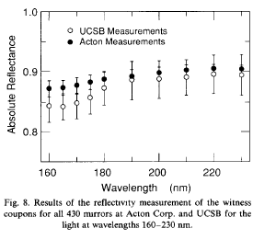
SIDIS L.-G. Cherenkov: Photon Detector
Gaseous Electron Multiplier + CsI: SoLID
The mirror: we need good reflectivity in the UV region
We found measurements down to 160 nm
Nuclear Instruments and Methods in Physics Research A300 (1991) 501-510
March 1971 / Vol. 10, No. 3 / APPLIED OPTICS

Slide 29
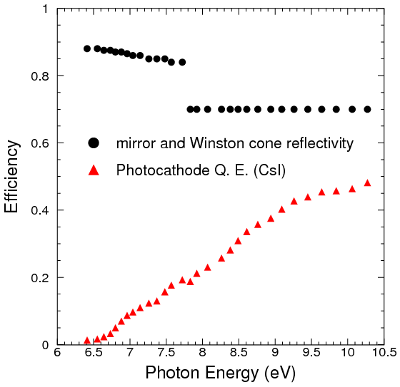
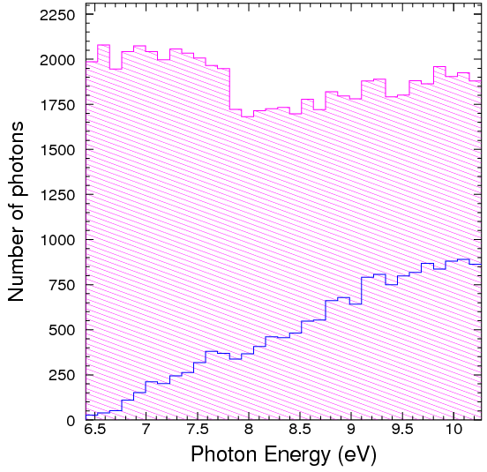
SIDIS L.-G. Cherenkov: Signal
The GEM option
Use 12” X 12” GEMs + CsI, no Winston cones needed
Wavelength-dependent corrections
Mirror
PMT
assumption

Slide 30
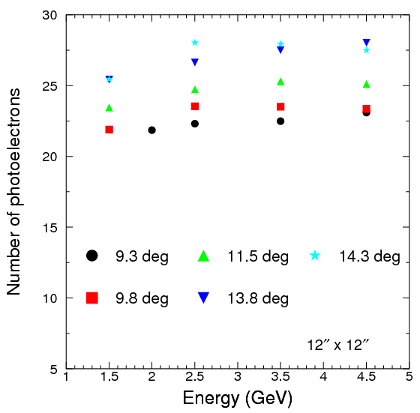
SIDIS L.-G. Cherenkov: Signal
The GEM option
Use 12” X 12” GEMs + CsI, no Winston cones needed
Takes into account: wavelength dependent corrections (mirrors and cones reflectivities and Q.E. of the PMT)
+
an additional correction of 0.54 from: optical transparency of mesh and photocathode, radiator gas transparency, transport efficiency

Slide 31
SIDIS L.-G. Cherenkov: COST
The GEM option: just the photon detector
Cost estimate from Nilanga for one 12” X 12”
General item | Item | Number | Item cost | Total requested
30 cm x 30 cm GEM chamber | GEM foils | 3 | $1,000 | $3,000
 | GEM chamber supplies | 1 | $300 | $300
 | HV distribution | 1 | $250 | $250
 | Readout boards | 1 | $400 | $400
 | support frames | 1 | $1,000 | $1,000
Tracker Electronics | APV25 readout | 150 | $7.50 | $1,125
 | high voltage supplies | 1 | $500 | $500
Manpower | Technician | 0.08 | $90,000 | $7,200.00
 | student | 0.08 | $40,000 | $3,200
Total |  |  |  | $16,975
X 30
Does not include the cost of Ni and Au and CsI coating

Slide 32
SUMMARY: SIDIS
Optics
12” X 12” spot size for SIDIS L.-G. Cherenkov with BaBar field
Can be squeezed safely to 6” x 6” with Winston cones (even to 4.5” x 4.5”)
Photon detector
2 options for now: maPMTs or GEMs + CsI
Both options pending on test (field, noise etc.)
Prototyping very important (especially for the GEM + CsI option)

Slide 33
PVDIS
Just started…

Slide 34
PVDIS Cherenkov: Kinematics
Wider polar angle coverage than SIDIS
At what kinematics would the Cherenkov be needed the most?
plot from S. Riordan
see his talk
Constant “large” pion-to-electron ratio from 22 deg on

Slide 35
PVDIS Cherenkov: Kinematics
Wider polar angle coverage than SIDIS
At what kinematics would the Cherenkov be needed the most?
Pion-to-electron ratio ~ 40 at 2.7 GeV and decreasing with increasing momentum
Is a pion threshold of 2.7 GeV good enough for PVDIS?
plot from S. Riordan
see his talk
Two gas options in the proposal:
C4F10: heavy gas (large number of p.e. expected) but with low pion threshold, ~2.7 GeV
CF4: ligher gas but with high pion threshold, ~4.2 GeV

Slide 36
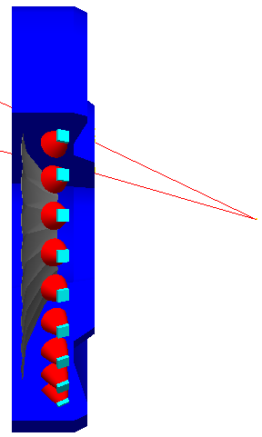
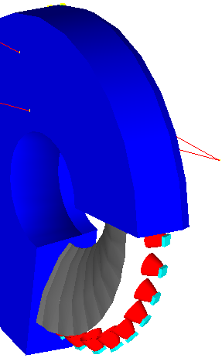
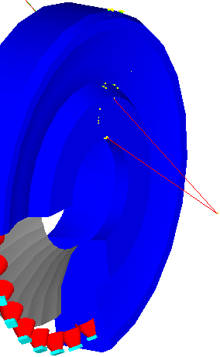
PVDIS Cherenkov: SIMULATION
We gave it a try with one spherical mirror, just as for SIDIS: easy transition in the simulation from SIDIS L.-G. Cherenkov to PVDIS
SIDIS
PVDIS
From SIDIS to PVDIS:
Example: PVDIS Cherenkov
Move the target from outside the magnet to the center of the coil
Make the tank shorter as seen by the beam and change gas
Optimize the mirror curvature for PVDIS kinematics
The photon detector was left at the same position as for SIDIS

Slide 37
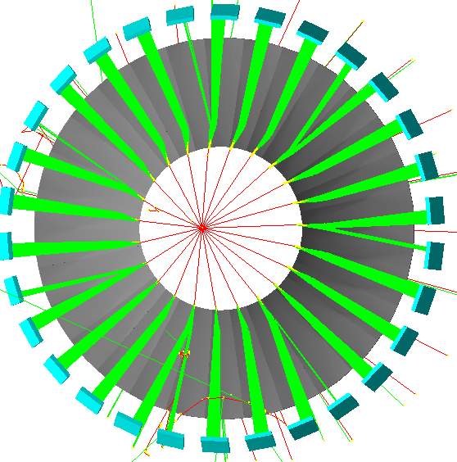
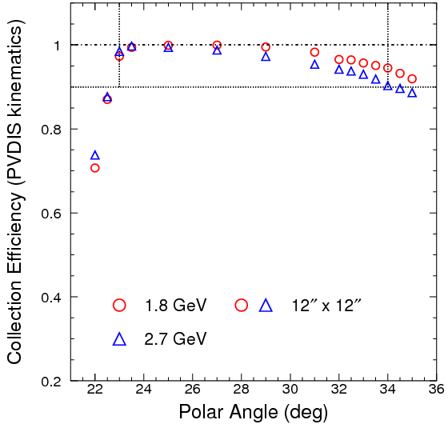
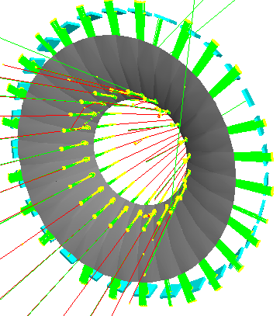
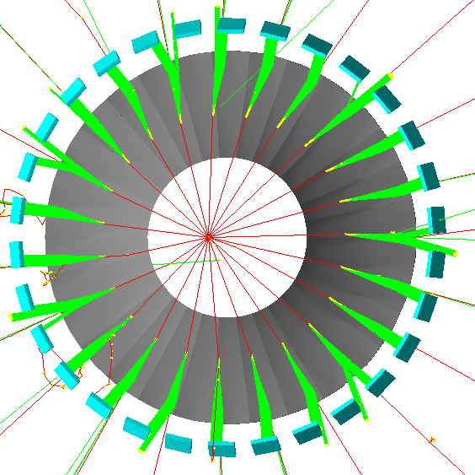
PVDIS Cherenkov: FOCUSING
Fairly good collection efficiency if we assume a 12” x 12” observer, no Winston cones
24 deg & 2.7 GeV
22 deg & 2.7 GeV
Collection efficiency above 90%:
from 23 deg to 34 deg
from 1.8 GeV to 2.7 GeV
35 deg & 2.7 GeV

Slide 38
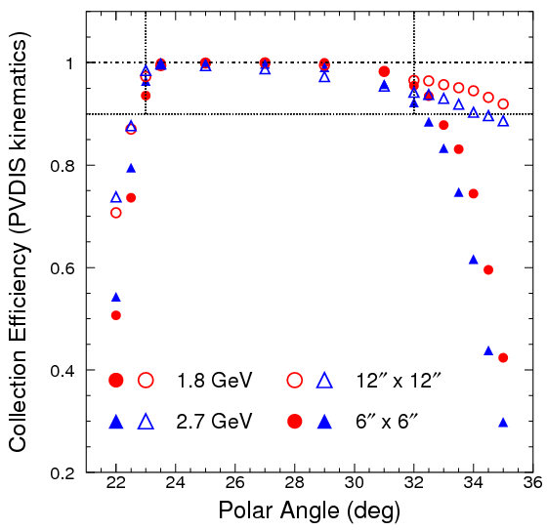
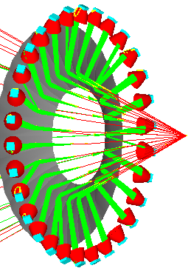
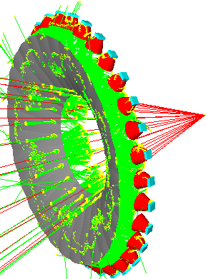
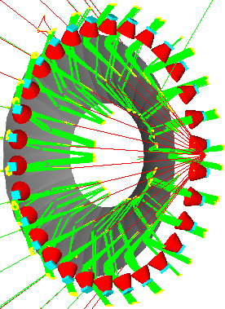
PVDIS Cherenkov: FOCUSING
Collection efficiency drops at the lowest and largest polar angles if we assume a 6” x 6” observer, with Winston cones
Additional optimization necessary for PVDIS!

Slide 39
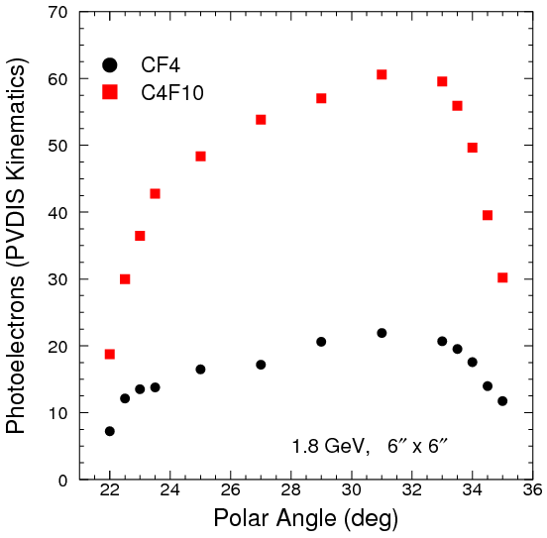
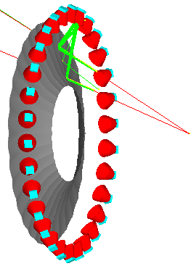
PVDIS Cherenkov: SIGNAL
6”
For now estimation for the PMT option only
6”
Two features:
Between 23 deg and 32 deg the number of p.e. increases: gas length correlation
Sharp drop at low and high polar angles: collection efficiency correlation
Even with poor collection efficiency we get enough p.e. with C4F10; not the case with CF4

Slide 40
BACKUP SLIDES

Slide 41
One slide from gary swift
Mirror section mounting trials for static deformation, due to gravity. Autodesk Inventor simulation

Slide 42
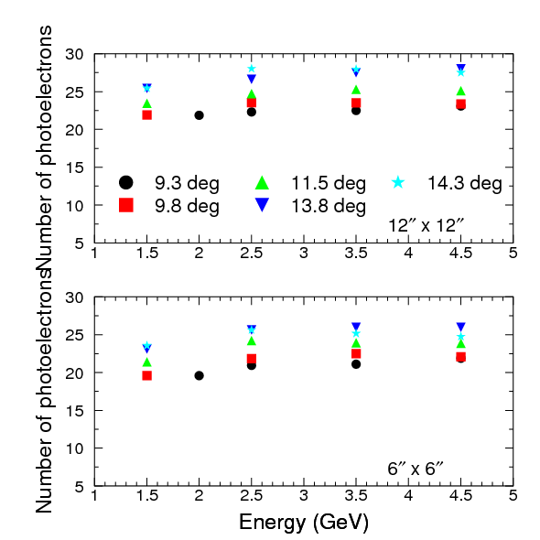
SIDIS L.-G. Cherenkov: Signal
The GEM option 2
Use 6” X 6” GEMs + CsI, with Winston cones
Slightly smaller signal than for 12” X 12” due to photon absorption by cones but still pretty good
The GEM option is pending on:
Noise tests
Cost
Background estimates
collaboration comitment

Slide 43
SIDIS L.-G. Cherenkov: Photon Detector
Gaseous Electron Multiplier + CsI: lessons from PHENIX

