Slide 1
GEM chambers for SoLID
Nilanga Liyanage
University of Virginia

Slide 2
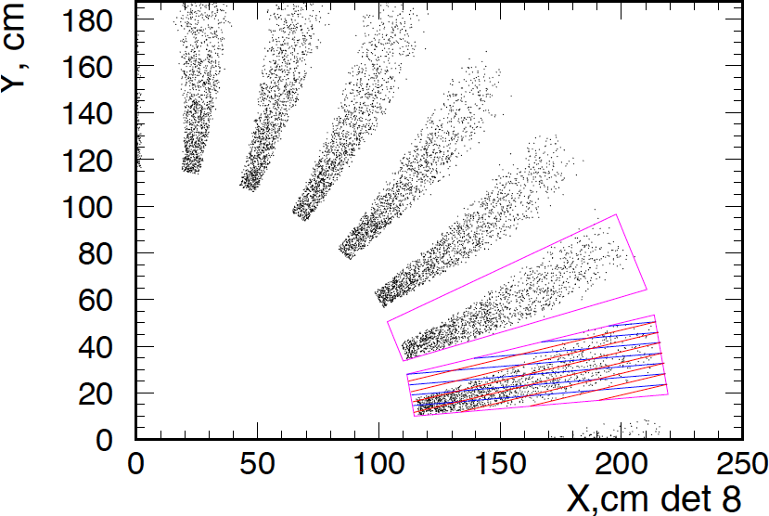
PVDIS GEM configuration
Current proposal to instrument locations 4, 5, 6, 7, and 8 with GEM:
  need to determine the number of GEM layers required and their locations, using the simulation
30 GEM modules at each location: each module with a 10-degree angular width.
Plane | Z (cm) | R_{I} (cm) | R_{O} (cm) | Active area (m²)
4 | 120 | 40 | 90 | 1.7
5 | 150 | 55 | 115 | 2.7
6 | 190 | 65 | 140 | 4.0
7 | 290 | 105 | 200 | 7.6
8 | 310 | 115 | 215 | 8.6
total: |  |  |  | ~ 25
Outline of a GEM module

Slide 3
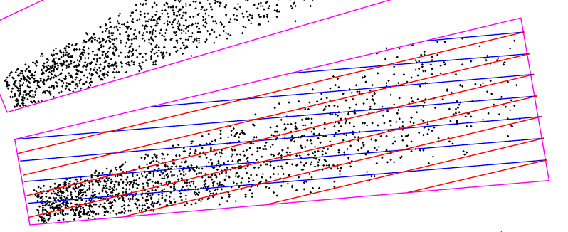
PVDIS GEM configuration
Suggested readout scheme:
  a 2D readout optimized to get high accuracy in the φ coordinate, lower but sufficient resolution in the r coordinate.
  each set of stripes parallel to one of the radial sides of the module: i.e. stripes at a 10-deg stereo angle to each other.
  strip pitch is 0.6 mm for locations 7 and 8;
  0.4 mm for locations 4, 5 and 6.
  Issues:
    A full tracking simulation needs to determine that this readout scheme gives the required tracking resolution.
    How well will the 10-deg stereo angle separated strip layers work ? – need to test with prototypes.

Slide 4
PVDIS GEM configuration
For this readout scheme readout channel estimation
Plane | Z (cm) | R_{I} (cm) | R_{O} (cm) | # of channels
4 | 120 | 40 | 90 | 24 k
5 | 150 | 55 | 115 | 30 k
6 | 190 | 65 | 140 | 36 k
7 | 290 | 105 | 200 | 35 k
8 | 310 | 115 | 215 | 38 k
total: |  |  |  | 164 k
with 20% spares, we will need about 200 k channels.
Simulations and prototypes may indicate that we need more channels for high rate tracking; can be as much as 300 k total.
Good news: cost of electronics going down – cost per channel for the RD51 SRS APV-25 based readout is estimated to be ~ $ 2.50 - $ 3.00
The total cost of readout electronics can be less than $ 1 M

Slide 5
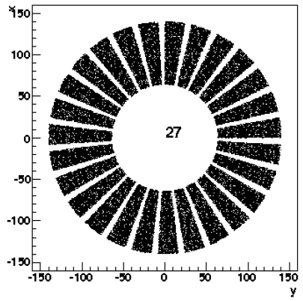
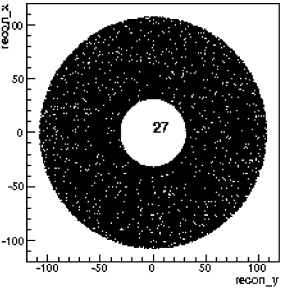
SIDIS GEM configuration
Six locations instrumented with GEM:
PVDIS GEM modules can be re-arranged to make all chamber layers for SIDIS. – move the PVDIS modules closer to the axis so that they are next to each other
More than enough electronic channels from PVDIS setup.
The two configurations will work well with no need for new GEM or electronics fabrication.
Plane | Z (cm) | R_{I} (cm) | R_{O} (cm) | Activearea | # of channels
1 | 197 | 46 | 76 | 1.1 | 24 k
2 | 250 | 28 | 93 | 2.5 | 30 k
3 | 290 | 31 | 107 | 3.3 | 33 k
4 | 352 | 39 | 135 | 5.2 | 28 k
5 | 435 | 49 | 95 | 2.1 | 20 k
6 | 592 | 67 | 127 | 3.7 | 26 k
total: |  |  |  | ~18 | ~ 161 k
SIDIS
PVDIS

Slide 6
large area GEM chamber challenges
SoLID needs GEM modules as large at 100 cm x 40 cm.
The biggest challenge used to be the non-availability of large area GEM foils.
Not a problem anymore: CERN shop can make foils as large as 200 cm x 50 cm now.
One problem may be the production capacity of the CERN shop: especially if a LHC related large GEM project gets underway.
Need to develop large GEM production capabilities in China.

Slide 7
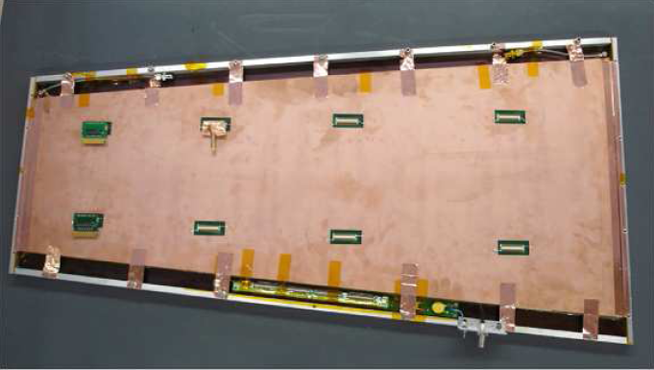
Recently, a very large prototype GEM module for CMS was constructed and tested at CERN
99 cm x (22 – 45.5) cm – very close the the dimensions of largest SoLID chambers

Slide 8
Bottom-line
With the strong effort led by RD-51 towards large GEM chambers and readout electronics:
  Costs are coming down
  Many technical challenges are overcome
But SoLID is a very large and very complicated GEM project from any standard; no one has ever done anything even close to this size.
We are soon starting on SBS GEM construction, this is about half the size of the SoLID GEM project.
So with large GEM chamber construction for SBS in Rome and at Uva and with the infrastructure and expertise we gain from the SBS project we would be ready for the SoLID GEM construction in a couple of years.

Slide 9
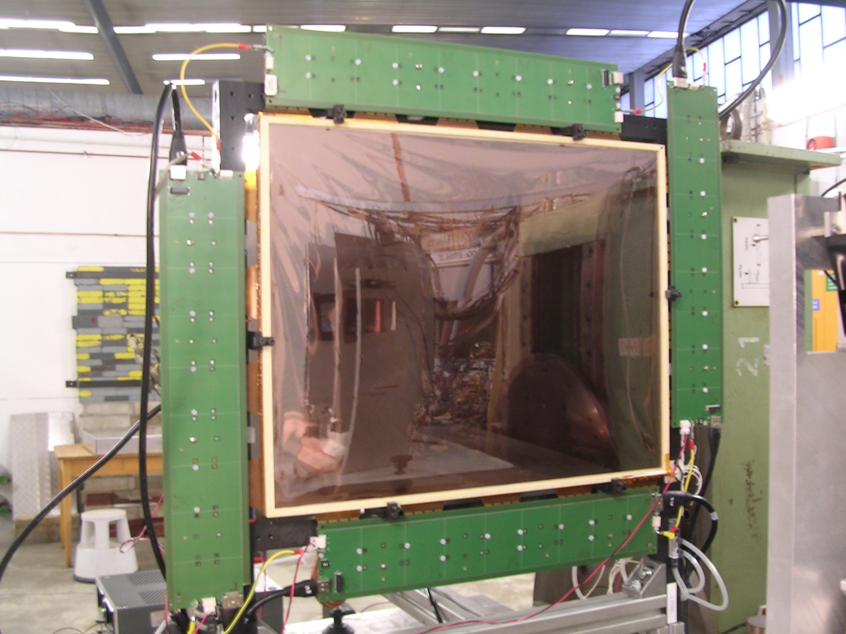
UVa GEM development status
Beam test at Mainz in September with 10 cm x 10 cm prototype chambers and APV-25 electronics.
Construct two 40 cm x 50 cm prototype chambers this Fall
  GEM and readout foils already ordered
  Expect chamber construction in October
  Move to Jlab and beam testing with APV-25 electronics: November-May
The 40 cm x 50 cm prototypes
  Size: 40x50 cm² active area + 8 mm frame width
  2D strip readout (a la COMPASS) - 0.4 mm pitch
  INFN is now going into 40x50 cm² GEM module production for SBS
The INFN 40 cm x 50 cm prototype: the Uva chambers will be similar with small modifications

Slide 10
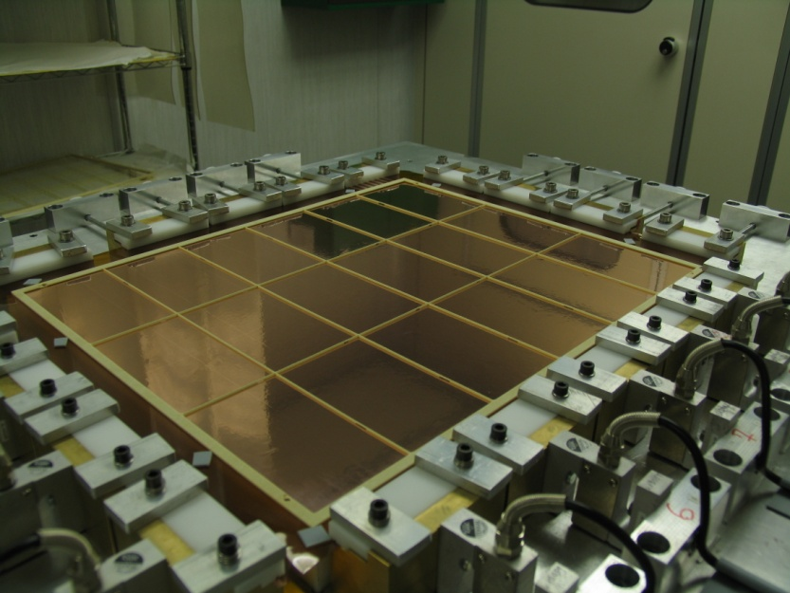
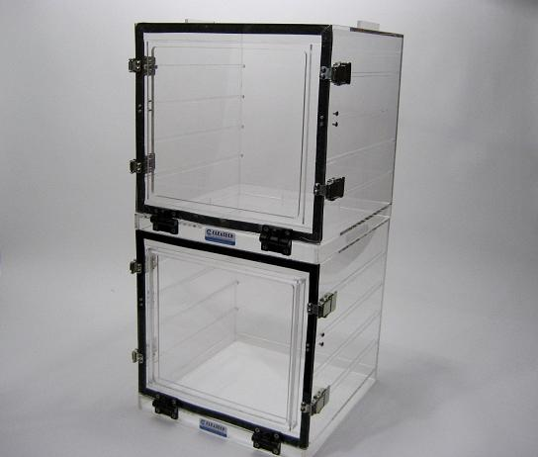
UVa GEM development status
  At present preparing lab for large prototype production
  Refurbish the clean room with new filters etc.
  Dry Nitrogen high voltage boxes for GEM foil testing
  Dry Nitrogen storage cabinets for foil storage (to minimize oxidization effects)
  mechanical stretcher for GEM foils. Etc. etc.
  mechanical stretcher for GEM foils
  Dry Nitrogen cabinets for foil storage

Slide 11
UVa GEM development status
Funding received under EIC detector R&D for a large prototype: ~ 100 cm x 40 cm section of a circle.
Close to large chamber module sizes of SoLID
Plan to fabricate this chamber in the spring.
Can learn a great deal for SoLID GEMs from this
  develop techniques for fabrication of large GEM modules.
  study readout schemes: 10 degree stereo angle
  Study issues of signal to noise ratio for long readout strips.

Slide 12
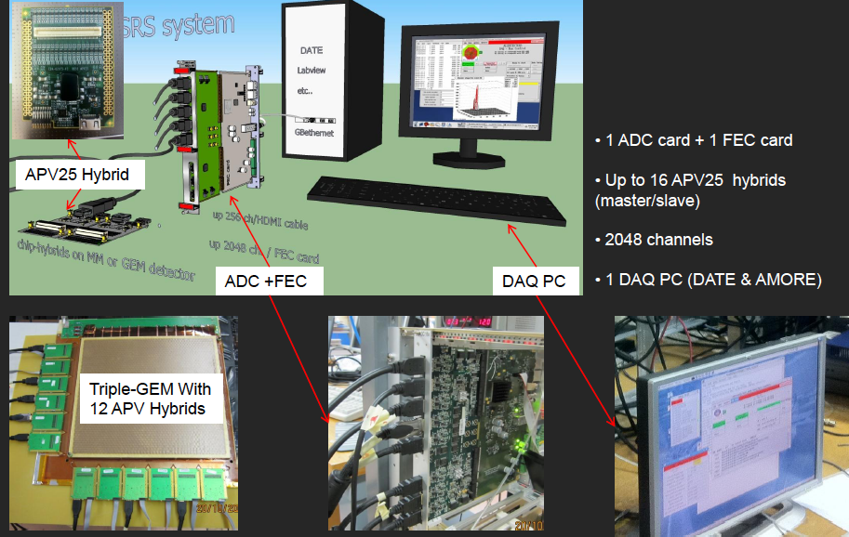
Uva group now owns an APV25 system (2000 chan.) from the RD-51 Scalable Readout System (SRS) development.
SRS system cost is lower; plus has the benefit of the large team effort backed by RD-51
RD-51 plans to commercialize the fabrication; there will be the possibility to get very large systems in the future.

Slide 13
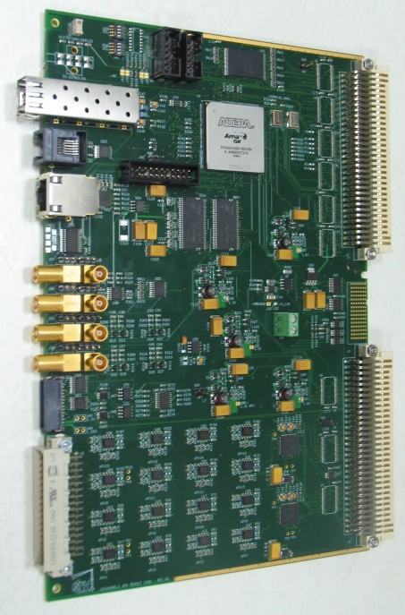
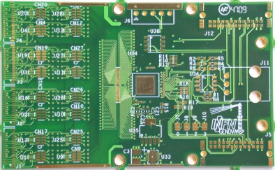
Electronics
Uva is also getting another APV-25 based prototype readout system (2800 chan.) from the INFN group
Some delays due to problems at the company fabricating the boards; hope to get soon
8 mm
Up to 10m
twisted,
shielded
copper cable
2D Readout
49.5 mm
75 mm

Slide 14
rough cost estimate
Item | Quantity | Unit cost | Total cost | Material only unit cost | Material only total cost
GEM foil | ~100 m² | $2000/m² | 0.2 M | $3000/m² | 0.2 M
readout boards | 120 | $ 2500 | 0.3 M | $ 2500 | 0.3 M
chamber support frame | 120 | $ 1500 | 0.2 M | $ 1500 | 0.2 M
Supplies and tooling |  |  | 0.1 M |  | 0.1 M
FEE and DAQ | 200 k | $ 3.0 | 0.6 M | $ 3.0 | 0.6 M
cables, power, etc |  |  | 0.5 M |  | 0.5 M
Gas system |  |  | 0.1 M |  | 0.1 M
Labor: Technicians | 12 FTE-years | $ 80 k | 1.0 M |  | -
Labor: Grad students | 6 student-years | $ 50 k | 0.3 M |  | -
support structure and integration |  |  | ??? |  | ???
TOTAL: |  |  | ~ 3.3 M |  | ~ 2.0 M
With 33% contingency |  |  | ~4.4 M |  | ~2.7 M
R&D and prototyping expenses: ~ $ 150 k

