Slide 1
SoLID Simulation Update
2011/09/21
Zhiwen Zhao, Seamus Riordan

Slide 2
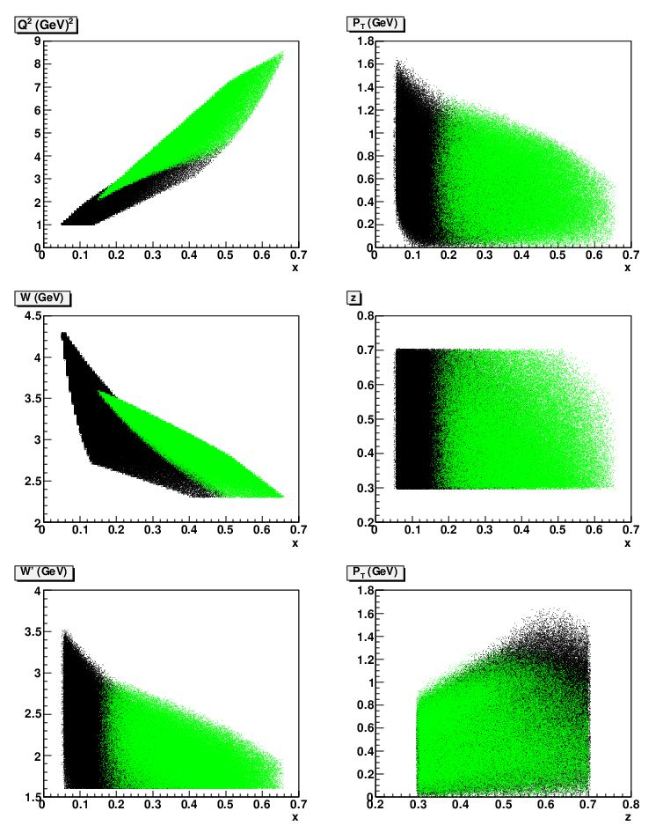
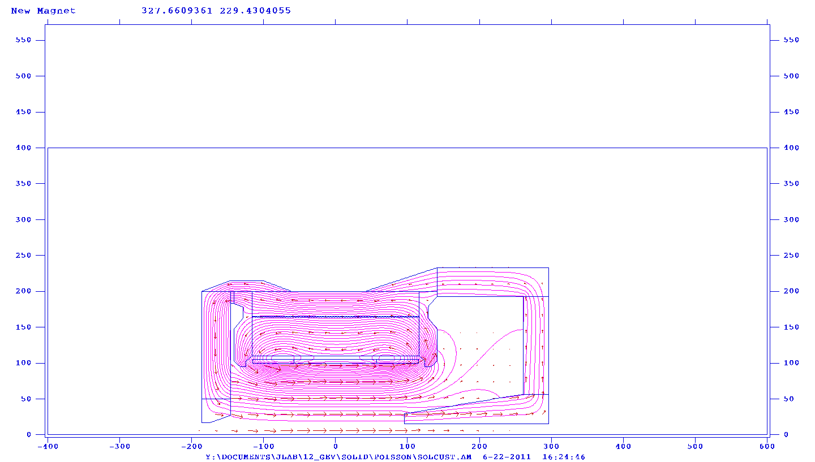
Ideal Magnet (Mehdi , Paul Reimer, Zhiwen Zhao)
SoLID simulation update
An ideal (short and fat) magnet and yoke are produced. Its SIDIS kinematics is studied. The result is similar to BaBar/CLEO

Slide 3
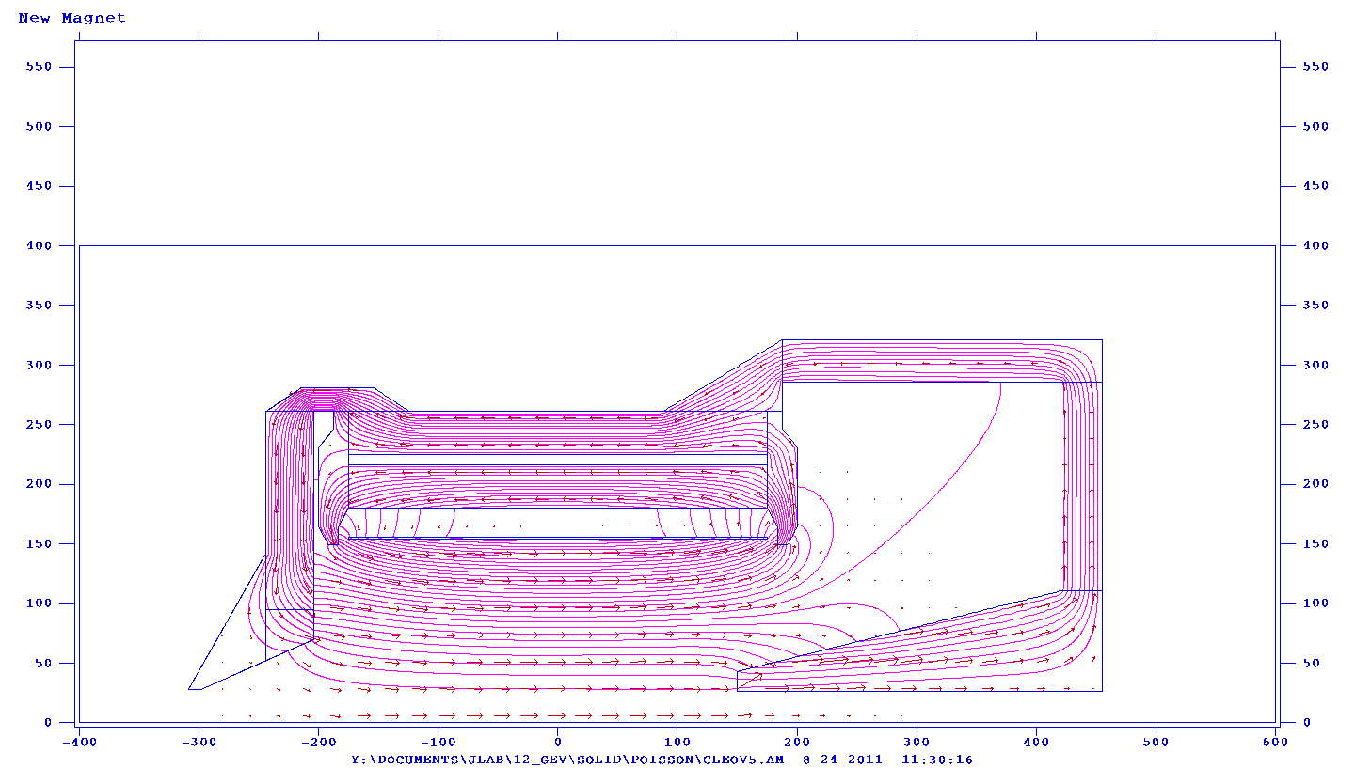
CLEO magnet (Paul Reimer, Yang Zhang, Zhiwen Zhao)
SoLID simulation update
A new yoke for CLEO magnet is design. Field map and geometry are implemented in GEMC.
Further tuning
is still needed
NO Edge in endup
YES Edge in endup

Slide 4
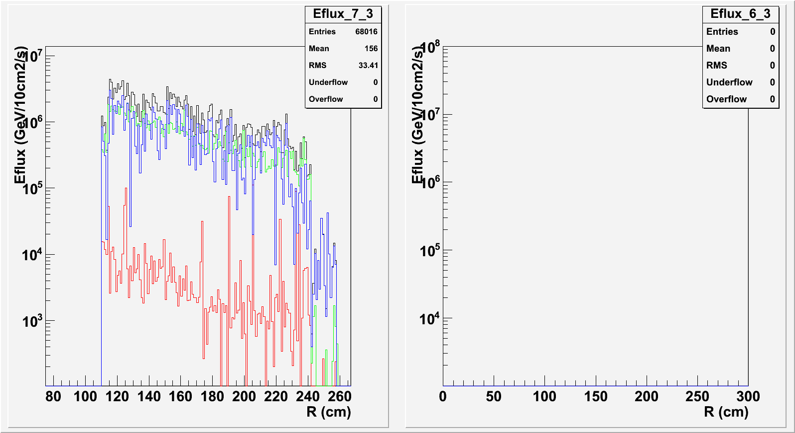
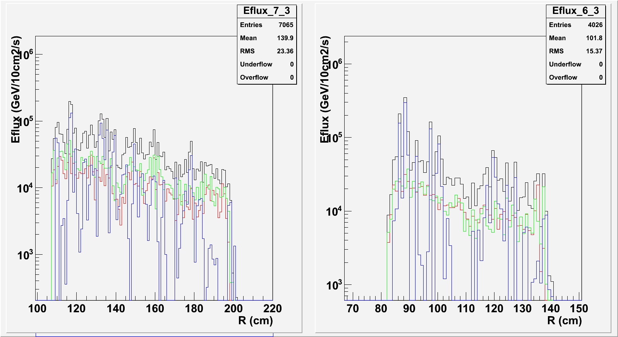
Background in EC (Zhiwen Zhao, Xin Qian)
SoLID simulation update
PVDIS forward angle
GEMC electron and photon energy flux confirms Geant3 result.
Hadron energy flux is under study.
SIDIS forward angle
SIDIS lareg angle
Black: total
Red: electron
Green: photon
Blue: hadron

Slide 5
GEM Response (Zhiwen Zhao, Evaristo Cisbani)
SoLID simulation update
# * HoneyComb
# * 0 NEMA G10 120 um
# * 1 NOMEX 3
# * 2 NEMA G10 120 um
# * Drift Cathode
# * 4 Kapton 50 um
# * 3 Copper 5 um
# * 5 Air 3 mm
# * GEM0
# * 6 Copper 5 um
# * 7 Kapton 50 um
# * 8 Copper 5 um
# * 9 Air 2 mm
# * GEM1
# * 10 Copper 5 um
# * 11 Kapton 50 um
# * 12 Copper 5 um
# * 13 Air 2 mm
# * GEM2
# * 14 Copper 5 um
# * 15 Kapton 50 um
# * 16 Copper 5 um
# * 17 Air 2 mm
# * Readout Board
# * 18 Copper 10 um
# * 19 Kapton 50 um
# * 20 G10 120 um + 60 um (assume 60 um glue as G10) # not implmented yet
# * Honeycomb
# * 21 NEMA G10 120 um
# * 22 NOMEX 3 um
# * 23 NEMA G10 120 um
To ontain more realistic GEM response, we borrow from SBS GEM simulation and the geometry and material of GEM module are realized in GEMC.
The EM background study is underway.

Slide 6
GEM Digitization (Seamus Riordan, Richard S. Holmes)
SoLID simulation update
Started and in good progress
Borrow from SBS and implement into GEMC.
Produce realistic GEM responses.
This includes background and signal digitization.
Produce tracking framework.
The digitization standard will be expended to other sub-systems.

Slide 7
Summary
SoLID simulation update
SoLID GEMC Framework is ready.
Event generators and data output are available.
Various magnet choices are implemented.
Fine tuning CLEO option is in progress.
PVDIS Baffle design is under control.
Energy flux on EC is under control.
GEM response is in progress.
Implementing digitization standard is in progress.

